Slide 1
UNIT 1
HOME

Slide 2

LESSON 9
REVIEW

Slide 3
VOCABULARY

Slide 4

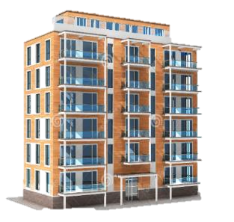

apartment (n)
/əˈpɑːtmənt/
căn hộ (chung cư)

Slide 5
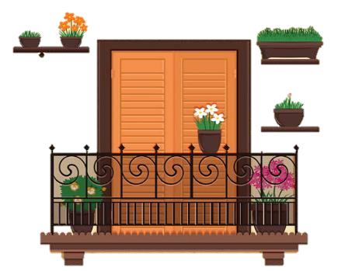
balcony (n)
/ˈbælkəni/
ban công

Slide 6
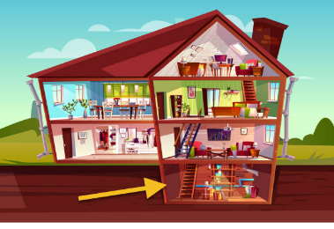
basement (n)
/ˈbeɪsmənt/
tầng hầm

Slide 7

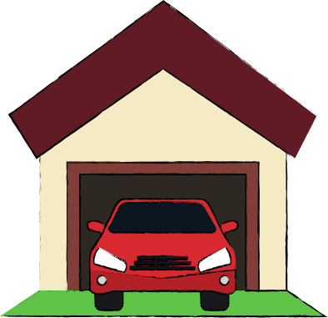
garage (n)
/ˈgærɑːʒ/
gara/ nhà để xe

Slide 8
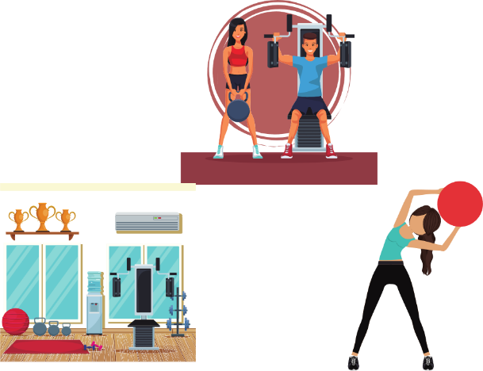
gym (n)
/ʤɪm/
phòng tập thể dục

Slide 9
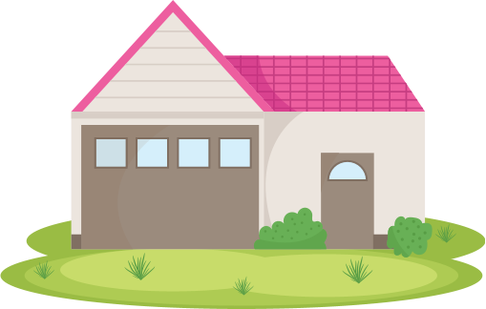
yard (n)
/jɑːd/
cái sân

Slide 10
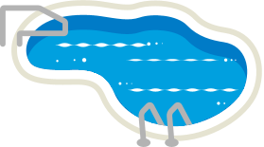
pool (n)
/puːl/
bể bơi

Slide 11
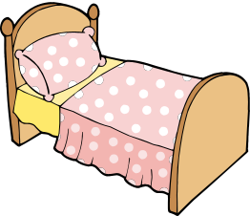
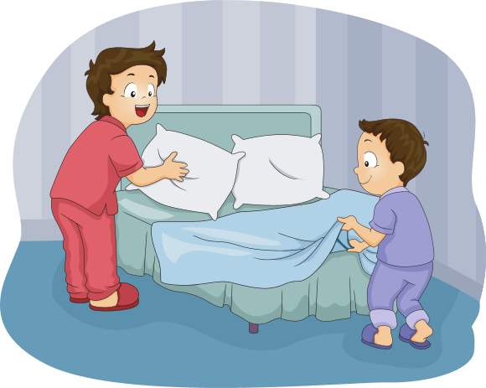
bed (n)
/bɛd/
Cái giường
make the bed (v)
/meɪk ðə bɛd/
dọn giường

Slide 12
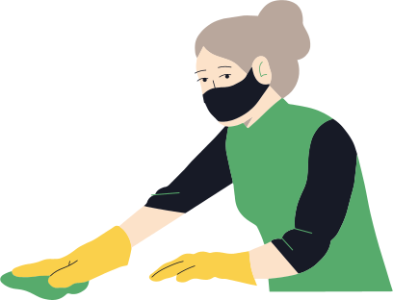
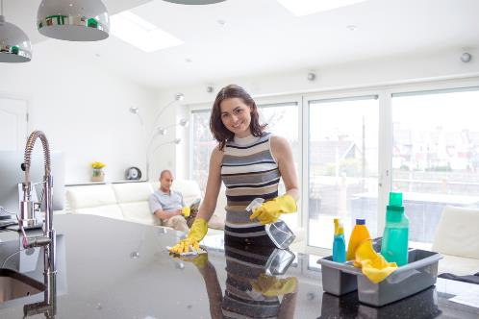
clean (v)
/kliːn/
clean the kitchen (v)
/kliːn ðə ˈkɪʧɪn/
lau chùi nhà bếp

Slide 13
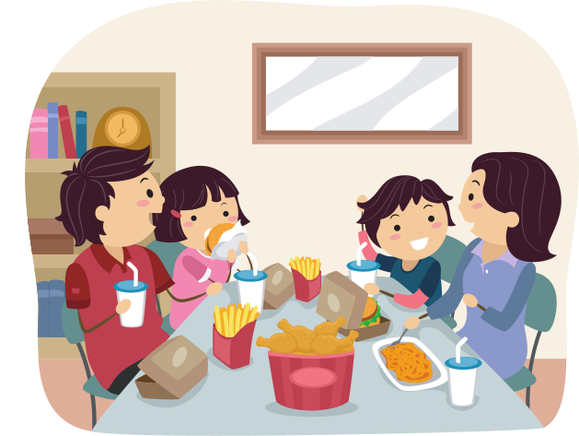
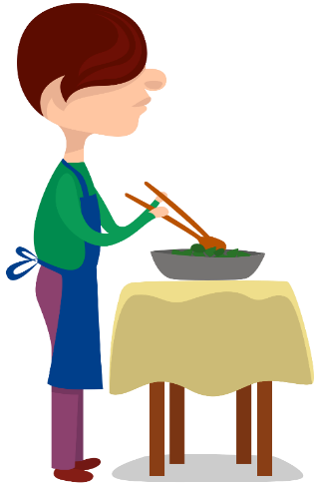
dinner (n)
/ˈdɪnə/
bữa tối
make dinner (v)
/meɪk ˈdɪnə/
nấu bữa tối

Slide 14

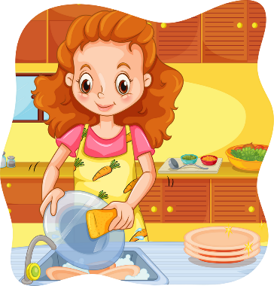
dish (n)
/dɪʃ/
cái đĩa
do the dishes (v)
/duː ðə ˈdɪʃɪz/
rửa bát đĩa

Slide 15
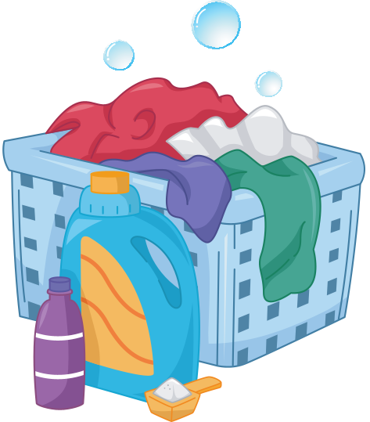
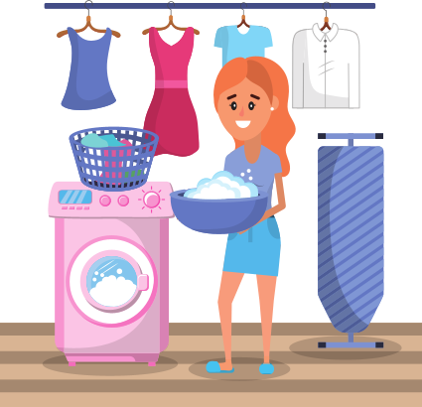
laundry (n)
/ˈlɔːndri/
việc giặt là
do the laundry (v)
/duː ðə ˈdɪʃɪz/
Who does the laundry in your house?
giặt quần áo
Ở nhà bạn thì ai giặt quần áo?

Slide 16
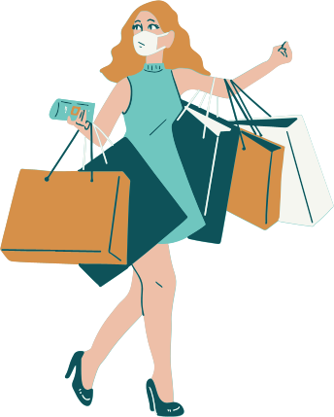
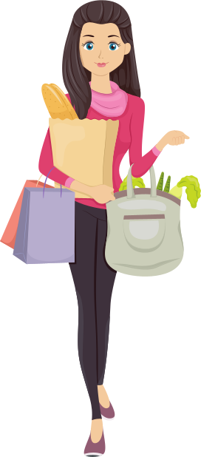
shopping (n)
/ˈʃɒpɪŋ/
việc mua sắm
do the shopping (v)
/duː ðə ˈʃɒpɪŋ/
đi mua đồ / đi chợ

Slide 17
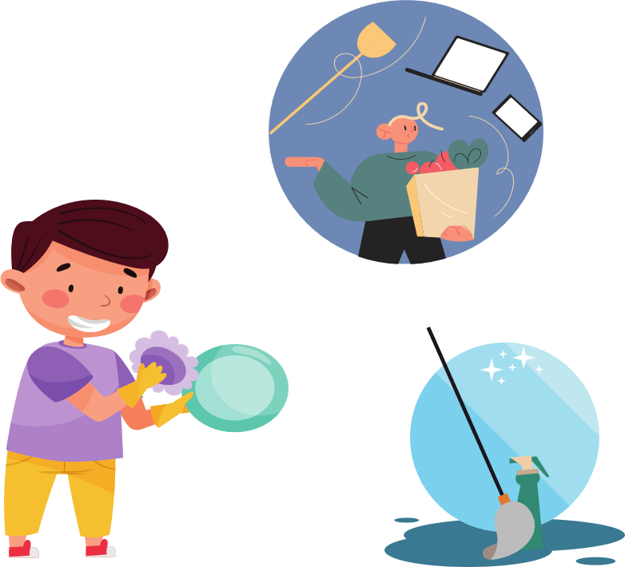
do the housework (v)
/duː ðə ˈhaʊswɜːk/
làm việc nhà

Slide 18

center (n)
/ˈsɛntə/
trung tâm

Slide 19
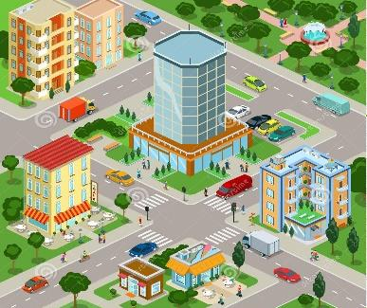
city (n)
/ˈsɪti/
thành phố

Slide 20
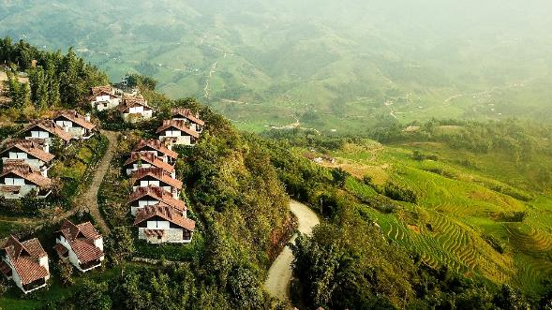
village (n)
/ˈvɪlɪʤ/
ngôi làng

Slide 21
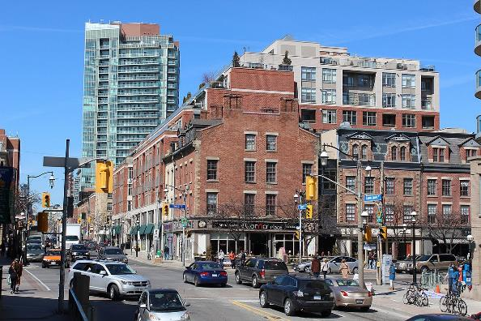
Town (n)
/taʊn/
thị trấn/ thị xã
This Photo by Unknown Author is licensed under CC BY-SA

Slide 22

famous for (adj)
/ˈfeɪməs fɔː/
nổi tiếng về ….

Slide 23
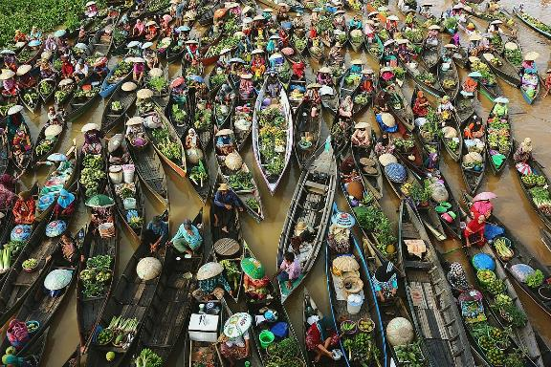
floating market (n)
/ˈfləʊtɪŋ ˈmɑːkɪt/
chợ nổi

Slide 24


East (n)
/iːst/
Phía Đông
West (n)
/wɛst/
Phía Tây

Slide 25


North(n)
/nɔːθ/
Phía Bắc
South (n)
/saʊθ/
Phía Nam

Slide 26







Review

Slide 27

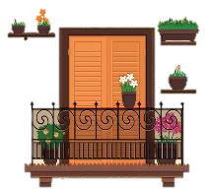
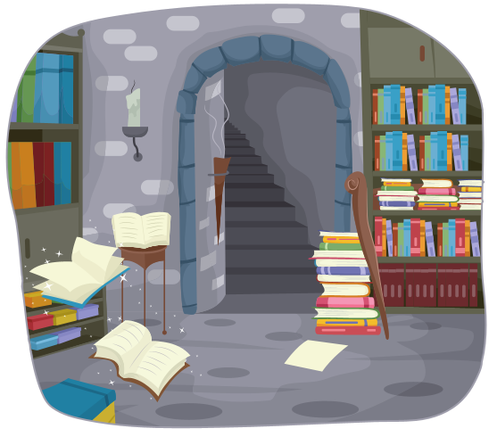
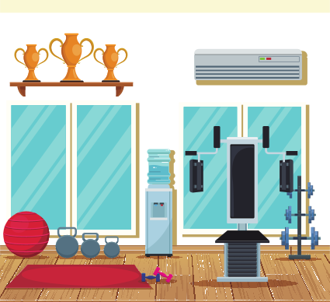
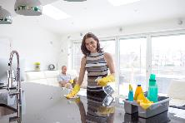

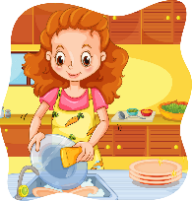
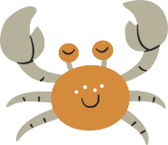
balcony
basement
gym
…………..
…………..
………
……………………
clean the kitchen
pool
…………..
…………..
………
…………
make the dinner
do the dishes
make the bed

Slide 28
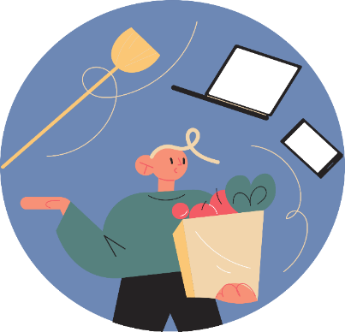

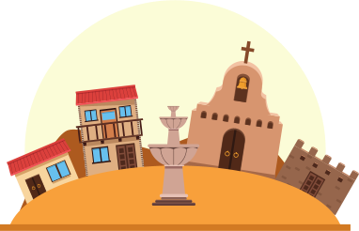
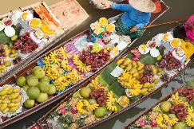

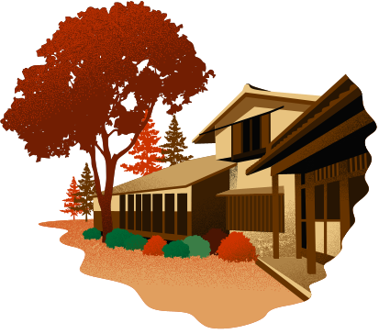
…………..
do the shopping
city
do the laundry
…………..
…………….…
……………
do the housework
village
…………..
famous for
…………..
………
…………
floating market
town

Slide 29

Listening
You will hear Jack talking to a friend about his family.
What housework do Jack’s family member do? For each questions, write lette ( A-H) next to each person. You will hear the conversation twice.
housework
Example :
0: uncle
C
A. do the landry
1. mother
A
B. make breafast
F
C. make dinner
2. father
D. make lunch
3. sister
D
E. do the dishes
4. brother
E
F. do the shopping
5.Jack
B
G. clean the kitchen
H. clean the livingroom

Slide 30
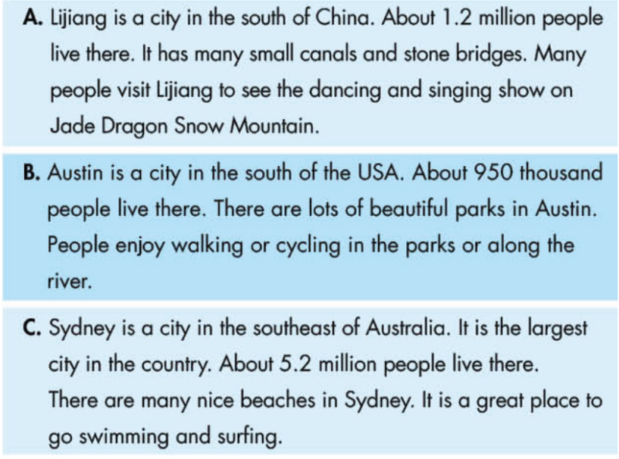
Reading
Read about the three places. Choose the correct answer. ( A,B , or C)
0. Which place has lots of stone bridge?
A
1. Which place has nice park?
B
2. Which place has the most people?
C
3. Which place is famous for a show?
A
4. Which place is good for taking a walk?
B
5. Which place is by the sea?
C

Slide 31
Vocabulary
Fill in the blanks with the words from the unit. The first letter is already there.
balcony
I like sitting outside on my _________________________ when it’s cold.
North, East, South, , and _____________________ are the four cardinal points of the compass.
After eating dinner, I do the ___________________________
I live in the countryside. My ___________________ is very small. It only has a few houses and one store.
My house has a very big ________________, I like playing soccer there with my friends.
West
dishes
village
yard

Slide 32
GRAMMAR
Underline the mistake in each sentences. Write the correct word on the line.
1. What are the Manchester famous for?
is
2. My house have a balcony and a garage.
has
3. I do lots of housework! I cleaning the bedroom on the weekend.
clean
4. Do your family have a car?
does
do
5. What housework does you do?
make
6. My sister and I don’t making the dinner.
7. There is two seasons : the dry season and the rainy season.
are

Slide 33
PRONUNCIATION
Circle the word that has the underlined part pronounced differently from others.
1. A. sister B. his C. police D. six
2. A. kitchen B. vegetable C. egg D. men
3. A. cake B. village C. make D. paper
4. A. bus B. fun C. sunny D. busy
5. A. women B. spring C. gym D. ski
6. A. machine B. dinner C. fish D. singer

Slide 34
Exercise 2. Listen and complete the sentences .
Tony usually ………………………in the morning.
Lisa always ……………………… after eating lunch.
Let’s ……………………… the bathroom. It is so dirty.
We are out of orange juice. Can you buy some when you ……………………?
The ……………………… are dirty. You should do the dishes.
My sister usually helps my mother to ……………………….
They sometimes ……………………… together.
What ……………………… does your father do?
My father usually ……………………… the kitchen.
There is ……………………… behind her house.
makes breakfast
does the dishes
clean
do the shopping
plates
do the laundry
make dinner
housework
cleans
a garage

Slide 35


Thank you !

