Slide 1
Circle the correct answers.
1. The ____________ in my building broke down, and I had to climb the stairs to my apartment.
A. furniture B. sensor C. curtain D. elevator
2. I think the ____________ is broken. It's getting too hot.
A. air conditioner B. voice assistant C. bunk bed D. monitor

Slide 2
3. We live in a pretty nice ____________. There's a big park, supermarket, and lots of things to do.
A. sensor B. neighborhood C. game console D. spa
4. Can you please close the ____________s? It's too bright in here.
A. appliance B. monitor C. curtain D. system
5. My mom's taking me to a ____________ this weekend. It's going to be relaxing.
A. nearby B. neighborhood C. spa D. elevator

Slide 3
6. The lights in my bedroom have ____________s. I don't have to worry about forgetting to turn off the lights.
A. sensor B. system C. generate D. appliance
7. My aunt gave me a ____________ for my birthday. I use it to play lots of games.
A. air conditioner B. curtain C. game console D. voice assistant
8. The biggest piece of ____________ in my room is my bed.
A. bunk bed B. flat screen C. sensor D. furniture

Slide 4

Unit 3: Living Environment
Review (Grammar, Pronunciation, Pronunciation, In the Real World, Conversation, Speaking & Writing)
pages 93 & 94

Slide 5
Tuesday, December, 2nd 2025
Period 37
Unit 3: Living Environment
Review (Grammar, Pronunciation, Pronunciation, In the Real World, Conversation, Speaking & Writing)
pages 93 & 94

Slide 6
Lesson Outline
Warm-up
Grammar
Pronunciation
In the real world
Conversation
Speaking
Writing
Consolidation
Wrap-up

Slide 7

By the end of this lesson, students will be able to…
- To review the target language learned in the unit.
- To practice test-taking skills.

Slide 8

WARM-UP

Slide 9
COMPETITION TIME:
Create groups/teams of 3 students.
You will be given some sentences with one mistake in each.
You will work in group to find out the mistakes and correct them.
The team(s) with the most correct answers win (s).
Time limit: 5 minutes

Slide 10
Find and correct the mistakes.
1. I wish I am taller.
2. I would like to live in a house which have smart appliances.
3. My brother wish he could speak Korean.
4. There are a swimming pool, a bookstore and a park in my neighborhood.
5. I wish my friend doesn’t live far from my me.

Slide 11
Answer
I wish I am taller.
I wish I were taller.
2. I would like to live in a house which have smart appliances.
I would like to live in a house which has smart appliances
3. My brother wish he could speak Korean.
My brother wishes he could speak Korean.

Slide 12
4. There are a swimming pool, a bookstore and a park in my neighborhood.
There is a swimming pool, a bookstore and a park in my neighborhood.
5. I wish my friend doesn’t live far from me.
I wish my friend didn’t live far from me.

Slide 13

Grammar

Slide 14

FORM: relative pronoun (who, whom which, that, whose) + subject + verb
USE: We can use defining relative clause with relative pronouns to give key information about the noun before them.
Presentation
1. These apartments have solar panels which generate electricity for the whole building.
2. People who love nature will like this place.

Slide 15
We use relative pronouns who/that for people.
Ex: This is a great home for families that/who like swimming.
We use relative pronouns which/that for things.
Ex: There is a smart garden that/which helps your plants grow better.
We use relative pronouns whose to show possession with people and things.
Ex: This home is great for people whose children are young.
This house whose yard is big is great for active people.
Presentation

Slide 16
Relative pronouns as subjects:
Noun + that/who/which + verb
Our apartments are great for people that/who have small children.
People that/who care about the environment will love this home.
He wants to live in a building that/which doesn't allow pets.

Slide 17
Relative pronouns as objects:
Noun + that/who/whom/which + subject + verb
This is the house which/that I really like.
The apartment manager who/whom/that you met is here.
Noun + whose + noun + verb
People whose parents are older will love this elevator.
Houses whose roofs have solar panels have lower electricity bills.

Slide 18
Note: We can leave out the pronoun when it is the object of the relative clause.
This is the house that I really like.
This is the house I really like. (that is the object of like)

Slide 19
FORM: S + wish/wishes + S + past tense verb + O
USE: express a wish for a thing / situation that is not real in the present.
Ex: I wish my house was closer to the park.
(My house isn't close to the park.)
John wishes he had a flat screen TV.
(John doesn't have a flat screen TV.)

Slide 20
Note: We can use was/wasn't or were/weren't after I/he/she/it/singular noun.
I wish my house was/were closer to the beach.
He wishes it wasn't/weren't so boring in his neighborhood.
Presentation

Slide 21
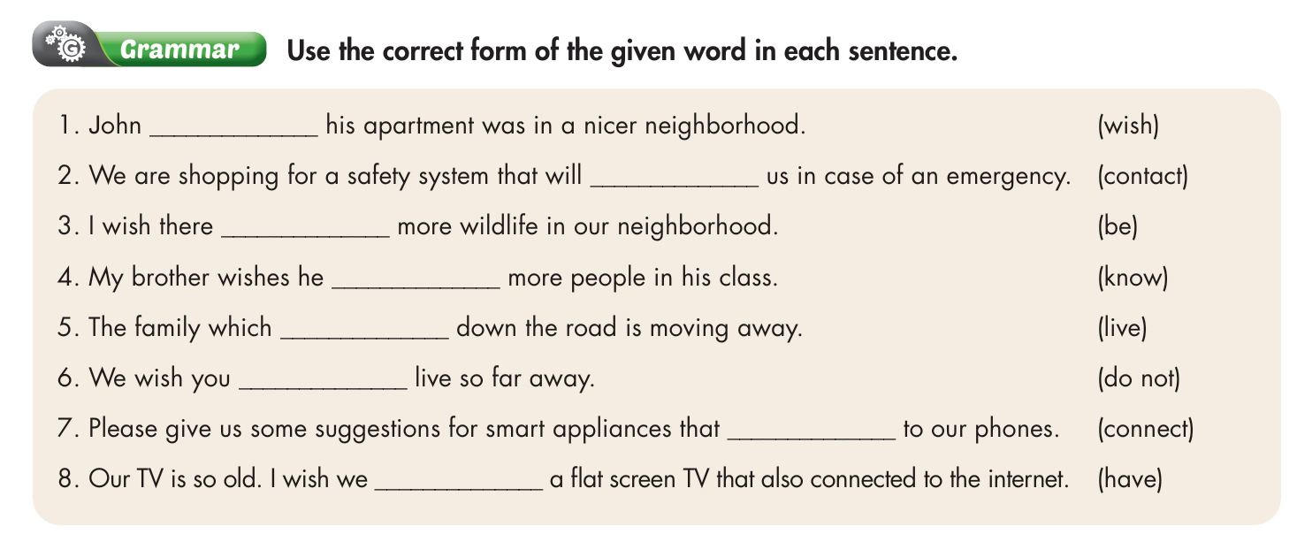

Slide 22
Answer
John _________ his apartment was in a nicer neighborhood. (wish)
We are shopping for a safety system that will __________ us in case of an emergency. (contact)
I wish there _______ more wildlife in our neighborhood. (be)
My brother wishes he ________ more people in his class. (know)
wishes
contact
was
knew

Slide 23
5. The family which ________ down the road is moving away. (live)
6. We wish you _________ live so far away. (do not)
7. Please give us some suggestions for smart appliances that __________ to our phones. (connect)
8. Our TV is so old. I wish we ______ a flat screen TV that also connected to the internet. (have)
lives
didn’t
connect
had

Slide 24
Pronunciation

Slide 25
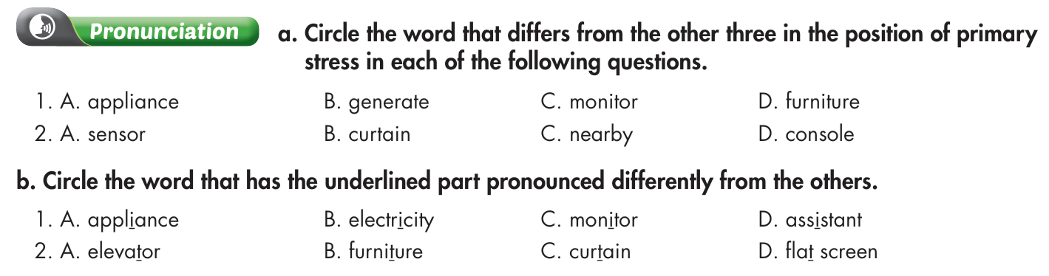

Slide 26
Answer
a. Circle the word that differs from the other three in the position of primary stress in each of the following questions.
1. A. appliance B. generate C. monitor D. furniture
/əˈplaɪəns/ /ˈdʒenəreɪt/ /ˈmɑːnətər/ /ˈfɜːnɪtʃər/
2. A. sensor B. curtain C. nearby D. console
/ˈsensər/ /ˈkɜːtən/ /nɪrˈbaɪ/ /ˈkɑːnsoʊl/

Slide 27
b. Circle the word that has the underlined part pronounced differently from the others.
A. appliance B. electricity C. monitor D. assistant
/əˈplaɪəns/ /ɪˌlekˈtrɪsəti/ /ˈmɑːnɪtər/ /əˈsɪstənt/
2. A. elevator B. furniture C. curtain D. flat screen
/ˈeləveɪtər/ /ˈfɜːnɪtʃər/ /ˈkɜːtən/ /flæt ˈskriːn/

Slide 28
In the real world

Slide 29
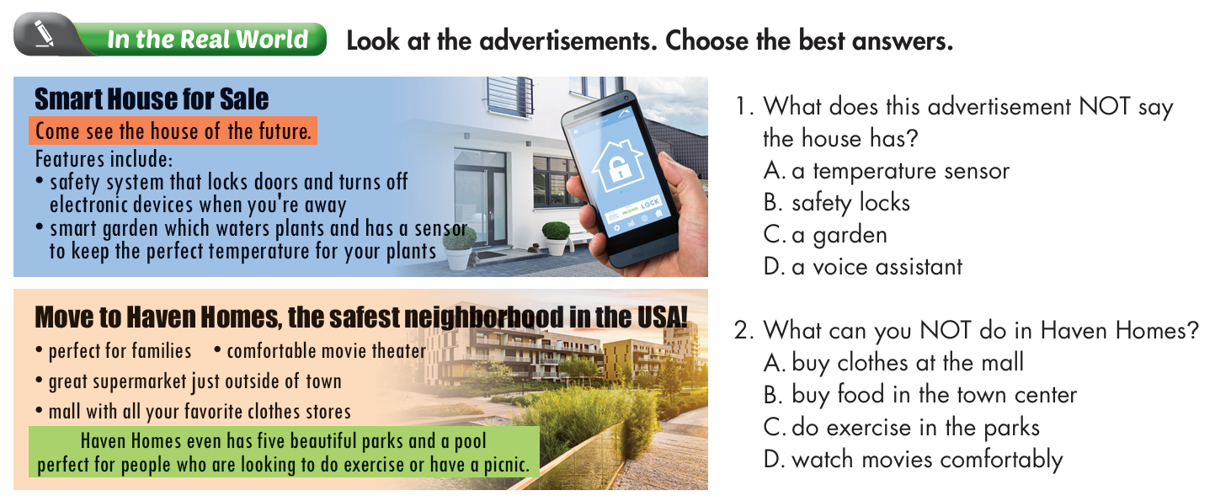

Slide 30
Underline the key words in the questions.
1. What does this advertisement NOT say the house has?
A. a temperature sensor
B. safety locks
C. a garden
D. a voice assistant
2. What can you NOT do in Haven Homes?
A. buy clothes at the mall
B. buy food in the town center
C. do exercise in the parks
D. watch movies comfortably

Slide 31
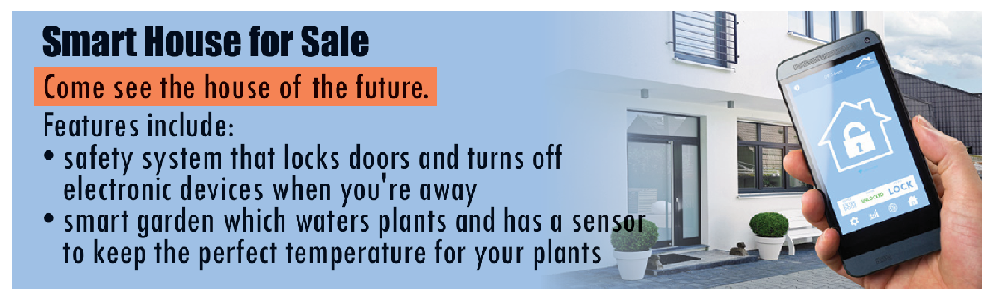
Answer
1. What does this advertisement NOT say the house has?
A. a temperature sensor
B. safety locks
C. a garden
D. a voice assistant

Slide 32

2. What can you NOT do in Haven Homes?
A. buy clothes at the mall
B. buy food in the town center
C. do exercise in the parks
D. watch movies comfortably

Slide 33
Conversation

Slide 34
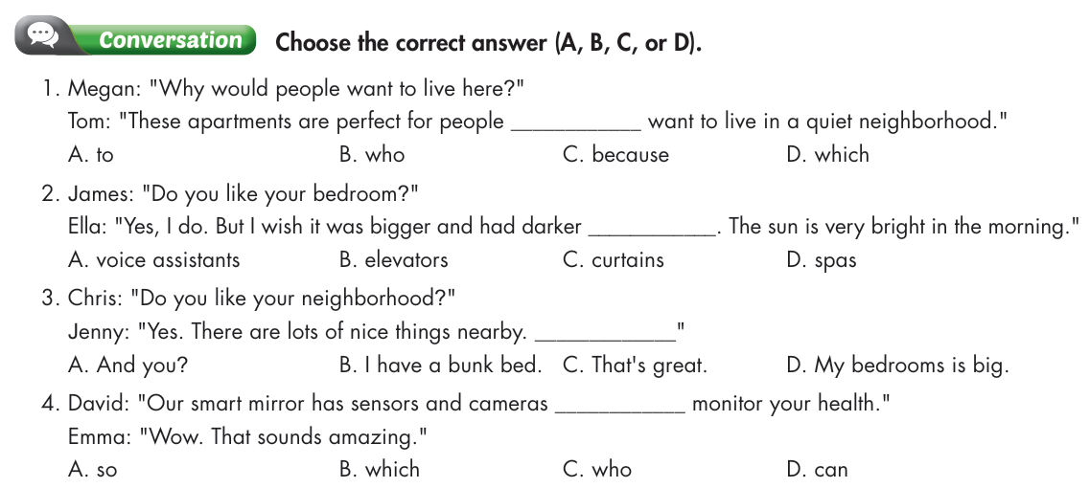

Slide 35
Megan: "Why would people want to live here?"
Tom: "These apartments are perfect for people ________ want to live in a quiet neighborhood."
A. to B. who C. because D. which
2. James: "Do you like your bedroom?"
Ella: "Yes, I do. But I wish it was bigger and had darker ____________. The sun is very bright in the morning."
A. voice assistants B. elevators C. curtains D. spas
Answer

Slide 36
3. Chris: "Do you like your neighborhood?"
Jenny: "Yes. There are lots of nice things nearby. _____________“
A. And you? B. I have a bunk bed.
C. That's great. D. My bedrooms is big.
4. David: "Our smart mirror has sensors and cameras ___________ monitor your health."
Emma: "Wow. That sounds amazing."
A. so B. which C. who D. can

Slide 37
Speaking

Slide 38
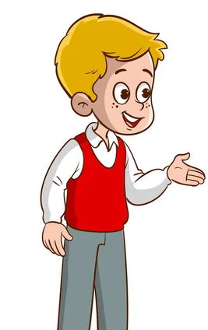
Suggested answer
I think the best smart features a house can have are smart appliances and sensors which allow you to control your house remotely.

Slide 39
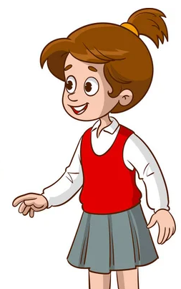
I think houses in the future might have a voice assistant that controls everything.
They also have solar panels that produce electricity using energy from the sun.

Slide 40
Writing

Slide 41
I really like my house and my neighborhood, but there are a few things I wish were different. I don't like my bedroom. I wish it was bigger and had thicker curtains. I also wish I had a game console and TV in my bedroom. My living room is OK, but I wish my sofa was more comfortable.
My neighborhood is OK. I just wish that my friends lived closer to me. I also wish it was a bit quieter at night. I hate hearing people sing karaoke. Finally, I wish there was a park near my house. I love playing soccer, but there's nowhere for me to play.

Slide 42

CONSOLIDATION

Slide 43
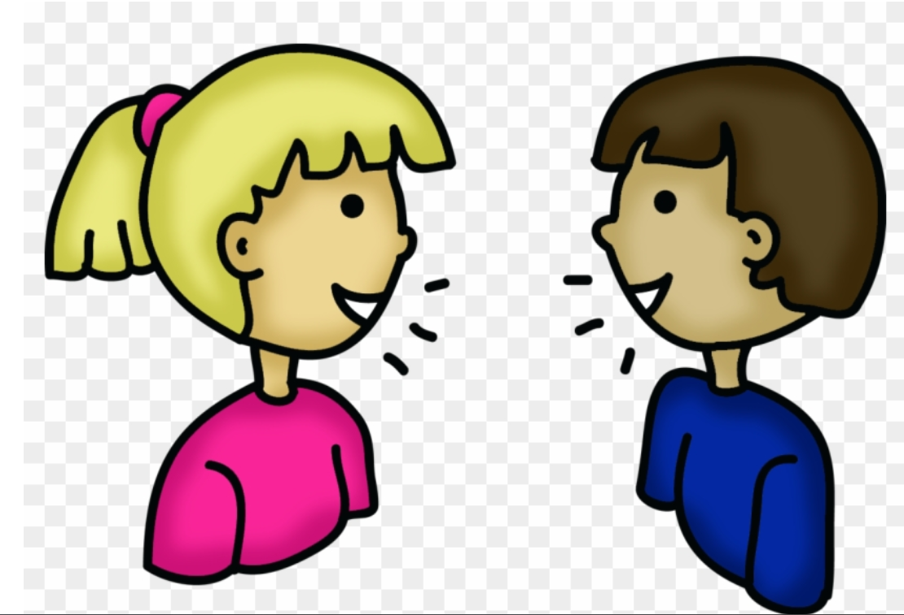
Talk to your partner about your house and neighborhood.

Slide 44
Sample answers
I like my bedroom, but I wish it was bigger and had thicker curtains. I also wish I had a game console and TV in my bedroom. My living room is OK, but I wish my sofa was more comfortable.
My neighborhood is OK. I just wish that my friends lived closer to me. I also wish it was a bit quieter at night. I hate hearing people sing karaoke. Finally, I wish there was a park near my house.

Slide 45

WRAP-UP

Slide 46
Today’s lesson
Grammar:
- review the target grammar points learned in the unit.
Speaking & Writing:
- practice speaking and writing.

Slide 47
Homework
Review relative clauses and wishes
Prepare for the next lesson (Review Unit 4, page 20)
Play the consolidation games on www.eduhome.com.vn

Slide 48

Lesson 3
Stay positive and have a nice day!

