Slide 1

Unit 3: Living Environment
Review: Listening, Reading & Vocab
Pages 92 & 93

Slide 2
Friday, November, 28th 2025
Period 36
Unit 3: Living Environment
Review: Listening, Reading & Vocab
Pages 92 & 93

Slide 3
Lesson Outline
Warm-up
Listening
Reading
Vocabulary
Consolidation
Wrap-up

Slide 4

By the end of this lesson, students will be able to…
- To review the target language learned in the unit
- To practice test-taking skills
.

Slide 5

WARM-UP

Slide 6
COMPETITION TIME:
Create groups/teams of 3 students.
You will be given some words with letters in incorrect order.
You will work in group to unscramble the words.
You will use the numbered letters to find out the secret word.
The team(s) with the most correct answers win (s).
Time limit: 5 minutes

Slide 7
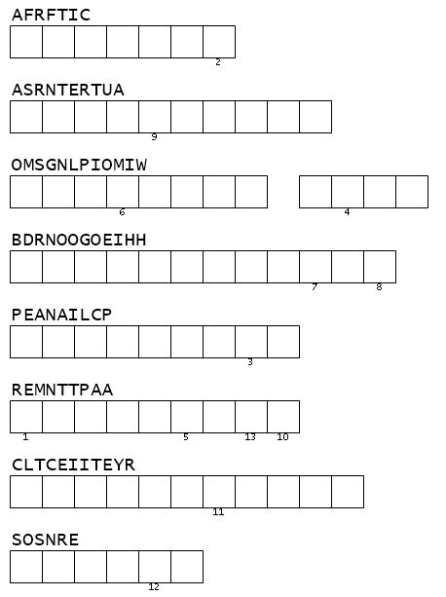
Unscramble the following words and find the secret word.
T R A F F I C
R E S T A U R A N T
S W I M M I N G P O O L
ACCOMMODATION
N E I G H B O R H O O D
A P P L I A N C E
A P A R T M E N T
E L E C T R I C I T Y
S E N S O R

Slide 8

Listening

Slide 9
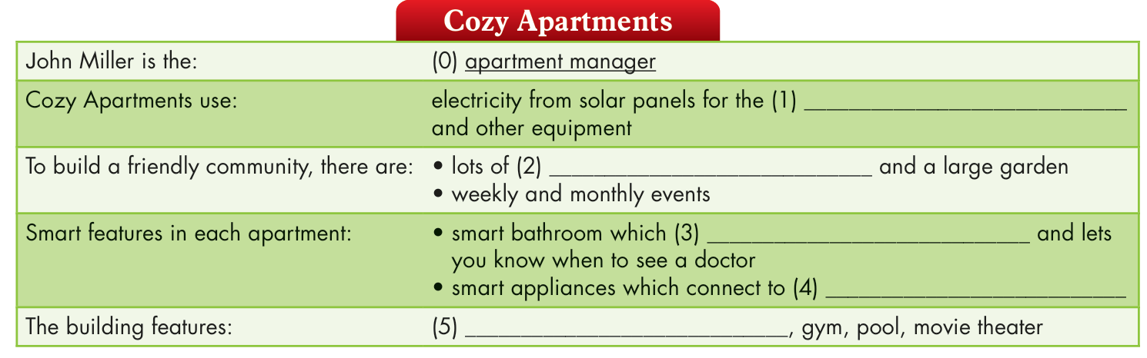
You will hear a man talking about a smart apartment building. Listen and fill in the blanks. You will hear the information twice.

Slide 10
Guess the type of the missing words.
noun
noun
verb
noun
noun

Slide 11
Underline key words.

Slide 12

You will hear a man talking about a smart apartment building. Listen and fill in the blanks. You will hear the information twice.

Slide 13
Answers:
elevator system
John: Welcome to Cozy Apartments! I'm John Miller, and I'm the apartment manager. Let me introduce you to the features of our apartments. First, our apartments have solar panels which generate electricity for the elevator system and other equipment. It's always sunny here, so you never have to worry about not having electricity.

Slide 14
outdoor spaces
Second, we try to build a friendly community here. There are lots of outdoor spaces which all connect to a larger garden. We'll organize weekly and monthly events so that everyone can meet.

Slide 15
monitors your health
a voice assistant
Third, each apartment has a smart bathroom which monitors your health and lets you know when to see a doctor. You'll also have lots of smart appliances which connect to a voice assistant. People who don't like these can tell us, and we'll turn off the smart features for you.

Slide 16
spa
Finally, there are many places which will make your life more comfortable such as a spa, gym, pool, and movie theater. If you have any questions or problems, please feel free to contact me. You can find me in my office on the first floor.

Slide 17
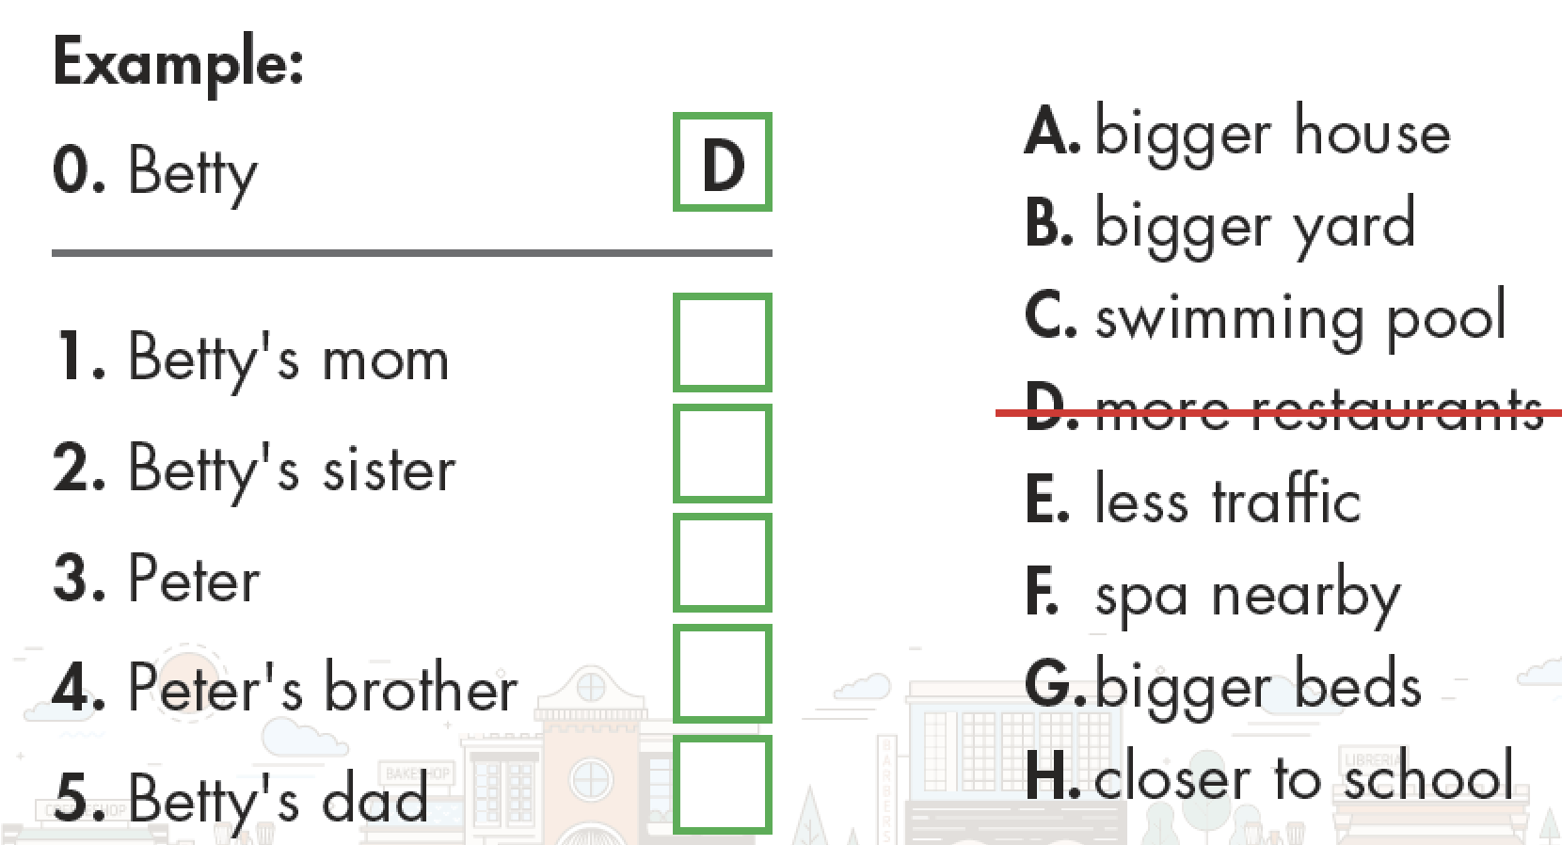
Further practice
You will hear Peter and Betty talking about their neighborhoods and houses.
Workbook p.52
What does each person wish was different? For each question, write a letter (A– H) next to each person.
You will hear the conversation twice.

Slide 18
ANSWERS
F
A
E
C
B

Slide 19
Reading

Slide 20
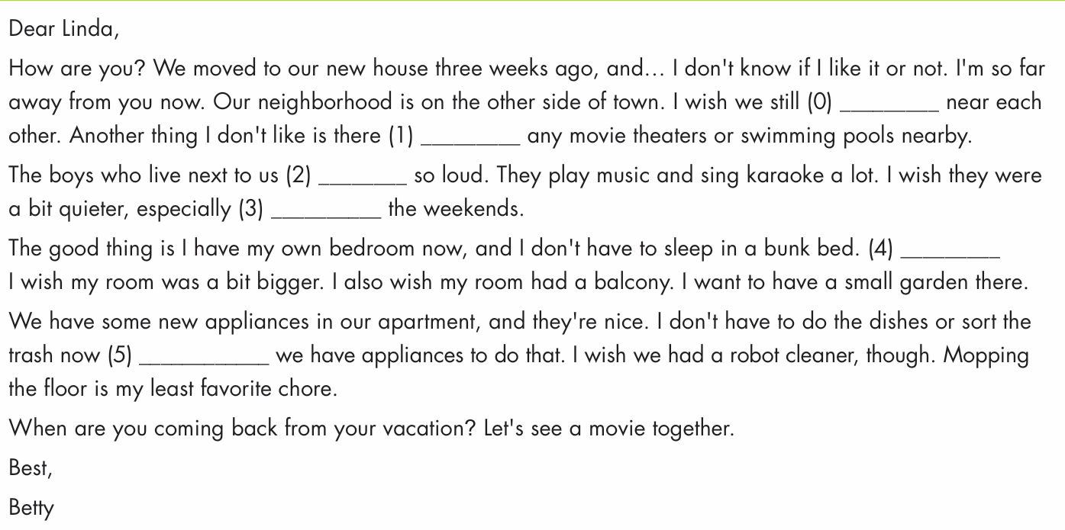
Read the email. Choose the best word (A, B, C, or D) for each space.

Slide 21
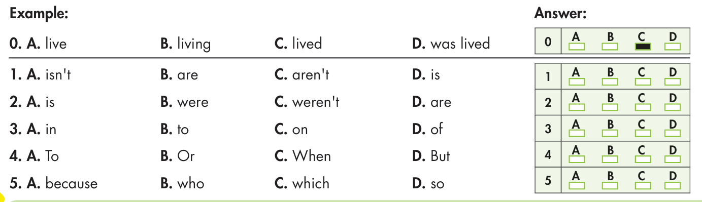

Slide 22
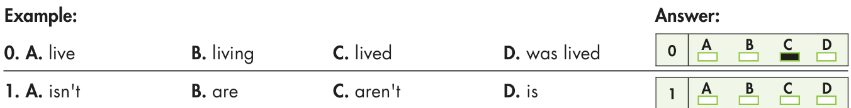
ANSWERS
Dear Linda,
How are you? We moved to our new house three weeks ago, and… I don't know if I like it or not. I'm so far away from you now. Our neighborhood is on the other side of town. I wish we still (0) _______ near each other. Another thing I don't like is there (1) _________ any movie theaters or swimming pools nearby.

Slide 23
The boys who live next to us (2) ________ so loud. They play music and sing karaoke a lot. I wish they were a bit quieter, especially (3) __________ the weekends.

Slide 24
The good thing is I have my own bedroom now, and I don't have to sleep in a bunk bed. (4) _________ I wish my room was a bit bigger. I also wish my room had a balcony. I want to have a small garden there.

Slide 25
We have some new appliances in our apartment, and they're nice. I don't have to do the dishes or sort the trash now (5) __________ we have appliances to do that. I wish we had a robot cleaner, though. Mopping the floor is my least favorite chore.

Slide 26
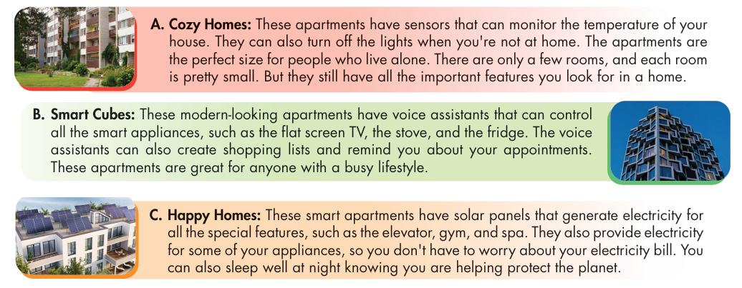
Further practice
Read the passages about three smart apartments. Choose the correct answer (A, B, or C).
Workbook p.52

Slide 27
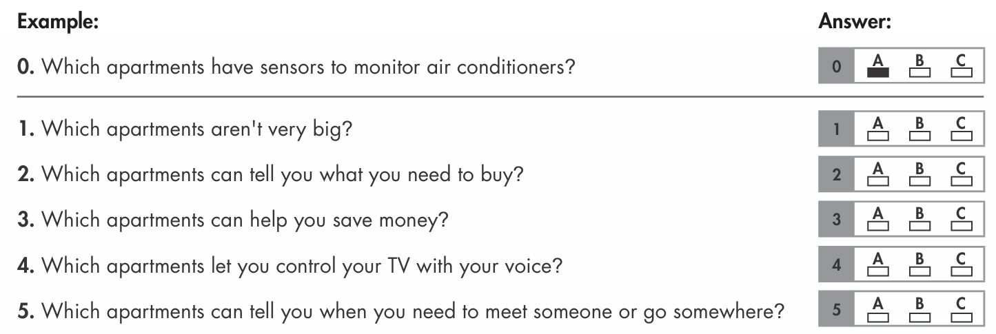

Slide 28
ANSWERS
A. Cozy Homes: These apartments have sensors that can monitor the temperature of your house. They can also turn off the lights when you're not at home. The apartments are the perfect size for people who live alone. There are only a few rooms, and each room is pretty small. But they still have all the important features you look for in a home.
0. Which apartments have sensors to monitor air conditioners?
A

Slide 29
A. Cozy Homes: These apartments have sensors that can monitor the temperature of your house. They can also turn off the lights when you're not at home. The apartments are the perfect size for people who live alone. There are only a few rooms, and each room is pretty small. But they still have all the important features you look for in a home.
A
1. Which apartments aren't very big?

Slide 30
B. Smart Cubes: These modern-looking apartments have voice assistants that can control all the smart appliances, such as the flat screen TV, the stove, and the fridge. The voice assistants can also create shopping lists and remind you about your appointments. These apartments are great for anyone with a busy lifestyle.
2. Which apartments can tell you what you need to buy?
B

Slide 31
C. Happy Homes: These smart apartments have solar panels that generate electricity for all the special features, such as the elevator, gym, and spa. They also provide electricity for some of your appliances, so you don't have to worry about your electricity bill. You can also sleep well at night knowing you are helping protect the planet.
3. Which apartments can help you save money?
C

Slide 32
B. Smart Cubes: These modern-looking apartments have voice assistants that can control all the smart appliances, such as the flat screen TV, the stove, and the fridge. The voice assistants can also create shopping lists and remind you about your appointments. These apartments are great for anyone with a busy lifestyle.
4. Which apartments let you control your TV with your voice?
5. Which apartments can tell you when you need to meet someone or go somewhere?
B
B

Slide 33
Vocabulary

Slide 34
Circle the correct answers.
1. The ____________ in my building broke down, and I had to climb the stairs to my apartment.
A. furniture B. sensor C. curtain D. elevator
2. I think the ____________ is broken. It's getting too hot.
A. air conditioner B. voice assistant C. bunk bed D. monitor

Slide 35
3. We live in a pretty nice ____________. There's a big park, supermarket, and lots of things to do.
A. sensor B. neighborhood C. game console D. spa
4. Can you please close the ____________s? It's too bright in here.
A. appliance B. monitor C. curtain D. system
5. My mom's taking me to a ____________ this weekend. It's going to be relaxing.
A. nearby B. neighborhood C. spa D. elevator

Slide 36
6. The lights in my bedroom have ____________s. I don't have to worry about forgetting to turn off the lights.
A. sensor B. system C. generate D. appliance
7. My aunt gave me a ____________ for my birthday. I use it to play lots of games.
A. air conditioner B. curtain C. game console D. voice assistant
8. The biggest piece of ____________ in my room is my bed.
A. bunk bed B. flat screen C. sensor D. furniture

Slide 37

CONSOLIDATION

Slide 38
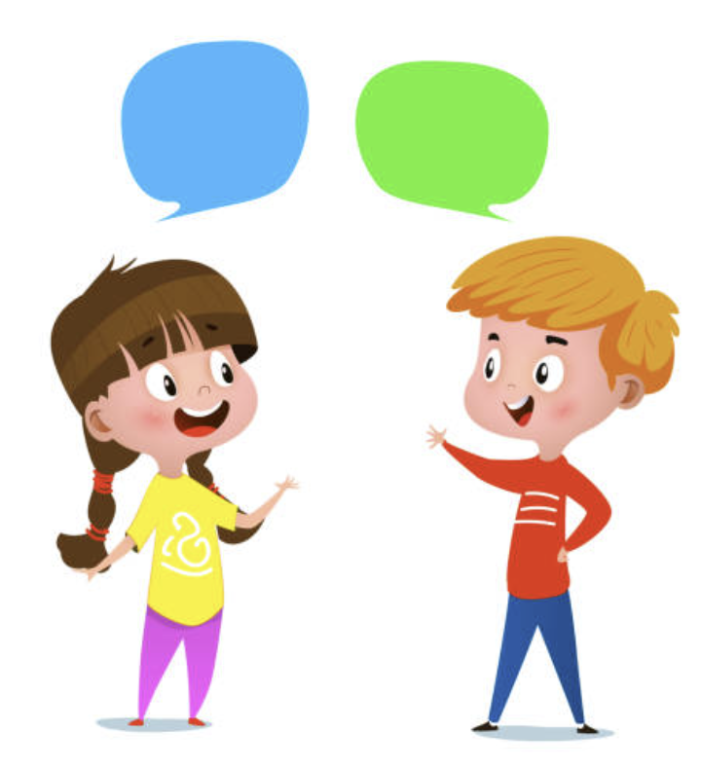
Talk to your partner about the technology you would like to have in your house.

Slide 39
Sample answers
I would like my house to have sensors so that I don’t have to turn on or turn off the lights.
I would like my kitchen to have voice assistants that can control all the smart appliances.
I would like to solar panels that generate electricity for the whole house.

Slide 40

WRAP-UP

Slide 41
Today’s lesson
Vocabulary:
- review the target language learned in the unit.
Listening & Reading:
- practice test-taking skills.

Slide 42
Homework
Review new words to describe living environment
Make sentences using the new words in SB
Prepare for the next lesson (Review Unit 3, pages 93 & 94
Play the consolidation games on www.eduhome.com.vn

Slide 43

Lesson 3
Stay positive and have a nice day!

