Slide 1

Unit 3: Living Environment
Lesson 2.3: Pronunciation & Speaking
Pages 30 & 31

Slide 2
Friday, November, 21st 2025
Period 33
Unit 3: Living Environment
Lesson 2.3: Pronunciation & Speaking
Pages 30 & 31

Slide 3
Lesson Outline
Warm-up
Pronunciation
Speaking
Consolidation
Wrap-up

Slide 4

By the end of this lesson, students will be able to…
practice the /aɪ/ sound
practice talking about things you don’t like about where you live

Slide 5

WARM-UP

Slide 6
Choose the word whose underlined part is pronounced differently from that of the others.
1. A. air B. game C. name D. fame
/er/ /ɡeɪm/ /neɪm/ /feɪm/
2. A. method B. nephew C. content D. system
/ˈmeθəd/ /ˈnefjuː/ /ˈkɑːntent/ /ˈsɪstəm/ 3. A. roller B. solar C. sensor D. console
/ˈroʊlər/ /soʊlər/ /ˈsensər/ /kɑːnsoʊl/
4. A. children B. childhood C. teacher D. schedule
/ˈtʃɪldrən/ /ˈtʃaɪldhʊd/ /ˈtiːtʃər/ /ˈskedʒuːl/
5. A. furniture B. appliance C. importance D. assistant
/ˈfɜːrnɪtʃər/ /əˈplaɪəns/ /ɪmˈpɔːrtns/ /əˈsɪstənt/

Slide 7

Pronunciation

Slide 8


Task a
Notes:
Focus on the /aɪ/ sound.

Slide 9

Task b
Listen to the words and focus on the underlined letters.
Crime
Nearby
Like

Slide 10
Task c
Listen and circle the words you hear.
Way why
White wait
Buy bay

Slide 11
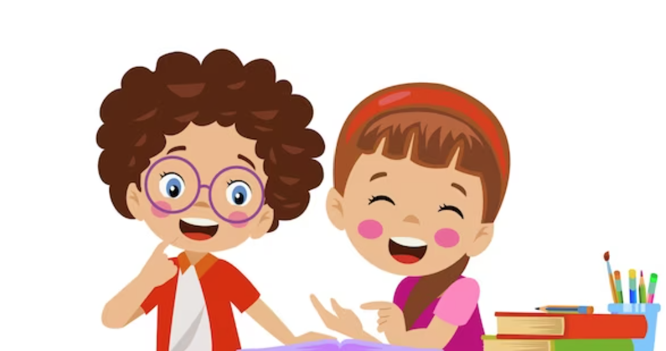
Task d
Take turns saying the words in Task c. while your partner points to them.
Way why
White wait
Buy bay

Slide 12

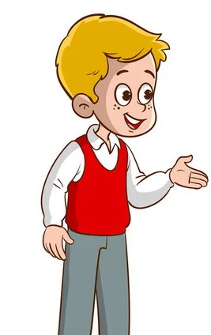
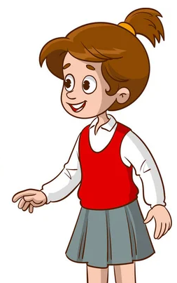
Task a
a. In pairs: Take turns making sentences using the pictures and prompts.

Slide 13
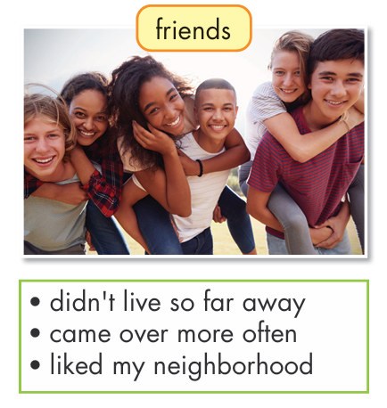
I wish my friends didn't live so far away. What about yours?
Example
I wish my friends came over more often. And you?
Yeah, I wish they liked my neighborhood.

Slide 14
Task a
Now, role-play the conversations in front of the class.

Slide 15
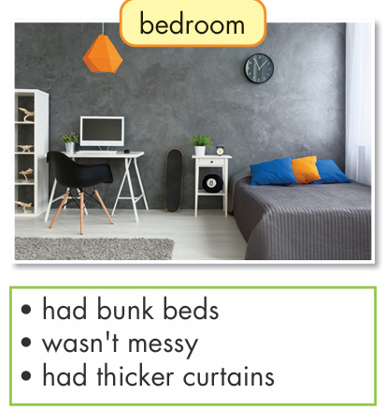
I wish my bedroom had bunk beds. What about yours?
Suggested answer
I wish my bedroom wasn’t messy. And you?
Yeah, I wish it had thicker curtains.

Slide 16
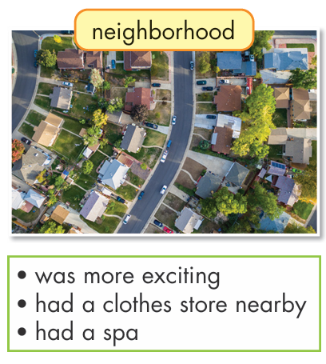
I wish my neighborhood was more exciting. What about yours?
Suggested answer
I wish my neighborhood had a clothes store nearby. And you?
Yeah, I wish it had a spa.

Slide 17
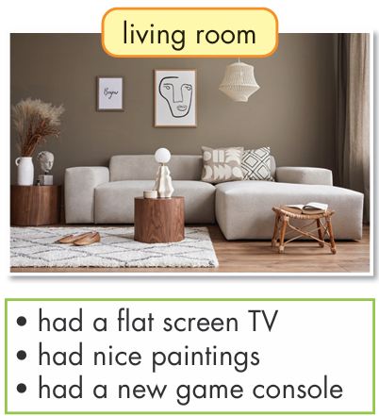
I wish my living room had a flat screen TV. What about yours?
Suggested answer
I wish my living room had nice paintings. And you?
Yeah, I wish it had a new game console.

Slide 18

Task b
Practice with your own ideas.

Slide 19
Suggested answer
I wish my friends spent more time with me . What about yours?
I wish my friends helped each other more.

Slide 20
Suggested answer
I wish my neighborhood was busier. What about yours?
I wish my neighborhood was cleaner.

Slide 21
Suggested answer
I wish my bedroom had a balcony. What about yours?
I wish my bedroom had a comfortable bed

Slide 22
Suggested answer
I wish my living room had a stereo. What about yours?
I wish my living room was bigger.

Slide 23
Presentation
Speaking

Slide 24

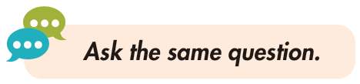
Task a
You are talking about things you don't like about where you live. In pairs: Use the topics in the boxes below to talk about things you wish were different in your house or neighborhood.

Slide 25

Example
There isn't anything to do near my house. I wish my neighborhood had a coffee shop.
There's lots to do near my house, but I wish my neighbors were quieter.

Slide 26

Suggested answer
My neighbors hardly talk. I wish they were more sociable.
I wish my neighbors didn’t sing karaoke every day.

Slide 27

Suggested answer
There isn’t a garden in my house. I wish there was a garden in my house so that I can plant flowers.
I wish my house was near my school so that I can walk to school.

Slide 28

Suggested answer
I wish there was a market near my house so that I can buy fresh food every day.
I wish it wasn’t crowded near my house.

Slide 29
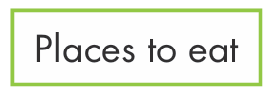
Suggested answer
I really like sushi. I wish my house was near a Japanese restaurant.
I wish my neighborhood had more places where I can enjoy street food.

Slide 30

Suggested answer
There isn’t anything to relax in my bedroom. I wish it had a desk top so that I can play games after study.
I wish my bedroom had a window so that I enjoy the sunshine in the morning.

Slide 31
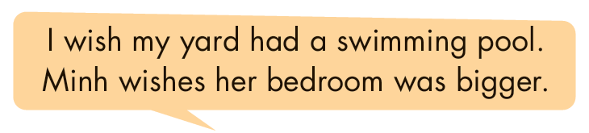
Task b
Join a new partner. Tell them about the changes you and your partner want to make to your living environment.

Slide 32

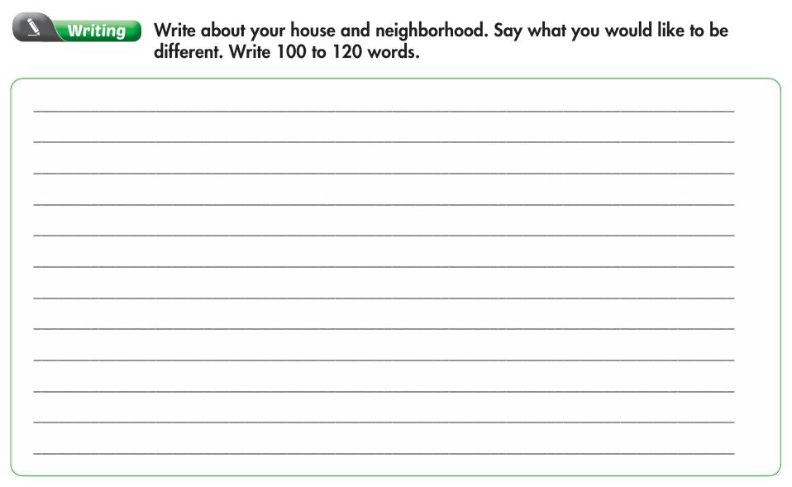
Extra practice - WB - page 17

Slide 33
Suggested answer
I really like my house and my neighborhood, but there are a few things I wish were different.
I don't like my bedroom. I wish it was bigger and had thicker curtains. I also wish I had a game console and TV in my bedroom. My living room is OK, but I wish my sofa was more comfortable.

Slide 34
Suggested answer
My neighborhood is OK. I just wish that my friends lived closer to me. I also wish it was a bit quieter at night. I hate
hearing people sing karaoke.
Finally, I wish there was a park near my house. I love playing soccer, but there's nowhere for me to play.

Slide 35
Extra Practice
Present what you have just written about your house to your class.

Slide 36

CONSOLIDATION

Slide 37
Practice saying these by focusing on the /aɪ/ sound.
crime
nearby
like

Slide 38

WRAP-UP

Slide 39
Today’s lesson
Pronunciation:
the /aɪ/ sound
Speaking:
talking about things you don’t like about where you live.

Slide 40
Homework
Practice saying words in the Pronunciation(SB) focusing on the /aɪ/ sound
Prepare for the next lesson (Reading & Listening - pages 32 & 33 - SB).
Play the consolidation games on www.eduhome.com.vn

Slide 41
COMPETITION TIME:
Create groups/teams of 5 students.
You will be given 5 groups of words.
You have to circle the word whose underlined part is pronounced differently from that of the others.
The team(s) with the most correct answers win(s).
Time limit: 5 minutes

Slide 42

Lesson 3
Stay positive and have a nice day!

