Slide 1


WELCOME TO OUR CLASS

Slide 2

Unit 2: Life in the past
Review 2
Pages 88 & 89

Slide 3
Friday, October, 24th 2025
Period 21
Unit 2: Life in the past
Review 2
Pages 88 & 89

Slide 4

By the end of this lesson, students will be able to…
Review the target language learned in the unit
Practice test-taking skills

Slide 5
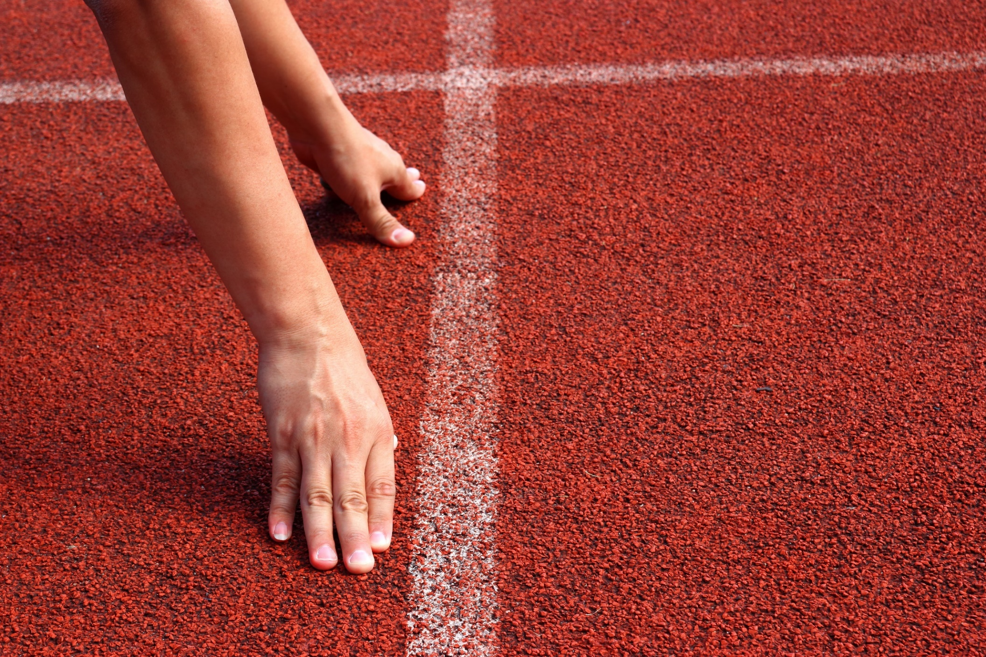
WARM-UP

Slide 6
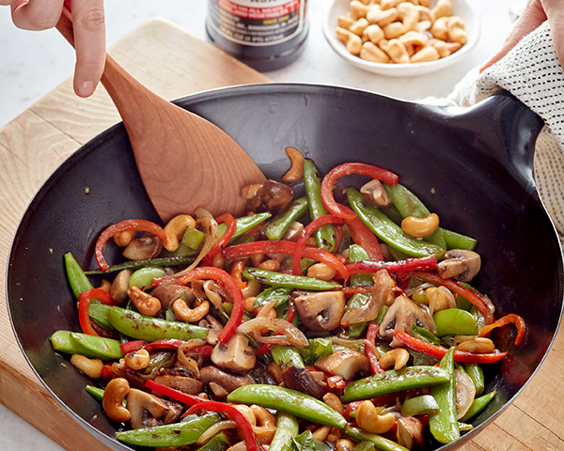
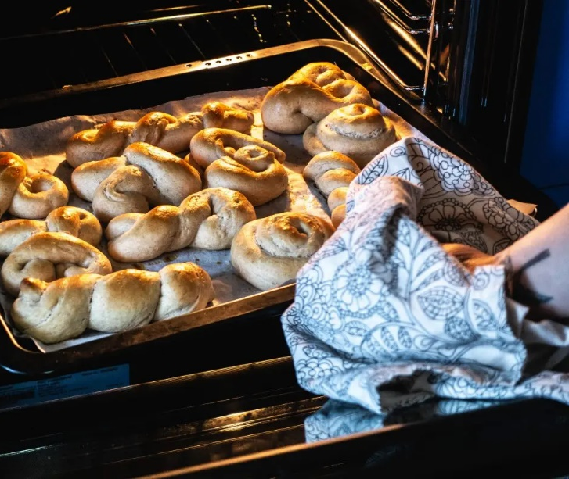
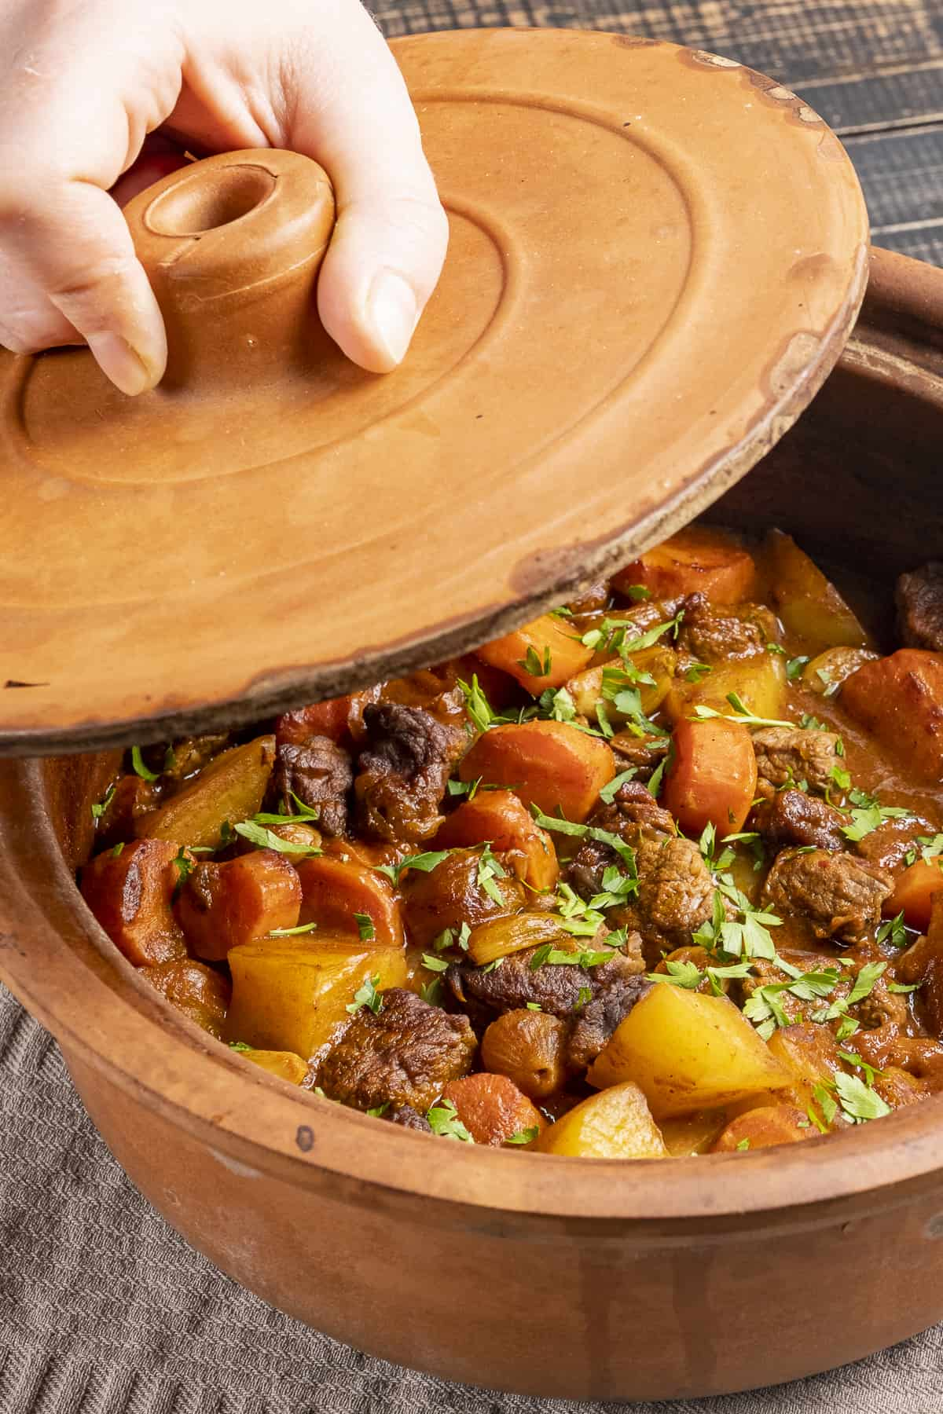
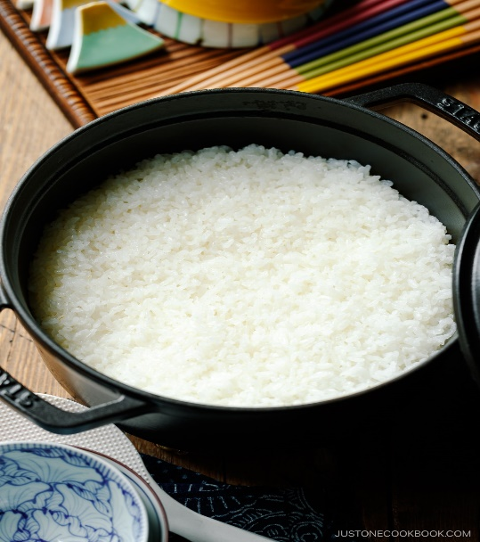
Match the words related to cooking with the correct pictures.
A. Bake desserts
B. Boil
rice
C. Fry vegetables
D. Use a clay pot
1
2
3
4

Slide 7

Grammar

Slide 8

Would:
To Talk about the things often happened in the past, not any more.
Form: (+) S + would + bare infinitive (+O)
(-) S + would + not + bare infinitive (+O)
(?) (Wh-word+) Would + S + bare infinitive (+O)?
Eg: I would hate working in an office all day.
She wouldn't be a good architect.

Slide 9
Used to:
To express a past situation or state (but no longer existing) or a repeated past action (but no longer continuing).
Form: (+) S + used to + bare infinitive (+O)
(-) S + didn’t use to+ bare infinitive (+O)
(?) (Wh-word+) Did + S + use to+ bare infinitive (+O)?
Eg: I used to walk to school.
I didn’t use to go to school by bus.

Slide 10
Rearrange the groups of words in the correct order to make complete sentences.
1. in the evenings./We used/delicious food/to make
2. work at a/used to/market stall./My sister
3. board games./would go/we'd play/My grandparents/fishing, and
4. with my/live in/I used to/extended family./a cottage
5. dinner together/Back then,/every day./most families ate
6. be breadwinners./husbands would/housewives, and/Women used/to be
7. often get/people would/In the past,/a young age./married at
8. at the/to meet/park after school./We used/our friends

Slide 11
Rearrange the groups of words in the correct order to make complete sentences.
Answers
1. in the evenings./We used/delicious food/to make _________________________________________________
2. work at a/used to/market stall./My sister _________________________________________________
3. board games./would go/we'd play/My grandparents/fishing, and
____________________________________________________
We used to make delicious food in the evenings.
My sister used to work at a market stall
My grandparents would go fishing, and we'd play board games.

Slide 12
Rearrange the groups of words in the correct order to make complete sentences.
Answers
4. with my/live in/I used to/extended family./a cottage _________________________________________________
5. dinner together/Back then,/every day./most families ate _________________________________________________
6. be breadwinners./husbands would/housewives, and/Women used/to be _______________________________________________________
I used to live in a cottage with my extended family.
Back then, most families ate dinner together every day.
Women used to be housewives, and husbands would be breadwinners.

Slide 13
Rearrange the groups of words in the correct order to make complete sentences.
Answers
7. often get/people would/In the past,/a young age./married at _________________________________________________
8. at the/to meet/park after school./We used/our friends
_________________________________________________
In the past, people would often get married at a young age.
We used to meet our friends at the park after school.

Slide 14
Pronunciation

Slide 15

Task a. Circle the word that differs from the other three in the position of primary stress in each of the following questions.
1. A. relative | B. family | C. breadwinner | D. extended
2. A. nephew | B. cottage | C. divorce | D. single

Slide 16
Answers
Task a. Circle the word that differs from the other three in the position of primary stress in each of the following questions.
1. A. relative | B. family | C. breadwinner | D. extended
/ˈrelətɪv/ | /ˈfæməli/ | /ˈbredwɪnər/ | /ɪkˈstendɪd/
2. A. nephew | B. cottage | C. divorce | D. single
/ˈnefjuː/ | /ˈkɑːtɪdʒ/ | /dɪˈvɔːrs/ | /ˈsɪŋɡl/

Slide 17
Answers
Task b. Circle the word that has the underlined part pronounced differently from the others.
1. A. divorce | B. relative | C. housewife | D. single
2. A. bake | B. clay pot | C. relative | D. generation

Slide 18
Answers
Task b. Circle the word that has the underlined part pronounced differently from the others.
1. A. divorce | B. relative | C. housewife | D. single
/dɪˈvɔːrs/ | /ˈrelətɪv/ | /ˈhaʊswaɪf/ | /ˈsɪŋɡl/
2. A. bake | B. clay pot | C. relative | D. generation
/beɪk/ | /kleɪ pɑːt/ | /ˈrelətɪv/ | /ˌdʒenəˈreɪʃn/

Slide 19
In the Real World

Slide 20

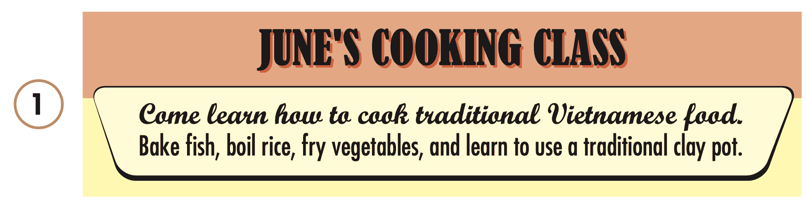
Look at the advertisements. Choose the best answers.
1. What don't you learn at the cooking class?
A. to use a clay pot
B. to bake desserts
C. to fry vegetables
D. to boil rice

Slide 21

Look at the advertisements. Choose the best answers.
2. How much would it cost to go to the mall and the beach?
A. $1.75
B. $2.75
C. $1.25
D. $3.50

Slide 22
Conversation

Slide 23

Choose the correct answer (A, B, C, or D).
1. Emma: "How were things different in the past?" Miss Stevens: "In the past, married women would live with their_________families.”
A. housewives' | B. generations' | C. husbands' | D. relatives’
2. John: "__________did she used to meet her friends?" Katie: "She used to meet her friends in the park."
A. When | B. Who | C. Where | D. How

Slide 24
Choose the correct answer (A, B, C, or D).
3. I_______the museum with my family last summer.
A. would go to | B. went to | C. used to go to | D. go to
4. Beth: "My grandpa used to go fishing on a lake by his cottage." Mark:"________________.”
A. That sounds awesome | B. Of course I will | C. Thank you very much families." | D. Lucky you

Slide 25
Speaking

Slide 26

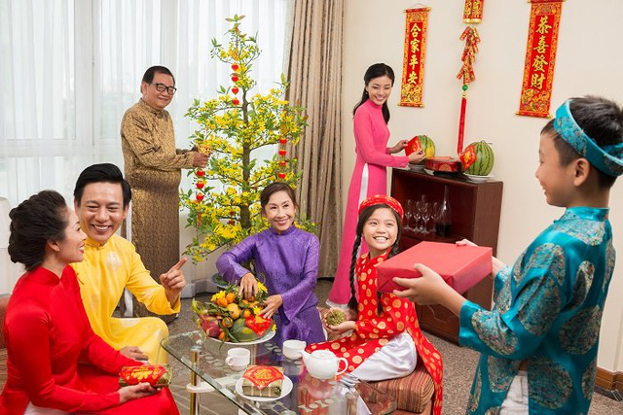
In pairs: Discuss how family traditions and customs have changed over time in your country. Give examples from your own family when possible.

Slide 27
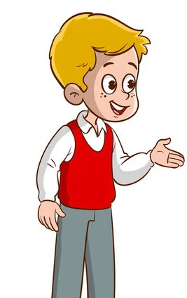
Suggested answer
How have family traditions and customs changed over time in your country?

Slide 28
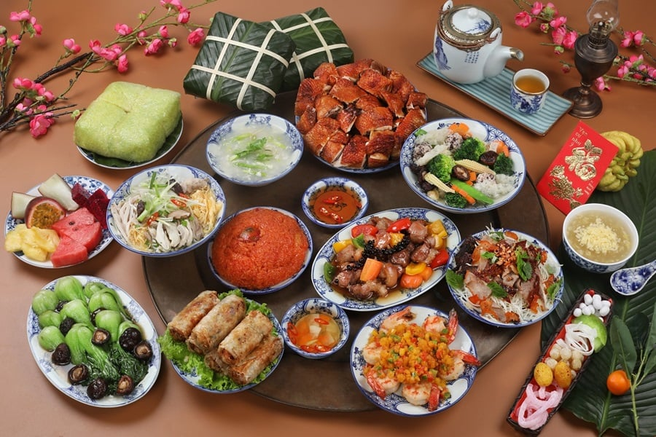
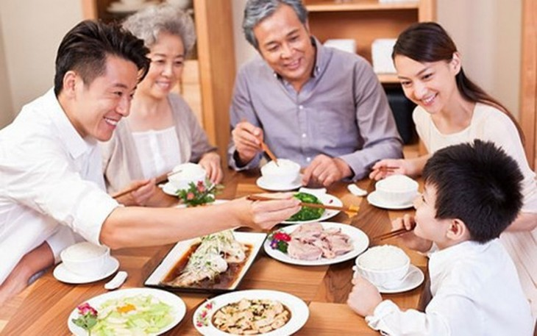
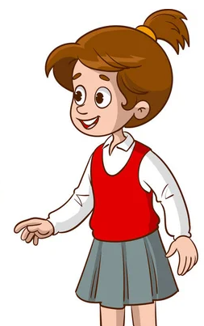
PAST
Suggested answer
NOW
Family traditions and customs in Vietnam have evolved significantly over time. For example, while traditional family meals used to be large and formal, nowadays, families often prefer more casual and relaxed gatherings.

Slide 29
Writing

Slide 30


Write about what your family used to do when you were little. Write 100 to 120 words.

Slide 31
Suggested answer
When I was little, my family and I used to go to a beach near my grandma's house. We would drive there really early in the morning. I used to swim in the sea with my brother and sister. My parents would sit on the beach and read their books. In the evenings, we used to go into town and eat at a restaurant by the river. It was such a nice place. I would always eat some fish. My brother would usually eat chicken curry. Sometimes, my grandma would cook for us. She would bake vegetables and meat in a clay pot, and we would eat it with rice. I loved those trips.
114 words

Slide 32

CONSOLIDATION

Slide 33

Ask and answer the question below with your partner, using “used to”
What sports did you use to play with friends when you were a child?

Slide 34
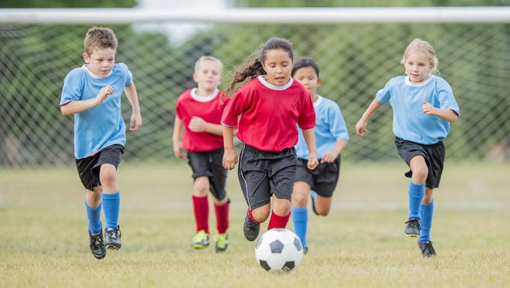
Suggested answer
Presentation
Production
When I was a child, I used to play soccer with my friends.

Slide 35
Today’s lesson
Review:
Review the target language learned in the unit
Practice test-taking skills

Slide 36
Homework
Review the target language learned in the unit
Prepare for the next lesson (Revision for the midterm test).
Play the consolidation games on www.eduhome.com.vn

Slide 37

Extra practice

Slide 38
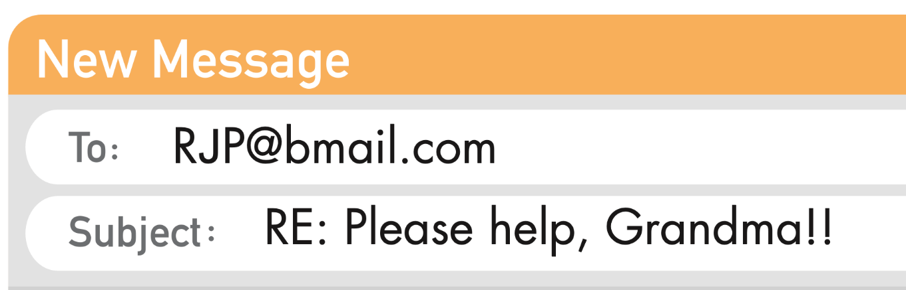
WB p. 51. Read the email. Choose the best word (A, B, or C) for each space.
Underline the key words and guess the type of missing word(s). Noun? Verb? Adj? etc.?
Dear Nancy,
I was very glad when I got your email asking me about life in the (0) _______. I'm more than happy to share my memories and experiences with you. Those were good days.
noun

Slide 39
WB p. 51. Read the email. Choose the best word (A, B, or C) for each space.
Underline the key words and guess the type of missing word(s). Noun? Verb? Adj? etc.?
When I was young, family was the center of everything. People would often live with their (1) _________ and spend a lot of time together. I lived with all my uncles, aunts, and cousins. The men were usually the (2) __________. They'd go out to work in the fields or in factories, and the women would cook and do all the chores together.
Plural noun
Plural noun

Slide 40
WB p. 51. Read the email. Choose the best word (A, B, or C) for each space.
Underline the key words and guess the type of missing word(s). Noun? Verb? Adj? etc.?
As for what I used to do when I was young, I had a few (3) _________ to keep me busy. I enjoyed reading and learning how to (4) ________________ from my mother. Her pie and cake recipes are the best. We didn't have all the (5) __________ options you have today, like TV and video games, but we had a lot of fun finding ways to spend our time.
Plural noun
Verb(bare infinitive)
Noun/adj

Slide 41
WB p. 51. Read the email. Choose the best word (A, B, or C) for each space.
I hope this information helps you with your class project. If you have any more questions, write to me or call me anytime.
With love,
Grandma

Slide 42
WB p. 51. Read the email. Choose the best word (A, B, or C) for each space.
ANSWERS
Dear Nancy,
I was very glad when I got your email asking me about life in the (0) _______. I'm more than happy to share my memories and experiences with you. Those were good days.
Example:
0. A. present | B. past | C. future

Slide 43
WB p. 51. Read the email. Choose the best word (A, B, or C) for each space.
ANSWERS
When I was young, family was the center of everything. People would often live with their (1) _______ and spend a lot of time together. I lived with all my uncles, aunts, and cousins. The men were usually the (2) _______. They'd go out to work in the fields or in factories, and the women would cook and do all the chores together.
1. A. extended families | B. cottages | C. stalls
2. A. house husbands | B. breadwinners | C. relatives

Slide 44
WB p. 51. Read the email. Choose the best word (A, B, or C) for each space.
ANSWERS
As for what I used to do when I was young, I had a few (3) _______ to keep me busy. I enjoyed reading and learning how to (4) _______ from my mother. Her pie and cake recipes are the best. We didn't have all the (5) _______ options you have today, like TV and video games, but we had a lot of fun finding ways to spend our time.
3. A. clay pots | B. nuclear families | C. hobbies
4. A. bake | B. clean | C. sketch
5. A. generation | B. nephew | C. entertainment

Slide 45
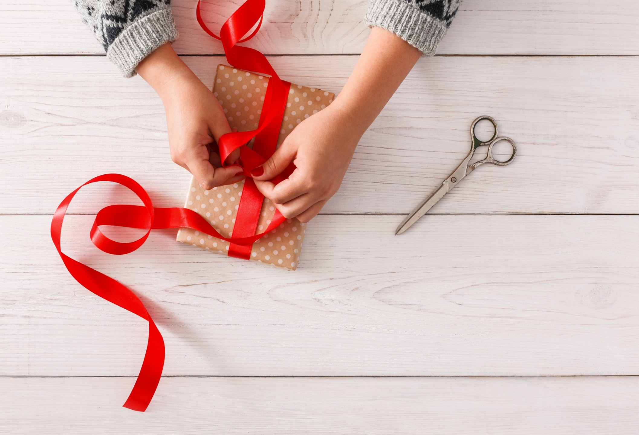
WRAP-UP

Slide 46

Lesson 3
Stay positive and have a nice day!

