Slide 1

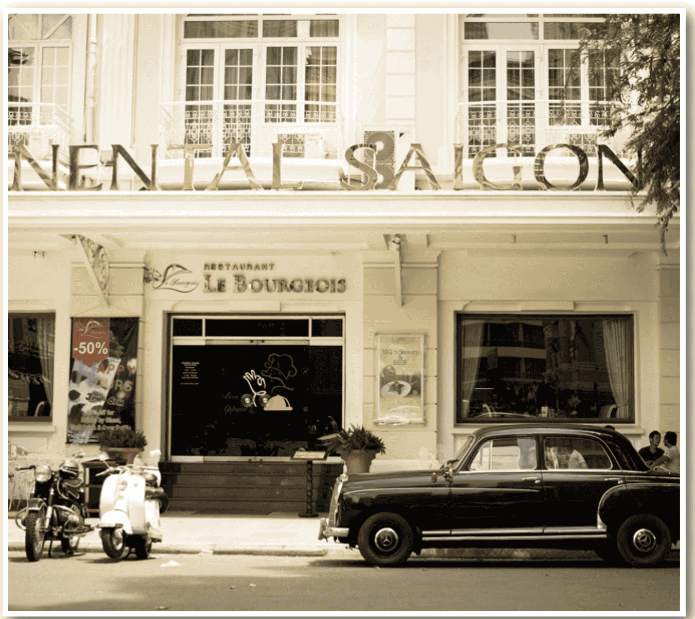
Extra Practice – WB, P 11
Underline the mistakes and write the correct words on the lines.
listen
1. People used to listening to the radio more. | __________
2. I didn't to used like drinking coffee. | __________
3. My grandma use to walk to school. | __________
use to
used

Slide 2
Extra Practice – WB, P 11
Underline the mistakes and write the correct words on the lines.
Men
4. Man used to wear hats outside in public. | __________
5. Where did you used to go on the weekends? | __________
6. My grandpa don't use to have a TV. | __________
use
didn’t

Slide 3

Unit 2: Life in the past
Lesson 2.3: Pronunciation & Speaking
Pages 20 & 21

Slide 4
Thursday, October, 16th 2025
Period 17
Unit 2: Life in the past
Lesson 2.3: Pronunciation & Speaking
Pages 20 & 21

Slide 5
Lesson Outline
Warm-up
Pronunciation
Speaking
Consolidation
Wrap-up

Slide 6

By the end of this lesson, students will be able to…
practice intonation for exclamations.
practice talking about a memorable day, using used to express past situations.

Slide 7
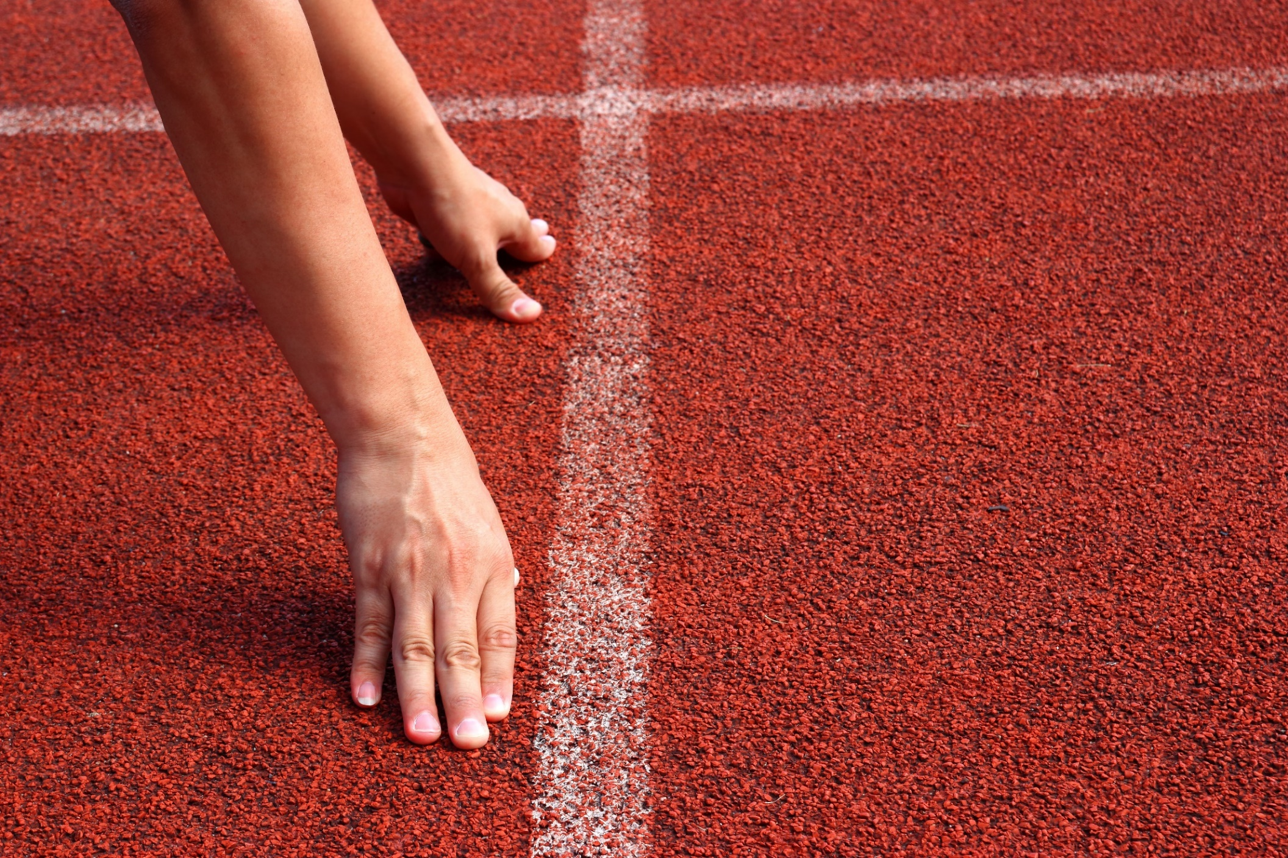
WARM-UP

Slide 8
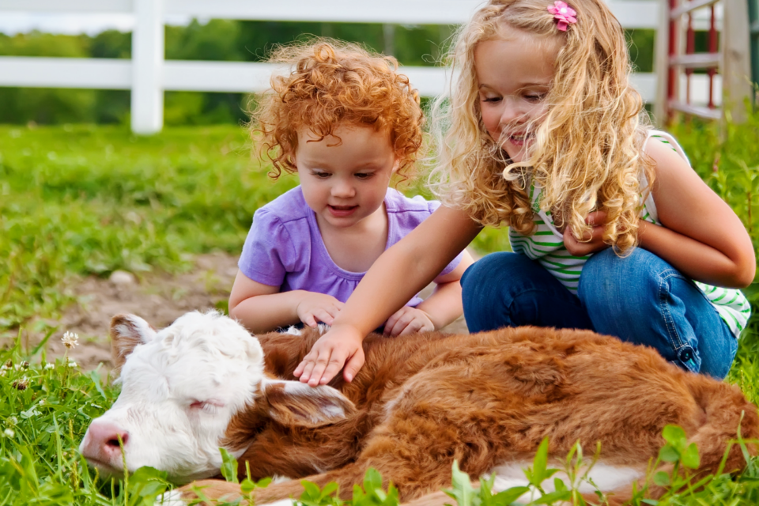
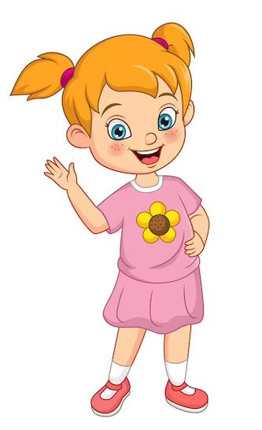
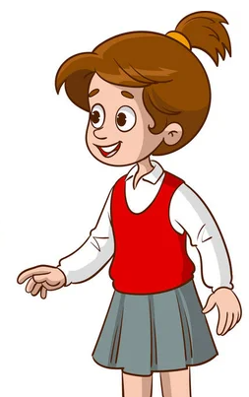
SB - p.20 - Task a. Intonation for exclamations usually falls
Look at the pictures and find the exclamatory sentence.
Wow, that sounds awesome!
I always wanted to experience life on a farm.
I used to spend summers at my grandparents' farm, helping out with chores and playing with the animals.

Slide 9
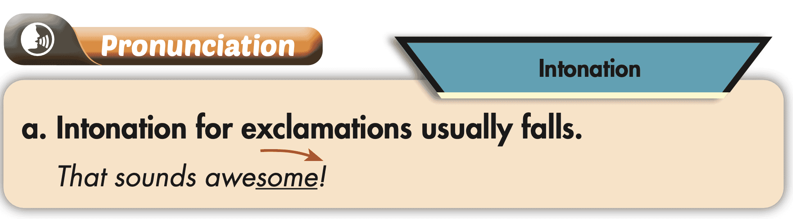
SB - p.20 - Task a. Intonation for exclamations usually falls
NOTE

Slide 10


SB - p.20 - Task b:
Listen. Notice how the underlined words fall in intonation
Lucky you!
I'd love to hear about it!

Slide 11

SB - p.20 - Task c.
Listen and cross out the sentence that doesn't follow the note in Task a.
M: That's really great!
M: I just can't believe it!

Slide 12
SB - p.20 - Task c.
Listen and cross out the sentence that doesn't follow the note in Task a.
ANSWERS
M: That's really great!
M: I just can't believe it!

Slide 13
SB - p.20 - Task d. Read the sentences with the intonation noted in Task a. to a partner.
I just can't believe it!

Slide 14
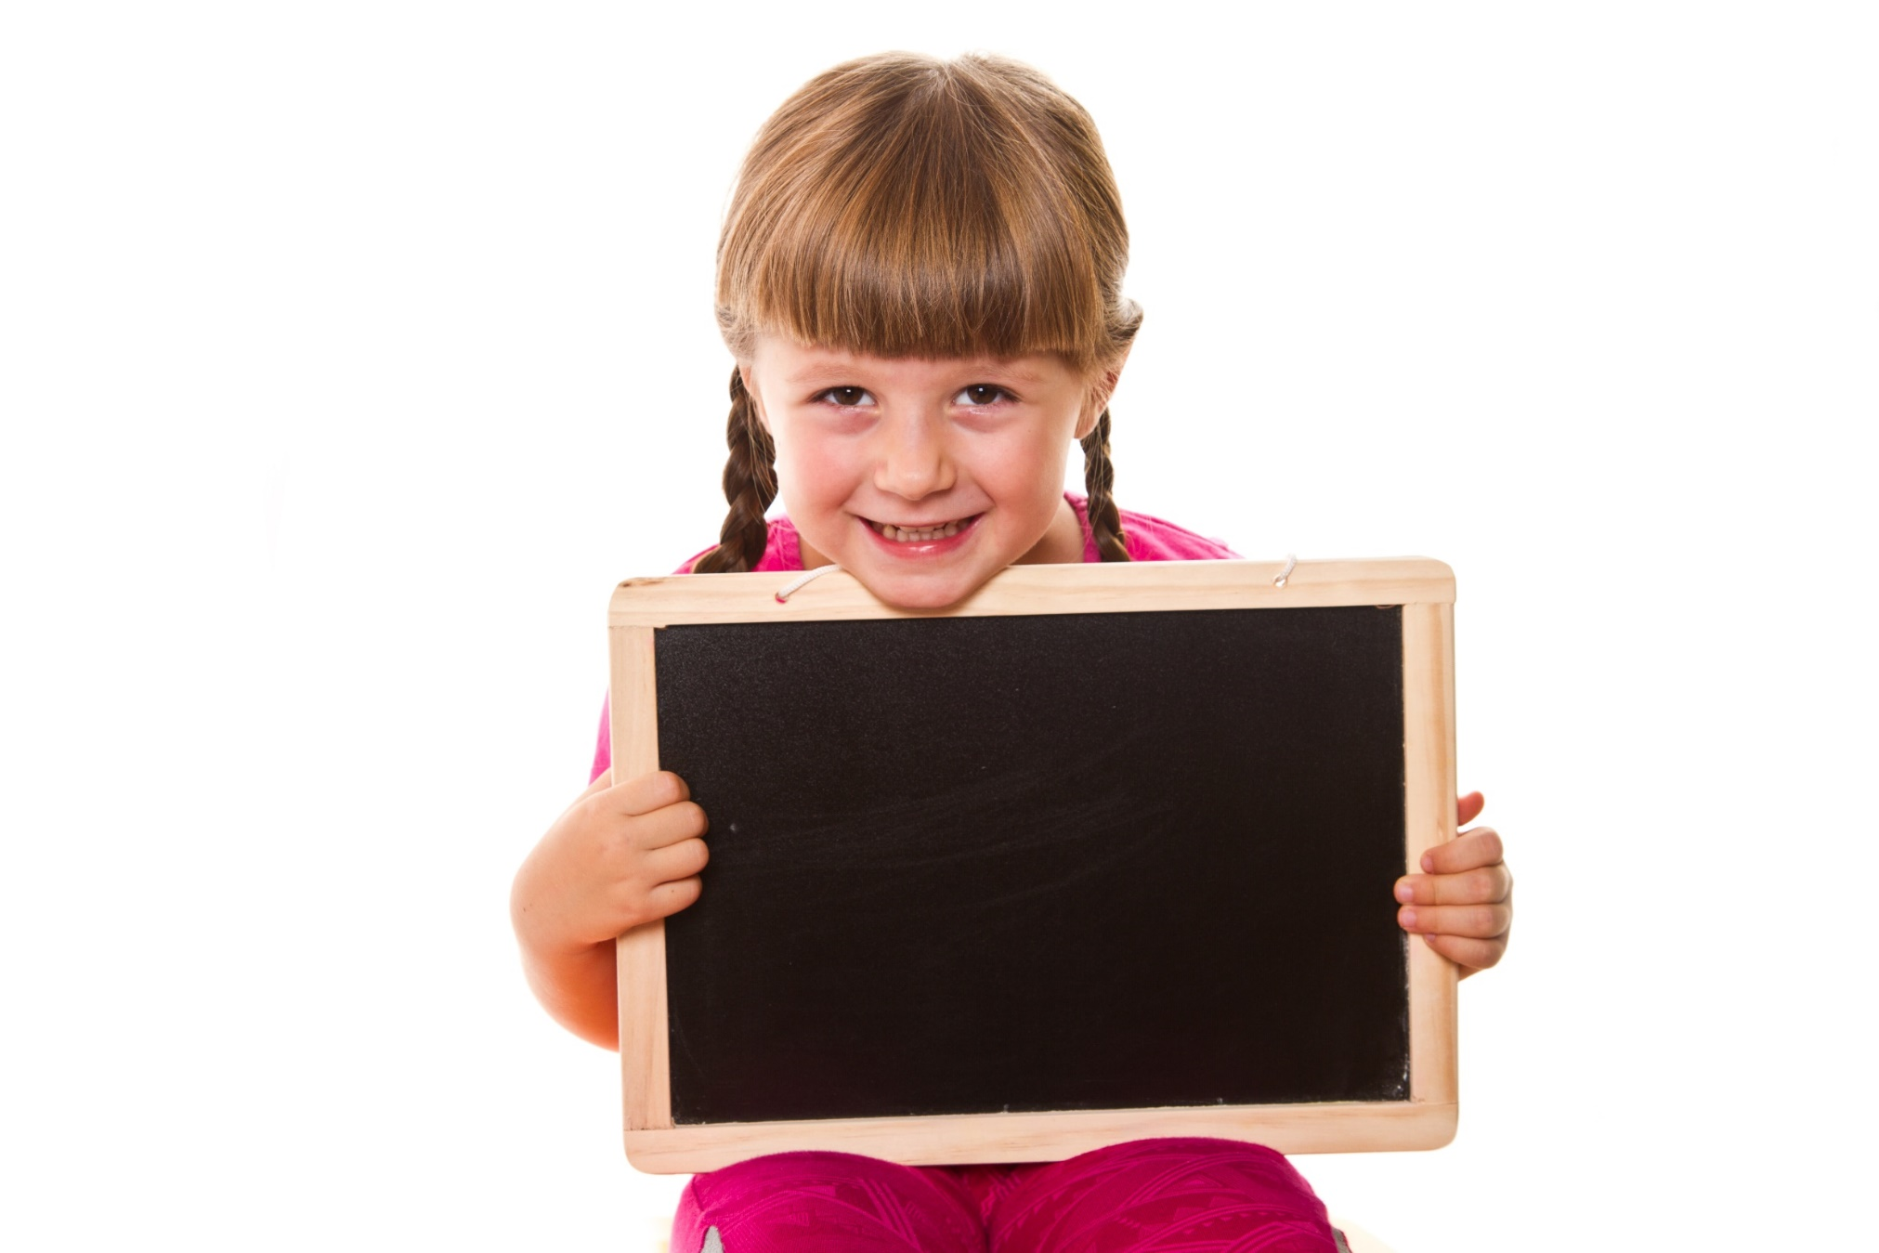
Presentation
Practice

Slide 15
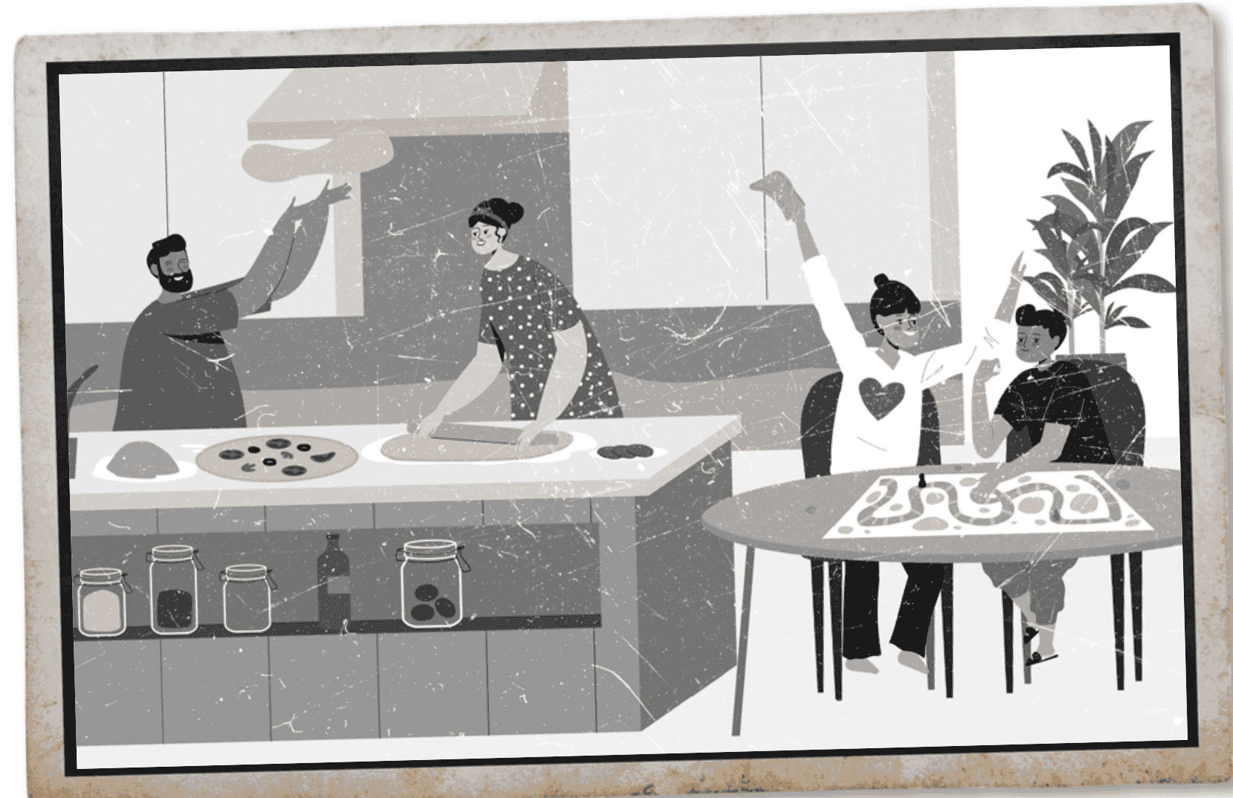
SB - p.21 - Task a. In pairs: Practice the conversations using the pictures and texts. Swap roles and repeat.
A: What's this photo?
B: That's a cottage we used to go to in the summer.
A: Lucky you. What did you use to do there?
B: We used to make delicious food. I would make pizza, and the children would play board games.

Slide 16
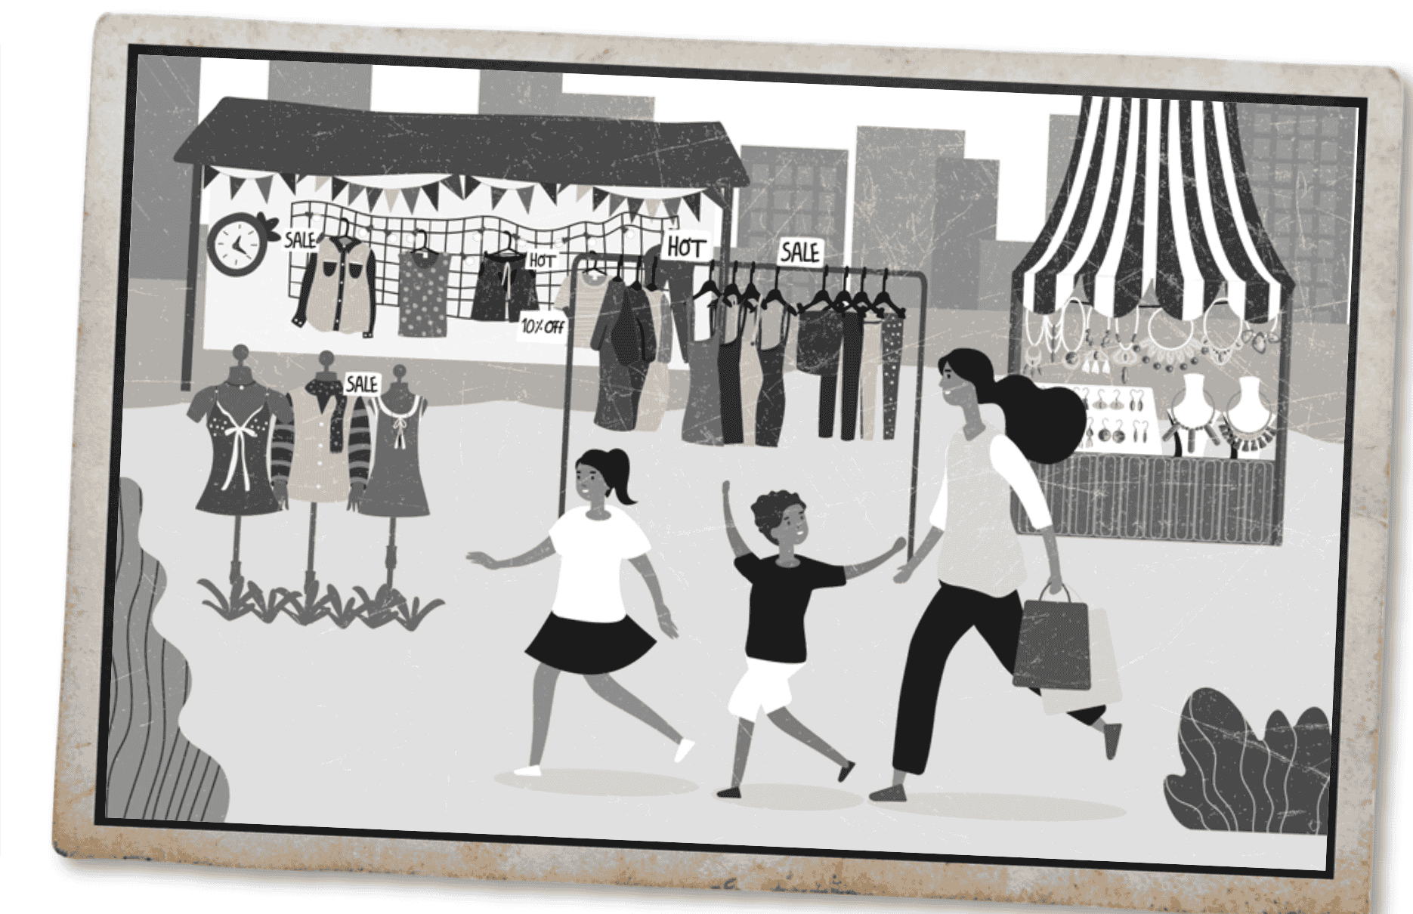
SB - p.21 - Task a. In pairs: Practice the conversations using the pictures and texts. Swap roles and repeat.
A: What's this photo?
B: That's a market I used to go to near my old house.
A: Oh, I'd love to hear more about it. What did people use to sell there?
B: They used to sell clothes and jewelry. I would go with my niece and nephew. We used to have so much fun.

Slide 17
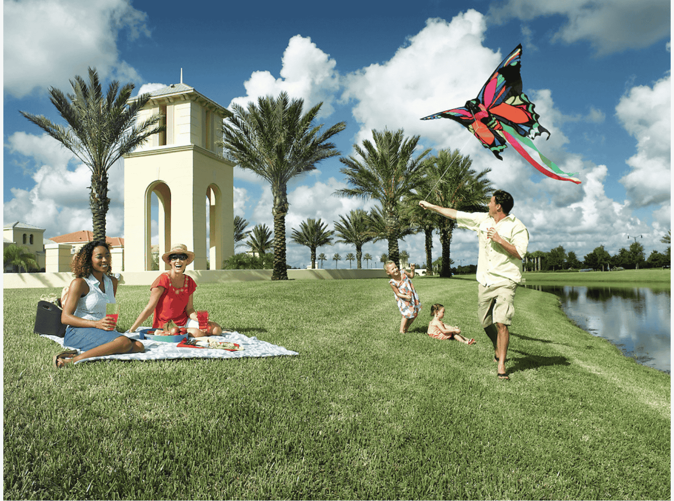
SB - p.21 - Task b: Practice again with your own ideas for the information in blue.
Suggested answer
A: What's this photo?
B: That's a park we used to go to in the spring.
A: Lucky you. What did you use to do there?
B: We used to have picnics. I would prepare sandwiches, and the kids would fly kites.

Slide 18
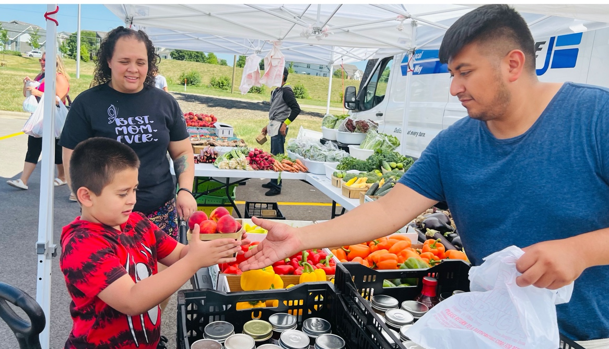
SB - p.21 - Task b. Practice again with your own ideas for the information in blue.
A: What's this photo?
B: That's a spring fair I used to go to near my grandparents' house.
A: Oh, I'd love to hear more about it. What did customers use to buy there?
B: They used to buy fresh fruits and vegetables. I would go with my grandmother. We used to pick out our favorite apples.
Suggested answer

Slide 19
Presentation
Production

Slide 20
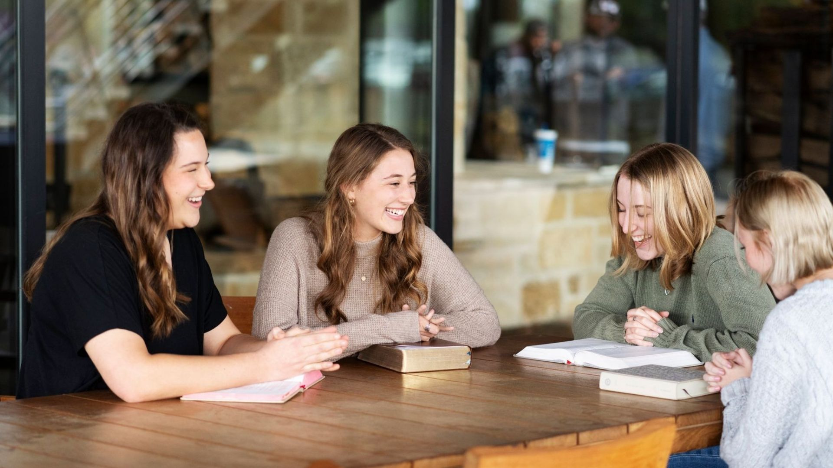
SPEAKING

Slide 21

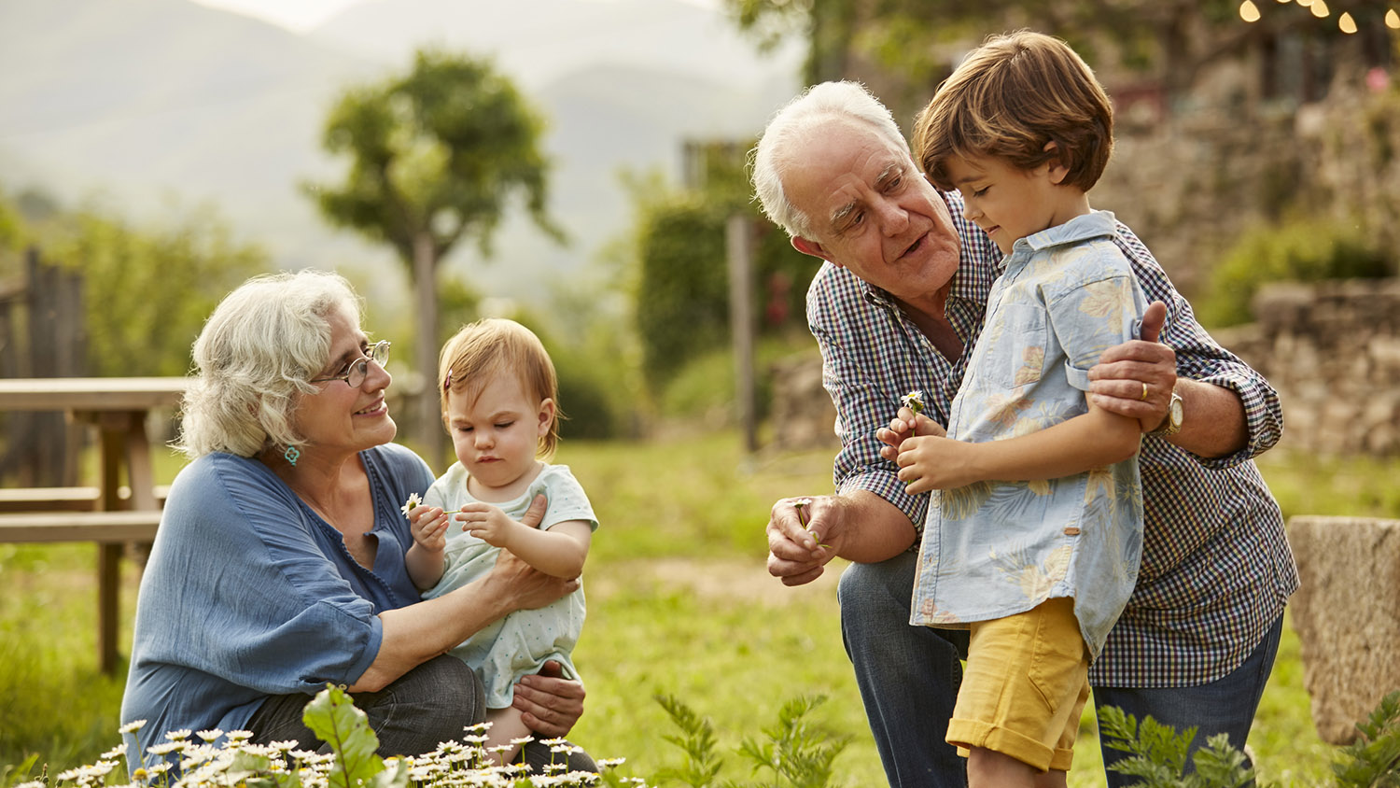
A Memorable Day
SB - p.21 - Task a. In pairs: Student A, you're the grandparent. Talk about memorable things you did using the photos and your own ideas. Student B, you're the grandchild. Listen and ask questions.

Slide 22
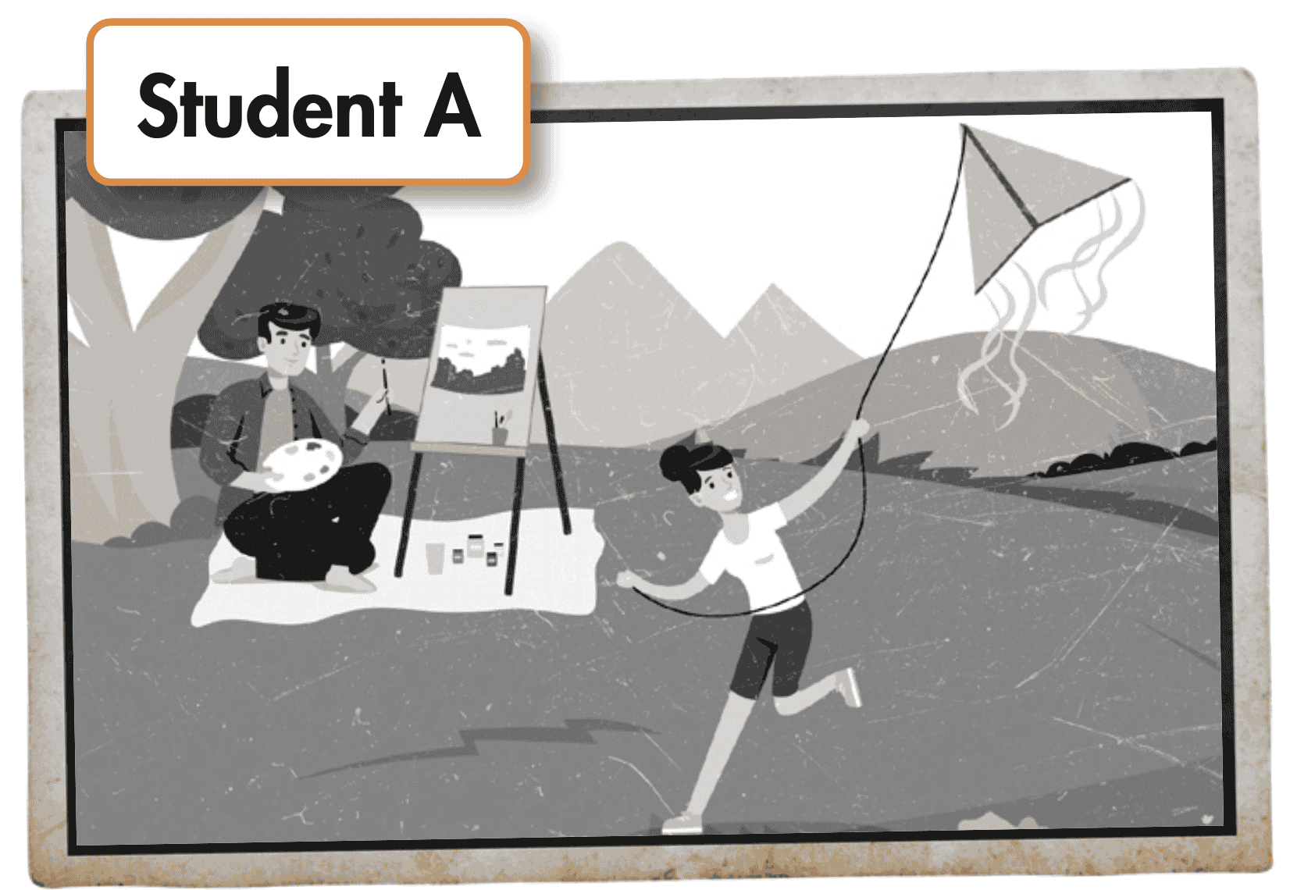
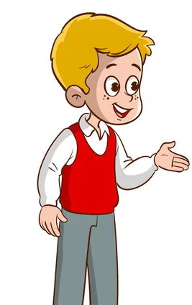
Suggested answer
I used to fly a kite in the park when I was a child.
Who did you use to fly a kite with in the park?
I used to fly a kite with my father in the park.

Slide 23
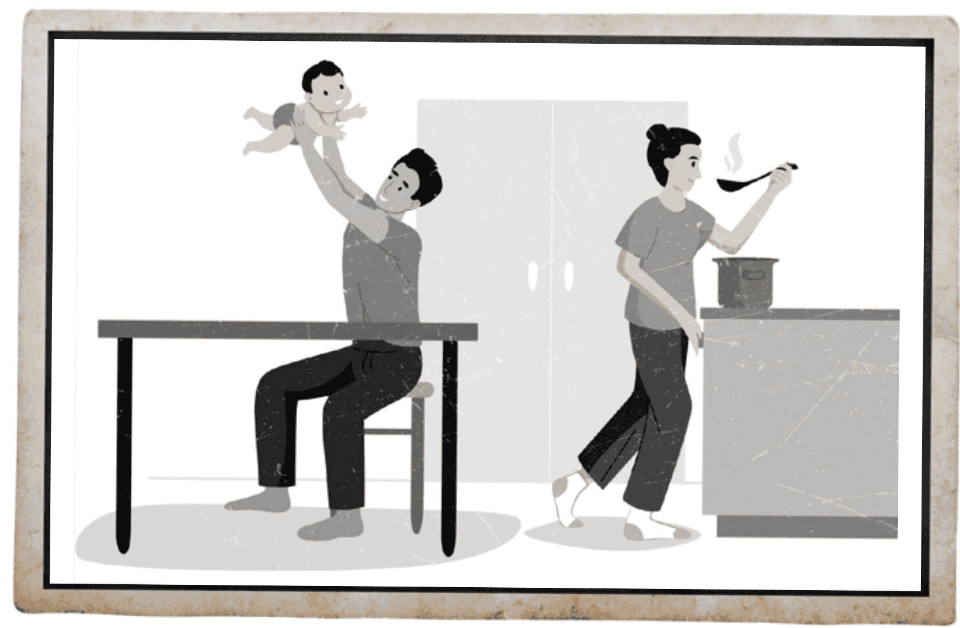
Suggested answer
My father used to hold me high when I was a baby.
Where did your father use to hold you high?
He used to hold me high in the kitchen.

Slide 24
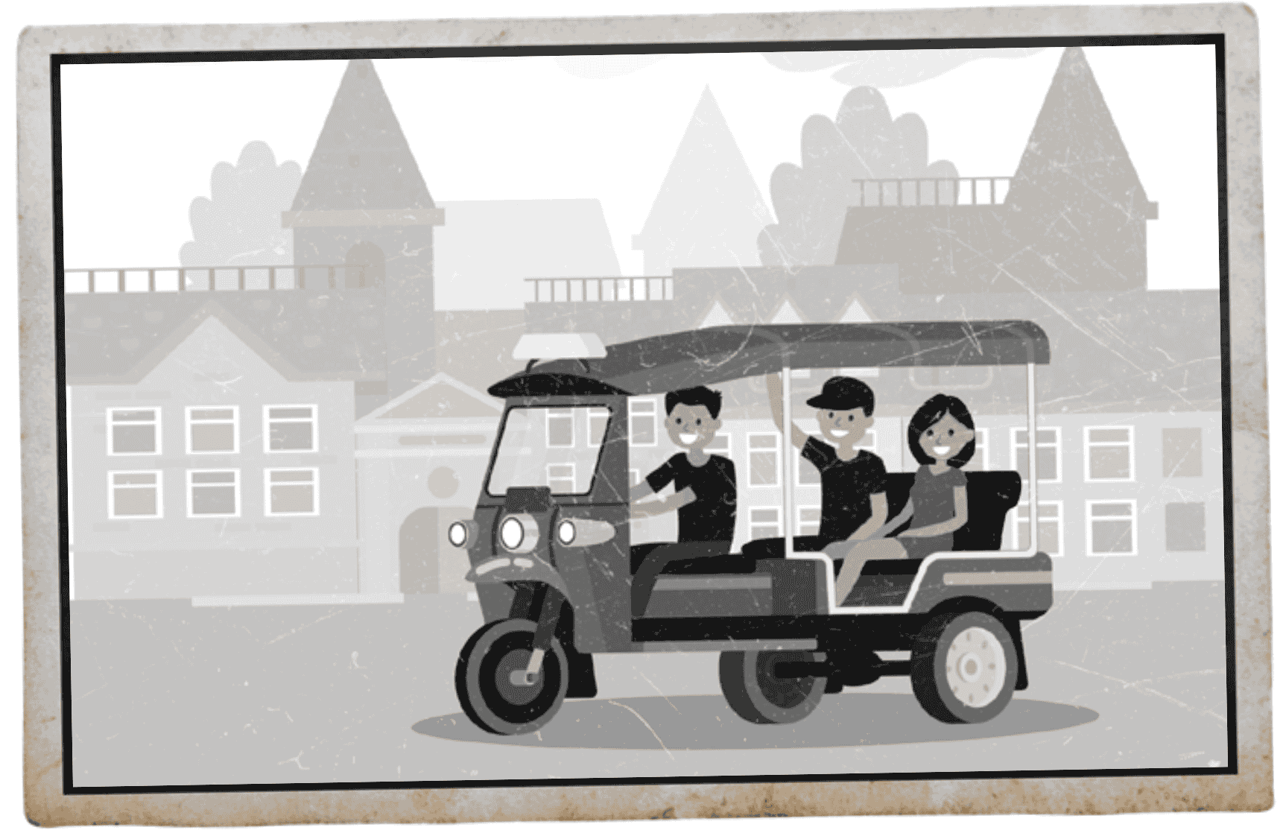
Suggested answer
I used to travel around on a tuk-tuk when I was younger.
Who did you use to travel with?
I used to travel with my sister.

Slide 25
A Memorable Day
SB - p.21 - Task b. Swap roles and repeat. Student A, you're the grandchild. Student B, you're the grandparent.

Slide 26
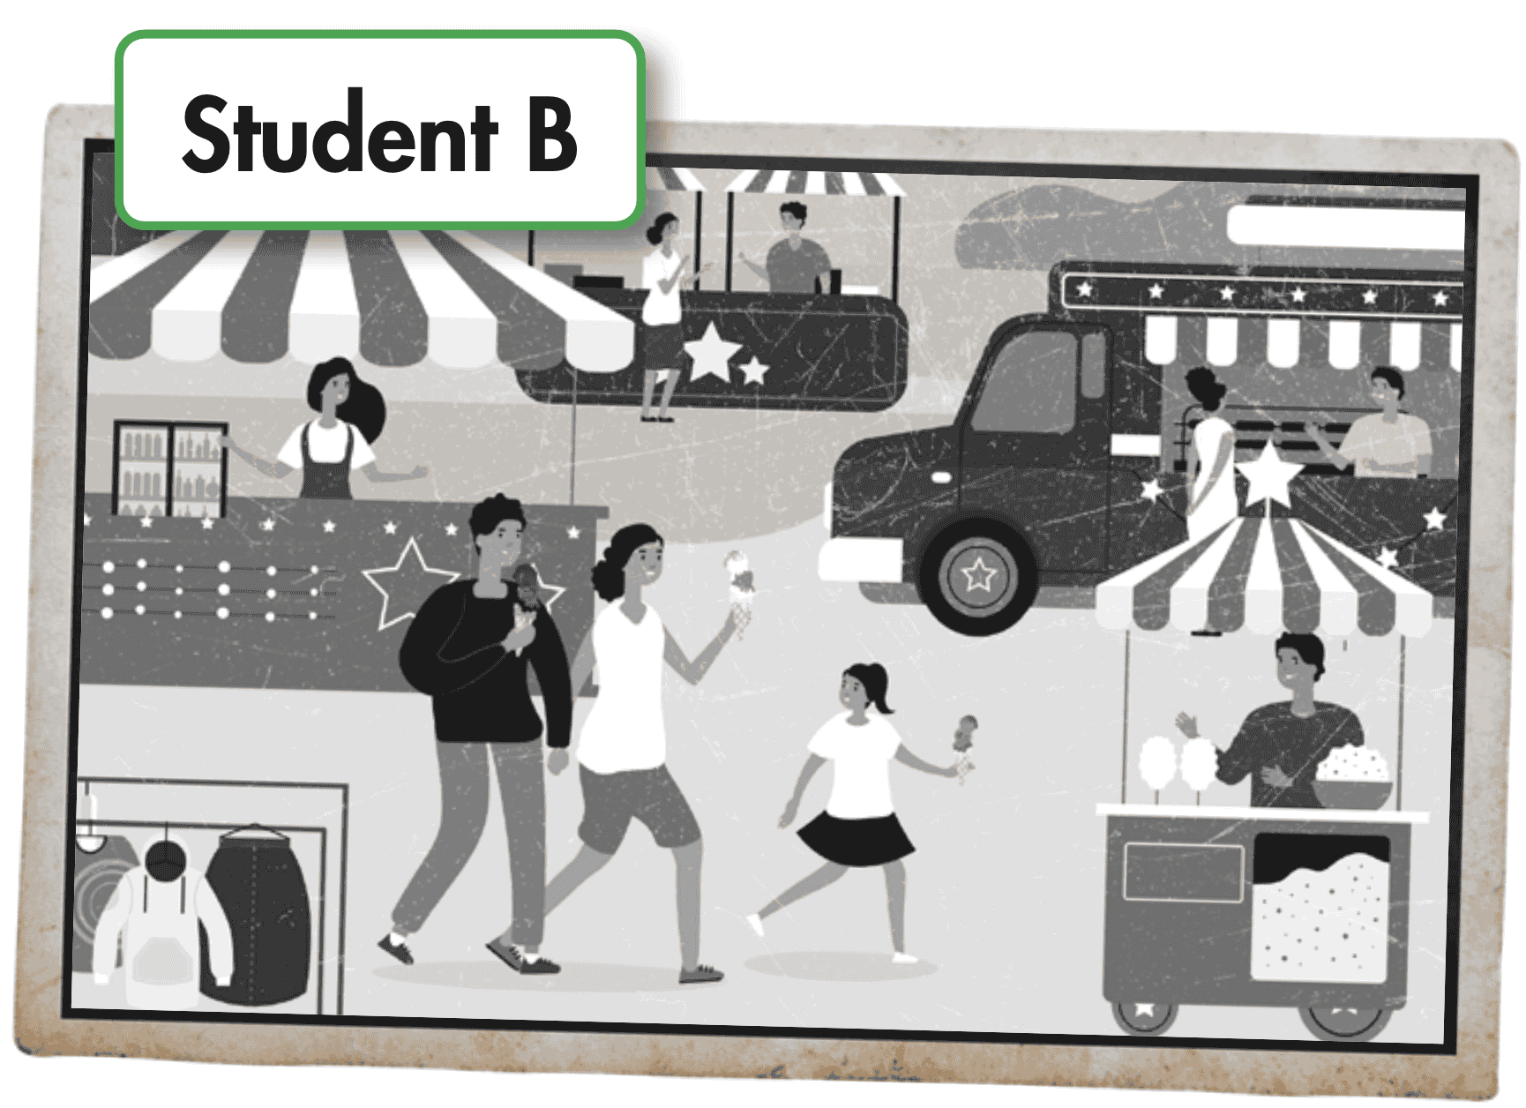
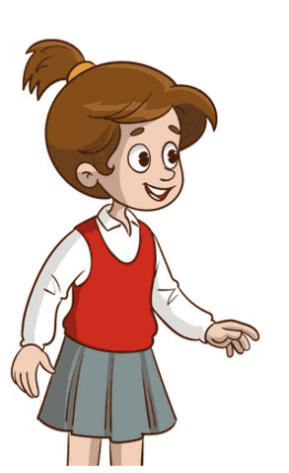
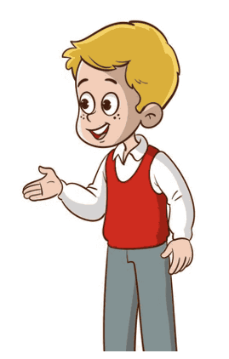
Suggested answer
Back then, I used to eat ice cream with my parents.
Where did you use to eat ice cream?
I used to eat ice cream at the amusement park.

Slide 27
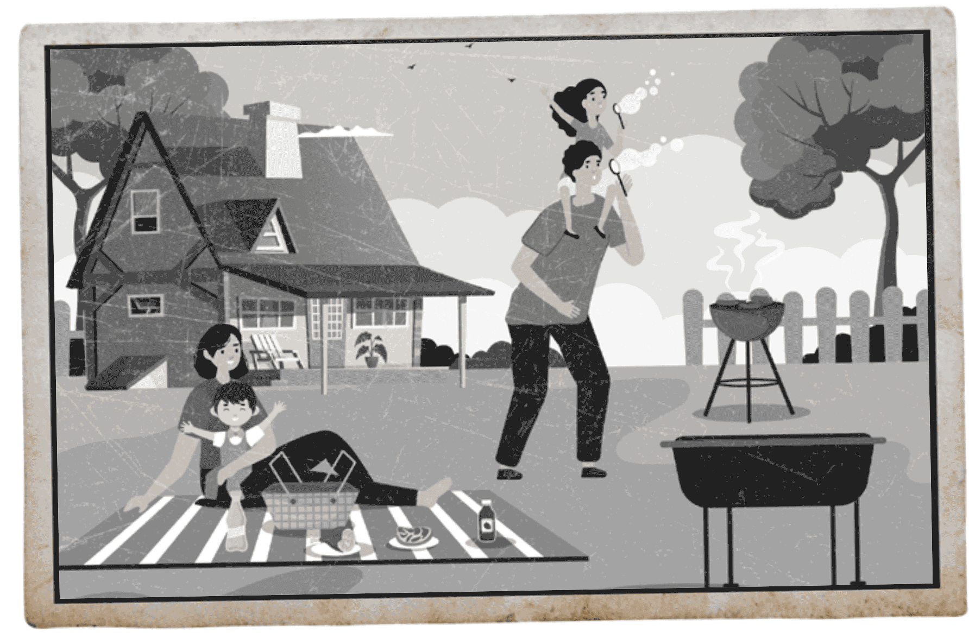
Suggested answer
I used to go for a picnic with my parents and my sister when I was a child.
Where did you use to go for a picnic?
I used to go for a picnic in front of my old house.

Slide 28
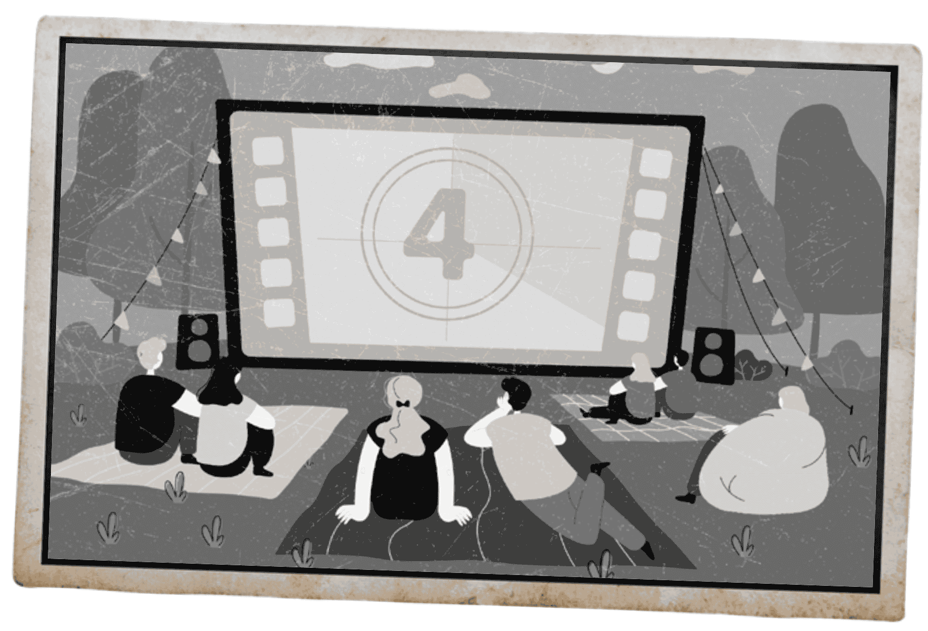
Suggested answer
Back then, I used to watch movies outdoors.
Who did you use to watch movies with?
I used to watch movies with my friends.

Slide 29
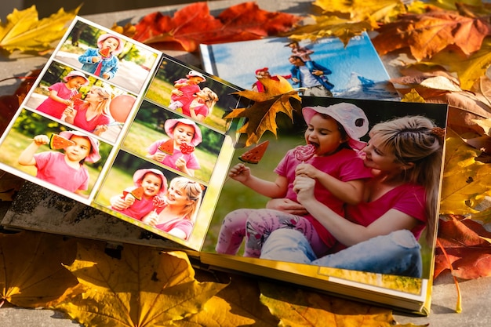
SB - p.21 - Task c. What about you? Tell your partner about memorable things you used to do.

Slide 30
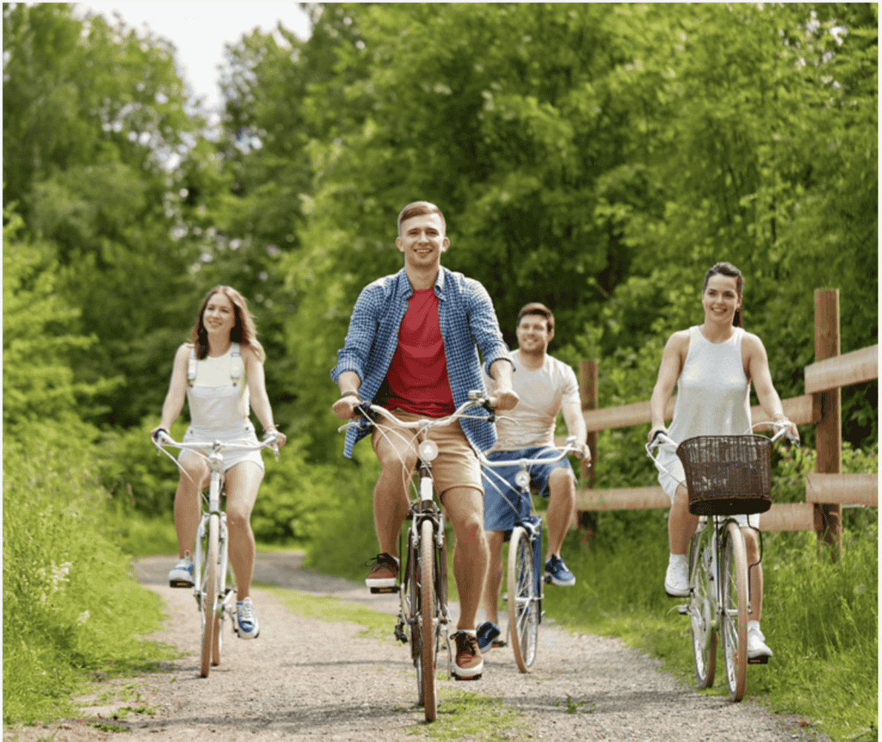
SB - p.21 - Task c.
What about you? Tell your partner about memorable things you used to do.
Suggested answer
Presentation
Production
Well, when I was younger, I used to play outside a lot with my friends. We would ride bikes around the neighborhood.

Slide 31
Extra
Practice
Presentation

Slide 32

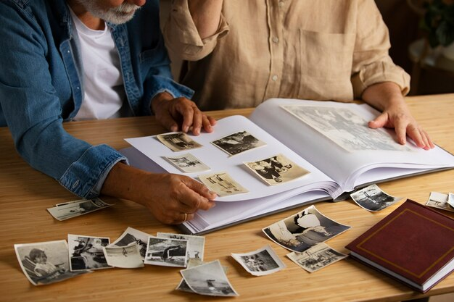
WB - p.11.Imagine you're a grandparent looking at an old photo of a memorable day. Write about what your life was like back then. Write 100 to 120 words.

Slide 33
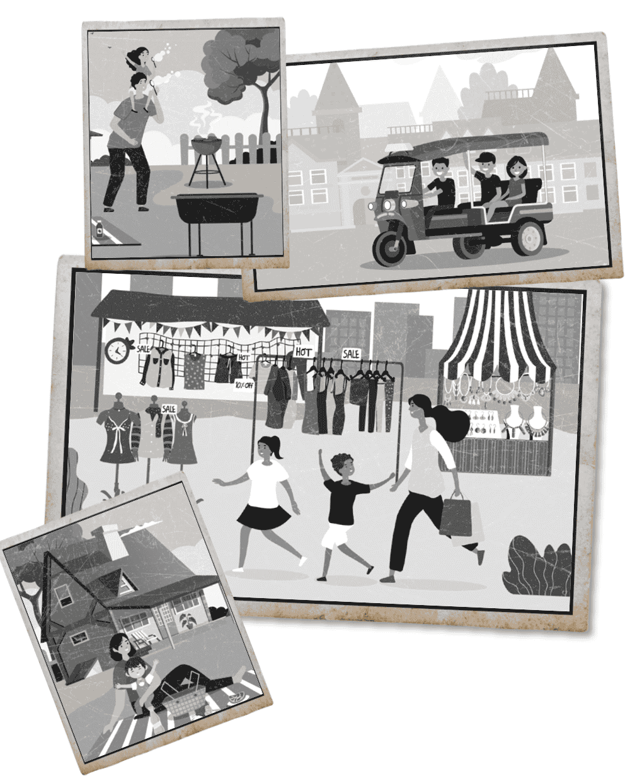
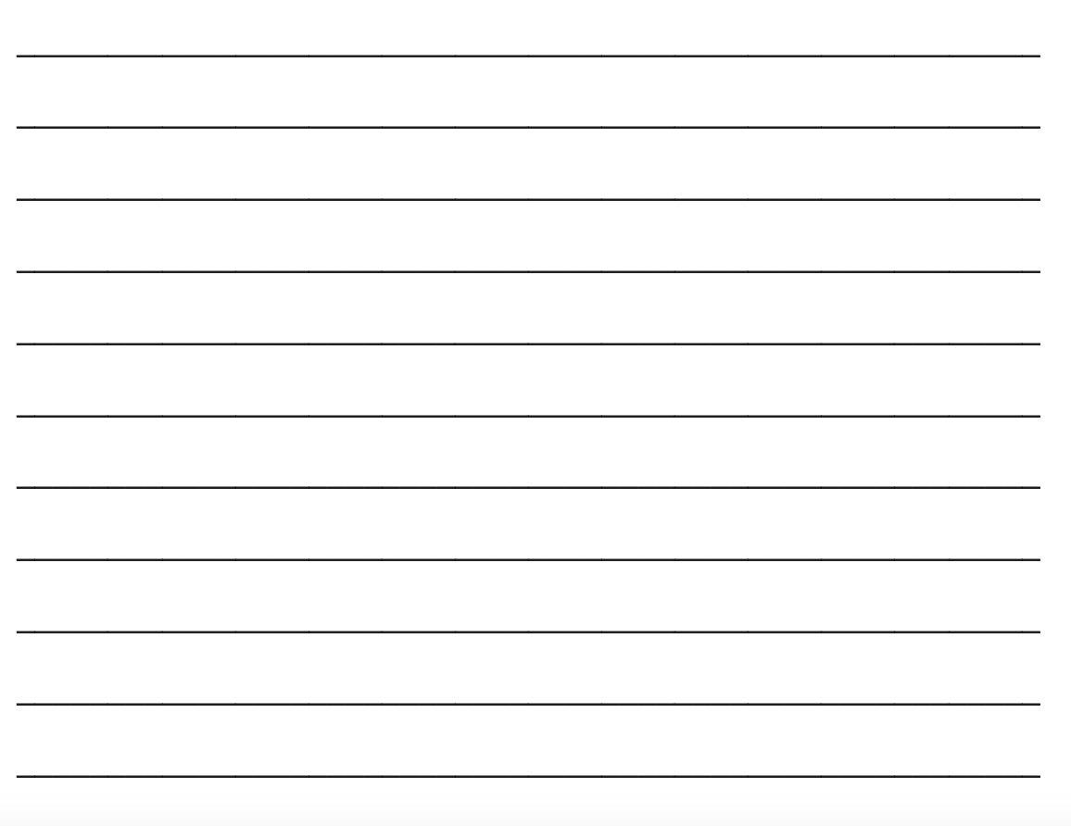

Slide 34
Sample answer
I used to work at a clothes stall at the market. It was my parents' stall, but I helped them run it. It was a lot of fun.
I used to live in a small cottage near the market. I lived there with my parents.
The clothes stall was near our cottage. We used to drive to the market in our tuk-tuk every day.
We didn't have electricity at the market, so we cooked on a fire. We used to eat fish from a clay pot for lunch. I think food is better when you cook it in a clay pot on a fire. We used to have so much fun.

Slide 35

CONSOLIDATION

Slide 36

Ask and answer the question below with your partner about a memorable day
What did you use to do with your family during holidays when you were younger?

Slide 37
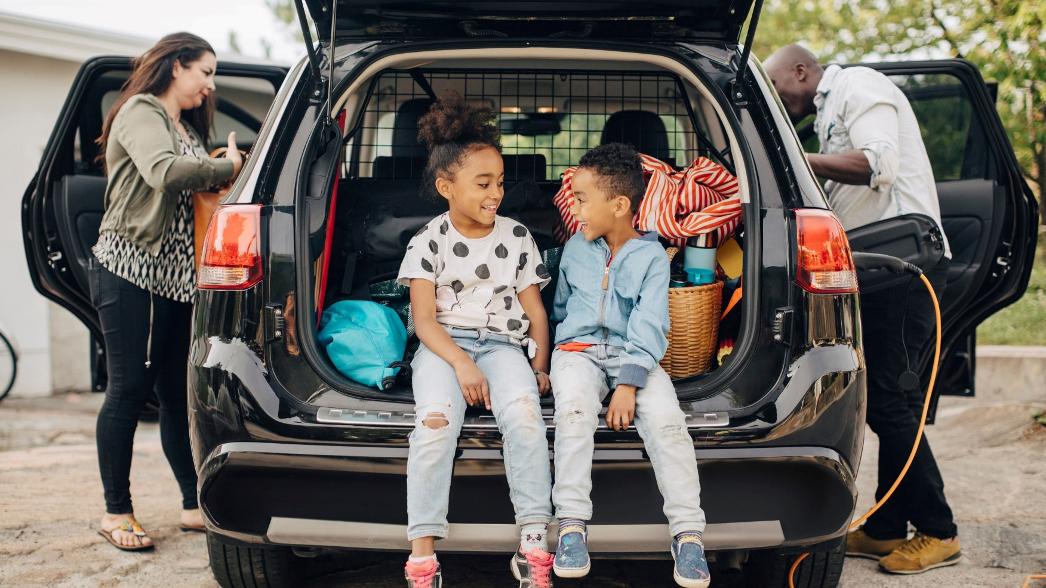
Suggested answer
Presentation
Production
When I was younger, my family and I used to go on road trips to explore new places during holidays.

Slide 38
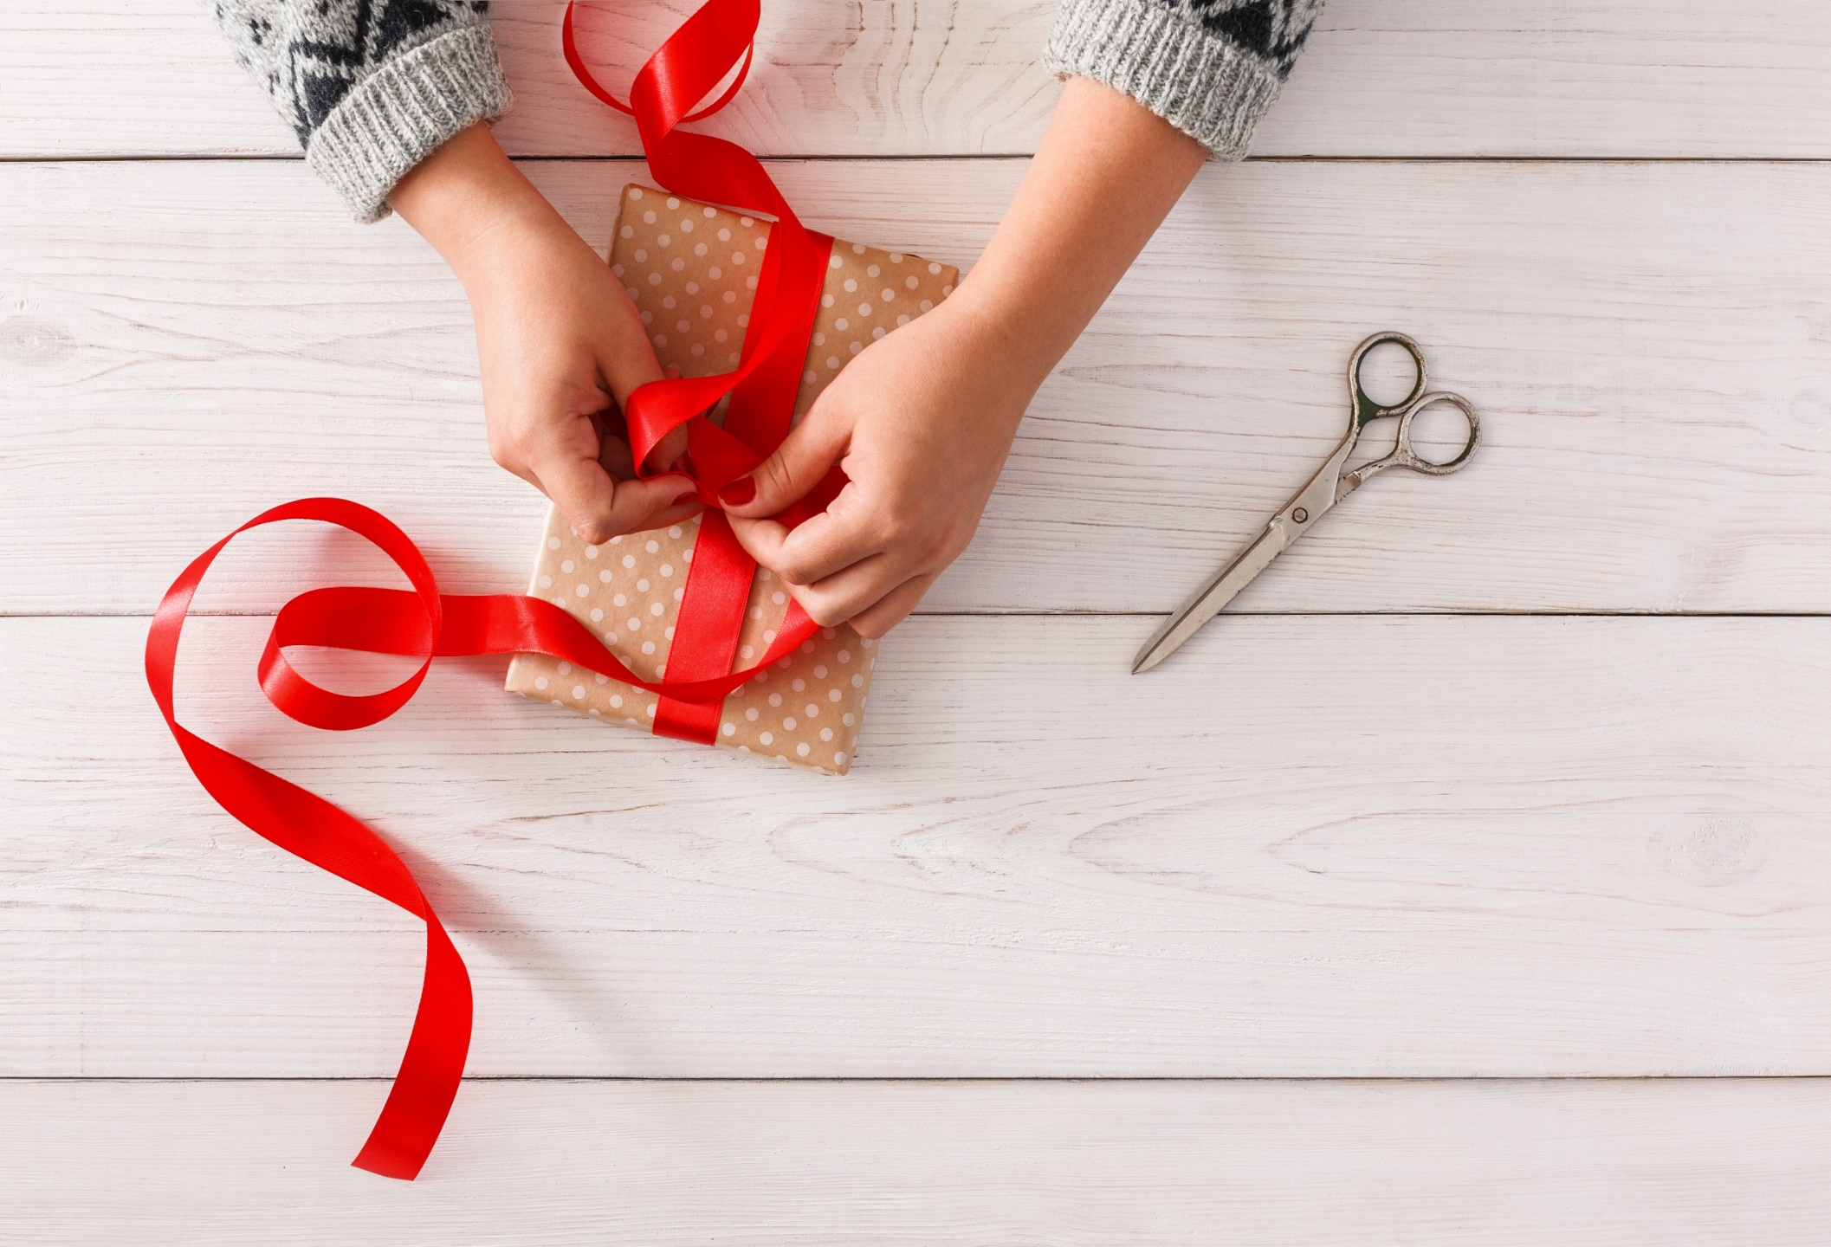
WRAP-UP

Slide 39
Today’s lesson
Pronunciation:
practice intonation for exclamations.
Speaking:
practice talking about a memorable day, using used to express past situations.

Slide 40
Homework
Practice intonation for exclamations.
Prepare for the next lesson (Reading - page 22 - SB).
Play the consolidation games on www.eduhome.com.vn

Slide 41
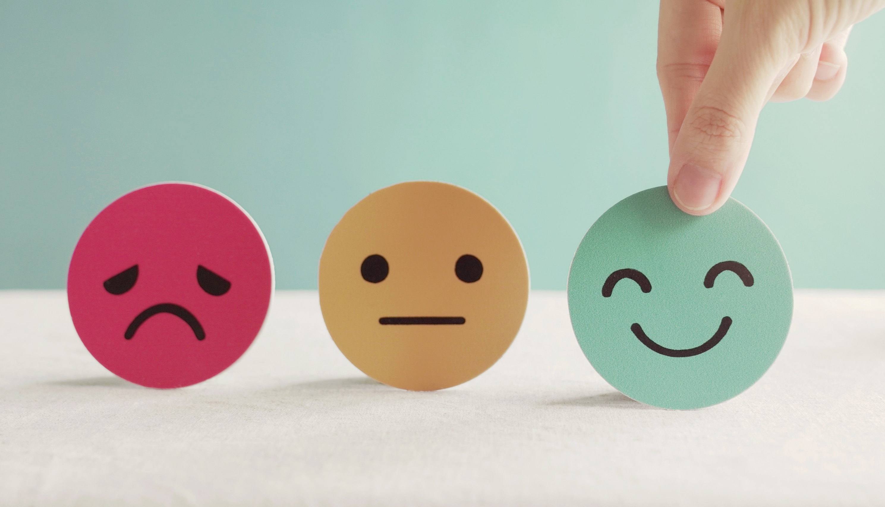
Lesson 3
Stay positive and have a nice day!

