Slide 1
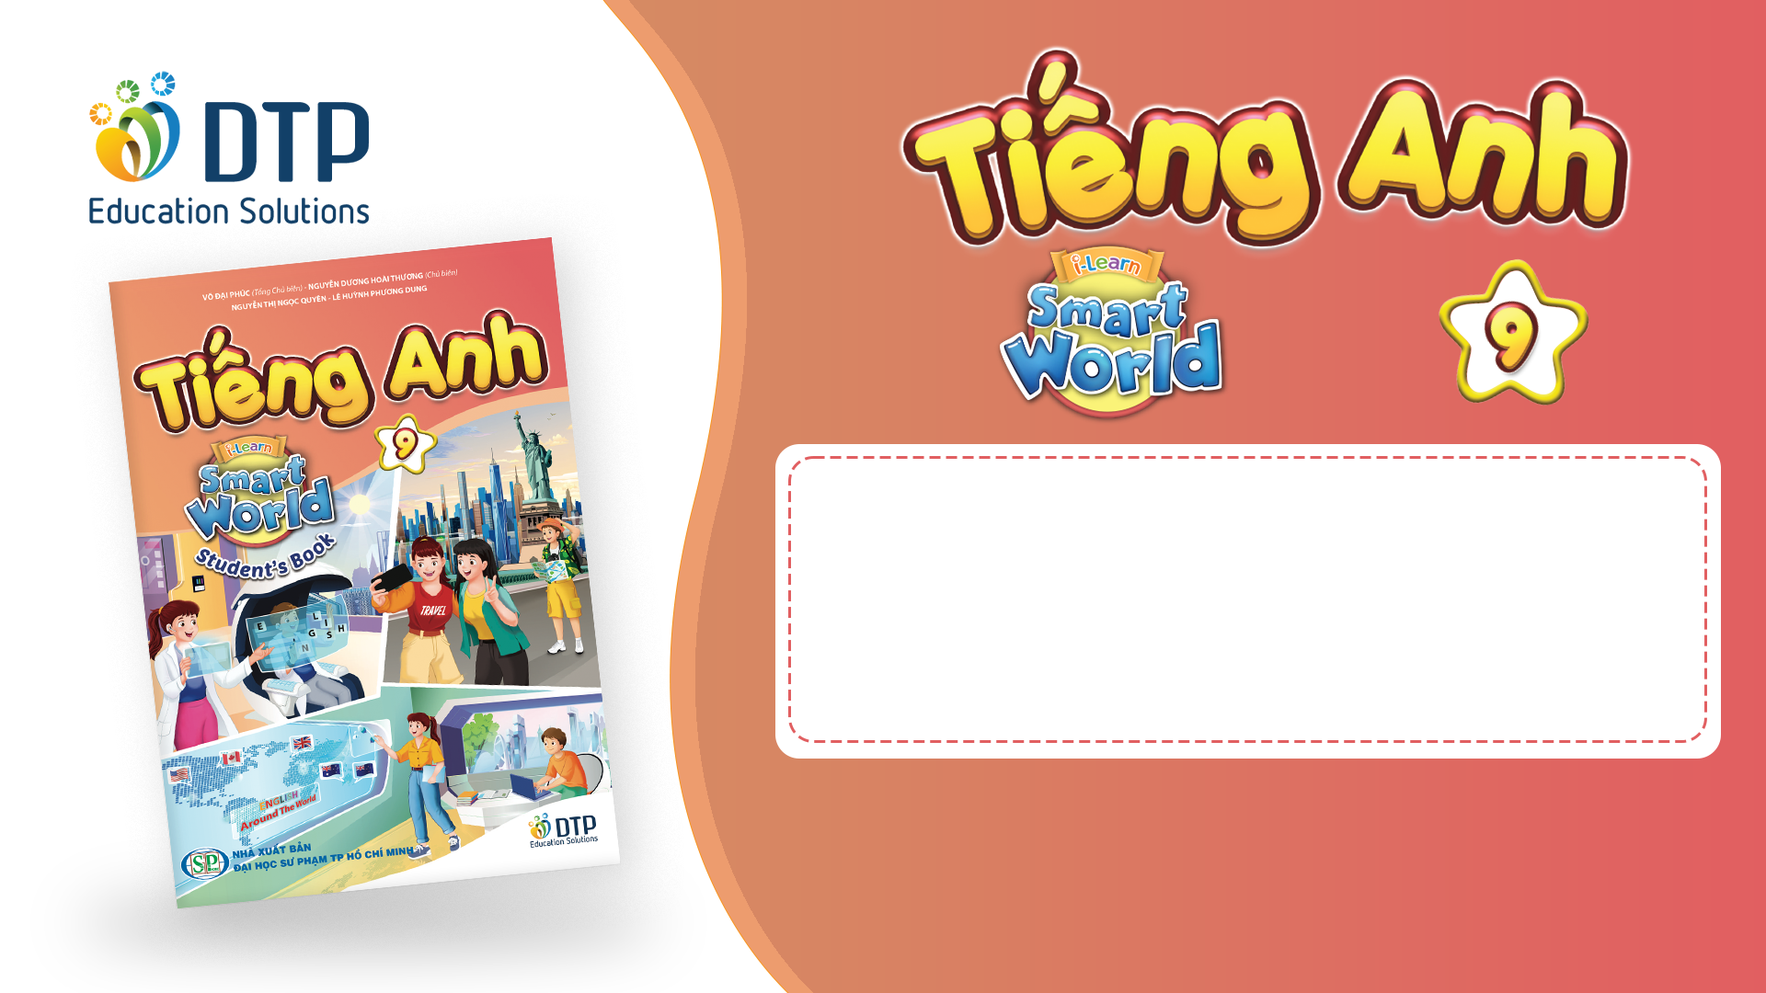
Unit 1: English in the World
Lesson 3.1: Reading
Pages 12 & 13

Slide 2
Thursday, September, 25th 2025
Period 8
Unit 1: English in the World
Lesson 3.1: Reading
Pages 12 & 13

Slide 3
Lesson Outline
Warm-up
Pre-reading
While-reading
Post-reading
Consolidation
Wrap-up

Slide 4
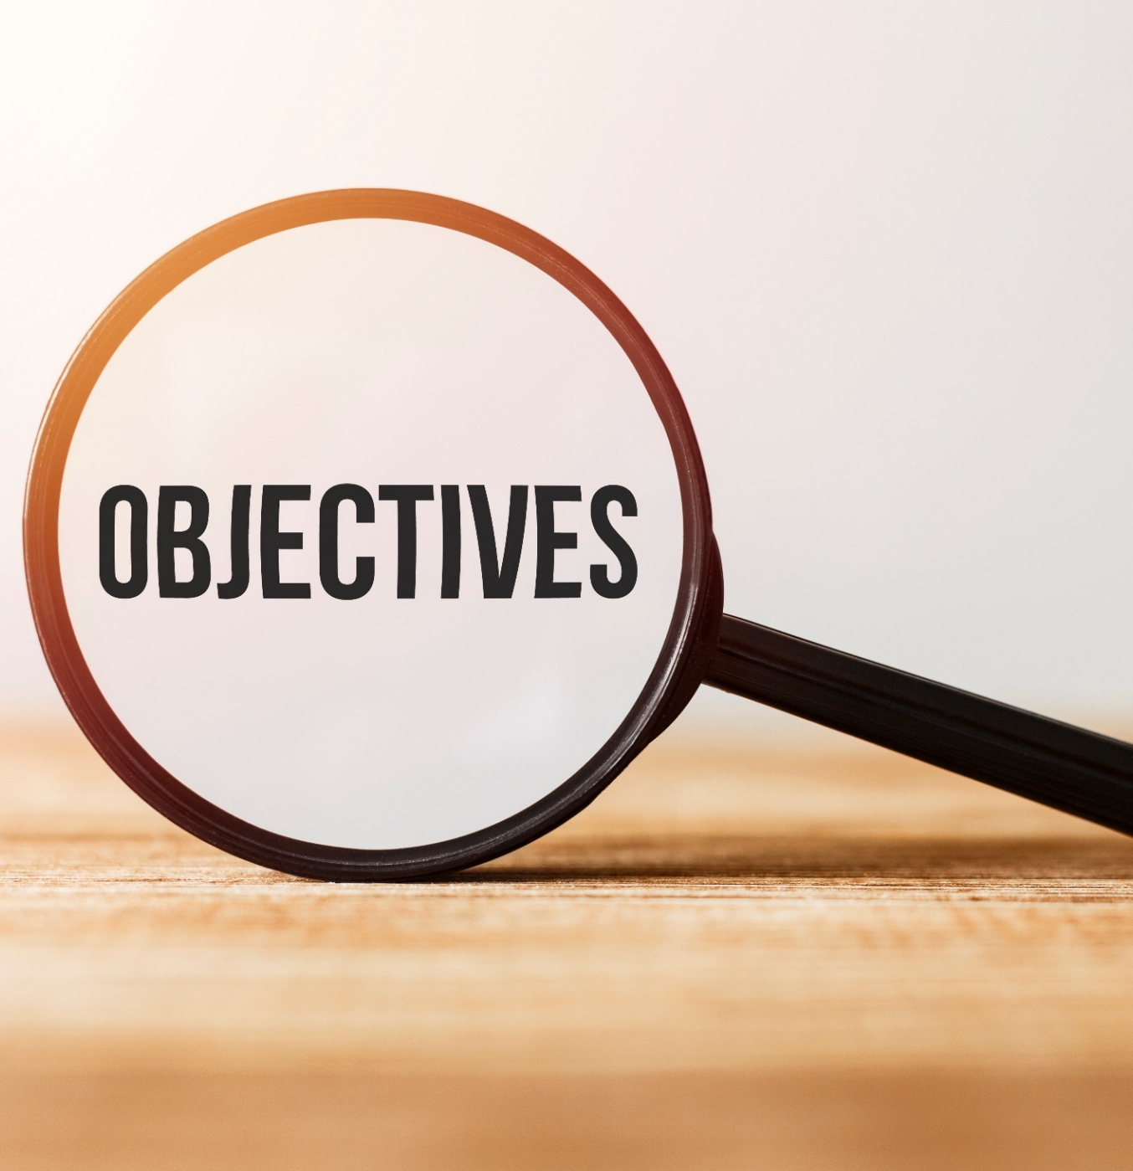
By the end of this lesson, students will be able to…
Practice reading for gist and detail.
Discuss the most interesting ways to study English.

Slide 5

WARM-UP

Slide 6
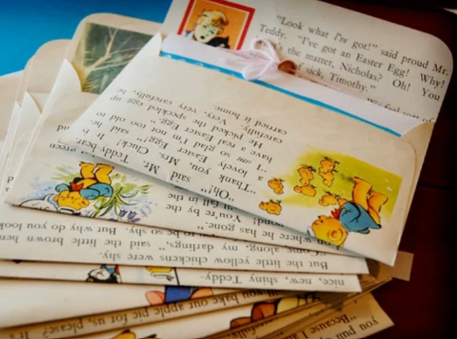
Read the explanation below and tell your partner: What kind of friend is it?
“A friend you keep in touch by writing letters, emails or sending online messages to each other, instead of talking face-to-face.”

Slide 7
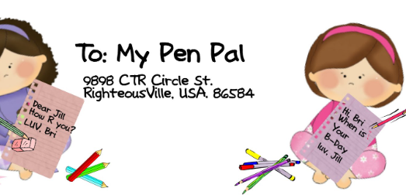

Read the explanation below and tell your partner: What kind of friend is it?
“A friend you keep in touch by writing letters, emails or sending online messages to each other, instead of talking face-to-face.”
Answer:
Pen pal /ˈpen ˌpæl/

Slide 8
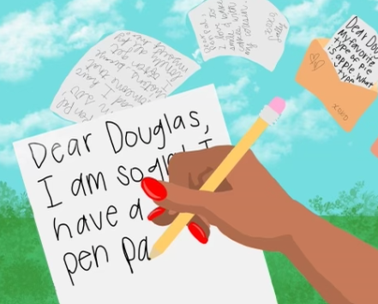
Pair work: Ask and answer the questions below:
How often do you communicate with your online friends or pen pals?
What activities do you enjoy doing together with your online friends or pen pals?
Have you ever learned anything new from your online friends or pen pals?

Slide 9


Some friends I chat with daily, while others I talk to once a week or even less.
We play online games, watch movies or shows together while chatting, share music playlists, or even work on projects together like writing stories or planning trips.
Definitely! They've taught me about their cultures, shared cool facts, and recommended books or movies I wouldn't have found otherwise.
Suggested answers

Slide 10

Pre-reading

Slide 11

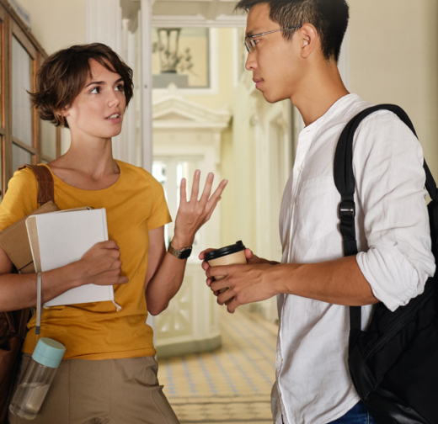

In pairs: Look at the pictures. Ask and answer:
What are these people doing?
Do you communicate like this?

Slide 12
Suggested answers:
They are communicating with their friend(s) face to face and by email.
Yes, I often keep in touch with my friends by email.

Slide 13
While-reading

Slide 14

Read the email between two pen pals. Choose the best subject for the email.
Ideas for a party
Ideas for this weekend
Ideas for learning at home
Task a

Slide 15
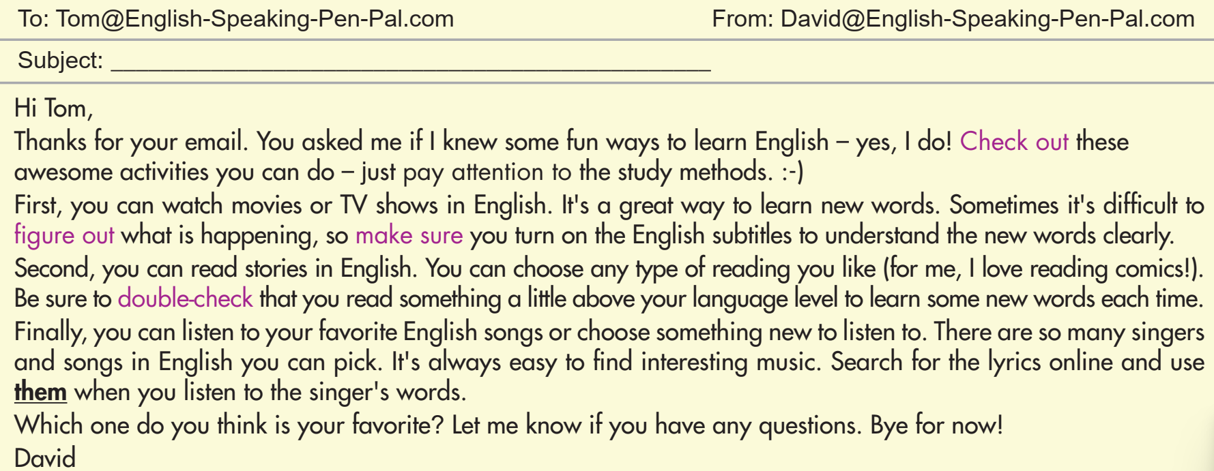

Slide 16
ANSWER
Read the email between two pen pals. Choose the best subject for the email.
Ideas for a party
Ideas for this weekend
Ideas for learning at home
Task a

Slide 17
Clue
Hi Tom,
Thanks for your email. You asked me if I knew some fun ways to learn English – yes, I do! Check out these awesome activities you can do – just pay attention to the study methods.

Slide 18
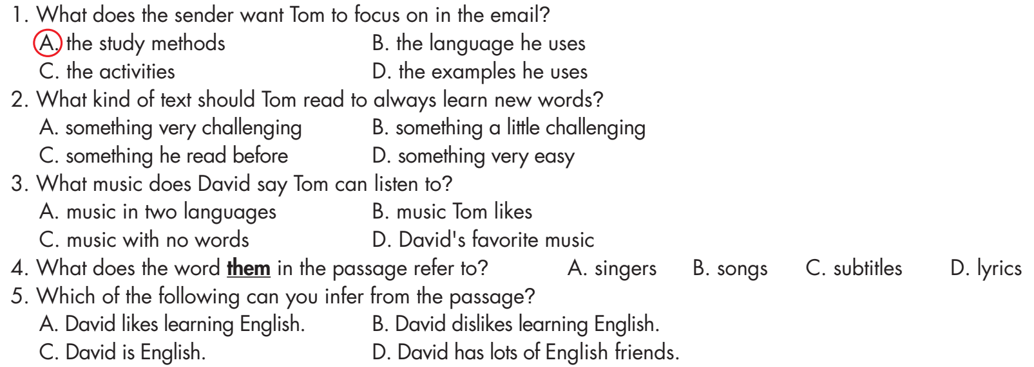
Task b
Now, read and choose the correct answers.

Slide 19
Task b
ANSWERS
2. What kind of text should Tom read to always learn new words?
something very challenging
something a little challenging
something he read before
something very easy
Be sure to double-check that you read something a little above your language level to learn some new words each time.

Slide 20
Task b
ANSWERS
3. What music does David say Tom can listen to?
music in two languages
music Tom likes
C. music with no words
D. David's favorite music
Finally, you can listen to your favorite English songs or choose something new to listen to.

Slide 21
Task b
ANSWERS
4. What does the word them in the passage refer to?
singers
songs
subtitles
lyrics
Search for the lyrics online and use them when you listen to the singer's words.

Slide 22
Task b
ANSWERS
5. Which of the following can you infer from the passage?
David likes learning English.
David dislikes learning English.
C. David is English.
D. David has lots of English friends.
B, C, and D are incorrect.
Thanks for your email. You asked me if I knew some fun ways to learn English – yes, I do! Check out these awesome activities you can do – just pay attention to the study methods.

Slide 23

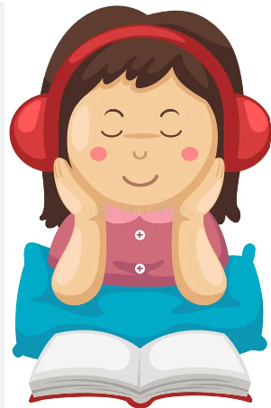
Listen and read
Task c

Slide 24
Post-reading

Slide 25
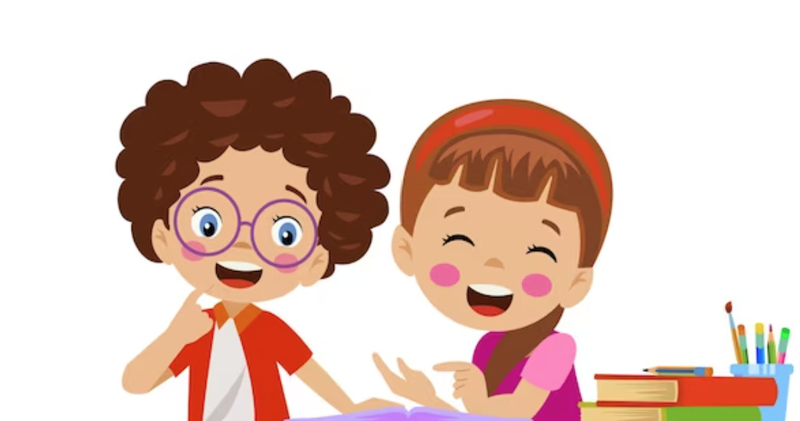
In pairs, ask and answer:
Which activity in the email do you think is the most interesting?
Why?
Task d

Slide 26

Suggested answer
"I think reading stories in English, particularly comics is the most interesting activity as they offer both relaxation and enjoyment, while at the same time allowing me to expand my vocabulary."

Slide 27
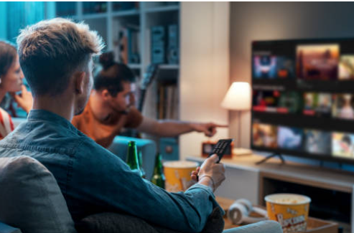
Suggested answer
"I think watching movies makes learning English more enjoyable since movies show you different parts of the English-speaking world, so you learn about their culture, customs, and way of life."

Slide 28
Extra Practice

Slide 29


Extra practice – WB, P6
Task a
Listen to a brother and sister talking. What are they mostly talking about?
1. how to learn new words in English
2. how to remember what John learned in class
3. how to improve John's English

Slide 30
Answer
What are they mostly talking about?
2. how to remember what John learned in class
CLUES
Kim: Hey, John. What's wrong?
John: Hi, Kim. I have a test next week, and I can't remember anything.
Kim: I'm sorry to hear that. What subject is it in?

Slide 31
Extra practice - WB
Task b
Now, listen and answer the questions.
What does John have next week?
What does Kim say that John should look at?
What is John going to do with his word list?
Where can John find practice tests?
Who can John study with?

Slide 32
Extra practice - WB
Task b
Now, listen and answer the questions.
What does John have next week?
a test
CLUES:
Kim: Hey, John. What's wrong?
John: Hi, Kim. I have a test next week, and I can't remember anything.

Slide 33
Extra practice - WB
Task b
Now, listen and answer the questions.
2. What does Kim say that John should look at?
his notes for the unit
CLUES:
John: It's in English class. It's a unit test. Could you help me?
Kim: Sure. There is a lot you can do. First, you can look at your notes for the unit. Did you make any?

Slide 34
Extra practice - WB
Task b
Now, listen and answer the questions.
3. What is John going to do with his word list?
write the words again in his notebook
CLUES:
Kim: That's perfect. You should look at your word list. Write the words again in your notebook. It will help you remember.

Slide 35
Extra practice - WB
Task b
Now, listen and answer the questions.
4. Where can John find practice tests?
in his textbook or online
CLUES:
Kim: Yeah. You can do the practice tests in your textbook or search for some online. They will help you remember.

Slide 36
Extra practice - WB
Task b
Now, listen and answer the questions.
5. Who can John study with?
his classmates
CLUES:
John: Amazing. I didn't know that.
Kim: You could also ask your classmates to study with you.

Slide 37
Audio script
Kim: Hey, John. What's wrong?
John: Hi, Kim. I have a test next week, and I can't remember anything.
Kim: I'm sorry to hear that. What subject is it in?
John: It's in English class. It's a unit test. Could you help me?
Kim: Sure. There is a lot you can do. First, you can look at your notes for the unit. Did you make any?
John: Yeah. I have my notes from class, my homework, and a word list.
Kim: That's perfect. You should look at your word list. Write the words again in your notebook. It will help you remember.
John: OK. Anything else?
Kim: Second, you can do practice tests.

Slide 38
Audio script
John: Really?
Kim: Yeah. You can do the practice tests in your textbook or search for some online. They will help you remember.
John: Amazing. I didn't know that.
Kim: You could also ask your classmates to study with you.
John: Hmm.
Kim: They will remember some things better than you, and you will remember some things better than them.
John: So, we can help each other?
Kim: Yes, exactly.
John: OK. I'll call Adam and Jess. Thanks for your help.
Kim: You're welcome.

Slide 39

Extra practice - WB
Task a
Read an email between two pen pals. Choose the best subject for the email.
1. Re: I need your help!
2. Re: I need some new books and TV shows to watch
3. Re: How is your new school?

Slide 40
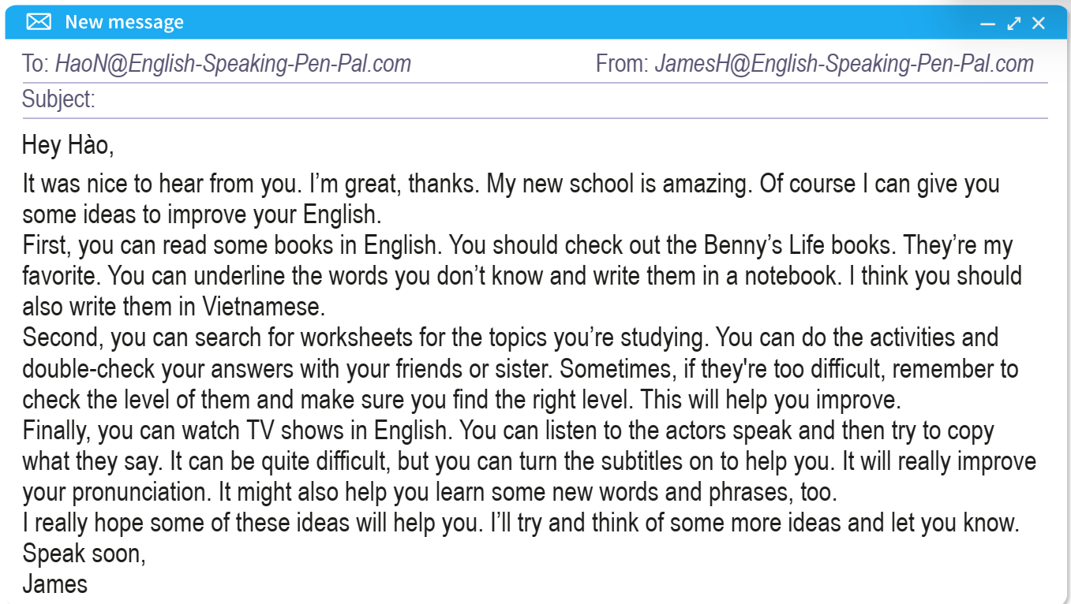

Slide 41
Extra practice - WB
Task a
Read an email between two pen pals. Choose the best subject for the email.
1. Re: I need your help!
2. Re: I need some new books and TV shows to watch
3. Re: How is your new school?
CLUE: I can give you some ideas to improve your English.

Slide 42
Extra practice - WB
Task b
Now, read and fill in the blanks. But let’s identify the word forms in the gaps first: 1. The _____________________ books are James's favorite.
2. Hào should write words in his notebook in English and _____________________.
3. James says Hào should find worksheets at _____________________ level.
4. Hào should listen and _____________________ what the actors say.
5. James says Hào should turn on _____________________ for the English TV shows.
Adj/ Noun
Noun (language)
Adj
Verb(bare)
Noun

Slide 43
Extra practice - WB
Task b
Now, read and fill in the blanks. 1. The _____________________ books are James's favorite.
2. Hào should write words in his notebook in English and _____________________.
3. James says Hào should find worksheets at _____________________ level.
4. Hào should listen and _____________________ what the actors say.
5. James says Hào should turn on _____________________ for the English TV shows.

Slide 44
Answers
Task b
Now, read and fill in the blanks. 1. The _____________________ books are James's favorite.
Benny's Life
You should check out the Benny’s Life books.
They’re my favorite.

Slide 45
Answers
Task b
Now, read and fill in the blanks. 2. Hào should write words in his notebook in English and _____________________.
(in) Vietnamese
You can underline the words you don’t know and write them in a notebook. I think you should also write them in Vietnamese.

Slide 46
Answers
Task b
Now, read and fill in the blanks. 3. James says Hào should find worksheets at ____________ level.
the right
Second, you can search for worksheets for the topics you’re studying. You can do the activities and double-check your answers with your friends or sister. Sometimes, if they're too difficult, remember to check the level of them and make sure you find the right level.

Slide 47
Answers
Task b
Now, read and fill in the blanks. 4. Hào should listen and _____________________ what the actors say.
copy
You can listen to the actors speak and then try to copy what they say.

Slide 48
Answers
Task b
Now, read and fill in the blanks. 5. James says Hào should turn on _____________________ for the English TV shows.
the subtitles
Finally, you can watch TV shows in English. You can listen to the actors speak and then try to copy what they say. It can be quite difficult, but you can turn the subtitles on to help you.

Slide 49
Task b
Now, read and choose the correct answers. But let’s underline the keywords first.
2. What kind of text should Tom read to always learn new words?
something very challenging
something a little challenging
something he read before
something very easy
3. What music does David say Tom can listen to?
music in two languages
music Tom likes
C. music with no words
David's favorite music

Slide 50
4. What does the word them in the passage refer to?
singers
songs
Subtitles
Lyrics
5. Which of the following can you infer from the passage?
David likes learning English.
David dislikes learning English.
C. David is English.
D. David has lots of English friends.

Slide 51

CONSOLIDATION

Slide 52
Read the explanation below and tell your partner: What kind of friend is it?
“A friend you keep in touch by writing letters, emails or sending online messages to each other, instead of talking face-to-face.”
Answer:
Pen pal /ˈpen ˌpæl/

Slide 53

WRAP-UP

Slide 54
Today’s lesson
Reading:
Practice reading for gist and detail.
Speaking:
Discuss the most interesting ways to study English.

Slide 55
Homework
Prepare for the next lesson (Writing & Speaking - page 13 - SB)
Play the consolidation games on www.eduhome.com.vn

Slide 56

Lesson 3
Stay positive and have a nice day!

