Slide 1

Unit 5: Around Town
Lesson 1.2: Grammar
Page 39

Slide 2
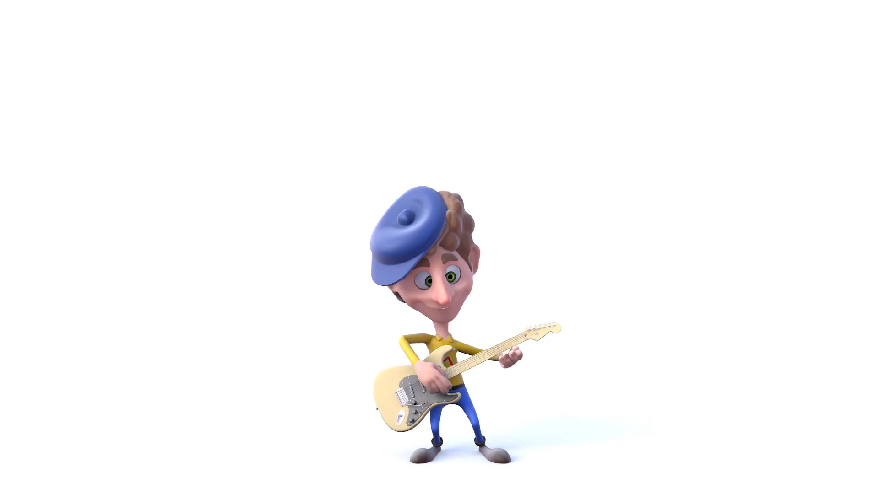
Listen to a song and sing a long.

Slide 3

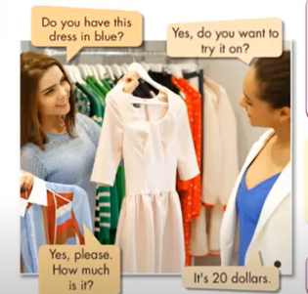
a. Listen and repeat.
Do you have this dress in blue?
Yes, do you want to try it on?
How much is this T-shirt?
Do you have that shirt in blue?
How much are those shoes over there?
do you have these socks in green?
Yes, please. How much is it?
It’s 20 dollars

Slide 4
GRAMMAR
1
THIS/THAT – THESE THOSE
2
OBJECT PRONOUNS

Slide 5
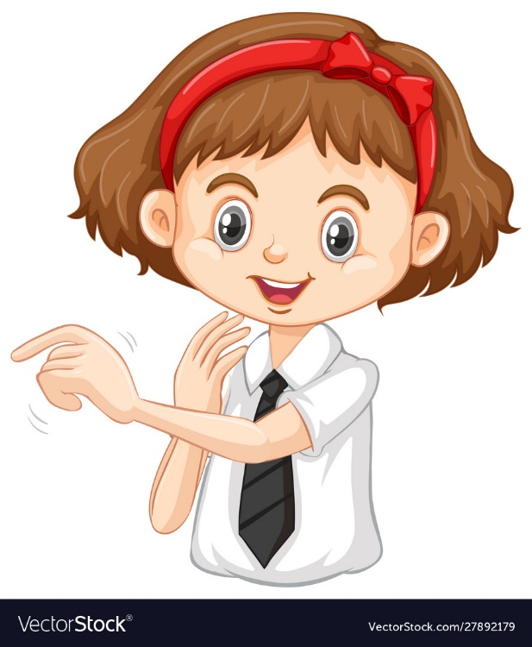
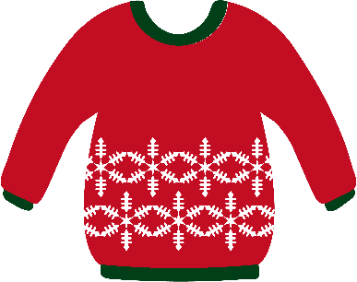
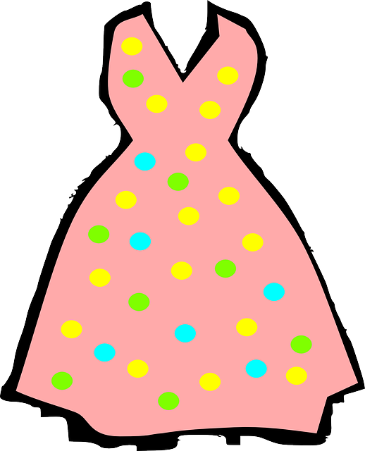
This is my sweater
That is my dress

Slide 6
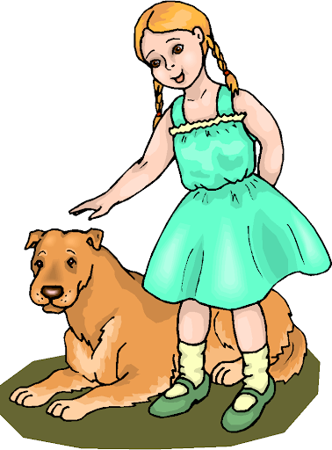
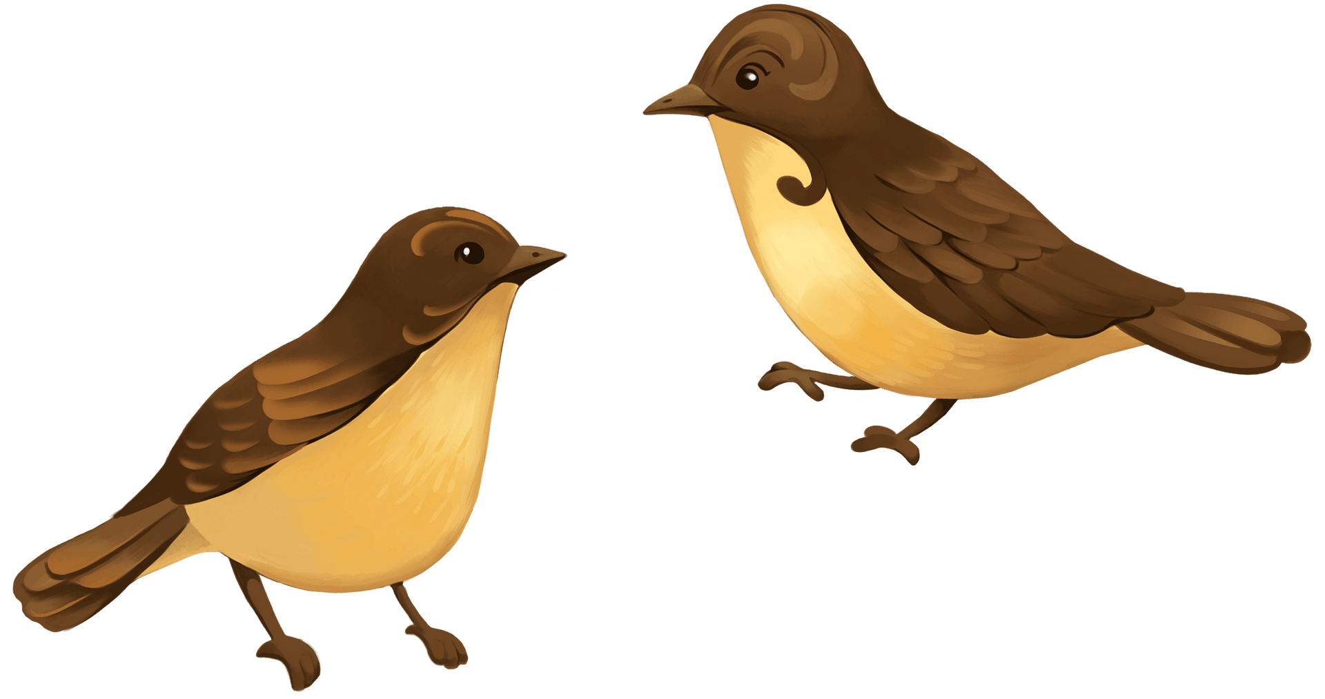

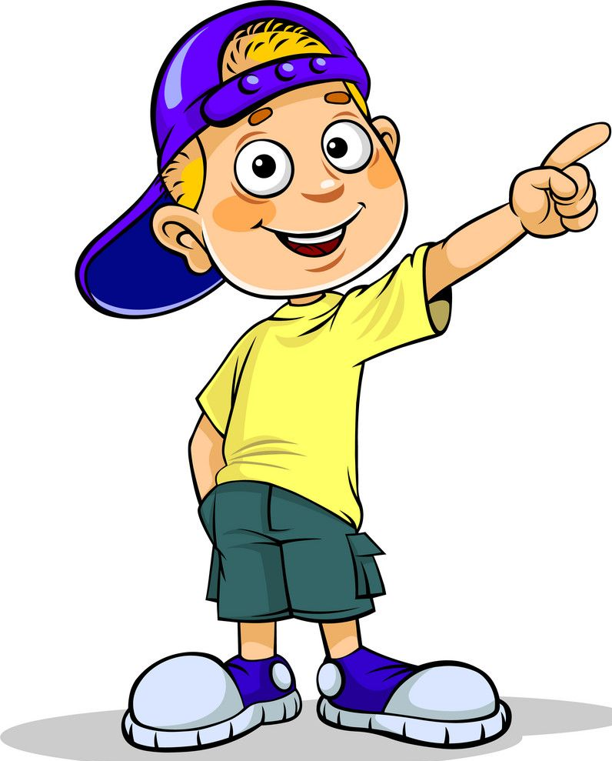
These are my dogs
Those are my birds

Slide 7
1. Demonstrative: this/that – these/those
(Đại từ chỉ định this/that – these/those)
Đại từ chỉ định this/that/these/those dùng để chỉ ra cụ thể vật được nói đến..
Eg. How much is this dress?
Do you have that dress in white?
Đi với danh từ số ít | Đi với danh từ số nhiều | Khoảng cách
This (này) | These (những cái này) | Gần
That (kia, đó) | Those (những cái kia) | Xa

Slide 8
2. Object pronouns: “it”, “them”
Đại từ làm tân ngữ “it”, “them”
- Đại từ làm tân ngữ được dùng để thay thế cho danh từ khi không cần thiết sử dụng hoặc lặp lại chính xác danh từ hoặc cụm danh từ đó.
- Đại từ làm tân ngữ it/them đứng sau động từ hoặc giới từ trong câu.
+ it: thay thế cho danh từ số ít
Eg. I like this jacket. Do you have it in blue?
+ them: thay thế cho danh từ số nhiều
Eg. I like these pants. Can I try them on?

Slide 9
SUBJECTS AND OBJECTS PRONOUN
SUBJECT PRONOUNS | OBJECT PRONOUNS
Làm chủ ngữ ở đầu câu
Theo sau một động từ
I
me
you
You
us
We
They
them
He
him
She
her
It
it

Slide 10
b. Read the sentences . Circle the correct words
How much are that/those shoes?
Excuse me! how much is this/these shirt?
I like that skirt. Do you have it/them in black.
Do you have this/these shoes in black?
I like these shorts. Can I try it/them on?
What size are those/these pants over there?
How much is that/this shirt by the window?

Slide 11
c. Complete the dialogue with “ This, those, it or them”
Sales assistant: Hi, can I help you?
Customer: Yes, do you have (1) __________T-shirt in (a) medium?
Sales assistant: Yes, here you are
Customer: Can I try (2)_______ on?
Sales assistant: Yes, the changing room’s over there.
( Later......)
Customer: Excuse me, I really like (3) _________shoes by the window.
Do you have (4) __________ in brown?
Sales assistant : Yes, here you are
Customer: Oh, they’re great! How much are they?
Sale assistant: They’re 39 dollars.
Customer : Can I try (5) ________ on?
Sales assistant: Sure!
This
it
those
them
them

Slide 12
Extra Practice
WB, page 27
1.
A: Do you have this/these shoes in black?
B: Yes, do you want to try it/them on?
A: Yes, please. How much is/are they?
B: It's/They're thirty-five dollars.

Slide 13
Extra Practice
WB, page 27
2.
A: Do you have this/these dress in red?
B: Yes, do you want to try it/them on?
A: Yes, please. How much is/are it?
B: It's/They're forty-three dollars.

Slide 14
Extra Practice
WB, page 27
Circle the mistakes. Use this/these, is/are to correct the sentences.
1. These T-shirt is very big. Do you have a smaller one?
2. A: Do you have this jeans in dark blue? Can I try them on? B: Of course. The changing rooms is over there.
3. A: This pink skirt are so nice. How much is it? B: It are ten dollars.
This
these
are
is
is

Slide 15
Extra Practice
WB, page 27
Circle the mistakes. Use this/these, is/are to correct the sentences.
4. These blue jacket is too big. Do you have it in a medium size?
5. A: How much are this jacket? B: It are twenty-five dollars.
This
is
is

Slide 16
WRAP-UP
* Demonstratives:
This / That: for singular nouns
These/Those: for plural nouns
This / These: for things close to the speaker
That / Those: for things further away to the speaker
* Asking about price:
How much is / are …?
What is the price of …?
How much does + name of clothe + cost?
*Object pronouns:
“it” for singular nouns. “them” for plural nouns

Slide 17
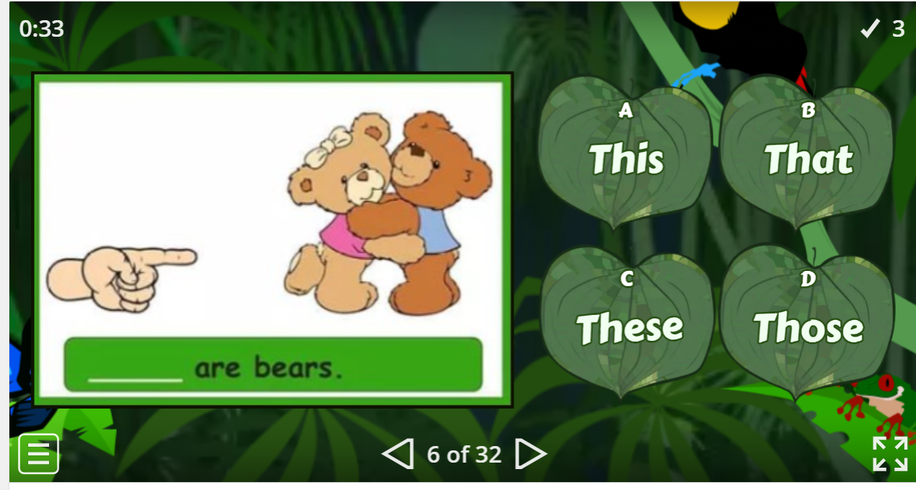


Slide 18
HOMEWORK
- Make 3 sentences, use the demonstratives and object pronouns.
- Do exercise in Work Book: Lesson 1 - Grammar (page 27).
- Prepare: Lesson 1 – Pronunciation and Speaking (page 40 – SB).

