Slide 1


Slide 2

WARM-UP: CHATTING
- What did Tom find out?
- What did he make with it?
- What happened with the flowers?

Slide 3
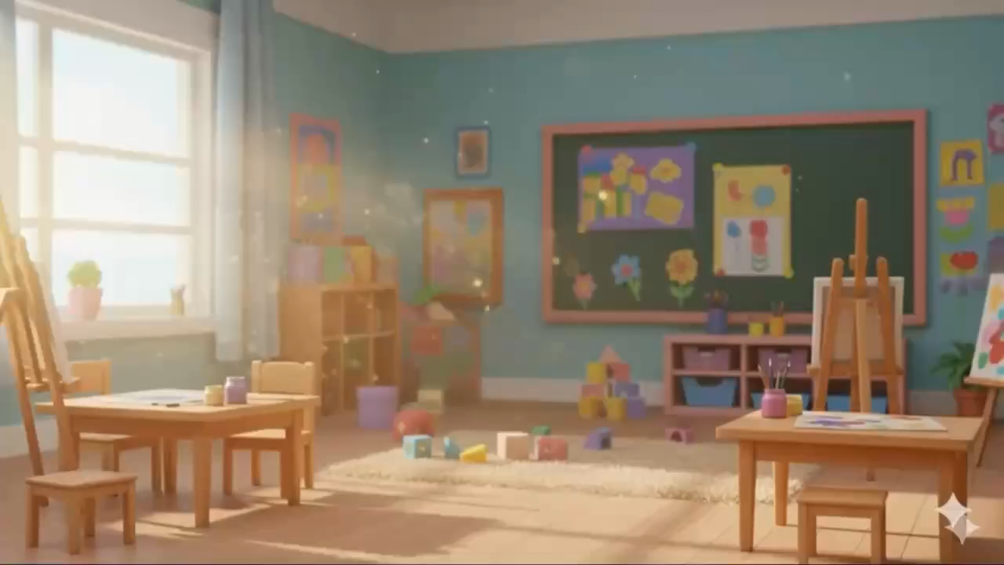
WARM-UP: CHATTING

Slide 4




Unit
4
MUSIC AND ARTS
LESSON 1: GETTING STARTED
A talk at the school gate
Unit
HOBBIES

Slide 5
LESSON 1: GETTING STARTED
WARM-UP
Chatting
PRESENTATION
Vocabulary
Listen and read.
Task 1: Circle the correct answer.
Task 2: Complete each of the sentences with a suitable word or phrase from the box.
Task 3: Write the correct word or phrase under each picture.
Task 4: Quiz “How artistic are you?”.
PRACTICE
CONSOLIDATION
Wrap-up
Homework

Slide 6
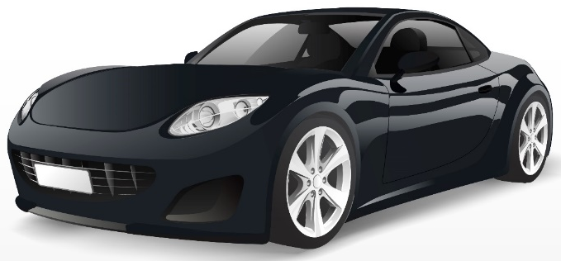
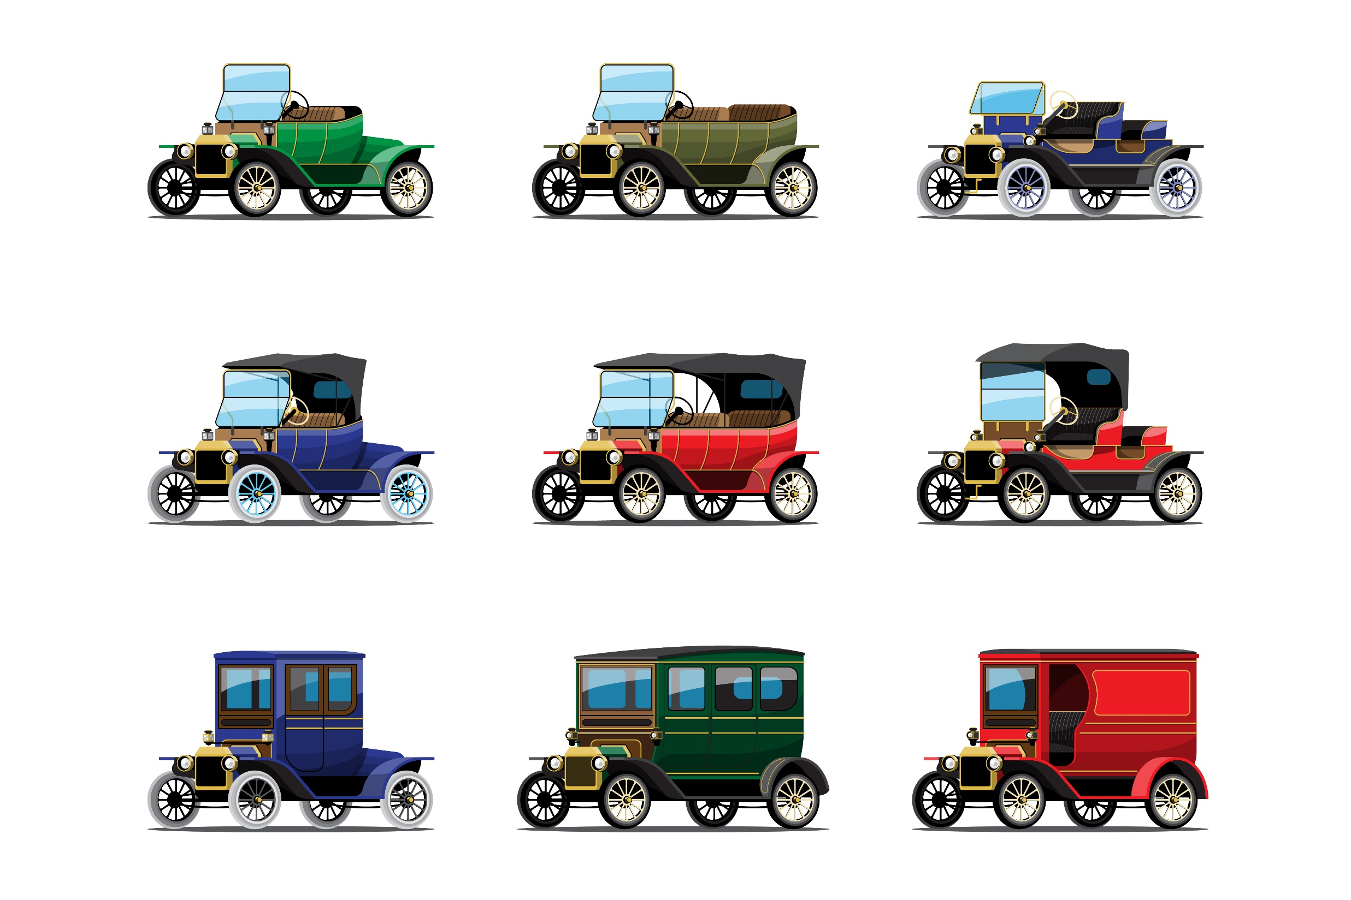
PRESENTATION
classical (adj)
modern
/ˈklæsɪkəl/
cổ điển

Slide 7

PRESENTATION
pleasure (n)
/ˈpleȝə (r)/
Niềm vui, sự hoan hỉ

Slide 8
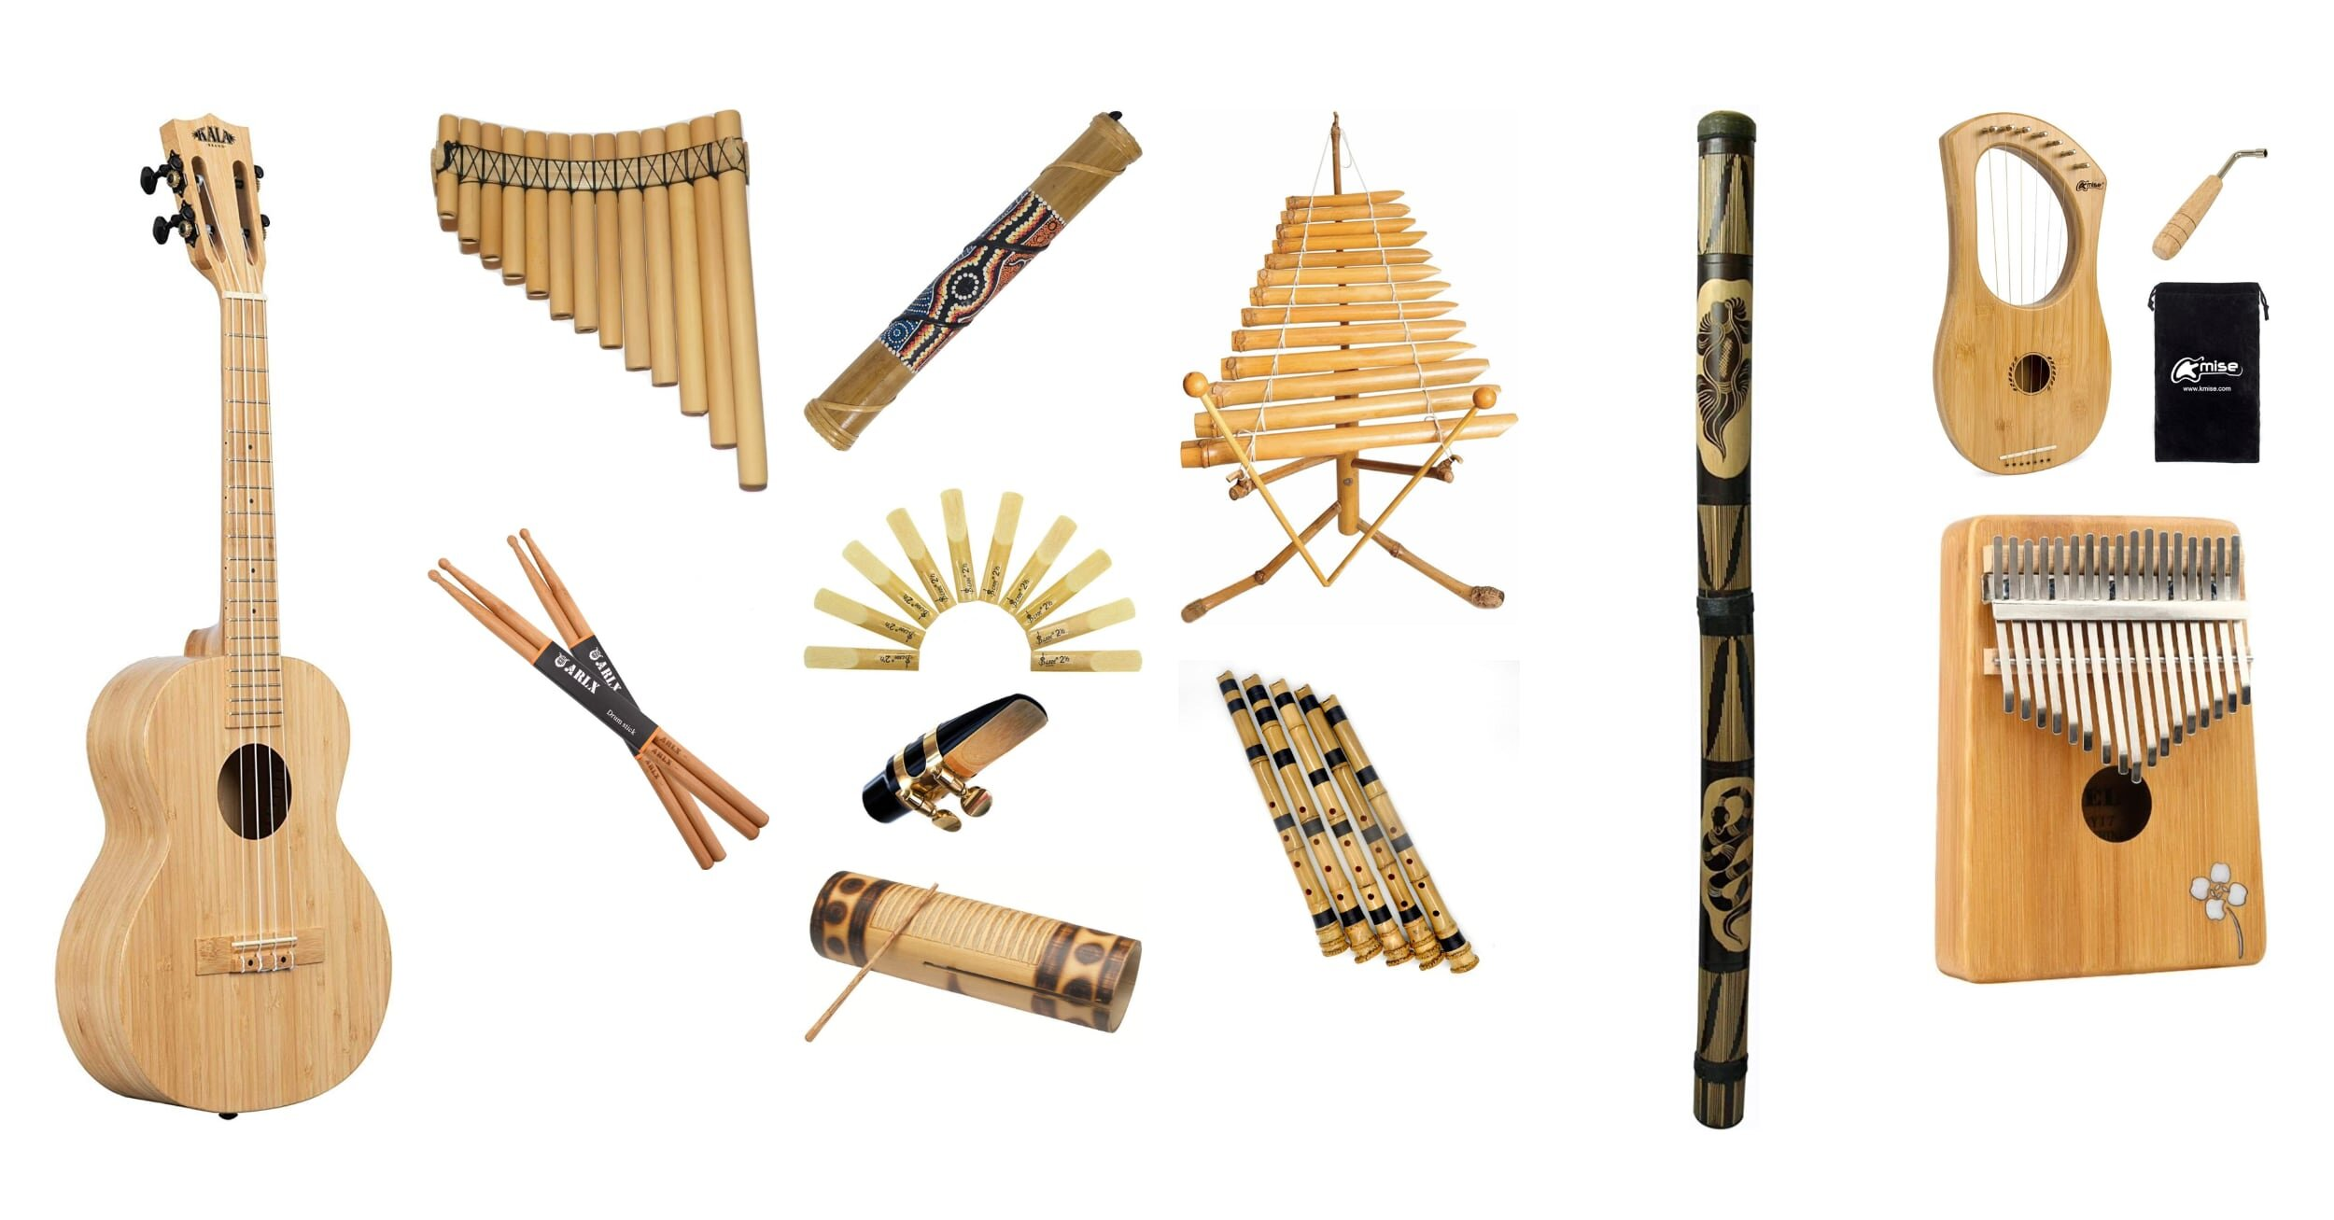
PRESENTATION
musical instruments (n)
/ˈmjuːzɪkəl ˈɪnstrəmənts/
nhạc cụ

Slide 9
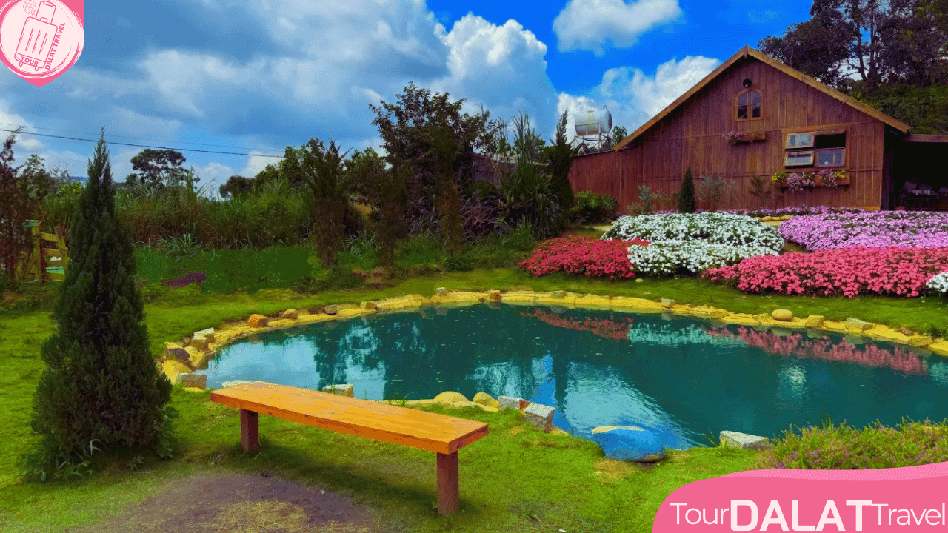
PRESENTATION
landscape
(n)
/ˈlændskeɪp/
cảnh quan,
phong cảnh

Slide 10
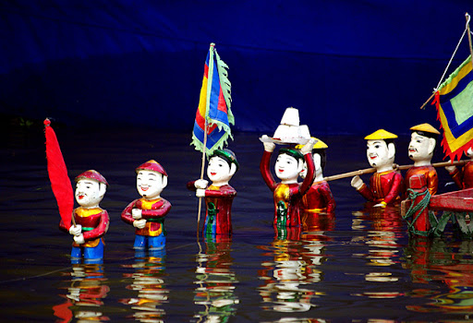
PRESENTATION
PUPPET(n)
/ˈpꓥpit//
Con rối

Slide 11
PRESENTATION
New words | Pronunciation | Meaning
classical (adj) | /ˈklæsɪkəl/ | cổ điển
pleasure (n) | /ˈpleȝə (r)/ | niềm vui, sự hoan hỉ
musical instruments (n) | /ˈmjuːzɪkəl ˈɪnstrəmənts/ | nhạc cụ
landscape (n) | /ˈlændskeɪp/ | cảnh quan
puppet (n) | /ˈpᴧpit/ | con rối

Slide 12

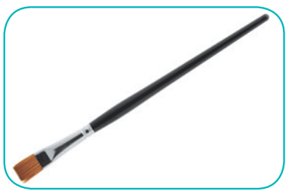

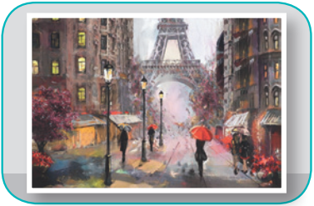
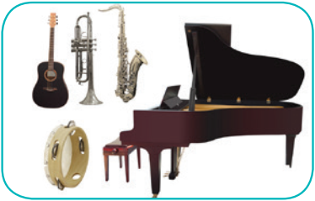
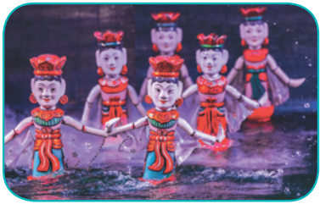
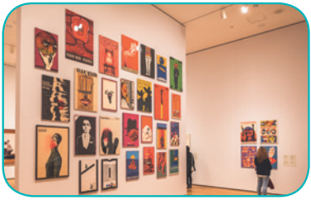
VOCABULARY CHECKING
4
Write the correct word or phrase under each picture. Then listen and repeat.
camera water puppet show art gallery
painting paintbrush musical instruments
paintbrush
camera
painting
1. ______________
2. ____________
3. ____________
musical instruments
water puppet show
4. __________________________
5. _________________________
art gallery
6. ____________

Slide 13
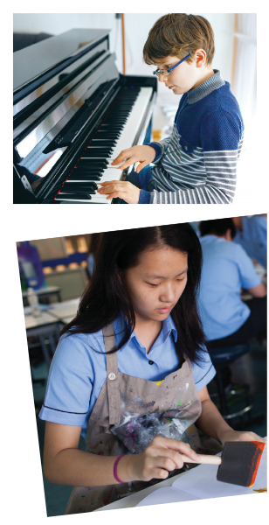
TASK 1- LISTEN AND READ
Trang: Hi Nick. What are you listening to?
Nick: I’m listening to music. I like classical music, and I often play
the piano in my spare time.
Trang: Wow. I can’t play any instruments.
Nick: And what about you? What’s your hobby?
Trang: I like painting and taking photos.
Nick: Taking photos? I’ve never tried it. Is it fun?
Trang: Yeah, it is, but not as fun as painting.
Nick: Right. They seem quite different from each other. What do you normally paint?
Trang: Landscapes and animals, just for pleasure, you know.
I sometimes share them with my friends.
Nick: Really? Um, maybe we should go to an art gallery next weekend?
Trang: Sounds good, but I’d prefer to go to the music festival at my school.
Nick: Well … OK. That’s fine.

Slide 14
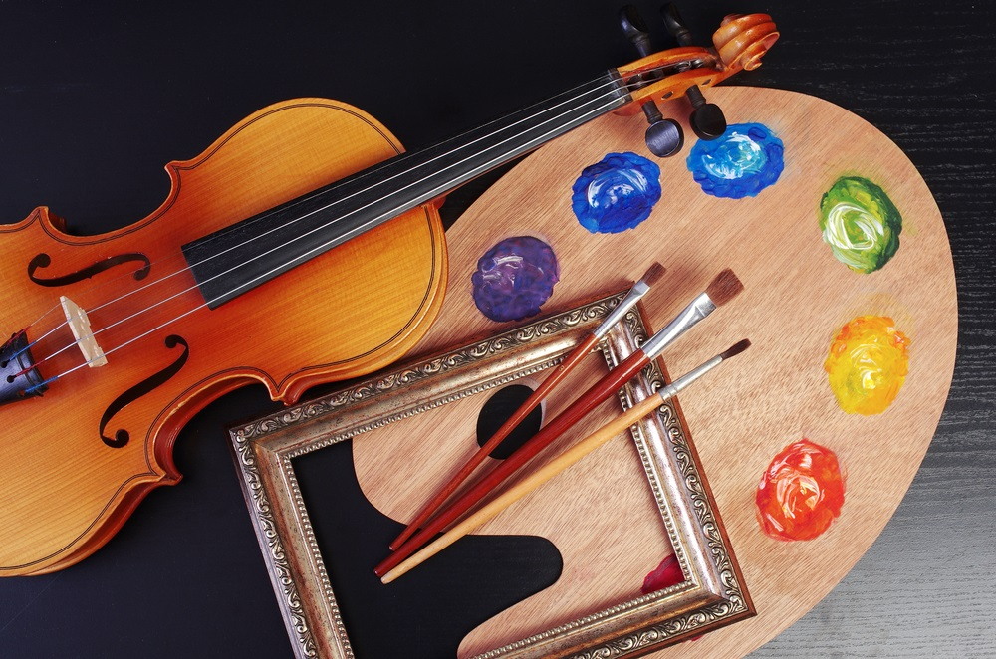
PRACTICE
2
Tick the correct answer.
1. What are Trang and Nick talking about? A. Playing the piano. B. Drawing and painting. C. Music and arts.
Trang: Hi Nick. What are you listening to?
Nick: I’m listening to music. I like classical music, and I often play the piano in my spare time.

Slide 15






Question 1. a(n) _____________ Nick wants to go to a(n) ______ next week.
A. different from
B. photos
C. art gallery
D. musical instruments

Slide 16


Question 2.
You can use your smartphone to take ______.
A. photos
B. games
C. likes
D. videos

Slide 17
Question 3.
Nick and Trang agree that taking photos is not ______ painting
A. art gallery
B. like
C. different from
D. photos

Slide 18
Question 4.
This photo is very bright. It is _______ that dark one.
A. beautiful
B. different from
C. like
D. similar

Slide 19
Question 5. My friend David is very talented. He plays three ____.
A. music
B. photos
C. musical instruments
D. art gallery

Slide 20
Question 6.
Thai Nguyen has a lot of______for you to paint.
A. landscapes
B. pleasure
C. music festival
D. instruments

Slide 21
PRACTICE
Complete each of the sentences with a suitable word or phrase from the box.
3
photos like different from art gallery musical instruments
Nick wants to go to a(n) _____________ next week.
You can use your smartphone to take ________.
This photo is very bright. It is _____________ that dark one.
Nick and Trang agree that taking photos is not _______ painting.
My friend David is very talented. He plays 3 _____.
art gallery
photos
different from
like
musical instruments

Slide 22


PRACTICE
4
Quiz “How artistic are you?”.

Slide 23
CONSOLIDATION
1
WRAP-UP
MUSIC AND ARTS
ABOUT MUSIC
ABOUT ARTS
Topic of the unit
Vocabulary

Slide 24

CONSOLIDATION
2
HOMEWORK
Prepare the vocabulary for the next lesson: A closer look 1.
Prepare for the Project lesson.

Slide 25



Slide 26
