Slide 1


Slide 2




Unit
2
HEALTHY LIVING
LESSON 4: COMMUNICATION
Unit
HOBBIES

Slide 3

OBJECTIVES
By the end of the lesson, students will be able to:
learn how to ask for and give health tips.
practise using some grammar points and vocabulary related to the topic.

Slide 4
LESSON 4: COMMUNICATION
WARM-UP
Game: Brainstorming
EVERYDAY ENGLISH
Task 1: Listen and read the dialogue.
Task 2: Make similar conversation.
Task 3: Read the passage and choose the correct title for it.
Task 4: Discuss and make a list for the tips which help the Japanese live long lives.
Task 5: Discuss and make a list for the tips that the Vietnamese can do to live longer.
TIPS FOR A HEALTHY LIFE
CONSOLIDATION
Wrap-up
Home work

Slide 5

LESSON 4: COMMUNICATION
WARM-UP
Game: Brainstorming
Aims of the stage:
To introduce the lesson

Slide 6
WARM-UP
HEALTH PROBLEMS

Slide 7

LESSON 4: COMMUNICATION
WARM-UP
Game: Brainstorming
EVERYDAY ENGLISH
Task 1: Listen and read the dialogue.
Task 2: Make similar conversation.
Aims of the stage:
to help students practise giving tips on health problems

Slide 8

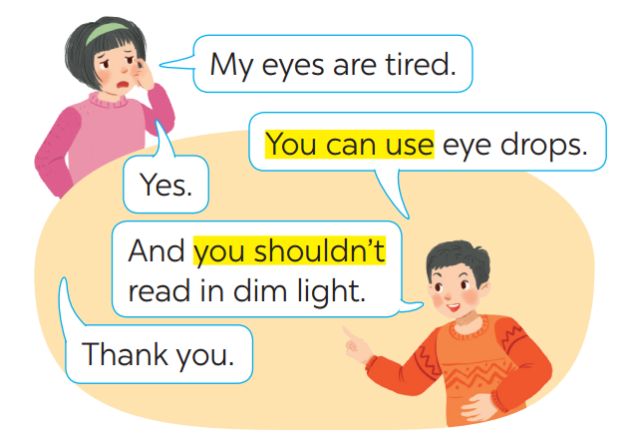
EVERYDAY ENGLISH
Giving tips for health problems
1
Listen and read the conversations. Pay attention to the highlighted sentences.

Slide 9
EVERYDAY ENGLISH
You should/ shouldn’t + V
You can + V
You shouldn’t read in dim light.
You can use eye drops.

Slide 10


EVERYDAY ENGLISH
2
Work in pairs. Make similar conversations with the following situations.
You should go to bed early.
You shouldn’t eat too much fastfood.
I’m tired.

Slide 11

EVERYDAY ENGLISH
2
Work in pairs. Make similar conversations with the following situations.
You should wash your face carefully..
I have acne.
You should avoid instant noodles and coffee.

Slide 12
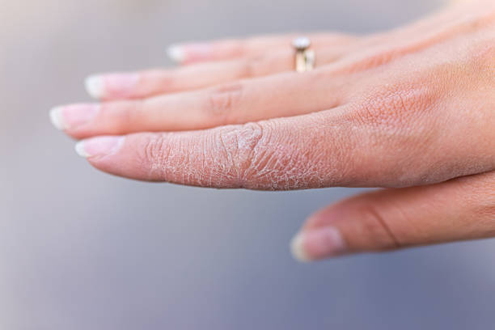
EVERYDAY ENGLISH
2
Work in pairs. Make similar conversations with the following situations.
My hands are chapped.
You can use coconut oil.
You shouln’d wash them in hot water.

Slide 13
LESSON 4: COMMUNICATION
WARM-UP
Game: Brainstorming
EVERYDAY ENGLISH
Task 1: Listen and read the dialogue.
Task 2: Make similar conversation.
Task 3: Read the passage and choose the correct title for it.
Task 4: Discuss and make a list for the tips which help the Japanese live long lives.
Task 5: Discuss and make a list for the tips that the Vietnamese can do to live longer.
TIPS FOR A HEALTHY LIFE

Slide 14

TIPS FOR A HEALTHY LIFE
TIPS FOR A HEALTHY LIFE
Aims of the stage:
to provide students with more knowledge about healthy living and help them practise the skill of reading for the main idea

Slide 15
TIPS FOR A HEALTHY LIFE
3
Read the passage and choose the correct title for it.
The Japanese live long lives. The main reason is their diet. They eat a lot of fish and vegetables. They cook fish with little cooking oil. They also eat a lot of tofu, a product from soybeans. Tofu has vegetable protein and vitamin B. It doesn’t have any fat. The Japanese work hard and do a lot of outdoor activities too. This helps them keep fit.
A. How to live long
B. What food to eat

Slide 16


TIPS FOR A HEALTHY LIFE
4
Discuss and make a list for the tips which help the Japanese live long lives.
Eating a lot of fish and vegetables.
Cooking fish with little cooking oil.
Eating a lot of tofu.
Working hard.
Doing a lot of outdoor activities.

Slide 17

FUTHER PRACTICE
Aims of the stage:
to help students practise giving health tips on their own context

Slide 18
FUTHER PRACTICE
5
Discuss and make a list for the tips that the Vietnamese can do to live longer.

Slide 19
LESSON 4: COMMUNICATION
WARM-UP
Game: Brainstorming
EVERYDAY ENGLISH
Task 1: Listen and read the dialogue.
Task 2: Make similar conversation.
Task 3: Read the passage and choose the correct title for it.
Task 4: Discuss and make a list for the tips which help the Japanese live long lives.
Task 5: Discuss and make a list for the tips that the Vietnamese can do to live longer.
TIPS FOR A HEALTHY LIFE
CONSOLIDATION
Wrap-up
Home work

Slide 20

CONSOLIDATION
1
WRAP-UP
In this lesson, we have learn to:
learn how to ask for and give health tips
practise using some grammar points and vocabulary related to the topic.

Slide 21
CONSOLIDATION
2
HOMEWORK
Do exercises in the workbook.

Slide 22

Website: sachmem.vn
Fanpage: facebook.com/sachmem.vn/

