Slide 1
UNIT 1
HOBBIES
Lesson 4: Communication

Slide 2
Objectives
Talk about likes and dislikes

Slide 3
01
EVERYDAY
ENGLISH
Talking about likes and dislikes

Slide 4
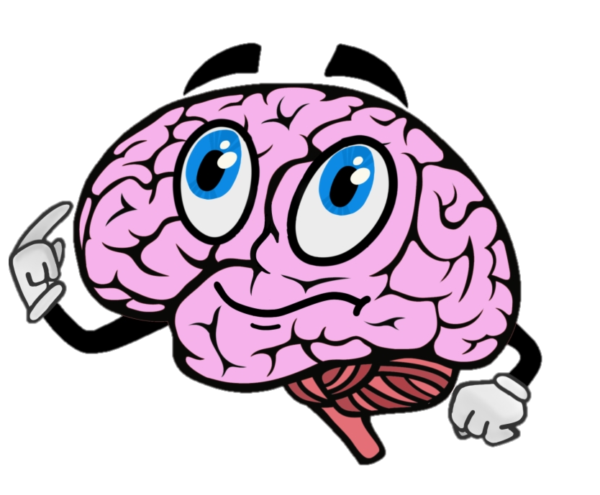
Check your remember!!!
Common verbs of liking and disliking are l_____, l_____, e_____ and h_____ (not like).
ove
ike
njoy
ate
We use
love/ like/ enjoy/ hate + _____
Ving

Slide 5

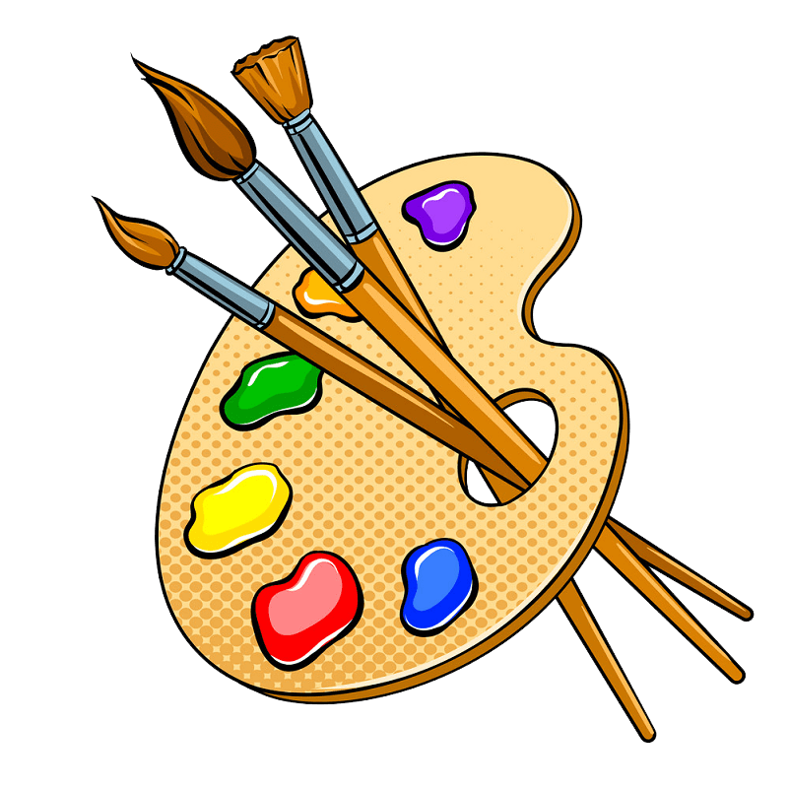


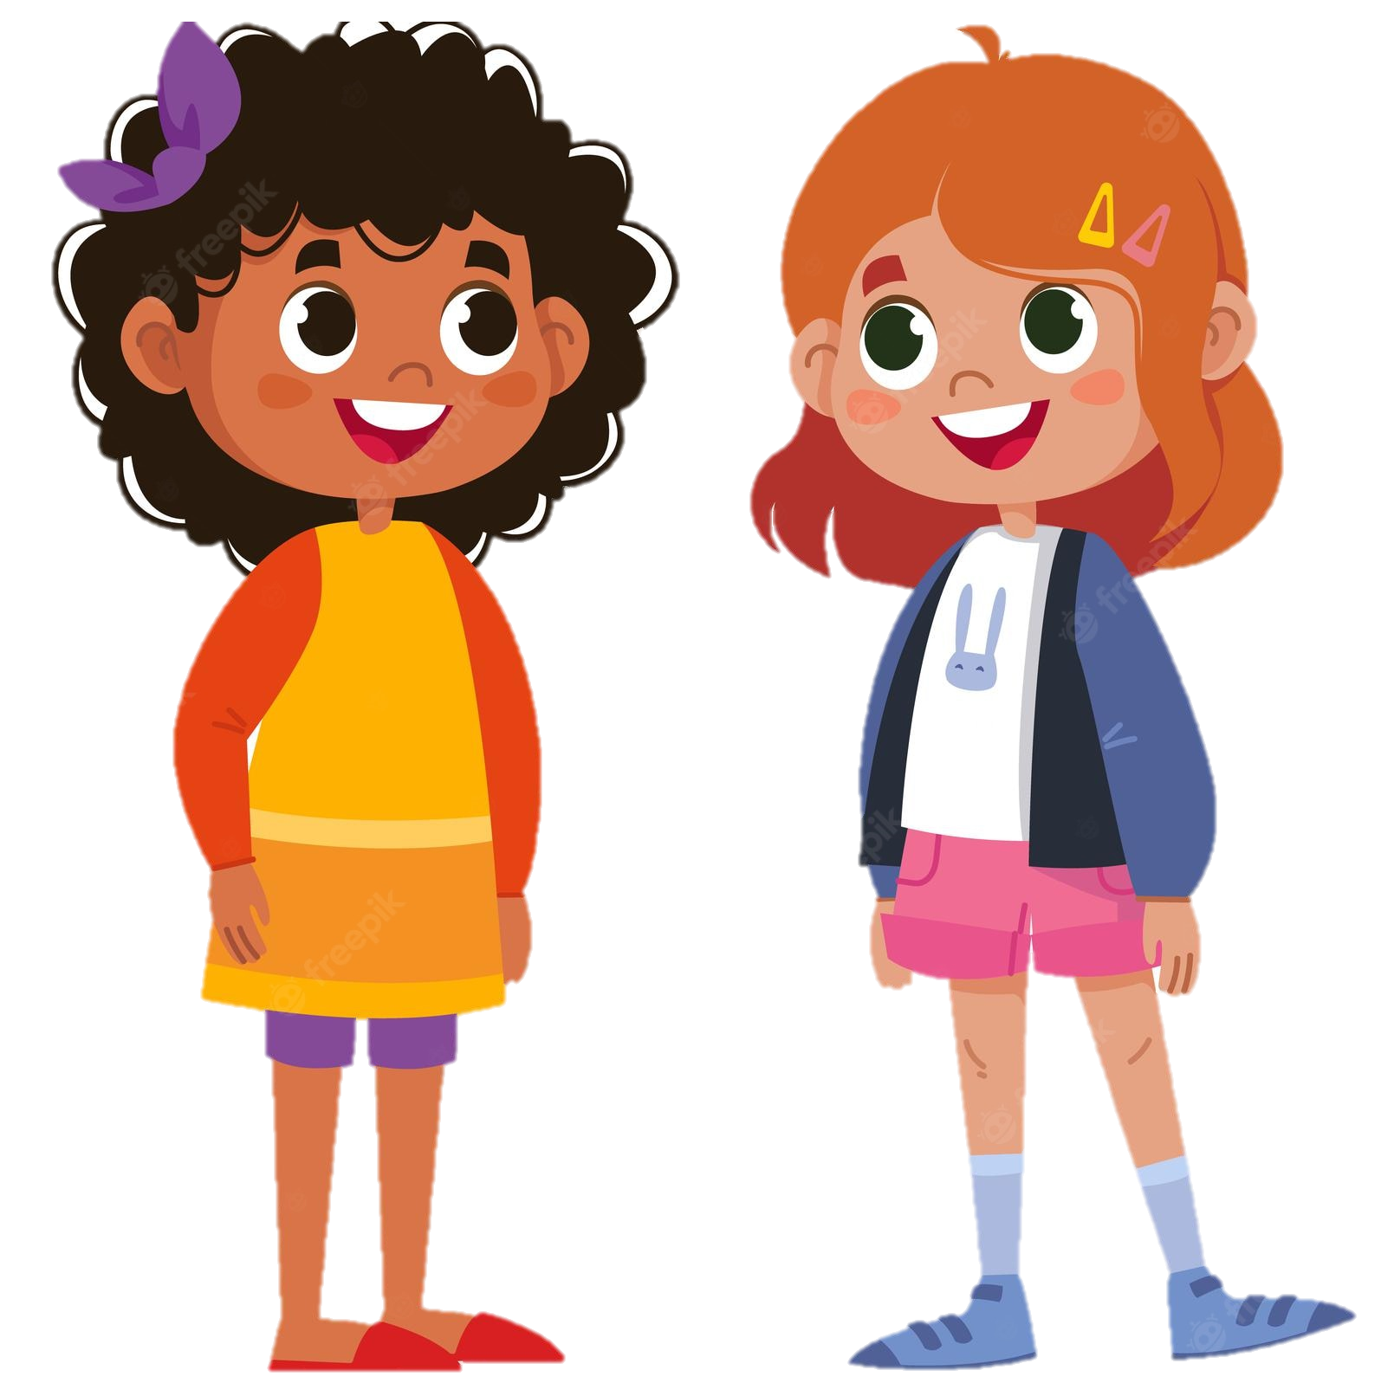
Listen and read the dialogue below. Pay attention to the questions and answers.
Mi: Do you like reading books?
Ann: Yes, very much, especially books about science.
Mi: What about painting? Do you like it?
Ann: No, I don't. I'm not interested in art.
Mi: Do you like reading books?
Ann: Yes, very much, especially books about science.
Mi: What about painting? Do you like it?
Ann: No, I don't. I'm not interested in art.
Mi
Ann

Slide 6
Work in pairs. Ask and answer questions about what you like and don't like doing.
Do you like ________ ?
Yes, … do.
No, … don’t.
What about…….?
Mi
Ann

Slide 7
02
ALL ABOUT
YOUR HOBBIES

Slide 8
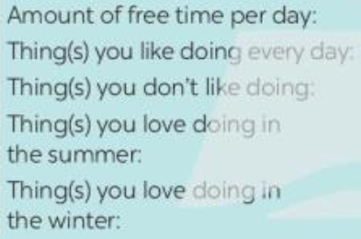
Answer the questions. Fill in column A with your answers.
Answer | A
How much free time do you have a day?
What do you like doing every day?
What do you not like doing?
What do you love doing in the summer?
What do you love doing in the winter?
The amount of free time per day I have 1 hour.
The amount of free time per day
I like watching movies everyday.
Thing(s) I like doing every day
I don’t like running.
Thing(s) I don’t like doing
Thing(s) I like doing in the summer
I like swimming in the summer.
Thing(s) I like doing in the winter
I like ice skating in the winter.

Slide 9
Now interview your friend, using the questions above. Write his / her answers in column B.
Answer | B
How much free time do you have a day?
What do you like doing every day?
What do you not like doing?
What do you love doing in the summer?
What do you love doing in the winter?
The amount of free time per day
Thing(s) you like doing every day
Thing(s) I don’t like doing
Thing(s) I like doing in the summer
Thing(s) I like doing in the winter

Slide 10


Interview your friend, using the questions in 3. Write his / her answers in column B.
Answer | B
How much free time do you have a day?
1 hour
How much free time do you have a day?
The amount of free time per day I have is 1 hour.
A
B

Slide 11

Present and share.
I have one hour of free time a day, but my friend Lan has only 30 minutes.
I like listening to music every day, and Lan likes it too. I don’t like exercising, but Lan does.

Slide 12
03
RECAP

Slide 13
Tick (✓)what you have learnt in the lesson today?
✓
□ Review the uses of Verbs of liking.
□ Review Past simple and Present continuous
□ Talk about likes and dislikes
✓

Slide 14
THANKS
Please keep this slide for attribution

