Slide 1

Unit 1: Home
Lesson 2.3: Pronunciation & Speaking
Student’s Book - Page 11

Slide 2
Lesson Outline
Warm-up
Pronunciation
Practice
Speaking
Consolidation
Wrap-up

Slide 3
Objectives
By the end of this lesson, students will be able to…
- pronounce the sound /ɪ/ correctly;
- talk about family members and household chores;
- use the Present Simple tense with Wh-questions.

Slide 4

WARM UP

Slide 5
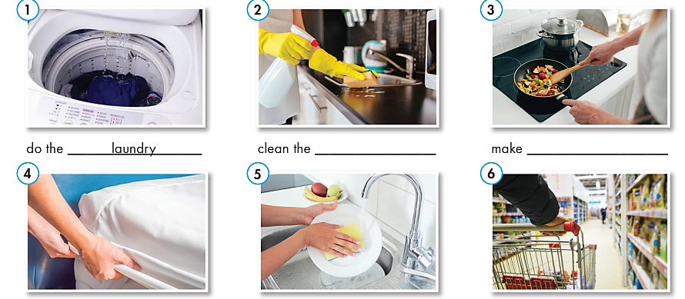
What chore is it?
Do the laundry
Clean the kitchen
Make dinner
Make the bed
Do the dishes
Do the shopping

Slide 6



Slide 7

Listen to the words and focus on the underlined letters.
Do the laundry
Clean the kitchen
Make dinner
Make the bed
Do the dishes
Do the shopping

Slide 8
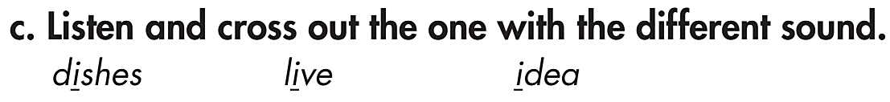
/ɪ/
/ɪ/
/aɪ/

Slide 9

Practice

Slide 10
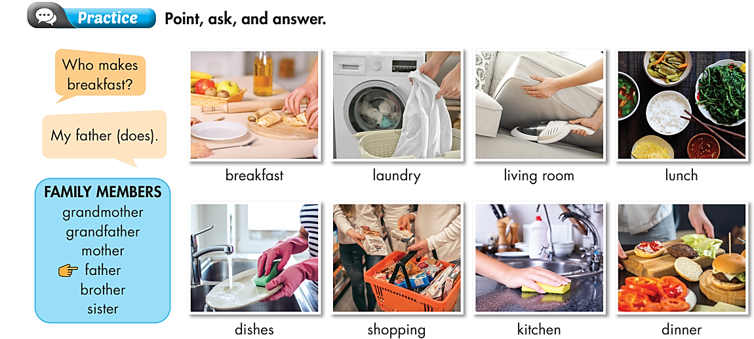

Work in pairs

Slide 11

Speaking

Slide 12
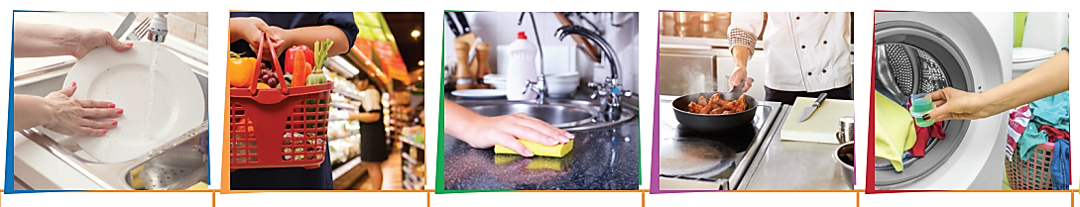
Pre-Speaking
What chore is it?
1 2 3 4 5
Do the dishes
Clean the kitchen
Do the laundry
Do the shopping
Make dinner

Slide 13
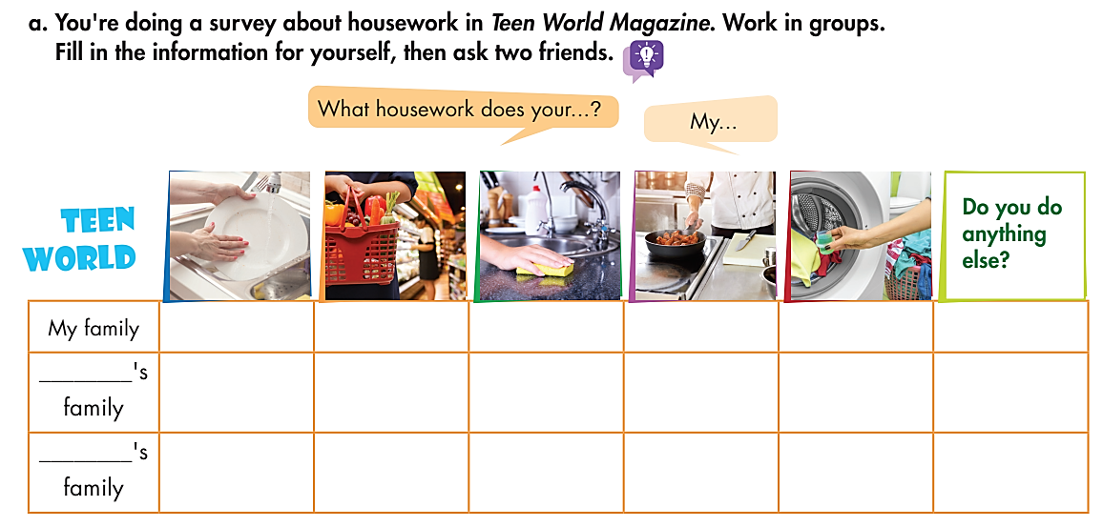
While-Speaking
What housework does your ……. do?
My …….. (does)

Slide 14
Post-Speaking
b. Discuss who does the most housework in the families.
Then present.
(Mai’s mom) does the most housework in his/ her family.
He/ She……………

Slide 15
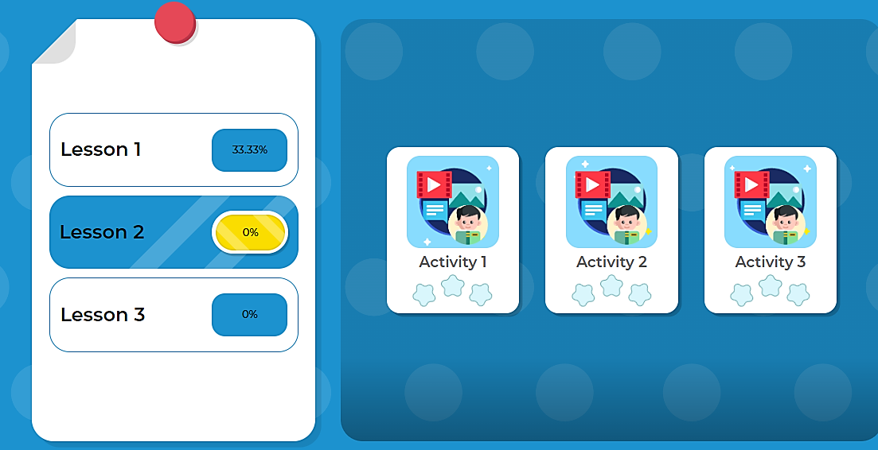
Click here to play the game

Slide 16

CONSOLIDATION

Slide 17
Talk about housework in your family.
  I ………..
  My mom…………
  My dad………
  My brother/ sister………………..
  ……….. does the most housework in my family.

Slide 18

WRAP-UP

Slide 19
Today’s lesson
Sound /ɪ/.
Family members.
What housework does ….. do?

Slide 20
Homework
Review the vocabulary and grammar notes in Tiếng Anh 6 i-Learn Smart World Notebook (pages 4 & 5).
Play the consolation games in Tiếng Anh 6 i-Learn Smart World DHA App on www.eduhome.com.vn.
Prepare the next lesson (page 12 - SB).

Slide 21

Lesson 3
Stay positive and have a nice day!

