Slide 1

Unit 1: Home
Lesson 2.2: Grammar
Student’s Book - Page 10

Slide 2
Lesson Outline
Warm-up
Grammar
Consolidation
Wrap-up

Slide 3
Objectives
By the end of this lesson, students will be able to…
use Present Simple and Wh- questions to ask about facts;
use the possessive “‘s”;
write about what housework they do at home.

Slide 4

WARM-UP

Slide 5
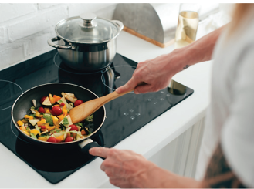
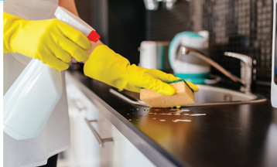
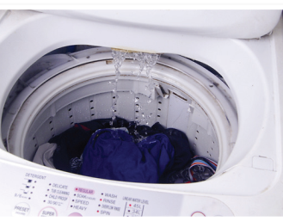
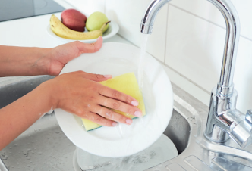
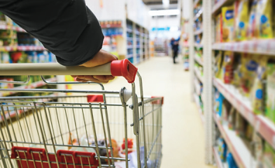
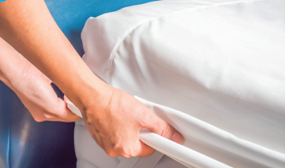
Match the chores with the suitable pictures
1
2
3
clean the kitchen
do the laundry
make the bed
do the shopping
do the dishes
make dinner
4
6
5

Slide 6

Presentation

Slide 7
FORM:
(+) S + V₁^{s/es}.
(-) S + do/ does + not + V_{inf}….
(?) Do/ Does + S + V_{inf}….?
PRESENT SIMPLE
(Revision)
Yes, S + do/ does.
No, S + do/ does + not.
Ex: She does exercise every morning.
They don’t have a house.
Do you like cats? – Yes, I do.

Slide 8

PRESENT SIMPLE
Wh- questions
(?) Wh + do/ does + S + V_{inf}….?
Who + V₁^{s/es}……?
Answer: S + V₁^{s/es}.
Ex: What housework do you do?
What housework does your sister do?
Who does the shopping?
*We can also use short answers.
E.g. "Who cleans the kitchen?
My mother./ My mother does.
I/ You/ We/ They do the dishes.
He/ She/ It/ Ken's father cleans the kitchen.

Slide 9
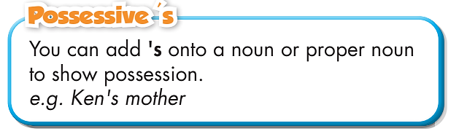
POSSESSIVE ‘S
Ex: Who does the shopping?
Ken’s mother.

Slide 10

Practice

Slide 11
Ask and answer, using Possessive ‘s
1
2
3
Tom / sister
Ken / dad
Mary / mom
Who………………?
…………

Slide 12
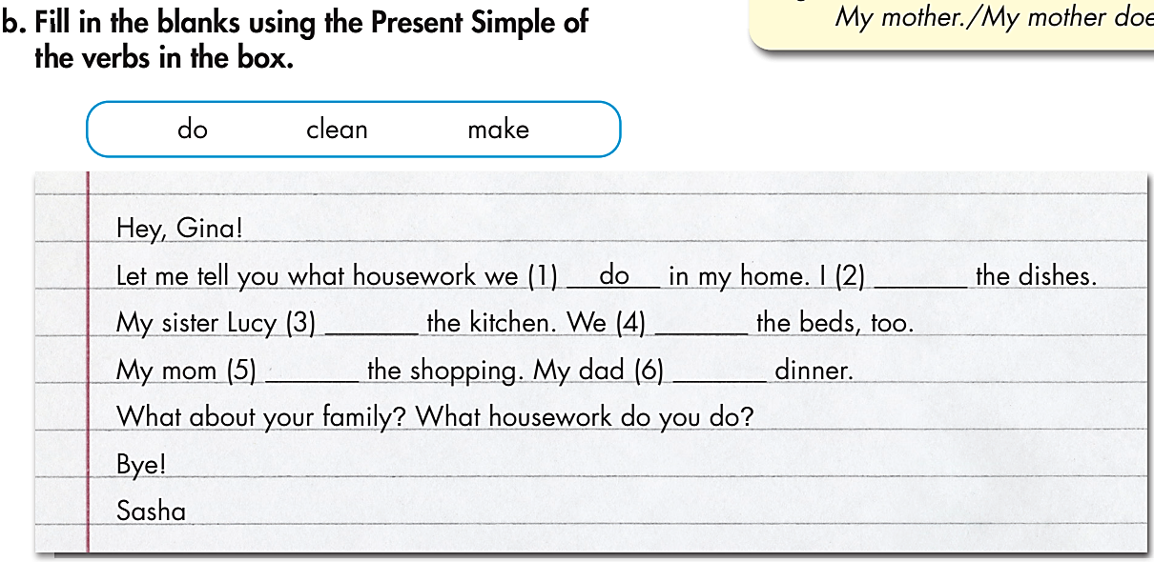

Slide 13
do
cleans
make
does
makes

Slide 14
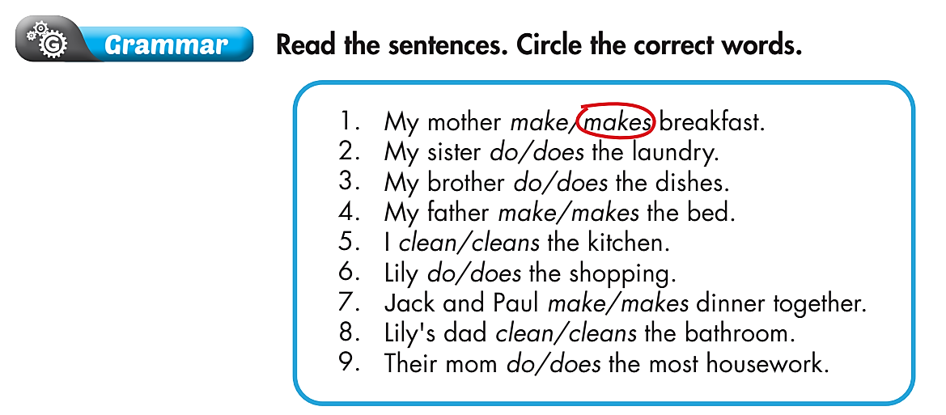
Extra Practice
WB page 5

Slide 15
Extra Practice
WB page 5

Slide 16
c. Write sentences using the prompts.
1. Who does the dishes?
– Joe's mom (does). ((Joe) mom)
2. _____________________________?
(What/ housework/ sister/ do)
– My sister cleans the kitchen.
3. Who makes breakfast? – _____________________________. (My dad)

Slide 17
c. Write sentences using the prompts.
1. Who does the dishes?
– Joe's mom (does). ((Joe) mom)
2. _______________________________________?
(What/ housework/ sister/ do)
– My sister cleans the kitchen.
3. Who makes breakfast? – ________________________________________. (My dad)
What housework does your sister do
My dad (makes breakfast) / My dad (does)

Slide 18
c. Write sentences using the prompts.
4. _________________________________________?
(Who/ do/ shopping)
– I do.
5. Who does the laundry?
– ___________________________________. ((Mary) brother)
6. _________________________________________?
(What/ housework/ they/ do)
– They clean the living room.
Who does the shopping
Mary’s brother (does the laundry)
Mary’s brother (does)
What housework do they do

Slide 19

Production

Slide 20

Ask your partner
What housework do you do?
I…………

Slide 21
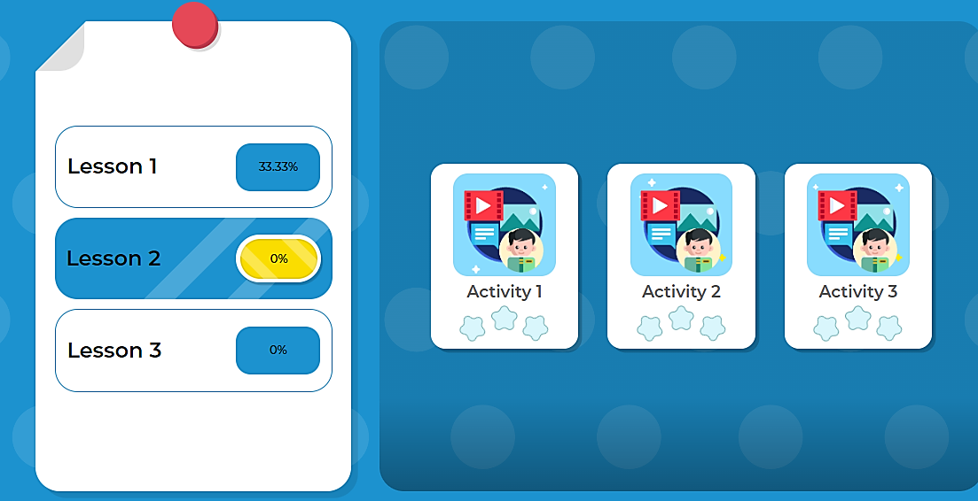
Extra Practice
DHA on Eduhome
Game
Tiếng anh 6 i-Learn Smart World

Slide 22

CONSOLIDATION

Slide 23
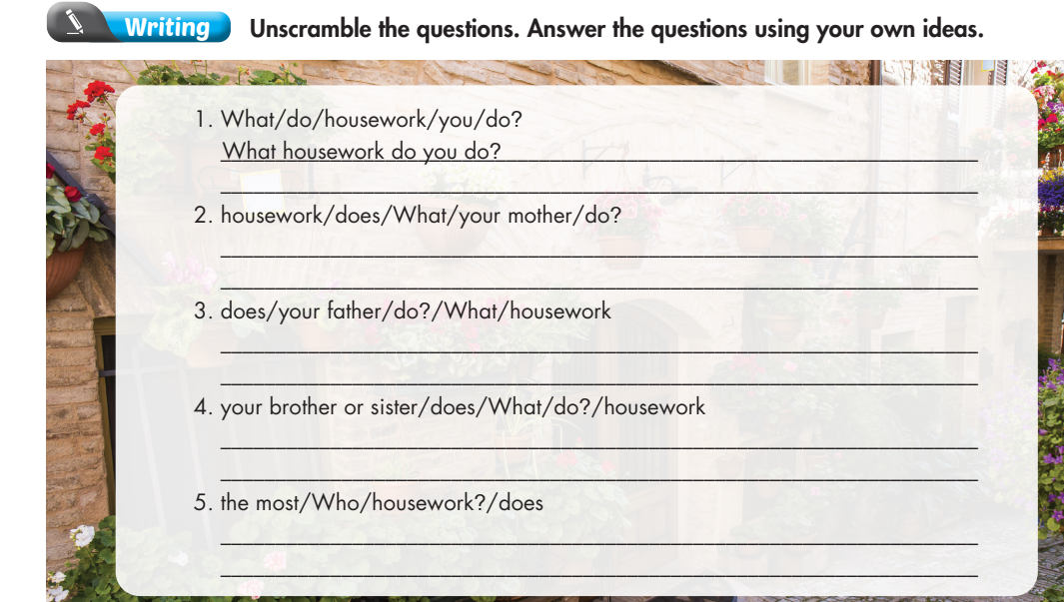
WB page 5
I……………………….
What housework does your mother do?
She……………………….
What housework does your father do?
He……………………….
What housework does your brother or sister do?
He/ She……………………….
Who does the most housework?
……………………….does.

Slide 24

WRAP-UP

Slide 25
Lesson 3
Today’s lesson
Structures/ Sentence patterns
Present Simple.
Wh- questions
Possessive ‘s

Slide 26
Lesson 3
Homework
Review the grammar and practice using them.
Do the exercise(s) in Tiếng Anh 6 i-Learn Smart World Workbook (page 5).
Complete the grammar notes in Tiếng Anh 6 i-Learn Smart World Notebook (page 5).
Play the consolation games in Tiếng Anh 6 i-Learn Smart World DHA App on www.eduhome.com.vn.
Prepare the next lesson (page 11 - SB).

Slide 27
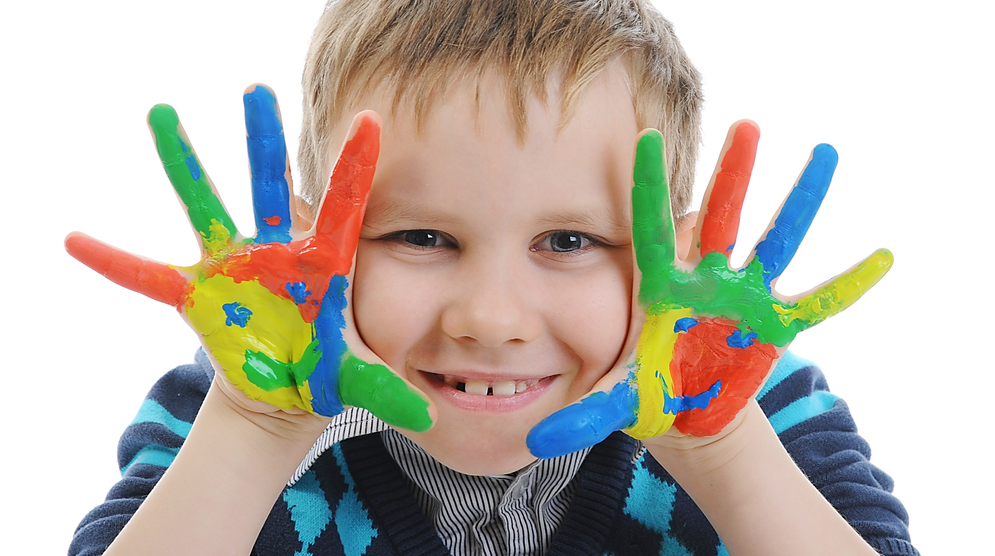
Enjoy your day!

