Slide 1

Unit 1: Home
Lesson 2.1: Vocabulary & Reading
Student’s Book - Page 9

Slide 2
Lesson Outline
Warm-up
Vocabulary
Reading
Consolidation
Wrap-up

Slide 3
Objectives
By the end of this lesson, students will be able to…
- know some chores at home;
- talk about housework they do at home;
- practice reading for specific information.

Slide 4
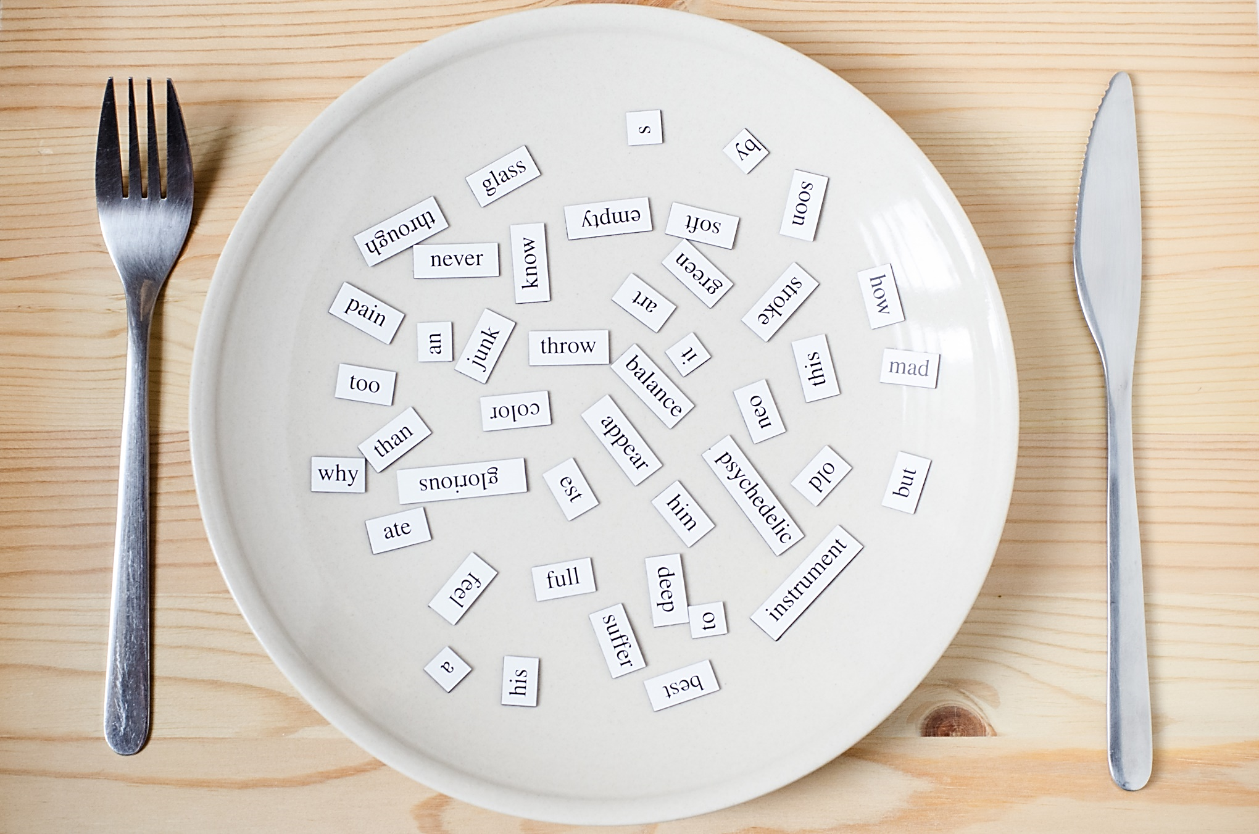
New words
Do the laundry
Make dinner
Do the shopping
Do the dishes
Clean the kitchen
Make the bed

Slide 5

WARM-UP

Slide 6

Work in pairs
What do you do to help your parents at home?
What housework does each member do at your home?

Slide 7
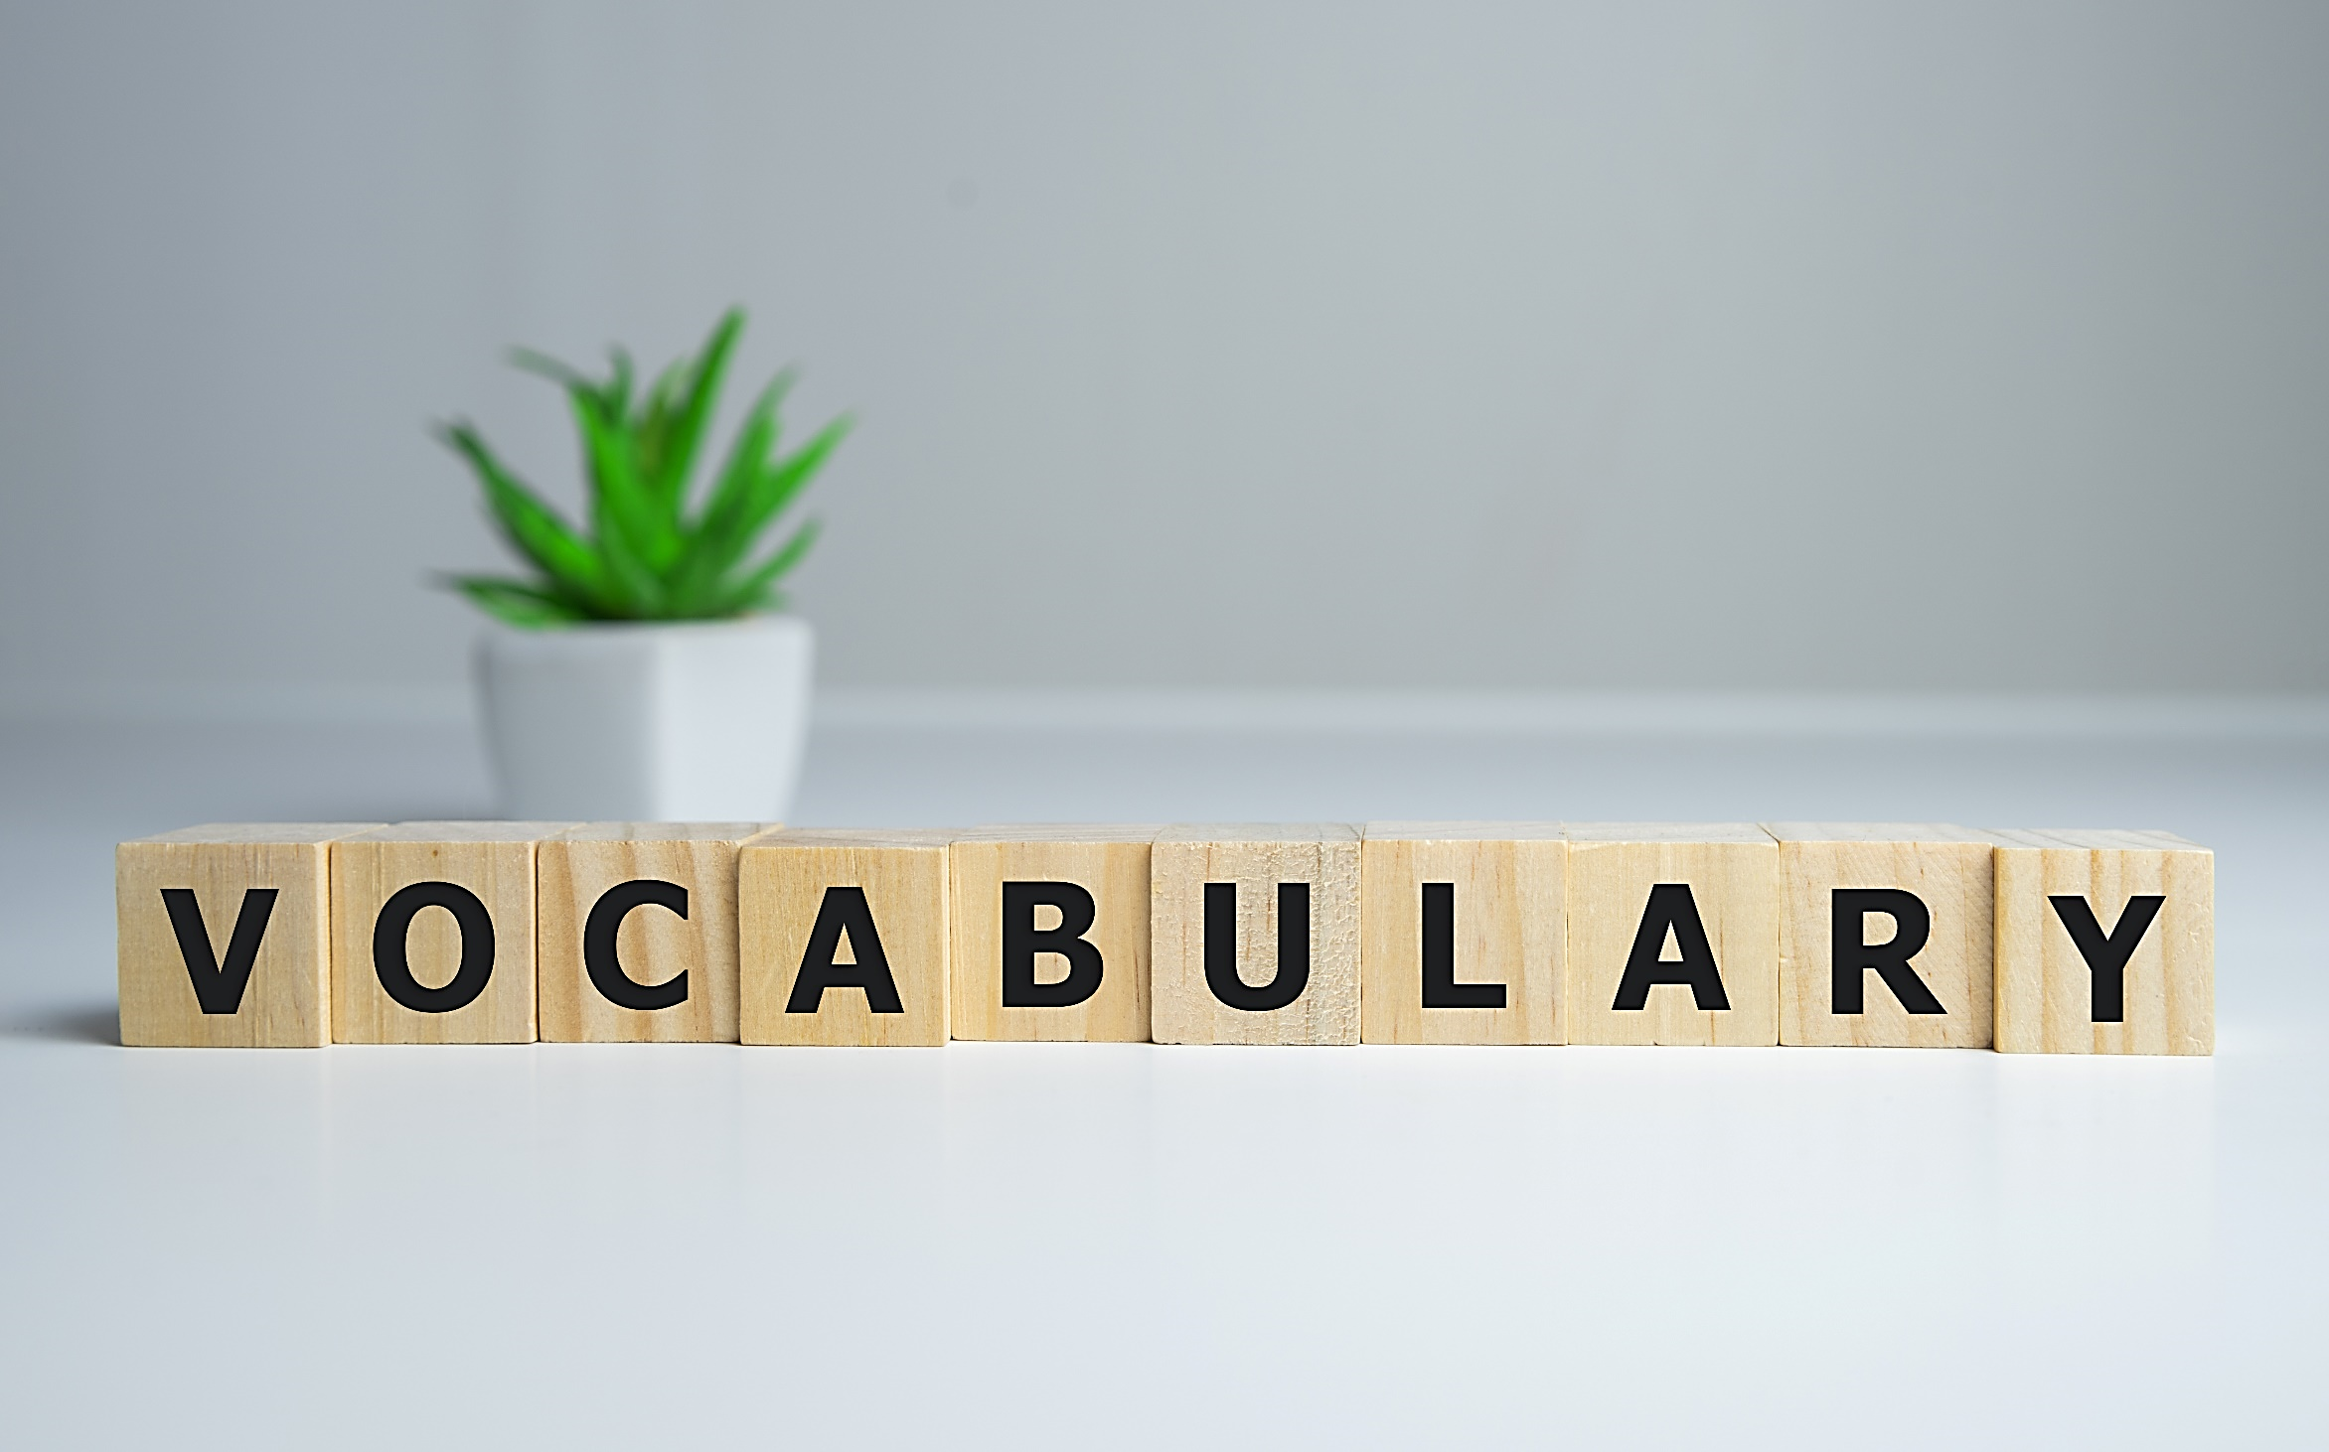

Slide 8

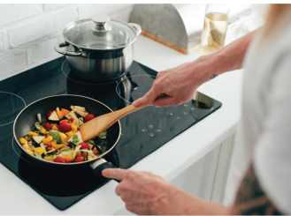
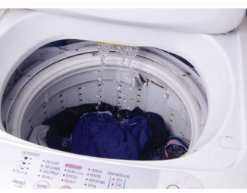
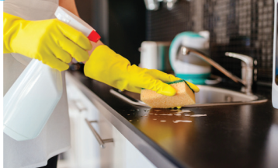

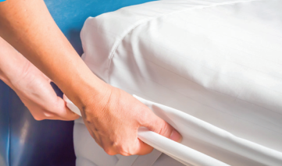
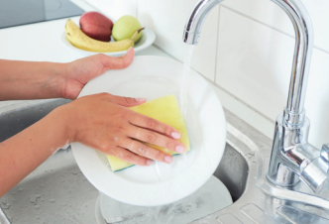
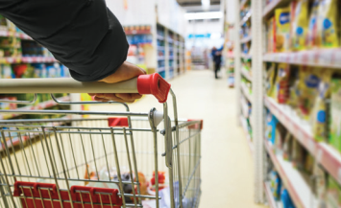
make dinner (v) /meɪk ˈdɪnər/ nấu bữa tối
do the dishes (v) /du: ðə dɪʃɪs/ rửa chén đĩa
do the shopping (v) /du: ðə ˈʃ ɑːpɪŋ/ mua sắm
make the bed (v) /meɪk ðə bed/ dọn giường
clean the kitchen (v) /kli:n ðə ‘kɪtʃən/ dọn bếp
do the laundry (v) /du: ðə ˈlaːndri/ giặt giũ

Slide 9
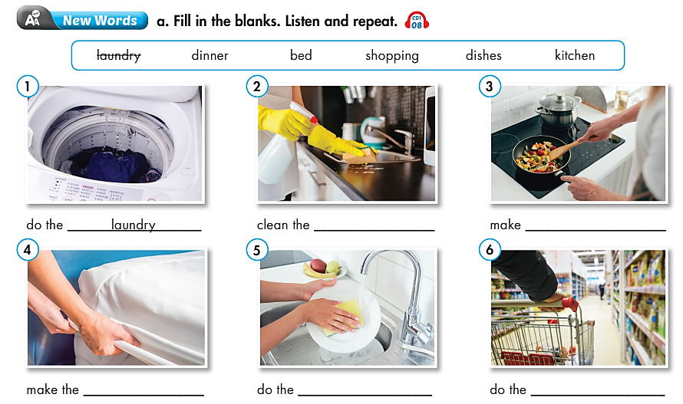
kitchen
dinner
bed
dishes
shopping

Slide 10


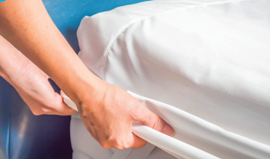



Say what housework you do at home.
I ……..

Slide 11
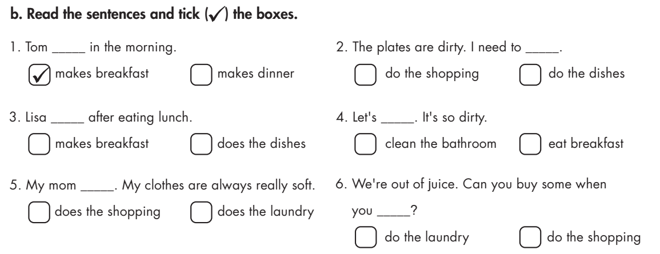
Extra Practice
WB page 4

Slide 12

Extra Practice
WB page 4
√
√
√
√
√

Slide 13
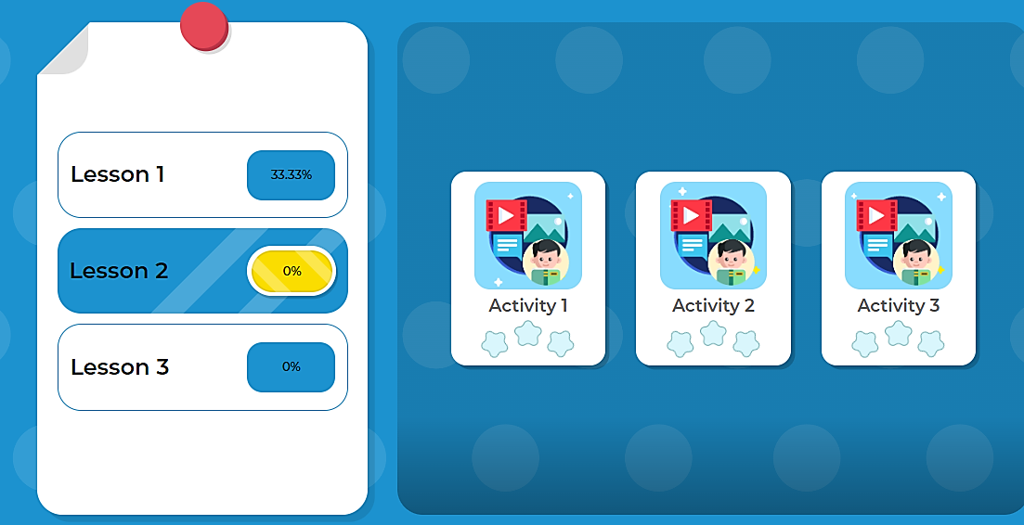
Click here to play the game

Slide 14

Reading

Slide 15
Pre-Reading
Read the instruction quickly. Underline the key words.
What are we going to do?
Read Ken's blog post about his family and circle the correct answers.

Slide 16
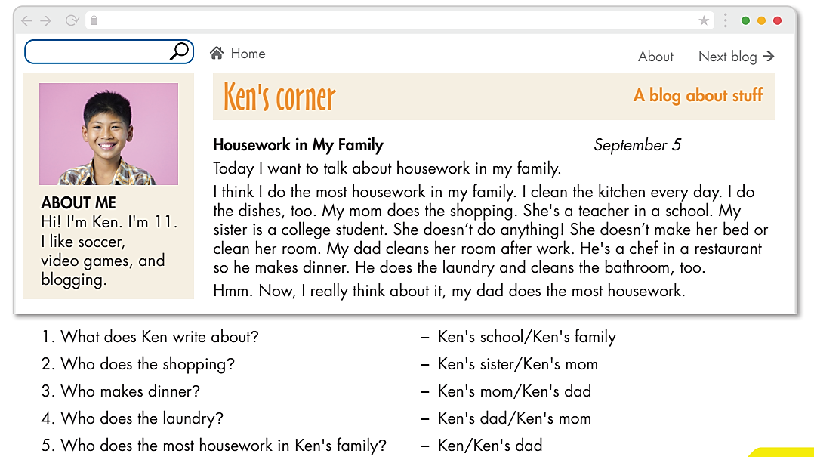
Read Ken's blog post about his family and circle the correct answers.

Slide 17
clean
make
cleans
does
makes
Close your books.
Fill in each gap with a right form of a verb
Post-Reading
I think I do the most housework in my family. I ……(1)……. the kitchen every day. I do the dishes, too. My mom does the shopping. My sister is a college student. She doesn’t do anything! She doesn’t ……(2)……. her bed or clean her room. My dad cleans her room, ……(3)……. dinner, ……(4)……. the laundry and ……(5)……. the bathroom, too.
Now, I really think my dad does the most housework.

Slide 18

CONSOLIDATION

Slide 19
Write a short paragraph about housework in your family.
  I ………..
  My mom …………
  My dad ………
  My brother/ sister ………………..
  ……….. does the most housework in my family.

Slide 20

WRAP-UP

Slide 21
Today’s lesson
Vocabularies
Do the laundry
Make dinner
Do the shopping
Do the dishes
Clean the kitchen
Make the bed
Structures/ Sentence patterns
I + do/ clean/ make
He/ She + does/ cleans/ makes

Slide 22
Homework
Review the vocabularies and practice using them.
Do the exercise(s) in Tiếng Anh 6 i-Learn Smart World Workbook (page 4).
Do the vocabulary exercise in Tiếng Anh 6 i-Learn Smart World Notebook (page 4).
Play the consolation games in Tiếng Anh 6 i-Learn Smart World DHA App on www.eduhome.com.vn.
Prepare the next lesson (page 10 - SB).

Slide 23

Lesson 3
Stay positive and have a nice day!

