Slide 1

Unit 1: Home
Lesson 1.3: Pronunciation & Speaking
Student’s Book - Page 8

Slide 2
Lesson Outline
Warm-up
Pronunciation
Practice
Speaking
Consolidation
Wrap-up
Tiếng Anh 6 i-Learn Smart World

Slide 3
Objectives
By the end of this lesson, students will be able to…
- rise intonation at the end of Y/N questions;
- ask and answer about their houses.
Tiếng Anh 6 i-Learn Smart World

Slide 4

WARM-UP

Slide 5

Practice the conversation with a partner.
Jenny: Excuse me. Could I ask you some questions?
Jim: Oh, you're in class 6A, aren't you?
Jenny: Yes, that's right. My name's Jenny. I'm doing a survey for my geography class.
Jim: My name's Jim. What do you want to know?
Jenny: Thank you, Jim. Do you live in a house?
Jim: No, I don't. I live in an apartment.
Jenny: How many bedrooms does it have?
Jim: Two.
Jenny: Does it have a pool?
Jim: Yes, a small one.
Jenny: Does it have a garage?
Jim: No, it doesn't.
Jenny: Does it have a gym?
Jim: Yes, it does. There's a gym in the basement.
Jenny: Does it have a balcony?
Jim: Yes, it does. I can see the city from it.
Jenny: Great! Thank you for your help.
Jim: You're welcome.
Jenny: Goodbye.
Tiếng Anh 6 i-Learn Smart World

Slide 6



Slide 7
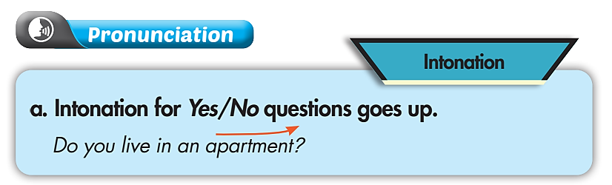
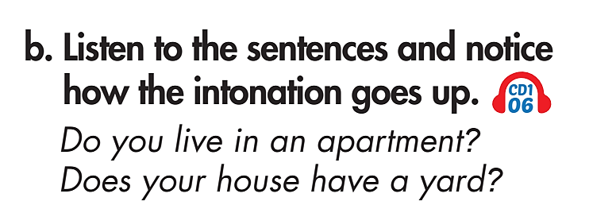

Tiếng Anh 6 i-Learn Smart World

Slide 8
Click on the sentence to hear
Practice with a partner.
Tiếng Anh 6 i-Learn Smart World

Slide 9
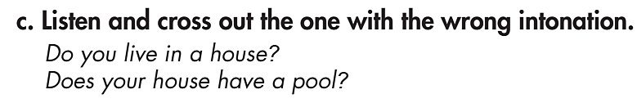
Tiếng Anh 6 i-Learn Smart World

Slide 10


Practice the right intonation with a partner.
Tiếng Anh 6 i-Learn Smart World

Slide 11
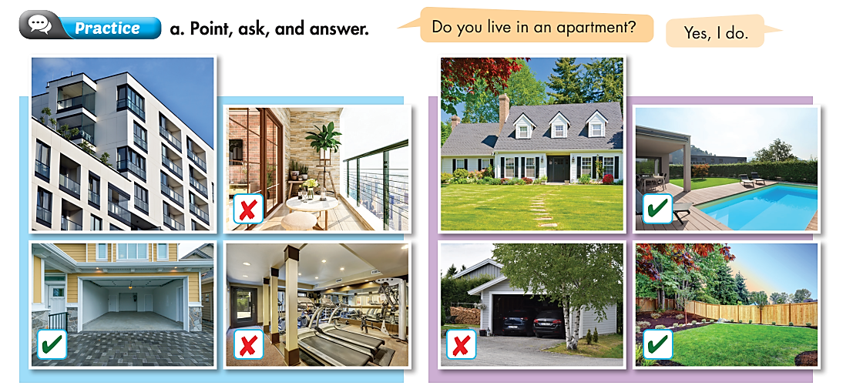
An apartment
A balcony
A house
A pool
A garage
A gym
A garage
A yard
Tiếng Anh 6 i-Learn Smart World

Slide 12
Yes, it does.
Does it have a ____?
No, it doesn’t.
Tiếng Anh 6 i-Learn Smart World

Slide 13
Use your own ideas
Yes, it does.
Does it have a ____?
No, it doesn’t.
Tiếng Anh 6 i-Learn Smart World

Slide 14

Speaking

Slide 15
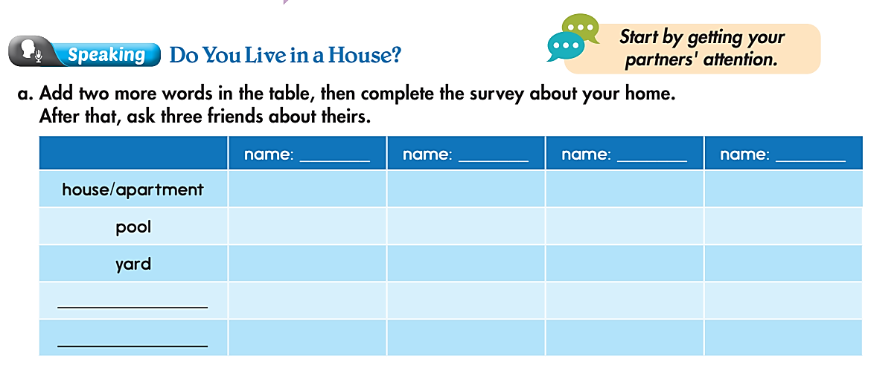
Pre-Speaking
A balcony
you
A garage
A gym
Do you live in a ____?
Yes, I do.
No, I don’t.
Does it have a ____?
Yes, it does.
No, it doesn’t.
Tiếng Anh 6 i-Learn Smart World

Slide 16
Pre-Speaking
you
Do you live in a ____?
Yes, I do.
No, I don’t.
Does it have a ____?
Yes, it does.
No, it doesn’t.
Tiếng Anh 6 i-Learn Smart World

Slide 17
Post-Speaking
b. Report to the class about your group.
In our group, two people live in houses.
Two people live in apartments.
Three people have balconies.
…………………………..
…………………………..
…………………………..
Tiếng Anh 6 i-Learn Smart World

Slide 18
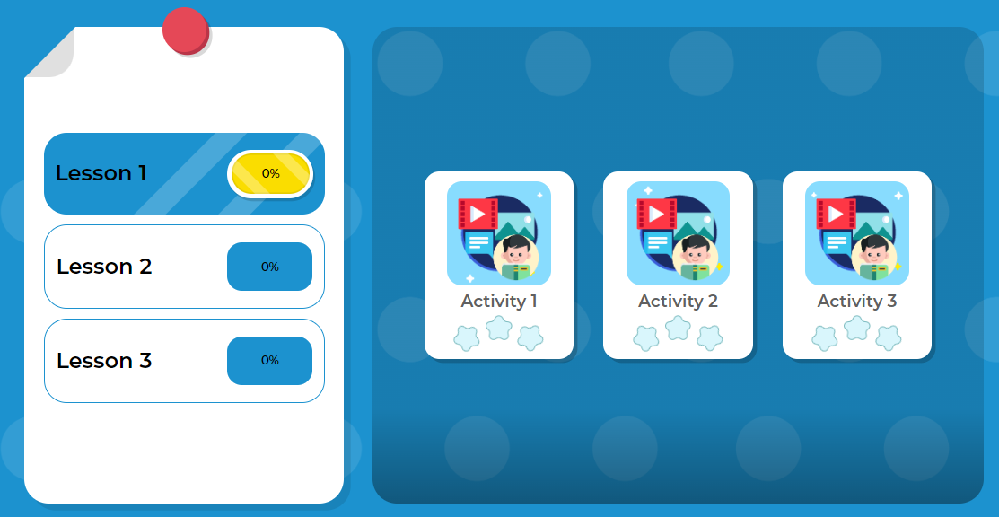
Extra Practice
DHA on Eduhome
Click here to play the game
Tiếng Anh 6 i-Learn Smart World

Slide 19

CONSOLIDATION
Tiếng Anh 6 i-Learn Smart World

Slide 20
Write a short paragraph about your friend’s house,
using the information you have. Write about 30-50 words.
Example:
A lives in a/ an …………
It has a ………..
It doesn’t have a …………..
Tiếng Anh 6 i-Learn Smart World

Slide 21

WRAP-UP

Slide 22
Today’s lesson
Speaking:
- rise intonation at the end of Y/N questions;
- ask and answer about our houses.
Tiếng Anh 6 i-Learn Smart World

Slide 23
Homework
Review the vocabulary and grammar notes in Tiếng Anh 6 i-Learn Smart World Notebook.
Play the consolation games in Tiếng Anh 6 i-Learn Smart World DHA App on www.eduhome.com.vn.
Prepare the next lesson (page 9 - SB).
Tiếng Anh 6 i-Learn Smart World

Slide 24

Enjoy your day!

