Slide 1
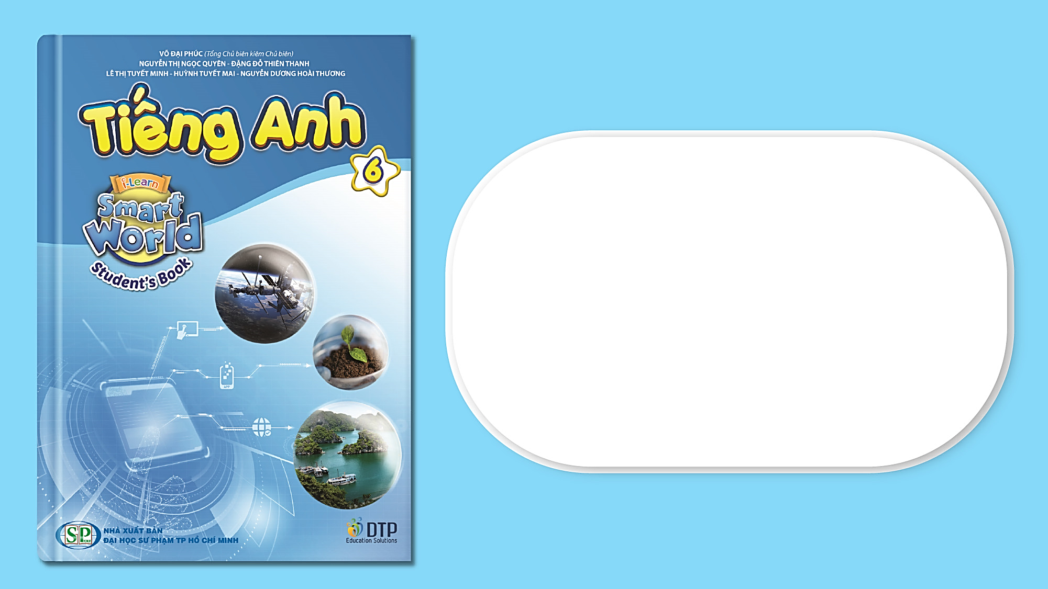
Unit 1: Home
Lesson 1.2: Grammar
Student’s Book - Page 7

Slide 2
Lesson Outline
Warm-up
Grammar
Consolidation
Wrap-up

Slide 3
Objectives
By the end of this lesson, students will be able to…
Use the Present Simple tense correctly.

Slide 4

WARM-UP

Slide 5

Work in pairs. Ask and answer.
Where do you live?
I live in a house.
Yes, it does./
No, it doesn’t.
Does it have a yard?

Slide 6

GRAMMAR
Present Simple tense
Presentation

Slide 7
FORM:
BE
(+) S + am/ is/ are + ….
(-) S + am/ is/ are + not ….
(?) Am/ Is/ Are + S + ….?
Yes, S + am/ is/ are.
No, S + am/ is/ are + not.
Ex: He is a student.
They are not desks. They are tables.
Are you a doctor? - No, I am a student.

Slide 8
FORM:
(+) S+ V₁^{s/es}.
(-) S + do/ does + not + V_{inf}….
(?) Do/ Does + S + V_{inf}….?
(?) Wh + do/ does + S + V_{inf}….?
Yes, S + do/ does.
No, S + do/ does + not.
S + V₁^{s/es}.
Ex: She does exercise every morning.
They don’t have a house.
Do you like cats? - Yes, I do.
Where does he live? - He lives in an apartment.

Slide 9
USAGE:
We use the Present Simple tense to talk about things that are facts or are true for a long time.
SIGNALS:
always, usually, often, rarely…
once, twice, … times,…
every….

Slide 10

Practice

Slide 11
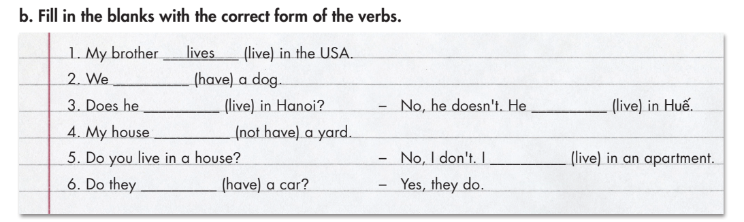
have
live
lives
doesn’t have
live
have

Slide 12
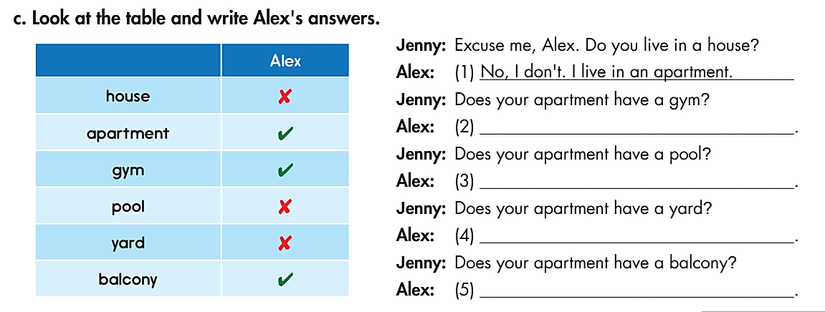
Now, practice the conversation with your partner.
Yes, it does.
No, it doesn’t.
No, it doesn’t.
Yes, it does.

Slide 13
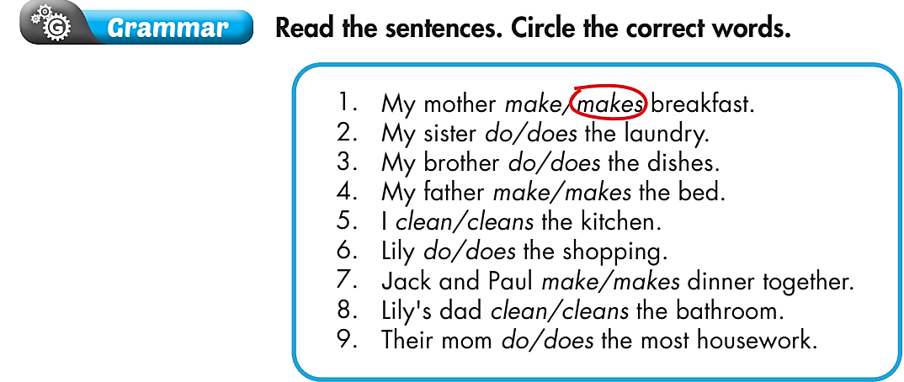
Extra Practice
WB page 5

Slide 14

Production

Slide 15

Work in pairs. Ask and answer, using the cues.
A. Hi, B. you/ live/ apartment?
B. Hello A. No, I/ not. I/ live/ house.
A. it/ have/ pool?
B. Yes.
A. it/ have/ gym?
B. No.
A. it/ have/ yard?
B. Yes.

Slide 16

CONSOLIDATION

Slide 17
Work in groups: Talk about your house/ apartment.
Use the grammar point:
  Present Simple tense.

Slide 18
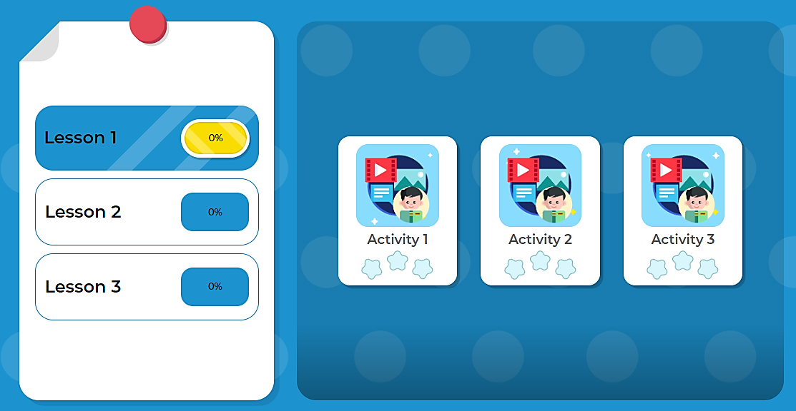
Click here to play the game

Slide 19

WRAP-UP

Slide 20
Today’s lesson
Grammar
The Present Simple tense

Slide 21
Homework
Review the grammar and practice using them.
Do the exercise(s) in Tiếng Anh 6 i-Learn Smart World Workbook (page 5).
Complete the grammar notes in Tiếng Anh 6 i-Learn Smart World Notebook (page 3).
Play the consolation games in Tiếng Anh 6 i-Learn Smart World DHA App on www.eduhome.com.vn.
Prepare the next lesson (page 8 - SB).

Slide 22

Enjoy your day!

