Slide 1

Unit 1: Home
Lesson: Review
Student’s Book - Pages 86 & 87

Slide 2
Lesson Outline
Warm-up
Listening
Reading
Vocabulary
Grammar
Pronunciation
Consolidation
Wrap-up

Slide 3
Objectives
By the end of this lesson, students will be able to…
- review vocabularies and grammar points;
- Review the sounds /ɪ/ and other vowels;
- practice test taking skills for listening and reading.

Slide 4

WARM-UP

Slide 5
Find as many words as you can
A | O | C | Z | H | T | U | O | S | U
W | C | L | I | Y | Q | V | H | K | B
P | W | E | S | T | Z | Y | Q | T | E
D | H | A | N | I | Y | H | S | I | D
I | O | N | O | T | Y | A | R | D | N
N | A | K | R | I | E | S | Z | J | E
N | J | L | T | C | F | R | Z | T | K
E | N | I | H | O | U | S | E | S | A
R | B | A | L | C | O | N | Y | Y | M
M | M | Y | R | D | N | U | A | L | Z

Slide 6
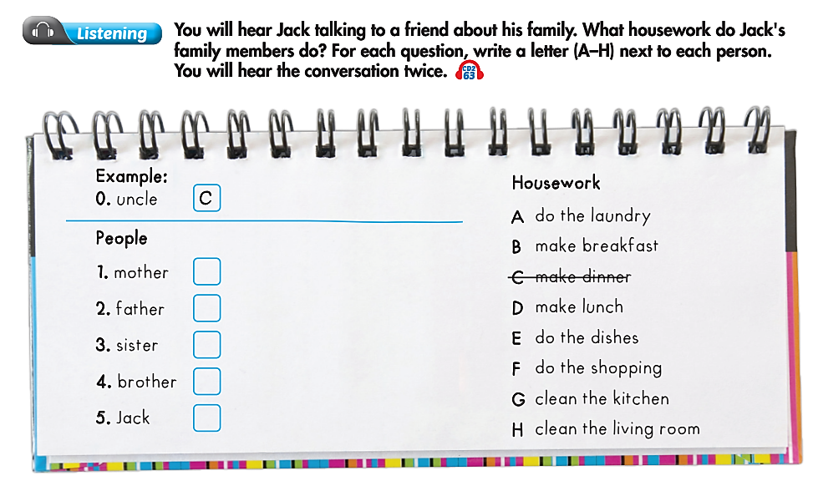

Slide 7

A
F
G
E
B

Slide 8
TAPESCRIPT
Emma: Who do you live with, Jack?
Jack: I live with my father, mother, brother, sister, and uncle.
Emma: You have a big family! Do you all help with housework?
Jack: Yes, we do.
Emma: Really? What does your uncle do?
Jack: He makes dinner. He's a great cook!
Emma: Cool! How about your mother? Does she cook?
Jack: No, she doesn't. She does the laundry.
Emma: I see. How about your father?
Jack: Well, he does the shopping. He helps my sister with housework, too. She's only five.
Emma: She does housework?
Jack: Yeah, she cleans the kitchen.
Emma: Wow! What about your brother? What housework does he do?
Jack: He does the dishes.
Emma: How about you?
Jack: I make breakfast. I like cooking.

Slide 9
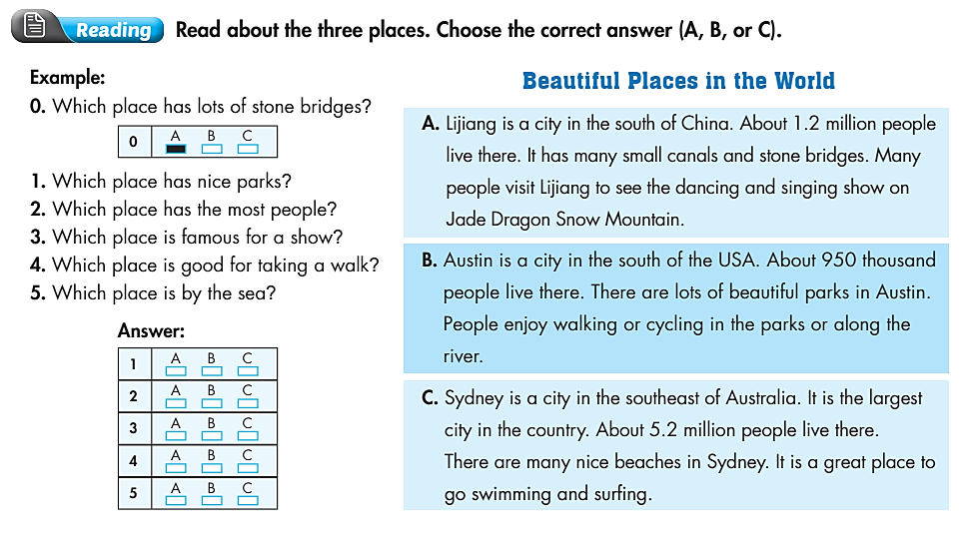

Slide 11
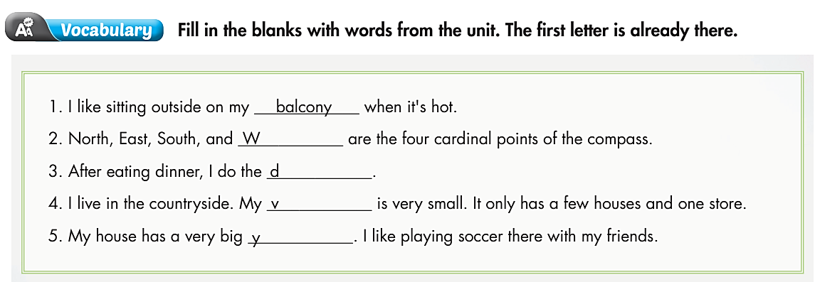

Slide 12
EST
ISHES
ILLAGE
ARD

Slide 13
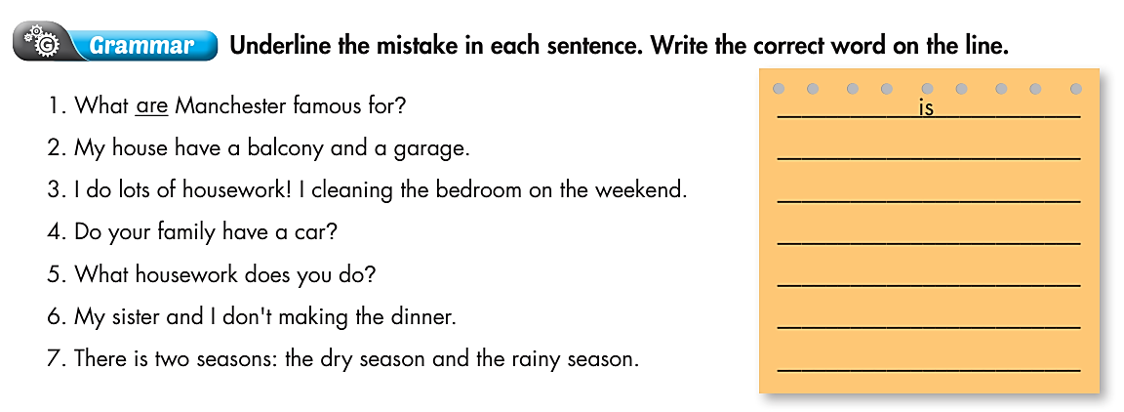

Slide 14
HAS
CLEAN
DOES
DO
MAKE
ARE

Slide 15
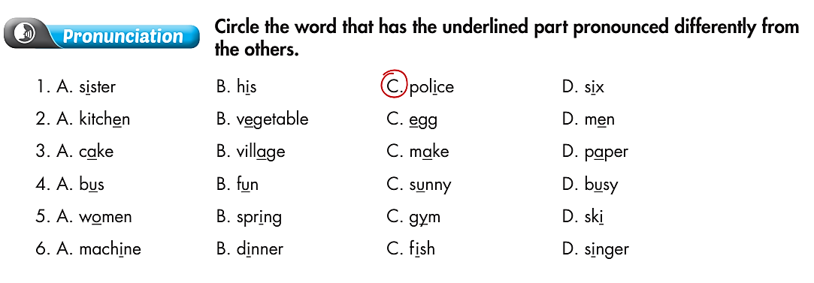

Slide 17

CONSOLIDATION

Slide 18
MAKE SENTENCES WITH THREE OF THE WORDS
YOU FOUND IN WARM-UP ACTIVITY.

Slide 19

WRAP-UP

Slide 20
Today’s lesson
Reading & Listening:
- Understand instructions
- Practice reading and listening for general and specific information
Pronunciation:
- Practice recognizing some vowels
Grammar:
- Review Present Simple tense

Slide 21
Homework
Do the exercise(s) in Tiếng Anh 6 i-Learn Smart World Workbook (page 62).
Play the consolation games in Tiếng Anh 6 i-Learn Smart World DHA App on www.eduhome.com.vn.
Prepare the next lesson (page 14 - SB).

Slide 22

Enjoy your day!

