Slide 1

Unit 1: Home
Lesson 3.2: Reading, Speaking,
& Writing
Student’s Book - Page 13

Slide 2
Lesson Outline
Warm-up
Reading
Speaking
Writing
Consolidation
Wrap-up

Slide 3
Objectives
By the end of this lesson, students will be able to…
- read for specific information;
- ask and answer about hometown;
- write a paragraph about hometown.

Slide 4

WARM UP

Slide 5

Ask and answer
1. Where do you live?
In a village/ town/ city.
2. Is it big or small?
It’s big/ small.
3. What do you like about it?
It’s convenient/ peaceful/ beautiful…

Slide 6

Reading

Slide 7
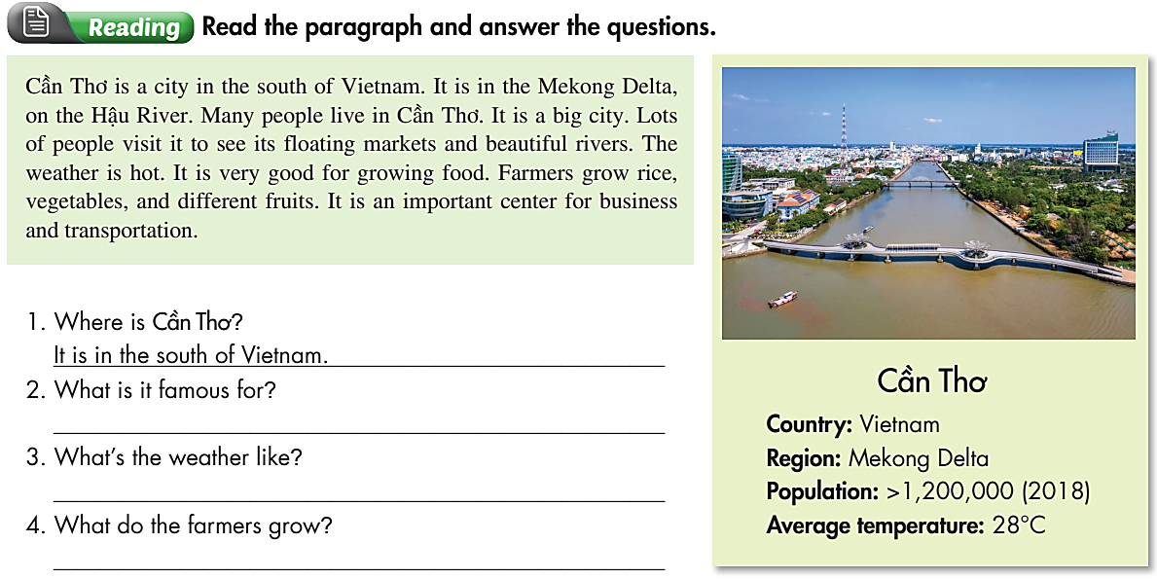
Pre-Reading

Slide 8
While-
Reading
It is famous for its floating markets and beautiful rivers.
It is hot.
They grow rice, vegetables, and different fruits.

Slide 9
Post-Reading
Talk about Cần Thơ city, using these information.
SOUTH OF VIET NAM
ON THE HẬU RIVER
CẦN THƠ
BIG
RICE, VEGETABLES, FRUITS
FLOATING MARKETS, BEAUTIFUL RIVER

Slide 10
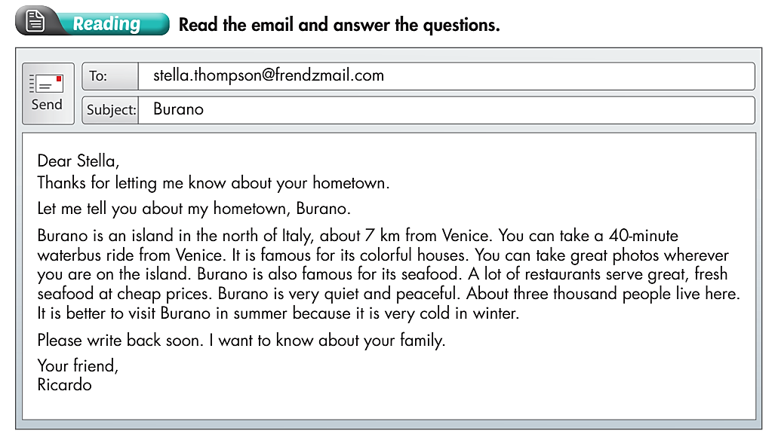
Extra Practice
WB page 7

Slide 11
Extra Practice
WB page 7

Slide 12
1. Where is Burano?
2. How can you get to Burano?
______________________________________________
3. What is Burano famous for?
______________________________________________
4. How many people live there?
______________________________________________
5. When is the best time to visit Burano?
______________________________________________
→ It's in the north of Italy.
→ We can take a 40-minute waterbus ride from Venice.
→ Burano is famous for its colorful houses and seafood.
→ About three thousand people live there.
→ The best time to visit Burano is summer.

Slide 13

Speaking

Slide 14
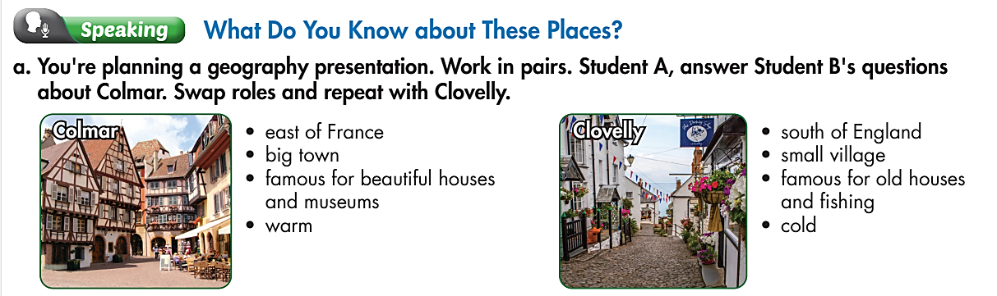
Pre-Speaking
1. Where is it?
3. What is it famous for?
2. Is it big or small?
4. What’s the weather like there?

Slide 15
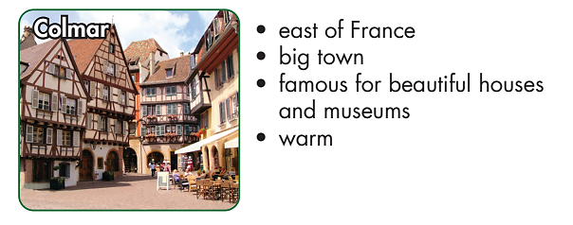
While-Speaking
1. Where is it?
3. What is it famous for?
2. Is it big or small?
4. What’s the weather like there?

Slide 16
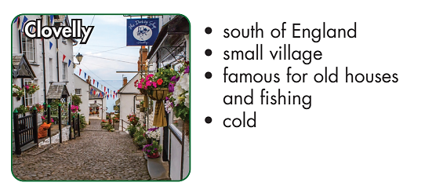
While-Speaking
1. Where is it?
3. What is it famous for?
2. Is it big or small?
4. What’s the weather like there?

Slide 17

Post-Speaking

Slide 18

Writing

Slide 19
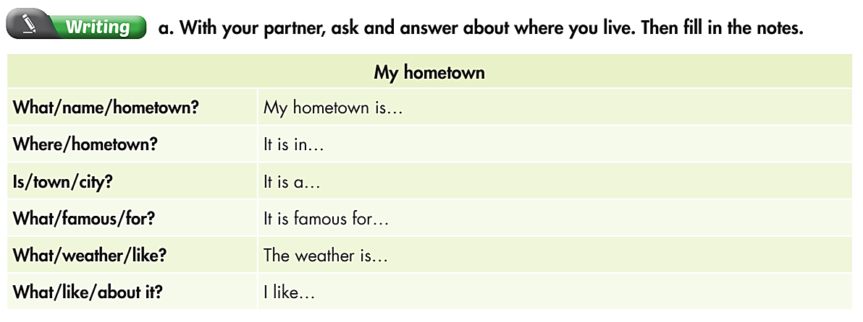
Pre-Writing
What is the name of your hometown?
Where is your hometown?
Is it a town or a city?
What is it famous for?
What’s the weather like there?
What do you like about it?

Slide 20
While-Writing
Use your notes to write a paragraph about your hometown. Use the Reading to help you.
Write 40 to 50 words.
My hometown is………..

Slide 21
Post-Writing
Present your writing to the class.

Slide 22
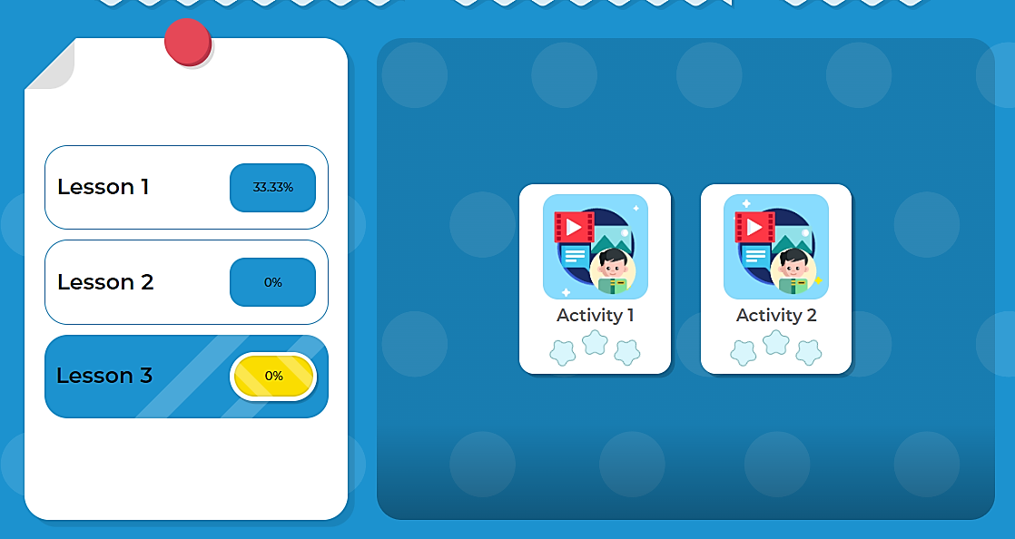
Click here to play the game

Slide 23

CONSOLIDATION

Slide 24
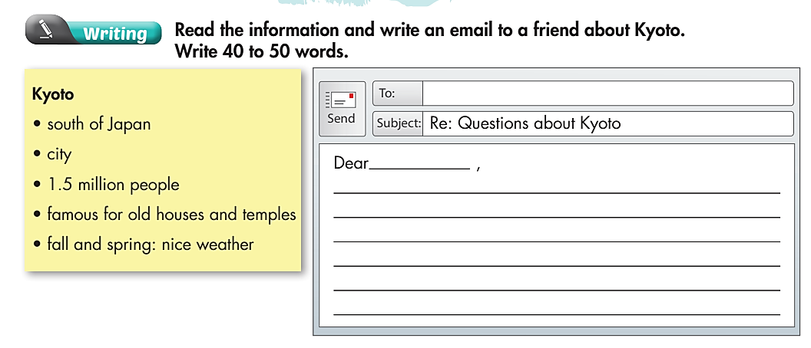

Slide 25

WRAP-UP

Slide 26
Today’s lesson
Structures/ Sentence patterns
What is the name of your hometown?
Where is your hometown?
Is it a town or a city?
What is it famous for?
What’s the weather like there?
What do you like about it?

Slide 27
Homework
Do the exercise(s) in Tiếng Anh 6 i-Learn Smart World Workbook (page 7).
Complete the writing notes in Tiếng Anh 6 i-Learn Smart World Notebook (page 7).
Play the consolation games in Tiếng Anh 6 i-Learn Smart World DHA App on www.eduhome.com.vn.
Prepare the next lesson (page 86 & 87 - SB).

Slide 28

Enjoy your day!

