Slide 1
Unit 3 Community service
Lesson 4: Communication

Slide 2
OBJECTIVES
After this lesson, students will be able to:
Give compliments.
Talk about benefits of community activities.

Slide 3
Everyday conversation
01

Slide 4
When somebody do good job, what will you tell him/ her?
3 minutes.
Note down as many answers as possible.
You’re amazing!
Good job!

Slide 5
https://youtu.be/-Hmai4_R5AQ
https://youtu.be/50mYb_WNgSk

Slide 6
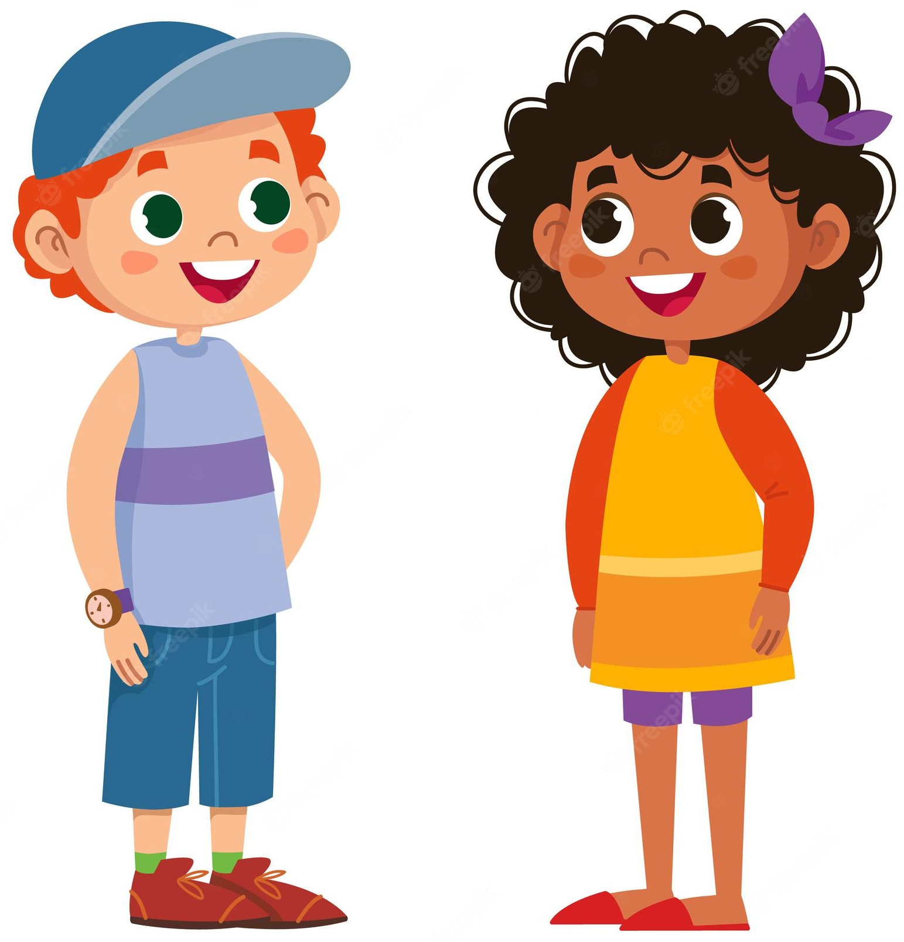
1. Listen and read the dialogue between Lan and Mark. Pay attention to the highlighted parts.
We planted some trees in the schoolyard and picked up a lot of rubbish along the nearby roads.
Mark
Lan
What did you do to help your community last summer, Mark?
Sounds like great work! We collected books and warm clothes for our friends in the mountainous areas.
Wonderful!
Sounds like great work!
Wonderful!
Give compliments.

Slide 7
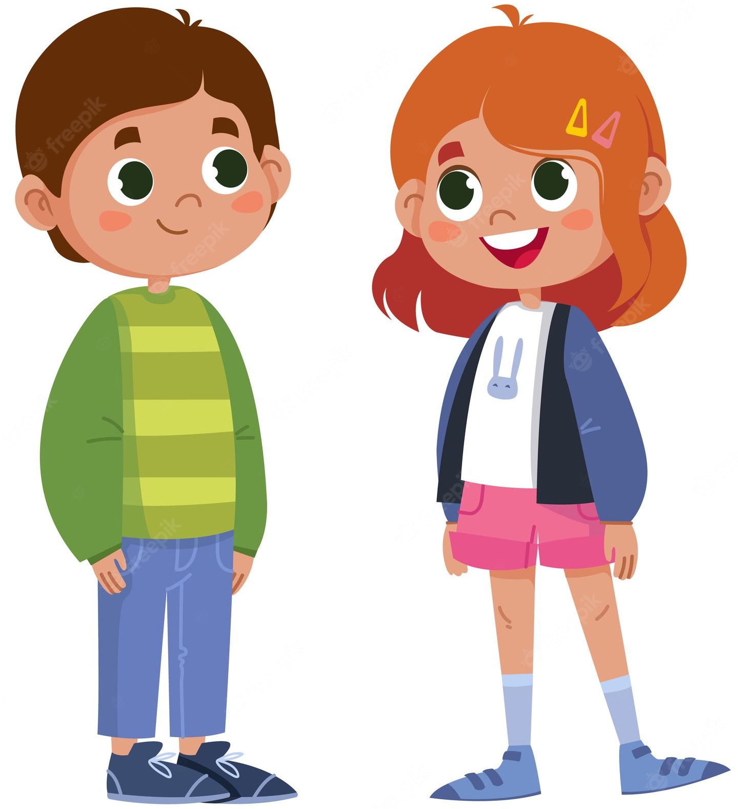
2. Work in pairs. Make similar conversations.
1. Mi helped lonely elderly people. 2. Tom and his friends cleaned and decorated parts of their neighbourhood.
Tom
Mi
__________
What did you do to help your community last summer, _____?
Wonderful!
Sounds like great work! __________

Slide 8
Changing our neighbourhood
02

Slide 9
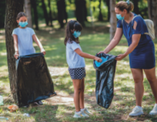
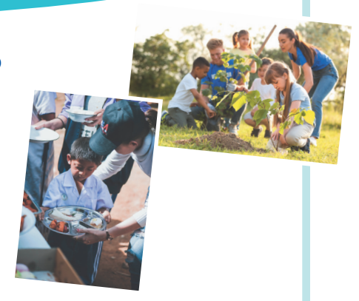
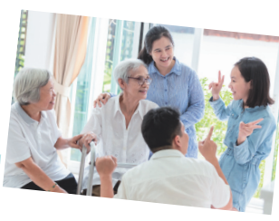
3. Work in pairs. Read the poster about the volunteer activities for teenagers at
Lending Hand.
Welcome to Lending Hand
Here are some activities you can do when you join our projects:
1. Protect the environment: – You can plant trees in your area. – You can join clean-up activities. 2. Help street children: – You can donate food and clothes. – You can teach street children to read and write. 3. Help old people: You can sing and dance with the elderly in a nursing home.

Slide 10
3. Write the project number (1 – 3) next to its benefit (A – E).
Benefits
Welcome to Lending Hand
Here are some activities you can do when you join our projects:
1. Protect the environment: – You can plant trees in your area. – You can join clean-up activities. 2. Help street children: – You can donate food and clothes. – You can teach street children to read and write. 3. Help old people: You can sing and dance with the elderly in a nursing home.
3
_____ A. making the elderly less lonely
_____ B. making the neighbourhood greener
_____ C. helping feed children
_____ D. helping children have a better future
_____ E. making the neighbourhood cleaner
1
2
2
1

Slide 11
4. Work in pair. Ask and answer which activities in Task 3 you want to join. Give reasons.
Example:
Welcome to Lending Hand
Here are some activities you can do when you join our projects:
1. Protect the environment: – You can plant trees in your area. – You can join clean-up activities. 2. Help street children: – You can donate food and clothes. – You can teach street children to read and write. 3. Help old people: You can sing and dance with the elderly in a nursing home.
Which activity do you want to join?
I want to join some clean-up activities.
Why do you want to join these activities?
Because they make the neighbourhood cleaner

Slide 12
5. Work in group .. Discuss which activity each member of your group chooses and the benefit(s) of the activity.
Example:
I want to donate food to street children because this helps feed them.
I want to join clean-up activities because these activities make our neighbourhood cleaner …

Slide 13
WRAP-UP

Slide 14
Answer these questions.
1. List at least 2 ways to give compliment.
Wonderful! Well done! Nice work! Good job!
Sounds like great work! You’re awesome!
2. List at least 2 benefits of community activities.
making the elderly less lonely
making the neighbourhood greener
helping feed children
helping children have a better future
making the neighbourhood cleaner

Slide 15
Thanks for your attention!

