Slide 1
Unit 7. Traffic
Lesson 5. Skills 1

Slide 2
Objectives
01
Reading
02
Speaking
By the end of the lesson, students will be able to:
Read for specific information about some rules about road safety
Talk about how
to avoid traffic
accidents.

Slide 3
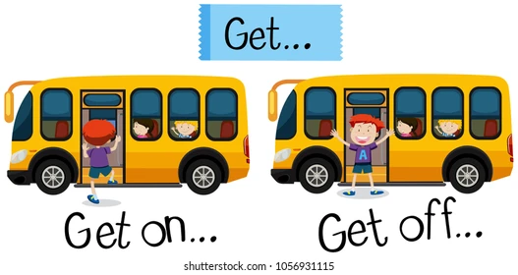
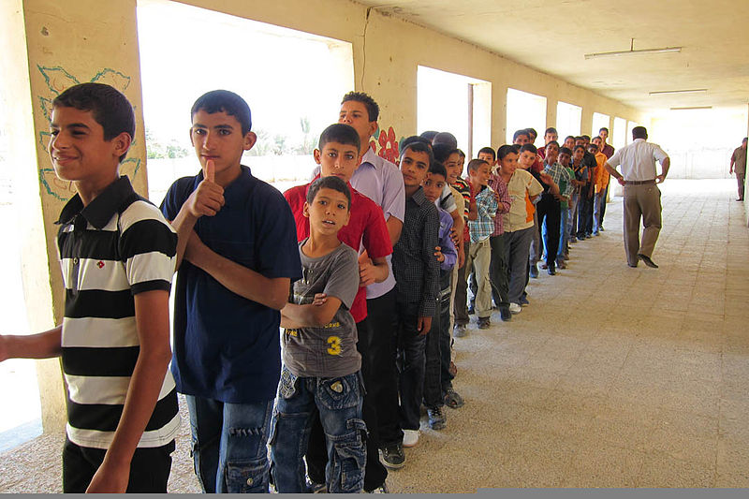
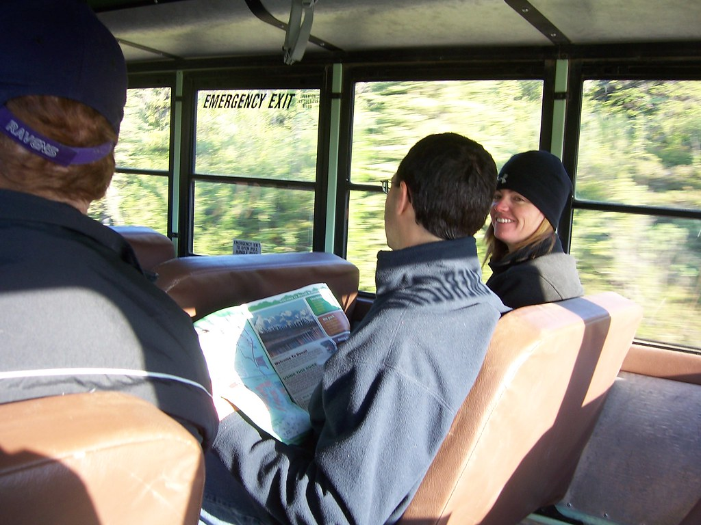
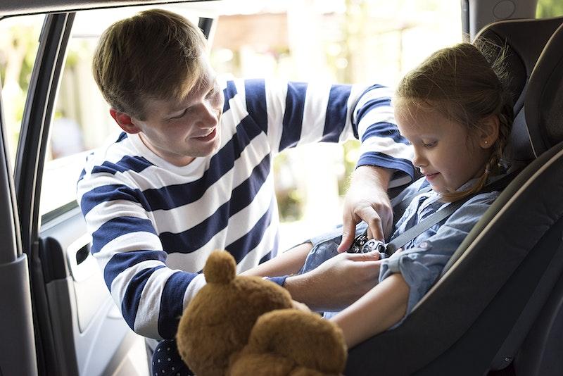
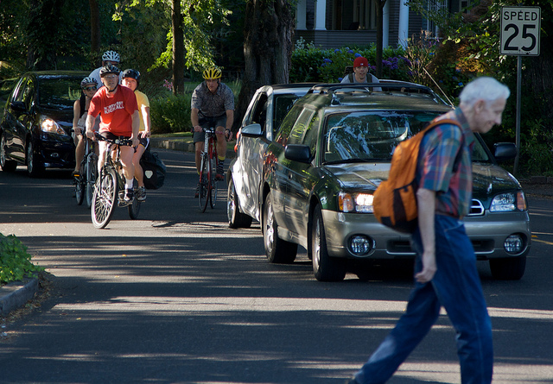
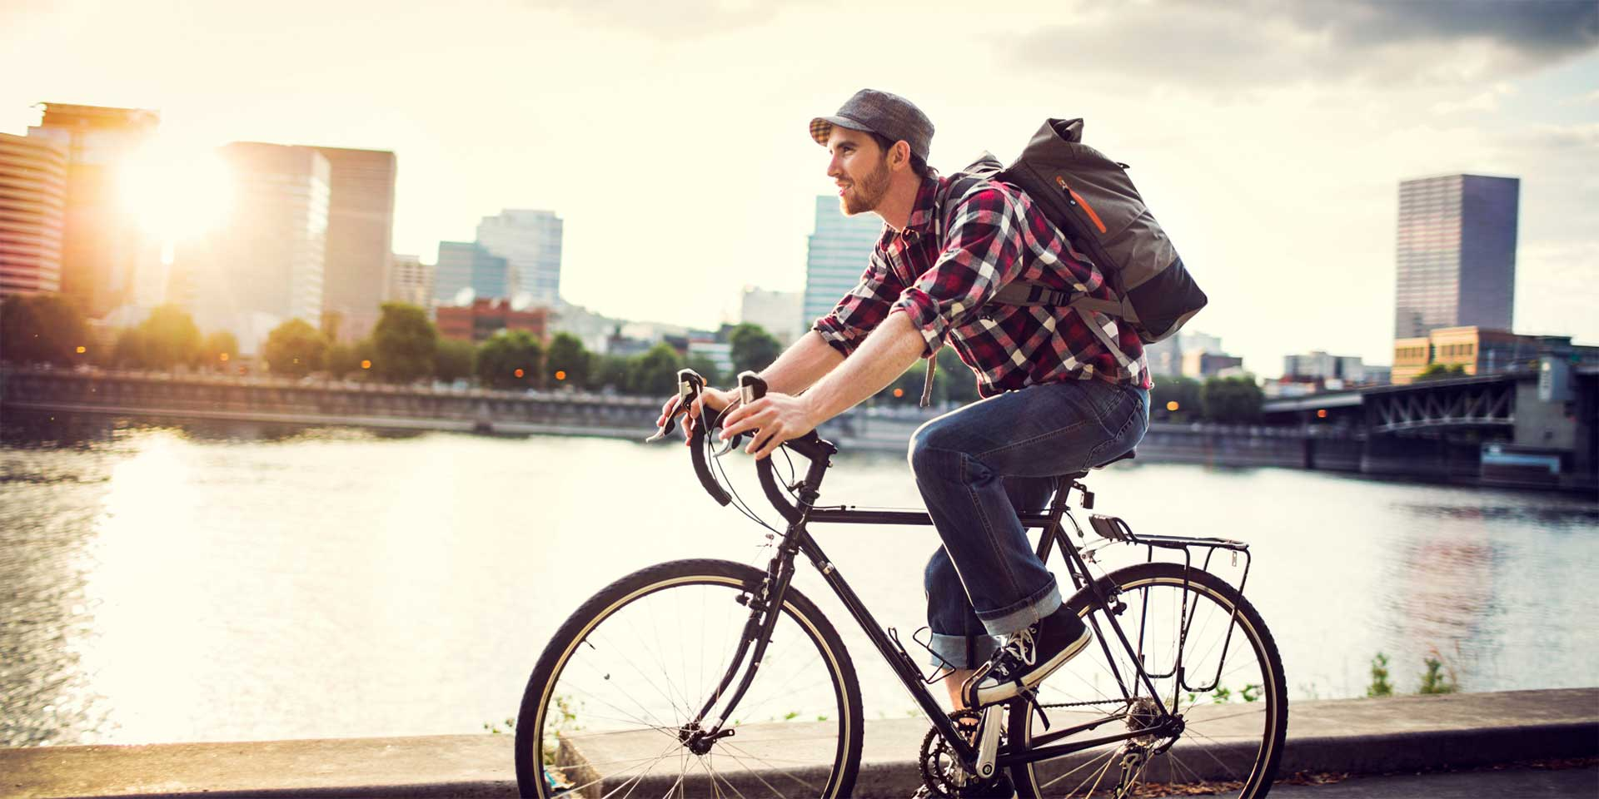
Vocabulary
người đi xe đạp
người tham gia giao thông
lên/ xuống xe
phương tiện đang di chuyển
xếp hàng
thắt dây an toàn
cyclist /ˈsaɪklɪst/ (n)
road user /rəʊd ˈjuːzə/(n.phr)
get on /off /gɛt ɒn /ɒf/ (phr.v)
moving vehicle
/ˈmuːvɪŋ ˈviːɪkl/ (n.phr)
stand in a line /stænd ɪn ə laɪn/ (v.phr)
fasten your seatbelt
/ˈfɑːsn jɔː ˈsiːtbɛlt/ (v.phr)

Slide 4
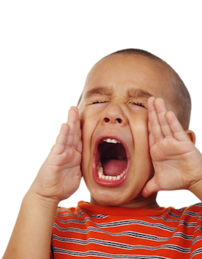
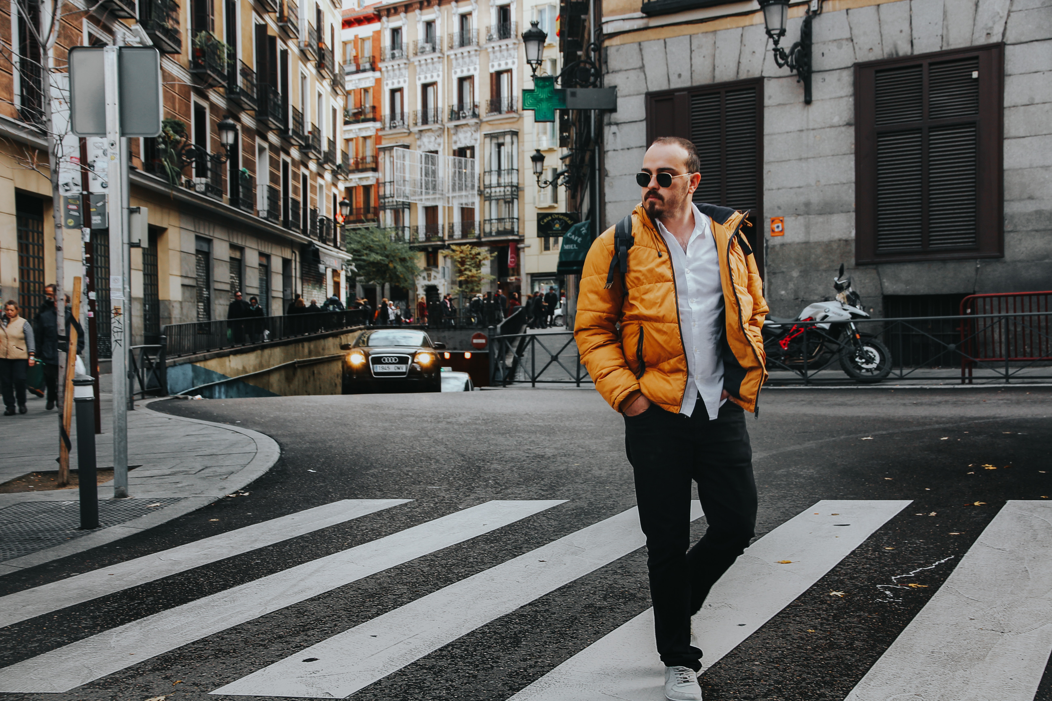
Vocabulary
dừng hoàn toàn
hành khách
dán
người đi bộ
vạch kẻ đường
la hét
fully stop / ˈfʊli stɒp/ (n.phr)
passenger /ˈpæsɪndʒə(r)/(n)
stick /stɪk/ (v)
pedestrian /pəˈdestriən/ (n)
zebra crossing /ˈziːbrə ˈkrɒsɪŋ/(n.phr)
shout /ʃaʊt/ (v)

Slide 5
Checking vocabulary
cyclist /ˈsaɪklɪst/ (n)
người đi xe đạp
người tham gia giao thông
lên/ xuống xe
phương tiện đang di chuyển
xếp hàng
thắt dây an toàn
la hét
dừng hoàn toàn
hành khách
dán
người đi bộ
vạch kẻ đường
road user /rəʊd ˈjuːzə/(n.phr)
get on /off /gɛt ɒn /ɒf/ (phr.v)
moving vehicle /ˈmuːvɪŋ ˈviːɪkl/ (n.phr)
stand in a line /stænd ɪn ə laɪn/ (v.phr)
fasten your seatbelt /ˈfɑːsn jɔː ˈsiːtbɛlt/ (v.phr)
shout /ʃaʊt/ (v)
fully stop / ˈfʊli stɒp/ (n.phr)
passenger /ˈpæsɪndʒə(r)/(n)
stick /stɪk/ (v)
pedestrian /pəˈdestriən/ (n)
zebra crossing /ˈziːbrə ˈkrɒsɪŋ/(n.phr)

Slide 6
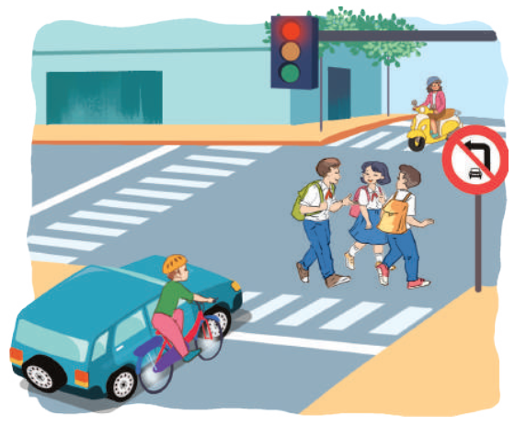
Can you see anything that is dangerous?
Ex 1. (p 78) Look at the picture and answer the question.
1. The students:
- They do not walk across the street at the zebra crossing.
- They are not paying attention to other vehicles on the road.
2. Vehicles:
- The cyclist goes too close to the car.

Slide 7
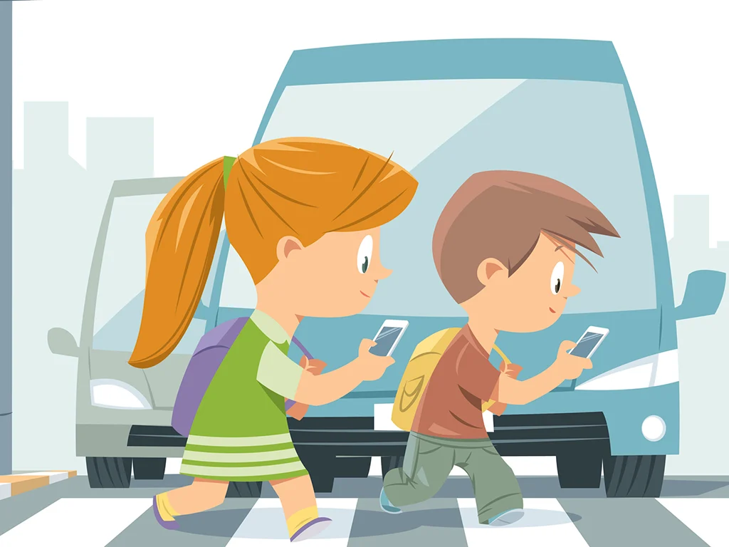
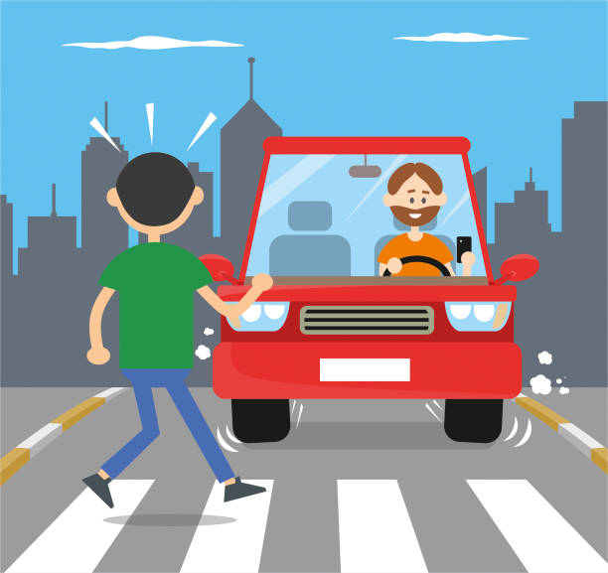
What dangers can you see on the way to school?

Slide 8
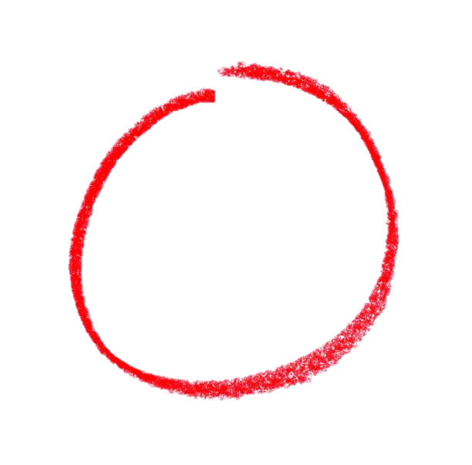
Ex 2. (p 78) Read the following text and choose the correct answer.
These are some rules about road safety. It is important to obey these rules when you are a road user.
These are some rules about road safety. It is important to obey these rules when you are a road user.
Pedestrians
1. Always look carefully when you cross the street.
2. Use the pavement or footpath.
3. Walk across the street at the zebra crossing.
4. Don't cross the road on a red light.
Pedestrians
1. Always look carefully when you cross the street.
2. Use the pavement or footpath.
3. Walk across the street at the zebra crossing.
4. Don't cross the road on a red light.
This text is about _________.
rules for pedestrians
traffic lights
traffic rules
Cyclists
1. Always keep both hands on the handlebars.
2. Wear helmets, and always use the cycle lane.
3. Give a signal before you turn.
4. Don't carry more than one passenger.
Cyclists
1. Always keep both hands on the handlebars.
2. Wear helmets, and always use the cycle lane.
3. Give a signal before you turn.
4. Don't carry more than one passenger.
Passengers
1. Fasten your seatbelt when you are in a car.
2. Wait for buses to fully stop before getting on or off.
3. Don't talk to the driver when he / she is driving.
4. Don't stick any body parts out of the window of a moving vehicle.
Passengers
1. Fasten your seatbelt when you are in a car.
2. Wait for buses to fully stop before getting on or off.
3. Don't talk to the driver when he / she is driving.
4. Don't stick any body parts out of the window of a moving vehicle.

Slide 9
Ex 3. (p 78) Read the text again and answer the question.
Ex 3. (p 78) Underline the keywords.
01
Where should pedestrians cross the street?
Where should pedestrians cross the street?
Which lane should you use when riding a bike?
02
Which lane should you use when riding a bike?
03
What should you do before you turn while riding a bike?
What should you do before you turn while riding a bike?
04
What must you do when you get on or off a bus?
What must you do when you get on or off a bus?
05
What mustn't you do when you are in a moving vehicle?
What mustn't you do when you are in a moving vehicle?

Slide 10
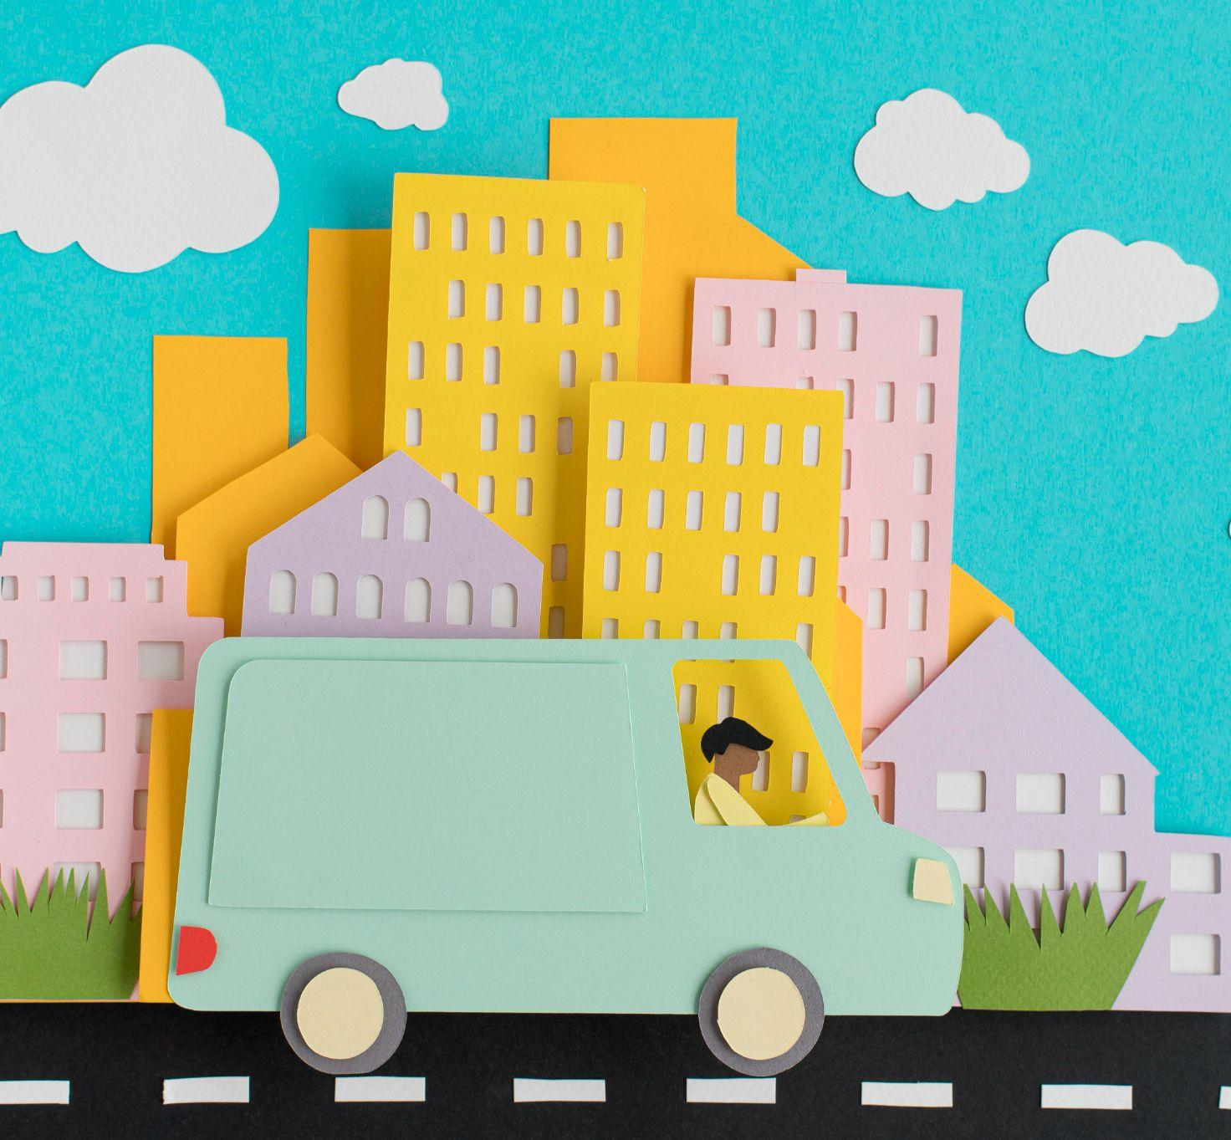
Ex 3. (p 78) Read the text again and answer the question.
Where should pedestrians
cross the street?
01
Answer: At the zebra crossing.
→ Walk across the street at the zebra crossing.

Slide 11
02. Which lane should you use when riding a bike?
Ex 3. (p 78) Read the text again and answer the question.
Answer: The cycle lane.
→ … and always use the cycle lane.

Slide 12
Ex 3. (p 78) Read the text again and answer the question.
What should you do before you turn while riding a bike?
03
Answer: Give a signal before you turn.
→… Give a signal before you turn.

Slide 13
Ex 3. (p 78) Read the text again and answer the question.
04. What must you do when you get on or off a bus?
Answer: Wait for buses to fully stop.
→…Wait for buses to fully stop before getting on or off.

Slide 14
Ex 3. (p 78) Read the text again and answer the question.
What mustn't you do when you are in a moving vehicle?
05
Answer: Don’t stick any body parts out of the window.
→…Don’t stick any body parts out of the window of a moving vehicle.

Slide 15
02
Speaking
When you are a road user, what should you NOT do?

Slide 16
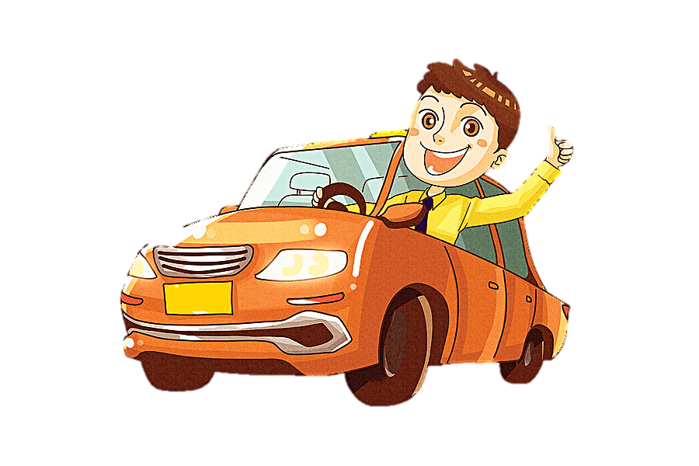
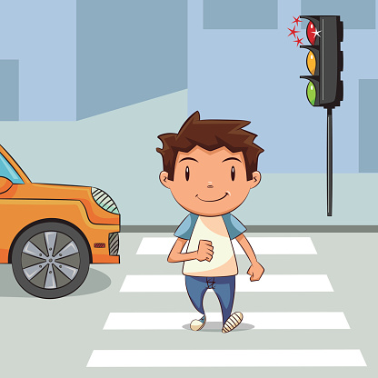
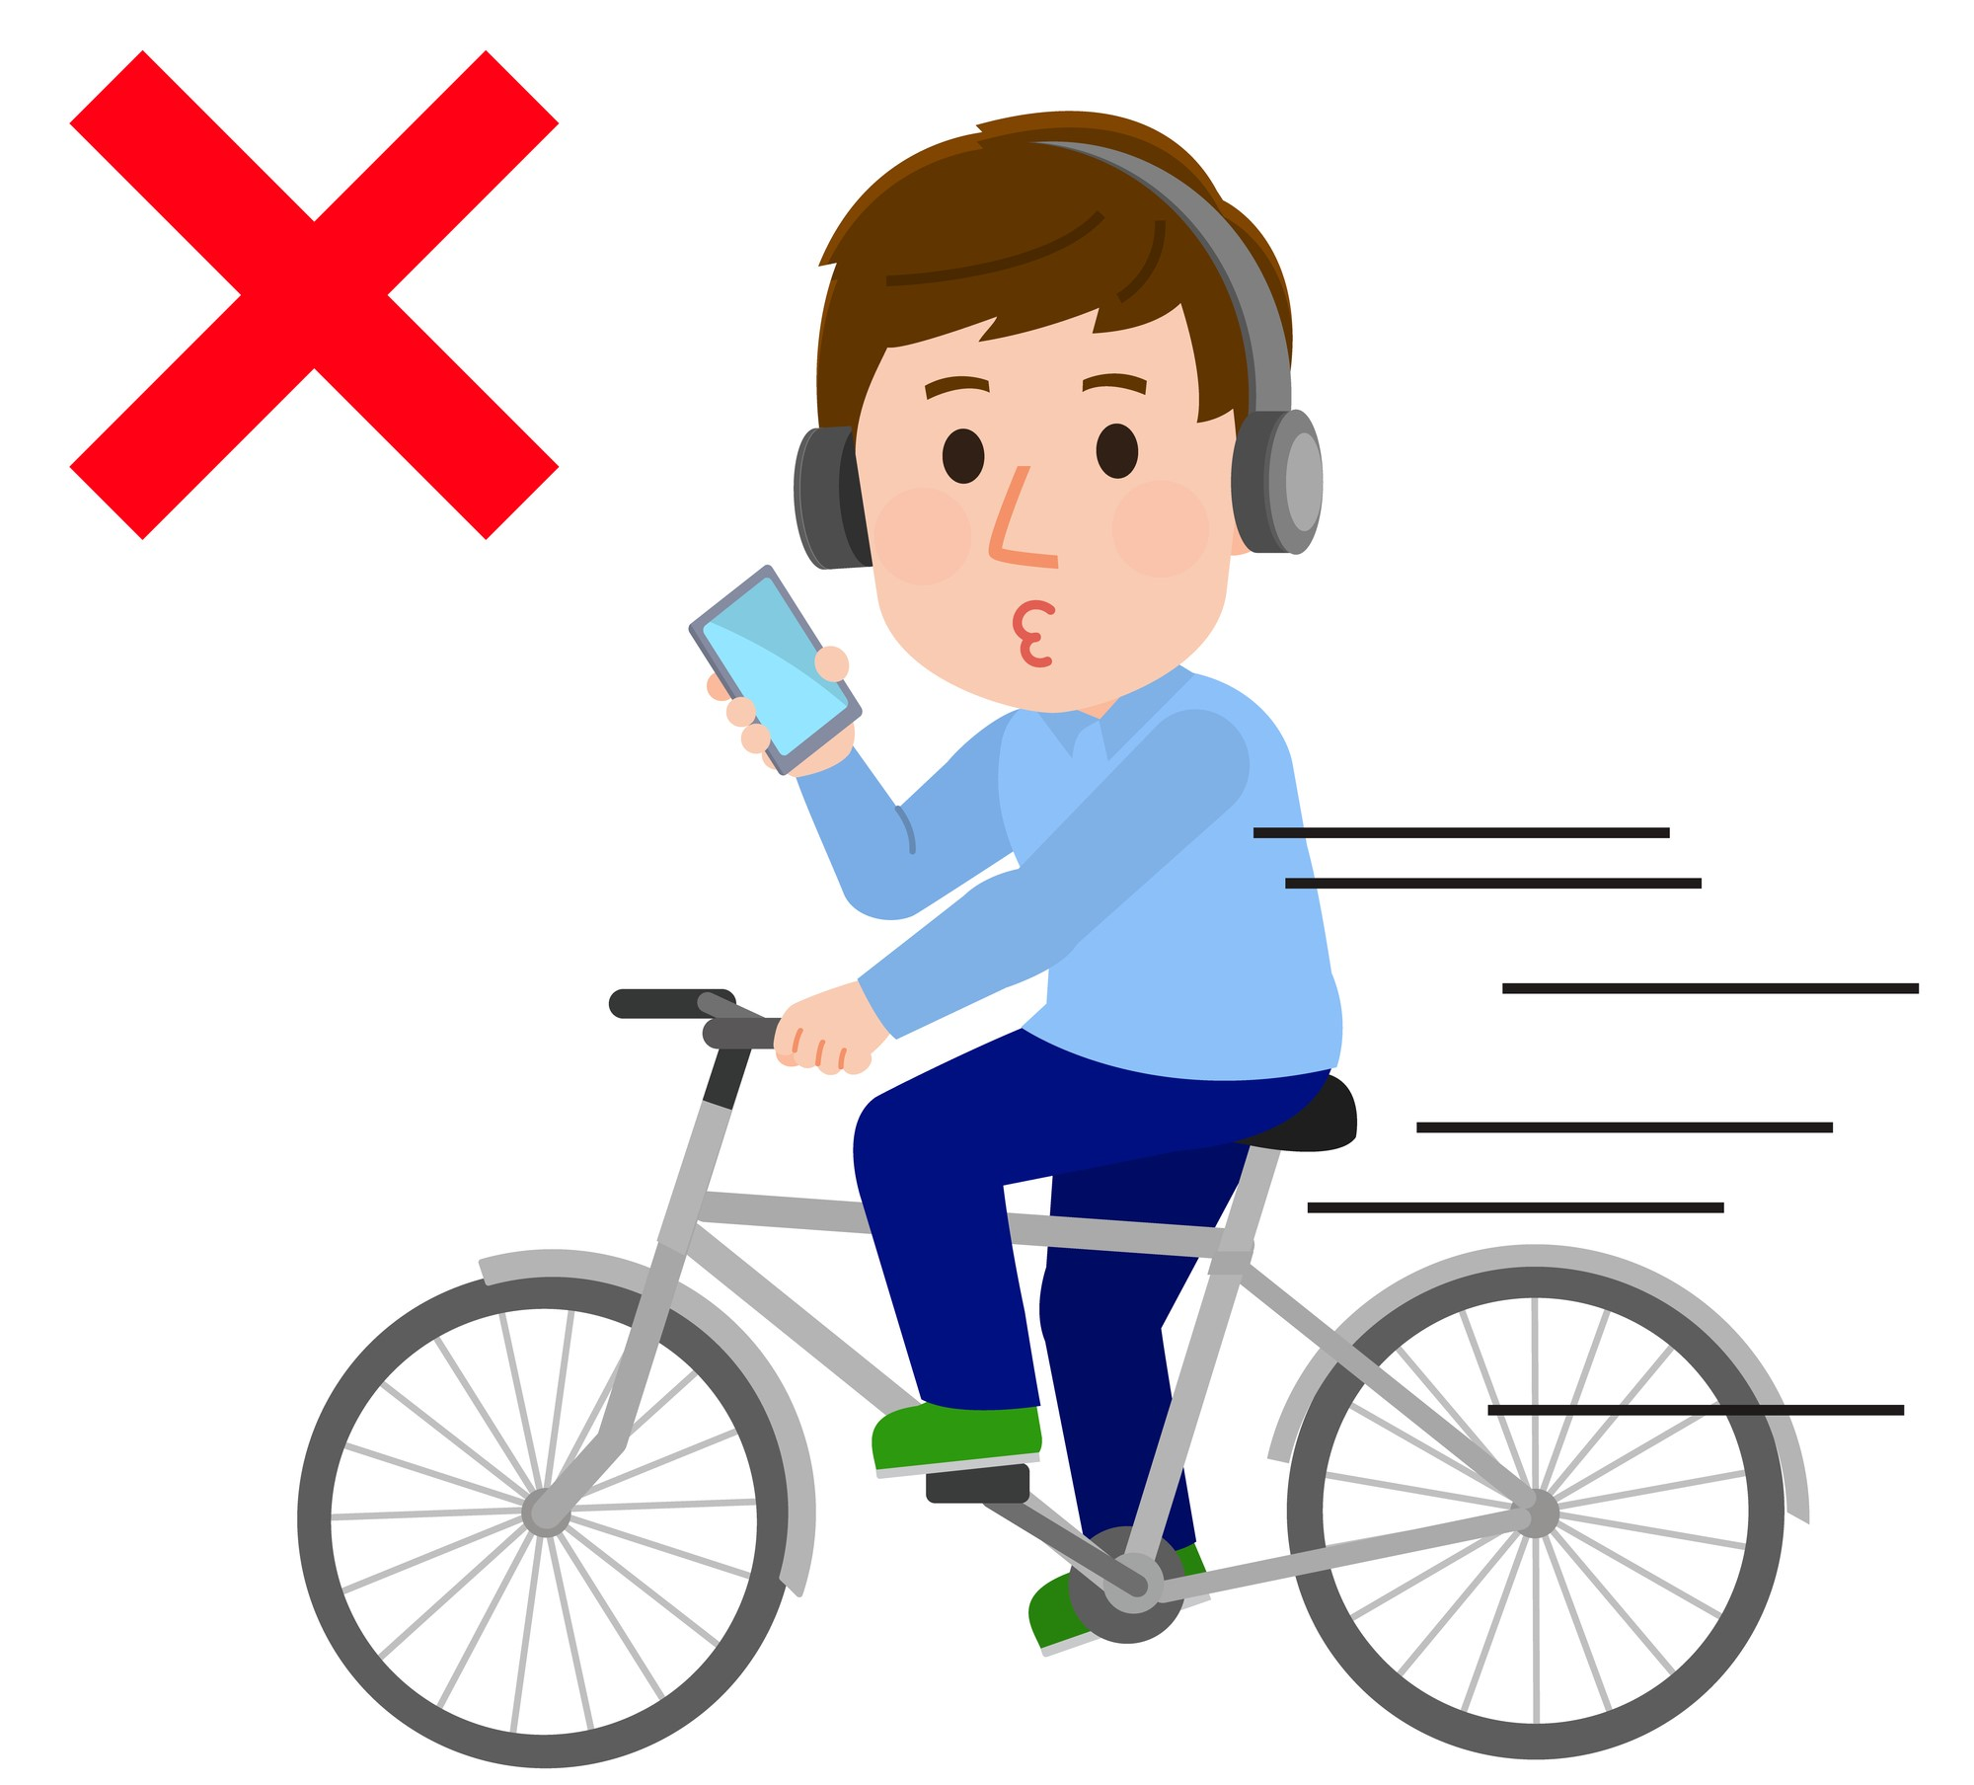
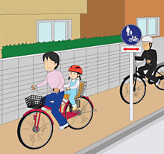
When being a road user, we had better not:
Ex 4. (p 78) Answer the following question.
Can you add more?
Don’t stick any body parts out of the window of a moving vehicle.
Cycle in the pavement or footpath.
Cross the road on a red light.
Use phone while driving.

Slide 17
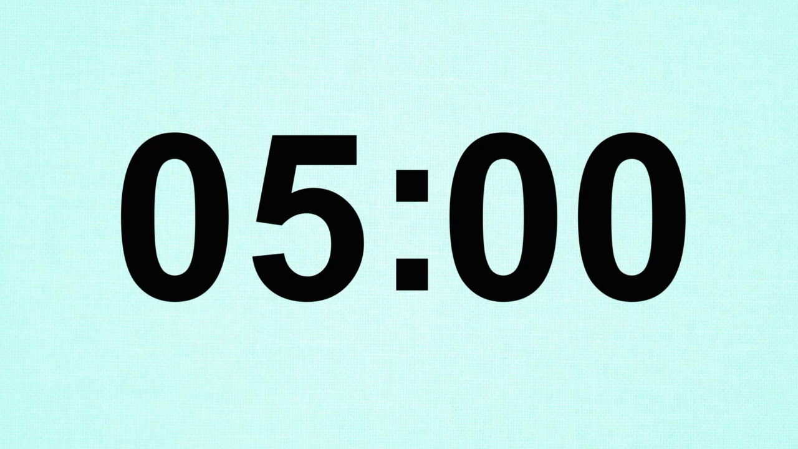
Discuss: Who is being safe, who isn’t?
Ex 5. (p 78) Work in group.
1. Hoang is riding a bike, and he is wearing a helmet.
2. It is raining hard, but Mr Long is driving quickly.
3. The students are standing in a line to get on the school bus.
4. Mr Binh is taking his daughter to school on his motorbike. She is sitting in front of him.
5. Michelle is cycling to school and she is waving and shouting to her friends.
1. Hoang is riding a bike, and he is wearing a helmet.
2. It is raining hard, but Mr Long is driving quickly.
3. The students are standing in a line to get on the school bus.
4. Mr Binh is taking his daughter to school on his motorbike. She is sitting in front of him.
5. Michelle is cycling to school and she is waving and shouting to her friends.

Slide 18

RECAP
What are the topics today?
About road safety
About how to avoid traffic accidents
About activities on the road
About traffic rules

Slide 19
RECAP
What are the correct rules?
Use the smart phone while driving.
Don’t wear helmet when you ride a bike.
Road users must stay in the right lane.
Passenger must fasten seatbelt while driving.

Slide 20
Homework

Slide 21
Thank you!

Slide 22
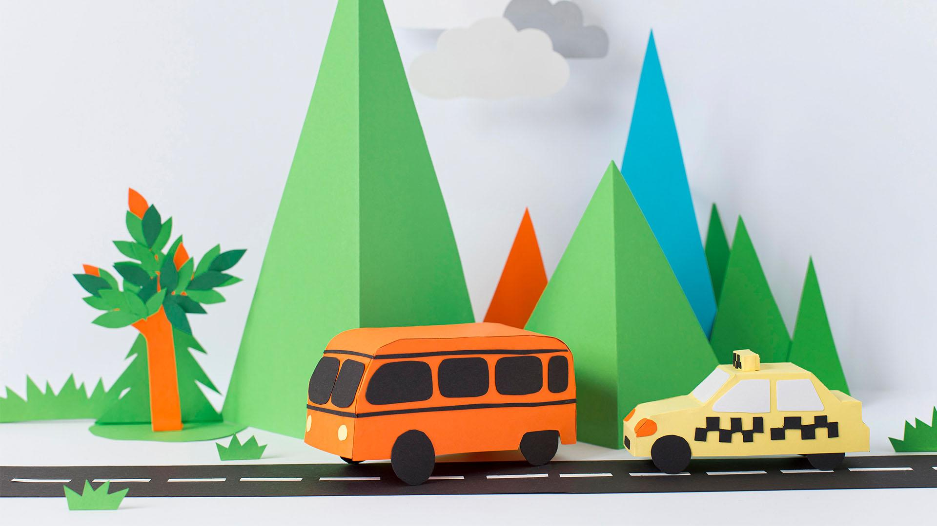
Thank you!

Slide 23
Exercise
Identify the mode of transportation and link with the correct answer:
Land
Water
Air

Slide 24
Match with the correct shadows

Slide 25
Icon pack: Vehicles and transport

Slide 26
Topic/main idea and details
Air
Modes of transport
Water
Land

Slide 27
Guess the mode of transportation
c_r
m_t_rc_cle
tr_uc_
sc_ot_r
el_ctr_c c_r
s_ilb_at
t_a_n
s_ubm_rin_

Slide 28
Alternative resources
Here’s an assortment of alternative resources whose style fits the one of this template:

