Slide 2
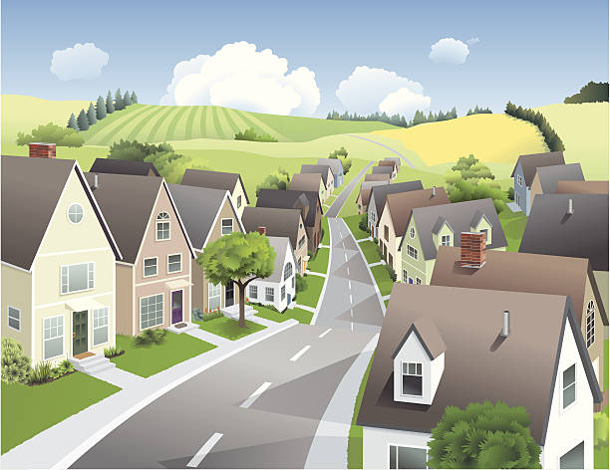
Unit
1
LOCAL COMMUNITY
LESSON 6: SKILLS 2
1

Slide 3
LESSON 6: SKILLS 2
LESSON 1: GETTING STARTED
WARM-UP
Brainstorming
Task 1: Work in pairs. Discuss the questions.
Task 2: Listen and fill in each blank with no more than two words.
Task 3: Listen again and tick T (True) or F (False).
LISTENING
Task 4: Work in pairs. Choose a community helper you like and answer the following questions.
Task 5: Write a paragraph (about 100 words) about your favourite community helper. Use the answers to the questions in 4 to help you.
WRITING
CONSOLIDATION
Wrap-up
Homework

Slide 4
WARM-UP
Who is your favourite community helper?
Why?
BRAINSTORMING

Slide 5
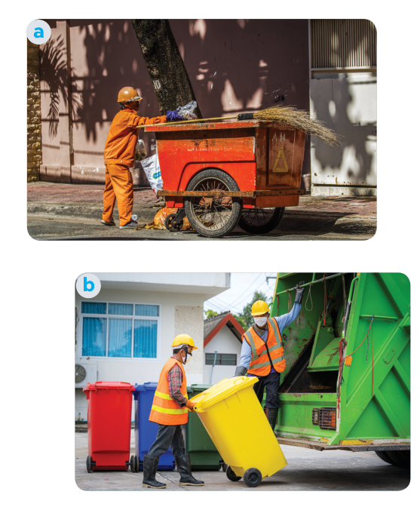
LISTENING
1
Work in pairs. Discuss the questions.
1. Who can you see in the pictures?
2. What are they doing?
We can see garbage collectors.
They are taking the garbage away.

Slide 6
LISTENING
2
Listen and fill in each blank with no more than TWO words.
1. The name of the writing contest is “My Favourite
________________”.
2. Mr Vinh is a _______________.
3. He is tall and ______.
4. He is hard-working, responsible, and ________.
Community Helper
garbage collector
slim
friendly

Slide 7
LISTENING
3
Listen again and tick T (True) or F (False).
 | T | F
1. Mr Vinh wears an orange uniform.
2. He arrives at Mi’s neighbourhoodat 9 p.m. every day.
3. He instructs people to putrubbish in two types of bins.
4. He shares information about his work and the importance of sorting rubbish.

Slide 8
WRITING
4
Work in pairs. Choose a community helper you like and answer the following questions.
- What is his / her job?
– What does he / she look like?
– What is he / she like?
– What does he / she do for the community?
– How do you feel about him / her?

Slide 9
WRITING
5
Write a paragraph (about 100 words) about your favourite community helper. Use the answers to the questions in 4 to help you.
My favourite community helper is Mr Nam. He is a delivery person in my neighbourhood. He is a friendly person. Whenever he delivers something to us, he smiles happily. He sometimes asks me about my study. In addition, he is hard-working and responsible. He delivers goods to my family and other families in the neighbourhood despite the weather. Sometimes he has to return twice to deliver us a parcel because we are not at home. I really appreciate his manner. In general, Mr Nam is a very dedicated community helper who makes our life easy and comfortable.

Slide 10
CONSOLIDATION
1
Wrap-up
What have we learnt in this lesson?
Listen for specific information about a community helper.
Write a paragraph about a community helper.

Slide 11
CONSOLIDATION
2
Homework
- Rewrite the paragraph in the notebooks.
- Do exercises in the workbook.

Slide 12
Website: hoclieu.vn
Fanpage: facebook.com/www.tienganhglobalsuccess.vn/

