Slide 1
UNIT 1
HOME

Slide 2

LESSON 7

Slide 3
WARM UP

Slide 4

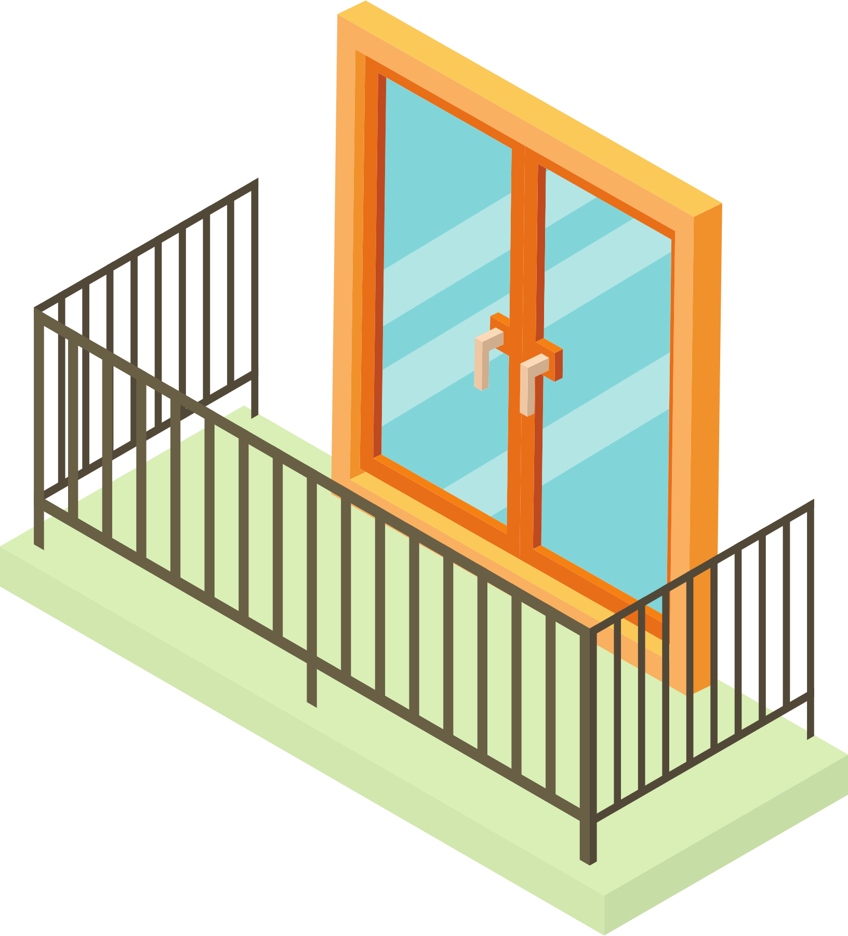
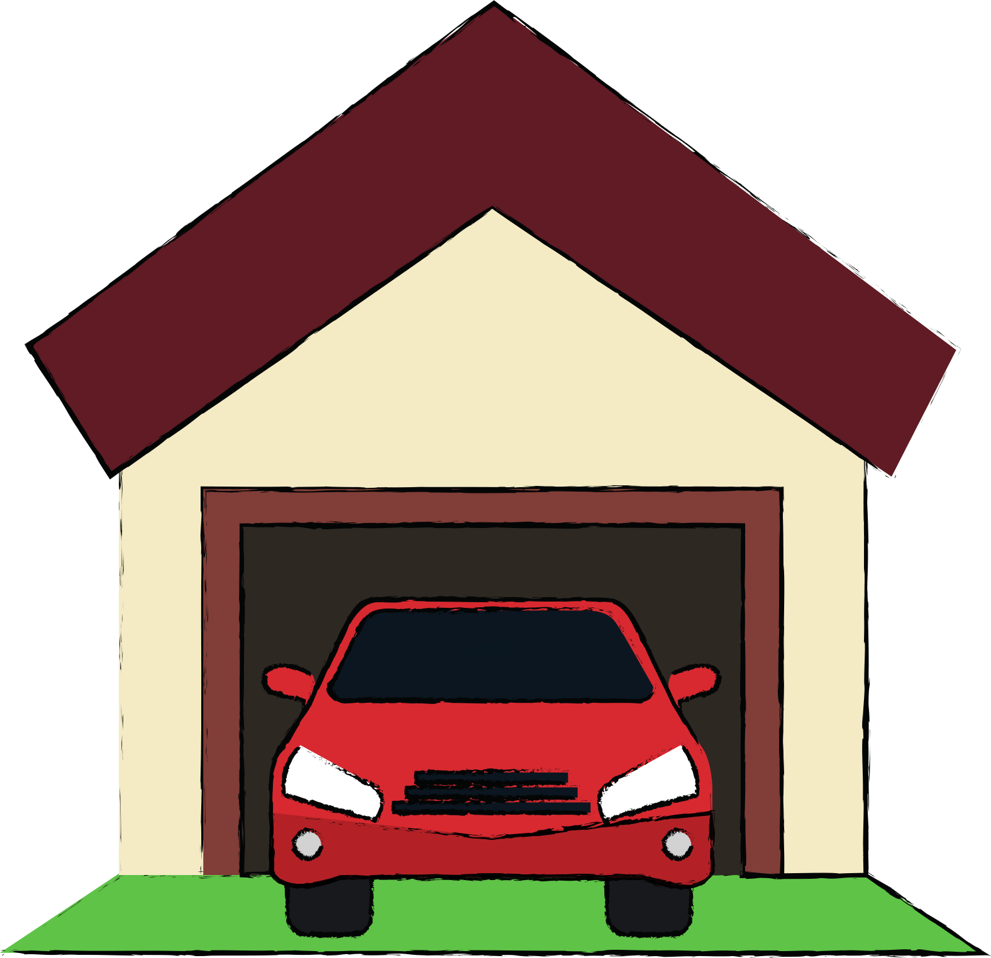

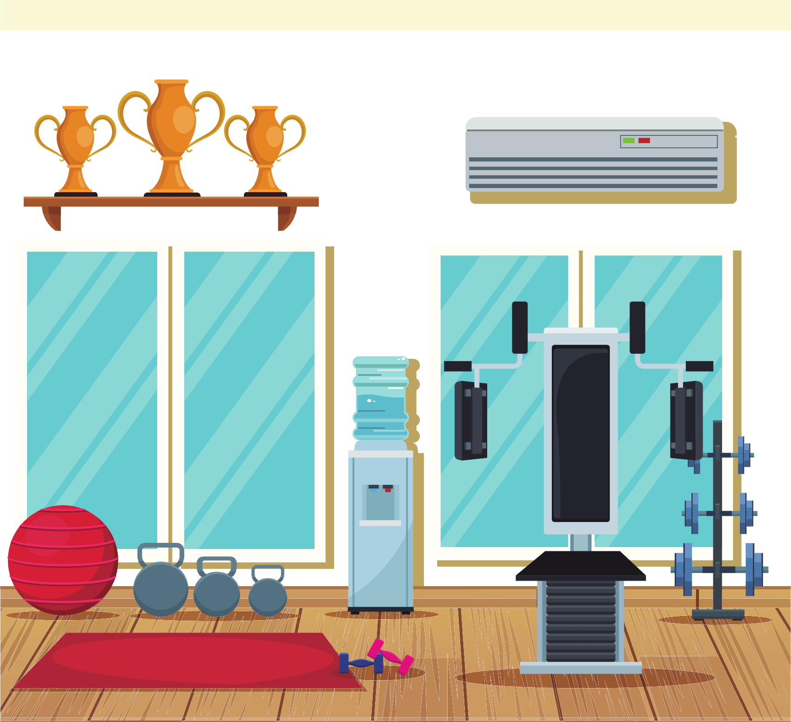
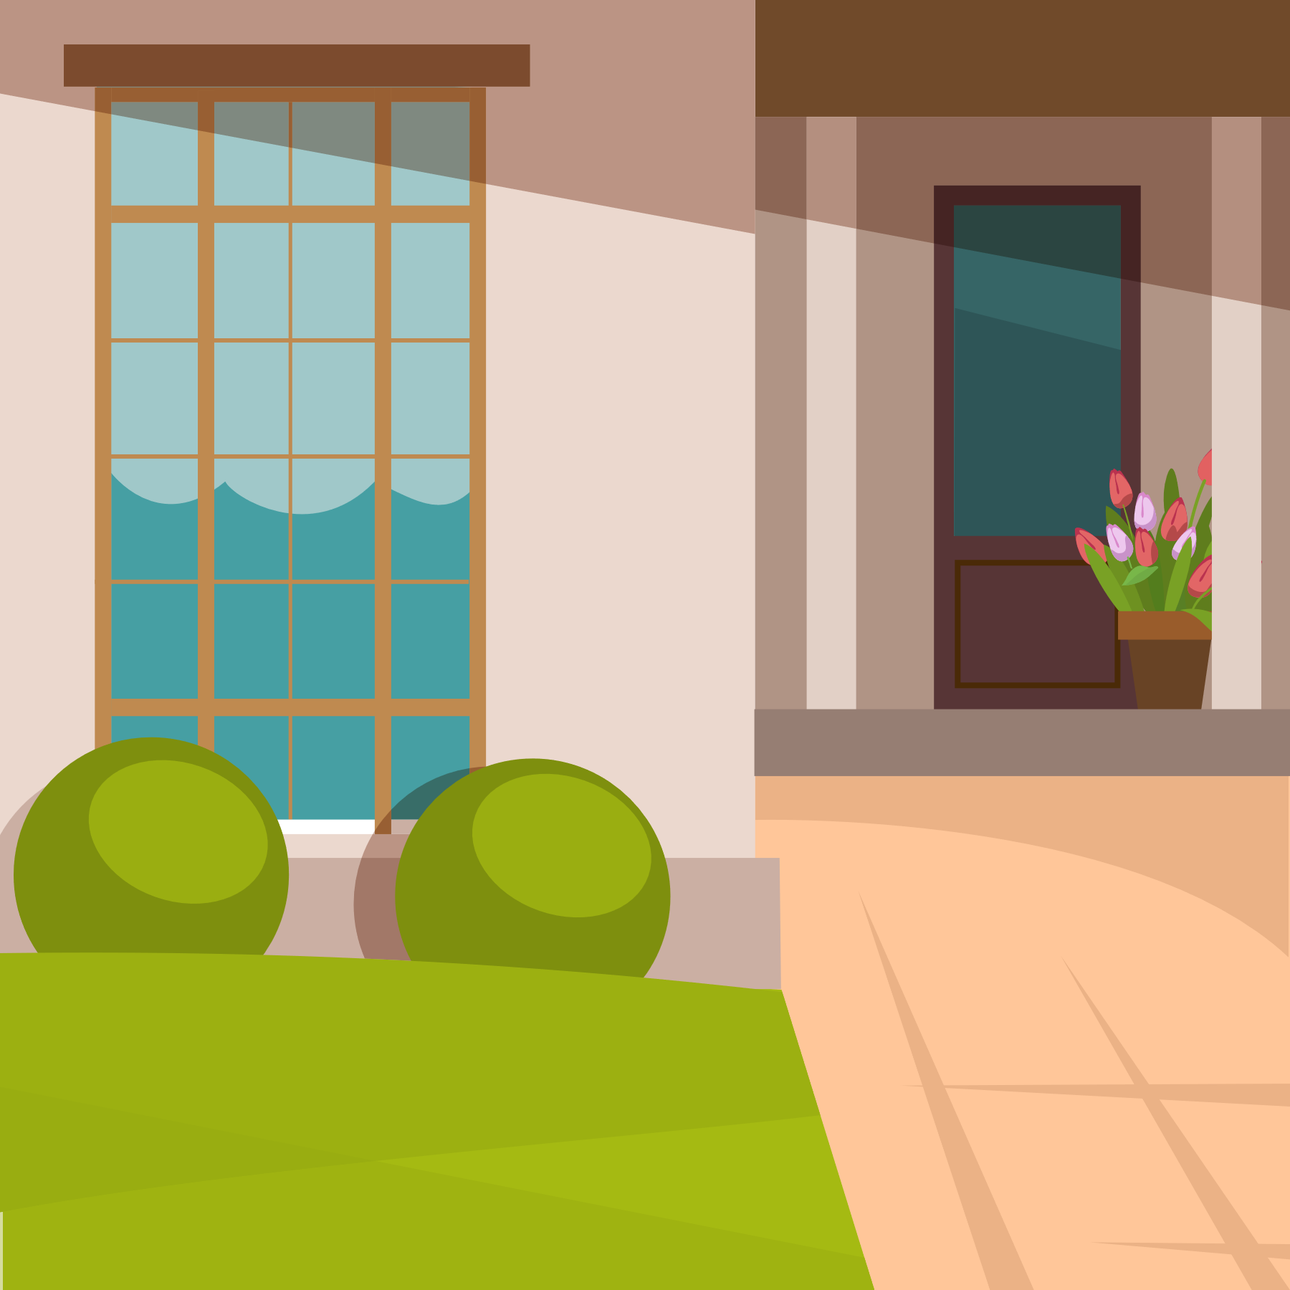

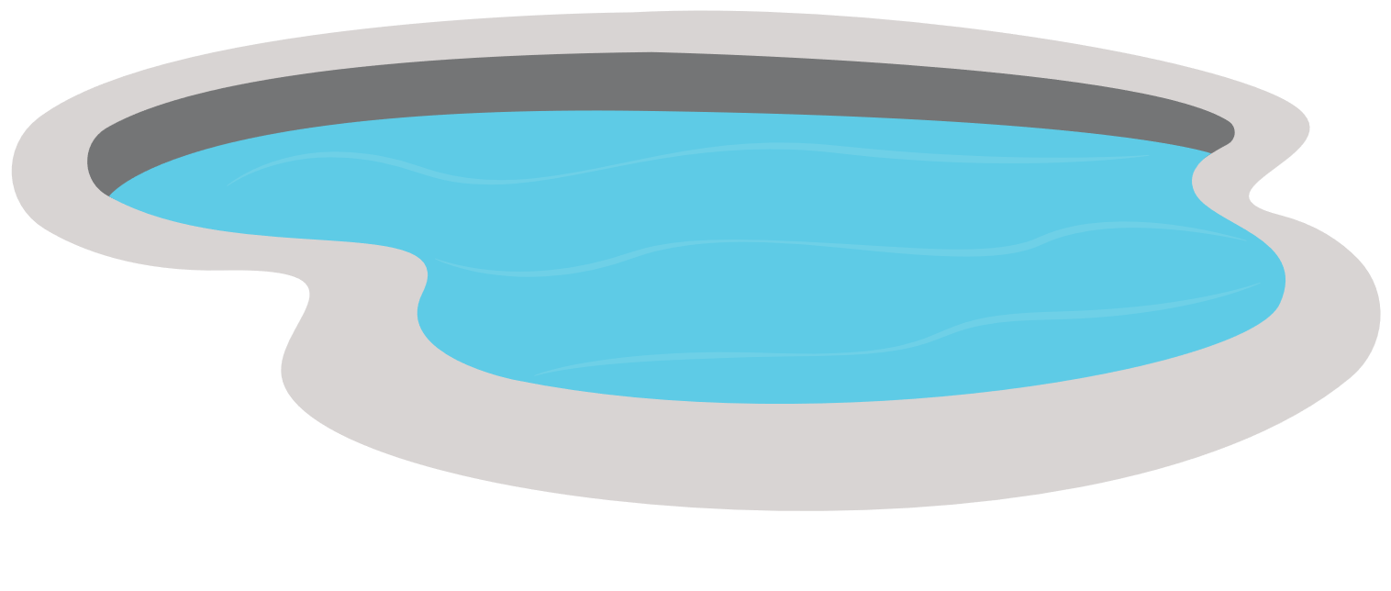
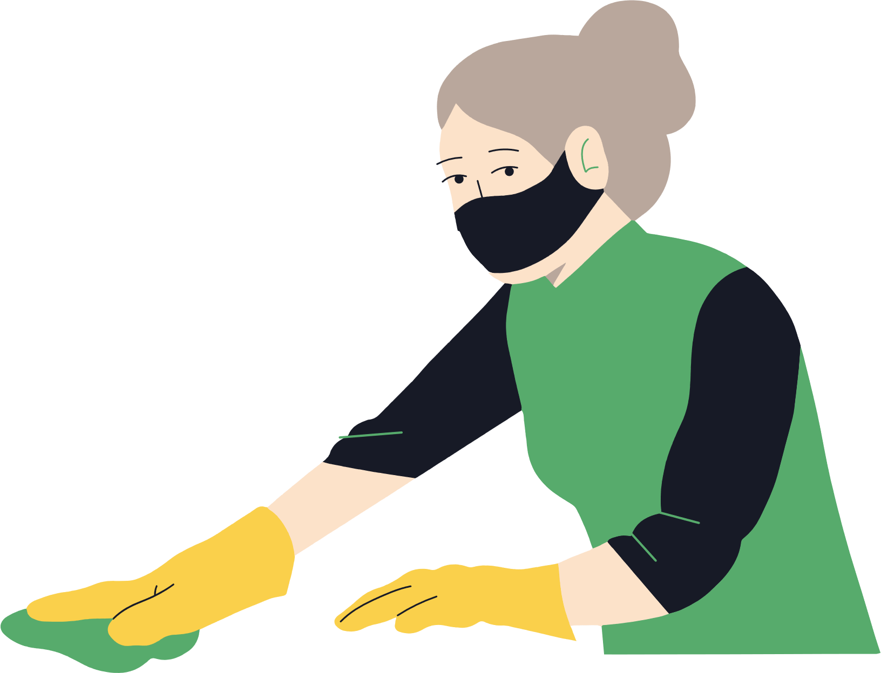
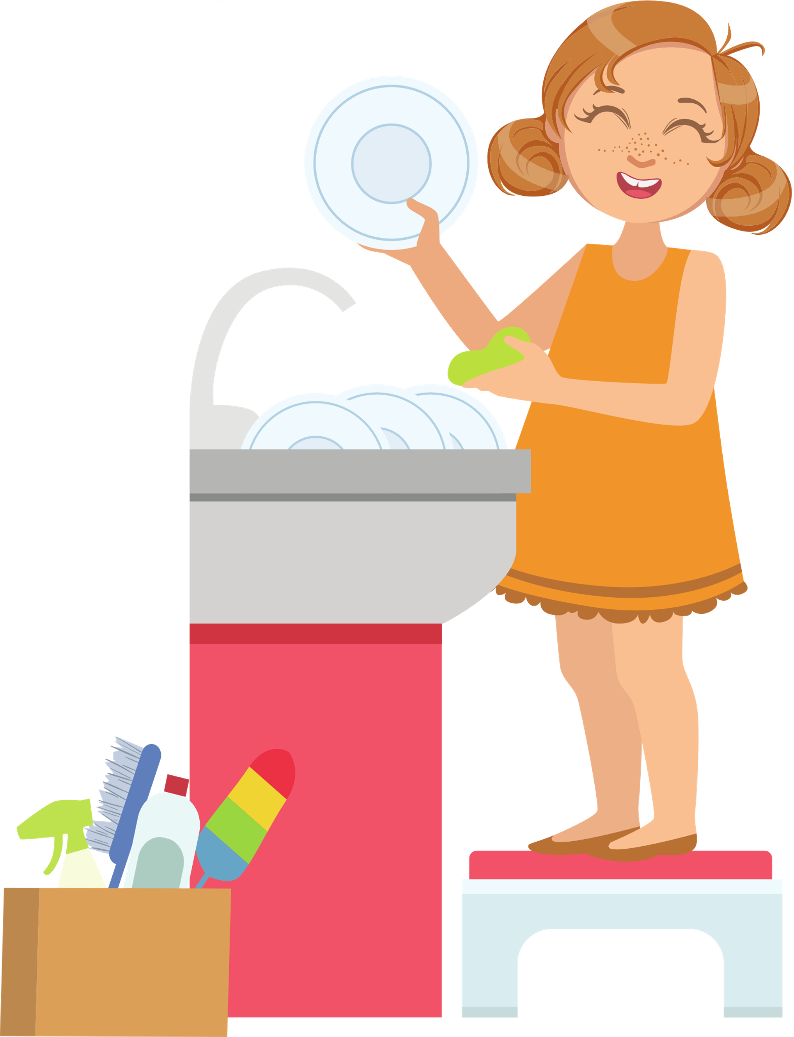

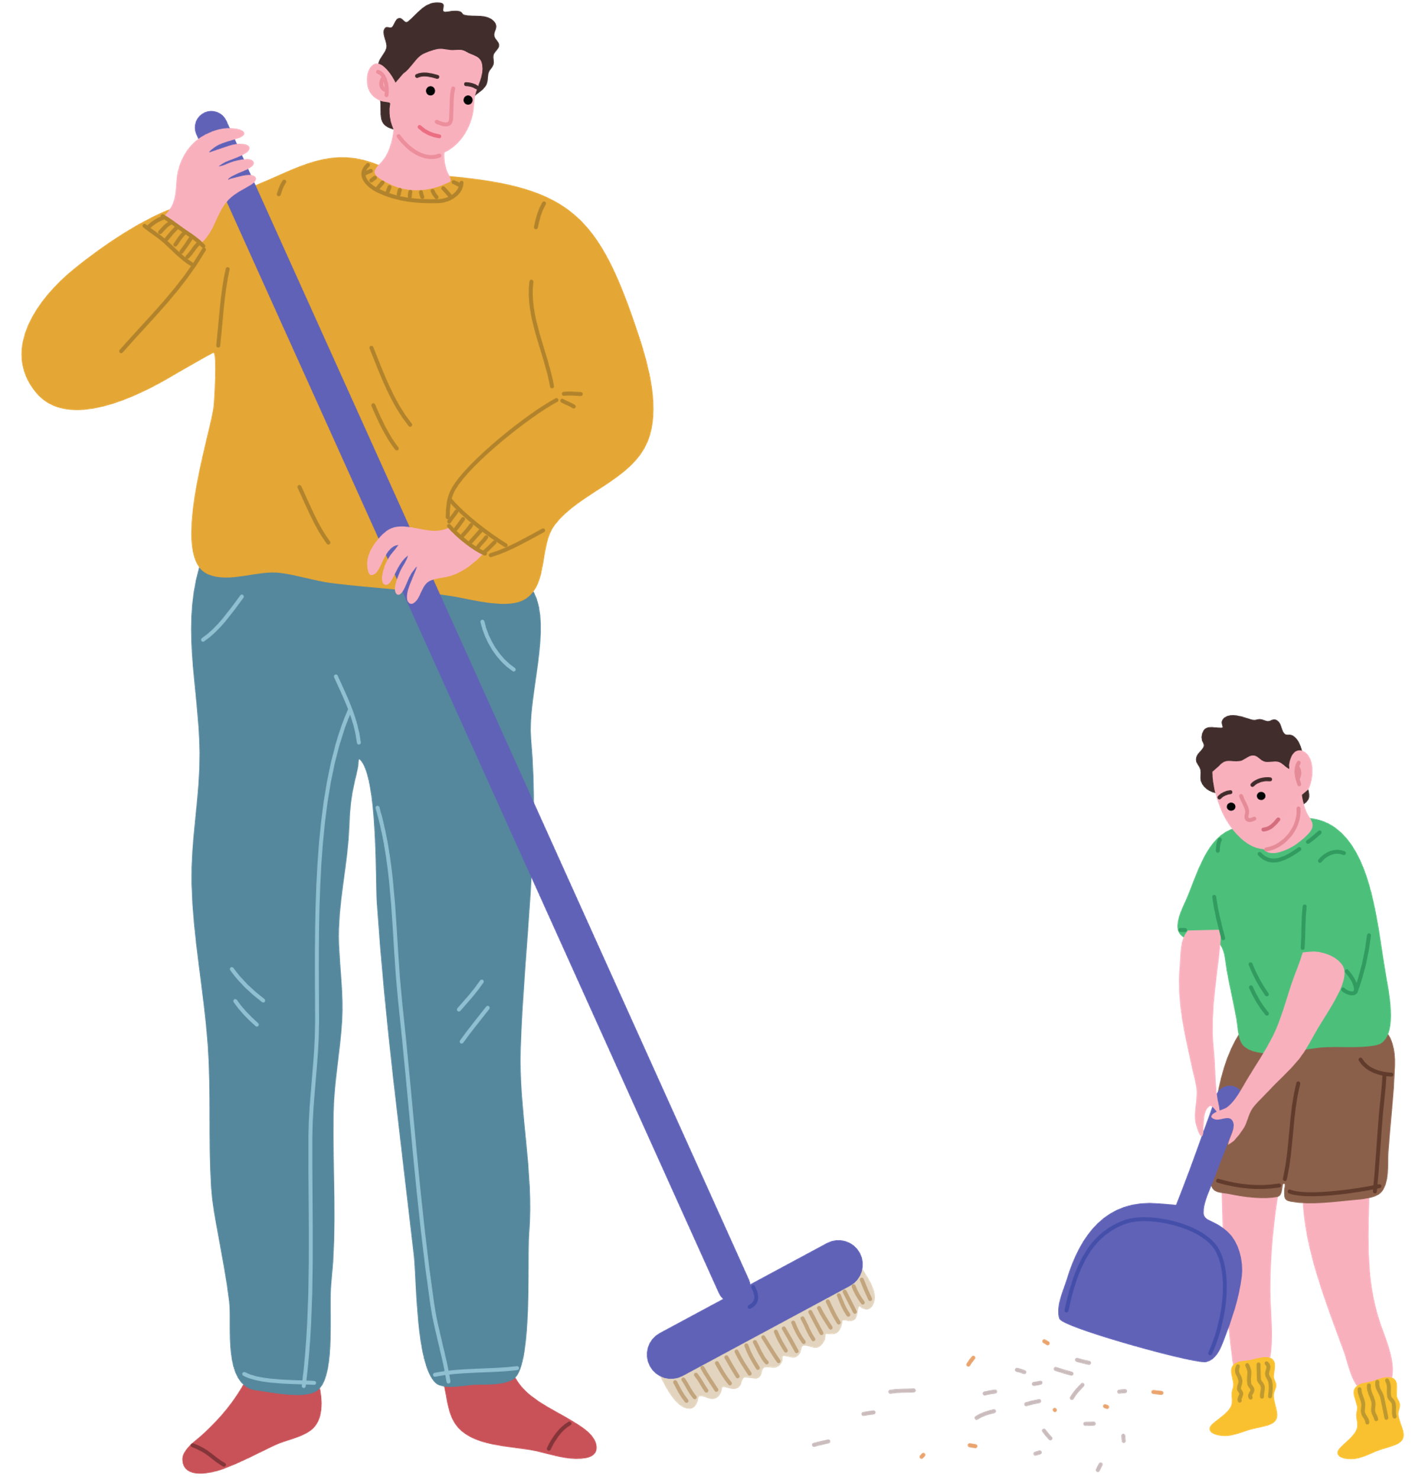
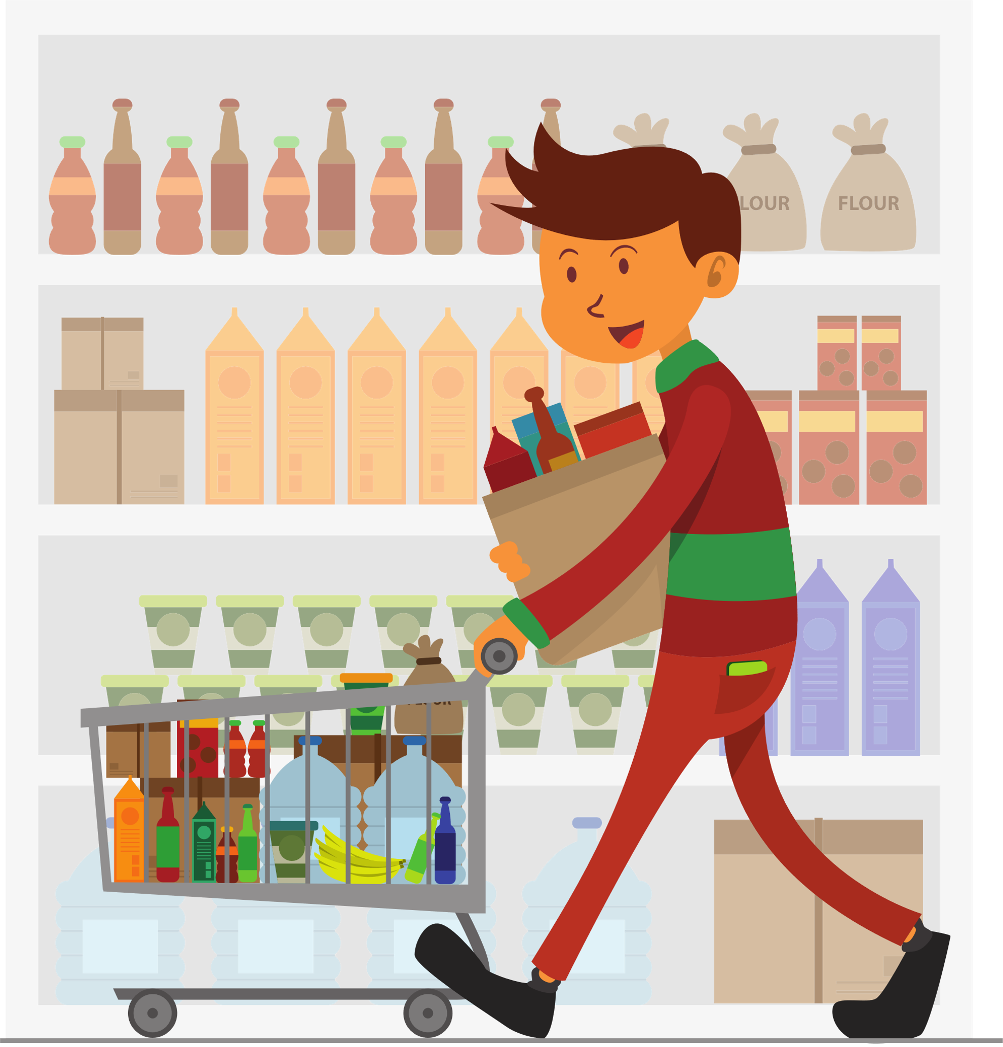
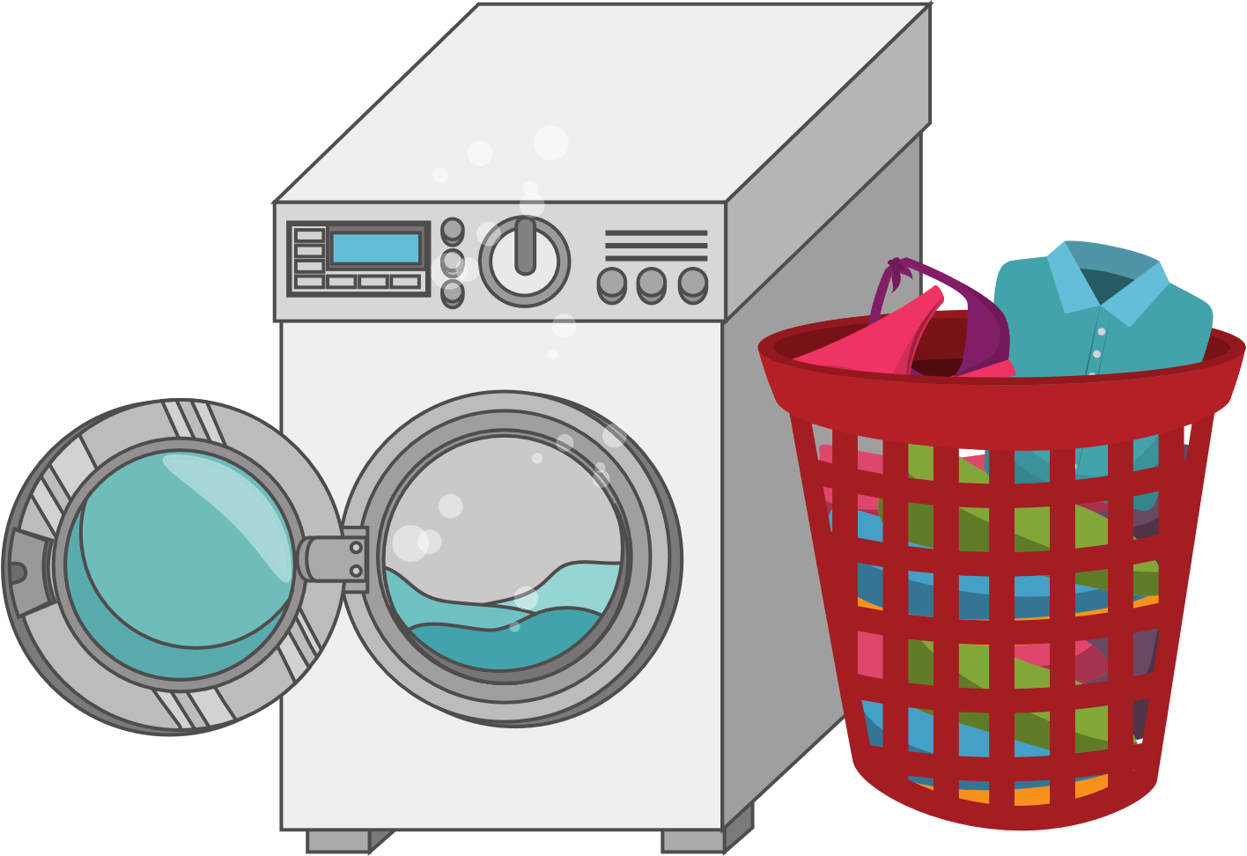
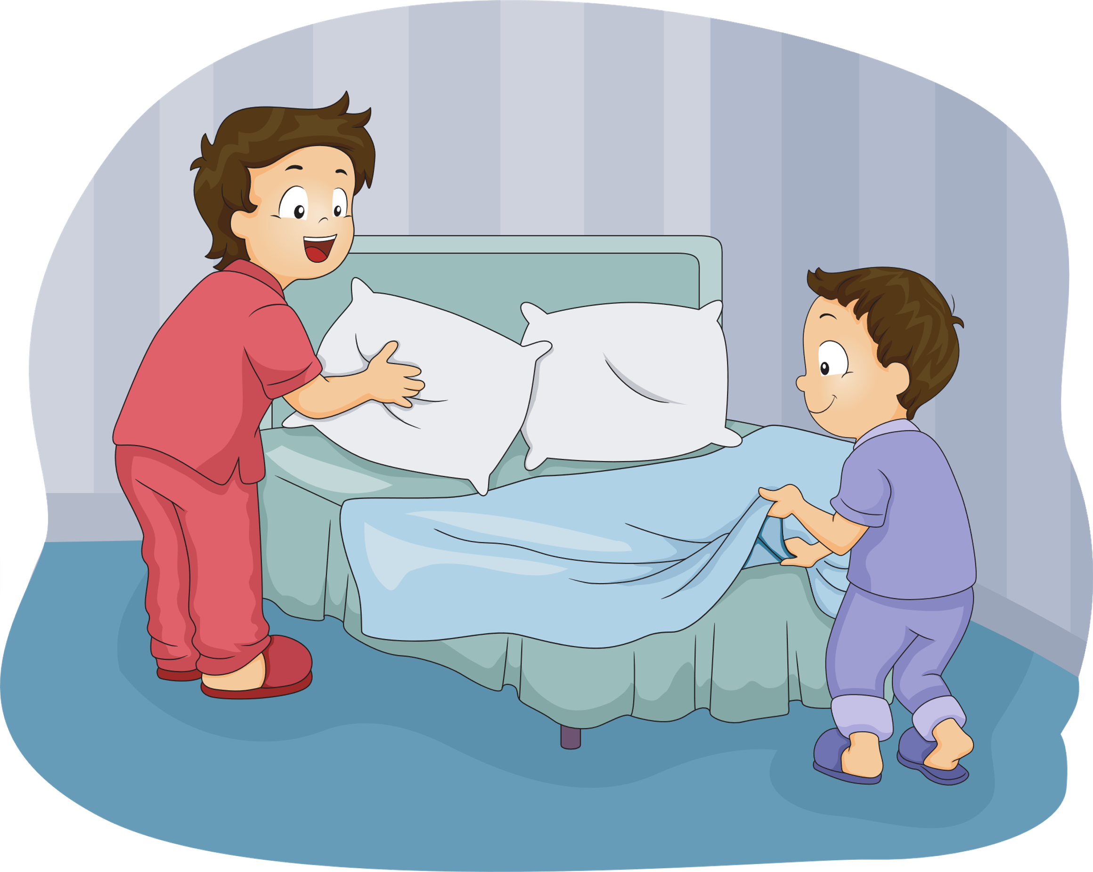
Dice game
https://freeonlinedice.com/
REVIEW VOCABULARY
1
2
3
4
5
6
7
14
10
9
8
13
12
11

Slide 5
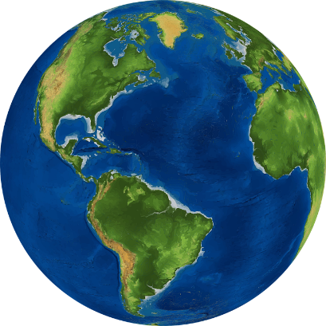
NEW WORDS
GEOGRAPHY

Slide 6




center (n)
/ˈsɛntə/
trung tâm
John lives in an apartment in the center of the city.
John sống trong 1 căn hộ ở trung tâm của thành phố.

Slide 7
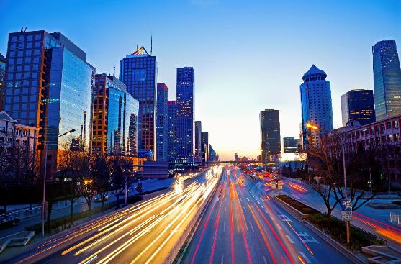
city (n)
/ˈsɪti/
thành phố
My friend lives in a big city.
Bạn của tớ sống ở một thành phố lớn.

Slide 8

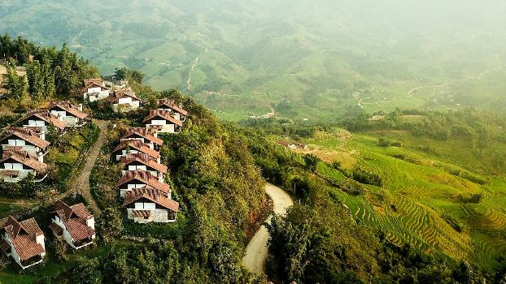
village (n)
/ˈvɪlɪʤ/
ngôi làng
My grandparents live in a small village in the countryside.
Ông bà tớ sống tại một ngôi làng nhỏ ở vùng nông thôn.

Slide 9
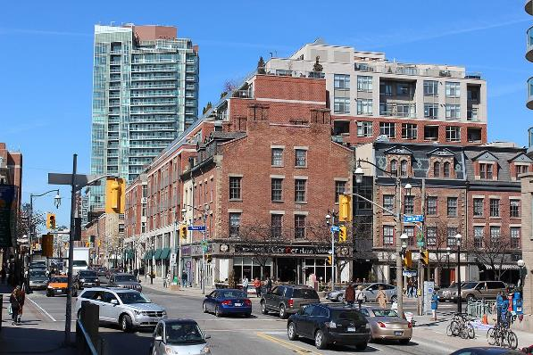
Town (n)
/taʊn/
thị trấn/ thị xã
Do you live in a town or in a city?
Bạn sống ở thị trấn hay thành phố vậy?
This Photo by Unknown Author is licensed under CC BY-SA

Slide 10
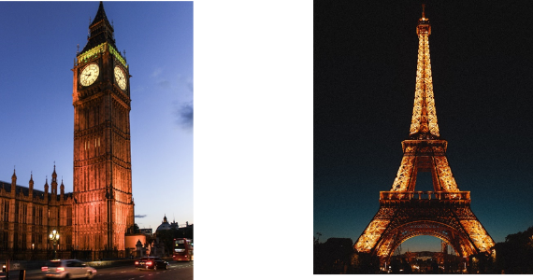
famous for (adj)
/ˈfeɪməs fɔː/
nổi tiếng về ….
Ho Chi Minh city is famous for Ben Thanh Market.
Thành phố Hồ Chí Minh nổi tiếng với chợ Bến Thành.

Slide 11
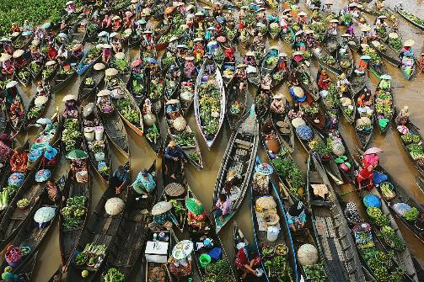
floating market (n)
/ˈfləʊtɪŋ ˈmɑːkɪt/
chợ nổi
Can Tho is famous for floating markets.
Cần Thơ nổi tiếng với các khu chợ nổi.

Slide 12




East (n)
/iːst/
Phía Đông
West (n)
/wɛst/
Phía Tây

Slide 13




North(n)
/nɔːθ/
Phía Bắc
South (n)
/saʊθ/
Phía Nam

Slide 14
WORD | CLASS | MEANING
center
(n)
trung tâm
north
(n)
Phía bắc
east
(n)
Phía đông
south
(n)
Phía nam
(n)
Phía tây
west
village
(n)
làng
town
(n)
thị trấn

Slide 15

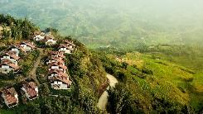
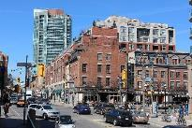
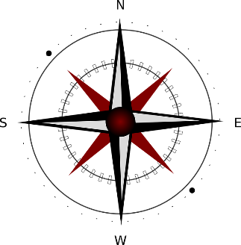
south north west east center
center
north
village
town
city
2.
3.
1.
west
east
Now, read the description and write the underline words under each picture. Listen and repeat.
A city has many buildings, schools and hospitals.
A village is in the countryside and usually has a few houses.
A town has houses, schools, parks and stores.
south

Slide 16
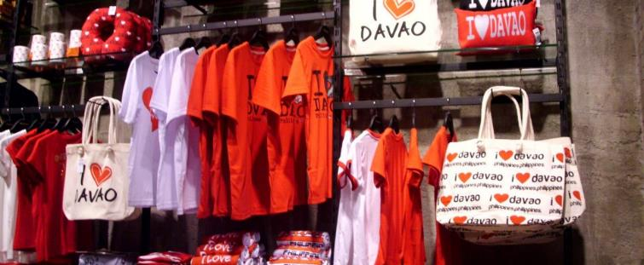
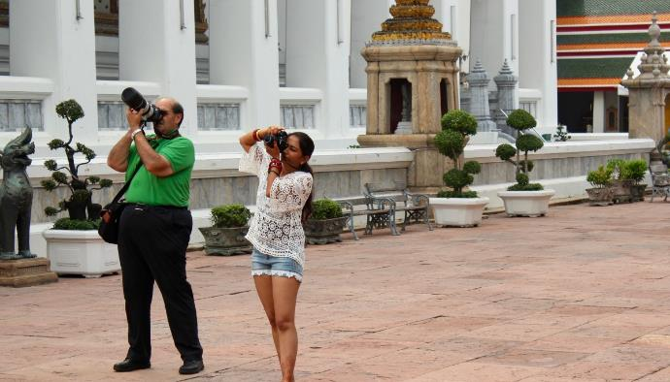
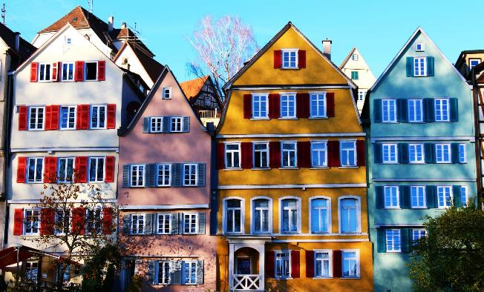
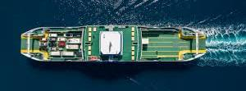
souvenir
tourists
Painted houses
ferry

Slide 17

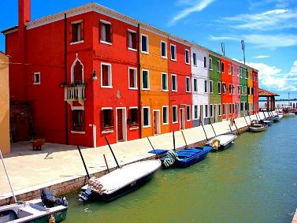
LISTENING
Listen to a boy talking about his hometown. Does he like living there?
Listen and circle
Luca lives in a village on Brurano Island. T F
His hometown is in the north of Italy. T F
It’s a big village T F
There are many painted houses. T F
This Photo by Unknown Author is licensed under CC BY-NC-ND

Slide 18
Listen again and fill in the blanks
Hi, everyone. My name is Luca. I live in a (1)__________village.
on Burano Island. It's in the (2)__________ of Italy, about nine
kilometers from Venice. You have to take a ferry to get
here. It isn't a big village, fewer than three thousand
people live here. Burano is (3)____________for its brightly
painted houses. My house is bright yellow. A lot of
tourists come here to take photos and buy souvenirs.
Here we have warm (4)____________ and very cold (5)____________
I love my village. It's the best place in the world.
small
north
famous
summers
winters

Slide 19
WRAP UP

Slide 20

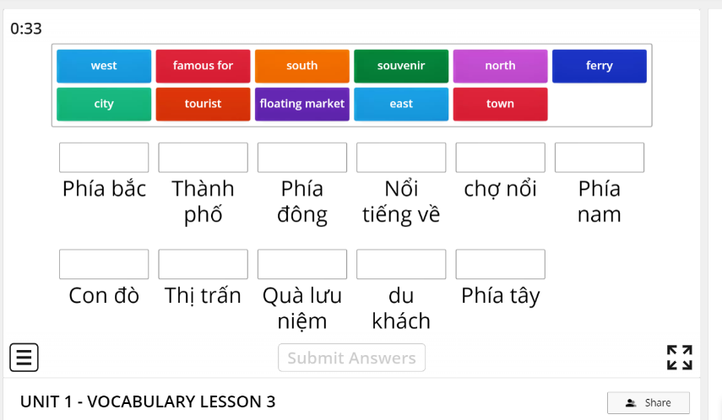
Click here
https://wordwall.net/resource/20542568

Slide 21
HOMEWORK
Learn vocabulary
Do workbook exercise page (……………….)

