Slide 1
Welcome to our class

Slide 2
LET’S
SING A SONG TOGETHER

Slide 3
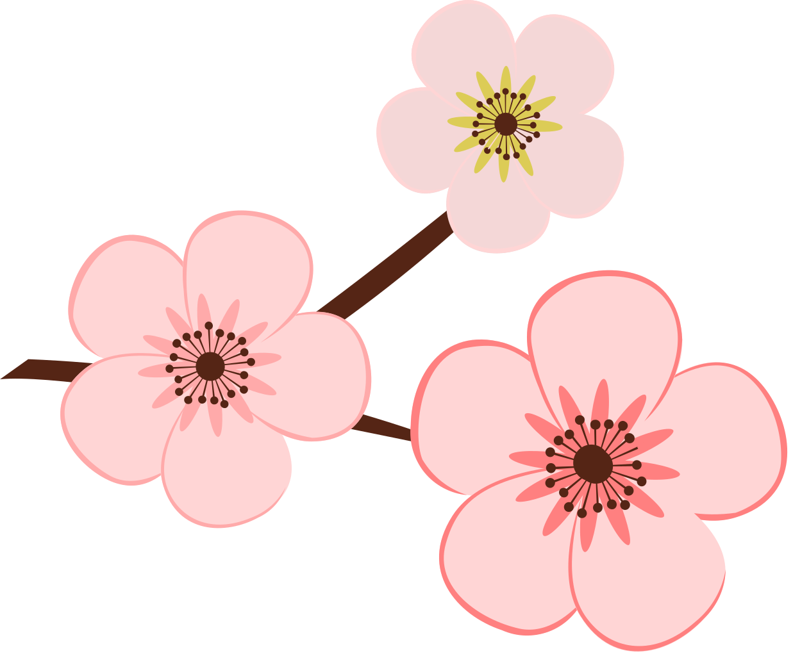
WHAT DO PEOPLE USUALLY DO AT TET?

Slide 4
In the song, at Tet, people often:
- Dress up
- Watch fireworks
- Meet up and hang out
- Go shopping together
- Go to pagodas to pray for good things

Slide 5
Unit 5:
OUR CUSTOMS AND TRADITIONS
Lesson 1: Getting Started

Slide 6
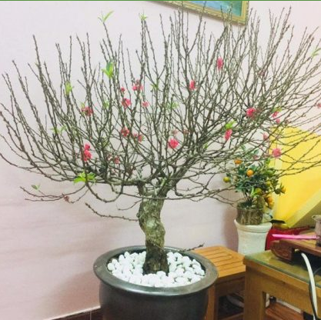
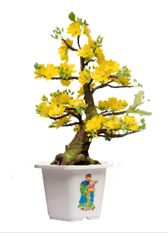
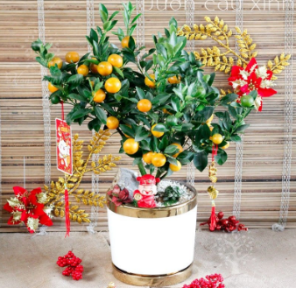
Vocabulary
/ən ɔːnəˈmentl triː/

Slide 7
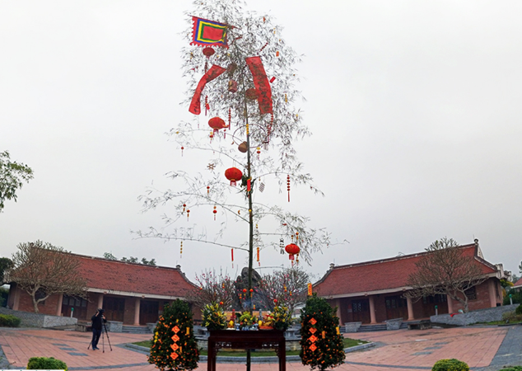
Vocabulary
/ə ˌbæmˈbuː pəʊl/

Slide 8
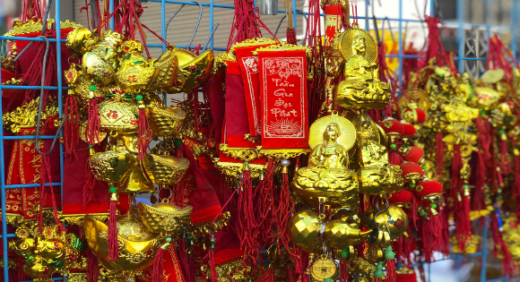
Vocabulary
/ˈdekərətɪv ˈaɪtəmz/

Slide 9
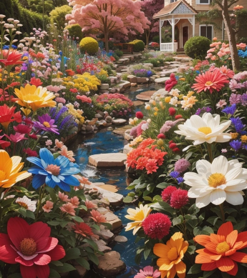
Vocabulary
/ˈbluːmɪŋ ˈflaʊərz/

Slide 10
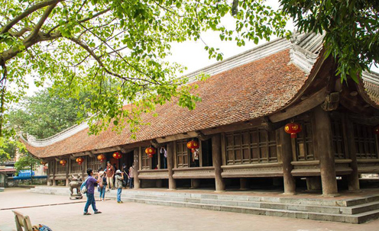
Vocabulary
/ə kəˈmjuːnl haʊs/

Slide 12
Match the phrases with the correct pictures. (Activity 3 in textbook)

Slide 13
Vocabulary
Make a sentence with one of the new words/phrases:
Eg: My mum often decorates our house with decorative items at Tet.

Slide 14
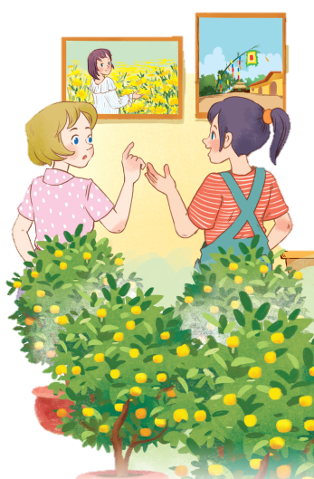

Slide 15
Listen and read
Elena: Wow, this girl looks so cute.
Trang: Yeah ... She’s my cousin. She’s at Sa Dec flower Village. Tet is coming soon, so many people visit flower villages to take pictures with the blooming flowers.
Elena: Oh, I’m fond of admiring the flowers. Does your family visit places like this too?
Trang: Yes, we do. We usually visit Nhat Tan Village to buy kumquat trees and peach blossoms.
Elena: I see flowers and ornamental trees everywhere these days. What are they for?
Trang: We, Vietnamese, use plants and flowers for decorations and for offerings. They are an important part of our Tet tradition.
Elena: And what’s that tall tree in the photo?
Trang: Well, it’s actually a bamboo pole. People place it in the yard of the communal house. They hang decorative items like small bells and lanterns on it. They want to chase away bad luck and pray for a lucky new year.
Elena: Interesting! I didn’t know that.

Slide 16
Read in pairs
Elena: Wow, this girl looks so cute.
Trang: Yeah ... She’s my cousin. She’s at Sa Dec flower Village. Tet is coming soon, so many people visit flower villages to take pictures with

Slide 17
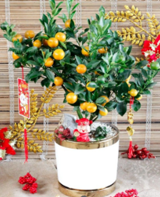
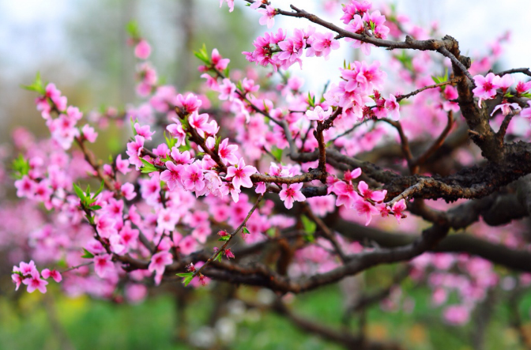
Read in pairs
Elena: Oh, I’m fond of admiring the flowers. Does your family visit places like this too?
Trang: Yes, we do. We usually visit Nhat Tan Village to buy and

Slide 18
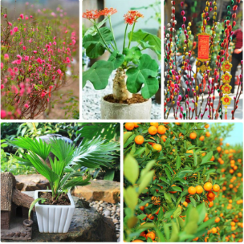
Read in pairs
Elena: I see flowers and everywhere these days. What are they for?
Trang: We, Vietnamese, use plants and flowers for decorations and for offerings. They are an important part of our Tet tradition.

Slide 19
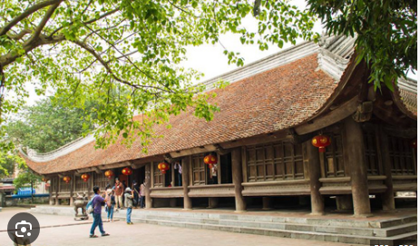
Elena: And what’s that tall tree in the photo?
Trang: Well, it’s actually a .People place it in the
yard of . They hang like small bells and lanterns on it. They want to chase away bad luck and pray for a lucky new year.
Elena: Interesting! I didn’t know that.
Listen in pairs

Slide 20
Read the conversation again and tick T (True) or F (False).
Sentences | T | F
1. Elena and Trang are at Sa Dec Flower Village.
2. Many people visit flower villages to take photos.
3. Trang’s family usually buys kumquat trees and peach blossoms at Nhat Tan Village.
4. Flowers are not part of any Vietnamese traditions.
5. People decorate bamboo poles with small bells and lanterns for New Years.

Slide 21
Check your answers
1. Elena and Trang are at Sa Dec Flower Village.
F
Trang’s cousin
Elena: Wow, this girl looks so cute.
Trang: Yeah ... She’s my cousin. She’s at Sa Dec flower Village.

Slide 22
Check your answers
T
2. Many people visit flower villages to take photos.
Trang: Yeah ... She’s my cousin. She’s at Sa Dec flower Village. Tet is coming soon, so many people visit flower villages to take pictures with the blooming flowers.

Slide 23
Check your answers
3. Trang’s family usually buys kumquat trees and peach blossoms at Nhat Tan Village.
T
Elena: Oh, I’m fond of admiring the flowers. Does your family visit places like this too?
Trang: Yes, we do. We usually visit Nhat Tan Village to buy kumquat trees and peach blossoms.

Slide 24
Check your answers
F
4. Flowers are not part of any Vietnamese traditions.
an important part of our Tet tradition.
Elena: I see flowers and ornamental trees everywhere these days. What are they for?
Trang: We, Vietnamese, use plants and flowers for decorations and for offerings. They are an important part of our Tet tradition.

Slide 25
Check your answers
5. People decorate bamboo poles with small bells and lanterns for New Years.
T
Elena: And what’s that tall tree in the photo?
Trang: Well, it’s actually a bamboo pole. People place it in the yard of the communal house. They hang decorative items like small bells and lanterns on it.

Slide 26
Look at the answers again.
Sentences | T | F
1. Elena and Trang are at Sa Dec Flower Village.
2. Many people visit flower villages to take photos.
3. Trang’s family usually buys kumquat trees and peach blossoms at Nhat Tan Village.
4. Flowers are not part of any Vietnamese traditions.
5. People decorate bamboo poles with small bells and lanterns for New Years.
Trang’s cousin
Plants and flowers are an important part of Tet.

Slide 27
Complete the sentences with the verbs from the box.
admire chase pray place
1. The British decorate their Christmas trees and ______ presents under them.
2. Tom likes to ______ the view from the hill.
3. In many cultures, knocking on wood is a way to ______ away bad spirits.
4. Many Asians go to Buddhist temples to ______ for good luck.
place
admire
chase
pray

Slide 28
NEW YEARS
AROUND THE WORLD
People around the world celebrate New Years differently. Choose the tradition below.

Slide 29
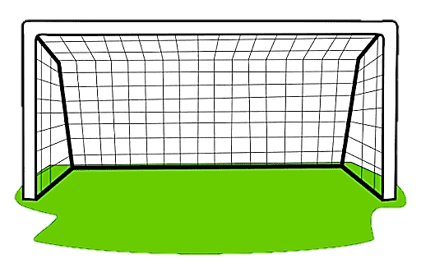
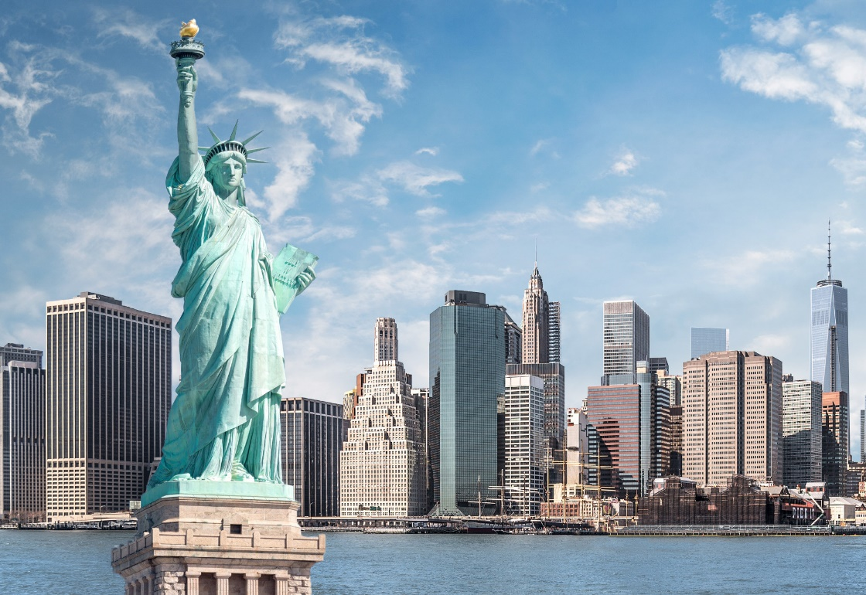
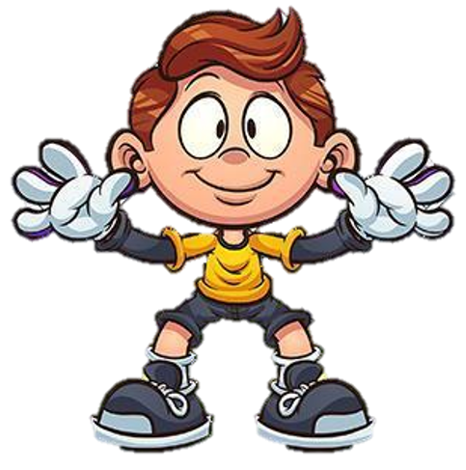
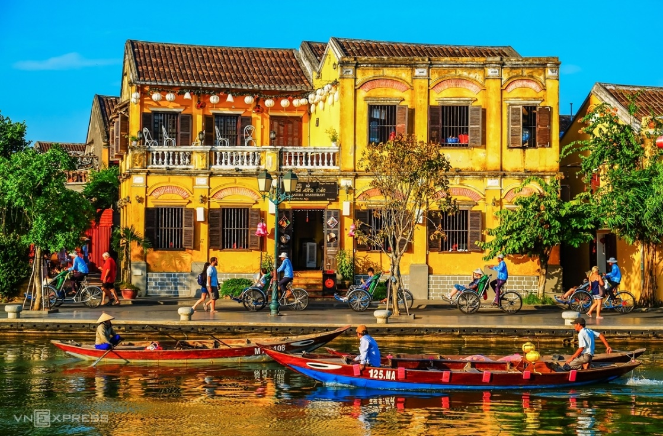
1. Visiting pagodas.
A. The US
B. Viet Nam

Slide 30
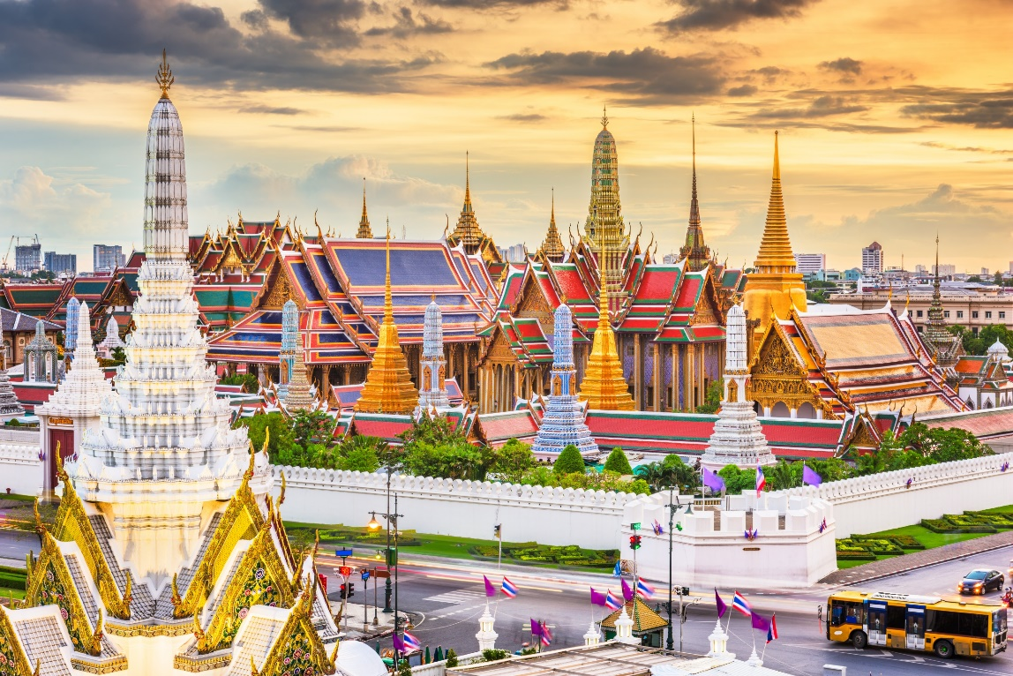
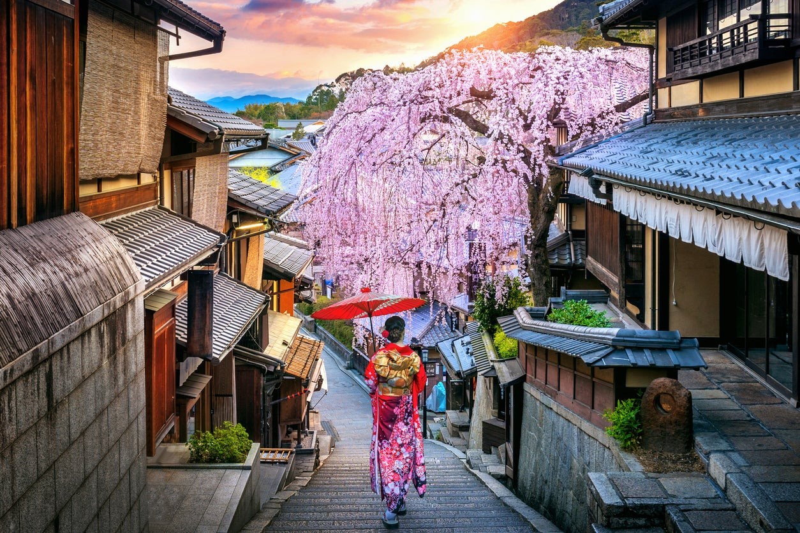
2. Throwing water at each other.
A. Thailand
B. Japan

Slide 31
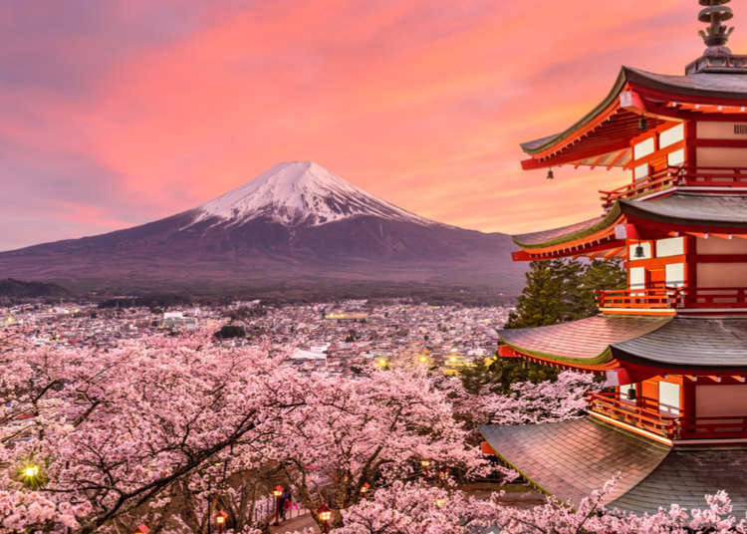
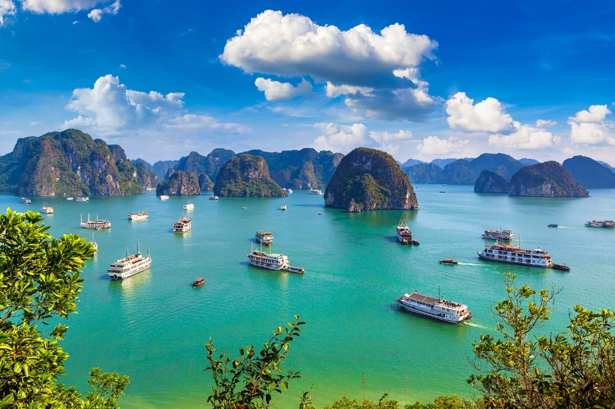
3. Ringing a bell 108 times.
A. Japan
B. Viet Nam

Slide 32
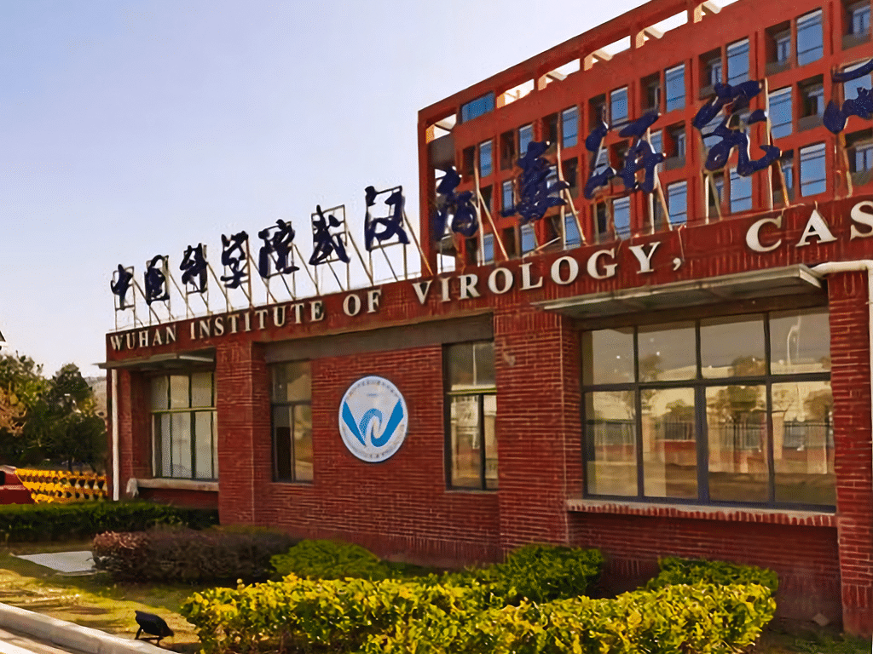
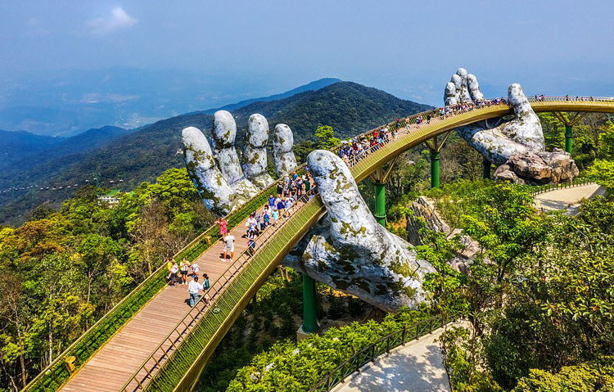
4. Giving and receiving lucky money.
A. The US
B. Viet Nam

Slide 33
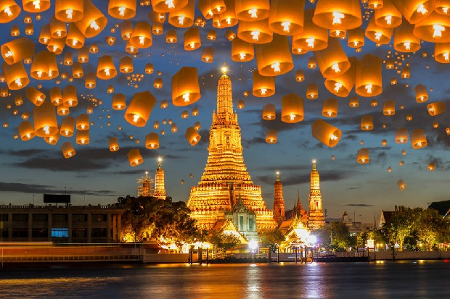
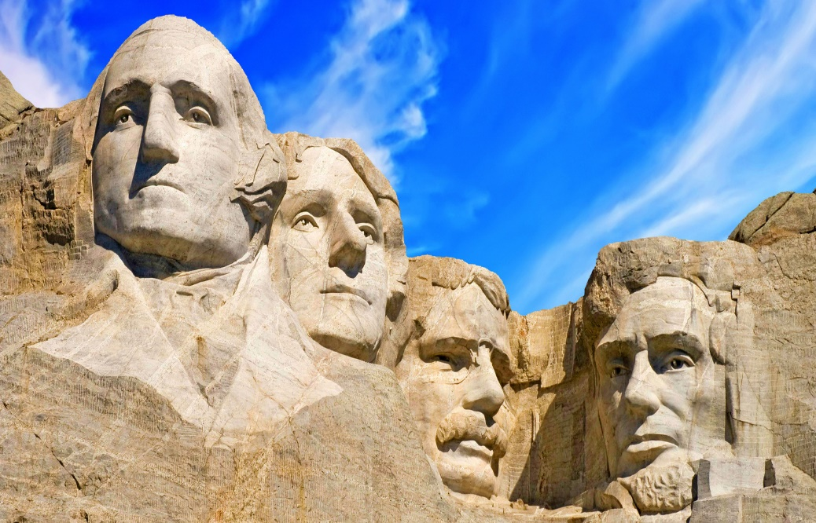
5. Watching a ball drop at midnight in Times Square.
A. Thailand
B. The US

Slide 34
What are you going to do in this coming Tet?

Slide 35
Wrap - up
What have we learnt in this lesson?
identify the topic of the unit
use lexical items related to Tet holiday.
identify the language features that are covered in the lesson.

Slide 36
Homework
- Learn the new words by heart.
- Practice talking about Tet Holiday.

