Slide 1
VIETNAMESE TET HOLIDAY: THEN AND NOW

Slide 2
In the past…

Slide 3
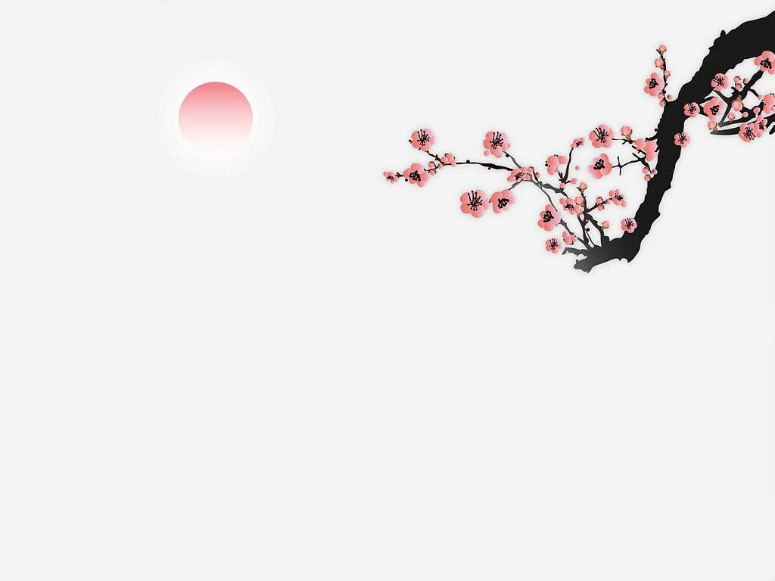
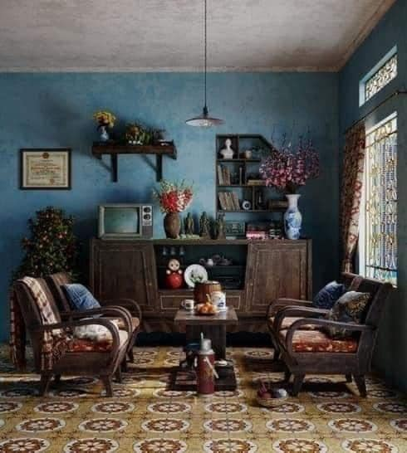
Decorate the house

Slide 4
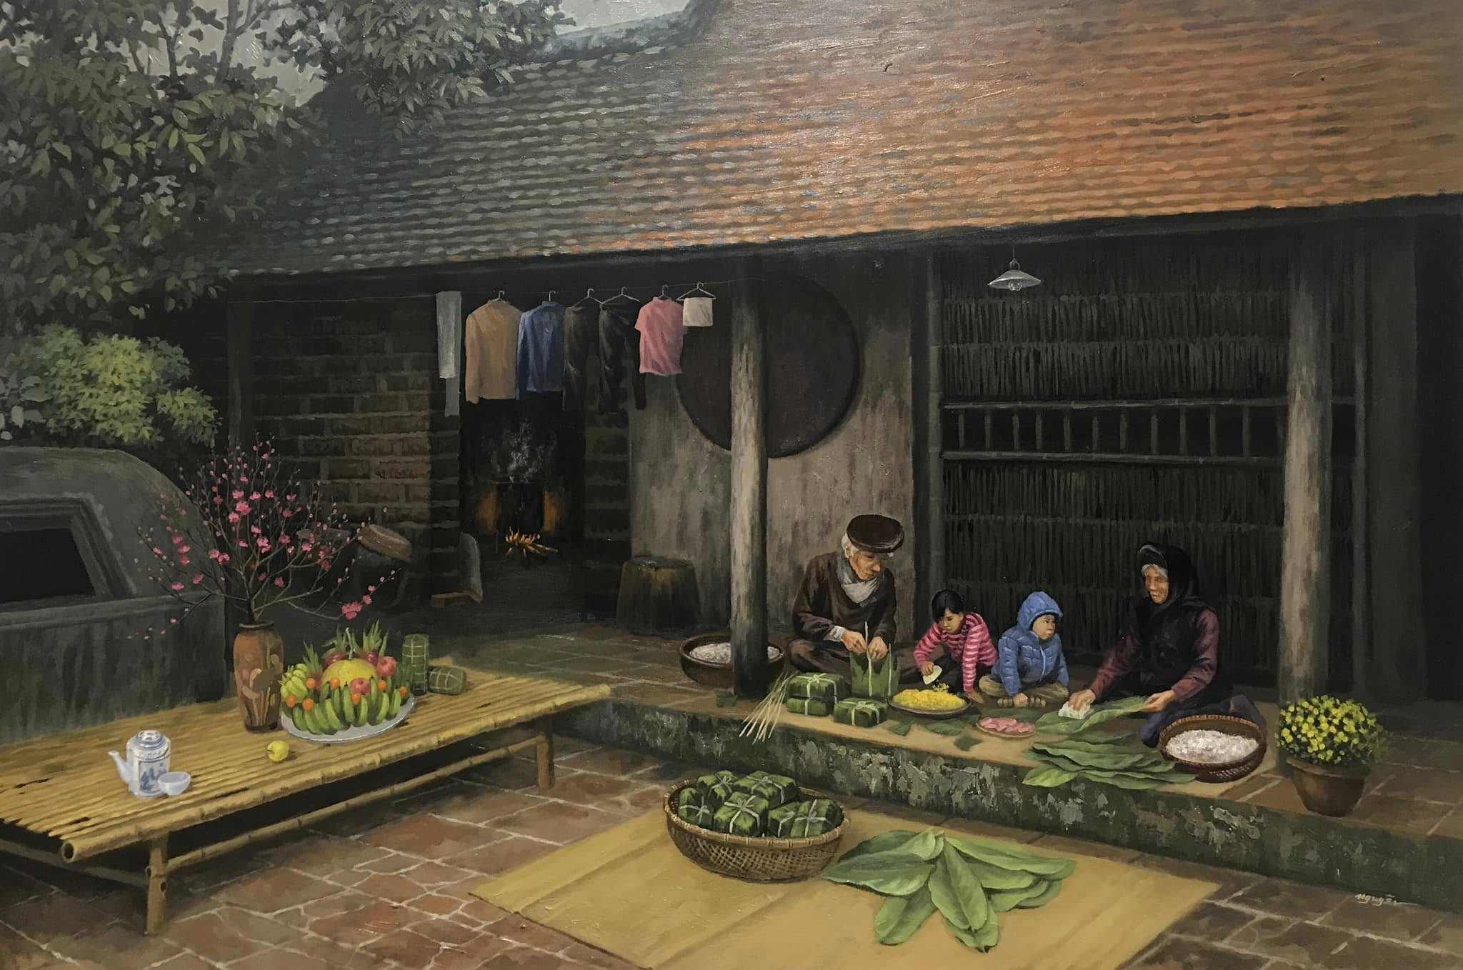
Make chung cake

Slide 5
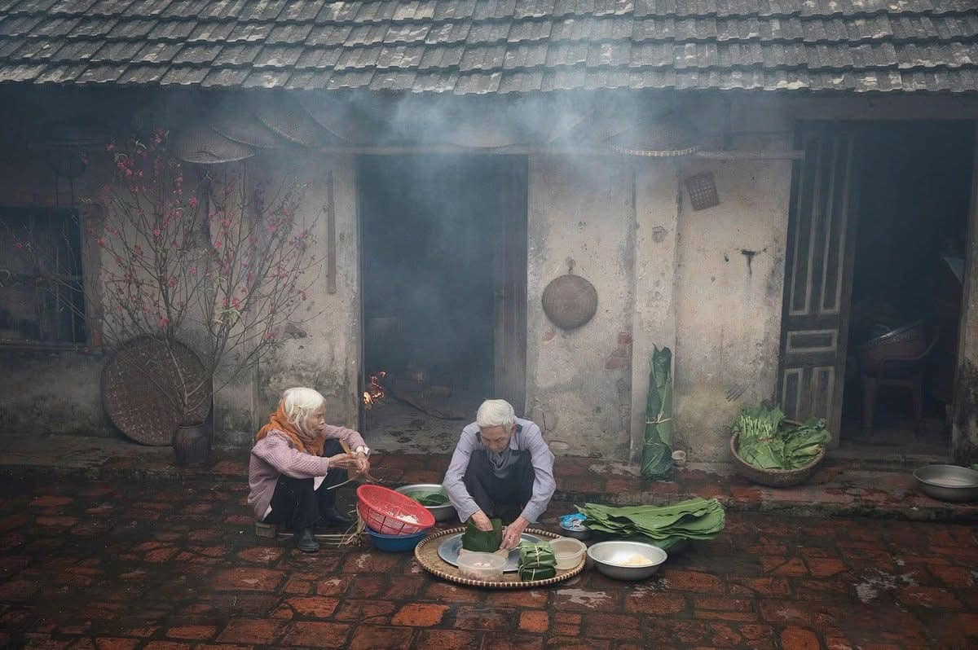

Slide 6
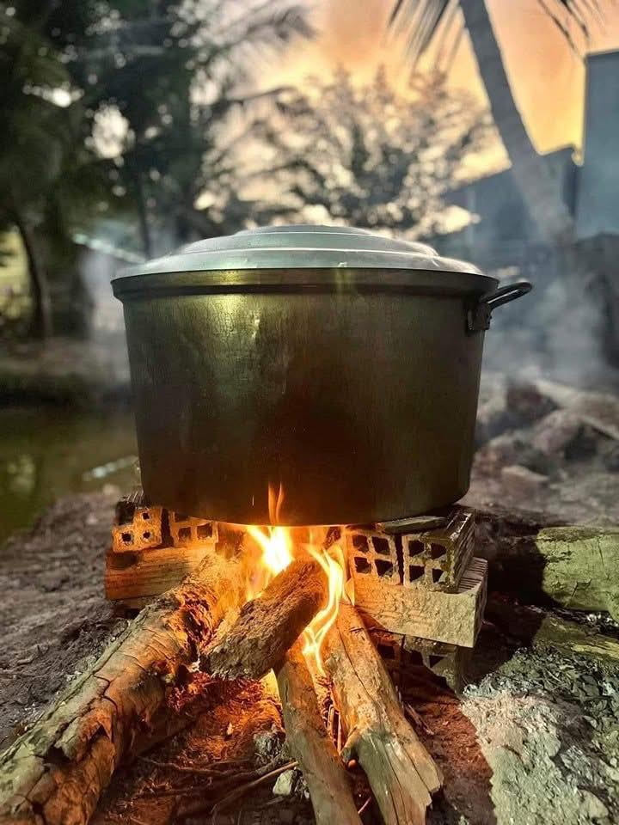
Boiling Chung cake

Slide 7
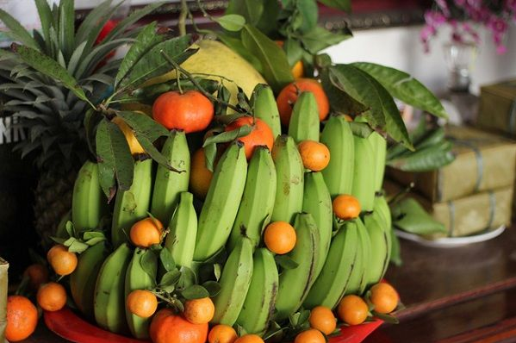
Preparing five-fruit tray

Slide 8
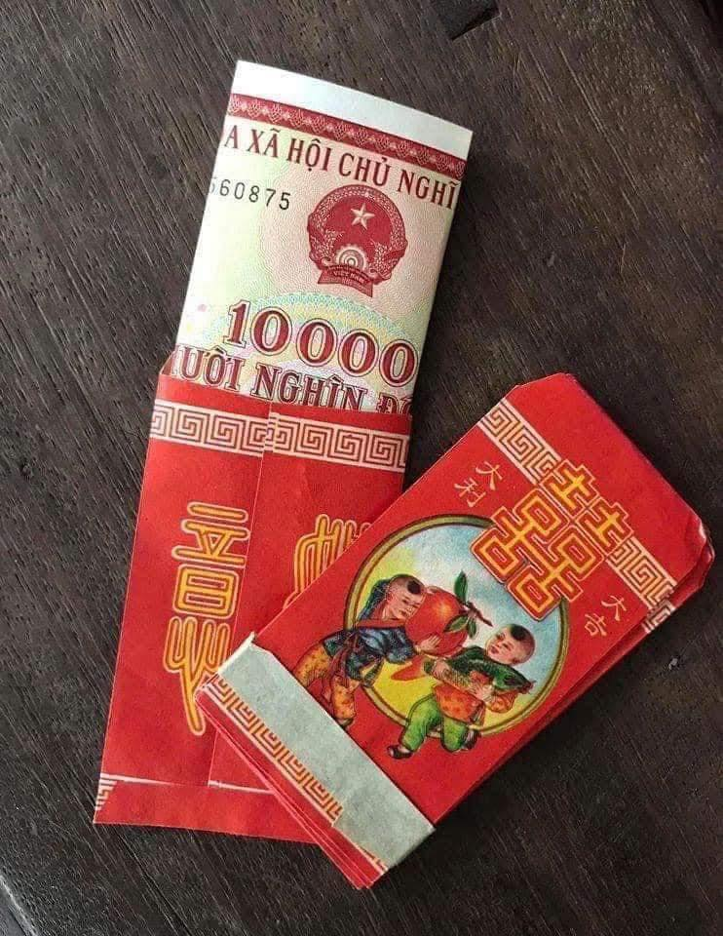
Give lucky money to children

Slide 9
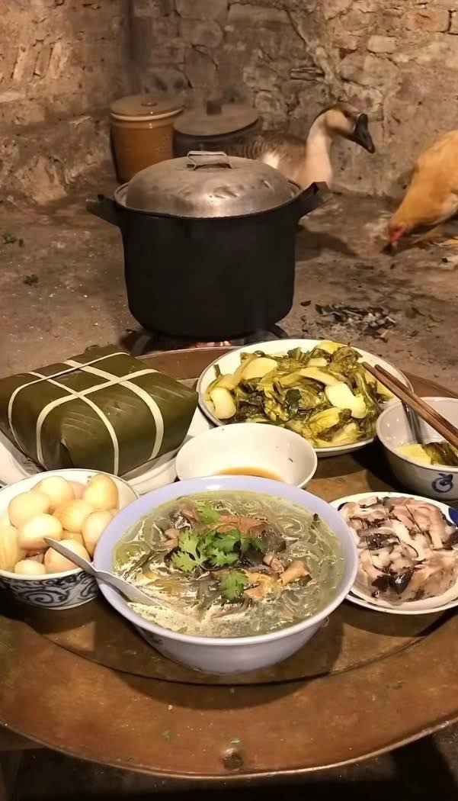
Cook special food

Slide 10
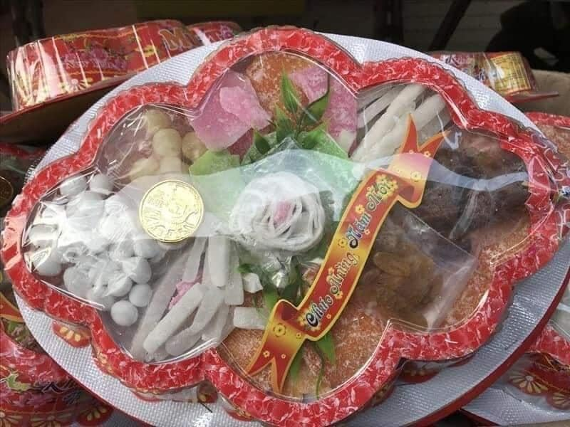
Eat Tet jam

Slide 11
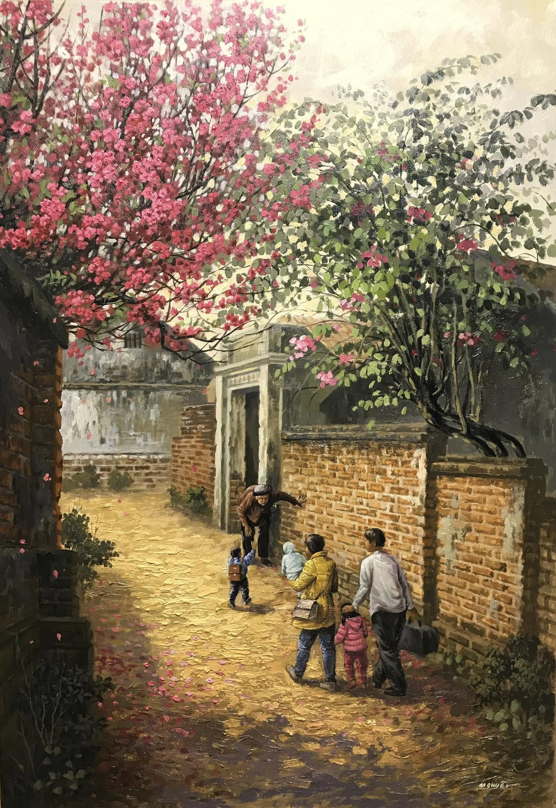
Visit relatives

Slide 12
Now…

Slide 13
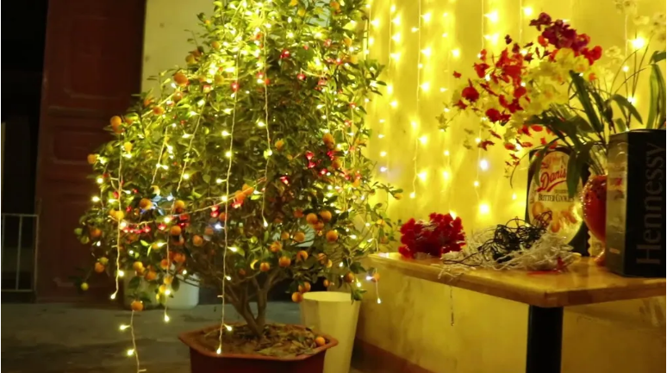
Decorate the house

Slide 14
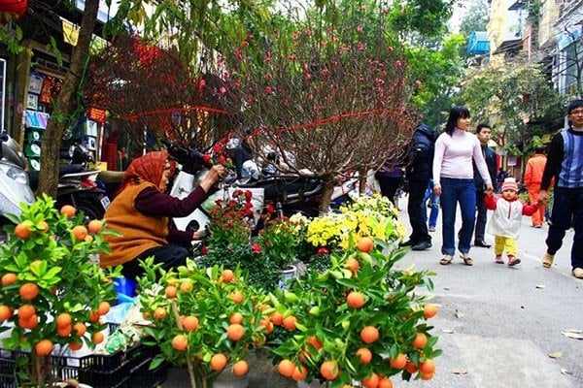
Going shopping

Slide 15
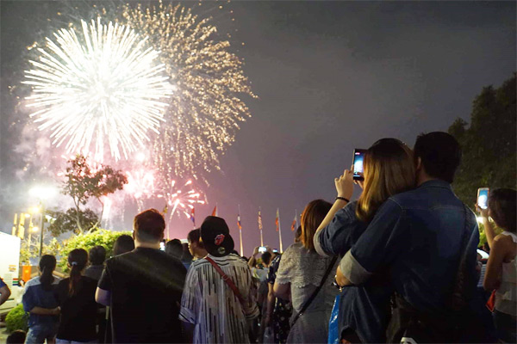
Watching firework

Slide 16
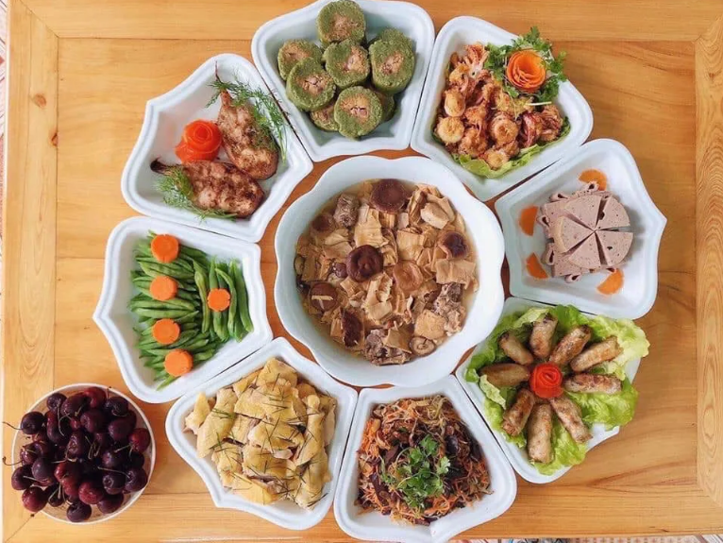

Slide 18
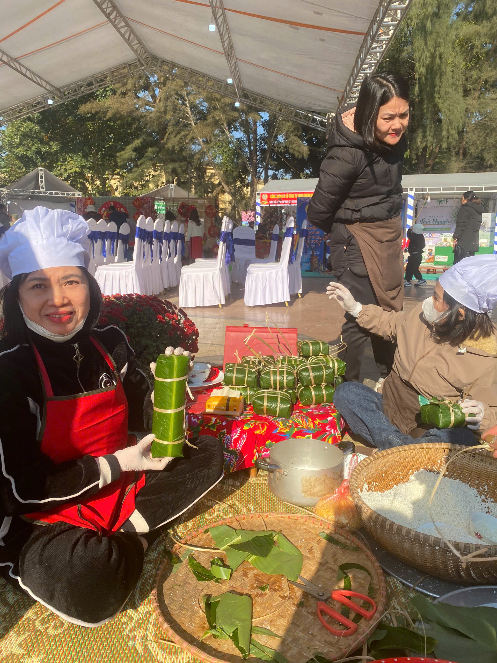
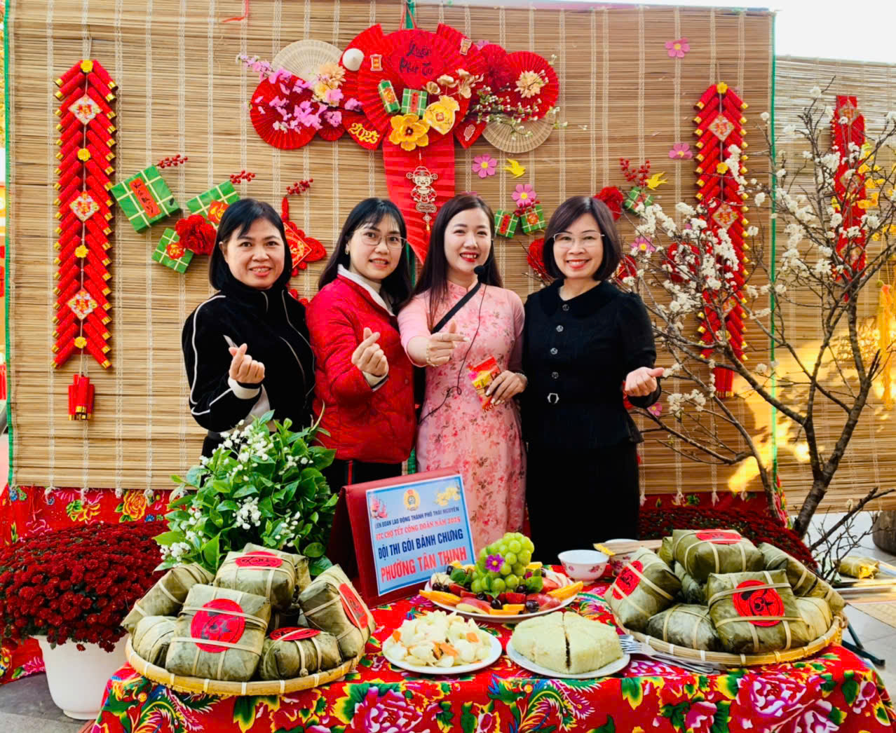
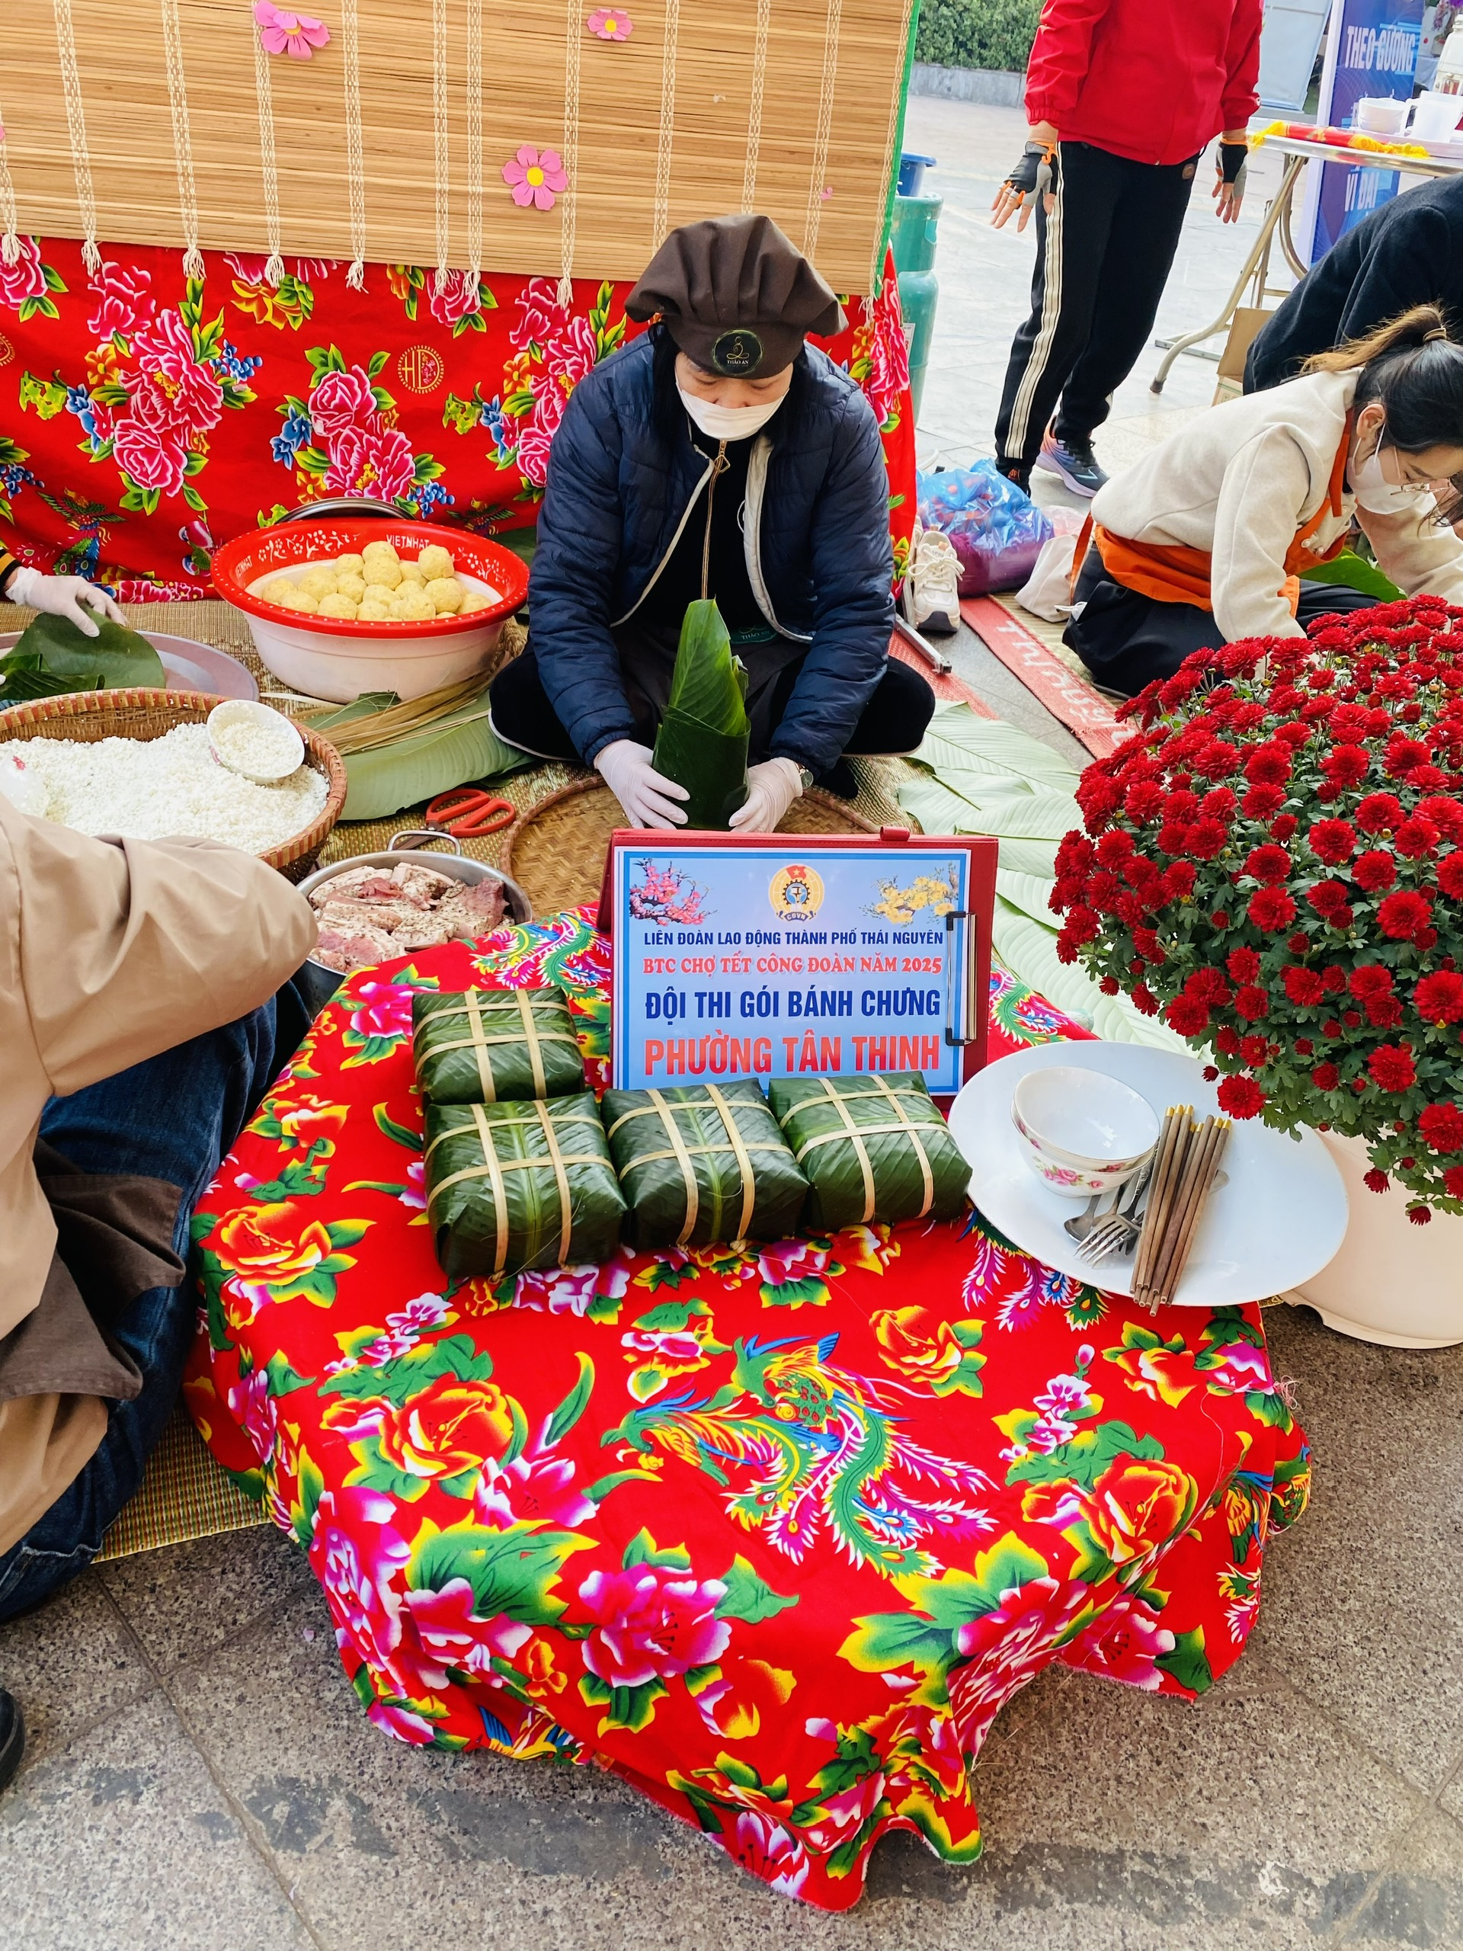
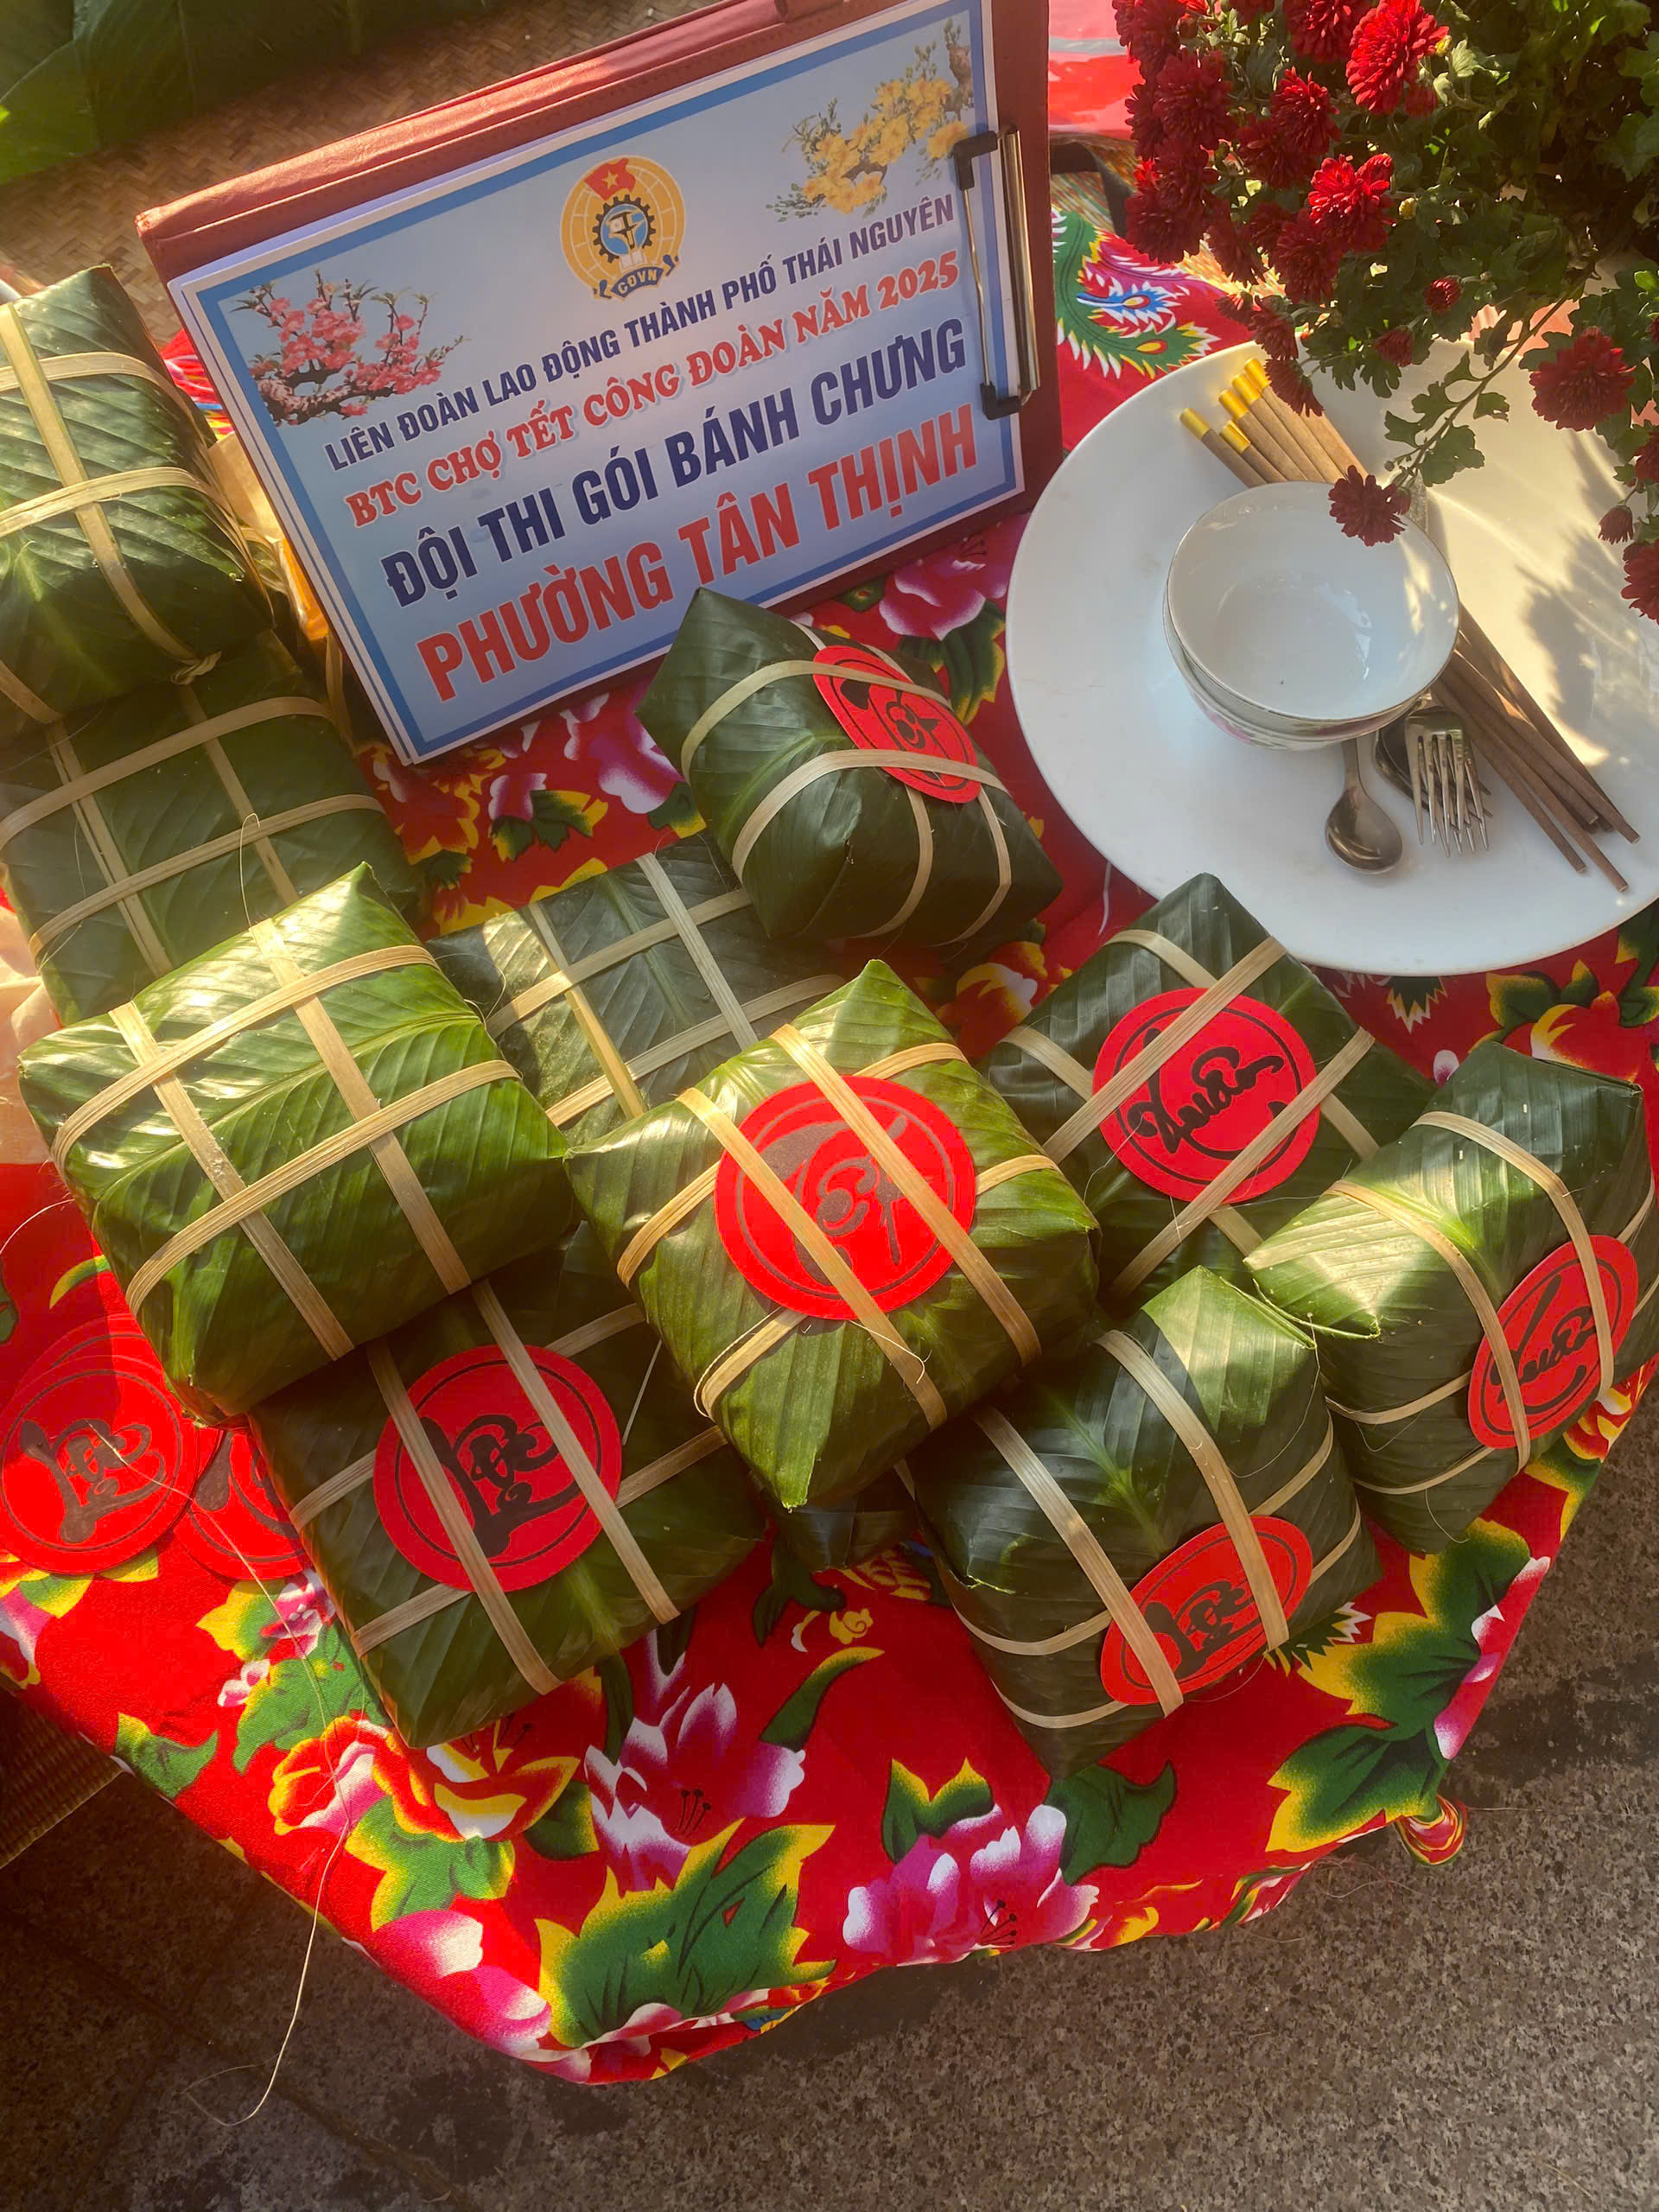
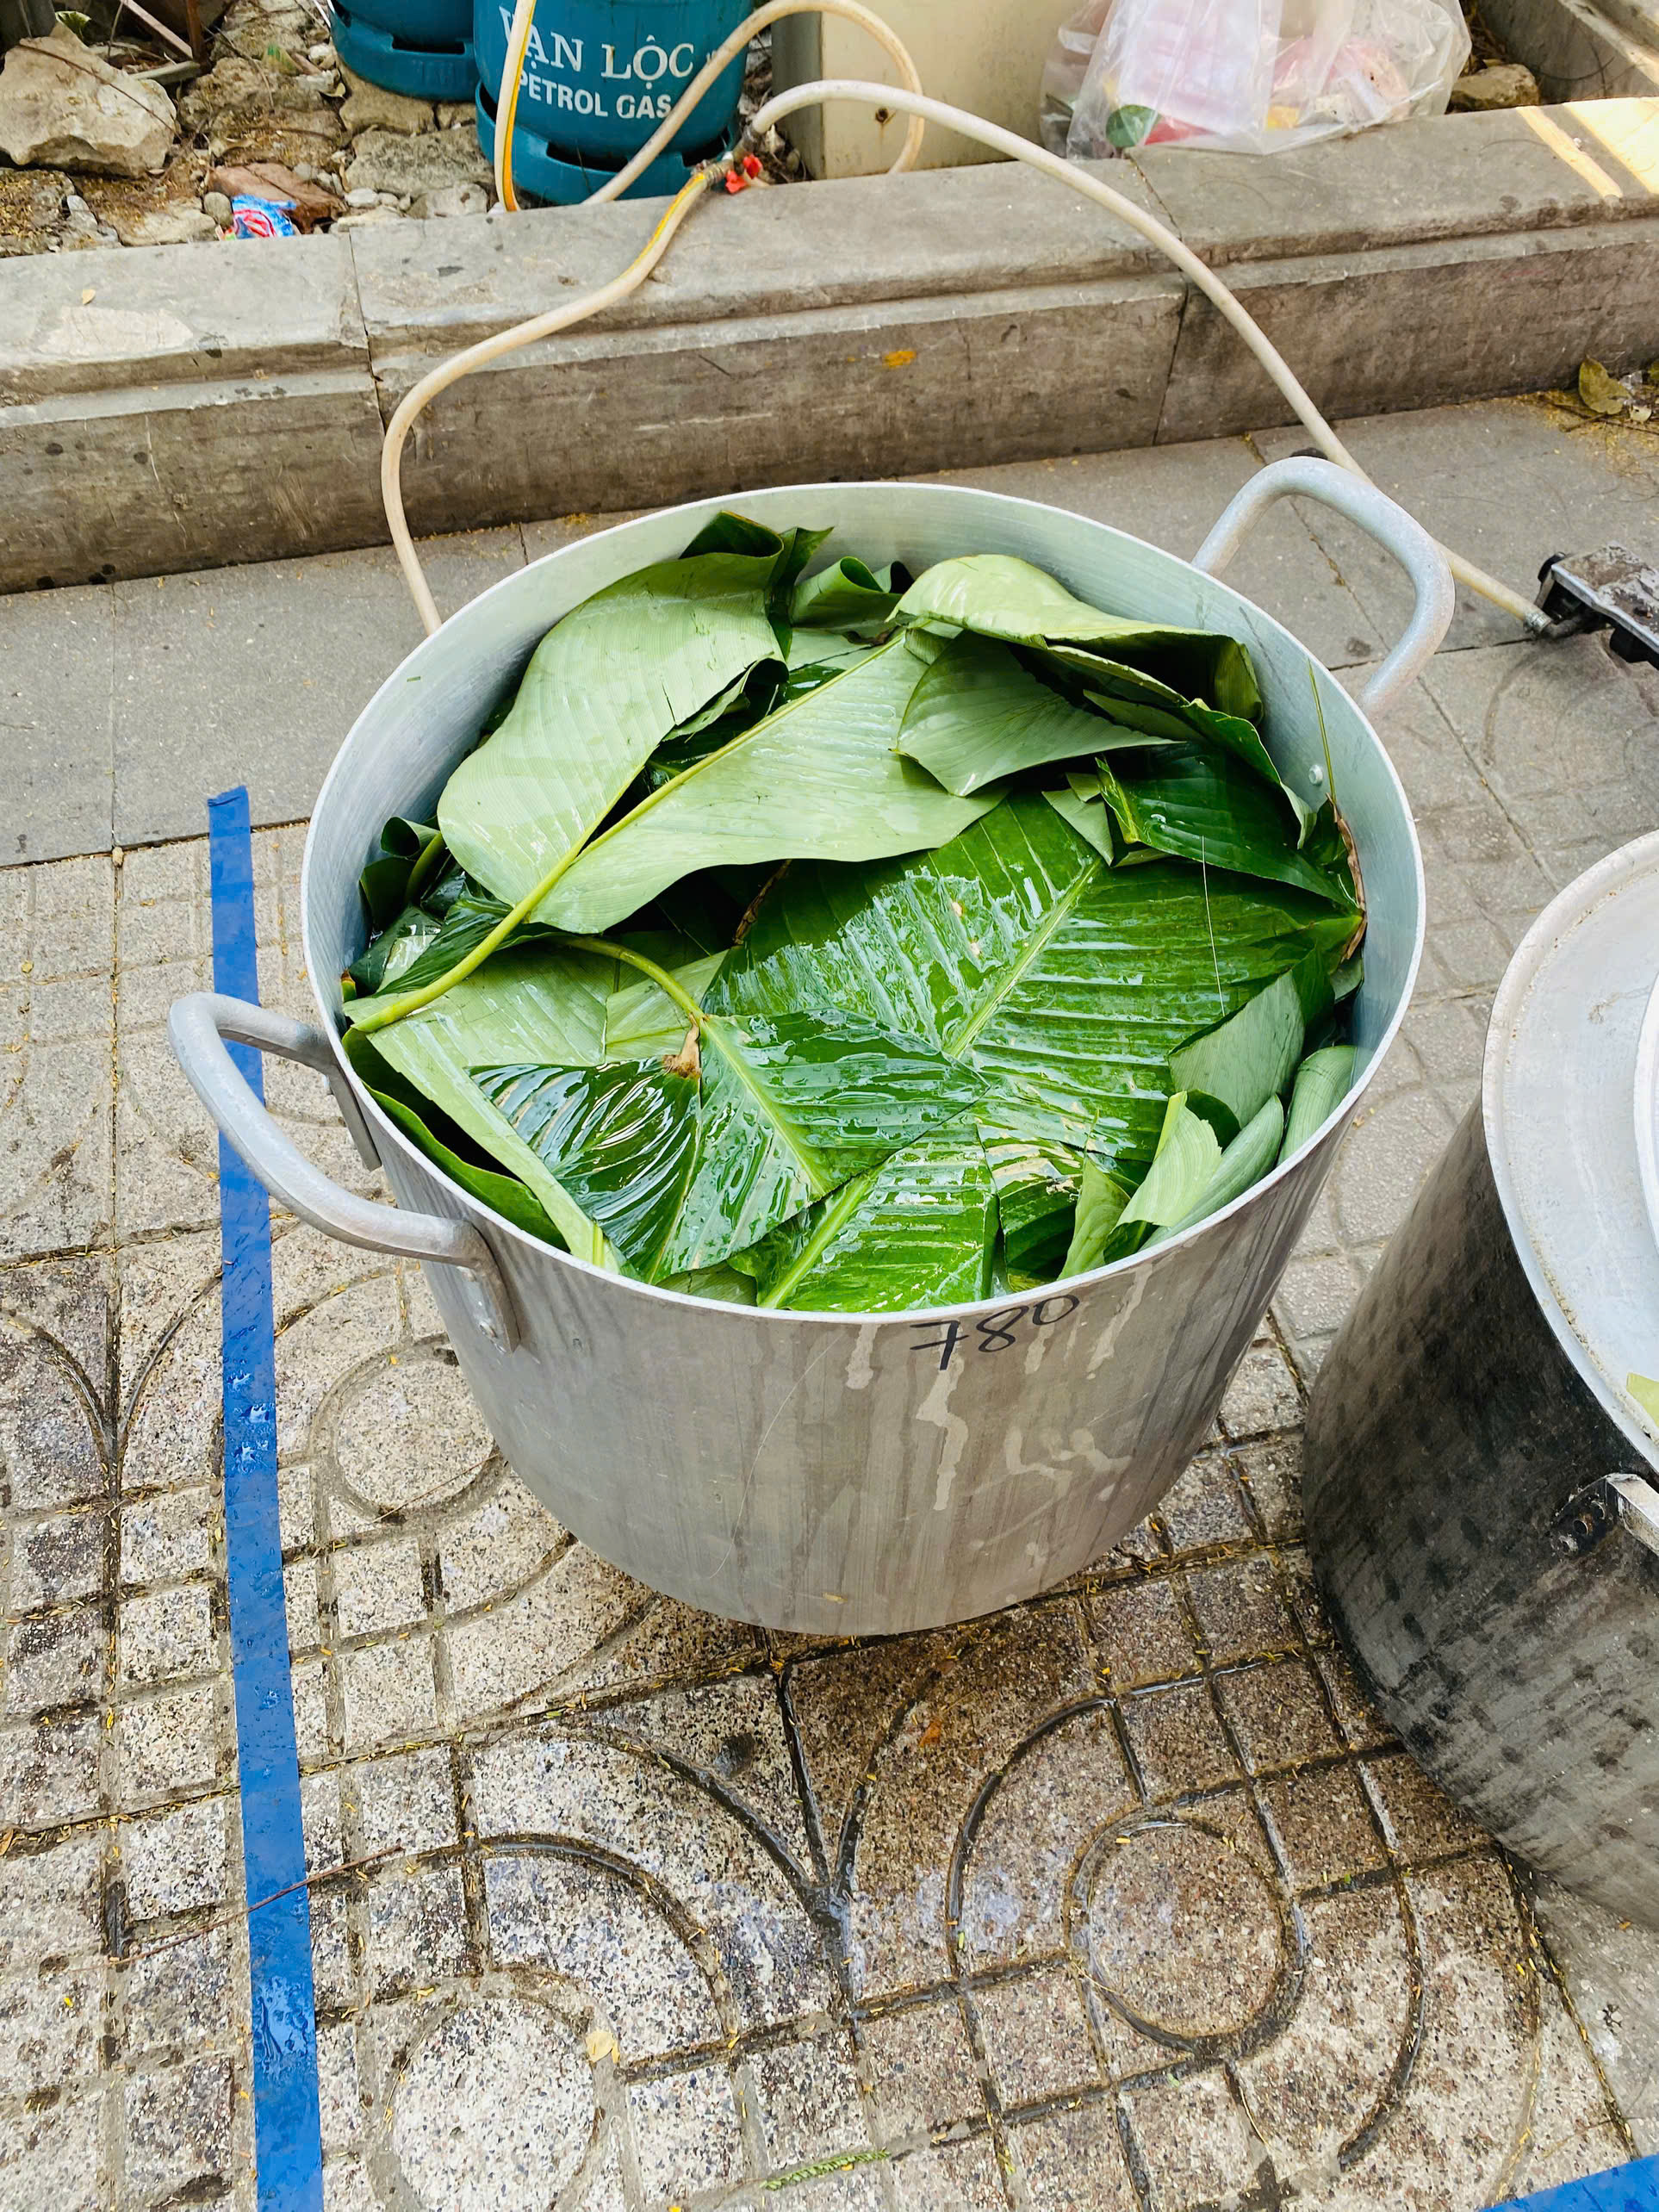
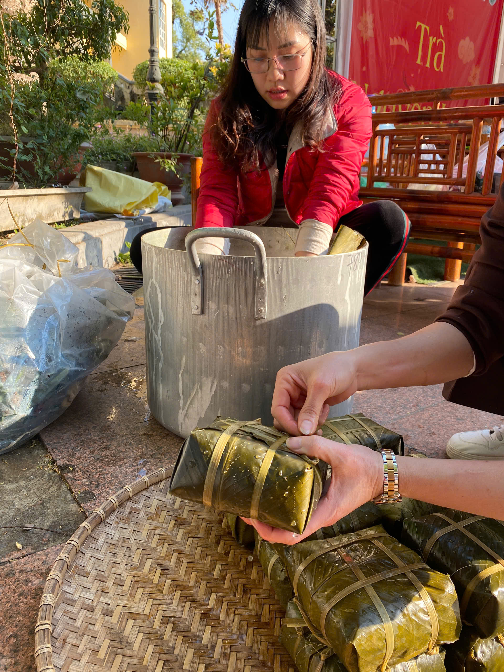
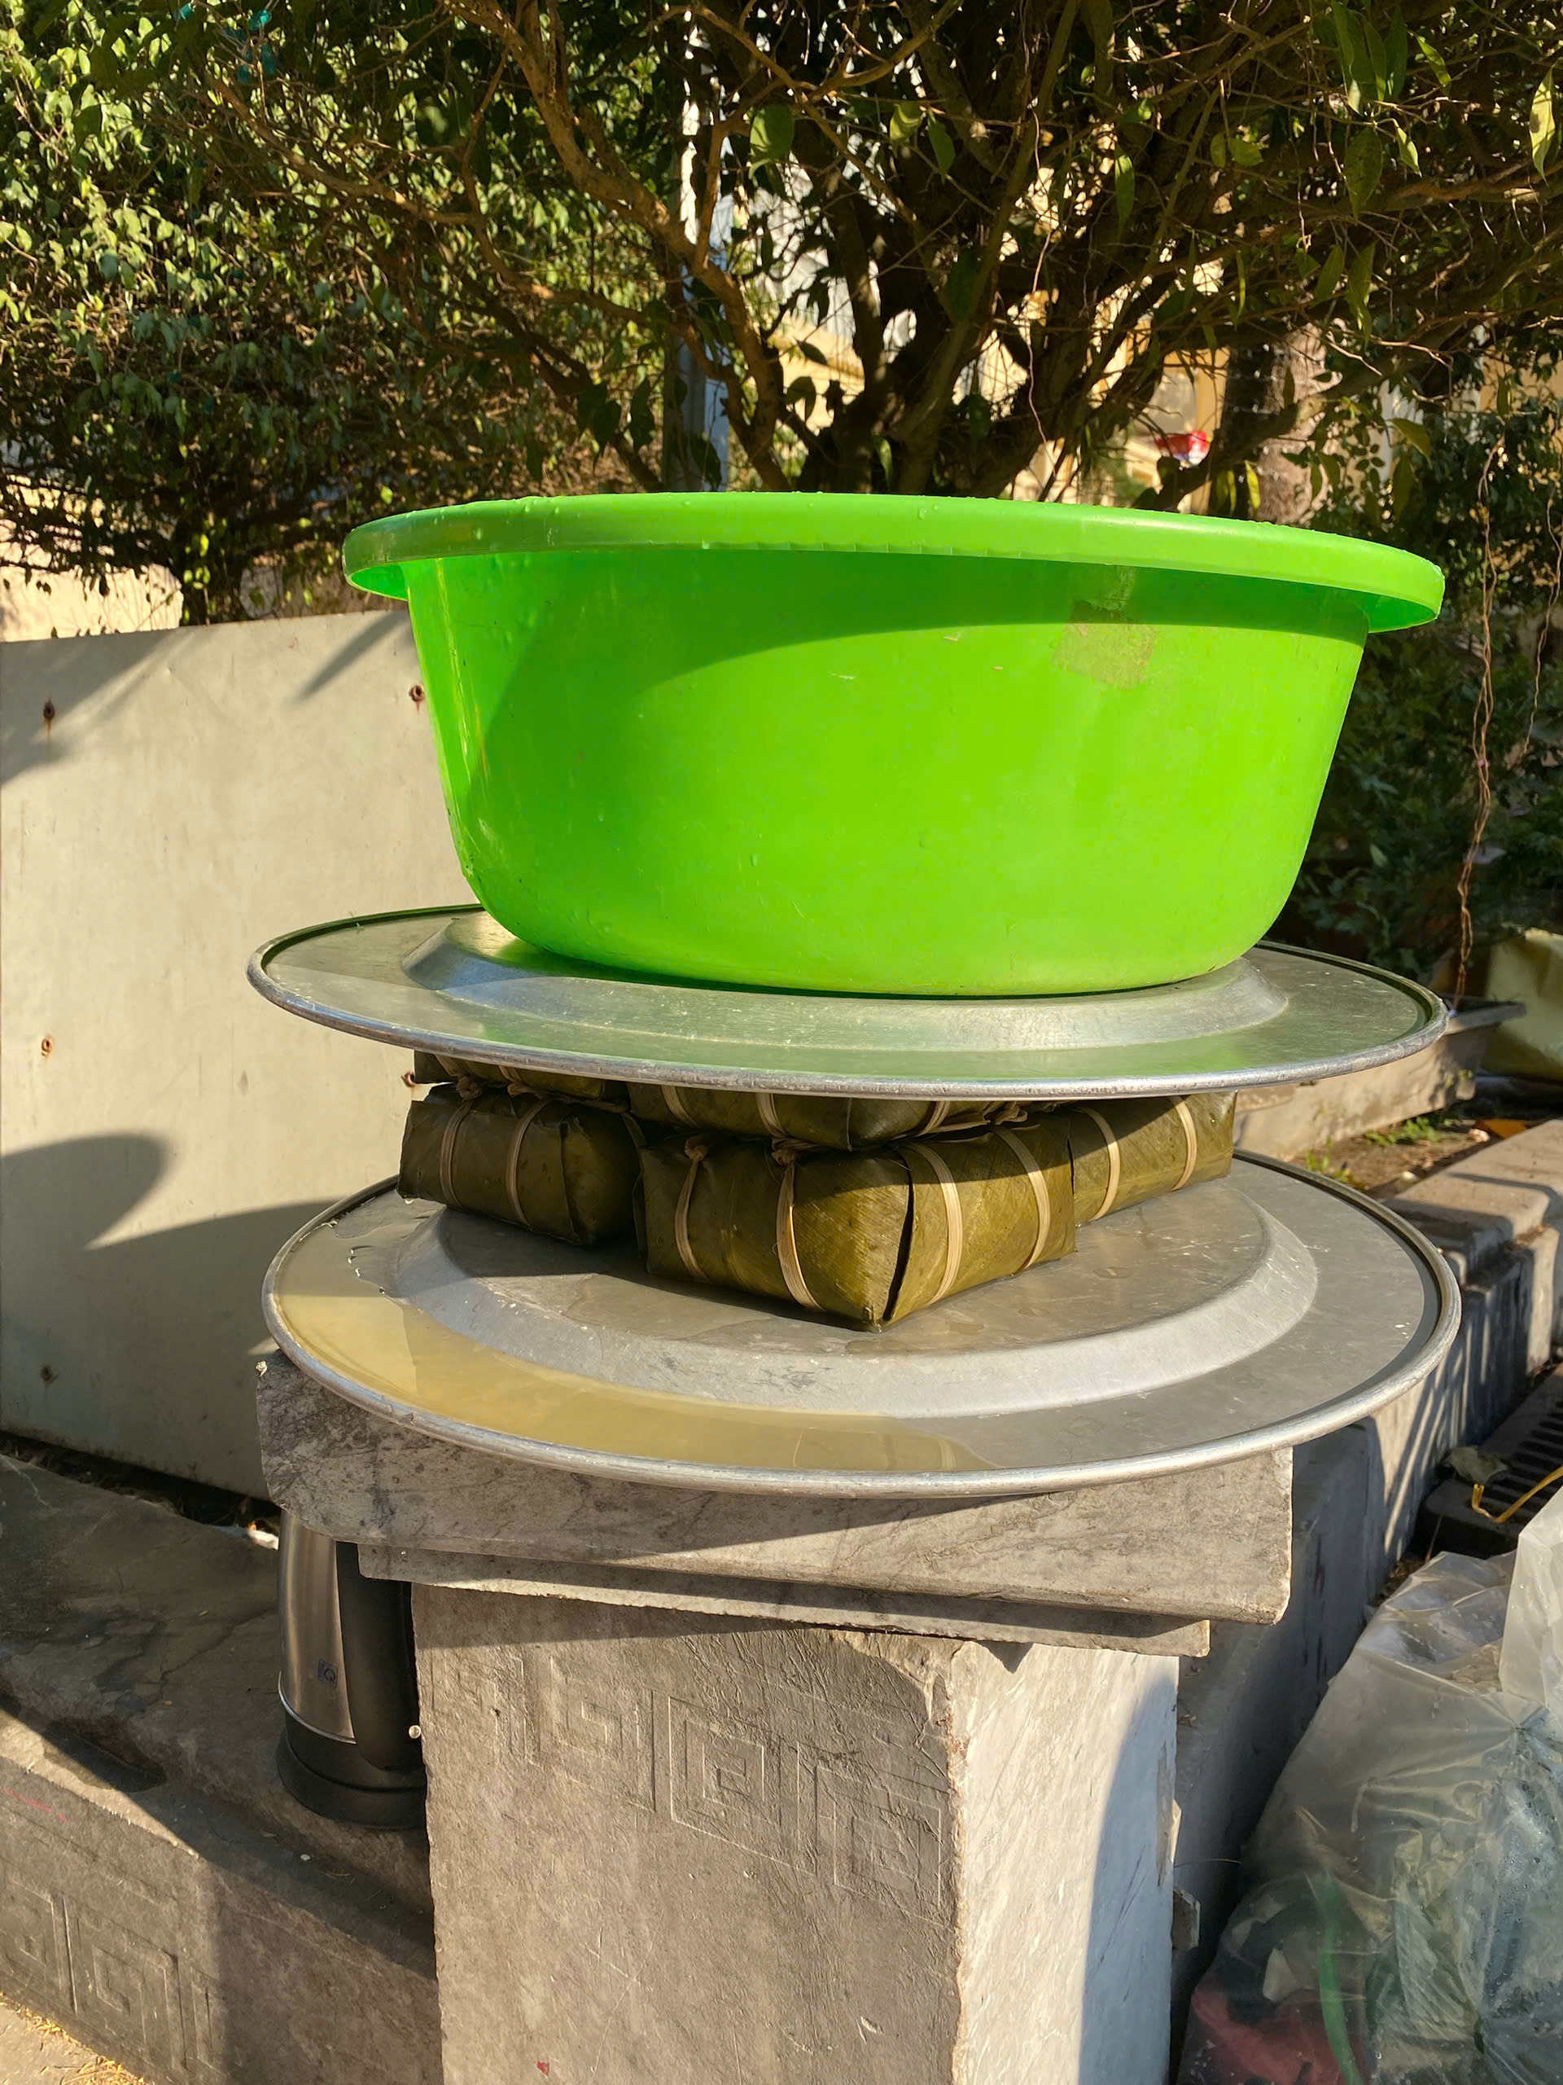
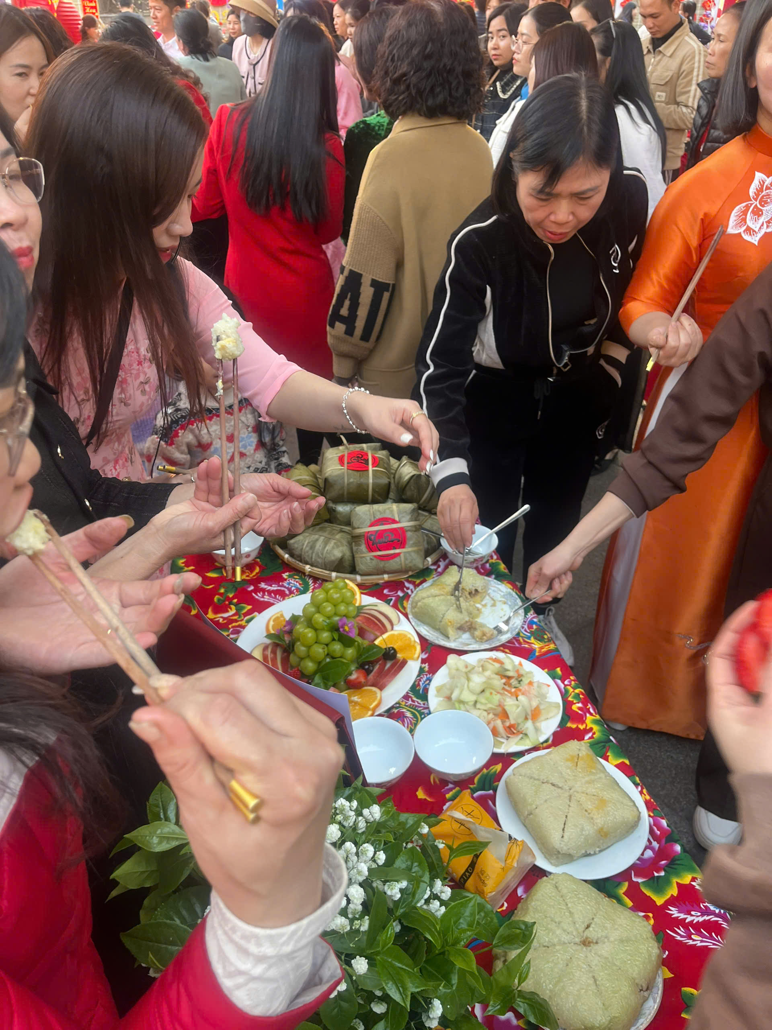

Slide 19
How much do you know about Tet?

Slide 20
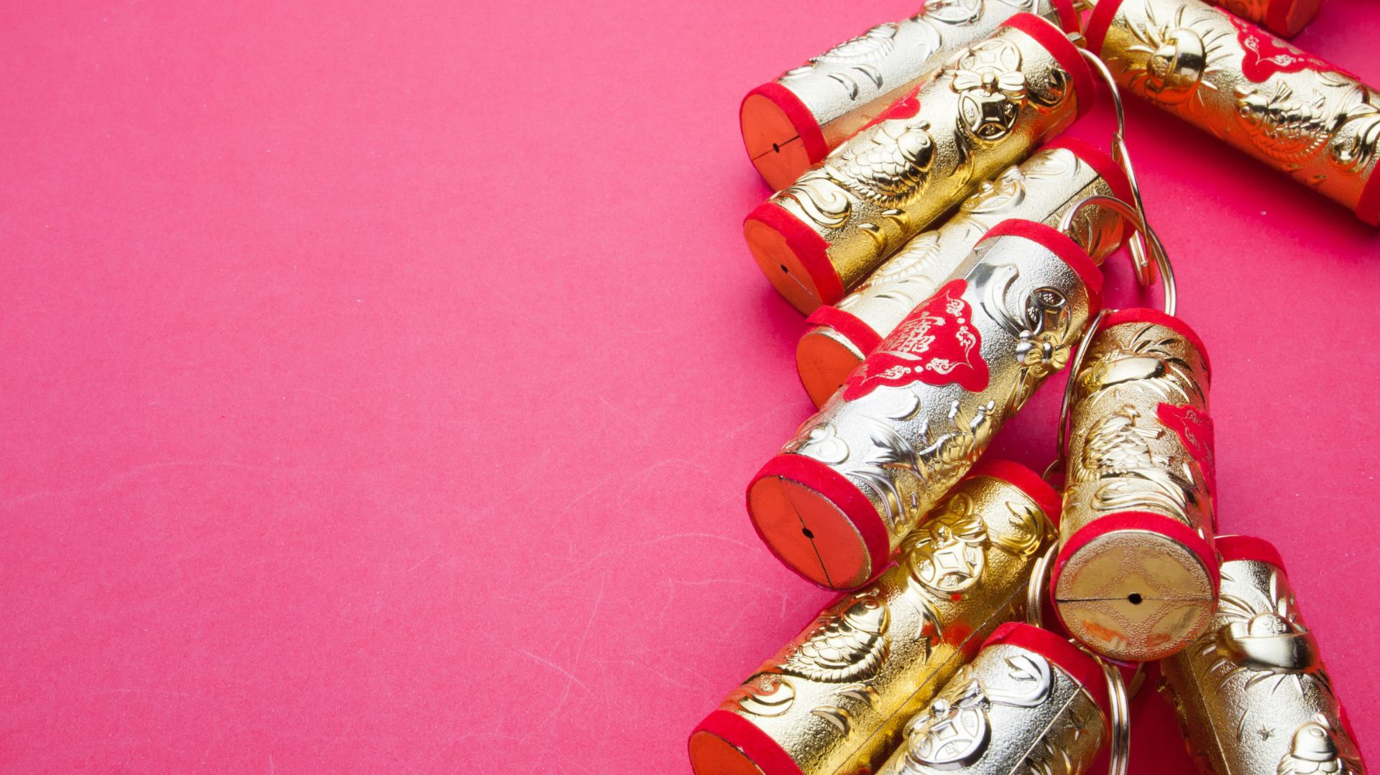
1. Which one is not traditional festival in Vietnam?
Christmas
Mid Autumn Festival
Lunar New Year

Slide 21
2. When is the first day
of Tet 2025?
28th January
29th January
30th January

Slide 22
3. How long does Tet holiday last?
A week
3 days
5 days

Slide 23
4. What do the elders give younger people at Tet?
Candies
Lucky money
Five-fruit tray

Slide 24
5. What do people often buy on the first day of New Year?
Salt
Sugar
Chilli

Slide 25
6. The special food of Tet which represents for the land?
Banh Chung
Banh day
Banh duc

Slide 26
7. The pink flowers that are used to decorate during Tet?
Apricot blossom
Peach blossom
Rose

Slide 27
8.One thing that people avoid doing on the first
day of New Year
Taking photos
Sweeping the floor
Going to the pagoda

Slide 28
9. Tet holiday is the time for______
Family gathering
Sleeping all day
Doing homework

Slide 29
10. The tree that Vietnamese people raise in front of their house to prevent devil or bad luck during Tet
Bamboo tree
Baobab tree
Pine tree

Slide 30
11. The first person to step into a household from the outside on the first day of New year
First footer
First guest
First buddy

Slide 31
12. What is the band who sings the famous song "Happy New Year“?
Maroon 5
The Beatles
ABBA

