Slide 1


Slide 2


LESSON 6: SKILLS 2
LESSON 1: GETTING STARTED
Jumble words
WARM-UP
Task 1: What are the students doing in each picture?
Task 2: Listen to Mi and Minh talking about their best friends. Look at the picture below and
say which one is Lan and which one is Chi.
Task 3: Listen to the talk again. Fill each blank with a word / number you hear.
LISTENING
Task 4: Work in pairs. Ask and answer about your best friend. Use these notes to help you.
Task 5: Write a diary entry of about 50 words about your best friend. Use the answers to the questions in 4.
WRITING
CONSOLIDATION
Wrap-up
Homework

Slide 3
WARM-UP
Jumble words
Unjumble the given words

Slide 4
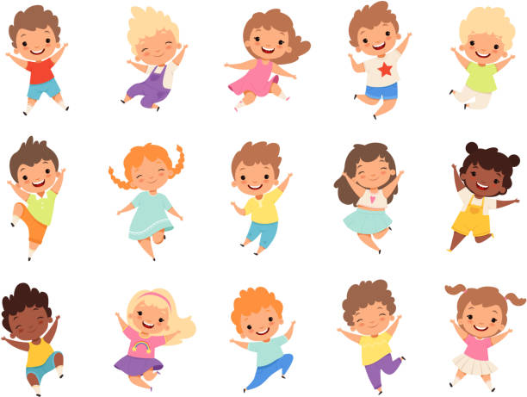
PRESENTATION
TACIEV
ACTIVE

Slide 5
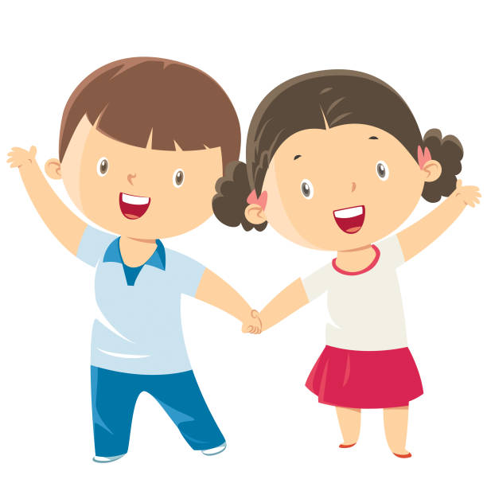
PRESENTATION
LFIEDRNY
FRIENDLY

Slide 6
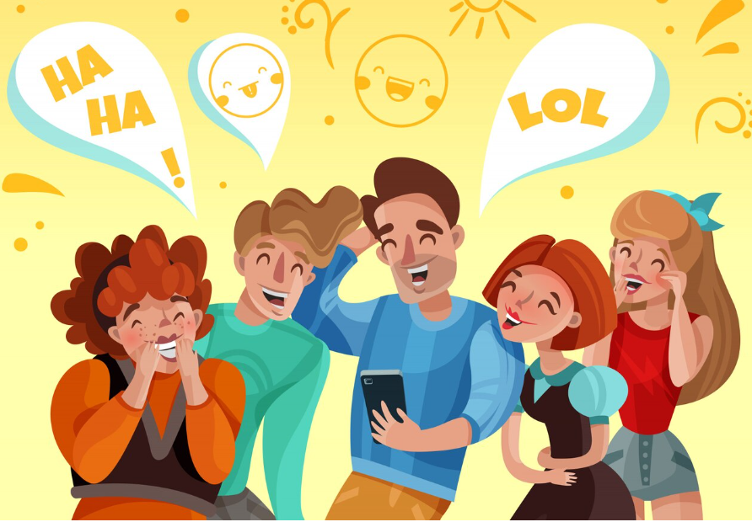
PRESENTATION
YNUNF
FUNNY

Slide 7

PRESENTATION
RCUFEAL
CAREFUL

Slide 8
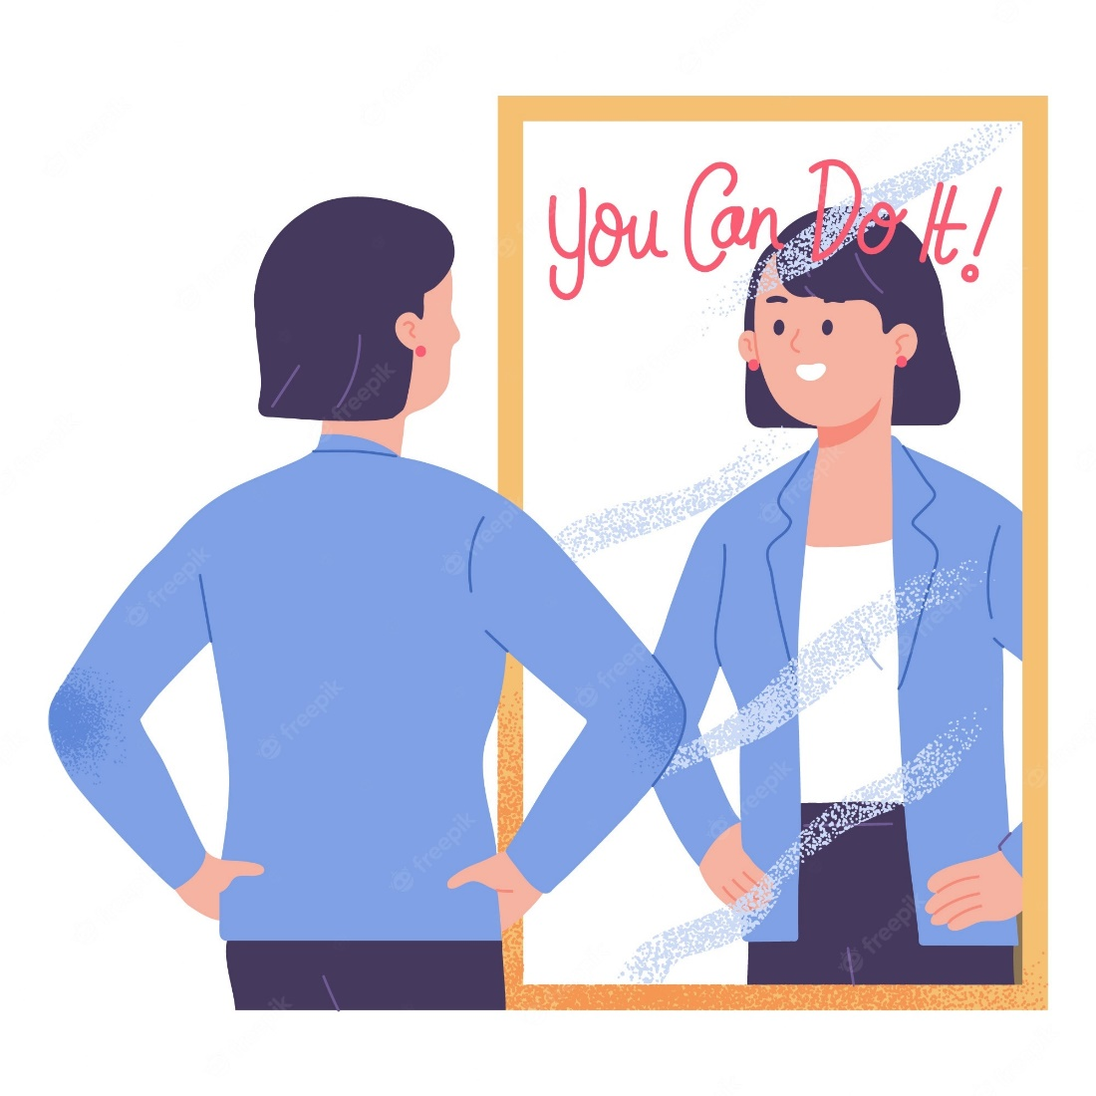
PRESENTATION
TOFCNDITEN
CONFIDENT

Slide 9
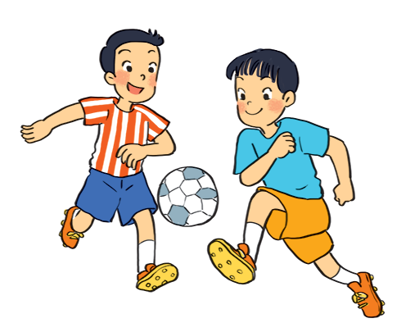
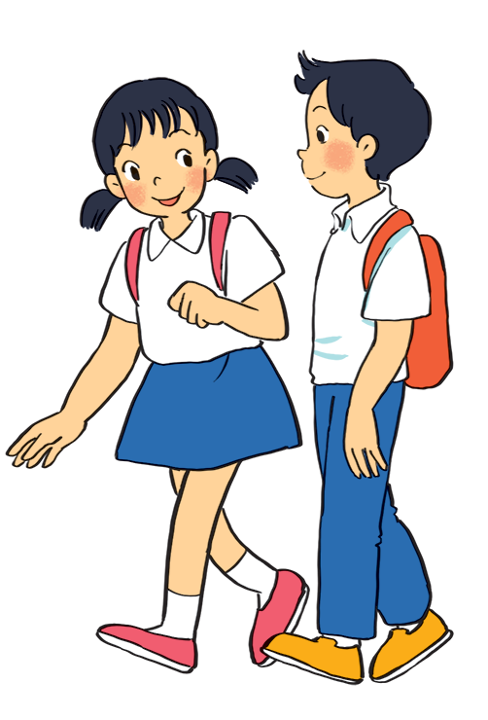
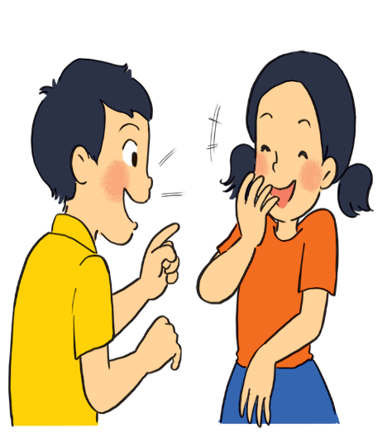
LISTENING
1
What are the students doing in each picture?
a
b
c
They are playing football.
They are talking.
They are walking.

Slide 10

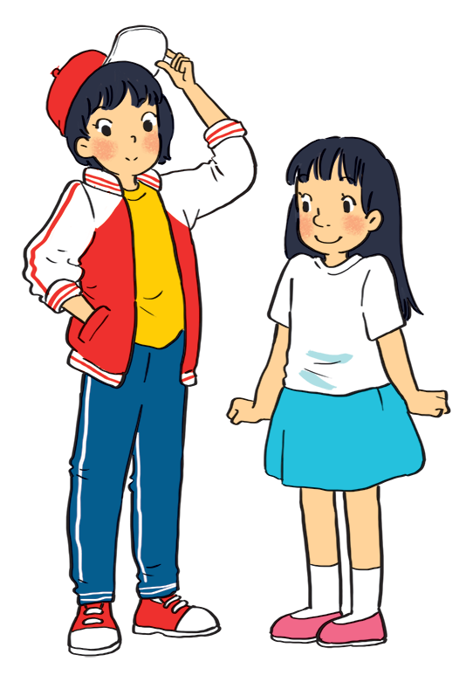
LISTENING
2
Listen to Mi and Minh talking about their best friends. Look at the picture below and say which one is Lan and which one is Chi.
Lan
Lan is the girl wearing a red and white jacket and a red cap.
Chi
Chi is the girl wearing a white T-shirt and a blue skirt.
Audio script

Slide 11
LISTENING
3
Listen to Mi and Minh talking about their best friends. Look at the picture below and say which one is Lan and which one is Chi.
1. Mi and lan are studying in class _____.
2. Lan has short _______ hair and a small _______.
3. Lan is active and _______.
4. Chi’s hair is long and black, and her nose is _______.
5. Chi is _______ to Minh.
6A
black
mouth
friendly
big
kind
Audio script

Slide 12

AUDIO SCRIPT
Mi: My best friend is Lan. She studies with me in class 6A. She’s tall and slim. She has short black hair and a small mouth. She’s very active and friendly. She likes playing sports and has many friends. Look, she’s playing football over there!
Minh: Chi is my best friend. We’re in class 6B. She’s short with long black hair and a big nose. I like her because she’s kind to me. She helps me with my English. She’s also hard-working. She always does her homework before class. Look, she’s going to the library.

Slide 13
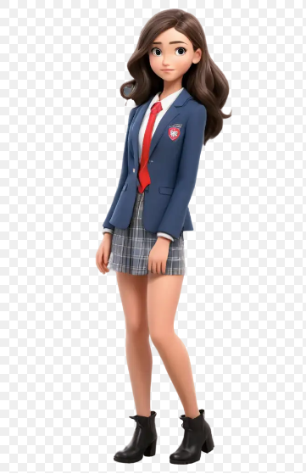

Slide 14
READING
4
Work in pairs. Ask and answer about your best friend. Use these notes to help you.
1.
What’s his / her name?
2.
What does he / she look like?
3.
What’s he / she like?
4.
Why do you like him / her?

Slide 15

READING
5
Write a diary entry of about 50 words about your best friend. Use the answers to the questions in 4.
Dear Diary,
My best friend is
I like
because

Slide 16
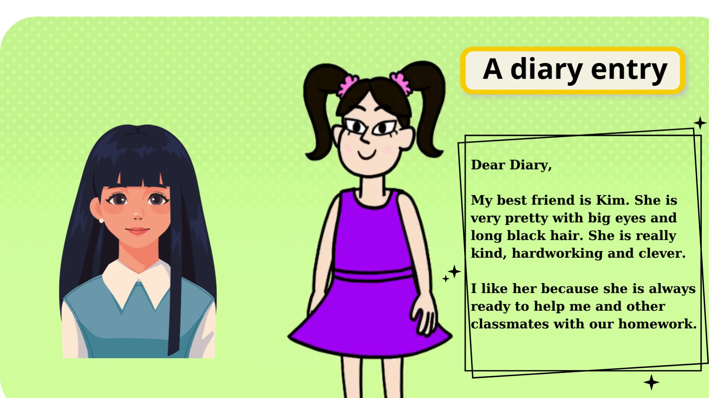

Slide 17

CONSOLIDATION
1
Wrap-up
What have we learnt in this lesson?
Listen for specific information about best friends
Write a diary entry about best friends

Slide 18

CONSOLIDATION
2
Homework
- Rewrite the diary entry in the notebook.
- Do exercises in the workbook.

Slide 19






Website: hoclieu.vn
Fanpage: facebook.com/www.tienganhglobalsuccess.vn/

