Slide 2
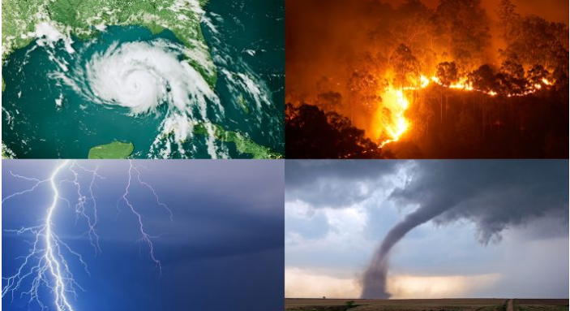
NATURAL DISASTERS

Slide 3
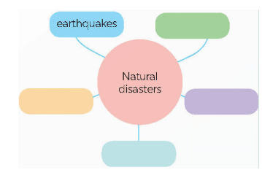
WARM-UP

Slide 4
UNIT 9: NATURAL DISASTERS
Lesson 7: Looking back and project

Slide 5
UNIT 9: NATURAL DISASTERS
Lesson 7: Looking back and project

Slide 6
WARM-UP
Unit 9

Slide 7
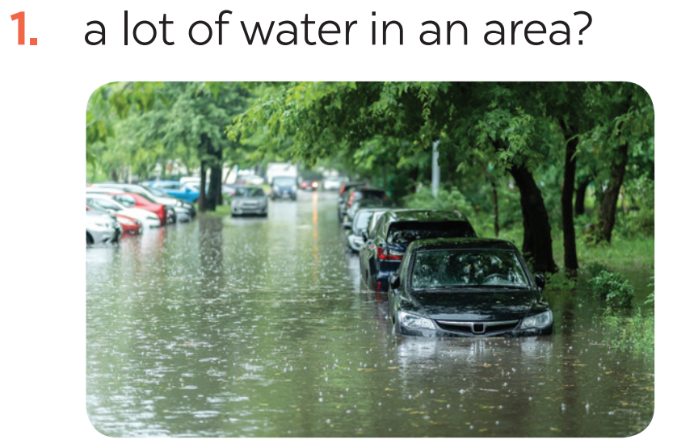
VOCABULARY
1
Write the name of a natural disaster in each blank.
flood

Slide 8
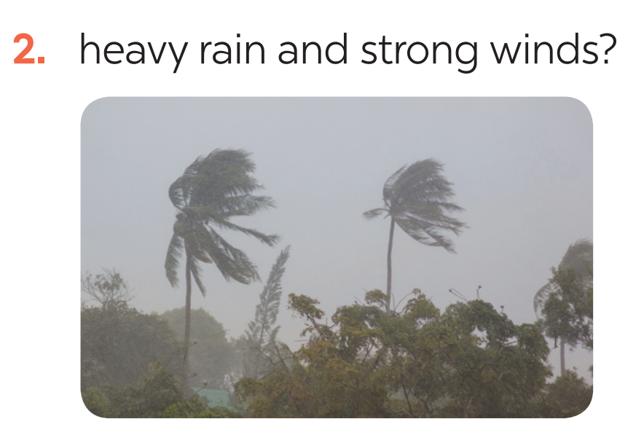
VOCABULARY
1
Write the name of a natural disaster in each blank.
storm

Slide 9
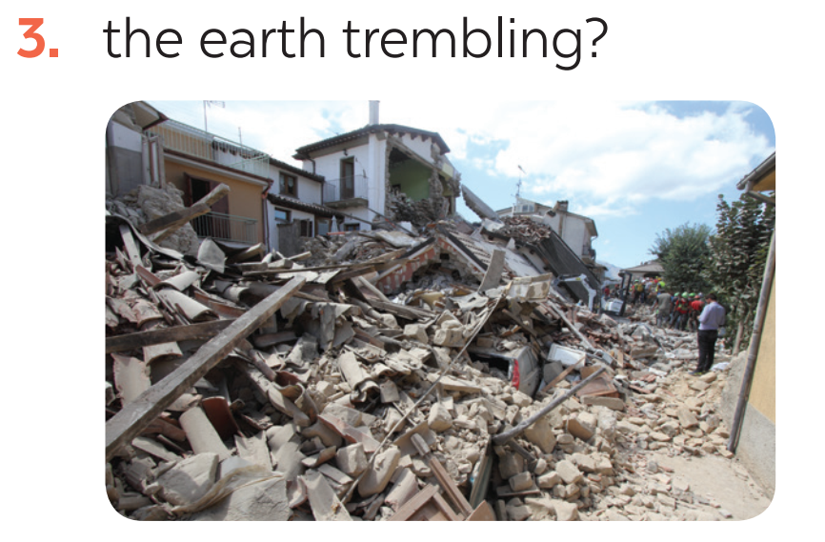
VOCABULARY
1
Write the name of a natural disaster in each blank.
earthquake

Slide 10
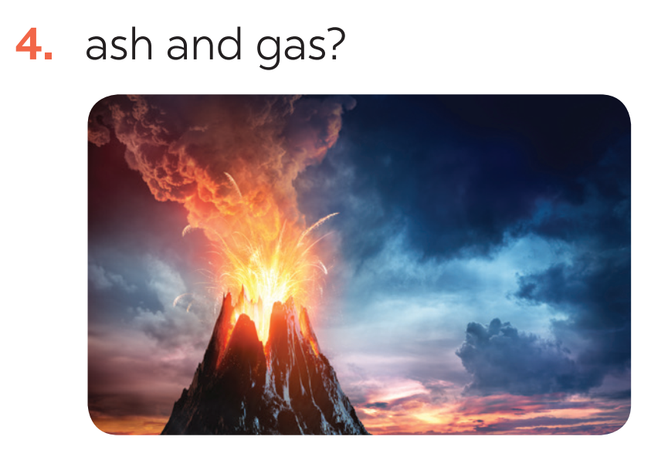
VOCABULARY
1
Write the name of a natural disaster in each blank.
volcanic eruption

Slide 11
VOCABULARY
1
Write the name of a natural disaster in each blank.
landslide

Slide 12
VOCABULARY
2
Fill in each blank with the correct form of the word in brackets.
1. The tsunami brought __________ to cities and towns near the sea. (destroy)
2. The government has developed some systems to help make __________ about natural disasters. (predict)
3. We are donating money and food to help the ______ of the landslide. (victim)
4. The local authorities _______ the villagers about a landslide yesterday. (warning)
5. Rescue _______ are trying hard to save people in the flooded area. (work)
destruction
predictions
victims
warned
workers

Slide 13
GRAMMAR

Slide 14
FORM
GRAMMAR

Slide 15
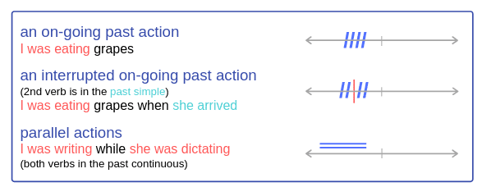
GRAMMAR
USES

Slide 16
GRAMMAR
3
Put the verbs into the correct tense: the past simple or past continuous.
1. What _____ you (do) _____ at 8 o’clock yesterday morning?
2. Last year, earthquakes (destroy) _________ a lot of houses in Japan.
3. He (water) ____________ the flowers in his garden when the tornado (come) _____.
4. While they (call) __________ for help, the rescue workers (appear) ________.
5. _______ you (listen) ________ to music at 9 o’clock yesterday evening?
were
doing
destroyed
was watering
came
were calling
appeared
Were
listening

Slide 17
GRAMMAR
4
Complete the sentences about you and your family members.
At 7 p.m. yesterday, …
1. I was ________________________________.
2. my grandmother / grandfather ____________.
3. my mother ____________________________.
4. my father _____________________________.
5. my sister / brother ______________________.

Slide 18
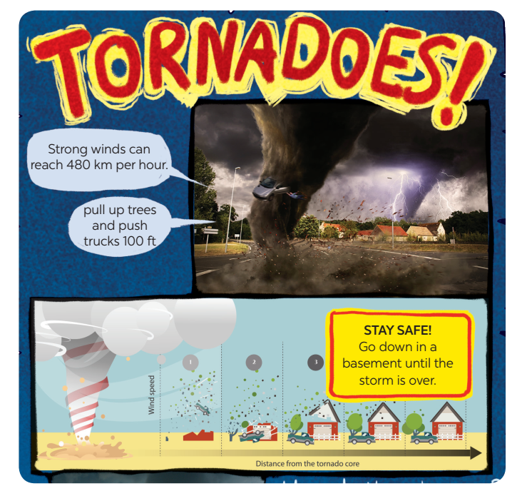
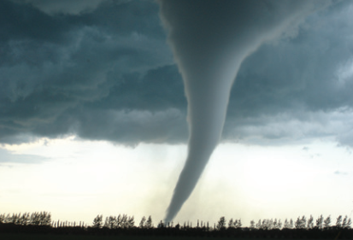
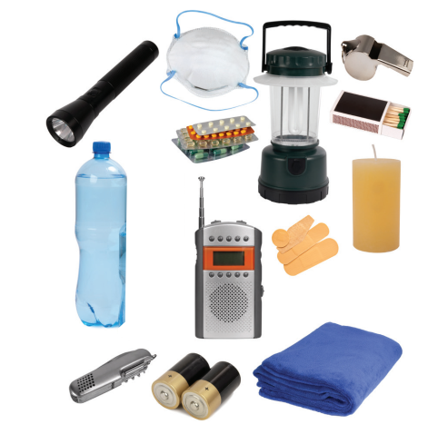
PROJECT

Slide 19
CONSOLIDATION
1
Wrap-up
In this lesson, you have:
revised more vocabulary items you have learnt in the unit.
revised the differences between the past simple and past continuous.
revised the past continuous.
researched more deeply into a natural disaster.

Slide 20
CONSOLIDATION
2
Homework
Do exercises in the workbook.
Prepare for Unit 10 – Getting started

