Slide 1
JUMBLED WORDS

Slide 2
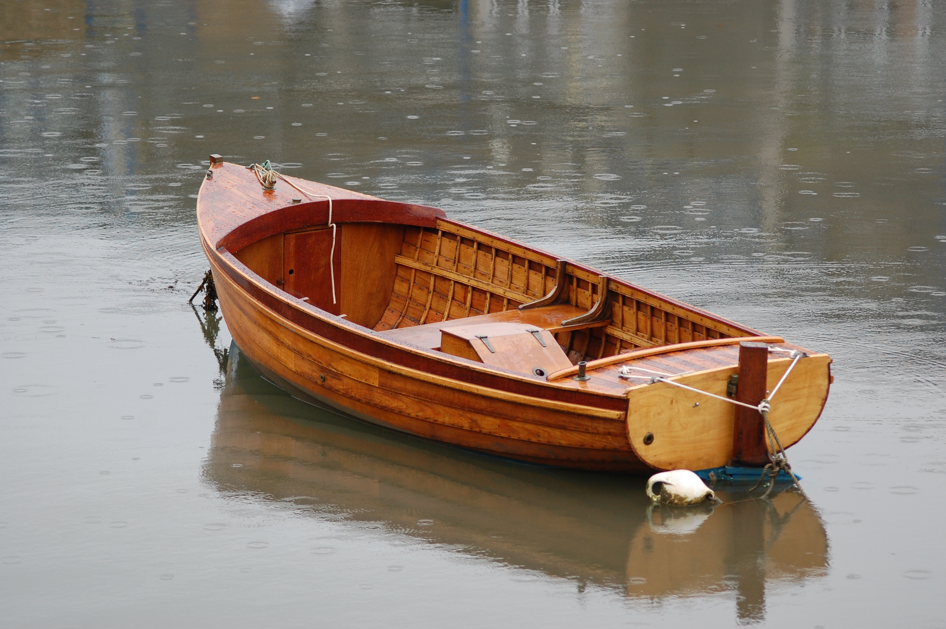
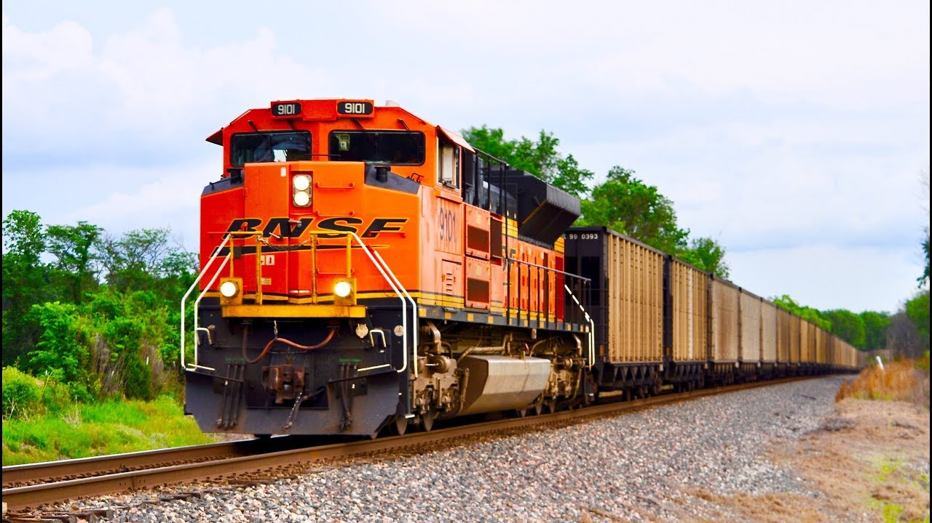
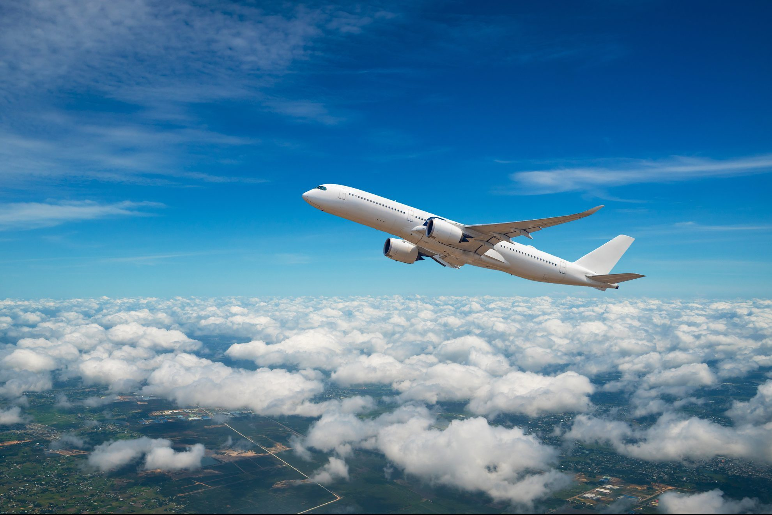
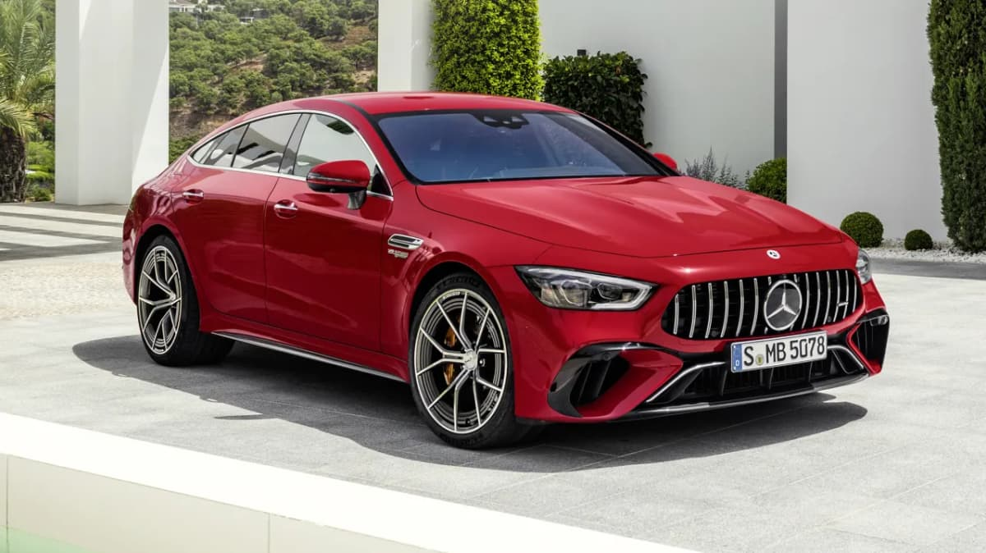
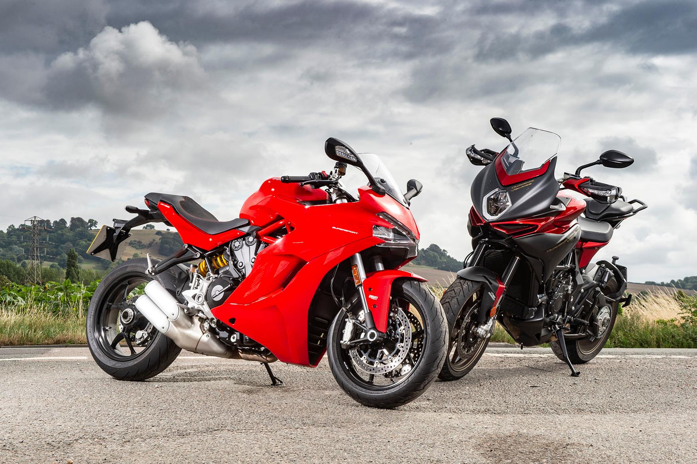
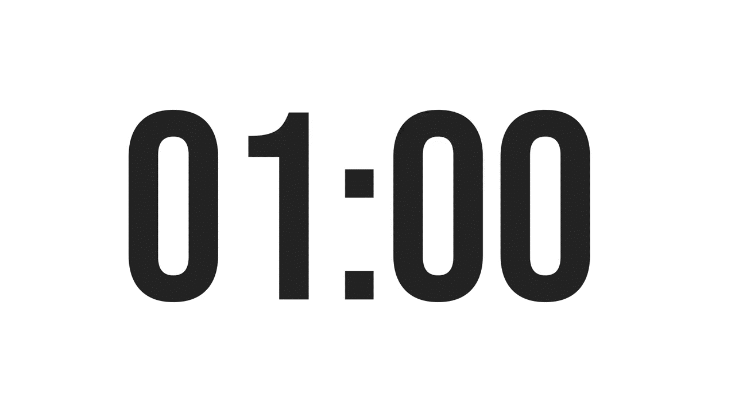
Look and rewrite
OTBA
ITANR
NPEILARA
ARC
OTMIROEKB

Slide 3
MEANS OF TRANSPORT
BOAT
AIRPLANE
OTBA
ITANR
NPEILARA
TRAIN
ARC
CAR
MOTORBIKE
OTMIROEKB

Slide 4
UNIT 7: TRAFFIC
LESSON 2:
A CLOSER LOOK 2

Slide 5
Objectives
By the end of the lesson, students will be able to:
VOCABULARY
use the verbs going with means of transport
read the road signs
PRONUNCIATION
pronounce and recognize the sounds /aɪ/ and /eɪ/

Slide 6
1
NEW WORDS

Slide 7
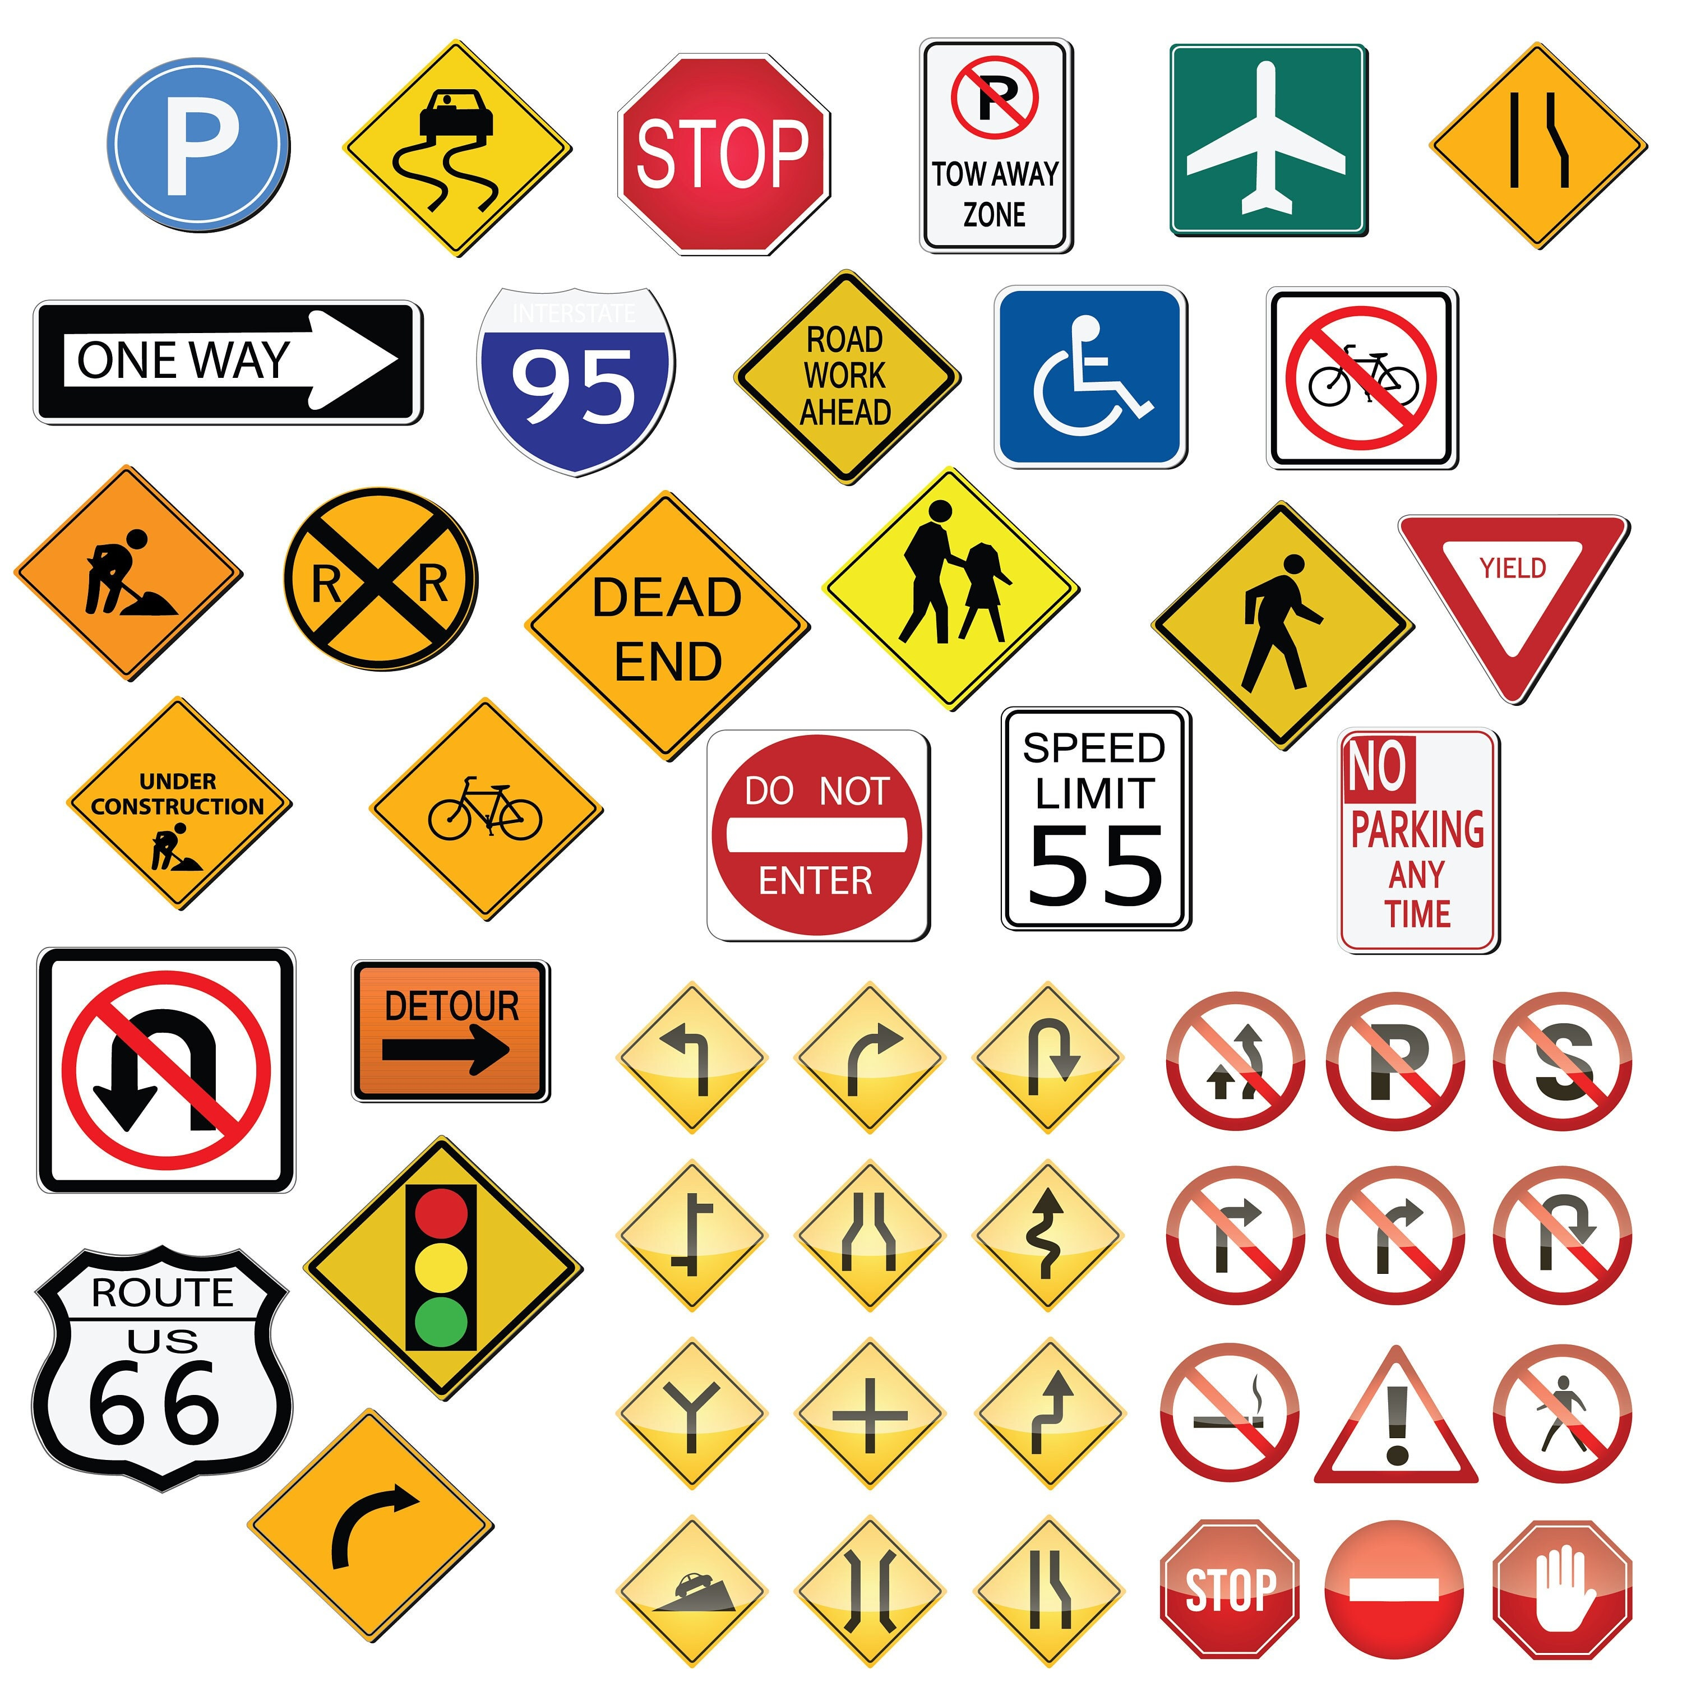

New words
road sign (n)
/ˈrəʊd saɪn/
biển báo giao thông

Slide 8
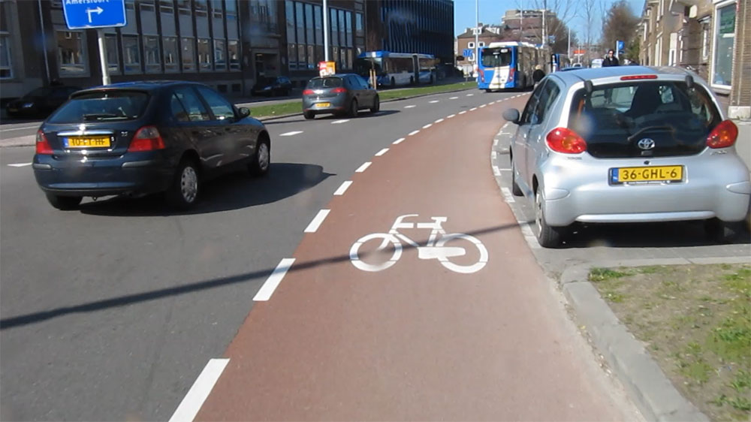
New words
cycle lane (n)
/ˈsaɪkl leɪn/
làn đường
dành riêng cho xe đạp

Slide 9
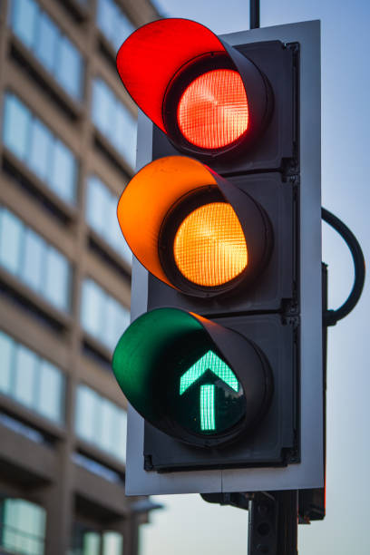
New words
traffic light (n.phr.)
/ˈtræfɪk laɪt/
đèn giao thông

Slide 10
New words
New words | Pronunciation | Meaning
1. road sign (n.phr.) | /ˈrəʊd saɪn/ | biển báo giao thông
2. cycle lane (n.phr.) | /ˈsaɪkl leɪn/ | làn đường dành riêng cho xe đạp
3. traffic light (n.phr.) | /ˈtræfɪk laɪt/ | đèn giao thông

Slide 11

DO YOU SAY?
ride a car?
ride a bicycle?
What about the others?

Slide 12
Ex 1. Match A with B (P.74)
A
B
1. ride
a. a car
2. drive
b. a boat
3. sail
c. a bike
4. go
d. by air
5. travel
e. on foot

Slide 13
Ex 1. Make your own sentences
A
B
Example:
My father taught me how to ride a bike.
1. ride
c. a bike
2. drive
a. a car
3. sail
b. a boat
4. go
e. on foot
5. travel
d. by air

Slide 14





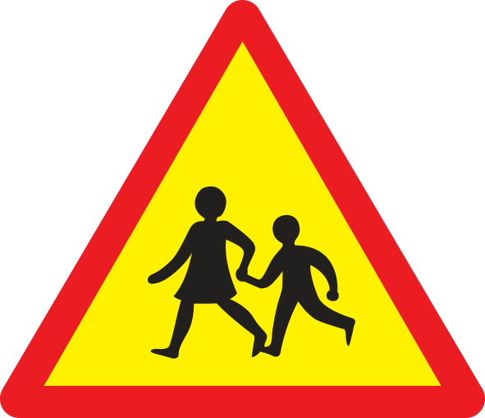
Ex 2. Look and write the correct phrases.
No right turn
Cycle lane
School ahead
Traffic lights
No cycling
Hospital ahead
Hospital ahead
No right turn
Traffic lights
Cycle lane
School ahead
No cycling

Slide 15


Ex 3. Work in pairs. Take turns to say which of the signs in 2 you see on the way to school.
On my way to school, there is a hospital, so I see a “hospital ahead” sign.
On the way to school, there are crossroads, so I see several traffic lights.

Slide 16

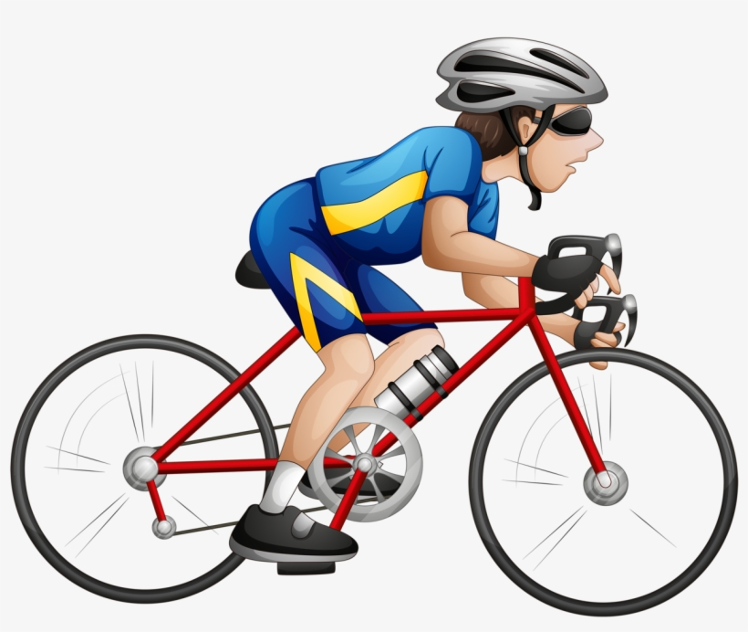
Guess the words
y
s_ _l
c_cle
a
i
/aɪ/
/eɪ/

Slide 17
2
PRONUNCIATION
/aɪ/
/eɪ/

Slide 18

Watch and repeat

Slide 19
Ex 4. Listen and repeat. Pay attention to the sounds /aɪ/ and /eɪ/.
/aɪ/ | /eɪ/
cycle | sail
fly | train
fine | plane
sign | station
motorbike | pavement

Slide 20
Ex 5. Underline the words with the sound /aɪ/ and circle the words with the sound /eɪ/.
1. The bus station is far from my house.
2. Remember to ride your bike carefully.
3. We must obey traffic rules for our safety.
4. You have to get there in time for the train.
5. Don’t ride on the pavement.

Slide 21
Ex 5. Listen, check and repeat.
1. The bus station is far from my house.
2. Remember to ride your bike carefully.
3. We must obey traffic rules for our safety.
4. You have to get there in time for the train.
5. Don’t ride on the pavement.

Slide 22
RECAP
01
My house is far from school, so I have to ____ a bike to school.
A. drive B. sail C. ride
02
What is the sign?
Hospital ahead
No right turn
No cycling
02
Choose the word pronounced different.
A. ride B. bike C. city

Slide 23
THANKS!
Do you have any questions?

