Slide 1








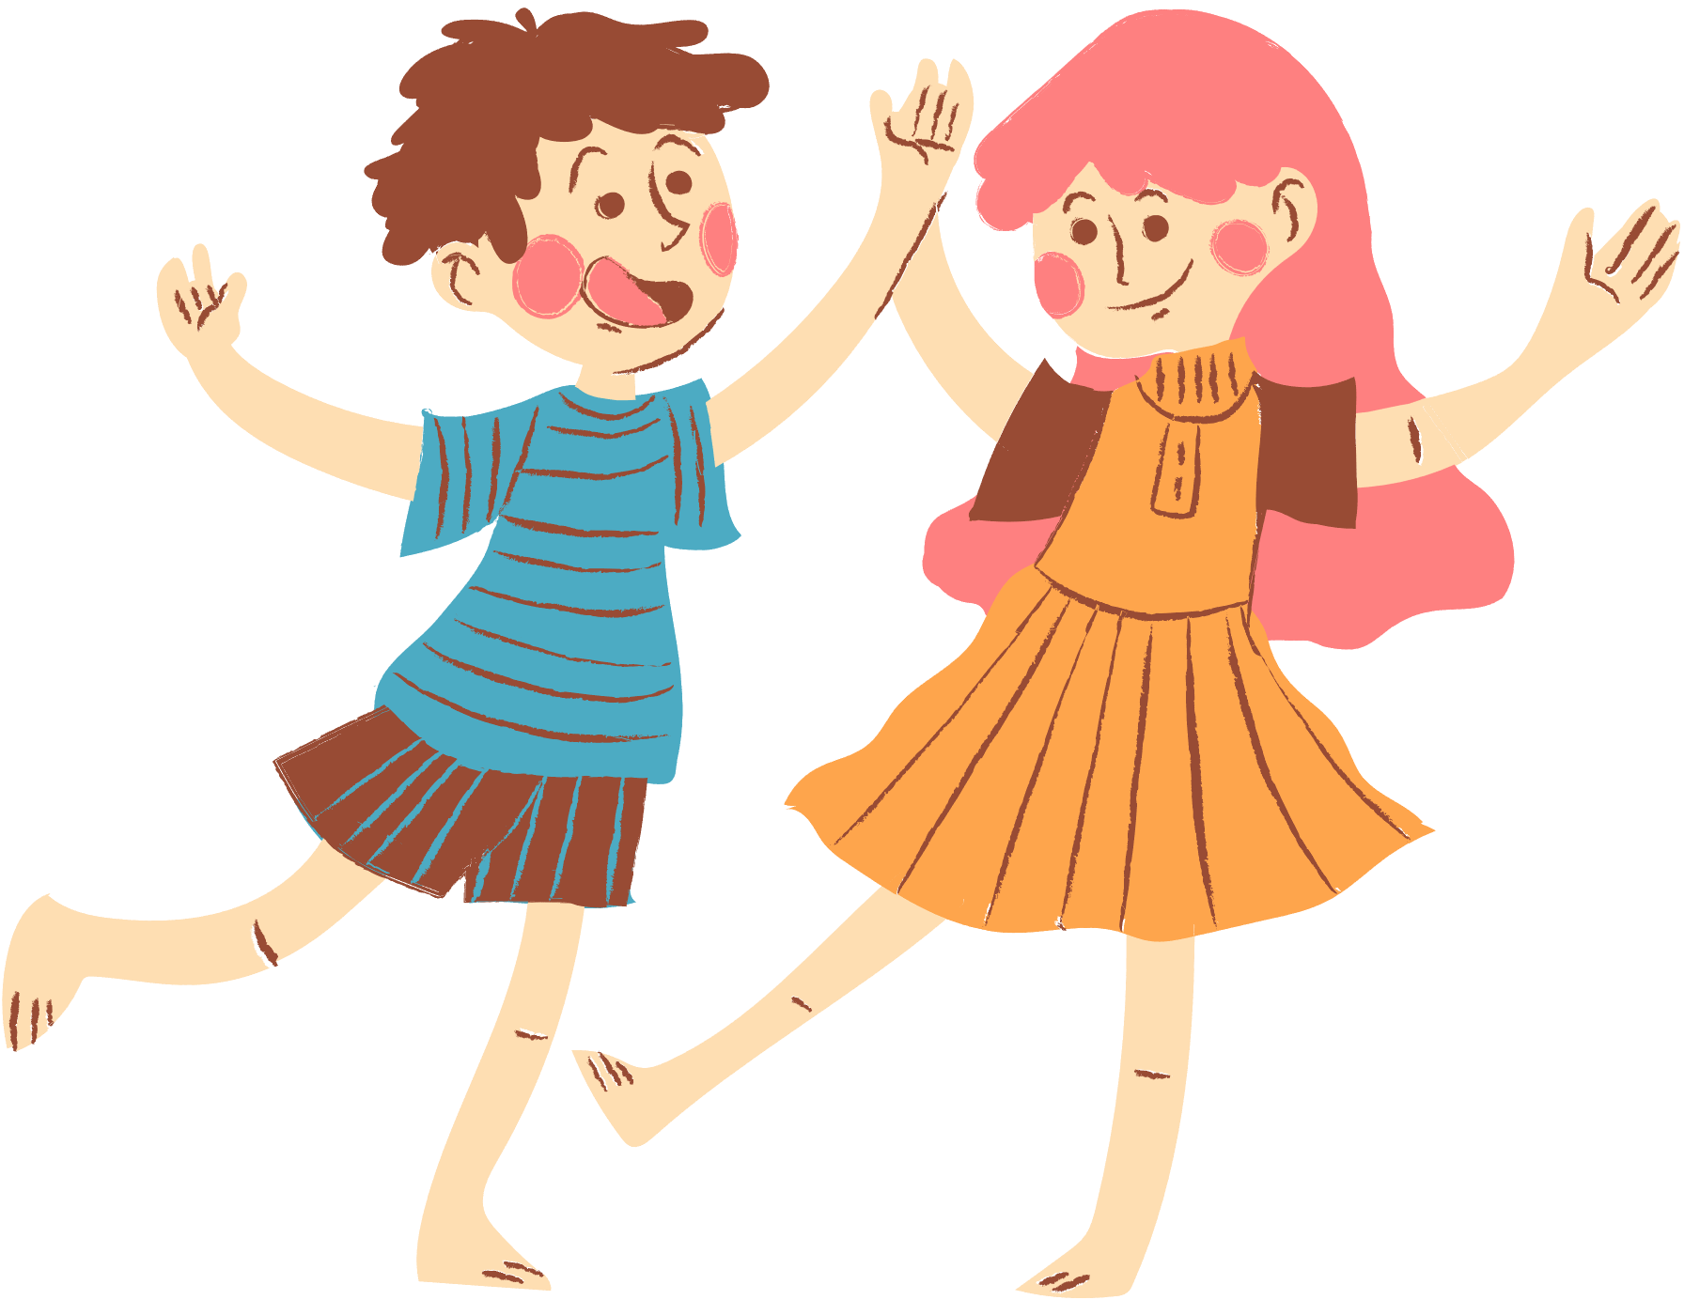
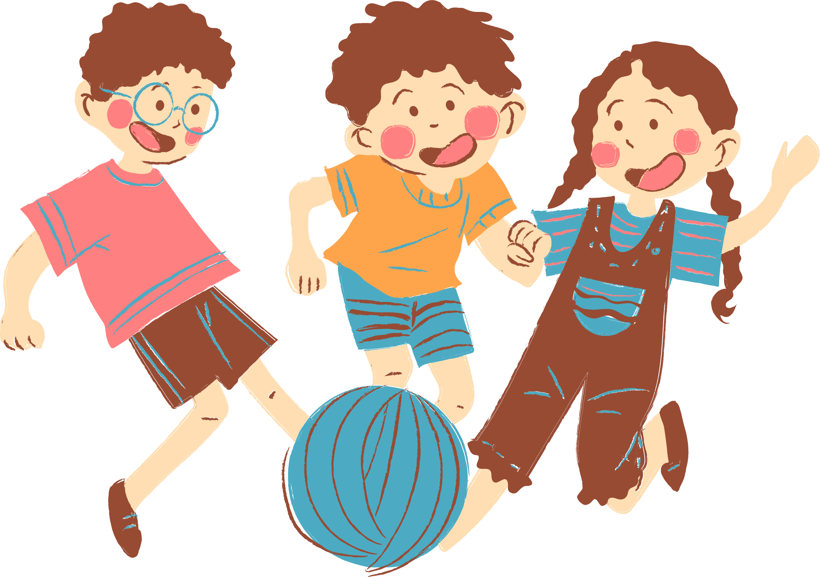
Teacher: Phan Cuc Nhat

Slide 2







Slide 3







He cooks food in the restaurant. Who is he?
cook
pupil
pupil

Slide 4

She works at school. She teaches pupils. Who is she?
actor
teacher

Slide 5

He works in a police station. Who is he?
cook
policeman

Slide 6

She takes care of sick people.
Who is she?
doctor
farmer

Slide 7

She’s young, she studies at school. Who is she?
pupil
teacher

Slide 8

She works on a farm. Who is she?
policeman
farmer

Slide 9

He can sing very well. Who is he?
actor
singer

Slide 10






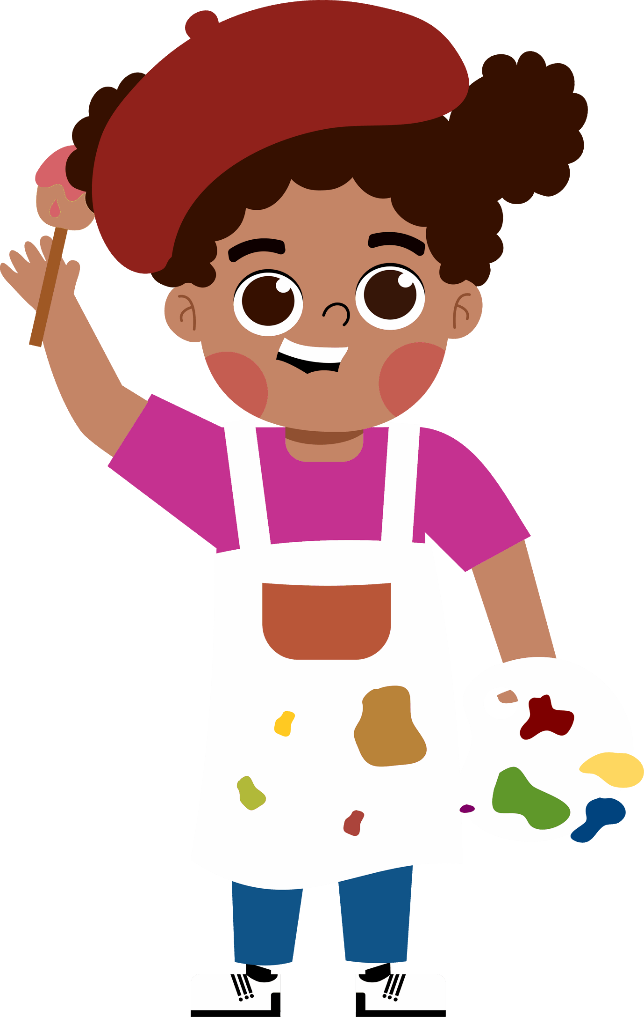







5
My future job

Slide 11
01.
Look, listen and repeat.

Slide 12


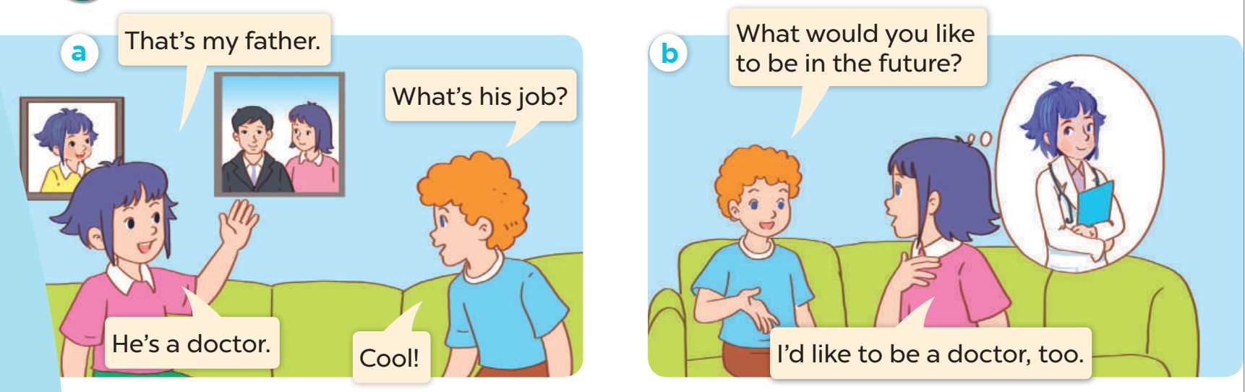

Listen and repeat.

Slide 13
02.
Listen, point and say.

Slide 14
New words
Look, listen and repeat.

Slide 15




firefighter

Slide 16

writer

Slide 17

gardener

Slide 18

reporter

Slide 19
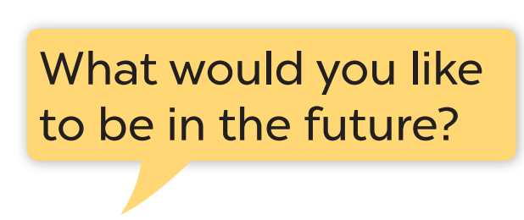
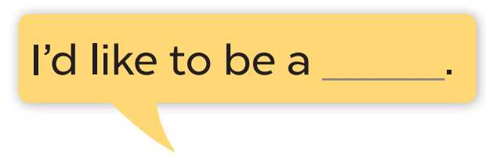
Listen and repeat.

Slide 21
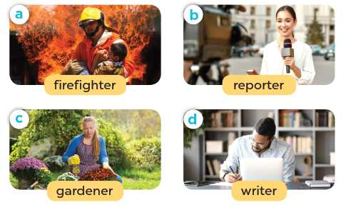
Listen, point and say.

Slide 22
03.
Let’s talk.

Slide 23
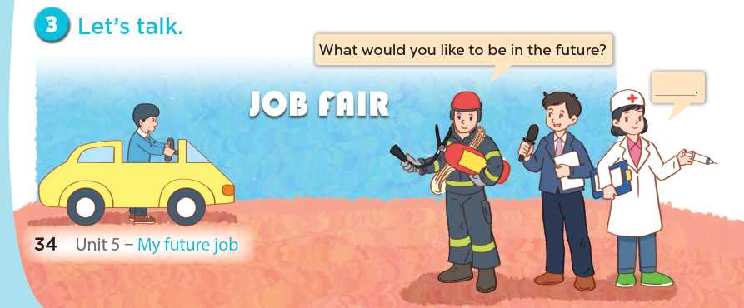

Slide 24
Fun corner and wrap-up

Slide 25

PASS THE BALL!

Slide 26
HOW TO PLAY
Pass the balls: When the music stops, whoever has a ball must stand up and either ask or answer the question on the screen.
Notes:
GV có thể thay tranh khác hoặc bỏ tranh để hs nói về mình.

Slide 27
PASS THE BALL!
STOP!

Slide 28

QUESTION:
ANSWER: here
gardener.

Slide 29
PASS THE BALL!
STOP!

Slide 30
QUESTION: Question here
ANSWER: here
firefighter.

Slide 31
PASS THE BALL!
STOP!

Slide 32

QUESTION: Question here
ANSWER: here
writer

Slide 33
PASS THE BALL!
STOP!

Slide 34

QUESTION: Question here
ANSWER: here
reporter.

Slide 35
PASS THE BALL!
STOP!

Slide 36

QUESTION: Question here
ANSWER: here
writer

Slide 37
PASS THE BALL!
STOP!

Slide 38
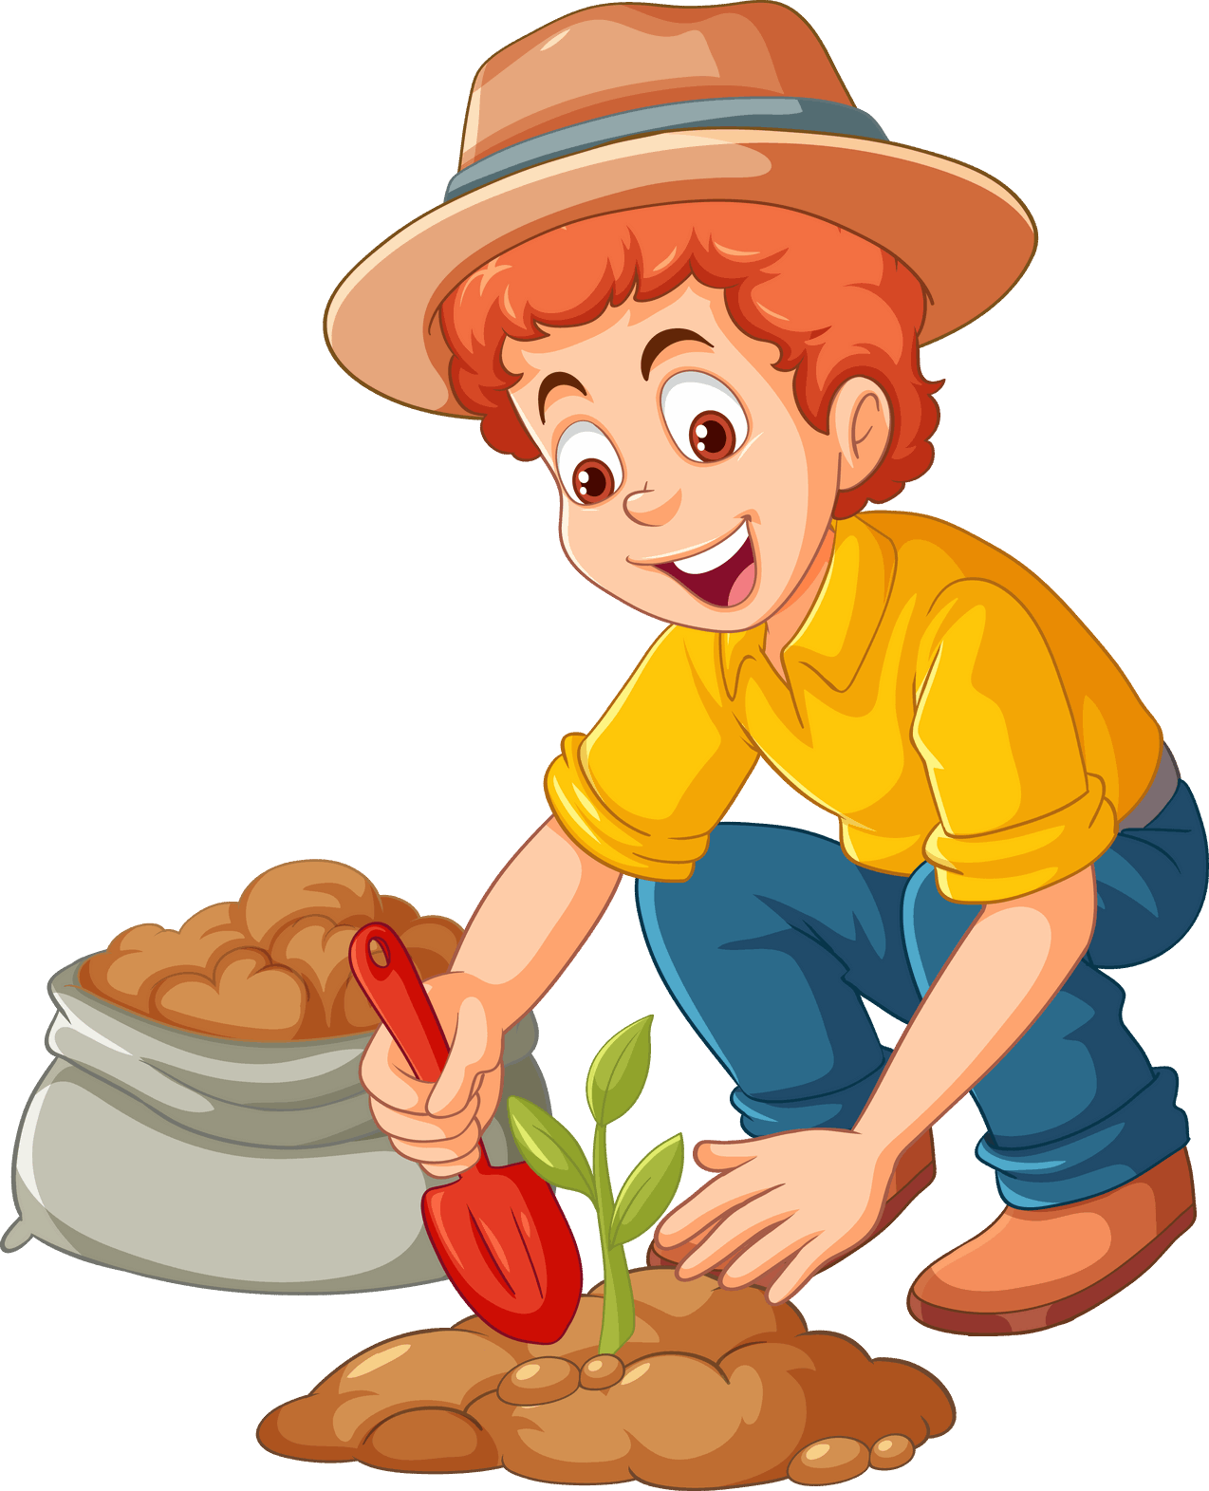
QUESTION: Question here
ANSWER: here
gardener.

Slide 39
PASS THE BALL!
STOP!

Slide 40

QUESTION: Question here
ANSWER: here
reporter.

Slide 41
PASS THE BALL!
STOP!

Slide 42

QUESTION: Question here
ANSWER: here
reporter.

Slide 43
PASS THE BALL!
STOP!

Slide 44

QUESTION: Question here
ANSWER: here
writer

