Slide 1
WELCOME TO OUR CLASS!

Slide 2
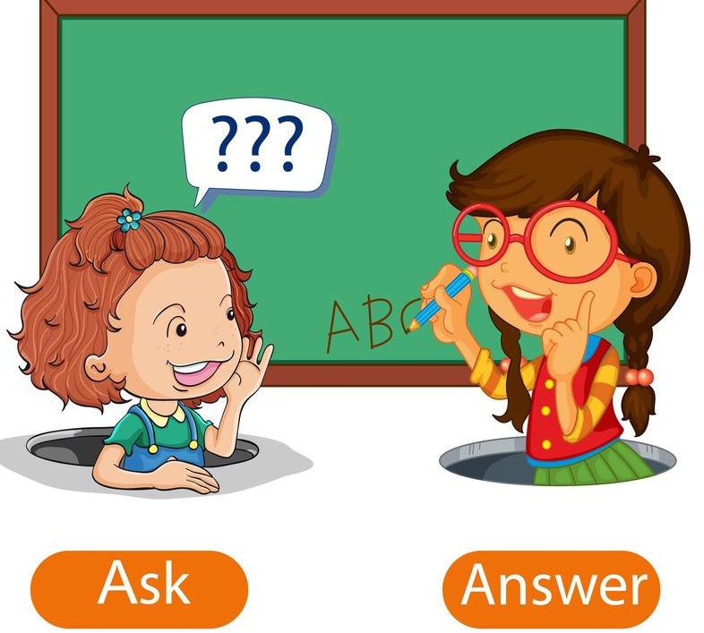
Answer the questions, using:
Yes, we do.
No, we don’t.
Yes, we are.
No, we aren’t.

Slide 3
Do you study at Tuc Tranh high school?

Slide 4
Do you go to school everyday?

Slide 5
Are you learning English?

Slide 6
Are you sleeping?

Slide 7
Which tenses have we used?
The present simple
The present continuous

Slide 8
UNIT 4: INTERNATIONAL ORGANIZATIONS & CHARITIES
Lesson 1.2 – Grammar
Page 30

Slide 9
Tense | The present simple | The present continuous
Uses | - - | - -
Form | +) -) ?) *Tobe: | +) -) ?)
Signs

Slide 10
Tense | The present simple | The present continuous
Uses | - Something that is true at present something that happens regularly at present Something that is fixed in the future something in the future after time words like when, after and before and after if and unless: Talking about the past when we tell a story or summarize a book/story/play. | - Something that is happening at present - Plan in the near future
Form | +) S+ V(s/es). -) S+ don’t/ doesn’t + V. ?) Do/Does+ S+ V? *Tobe: am/is/are | + S+am/ is/ are+ Ving - S+am/ is/ are+ not+ Ving. ? Am/ is/are+ S+ Ving?
Signs | always, usually, often, sometimes, never, occasionally, normally, regularly, hardly, seldom, rarely, barely, scarcely, every+ time, once/twice/3 times+ a/per+ time | now, at present, at the moment, currently…, exclamations: Keep silent! / watch out!/ look out!...
I’m a student.
She usually goes to bed late.
The bus leaves at 6:45.
I'll talk to John when I see him.
We are learning English at the moment.
I’m having my birthday party next Sunday. Would you like to come?
Once upon a time, there is a girl called Little Red Riding Hood.

Slide 11
Question 5: He ______ German so well
because he ______ from Germany.
speak/come B. speaks/comes
C. speaking/coming D. is speaking/come
Question 7: Ann ____________her job very much.
A. like B. liked C. is liking D. likes
Question 3: Jean______ hard all day but she ______ at the moment.
work/doesn’t work B. works/ isn’t working
C. is work/ isn’t working D. is working/doesn’t work
Question 6: Shh! The boss ______. We _____ him in an hour and nothing is ready!
A. comes/ are meeting B. comes/ meet C. is coming/are meeting D. is coming/meet
Question 8: The train __________at 7 a.m.
is arriving B. arrives
C. arrive D. are arriving
Question 9: My elder sister ___ married next Sunday.
A. is getting B. are getting C. gets D. get
Question 10: According to the time table, the English lesson__________at 8:50 on Tuesday.
A. start B. starts C. starting D. is starting
Question 1: Where’s John? He _____ to a new CD in his room.
A. listening B. listen C. is listening D. listens
Question 2: Don’t forget to take your umbrella with you to London. You know it always ____ in England.
A. rains B. is raining C. rain D. rained
Question 4: Look! That boy ______ after the bus.
A. is running B. run C. runs D. ran

Slide 13
Dear Jenny, How are you doing?
Right now I (1) _____________(volunteer) in Myanmar. I (2) ____ (live) in a local village, and I’ll be here until December. It’s small, but it (3) ___ (have) some beautiful old buildings. We (4) __________(build) a new school for a charity called Global Classroom. This charity is really great and over the years has helped a lot of people. It (5) _______ (provide) free education for children and (6) _____ (pay) for all their uniforms and school supplies. I do a lot of things to help, but this month I (7) ______________ (teach) English.
I will be home for Christmas. I (8) ______ (hope) we can meet then. I miss you a lot.
Love to everyone,
Phương
am volunteering
live
has
are building
provides
pays
am teaching
hope

Slide 14
Presentation:
Using the Present simple and
the Present continuous
to talk about your school

Slide 15
Practice making sentences using the Simple Present and Present Continuous Tenses.
Prepare the next lesson – Pronunciation and Speaking, page 32 in SB.

Slide 16
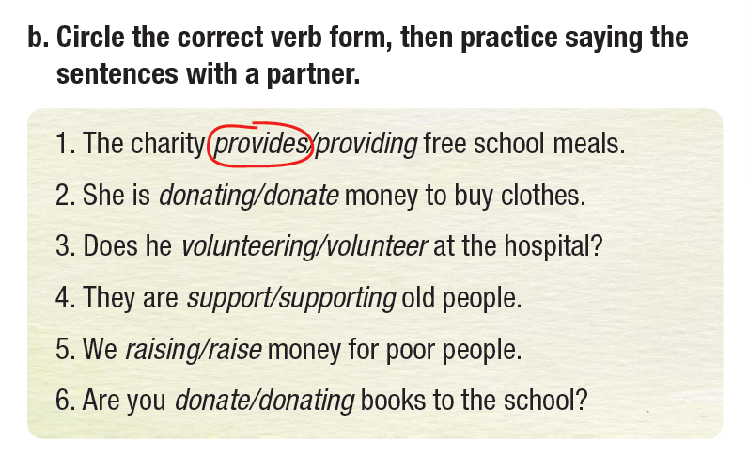

Slide 17
Work in pairs.
Look around the classroom, describe what your classmates are doing. Try to make as many sentences as possible.
Example:
Mai and Linh are talking to each other.
Tam is looking out the window.
Hoang is writing something in his notebook.

Slide 18
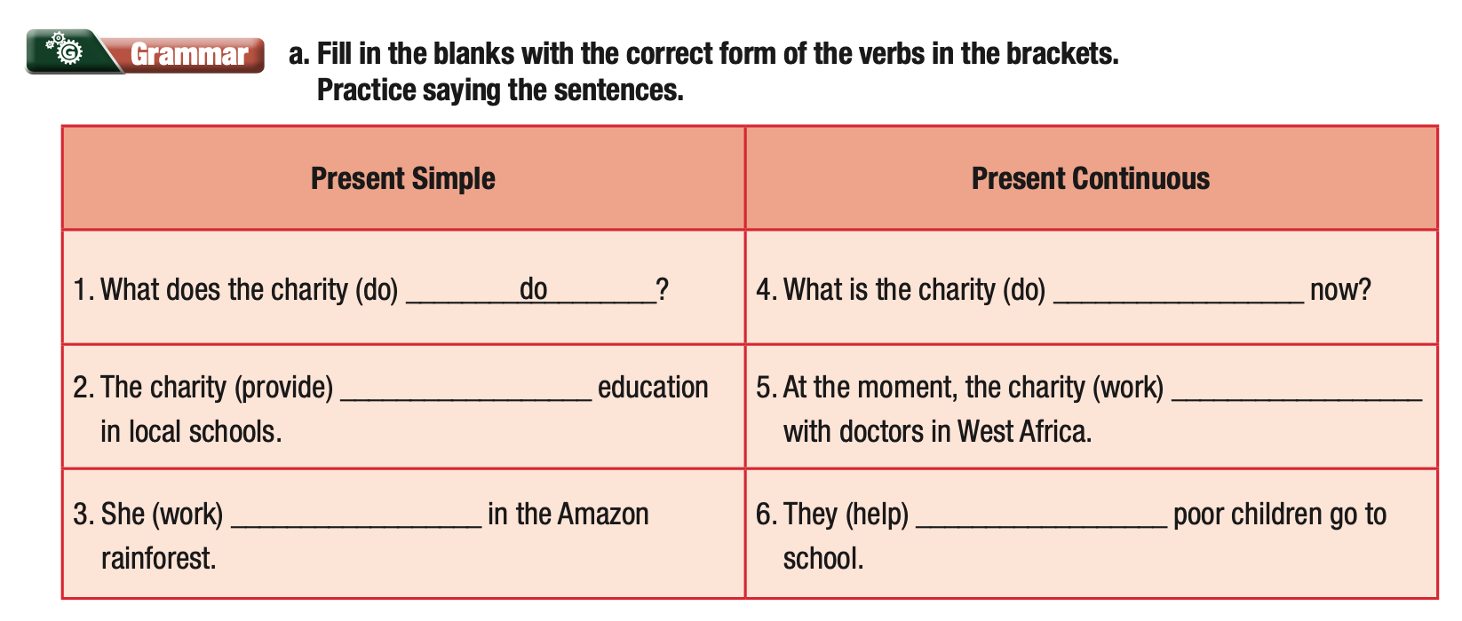
Extra Practice
WB, Page 21
doing
provides
is providing
works
are helping

Slide 19
Extra Practice
WB, Page 21
Present Simple | Present Continuous
1. What does the charity (do) _________? | 4. What is the charity (do) __________________ now?
2. The charity (provide) ________ education in local schools. | 5. At the moment, the charity (work) __________________ with doctors in West Africa.
3. She (work) ______________ in the Amazon rainforest. | 6. They (help) ______________ poor children go to school.
do
provides
is doing
is providing
works
are helping

Slide 20
Extra Practice
WB, Page 21
b. Rewrite the Present Simple sentences in Present Continuous.
1. We build homes for people living in the mountains.
___________________________________________________
2. The charity works with volunteers to clean up beaches.
___________________________________________________
3. They donate clothes to Africa.
___________________________________________________
4. I teach children in poor countries.
___________________________________________________
5. He raises money for tigers and rhinos.
___________________________________________________________
We are building homes for people living in the mountains.
The charity is working with volunteers to clean up beaches.
They are donating clothes to Africa.
I am teaching children in poor countries.
He is raising money for tigers and rhinos.

Slide 21
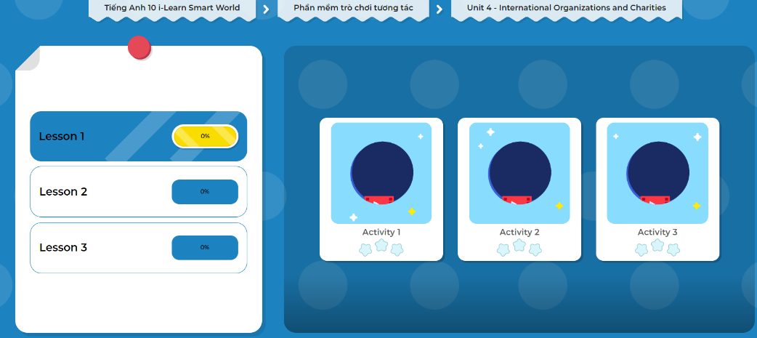
LET’S PLAY!
Click here to play the games.

