Slide 1
THAI NGUYEN EDUCATION & TRAINING DEPARTMENT
TUC TRANH HIGH SCHOOL
WARMLY WELCOME TEACHERS, AND STUDENTS TO OUR CLASS!
Teacher: Nguyen Hai Viet, M.A
Foreign Languages & Information Technology Group

Slide 2
1. Warm- up
https://wordwall.net/resource/77943032

Slide 3
Saturday, September 14th , 2024
UNIT 1: FAMILY LIFE
Period 03: Lesson 1.2: Grammar

Slide 4
use Adverbial Phrases of Frequency to show how often something happens in oral and written forms related to the topic household chores.
describe the pictures using the suggestions.

Slide 5
2. Grammar

Slide 6
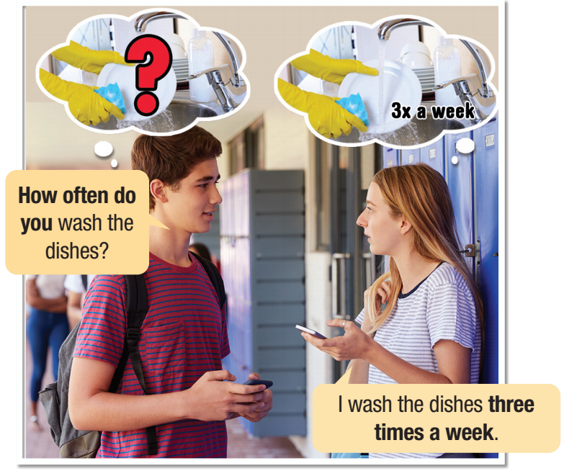


Slide 7
Picture description
How many people?
Who are they?
Where are they?
What are they doing?

Slide 8

How often do you wash the dishes?
I wash the dishes three times a week

Adverbial Phrases of Frequency


Slide 9
2. Grammar
Adverbial Phrases of Frequency
Questions:
What chores do you do?
How often do you tidy your bedroom?
Do you often dust the furniture? (Yes, I do./No, I don't.)

Slide 10
2. Grammar
Adverbial Phrases of Frequency
- use adverbial phrases of frequency (adv phrases. F) to show how often something happens in a certain time period.
once (a day, week, month, year,...), twice (a day, a week, a month,...), every (day, night, week,...)
Answers:
one time = once
two times = twice
I wash dishes twice a week.
I vacuum the floor every day.
They dust the furniture once a week.
We sweep the floor twice a day.

Slide 11
2. Grammar
1. How often do/ does+ S+ ………………?
S+ Vo/ Vs/ Ves ……………… + Adv. Phrases of Frequency
once
twice
three times
four times….
a week/ a month

Slide 12
3. Practice
Task b: Writing
I/tidy my bedroom/twice/week. _________________________________________________
she/mop the floor/once/week. _________________________________________________
what/chores/you/do? _________________________________________________
how often/you/chores? _________________________________________________
dad/vacuum/living room/three times/week. _________________________________________________
mom/mop/bathroom floor/every day. _________________________________________________
I tidy my bedroom twice a week.
She mops the floor once a week.
What chores do you do?
How often do you do chores?
My dad vacuums the living room three times a week.
My mom mops the bathroom floor every day.

Slide 13
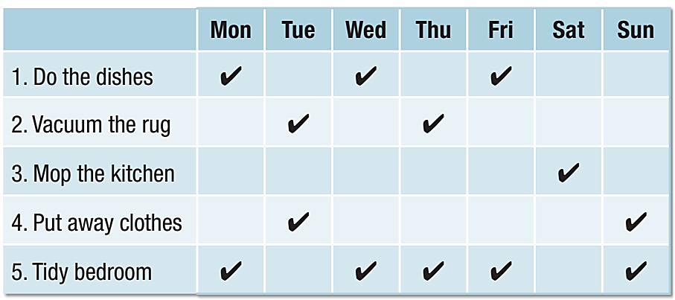
4. Production
Task c+b: Speaking
__________________________
__________________________
__________________________
Ben does the dishes three times a week.
__________________________
__________________________
He puts away clothes twice a week.
He vacuums the rug twice a week.
He tidies his bedroom four times a week.
He mops the kitchen once a week.

Slide 14
5. Consolidation
Unit 1: Family life
Period 03: Lesson 1.1. Grammar
Warm-up
Grammar (Adverbial phrases of Frequency)
Practice
Production
Consolidation
Homework

Slide 15
Practice the conversation with your friend(s) at home (Task c+d).
Write “Task c+d” on your notebooks in the form of writing a paragraphs.
Prepare the next lesson (pronunciation & speaking).
Write 10 sentences, using Adv phrases. F, then practice speaking aloud.

Slide 16
Have a nice day!

