Slide 1


Teacher: Tran Thi Thu Hoa
Class : 10a2

Slide 2
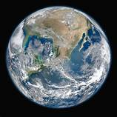
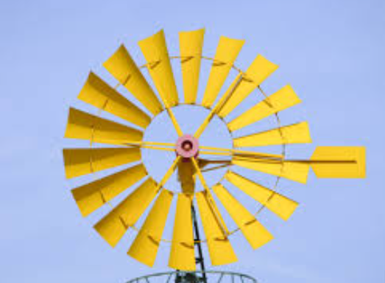

Find the similarities in the following figures?
In the coordinate plane,
what is the equation of a circle?
F.1
F.2
F.3
F.4

Slide 3
LESSON 21, PERIOD 30
CIRCLE IN THE COORDINATE PLANE

Slide 4
WARMING UP

Slide 5
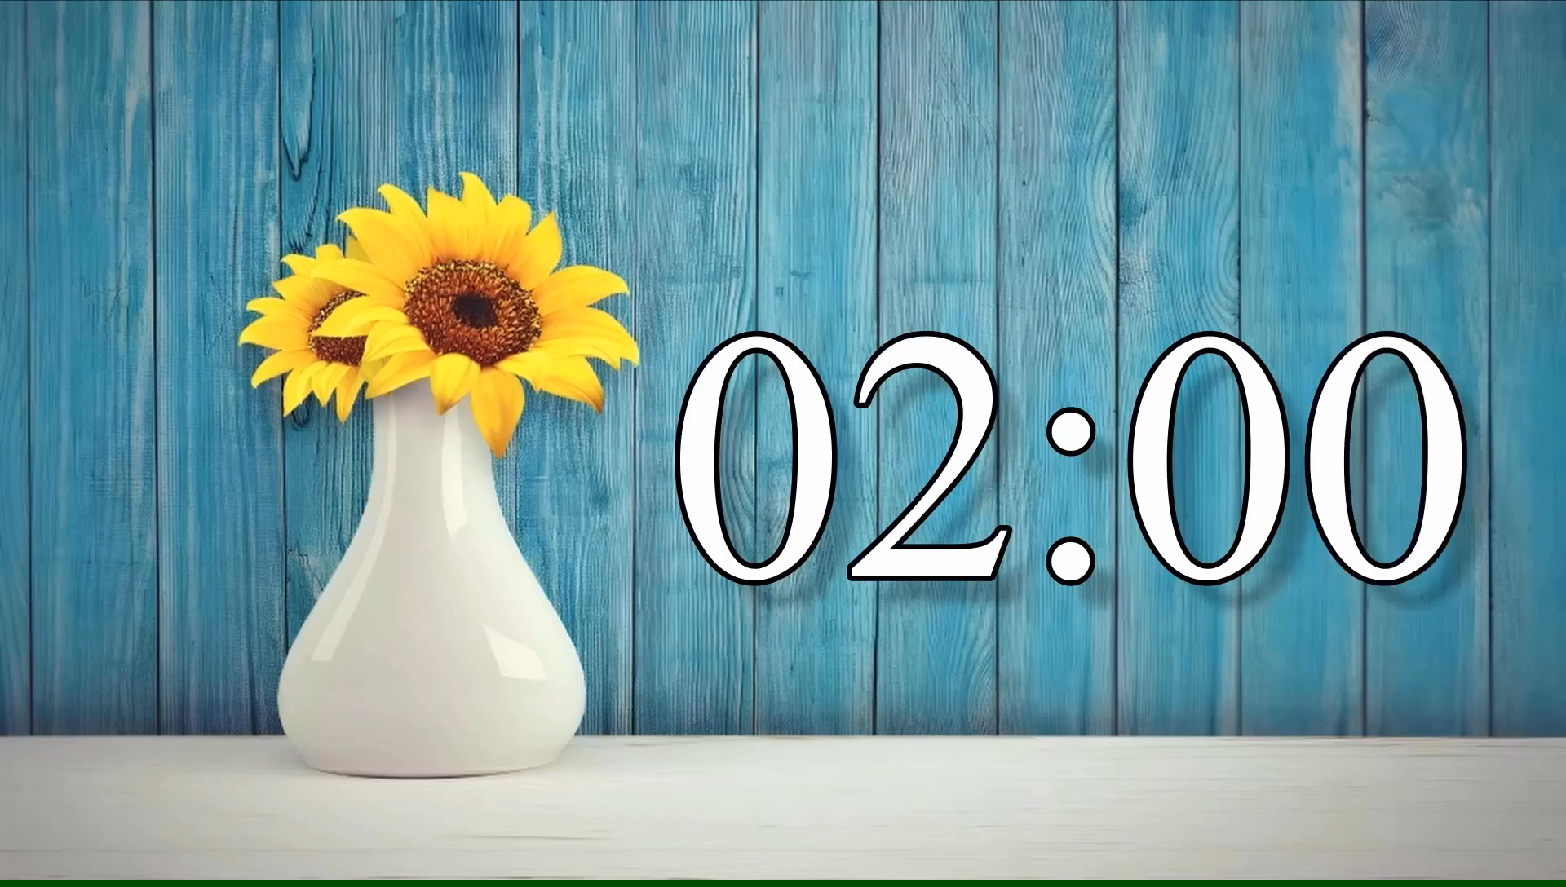


WARMING UP
Question 1: Fill in the banks True (T) or False (F) in the following exercise:
1. In the Oxy plane
+ Given $A\left(x_{A};y_{A}\right),B\left(x_{B};y_{B}\right)$. We have $AB=\sqrt{{\left(x_{B}−x_{A}\right)}^{2}+{\left(y_{B}−y_{A}\right)}^{2}}$
T
+ Given A$\left(1;2 \right),B\left(4;6 \right)$. We have $AB=4$
F
$$AB=\sqrt{{\left(4−1\right)}^{2}+{\left(6−2\right)}^{2}}=5$$
2. Given circle (C) with center I and radius R ( denoted by (I; R)). The point M belongs to (C) if only if IM = R
T

Slide 6

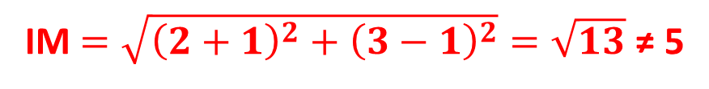
WARMING UP
Question 2. In the Oxy plane, given circle (C) with center I(-1; 1) and radius R = 5.
Which of the following points belongs to (C) ?
A. M = (2; 3).
B. N = (3; 4).
IM$=\sqrt{{\left(2+1\right)}^{2}+{\left(3−1\right)}^{2}}=\sqrt{13}$ ≠ 5
$$IN=\sqrt{{\left(3+1\right)}^{2}+{\left(4−1\right)}^{2}}=5=R$$
C. P = (-2; 3).
D. Q = (4; 3).

Slide 7
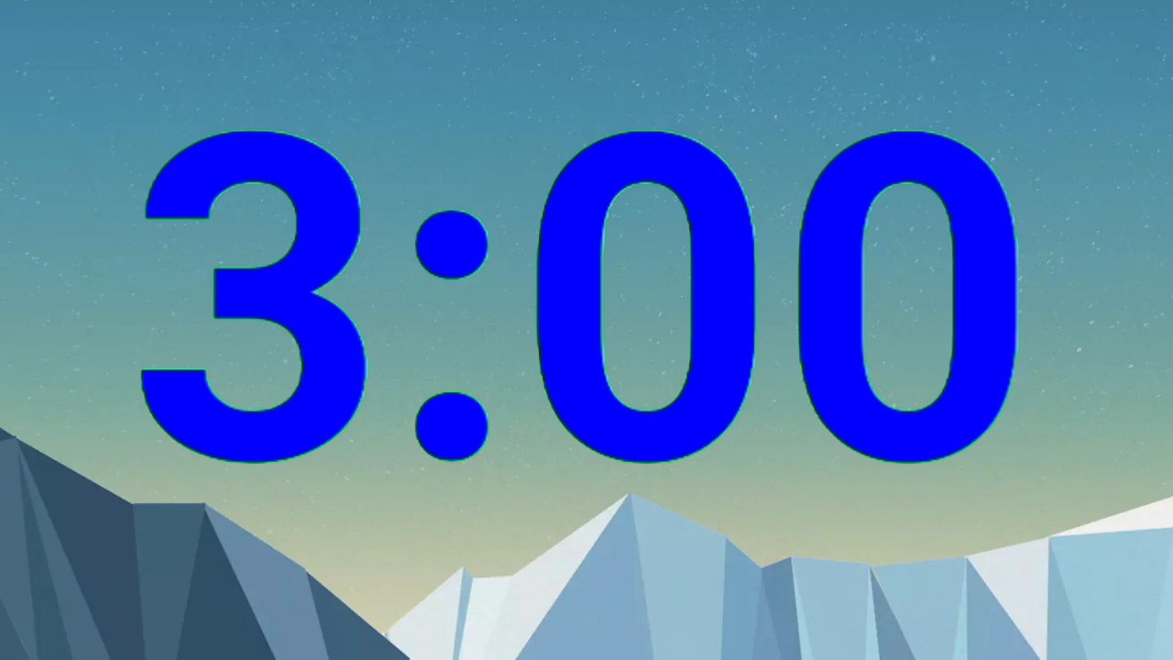
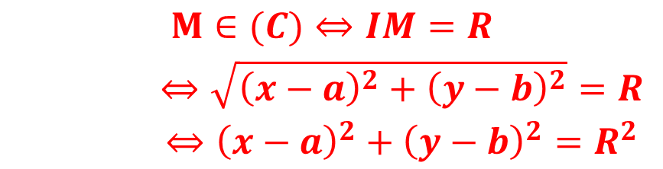
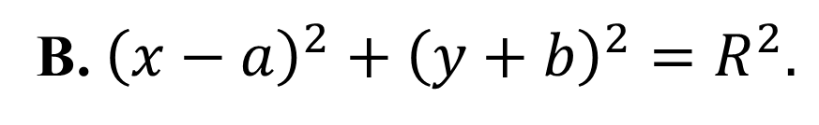
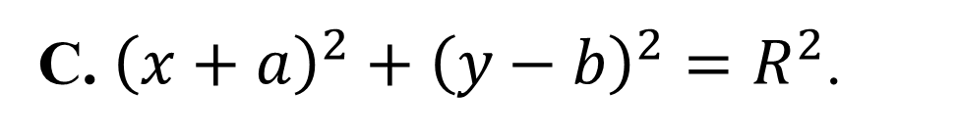
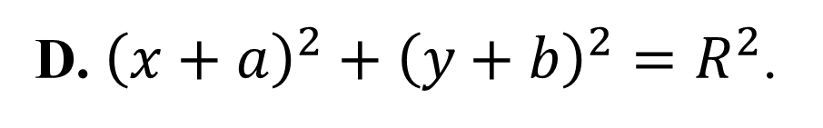
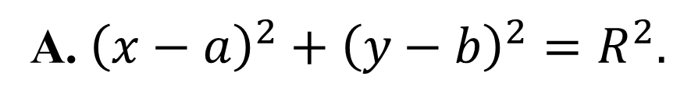
WARMING UP
WARMING UP
Question 3. In the Oxy plane, given circle (C) with center I(a; b) and radius R .
Find the condition for point M(x; y) belong to (C).
A. ${\left(x−a\right)}^{2}+{\left(y−b\right)}^{2}=R^{2}.$
B. ${\left(x−a\right)}^{2}+{\left(y+b\right)}^{2}=R^{2}.$
$$\begin{matrix}M∈(C)⇔IM=R \\ ⇔\sqrt{{\left(x−a\right)}^{2}+{\left(y−b\right)}^{2}}=R \\ ⇔{\left(x−a\right)}^{2}+{\left(y−b\right)}^{2}=R^{2}\end{matrix}$$
C. ${\left(x+a\right)}^{2}+{\left(y−b\right)}^{2}=R^{2}$.
D. ${\left(x+a\right)}^{2}+{\left(y+b\right)}^{2}=R^{2}$.
The equation ${\left(x−a\right)}^{2}+{\left(y−b\right)}^{2}=R^{2}$ is called the equation of the circle

Slide 8


CIRCLE IN THE COORDINATE PLANE
1. CIRCLE EQUATIONS
In the Oxy plane, the equation for the circle (C) with center I(a;b) and radius R is
${\left(x−a\right)}^{2}+{\left(y−b\right)}^{2}=R^{2}$
I(a;b)
$$R=\sqrt{R^{2}}$$
If given the equation of a circle, can you find coordinate of the center I and radius R ?

Slide 9
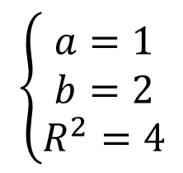
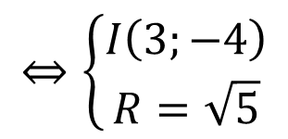
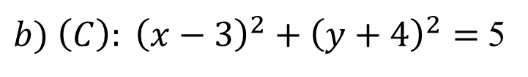
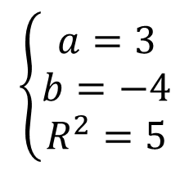
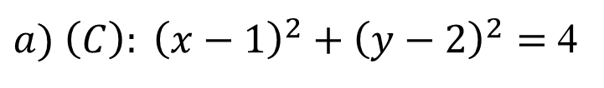
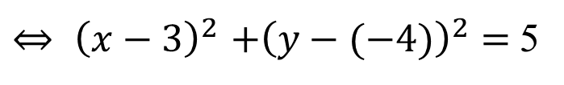

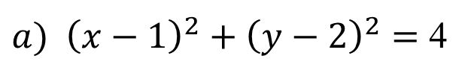
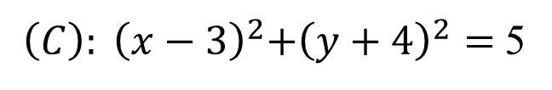

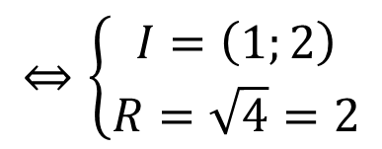

CIRCLE IN THE COORDINATE PLANE
Example 1: Find the center I and radius R of the following circles:
${a) \left(C\right): \left(x−1\right)}^{2}+{\left(y−2\right)}^{2}=$ 4
${b) \left(C\right): \left(x−3\right)}^{2}+{\left(y+4\right)}^{2}=$5
$${c) \left(C\right): \left(x+2\right)}^{2}+{\left(y−5\right)}^{2}=9$$
$${c) \left(C\right): \left(x+1\right)}^{2}+{\left(y+6\right)}^{2}=16$$
Solution:
$${\left(x−a\right)}^{2}+{\left(y−b\right)}^{2}=R^{2}$$
$$\left\{\begin{matrix}a=1 \\ b=2 \\ R^{2}=4\end{matrix}\right.$$
a)We have:
$$⇔\left\{\begin{matrix}I=\left(1;2\right) \\ R=\sqrt{4}=2\end{matrix}\right.$$
${a) \left(x−1\right)}^{2}+{\left(y−2\right)}^{2}=$ 4
b)
${ \left(C\right): \left(x−3\right)}^{2}+{\left(y+4\right)}^{2}=$5
${⇔ \left(x−3\right)}^{2}+{\left(y−(−4)\right)}^{2}=$5
$$\left\{\begin{matrix}a=3 \\ b=−4 \\ R^{2}=5\end{matrix}\right.$$
$$⇔\left\{\begin{matrix}I\left(3;−4\right) \\ R=\sqrt{5}\end{matrix}\right.$$
We have:

Slide 10

CIRCLE IN THE COORDINATE PLANE
1. CIRCLE EQUATIONS
In the Oxy plane, the equation for the circle (C) with center I(a;b) and radius R is
${\left(x−a\right)}^{2}+{\left(y−b\right)}^{2}=R^{2 } (1)$
What factors are needed
to write the equation of
a circle?
the CENTER I(a;b)
and RADIUS R of the circle.
Find a, b, R and then substitute into (1)

Slide 11
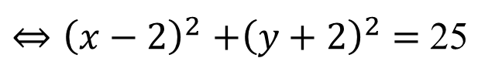
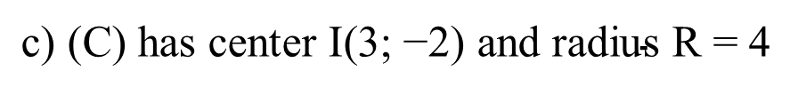

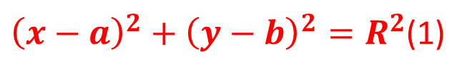
CIRCLE IN THE COORDINATE PLANE
Example 2: Write equation of the circle (C), know:
${\left(x−a\right)}^{2}+{\left(y−b\right)}^{2}=R^{2}$(1)
a) (C) has center I(1; 3) and radius R = 3
We find a, b, R anh then substitute into (1)
b) (C) has center I(2; -2) and passes through M(6; 1)
$\text{c}\text{) (}\text{C}\text{) }\text{has} \text{center} \text{I}\text{(3; −2) }\text{and} \text{radius} \text{R}\text{ = }$4
d) (C) has center I(-2; 0) and passes through M(3; 1)
Solution:
a) We have a = 1, b = 3, R = 3
So equation of circle (C) is ${ \left(x−1\right)}^{2}+{\left(y−3\right)}^{2}=$ 3² = 9
b) We have a = 2 , b = -2 , R =
IM
$$=\sqrt{{\left(6−2\right)}^{2}+{\left(1−(−2)\right)}^{2}}$$
= 5
So equation of circle (C) is ${ \left(x−2\right)}^{2}+{\left(y−(−2)\right)}^{2}=$ 5²
${⇔\left(x−2\right)}^{2}+{\left(y+2\right)}^{2}=$ 25

Slide 12
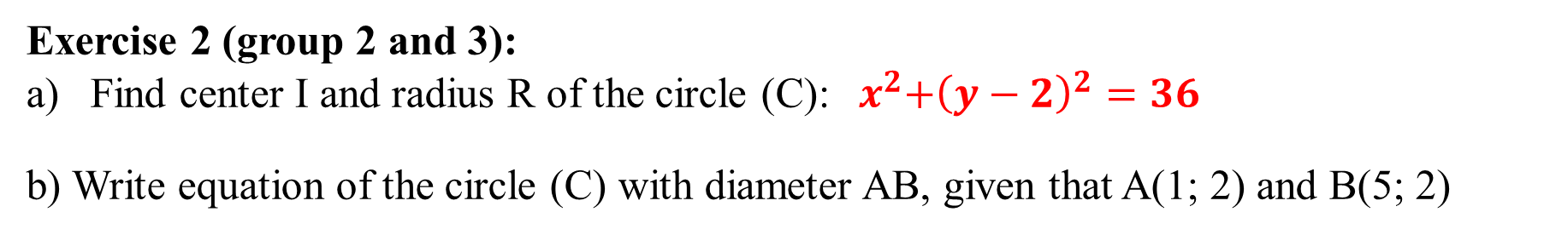
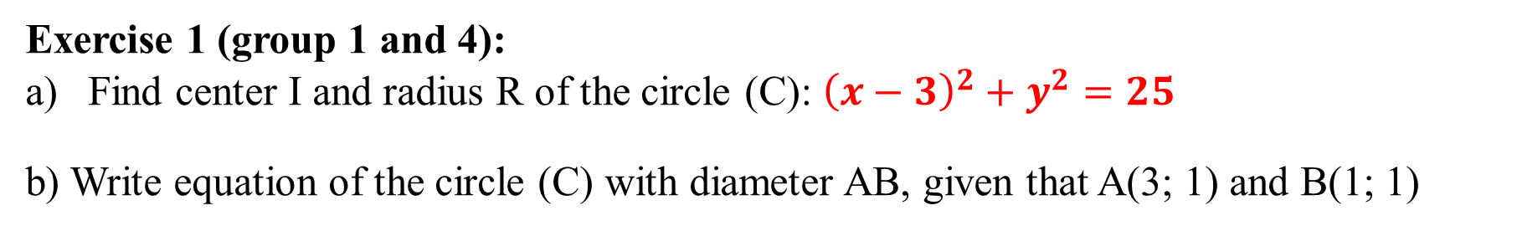
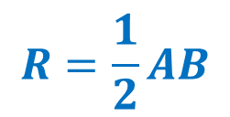

CIRCLE IN THE COORDINATE PLANE
PRACTICE
$${\left(x−3\right)}^{2}+{\left(y−0\right)}^{2}=5^{2}$$
I = (3; 0), R = 5
Exercise 1 (group 1 and 4):
Find center I and radius R of the circle (C): ${\left(x−3\right)}^{2}+y^{2}=25$
b) Write equation of the circle (C) with diameter AB, given that A(3; 1) and B(1; 1)
Exercise 2 (group 2 and 3):
Find center I and radius R of the circle (C):${ x}^{2}+{\left(y−2\right)}^{2}=36$
b) Write equation of the circle (C) with diameter AB, given that A(1; 2) and B(5; 2)
I = (0; 2), R = 6
I is the midpoint of line segment AB
R
I
R
$$R=\frac{1}{2}AB$$

Slide 13



