Slide 2


TOPIC10: VIRUS
Lesson 21:
The concept, structure and replication cycle of viruses
March, 2024
Notes:
Trang bìa

Slide 4
I. VIRUS CONCEPT.
- No cellular structure
- Very Small
- Compulsive parasitic living

Slide 6
II.STRUCTURE OF THE VIRUS .

Slide 7
Find out about the structure and function of each component
of the virus
- Divides students into 4 groups and requests to choose a team leader and secretary.
- Students look at the picture, read the book, discussion and complete the task sheet in 8 minutes.

Slide 8
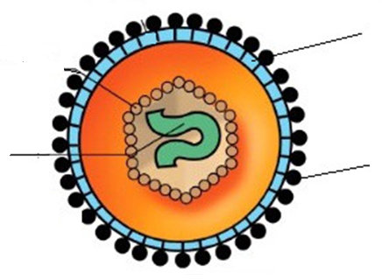
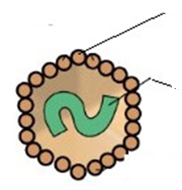
Using the given words or phrases to complete the picture (8 Minutes)
Capsid (protein)
Membranous envelope (phospholipid)
Viral Genome (Nucleic acid)
Glycoprotein spike
Naked virus
Enveloped virus
Capsid (protein) Glycoprotein spike
Viral Genome (Nucleic acid) Naked virus
Membranous envelope (phospholipid) Enveloped virus

Slide 9

Capsid (protein) /ˈkæpsɪd/
Glycoprotein spike /ɡlaɪ.kəʊˈprəʊ.tiːn spaɪk/
Viral Genome (Nucleic acid) /ˈvaɪə.rəl ˈdʒiː.nəʊm/ (njuːˌkleɪ.ɪk ˈæs.ɪd)
Naked virus /ˈneɪkɪd vaɪərəs/
Membranous envelope (phospholipid) /ˈmembrənəs inˈveləp/
Enveloped virus /inˈveləp vaɪərəs/

Slide 11
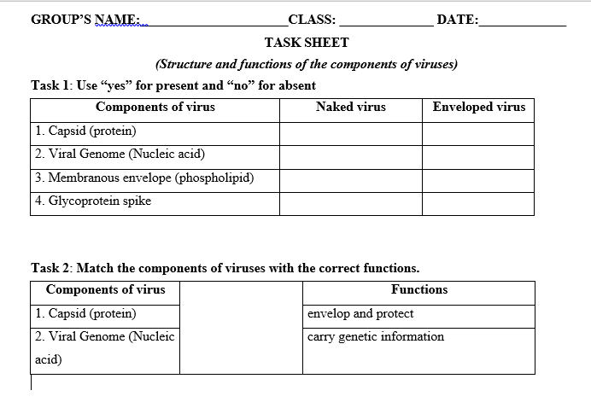
Yes
Yes
Yes
Yes
No
Yes
No
Yes

Slide 14

Revision
Choose the best answer A, B, C or D
Question 1. Which of the following is not part of Ivanovsky's experiment?
A. Extract the sap from tobacco plant with tobacco mosaic disease.
B. Solate the filtrate on nutrient medium.
C. Filter through a bacterial filter.
D. Infect the filtrate to healthy animals.
10
7
2
6
3
5
8
1
9
4

Slide 15

Choose the best answer A, B, C or D
Question 2. The two basic components of a virus are
A. capsid and membranous envelope.
B. viral genome and glycoprotein spike.
C. membranous envelope and viral genome.
D. capsid and viral genome.
10
7
2
6
3
5
8
1
9
4

Slide 16
Choose the best answer A, B, C or D
Question 3. Which of the following structures is found only in enveloped viruses but not in naked viruses?
A. capsid.
B. viral genome.
C. membranous envelope.
D. capsid and viral genome.
10
7
2
6
3
5
8
1
9
4

Slide 17
Choose the best answer A, B, C or D
Question 3. What is the function of the viral genome?
A. Protect genetic material.
B. carry genetic paragraph
C. is the receptor.
D. Envelop genetic material.
10
7
2
6
3
5
8
1
9
4

Slide 18
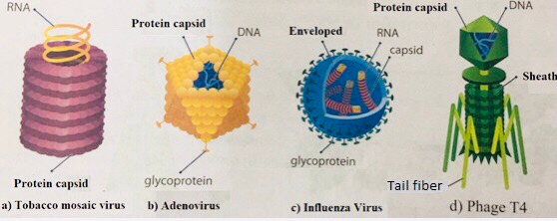
Why does each virus cause disease only in certain species of organisms?

Slide 19



Slide 21
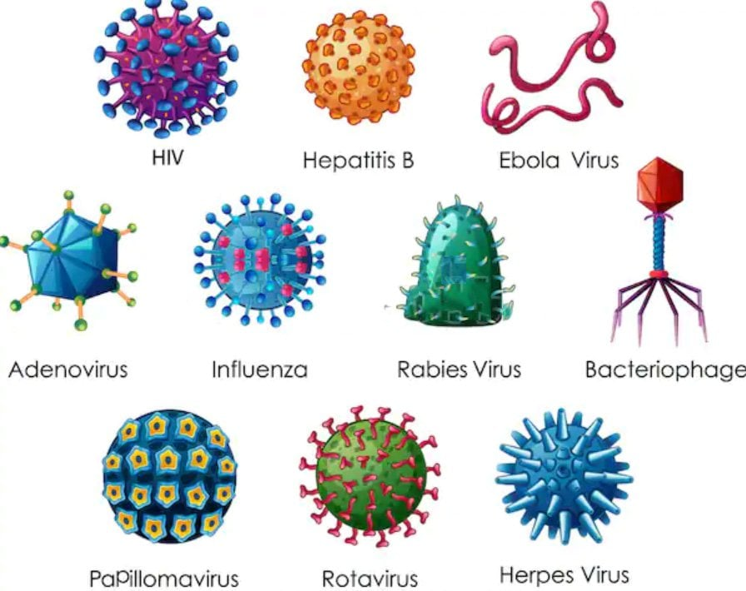
Human Immuno-deficiency Virus
Find out some characteristics of virus
Some viruses cause diseases today

