Slide 2


Watch a video clip
What does the video clip tell you?
What does the video clip tell you?
Ha Noi : then and now
Urbanisation

Slide 3
Unit 4
urbaniSation
LESSON 3 : READING
Urbanisation
of
Ha Noi

Slide 4

PRE - READING

Slide 5




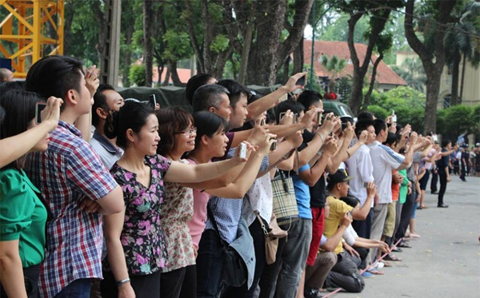
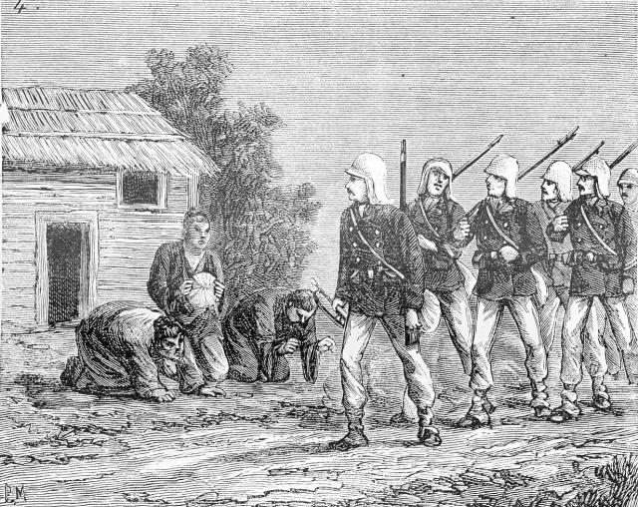
Listen and repeat.
1. resident (n) | /ˈrez.ɪ.dənt/
a person who lives in a particular place
Người dân
2. colonial (adj)
connected with a country that controls another country
/kəˈləʊniəl/
Thuộc địa, thuộc dân
3. gradually (adv)
/ˈɡrædʒuəli/
slowly, over a period of time
dần dần, từ từ
4. Modernising (n)
making use of the latest technology, design, etc.
/ˈmɒdərnaɪzɪŋ/
Hiện đại hóa, đổi mới
5. concern (n)
A feeling of worry about something important
/kənˈsɜːn/
mối quan tâm, lo lắng,

Slide 6
Checking: Playing Game
Listen , clap and say

Slide 7
Listen, clap and say.
1. resident (n) | /ˈrezɪdənt/
 | /kəˈləʊniəl/
 | /ˈɡrædʒuəli/
 | /ˈmɒdərnaɪzɪŋ/
 | /kənˈsɜːn/
Người dân
2. colonial (adj)
Thuộc địa, thuộc dân
3. gradually (adv)
dần dần, từ từ
4. Modernising (n)
Hiện đại hóa, đổi mới
5. concern (n)
mối quan tâm, lo lắng,

Slide 8
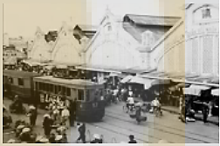
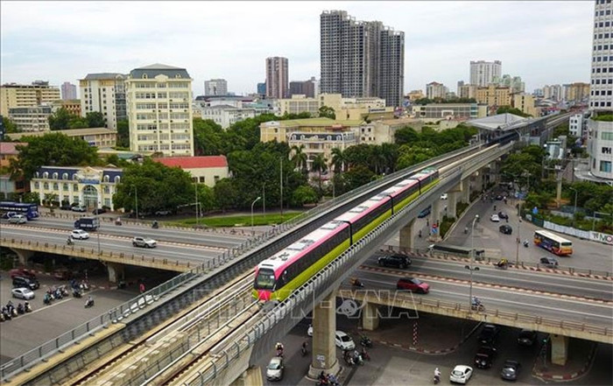
- What can you see in each picture?
- What do the pictures tell you about Ha Noi?
Ha Noi: Then/ in the past
Ha Noi : Now
Architecture ?
Transport ?

Slide 9



Slide 10
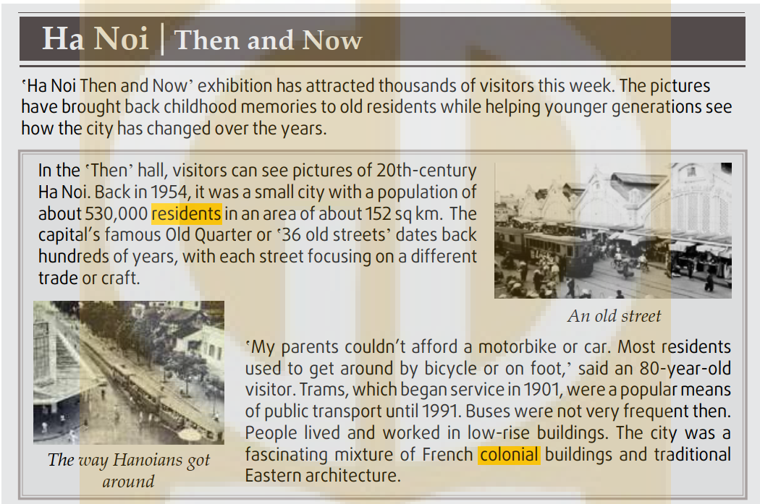
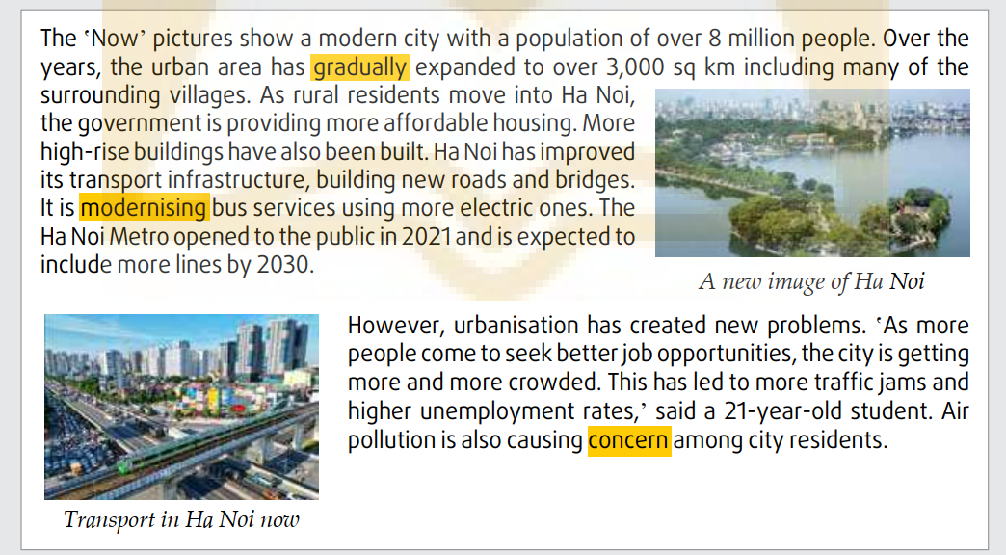
Read the article and do the following tasks
0
1
Then (20th century)
2
3
Now
4

Slide 11
Handout: Work in groups
a. Read the article again. Put the main ideas in the order they appear in the article.
The correct order is: 1. ______ 2. ______ 3. ______4. _______
A. Ha Noi's modern infrastructure and architecture
B. The challenges of urban growth
C. Ha Noi as a small city with old streets selling different products
D. 20th-century transport and architecture
b. Read the article again and complete the table using no more than THREE words and/or a number for each gap.
What is the title of the passage?
→ Teen shopping habits in Vietnam
Ha Noi | 20th century | now
Area | - About (1)______sq km (1954) | - Over 3,000 sq km
Population | - About 530,000 people (1954) | - Over (2) ______people
Public transport | - (3) ______and buses | - Modern buses and (4)______
Architecture | - Mainly (5)______ buildings | - More high – rise buildings

Slide 12
1. Work in group ( 5’)
2. Share and check
3. Give mark:
- Correct answer : 1 points
- Time : 1 points
- Explanation : 2 points ( go to the board)
=> Total: 10 points

Slide 13
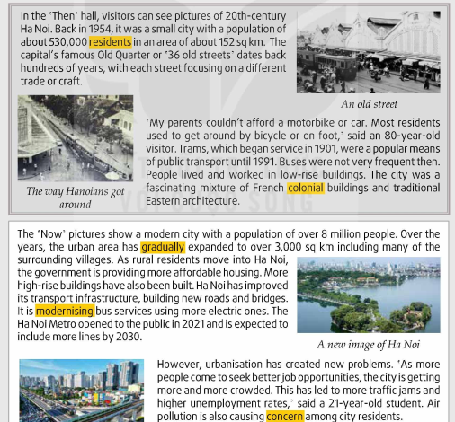
Handout: Work in groups
a. Read the article again. Put the main ideas in the order they appear in the article.
The correct order is: 1. ______ 2. ______3. ______4. _______
A. Ha Noi's modern infrastructure and architecture
B. The challenges of urban growth
C. Ha Noi as a small city with old streets selling different products
D. 20th-century transport and architecture
b. Read the article again and complete the table using no more than THREE words and/or a number for each gap.
C
What is the title of the passage?
→ Teen shopping habits in Vietnam
1
2
Ha Noi | 20th century | now
Area | - About (1)______sq km (1954) | - Over 3,000 sq km
Population | - About 530,000 people (1954) | - Over (2) ________people
Public transport | - (3) ______and buses | - Modern buses and (4)______
Architecture | - Mainly (5)________ buildings | - More high – rise buildings
3
2
4

Slide 14
1
Handout: Work in groups
a. Read the article again. Put the main ideas in the order they appear in the article.
The correct order is: 1. ______ 2. ______3. ______4. _______
A. Ha Noi's modern infrastructure and architecture
B. The challenges of urban growth
C. Ha Noi as a small city with old streets selling different products
D. 20th-century transport and architecture
b. Read the article again and complete the table using no more than THREE words and/or a number for each gap.
20th century
C
2
What is the title of the passage?
3
→ Teen shopping habits in Vietnam
Now
4
Ha Noi | 20th century | now
Area | - About (1)_________sq km (1954) | - Over 3,000 sq km
Population | - About 530,000 people (1954) | - Over (2) ________people
Public transport | - (3) ______and buses | - Modern buses and (4)______
Architecture | - Mainly (5)________ buildings | - More high – rise buildings
Line 3, para 1
152
Number

Slide 15

Handout: Work in groups
a. Read the article again. Put the main ideas in the order they appear in the article.
The correct order is: 1. ______ 2. ______
3. ______4. _______
Ha Noi's modern infrastructure and architecture
B. The challenges of urban growth
C. Ha Noi as a small city with old streets selling different products
D. 20th-century transport and architecture
b. Read the article again and complete the table using no more than THREE words and/or a number for each gap.
C
What is the title of the passage?
→ Teen shopping habits in Vietnam
Ha Noi | 20th century | now
Area | - About (1)______sq km (1954) | - Over 3,000 sq km
Population | - About 530,000 people (1954) | - Over (2) ________people
Public transport | - (3) ______and buses | - Modern buses and (4)______
Architecture | - Mainly (5)________ buildings | - More high – rise buildings
152

Slide 16
1. Work in group ( 5’)
Share and check
Give mark:
- Correct answer : 1 points
- Time : 1 points
- Explanation : 2 points ( Go to the board )
=> Total: 10 points

Slide 17
Handout: Work in groups
a. Read the article again. Put the main ideas in the order they appear in the article.
The correct order is: 1. ______ 2. ______
3. ______4. _______
Ha Noi's modern infrastructure and architecture
B. The challenges of urban growth
C. Ha Noi as a small city with old streets selling different products
D. 20th-century transport and architecture
b. Read the article again and complete the table using no more than THREE words and/or a number for each gap.
C
D
A
B
What is the title of the passage?
→ Teen shopping habits in Vietnam
Ha Noi | 20th century | now
Area | - About (1)______sq km (1954) | - Over 3,000 sq km
Population | - About 530,000 people (1954) | - Over (2) ________people
Public transport | - (3) ______and buses | - Modern buses and (4)______
Architecture | - Mainly (5)________ buildings | - More high – rise buildings
152
8 million
trams
metro/trains
low-rise

Slide 18
Explanation
0
1
Then (20th century)
2
3
Now
4

Slide 19
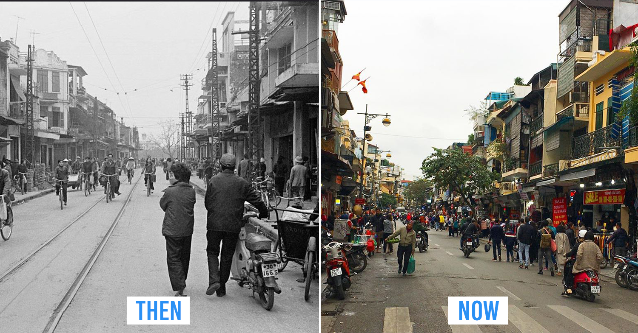

PRODUCTION
5
Work in pairs. discuss the following questions.

Slide 20

PRODUCTION
A: Which one do you prefer to live in: Ha Noi in the past or Ha Noi at present?
B: I prefer to live in Ha Noi at present
A: Why?
B: Because I like the modern facilities. Getting around in Ha Noi is very convenient nowadays.

Slide 21
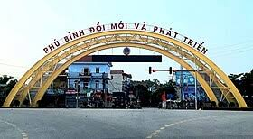
PRODUCTION
Which one do you prefer to live: Your hometown in the past or your hometown at present? Why?
Suggestions:
Population
Transport
Architecture
Infrastructure
…….
A: Which one do you prefer to live in: your hometown in the past or your hometown at present?
B: I prefer to live in my hometown at present
A: Why?
B: Because I like the modern facilities. Getting around in Ha Noi is very convenient nowadays.

Slide 22

CONSOLIDATION
1
Wrap-up
What have you learnt today?
Read for main ideas and specific information in news items about the Urbanisation of Ha Noi
New vocabulary words

Slide 23

CONSOLIDATION
2
Homework
Do exercises in the workbook.
Prepare for Lesson 4 - Unit 4.

Slide 24
Website: hoclieu.vn
Fanpage: facebook.com/www.tienganhglobalsuccess.vn

Slide 25
LESSON 3
READING
WARM-UP
Game: Fishing
PRE- READING
Task 1: Discuss the questions.
Task 2: Discuss and follow the question
Task 3: Match the highlighted words with their meanings.
Task 4: Answer the question.
WHILE- READING
POST- READING
Task 5: Discussion
CONSOLIDATION
Wrap-up
Homework

Slide 26
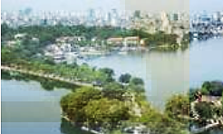
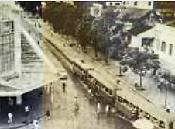
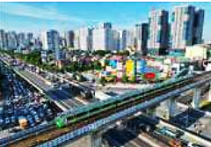
PRE- READING
11
Work in pairs. Look at the pictures in the article in 2 below. discuss the following questions.

Slide 27

PRE- READING
11
In the first and second pictures, I can see old streets of Ha Noi. There were only low-rise buildings, and people mainly got around on foot, trishaw, bicycle or tram.
In the third and fourth pictures, I can see a present-day Hanoi with many high-rise buildings. There are more modern vehicles such as cars and trains. Streets are very busy, too.

