Slide 1


Slide 2
Unit
7
Education options for
school-leavers
Unit
FAMILY LIFE
LESSON I
GETTING STARTED
Planning our education

Slide 3
LESSON I
GETTING STARTED
WARM-UP
GAME: Guessing game
Vocabulary
PRESENTATION
Task 1: Listen and read.
Task 2: True or false
Task 3: Find phrases in the conversation that mean the following.
Task 4: Complete the sentences.
PRACTICE
PRODUCTION
Role play
CONSOLIDATION
Wrap-up
Homework

Slide 4
WARM-UP
GUESSING GAME
Work in 4 groups.
Look at the pictures.
Guess the name of the famous universities in Viet Nam
The team with more correct answers is the winner.

Slide 5
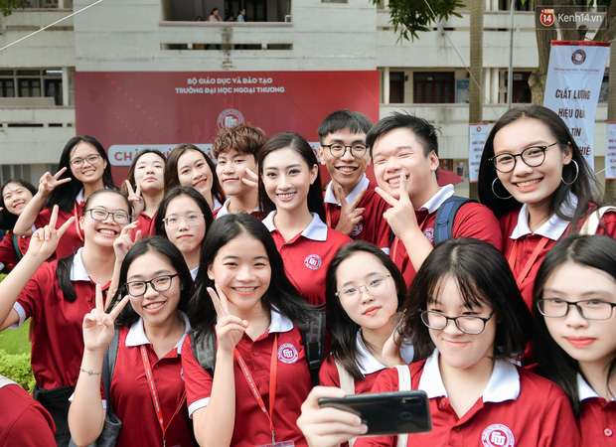
GUESSING GAME
Foreign Trade University

Slide 6

GUESSING GAME
University of Languages and International Studies

Slide 7

GUESSING GAME
National Economics University

Slide 8
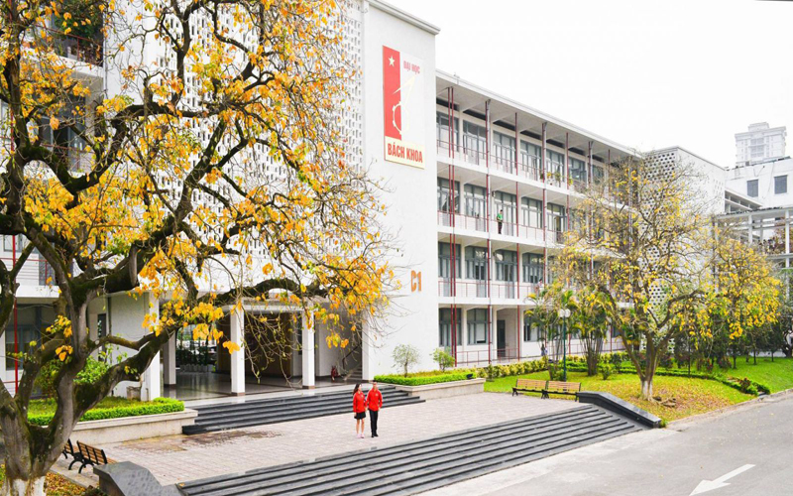
GUESSING GAME
Hanoi University of Science and Technology

Slide 9
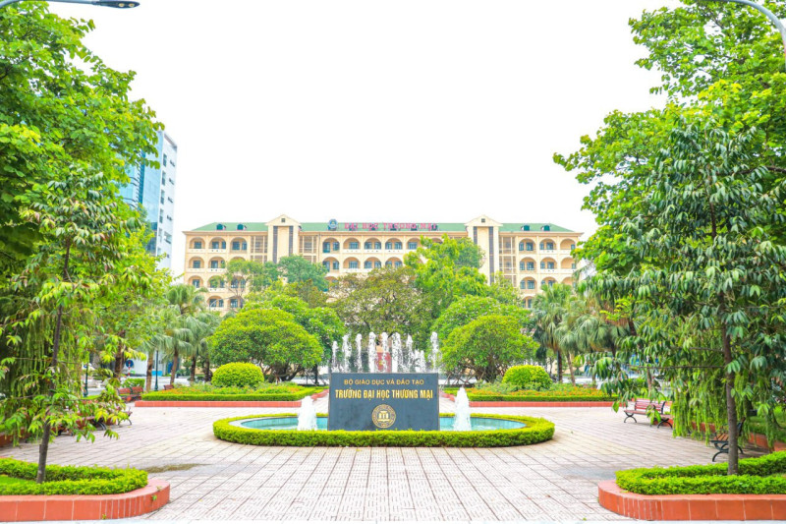
GUESSING GAME
University of Trade

Slide 10
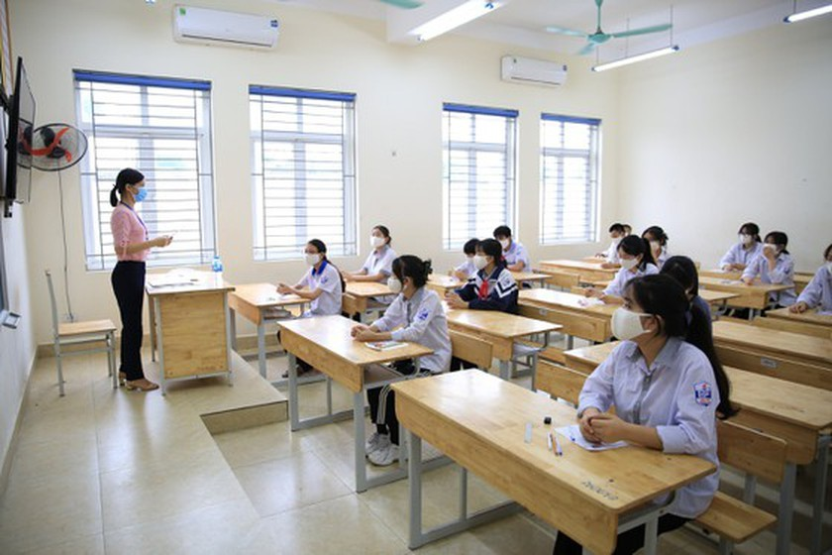

PRESENTATION
(university) entrance exam
/ˈentrəns ɪɡˌzæm/
an exam that you take to be accepted into a university

Slide 11

PRESENTATION
option (n)
/ˈɒpʃən/
one thing that can be chosen from a set of possibility, or the freedom to make a choice

Slide 12

PRESENTATION
academic (adj)
/ˌækəˈdemɪk/
connected with education, especially studying in schools and universities

Slide 13

PRESENTATION
vocational (adj)
/vəʊˈkeɪʃənəl/
connected with the skills, knowledge, etc. that you need to have in order to do a particular job

Slide 14


PRESENTATION
mechanic (n)
/məˈkænɪk/
someone whose job is repairing the engines of vehicles and other engines

Slide 15
PRESENTATION
sensible (adj)
Example:
It wasn’t very sensible to go out on your own so late at night.
/ˈsensəbəl/
able to make good judgements based on reason and experience rather than emotion

Slide 16


PRESENTATION
1
Listen and read.

Slide 17
PRACTICE
2
Read the conversation again. Decide whether the following statements are true (T) or false (F).
 |  | T | F
1. | School-leavers only have the option of academic education.
2. | Good grades at school can help students get into university.
3. | Vocational schools are for those who want to develop job skills.
4. | Nam wants to work at his father’s car repair shop after leaving school.
✓
✓
✓
✓

Slide 18
PRACTICE
3
Find phrases in the conversation that mean the following.
1. an event at which students can talk to representatives of universities or vocational schools about their study options
2. an exam that someone takes to be accepted into a school or university
3. studying at school or university to gain knowledge and develop thinking skills
4. a place that teaches skills needed for particular jobs
education fair
entrance exam
academic education
vocational school

Slide 19
PRACTICE
4
Complete the sentences using phrases from the conversation.
1. ______________ several biology competitions, Mai wants to study biology and become a scientist.
2. Mai's mum still regrets not ______________ to university.
3. _______________ his father work very hard for many years helped Nam make his decision.
Having won
having gone
Having watched

Slide 20

PRODUCTION
Role-play
- Ss work in groups of 4.
- In each group, one student plays the role of teacher, other students play the roles of students.
- Teacher asks students to share their plans after school.
- 3 minutes to prepare for the role-play.
- 2 minutes for a performance.

Slide 21
CONSOLIDATION
1
Wrap-up
What have you learnt today?
Some lexical items about education options.
Identify perfect gerunds and perfect participle clauses

Slide 22
CONSOLIDATION
2
Homework
Do exercises in the workbook.
Prepare for Lesson 2 - Unit 7.
Prepare materials for the project in lesson 8

Slide 23

Website: hoclieu.vn
Fanpage: facebook.com/tienganhglobalsuccess.vn/

