Slide 1
Good morning
Presented by :Vu Thi Hoa

Slide 2
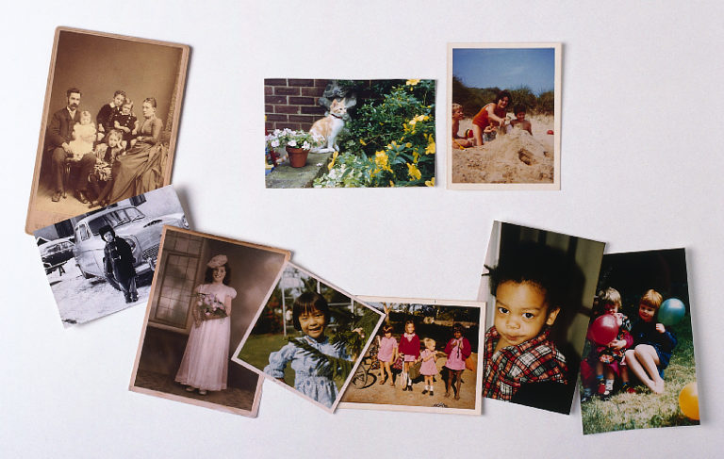
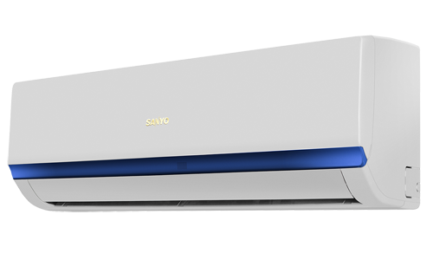
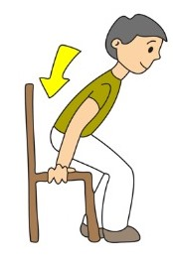
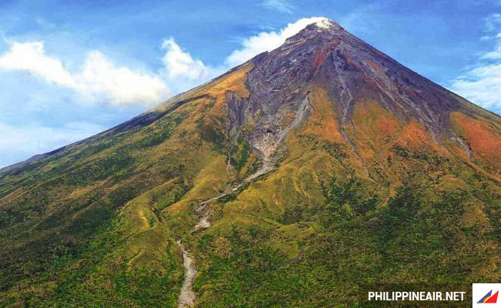
CROSSWORD PUZZLE
M
1
M O U N T A I N
E X I T
2
I
C
3
O C C U P I E D
Row 1st : There are 8 letters
Row 7th: There are 14 letters
H
Row 5th : There are 3 letters
P H O T O G R A P H S
Row 4th : There are 11 letters
4
Row 8th: There are 3 letters
Row 2nd : There are 4 letters
Row 6th: There are 4 letters
This word is opposite meaning to “ BAD”
Row 3th : There are 8 letters
LEAVE ME OUT :
I
5
S I T
O | C | V | C | U | P | I | E | D
G
6
G O O D
A I R- C O N D I T I O N E R
7
A
S U N
N
8
Key

Slide 3
CROSSWORD PUZZLE
M
1
M O U N T A I N
E X I T
2
I
C
3
O C C U P I E D
Row 1st : There are 8 letters
Row 7th: There are 14 letters
H
Row 5th : There are 3 letters
P H O T O G R A P H S
Row 4th : There are 11 letters
4
Row 8th: There are 3 letters
Row 2nd : There are 4 letters
Row 6th: There are 4 letters
This word is opposite meaning to “ BAD”
Row 3th : There are 8 letters
LEAVE ME OUT :
I
5
S I T
O | C | V | C | U | P | I | E | D
G
6
G O O D
A I R- C O N D I T I O N E R
7
A
S U N
N
8
Key

Slide 4
Lake Michigan is in chicago. it is one of the five Great Lakes in North America.

Slide 5
UNIT 6: AN EXCURSION
B. SPEAKING
C- SUNDESK
B- NON- AIR CONDITIONED
A- AIR - CONDITIONED
Tim’s class is going on trip on Lake Michigan
a boat

Slide 6
I. PRE - SPEAKING
2. Activity 2: A. Read the information about the participants and complete the table below.
NAME | WANT / DON’T WANT/ REASONS
MRS. ANDREWS
SUSAN
MARY
TIM
JOHN
SAM
Not want to sit on the sundeck
- Need to see all the students
Want to be near Mary
- Not want to get sunburnt
Suffer from travel sickness
- Need plenty of fresh air
Like to sit on the sun
- Want to be by himself
Not like air- conditioning
- Like to take photographs
Want to have a good view

Slide 7
I. PRE - SPEAKING
2.Activity 2: B. Decide the best seat for each person.
SUGGESTED SEATS / SECTION
NAME | WANT / DON’T WANT/ REASONS
MRS. ANDREWS
SUSAN
MARY
TIM
JOHN
SAM
Not want to sit on the sundeck
- Need to see all the students
SECTION A:
46,43,45,41
Want to be near Mary
- Not want to get sunburnt
SECTION B:
33,36
Suffer from travel sickness
- Need plenty of fresh air
SECTION B:
32, 37
Like to sit on the sun
- Want to be by himself
SECTION C:
1, 9,12
Not like air- conditioning
- Like to take photographs
SECTION C:
1, 4,5, 9
Want to have a good view
SECTION C:
1, 4,5, 9

Slide 8
II. WHILE - SPEAKING
3.Activity 3: Conduct a conversation.
SUGGESTED SEATS / SECTION
NAME |  | USEFUL EXPRESSIONS
MRS. ANDREWS
SUSAN
MARY
TIM
JOHN
SAM
SECTION A:
46,43,45,41
MODEL 1:
A: Well I think Susan should sit in section B
B: Yes, put her in seat 36
C: I quite agree with you because she want to be near Mary
SECTION B:
33,36
SECTION B:
32, 37
SECTION C:
1, 9,12
SECTION C:
1, 4,5, 9
SECTION C:
1, 4,5, 9

Slide 9
II. WHILE - SPEAKING
3.Activity 3: Conduct a conversation.
SUGGESTED SEATS / SECTION
NAME |  | MODELS
MRS. ANDREWS
SUSAN
MARY
TIM
JOHN
SAM
SECTION A:
MODEL 2:
46,41,43,38
A. I think Mary should sit in section B
B.Yes, put her in seat 16
C. No, that’s not a good idea because Susan wants to sit near her.
D. Ok.Seat 37 would be better / suitable for her.
SECTION B:
33,36
SECTION B:
32, 37
SECTION C:
1, 9,12
SECTION C:
1, 4,5, 9
SECTION C:
1, 4,5, 9

Slide 10
III. POST - SPEAKING
4.Activity 4. Work in pairs:Discuss the question:
A: “Which seat do you think is the most suitable for you ? Why?”
B: I think I would like to sit in section ....in seat .... because I ......
Example:
A: Which seat do you think is the most suitable for you ? and Why?”
B: I think I would like to sit in section C in seat 5 because
I want to have a good view and I like taking photographs.

Slide 11
UNIT 6: AN EXCURSION
Part B: SPEAKING
* SUMMARY
Talk about the seat plan on a boat trip
Learn some words related to the topic

Slide 12
UNIT 6: AN EXCURSION
HOMEWORK
- Learn by heart the new words and useful expressions.
- Prepare the part C. LISTENING for the next period.

Slide 13
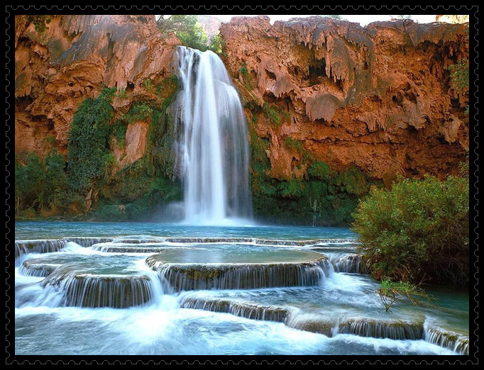
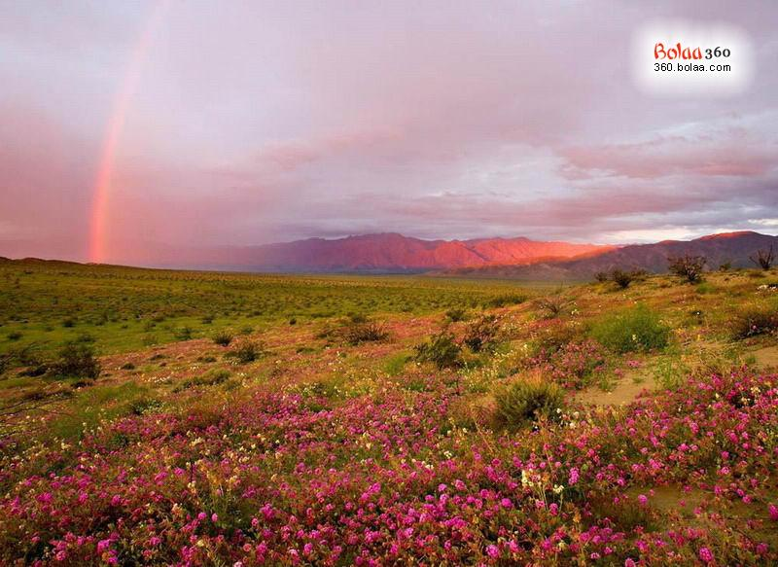
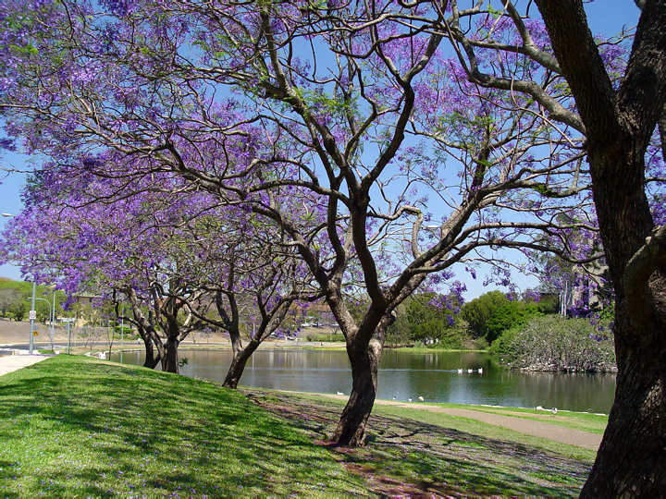
Thanks for your attention!

Slide 14
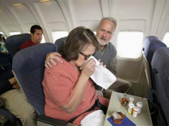
UNIT 6: AN EXCURSION

