Slide 1









Slide 2
LESSON 3
READING
WARM-UP
Write down activities
Task 1: Tick the appropriate box.
PRE-READING
Task 2. Read the article. Match the paragraphs with their headings.
Task 3. Match the highlighted phrase with the heading.
Task 4. Complete the diagrams with information from the text.
WHILE-READING
POST-READING
Discussion
CONSOLIDATION
Wrap-up
Homework

Slide 3
WARM-UP
Write down activities which are skills to become
independent.
LOOK AT THE PICTURES

Slide 4
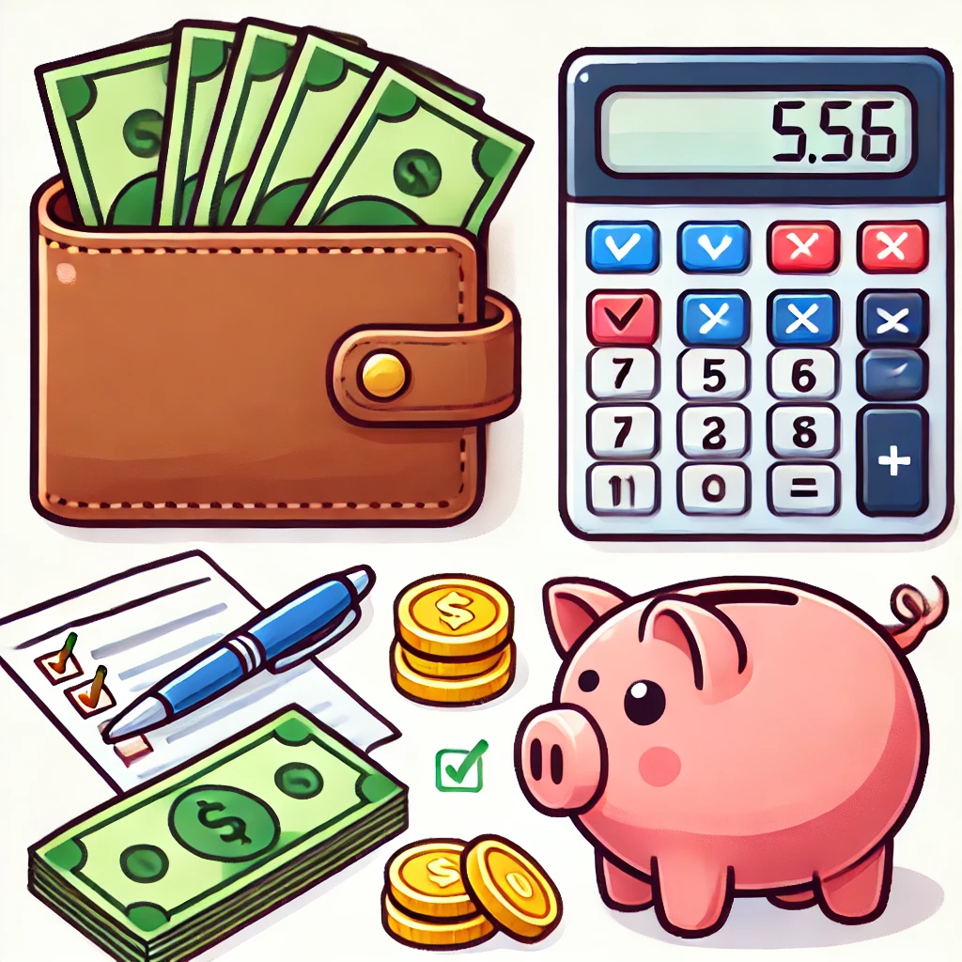
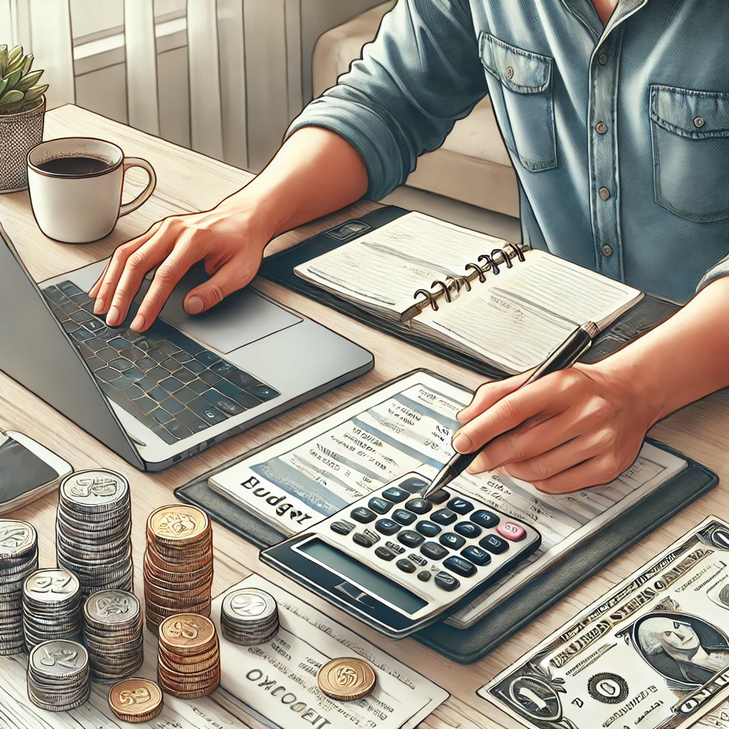
including a wallet, money, a calculator, a piggy bank, a checklist, laptop .
Managing money

Slide 5
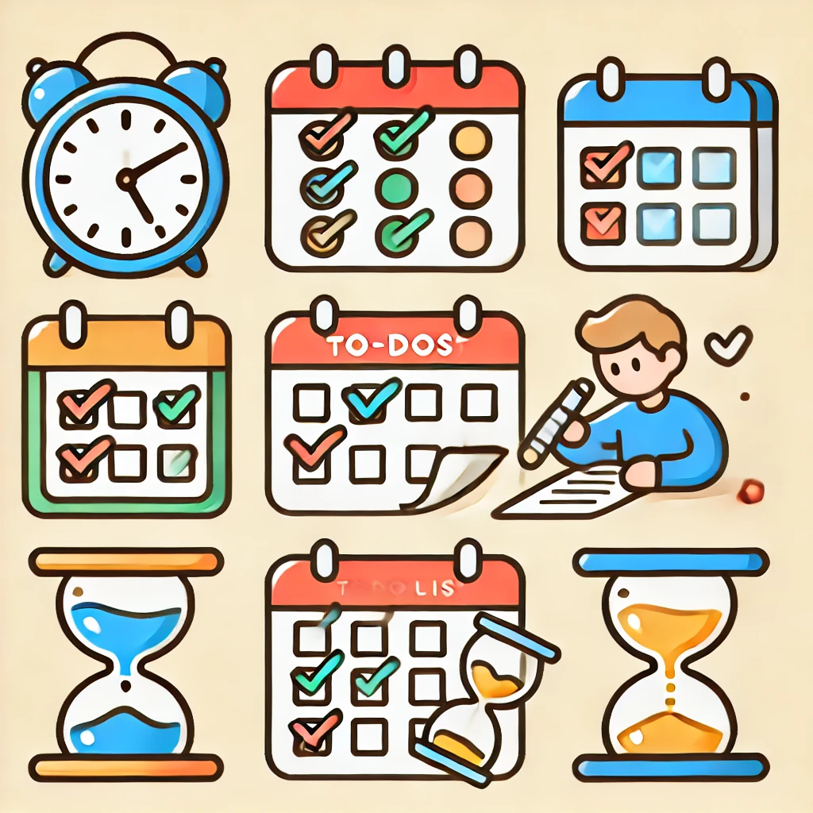
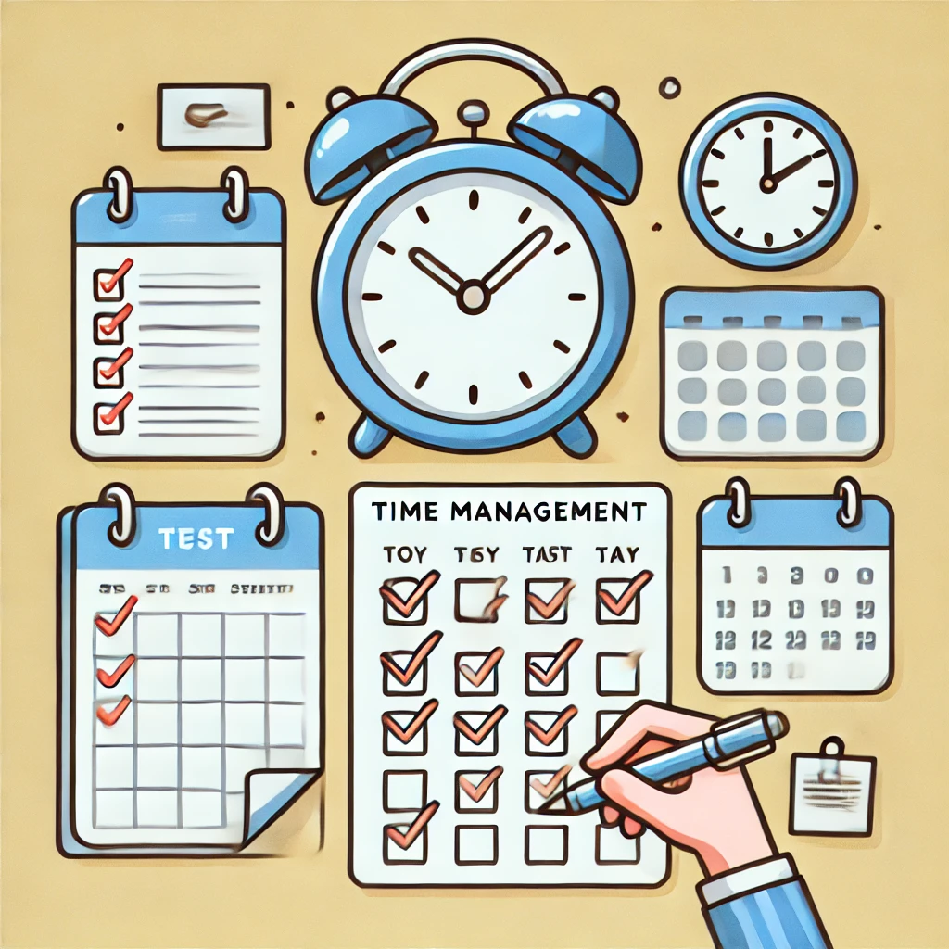
Including a clock, a calendar, a to-do list, an hourglass, and a person organizing their schedule.
Managing time

Slide 6
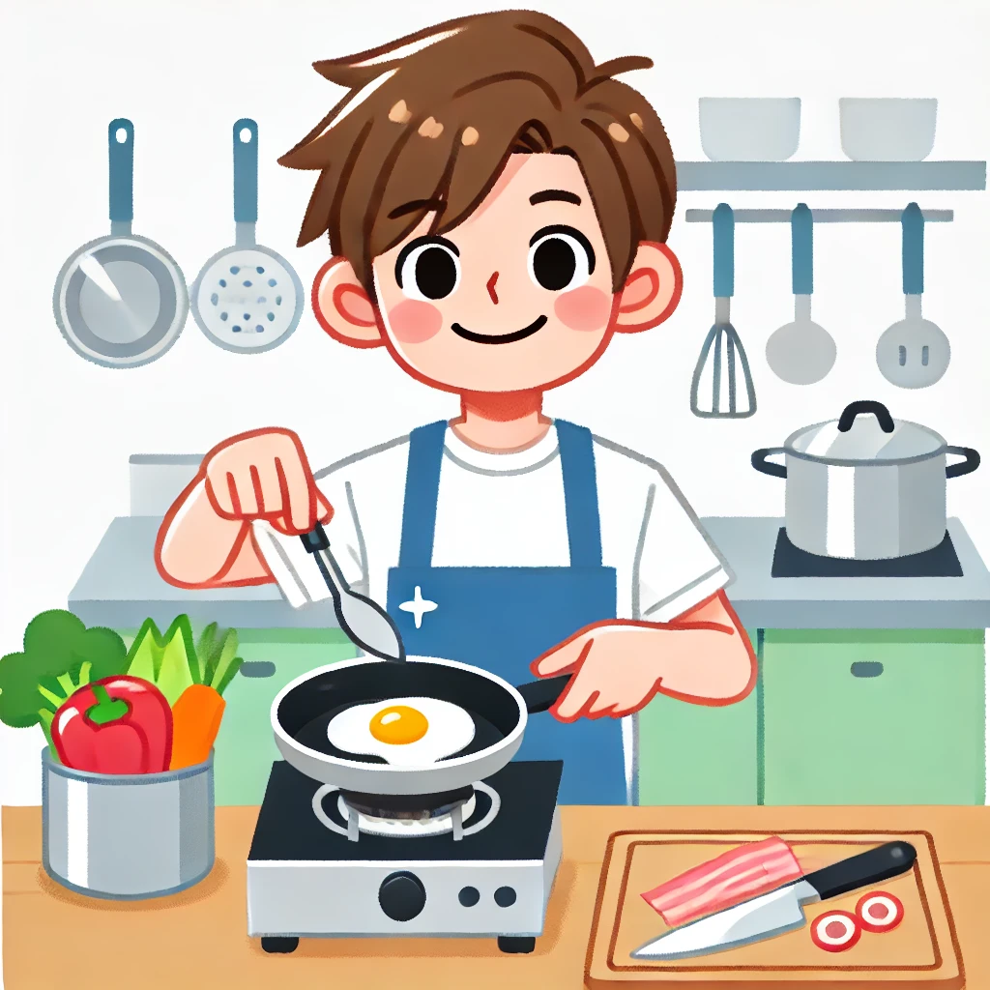
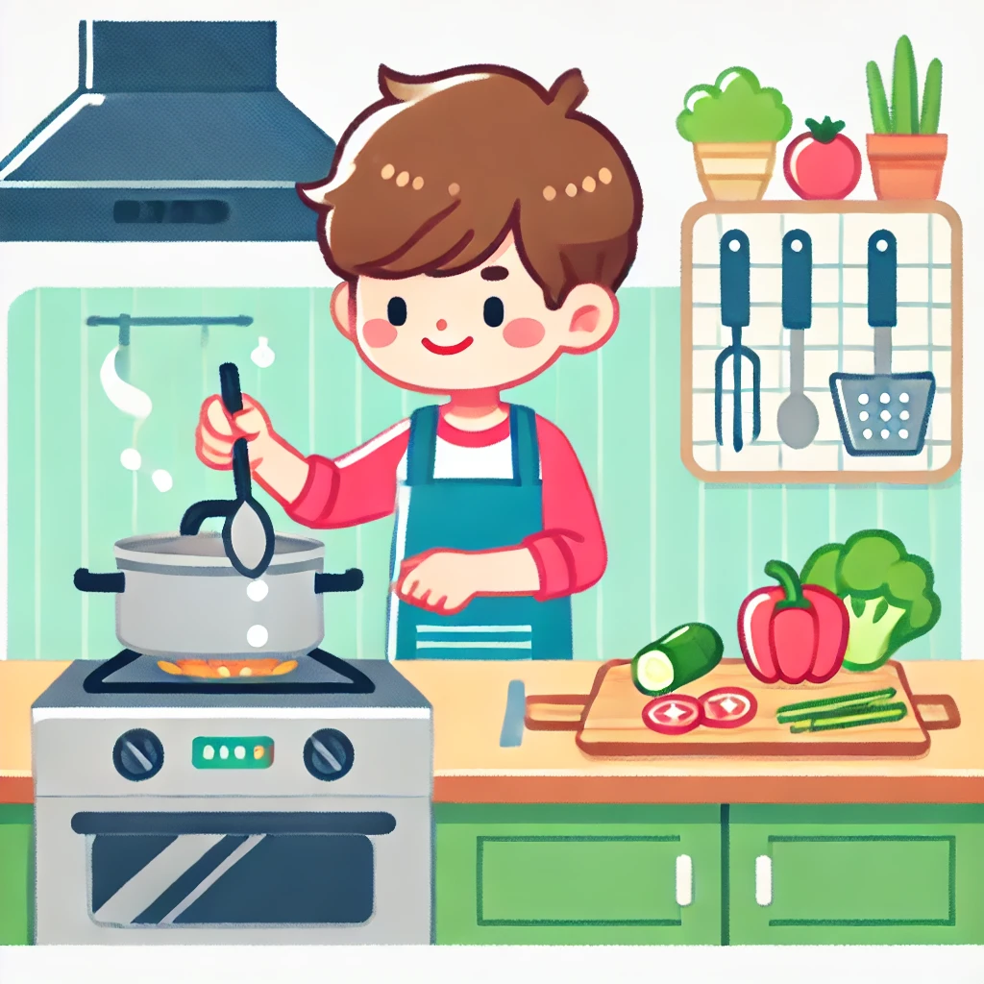
Cooking meals

Slide 7
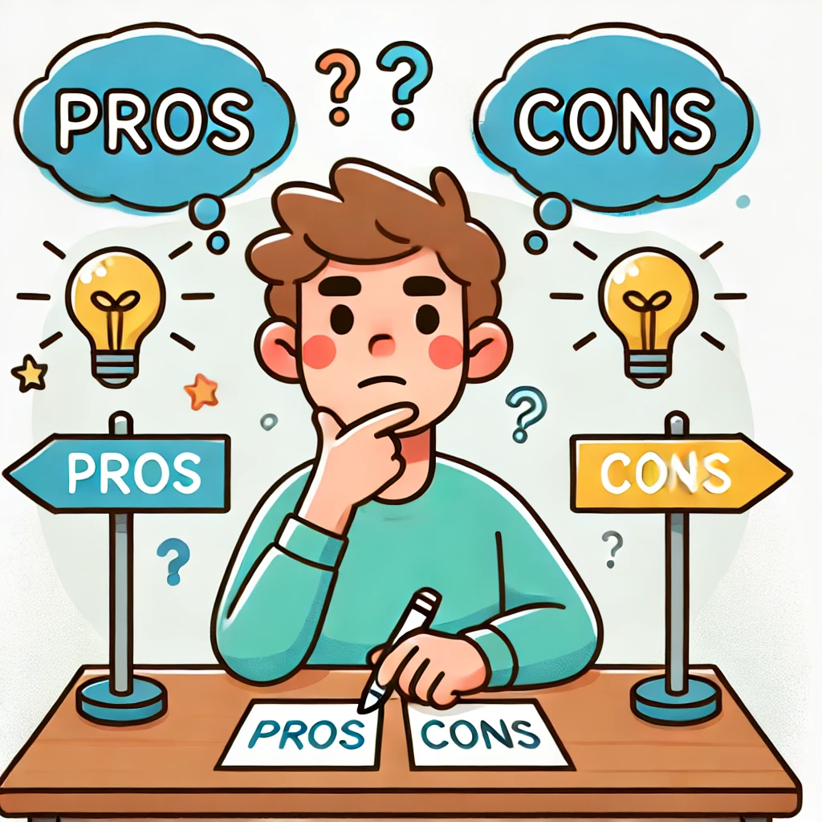

Resting their chin on their hand, with a signpost and pros-and-cons symbols above.
Thinking carefully before making decisions

Slide 8

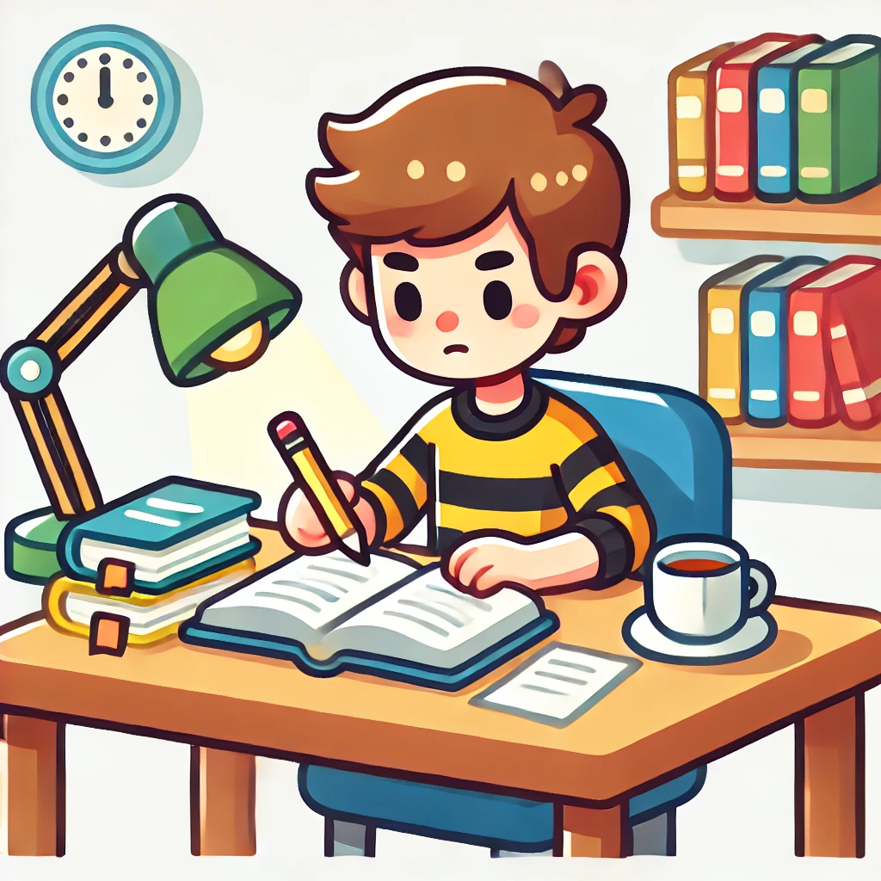
Self - study

Slide 9





WARM-UP
LOOK AT THE PICTURES
Write down activities which are skills to become independent.
- > these are the skills that help us become independent

Slide 10
Unit
8
BECOMING INDEPENDENT
Unit
FAMILY LIFE
LESSON 3
READING
How to become independent

Slide 11
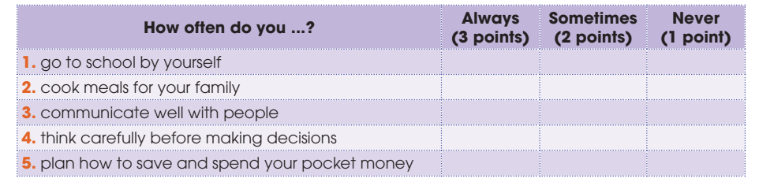
PRE-READING
1
Tick the appropriate box to see how independent you are. Add up your points. If your total score is nine or above, you are independent. Compare with a partner.

Slide 12
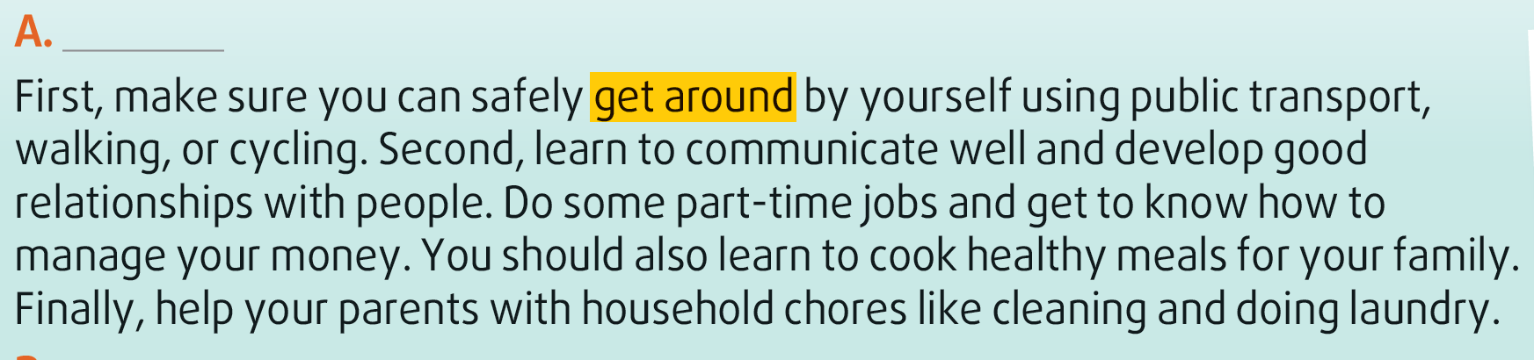
WHILE-READING
2
Read the text. Match the paragraphs (A-C) with their headings (1-5).
5

Slide 13
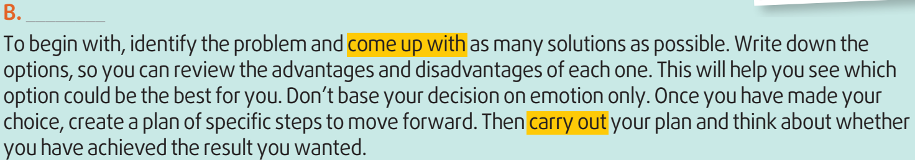
WHILE-READING
2
Read the text. Match the paragraphs (A-C) with their headings (1-5).
4

Slide 14
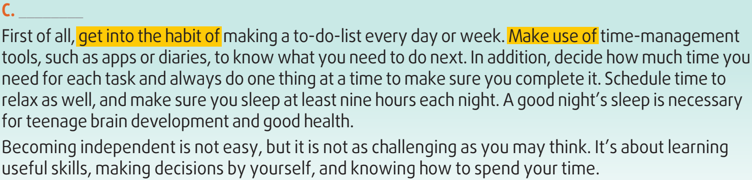
WHILE-READING
2
Read the text. Match the paragraphs (A-C) with their headings (1-5).
3

Slide 15
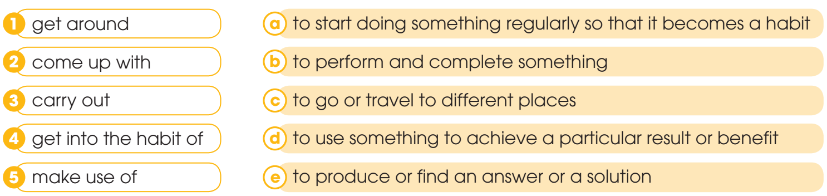
WHILE-READING
3
Read the text again and match the highlighted phrases in the text with their meanings.
1. c 2. e 3. b 4. a 5. d

Slide 16
WHILE-READING
4
Complete the diagrams with information from the text.
Decision-making skills
Identify the problem
Think of (1) ______________
Review pros and cons
Pick the (2) ______________
Create and carry out your plan
many solutions
best option

Slide 17
WHILE-READING
4
Complete the diagrams with information from the text.
Time-management skills
Make (3) ______________
Use time-management tools
Do one thing at a time
Schedule time to relax
Have a good (4) ______________
a to-do-list
night’s sleep

Slide 18

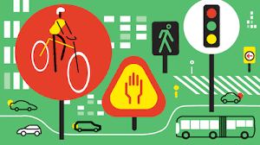
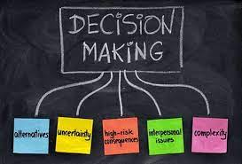
POST-READING
5
Discussion
Which of the skills mentioned in the text do you have?
What other skills do you think teenagers need to become independent?

Slide 19
CONSOLIDATION
1
Wrap-up
What have you learnt today?
Some skills to become independent
Reading for main ideas and specific information about how to become independent

Slide 20
CONSOLIDATION
2
Homework
Do exercises in the workbook.
Prepare for Lesson 4 - Unit 8.

Slide 21

Website: hoclieu.vn
Fanpage: facebook.com/www.tienganhglobalsuccess.vn

