Slide 1
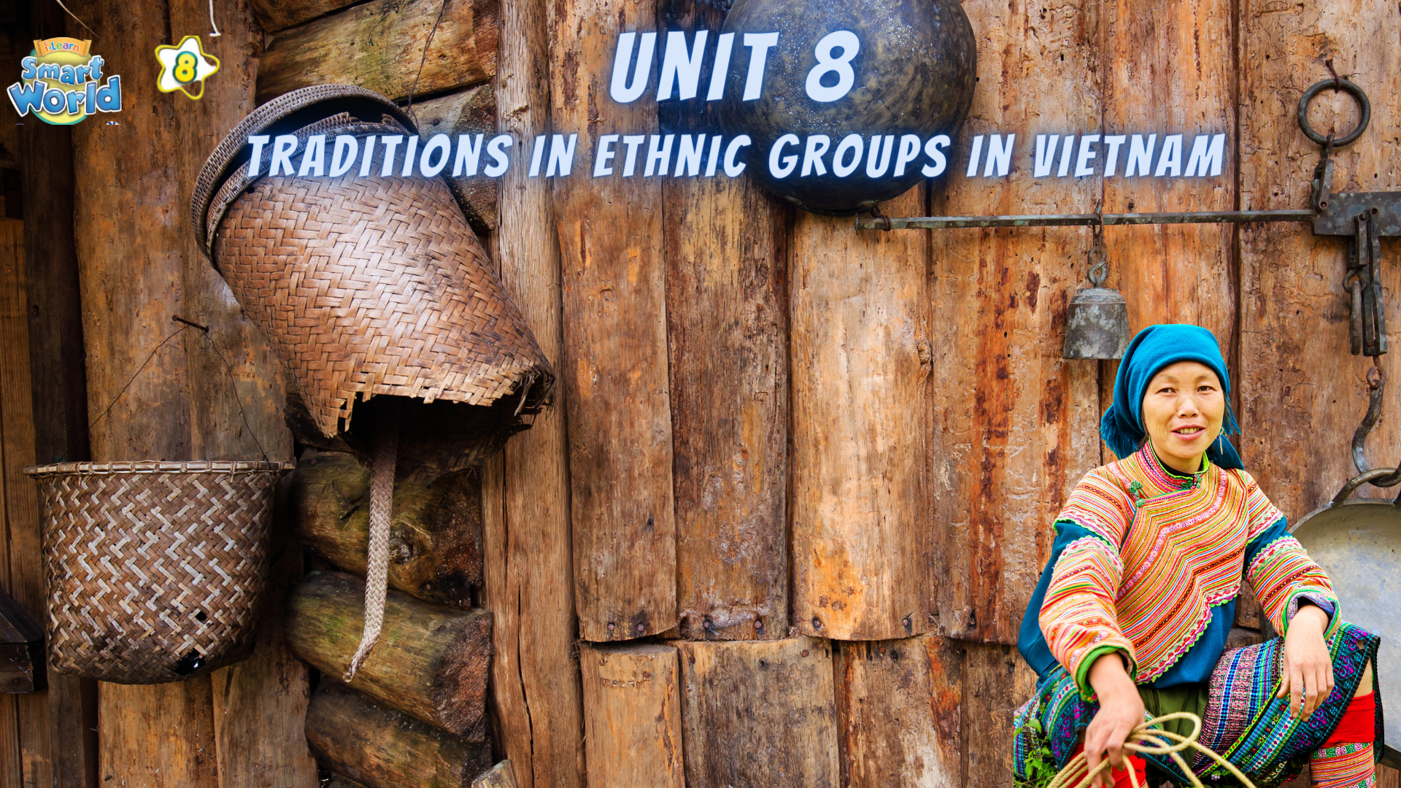

Slide 2
Choose the word whose underlined part is pronounced differently from that of the others.
1. A. market B. pattern C. basket D. mansion
/ˈmɑːrkɪt/ /ˈpætən/ /ˈbæskət/ /ˈmænʃən/
2. A. highlands B. flowers C. shoulders D. products
/ˈhaɪləndz/ /ˈflaʊərz/ /ˈʃoʊldərz/ /ˈprɑːdʌkts/
3. A. chore B. school C. chat D. chip
/tʃɔːr/ /skuːl/ /tʃæt/ /tʃɪp/

Slide 3
Choose the words whose main stress is placed differently from the others.
A. culture B. wedding C. guitar D. custom
/ˈkʌltʃər/ /ˈwedɪŋ/ /ɡɪˈtɑːr/ /ˈkʌstəm/
2. A. beautiful B. important C. talented D. regular
/ˈbjuːtɪfəl/ /ɪmˈpɔːrtənt/ /ˈtæləntɪd/ /ˈreɡjələr/
3. A. population B. embroidery C. celebrity D. experience
/pɑːpjəˈleɪʃən/ /ɪmˈbrɔɪdəri/ /səˈlebrəti/ /ɪkˈspɪriəns/

Slide 4
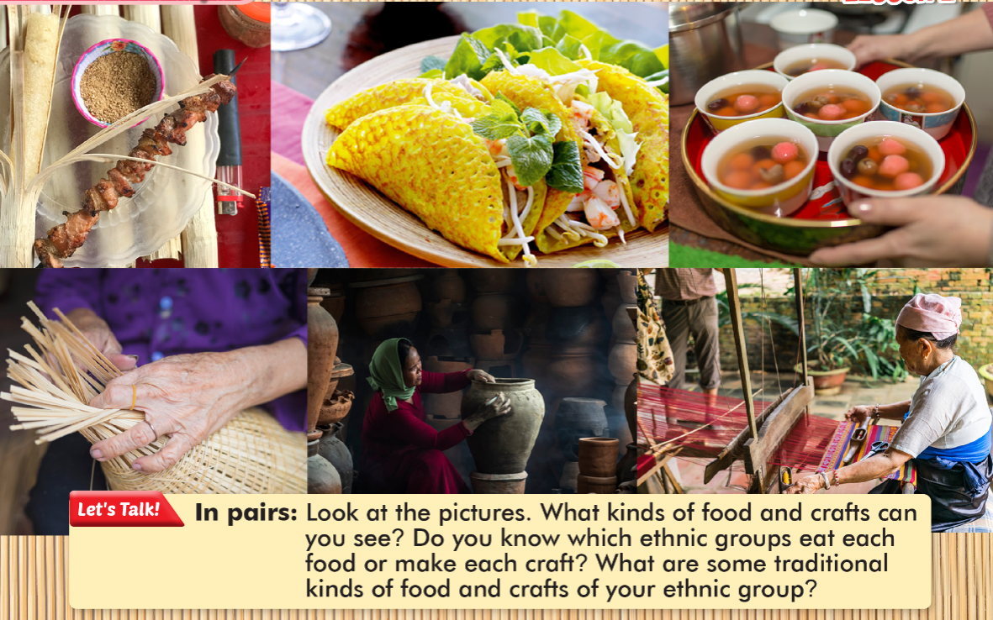

Slide 5




VOCABULARY
LESSON 4
LISTENING

Slide 6


blouse
(n) /blaʊz/
Áo cánh kiểu nữ
The blouse is a significant element of the traditional attire worn by women in various ethnic groups.
Áo dài là một phần quan trọng của trang phục truyền thống mà phụ nữ nhiều dân tộc mặc.

Slide 7
apron
(n) /ˈeɪprən/
Tạp dề
In some ethnic costumes, women wear beautifully adorned aprons as part of their traditional dress.
Trong một số trang phục truyền thống, phụ nữ mặc những chiếc tạp dề được trang trí đẹp mắt

Slide 8
sticky rice
(n) /ˌstɪki ˈraɪs/
Xôi
Sticky rice is a common staple in the diet of many ethnic groups in Vietnam.
Xôi là thực phẩm cơ bản trong chế độ ăn của nhiều dân tộc ở Việt Nam.

Slide 9
utensil
(n) /juːˈtensl/
Đồ dùng, dụng cụ trong gia đình
Traditional utensils, such as wooden spoons and bamboo trays, are used in daily life by ethnic communities.
Dụng cụ truyền thống như muỗng gạt và khay tre thường được sử dụng hàng ngày trong cộng đồng dân tộc

Slide 10
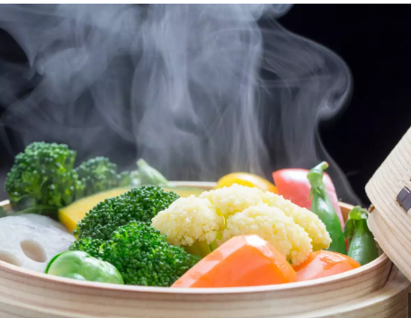
steamed
(adj) /stiːmd/
Đồ dùng, dụng cụ trong gia đình
Traditional dishes, such as sticky rice, are often prepared using the steam cooking method
Những món truyền thống như cơm nén thường được chuẩn bị bằng cách nấu hấp.

Slide 11
corn
(n) /kɔːn/
Ngô
Corn is a staple crop in the agricultural practices of several ethnic communities in Vietnam.
Bắp ngô là một loại cây lương thực quan trọng trong nông nghiệp của một số cộng đồng dân tộc ở Việt Nam.

Slide 12

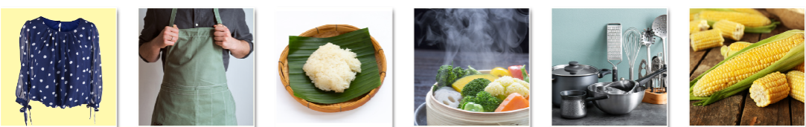
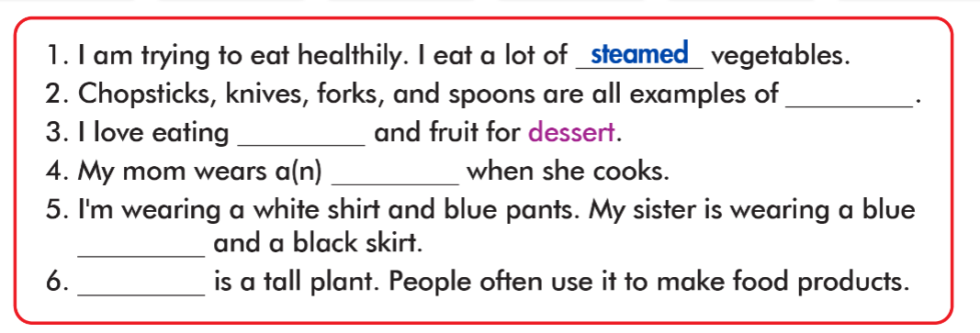
blouse
apron
sticky rice
steam
utensil
corn
utensils
sticy rice
apron
blouse
corn

Slide 13
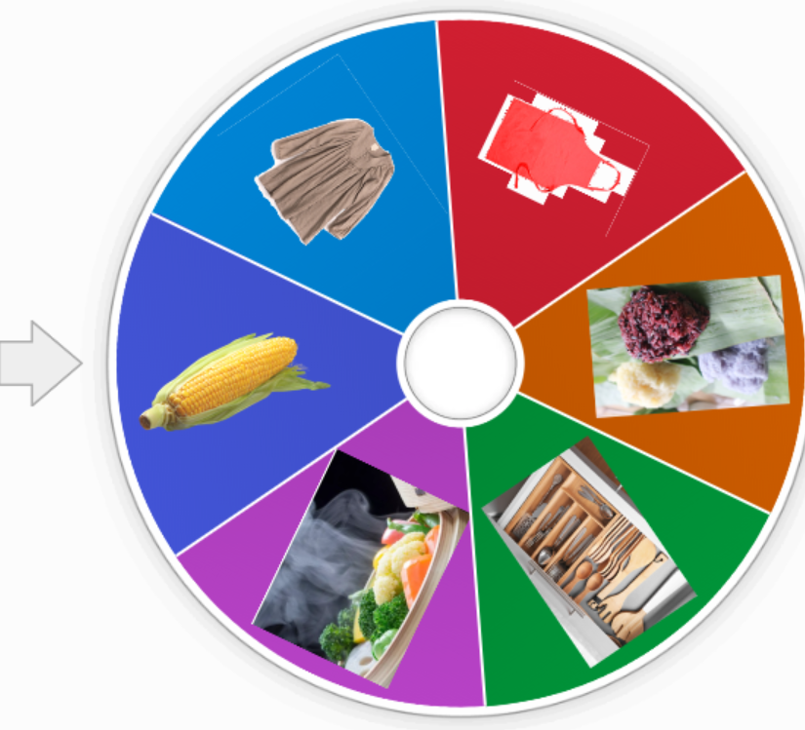

ONLINE GAME

Slide 14
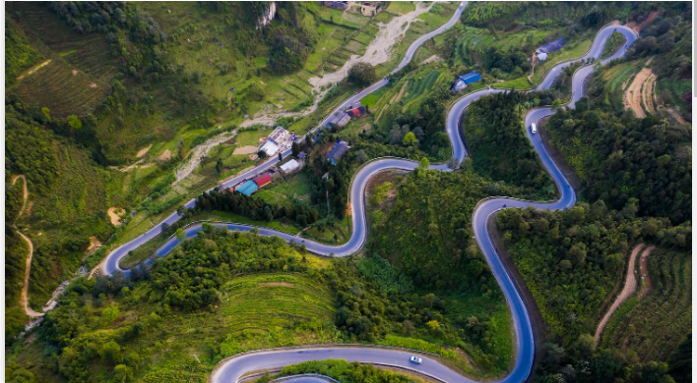
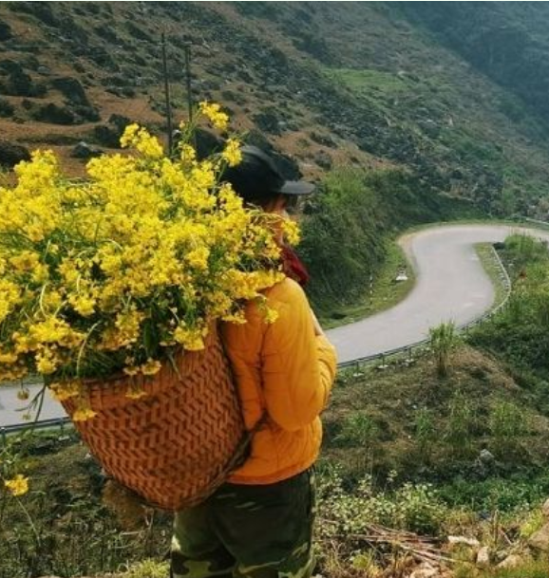
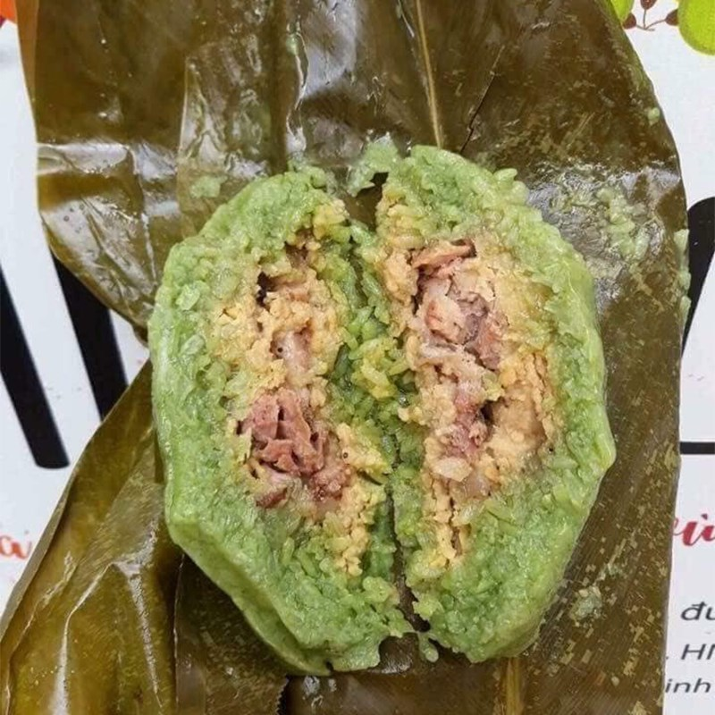
Ma Pì Lèng
Đồng Văn
Bánh trưng gù

Slide 15

Ha Giang Province

Slide 16

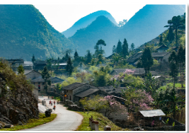


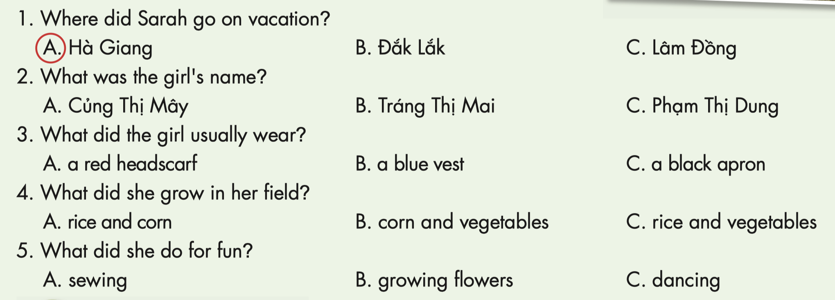

Slide 17
Sarah : Hey, John.
John : Hi, Sarah. Did you have a good 1)………………………………………………..?
Sarah : It was great. I went to Hà Giang in Vietnam.
John : Wow.
Sarah : Yeah. I met a really interesting
Pu Péo girl.
John : Pu Péo
Sarah : It’s a small 2) ………………………in Vietnam.
John : Oh, cool.
Sarah : I asked her what her name was. She said it was Tráng Thị Mai.
John : 3) ………………………………………………………….?
Sarah :I asked her what she usually wore
John : And?
Sarah : She said she usually wore Pu Péo
4) …………………..clothes. She was wearing a long blue skirt, a black vest, black 5) ……………….., and a purple 6) …………………………… .
John : That sounds pretty.
Sarah : Yeah. I also asked her what her family did and she told me what they 7 ) ……... in their field.
John : Oh?
Sarah : She said they grew 8) ………., ……….., and bean.
John : Interesting.
Sarah : Last, I asked her what she did for fun.
John : What did she say?
Sarah : She said she liked 9) ………………… .
John: I like sewing, too.
Sarah : I didn’t know that.
traditional
summer vacation
apron
headscarf
grew
corn
rice
ethnic group
sewing
What else did you ask her?

Slide 18

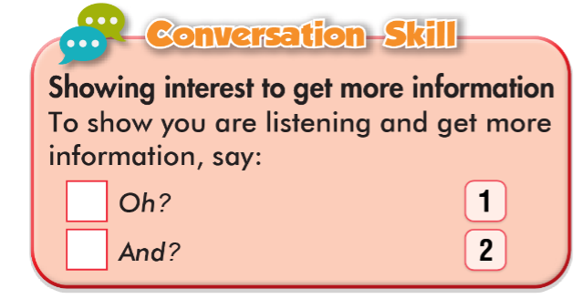
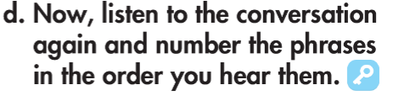
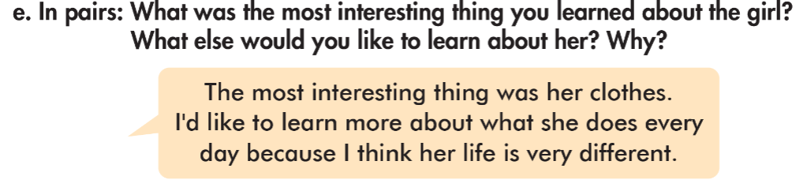

Slide 19

WARP-UP
Unit 8
TRADITIONS IN ETHNIC GROUPS IN VIETNAM
Lesson 4: New words & Reading
Ms Phương
Zalo: 0966765064
Vocabularies
steamed, apron, blouse, utensil, corn, sticky rice
Listening
Listening to a conversation and circle the correct answer
Speaking
Talking about a summer vacation

Slide 20
Vocabulary Review
No | Word | Meaning
blouse
Áo cánh kiểu nữ
1
2
apron
Tạp dề
3
sticky rice
Xôi
4
utensil
Dụng cụ nhà bếp
5
steamed
Hấp
6
corn
ngô

Slide 21

Homework
Learn by heart the new words and practice making sentences with them.
Do exercises on page 46 WB.
Do the exercises in Tiếng Anh 8 i-Learn Smart World Notebook on pages 65 & 66.
Prepare the next lesson (pages 79 & 80 SB)

Slide 22


