Slide 1


Slide 2
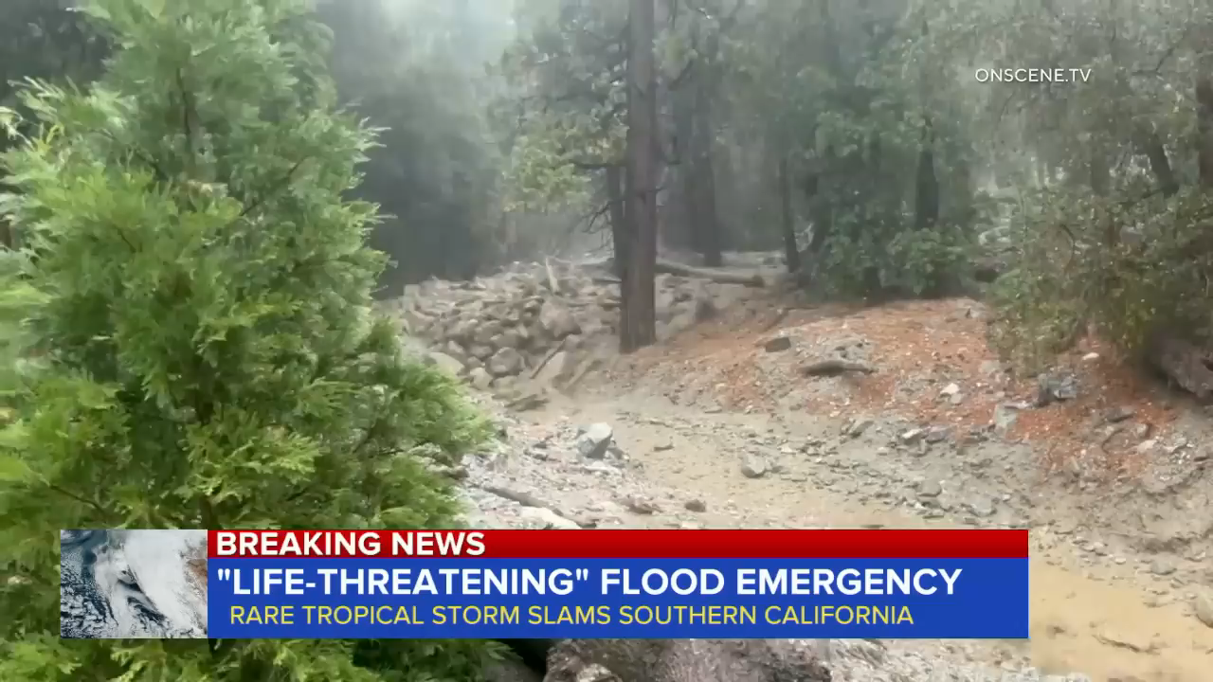

Slide 3




WRITING
LESSON 7
READING

Slide 4
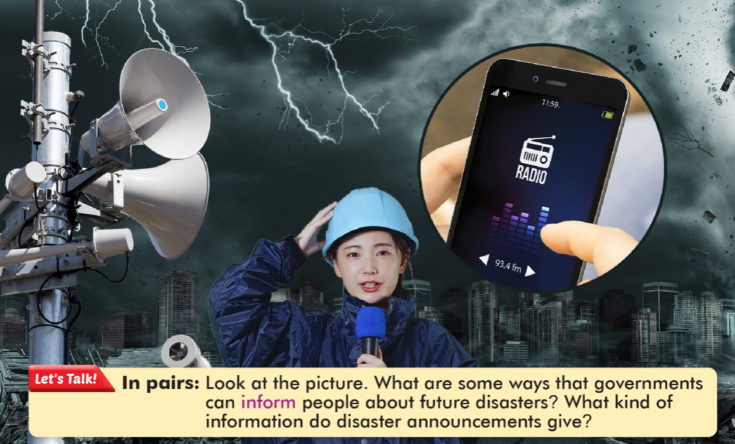

Slide 5





task (n)
immediately (adv)
warning (n)
inform (v)
expect (v)

Slide 6
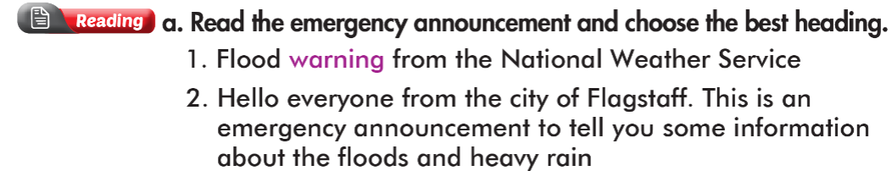
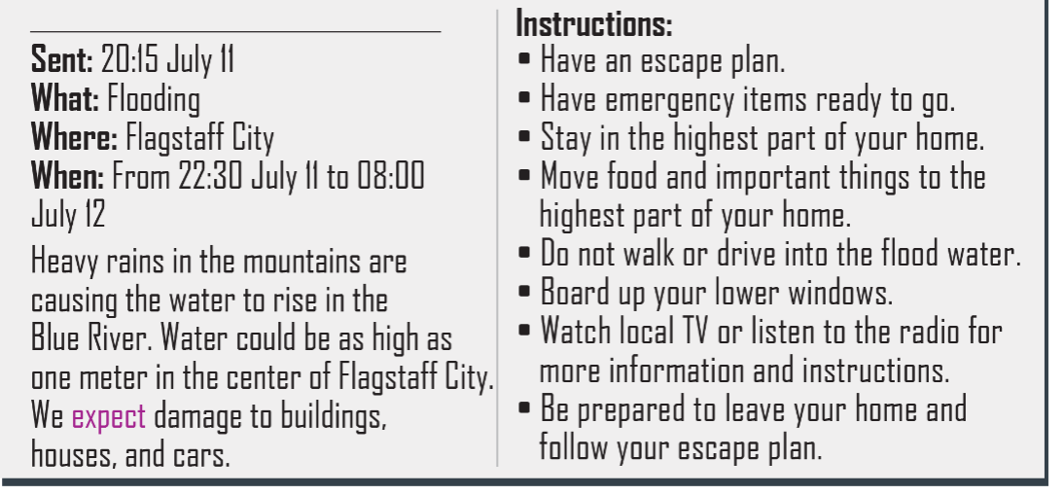

Slide 7
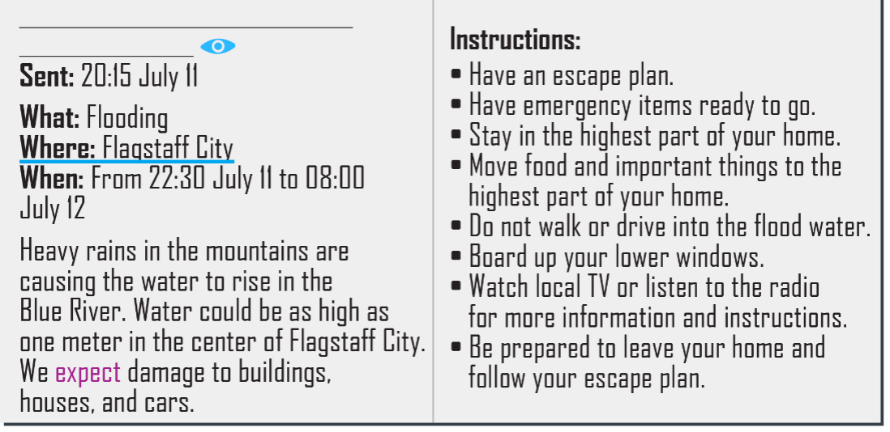


Slide 8

At 8 a.m. on July 12th

Slide 9

Emergency items

Slide 10
In the highest part of their homes

Slide 11

From the local TV or radio

Slide 12


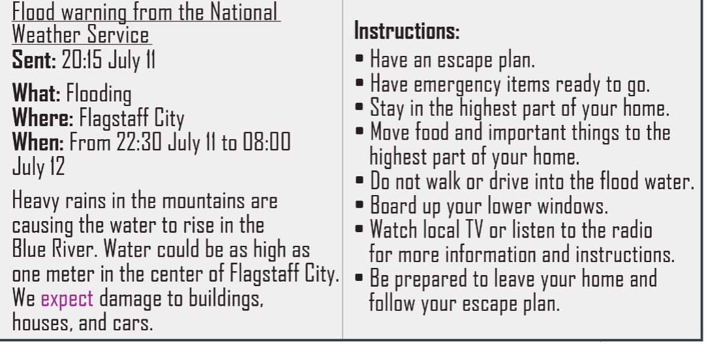

Slide 13
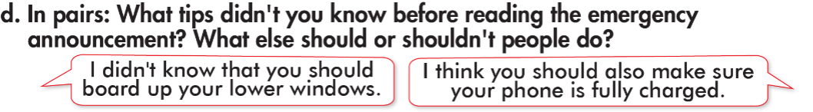


Slide 14
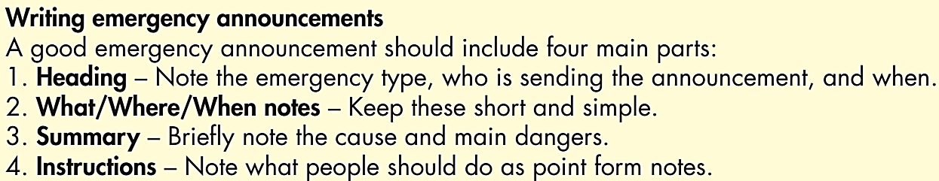

Slide 15

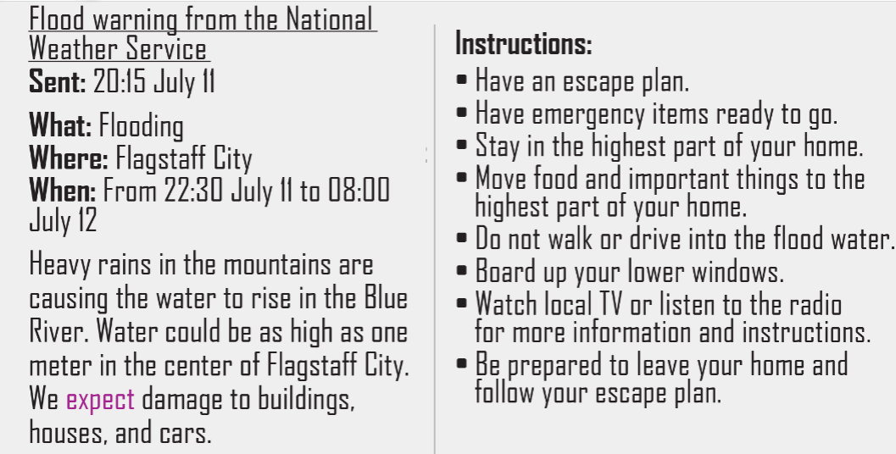
1
4
2
3

Slide 16

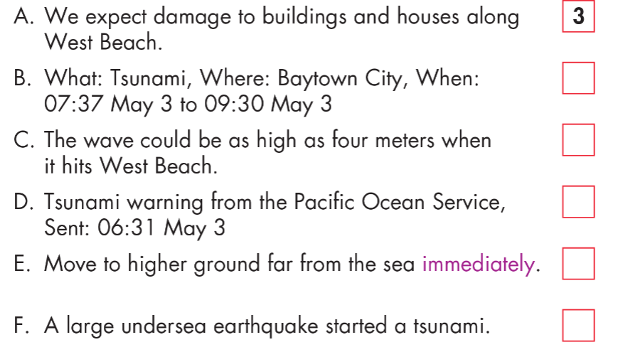
2
3
1
4
3

Slide 17

WARP-UP
Unit 4
DISASTERS
Lesson 7: Reading & Writing
Ms Phương
Zalo: 0966765064
Reading:
- Practice reading for main ideas and specific information
Writing:
- Learn how to write emergency announcements

Slide 18

Homework
1. Do the exercises on page 24, WB.
2. Do the exercises in Tiếng Anh 8 i-Learn Smart World Notebook on page 34.
3. Prepare the next lesson (page 43, SB)

Slide 19


