Slide 2
Spin the wheel and say the words.
ONLINE GAME

Slide 3
Ms Lương
Zalo: 0966765064
LESSON 2
GRAMMAR

Slide 4
Wh-questions REVISION
Câu hỏi chủ ngữ:
Question word + V + (complement) + (modifier)?
Câu hỏi tân ngữ/ bổ ngữ/ trạng ngữ:
Question word + aux./ modal + S + V …?

Slide 5
Who hoặc What:
Từ hỏi dùng để hỏi chủ ngữ
• What: Dùng để hỏi về sự vật/ sự việc
What happened last night? (Điều gì đã xảy ra tối qua?) | What are on the table? (Những cái gì trên bàn vậy?)
• Who: Dùng để hỏi về người.
Who are talking? (Ai đang nói chuyện vậy?) | Who opened the door? (Ai đã mở cửa vậy?)

Slide 6
Who/whom hoặc What:
Từ hỏi dùng để hỏi tân ngữ
• What: Dùng để hỏi về đồ vật/ sự vật/ sự việc
What did your brother buy? (Điều gì đã xảy ra tối qua?) | What are those? (Những cái gì là gì vậy?)
• Who: Dùng để hỏi về người.
Who/ Whom did you give the book to? (Bạn đã tặng cuốn sách cho ai? | Who do you go holiday with? (Bạn đã đi nghỉ cùng ai?)

Slide 7
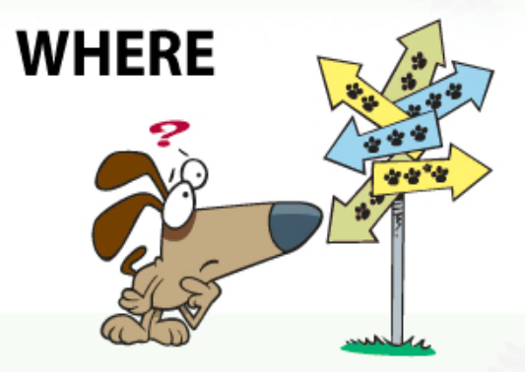
Từ hỏi dùng để hỏi trạng ngữ
How: Dùng để hỏi về phương tiện đi lại
When: Dùng để hỏi về thời gian
Where: Dùng để hỏi về nơi chốn/ địa điểm
Why: Dùng để hỏi về lí do

Slide 8
 | Usage | Example
How much | Dùng để hỏi với danh từ không đếm được | How much water do you need?
How many | Dùng để hỏi với danh từ đếm được | How many books does she have?
How old | Dùng để hỏi tuổi | How old is your mother?
How often | Dùng để hỏi về tần suất | How often do you go to the cinema?
How long | Dùng để hỏi về thời lượng của hành động | How long have you been waiting for me?
How far | Dùng để hỏi về khoảng cách | How far is it from your house to school?
How + adj | Dùng để hỏi về tính chất | How large is the yard?

Slide 9
Yes/ No questions
Aux./ Modal + S + V …?
- Yes, S + aux./ modal. (positive verb)
No, S + aux./ modal + not (negative verb)

Slide 10
Choose the correct answer
1. A: .................... is your favourite cartoon? B: It is “Kung Fu Panda”.
A. Who B. What C. When D. Why.
2. A: .................... is the weathergirl on VTV3 at 8 o’clock tonight? B: She is Hoai Anh.
A. Who B. What C. When D. Why
3. A: .................... is the film “Harry Potter”? B: It is very mysterious and thrilling.
A. Who B. What C. When D. Ho
4. A: .................... is the studio of Vietnam Television? B: In Hanoi.
A. When B. Where C. Why D. How
5. A: .................... do people like watching game shows? B: Because they are educational and entertaining.
A. When B. Where C. Why D. How

Slide 11
Choose the correct answer
6. A: .................... did the first channel broadcast in the world? B: In 1928.
A. When B. Where C. Why D. How
7. A: .................... do you watch this TV programme? B: Three times a week.
A. When B. How often C. How long D. How much
8. A: .................... have we watched this programme? B: About one year.
A. When B. How often C. How long D. How much
9. A: .................... televisions are there in your house? B: There are two televisions in my house.
A. How many B. How much C. How long D. How often
10. A: .................... will you buy a new television? B: Maybe tomorrow.
A. Why B. Where C. When D. How

Slide 12
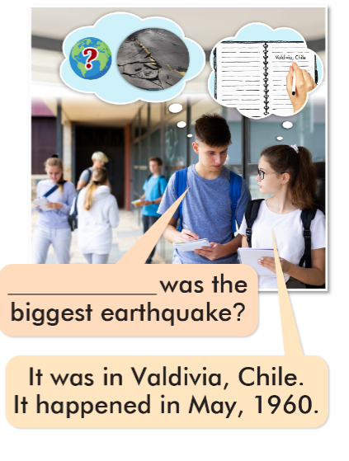
Where

Slide 13
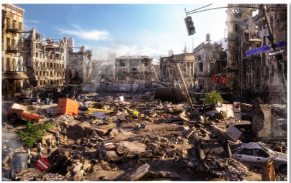

Slide 14
How much
How long
How tall
Where
How many

Slide 15
When was the worst avanche?
How many people died in the earthquake?
How much damage did the typhoon cause?
Where was the worst heat wave?
How deep was the snow in the 1972 Iran Blizzard?
What was the largest landslide?

Slide 17
WARP-UP
Unit 4
DISASTERS
Lesson 2: GRAMMAR
Ms Phương
Zalo: 0966765064
Grammar: - To practice and use Wh-questions.
Speaking: - To practice asking and answering Wh-questions.

Slide 18
START

Slide 19
Click on the right question word to complete the sentence.
NEXT
When
__________ are you leaving? I’m leaving tomorrow.
1/18

Slide 20
Click on the right question word to complete the sentence.
NEXT
Where
__________ do you live? I live in Spain.
2/18

Slide 21
Click on the right question word to complete the sentence.
NEXT
Why
__________ are you late? Because I overslept.
3/18

Slide 22
Click on the right question word to complete the sentence.
NEXT
Whose
This is my sweatshirt. ________ is that?
4/18

Slide 23
Click on the right question word to complete the sentence.
NEXT
When
__________ is the football match? It’s next Sunday.
5/18

Slide 24
Click on the right question word to complete the sentence.
NEXT
How
__________ old are you? I’m twelve.
6/18

Slide 25
Click on the right question word to complete the sentence.
NEXT
How
__________ do you get to school? By bus.
7/18

Slide 26
Click on the right question word to complete the sentence.
NEXT
Which
__________ subjects do you prefer? English and art.
8/18

Slide 27
Click on the right question word to complete the sentence.
NEXT
Where
__________ did you go? I went to the park.
9/18

Slide 28
Click on the right question word to complete the sentence.
NEXT
Whose
__________ candies are those? They’re Peter’s.
10/18

Slide 29
Click on the right question word to complete the sentence.
NEXT
Which
All the smartphones are great. _______ is cheaper?
11/18

Slide 30
Click on the right question word to complete the sentence.
NEXT
What
__________ is your name? My name is Paul.
12/18

Slide 31
The
Click on the right question word to complete the sentence.
NEXT
Why
__________ did they lose the game?
Because they played badly.
13/18

Slide 32
Click on the right question word to complete the sentence.
NEXT
What
__________ is that? It’s my schoolbag.
14/18

Slide 33
Click on the right question word to complete the sentence.
NEXT
Who
__________ did you go with? I went with Peter.
15/18

Slide 34
Click on the right question word to complete the sentence.
NEXT
Which
__________ cap do you like? I like the red one.
16/18

Slide 35
Click on the right question word to complete the sentence.
NEXT
Whose
__________ car is that? It’s ours.
17/18

Slide 36
Click on the right question word to complete the sentence.
EXIT
Who
__________ wrote Hamlet? William Shakespeare.
18/18

Slide 37
Homework
1. Review how to make Wh-questions.
2. Do the exercises on page 21 WB.
3. Do the exercises in Tiếng Anh 8 i-Learn Smart World Notebook on pages 29&30.
4. Prepare the next lesson (pages 36 & 37, SB)

