Slide 1


Slide 2



LESSON 9
REVIEW 1

Slide 3
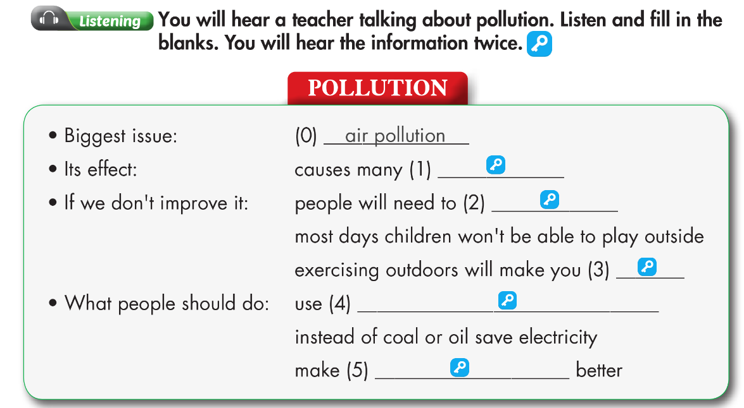

diseases
stay indoors
sick
renewable energy/solar or wind
public transportation

Slide 4
Audio Scripts
Example:
Narrator: You will hear a teacher talking about pollution. Listen and fill in the blanks. You will hear the information twice.
W: Pollution is a problem in many places, but air pollution affects our town the most.
It causes many diseases. Every year, thousands of people die because of air pollution. If we don’t do anything to improve it, we will need to stay indoors most days. Children won’t be able to play outside, and exercising outdoors will make you sick. So, what can we do to reduce air pollution? Power plants often cause lots of air pollution. Our government should use renewable energy like solar or wind instead of coal or oil. Each of us should save electricity because it takes lots of energy to make electricity. The town should make public transportation better so people will use it more. If we all walk, ride our bikes, or use public transportation, there will be less traffic and air pollution.
Narrator: Now, listen again

Slide 5
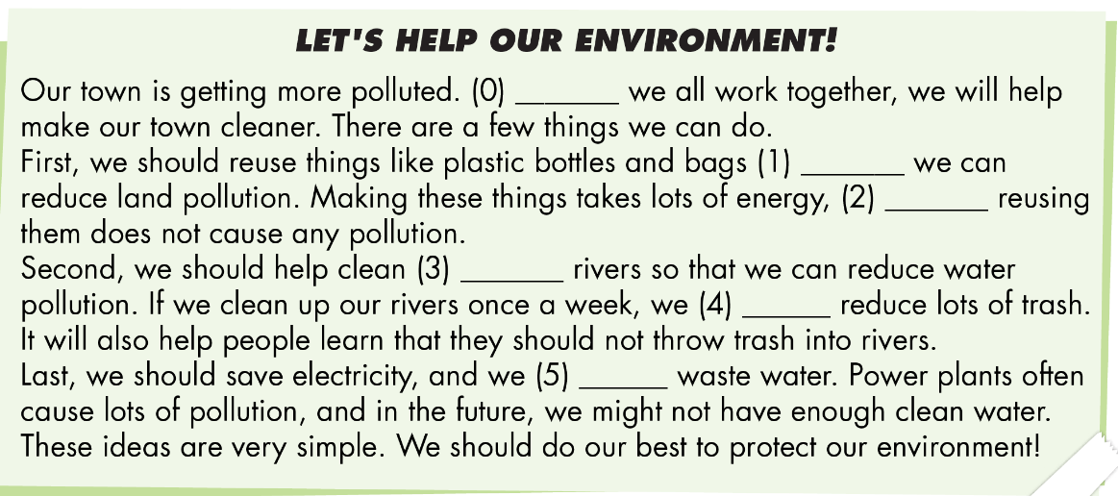

Slide 6


Slide 11

WARP-UP
Unit 3
PROTECTING THE ENVIRONMENT
Lesson 9: REVIEW 1
Review:
- Grammar of Unit 3: First Conditional, Compound and Complex sentences
- Vocabulary of Unit 3: Words of the topic “Protecting the Environment”: (affect, cause, pollute, disease, wildlife, tourism, environment, damage, recycle, reuse, reduce, save, waste, clean up, electricity, air conditioner, provide).
- Listening and Reading Practice to review the topic “Protecting the Environment”
Ms Phương
Zalo: 0966765064

Slide 12

Homework
Review vocabulary, grammar and language skills of unit 3
- Do the exercises in WB: Unit 3 Review - Part 1 (page 52)
- Prepare: Review – SB (page 91)

Slide 13


