Slide 1
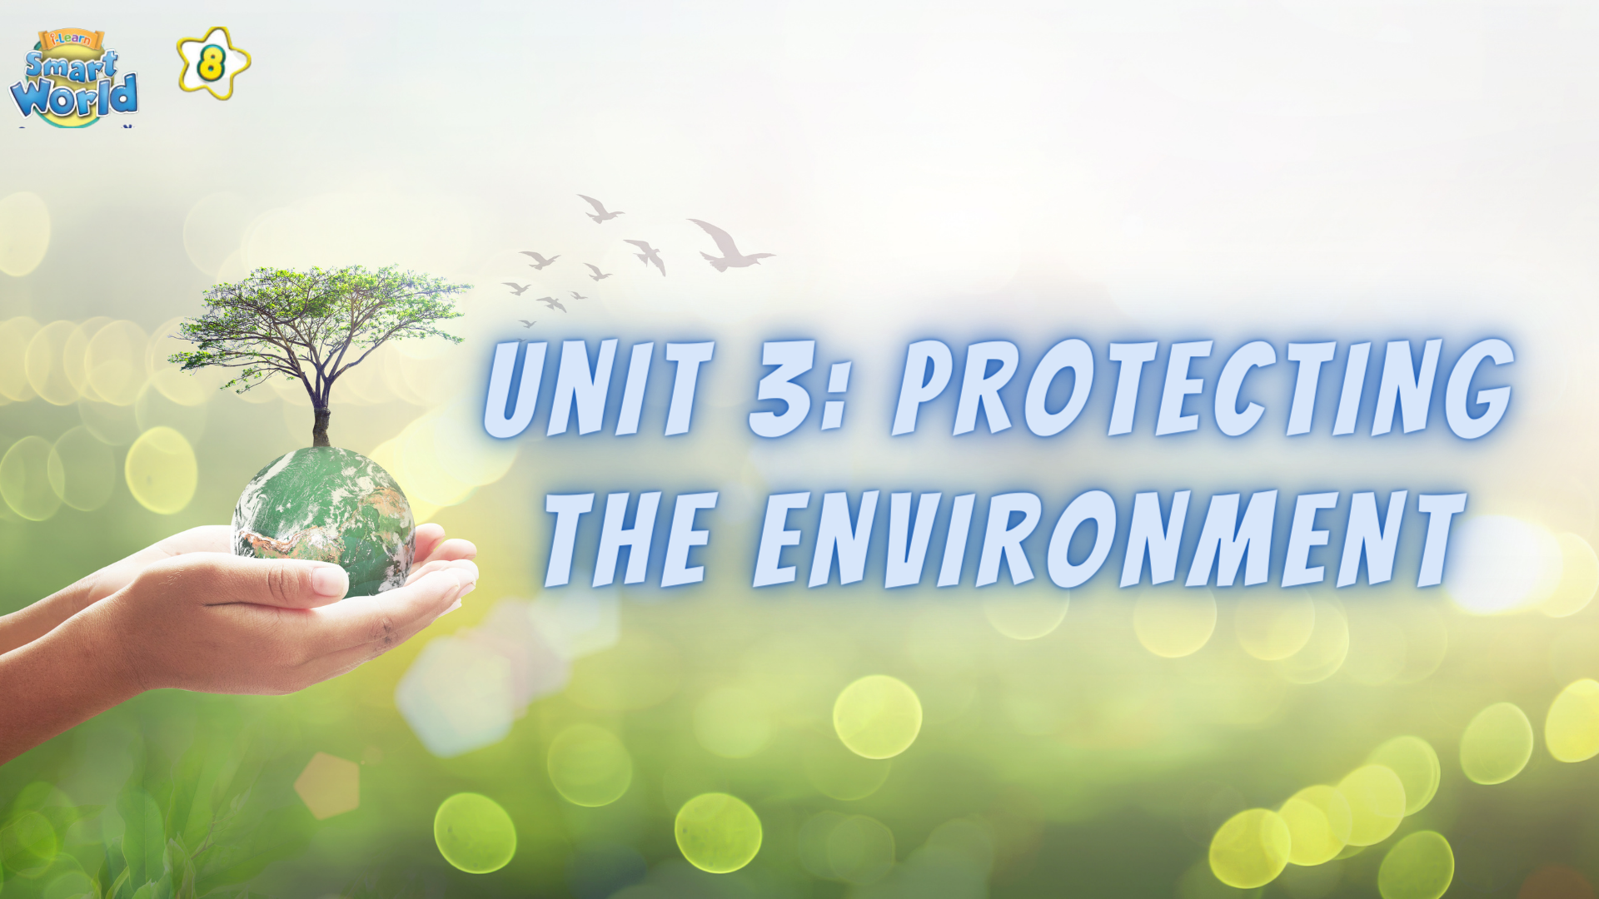

Slide 2
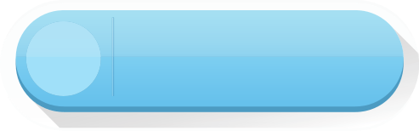



WRITING
LESSON 7
READING

Slide 3
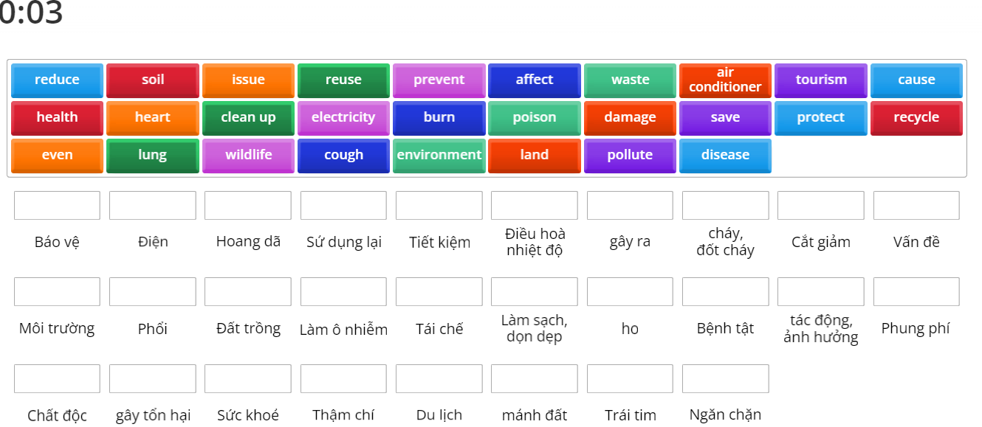

Vocabulary Review
ONLINE GAME

Slide 4
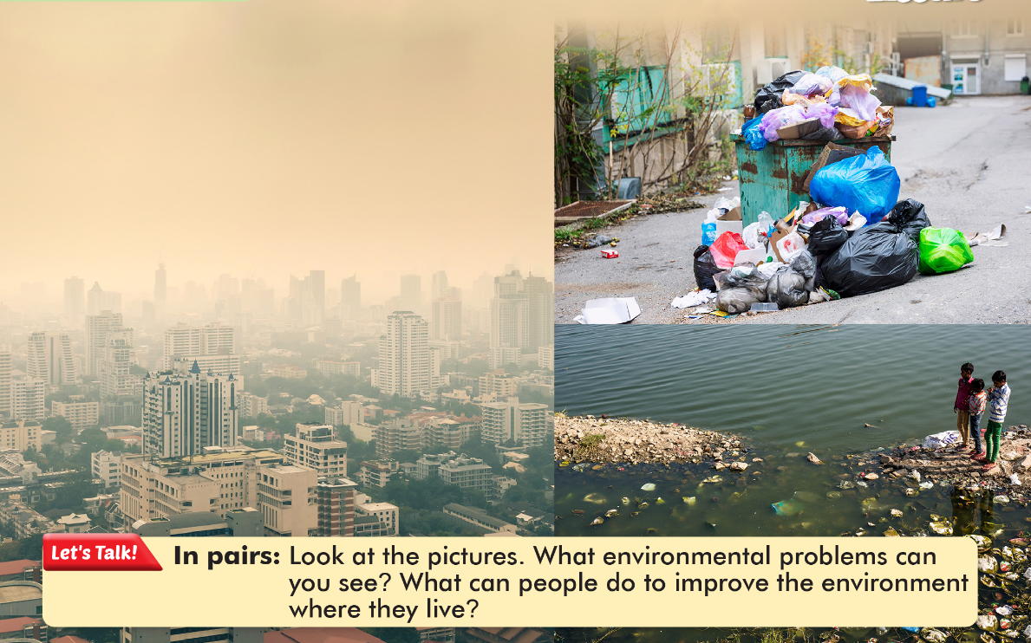

Slide 5
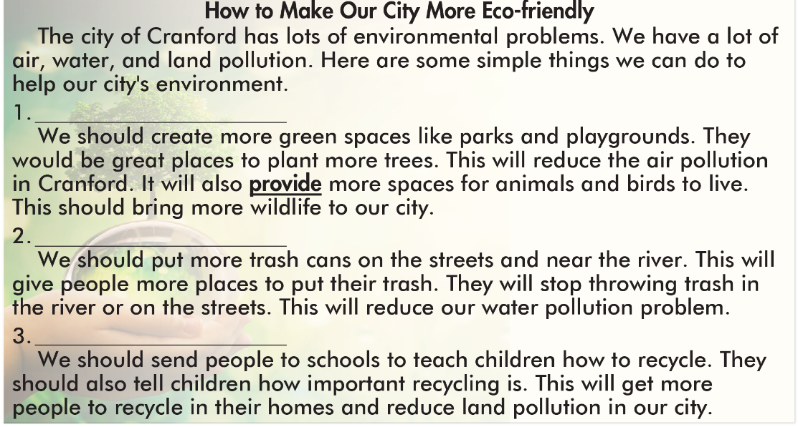
Create some parks
Provide more trash cans
Teach people to recycle

Slide 6


Slide 11



Slide 12
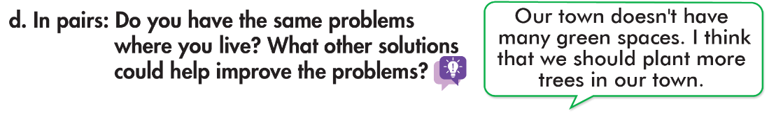
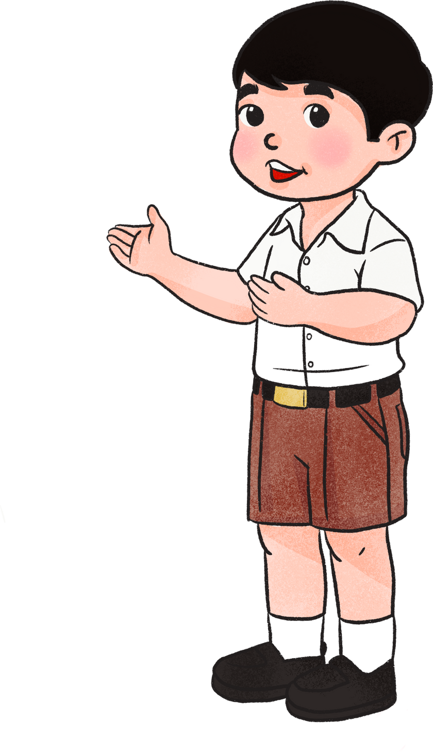


Slide 13
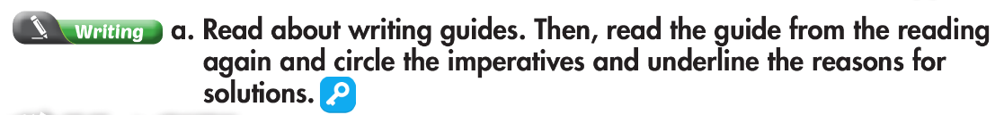
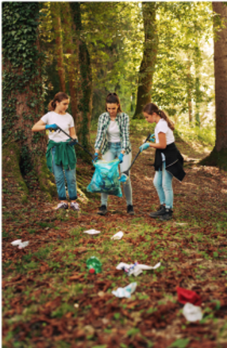
Create some parks
Provide more trash cans
Teach people to recycle

Slide 14
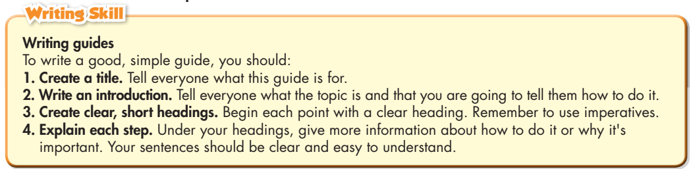

Slide 15
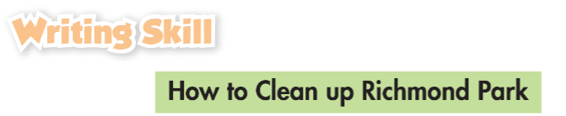
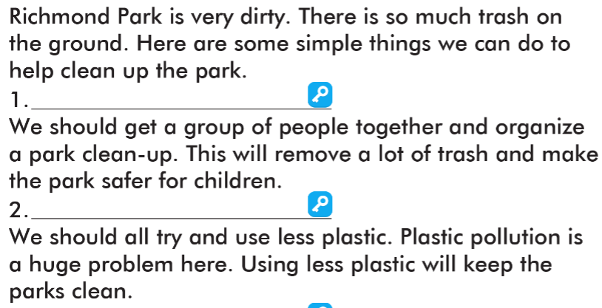
Organize a park clean-up
Use less plastic

Slide 16
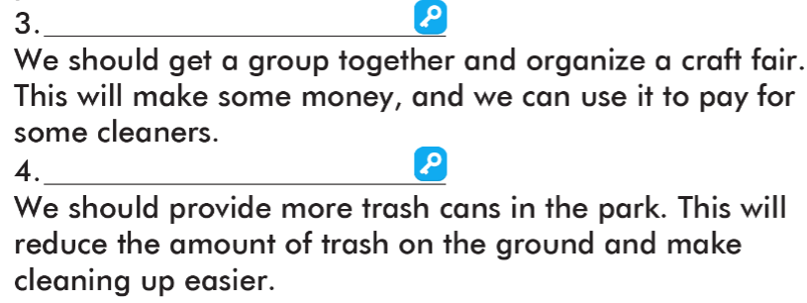
Organize a craft fair
Provide more trash cans

Slide 17

Write the five sentences about how to clean up your neighborhood.

Slide 18

WARP-UP
Unit 3
PROTECTING THE ENVIRONMENT
Lesson 7: Reading and Writing
Reading
Reading the guide about how to make our city more eco-friendly.
Writing
Writing guides.
Ms Phương
Zalo: 0966765064

Slide 19

Homework
1. Do the exercises on page 19 WB.
2. Prepare the next lesson (page 33 SB)
3. Do the exercises in TA 8 i-Learn Smart World Notebook, page 26

Slide 20


