Slide 1
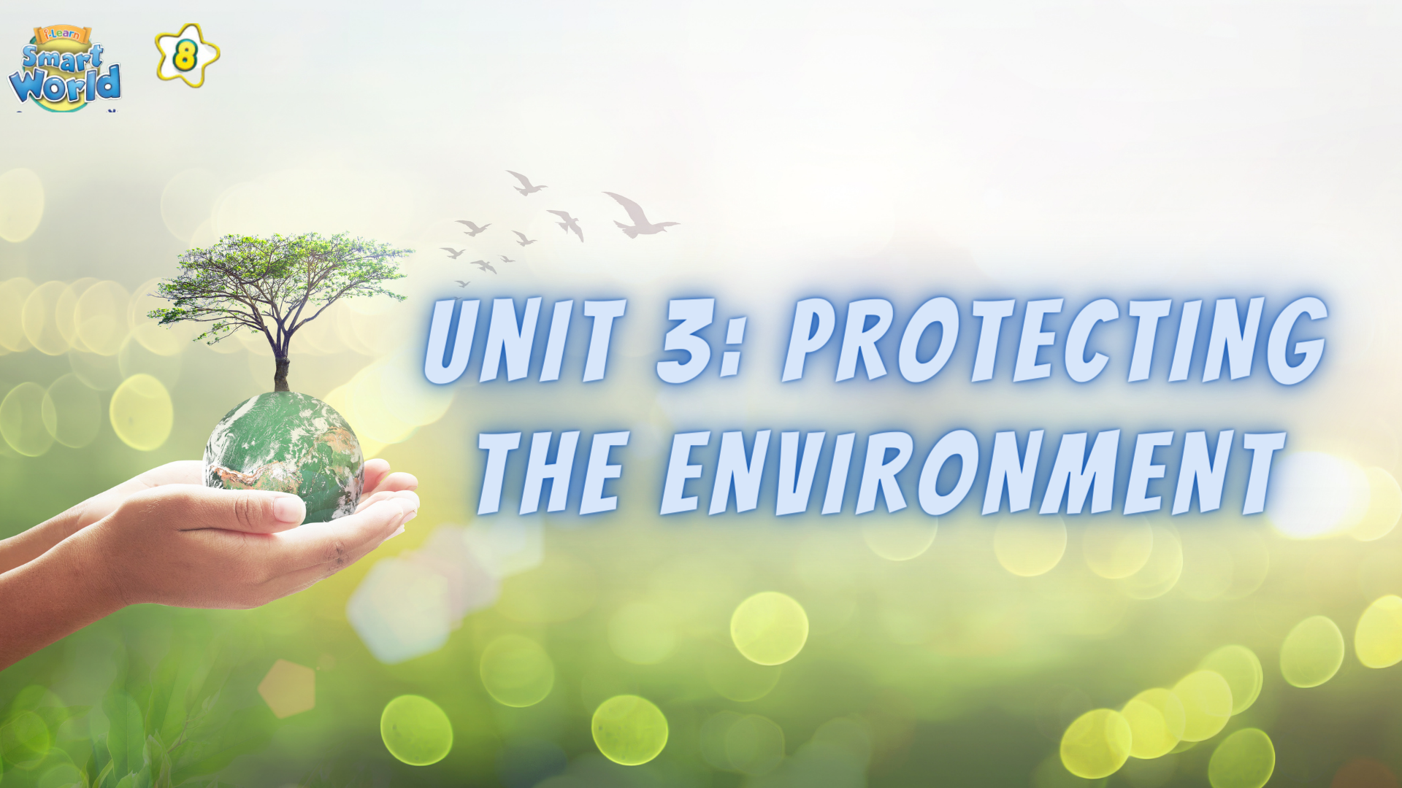

Slide 2




PRONUNCIATION
LESSON 3
SPEAKING

Slide 3
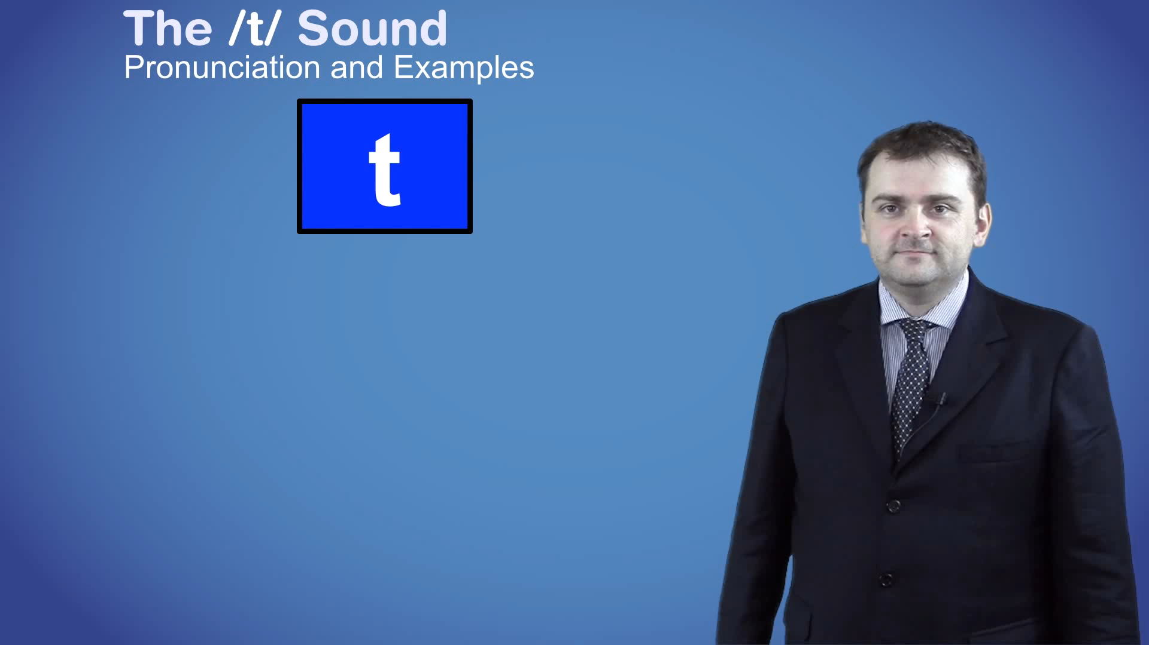
Watch the videos.

Slide 4
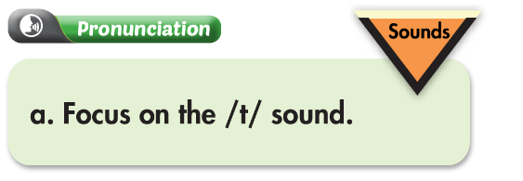
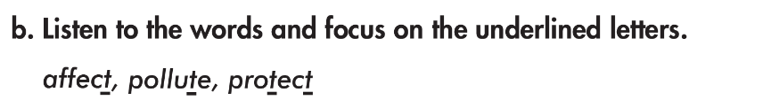


Slide 5
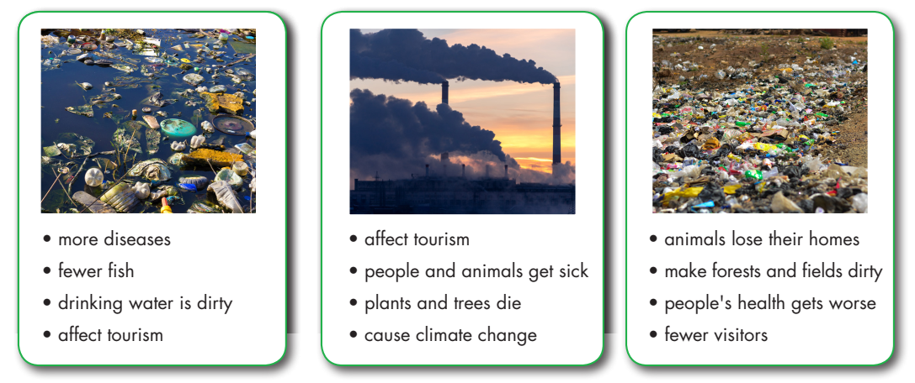
Look at the pictures and say what kinds of pollution?
water pollution
air pollution
soil pollution

Slide 6
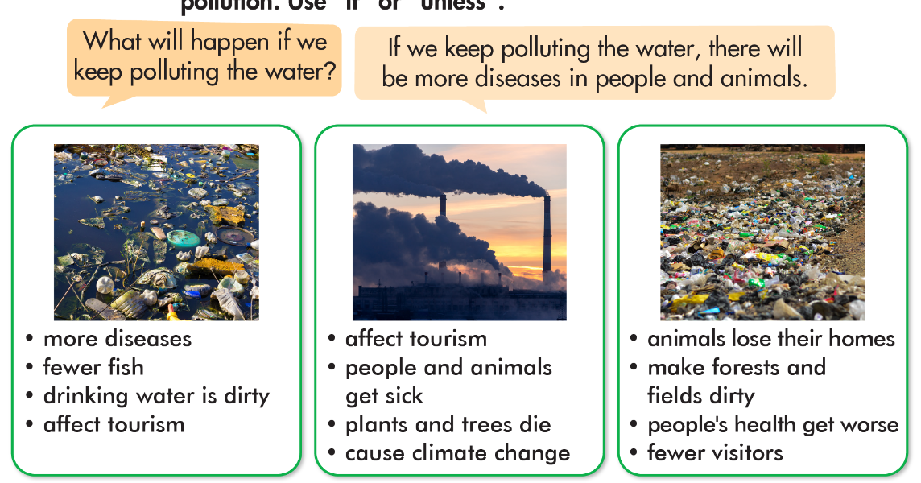


Slide 8
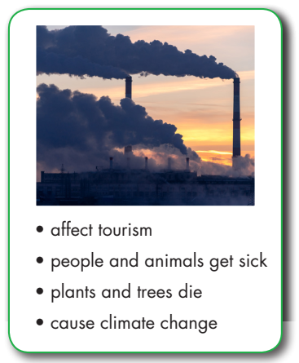
What will happened if we keep polluting the air?
If we keep polluting the air, there will affect tourism.

Slide 9
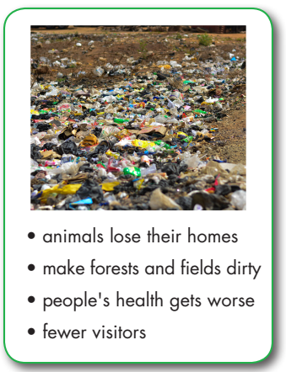
What will happened if we keep polluting the land?
If we keep polluting the land, it will make forests and fields dirty.

Slide 11
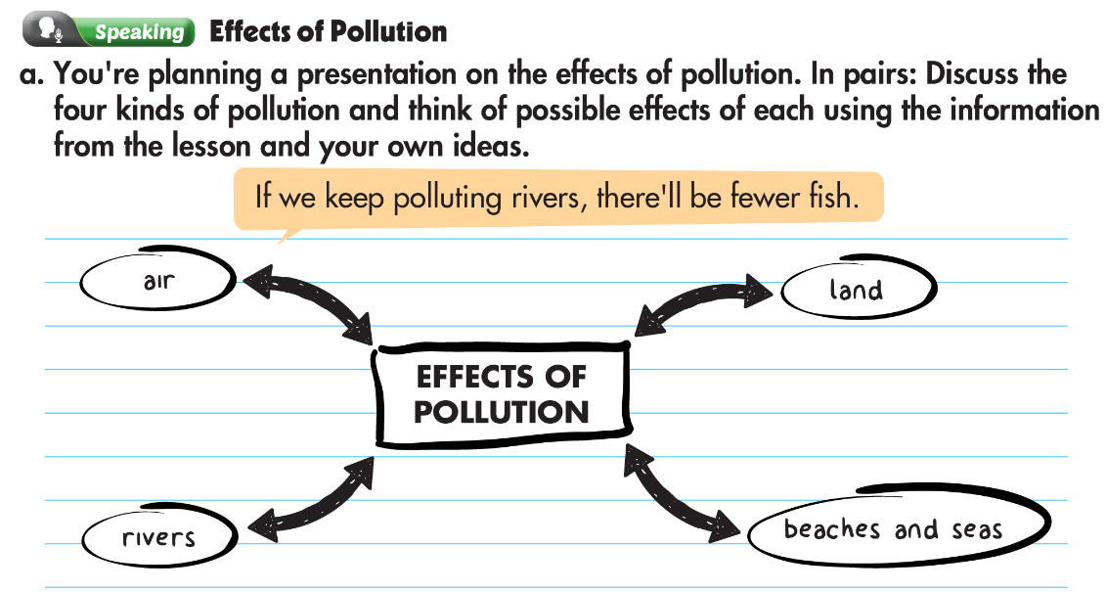

Slide 12
dirty water
  health problems
fewer fish
shortage of water

Slide 13
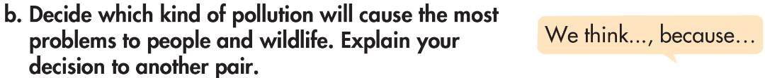
                Examples
We think water pollution will cause the most problems to people and wildlife, because there will be fewer fish.
We thin water pollution will cause the most problems to people and wildlife, because there will affect tourism.

Slide 14

WARP-UP
Unit 3
PROTECTING THE ENVIRONMENT
Lesson 3: Pronunciation & speaking
Ms Phương
Zalo: 0966765064
Pronunciation
Pronouncing the /t/ sound.
Speaking
Talking about the different effects of pollution.

Slide 15

Homework
1. Practice saying the /t/ sound.
2. Prepare the next lesson (pages 28 & 29 SB)
3. Play the consolidation games on www.eduhome.com.vn

Slide 16


