Slide 1
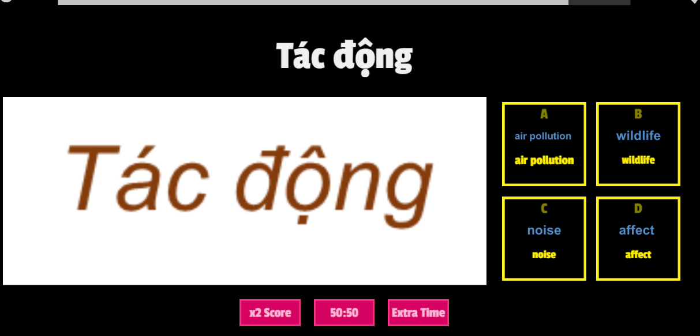

ONLINE GAME

Slide 2
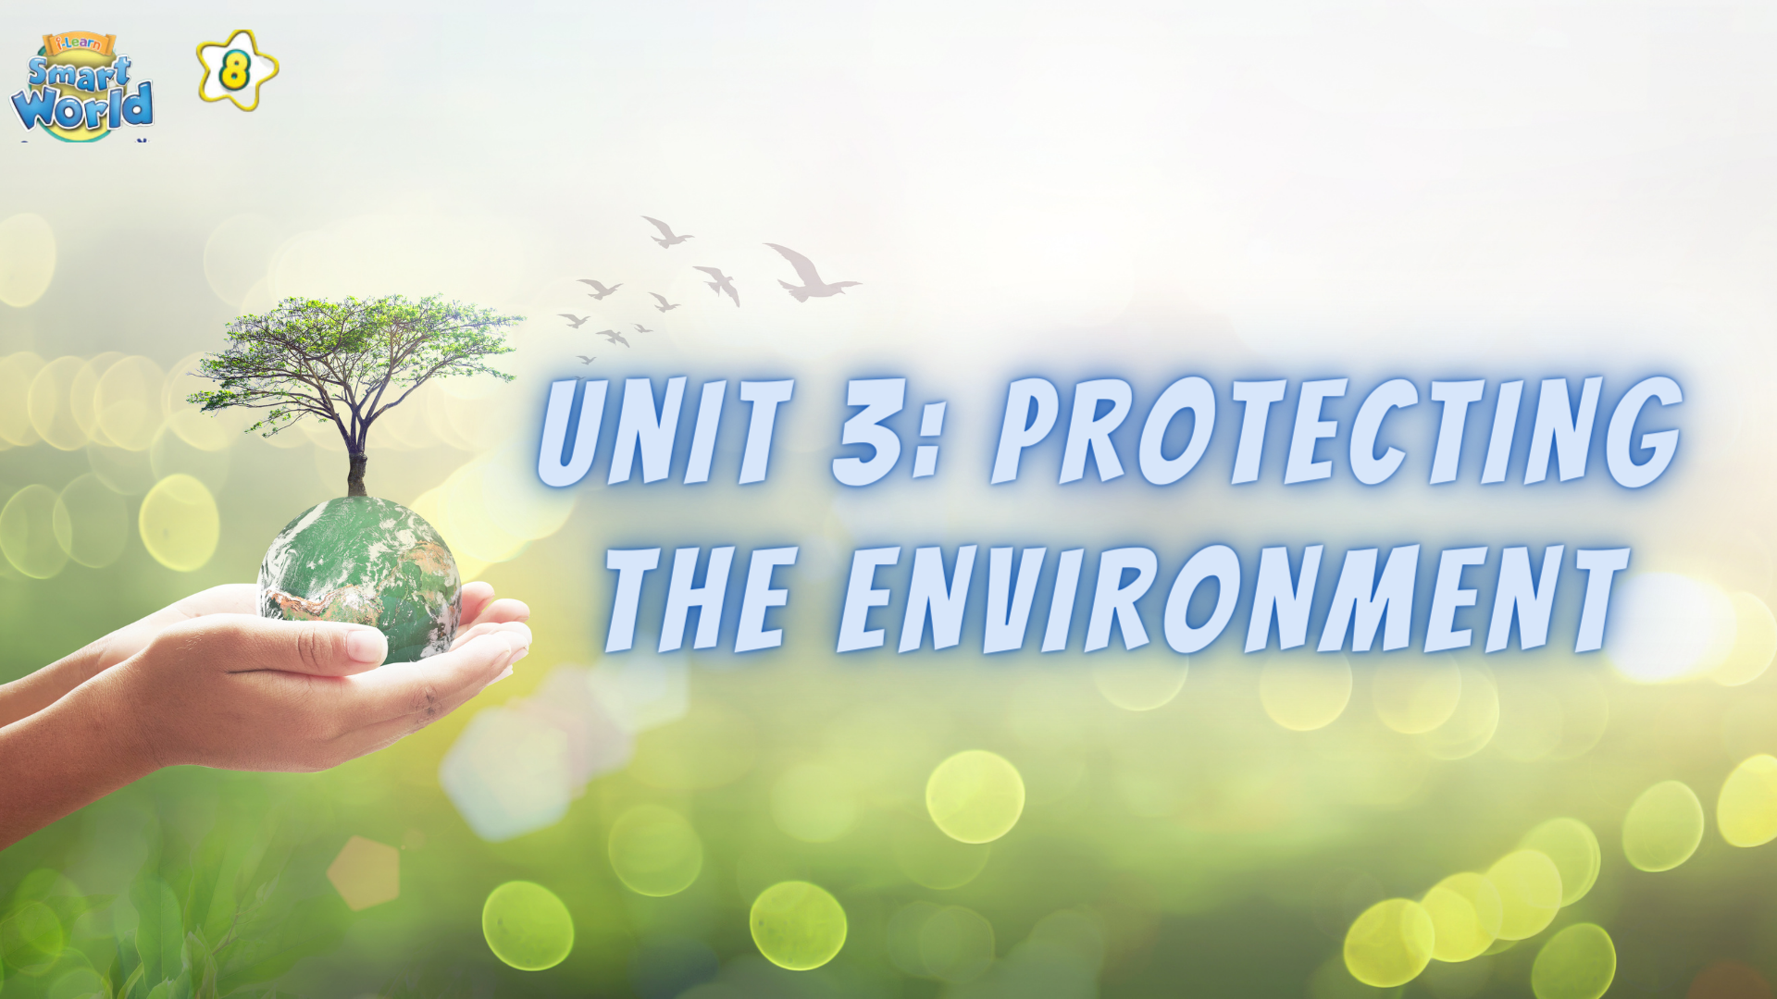

Slide 3




Ms Phương
Zalo: 0966765064
LESSON 2
GRAMMAR

Slide 4

What will you do if …………………………?

Slide 5


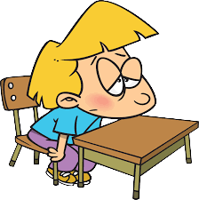


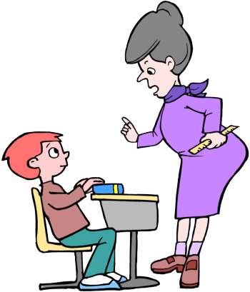
stay at home
1. If it rains, I will …………………
fail
2. If I don’t study for the exam, I will ……………
be angry
3. If I go to school late, my teacher will ……………

Slide 6
1. If it rains, I will stay at home.
2. If I don’t study for the exam, I will fail.
3. If I go to school late, my teacher will be angry.
Discussion
1. Can these situations happen at the present or in the future?
2. Which tense goes after “ if ’
3. Which tense is used in “ main clause”

Slide 7
- FIRST CONDITION
- Unless
Câu điều kiện loại 1

Slide 8
FIRST CONDITION
(Câu điều kiện loại 1)
Talks about possibilities in present or in the future.
(Nói về những khả năng có thể xảy ra ở hiện tại hoặc tương lai.)

Slide 9
FORM
If clause
(mệnh đề If)
main clause
(Mệnh đề chính)
Present simple
future simple
- will + V(inf)
- can , may + V(inf)
Ex:
1. If it rains,
I will stay at home.
2. If my parent allow,
I can go with you.
3. If I go to school late,
my teacher will be angry.
If he comes here, we will have a party.
If he doesn’t study for the exam, he will fail.

Slide 10
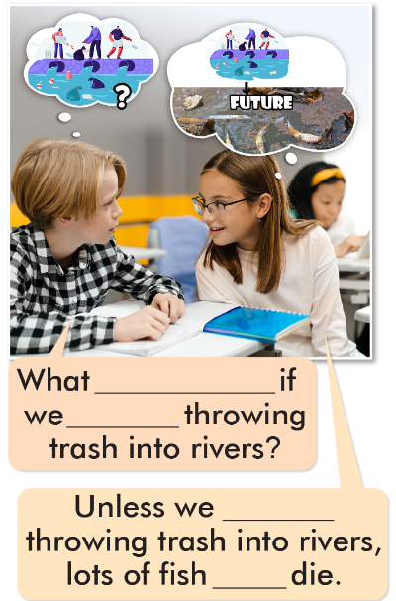
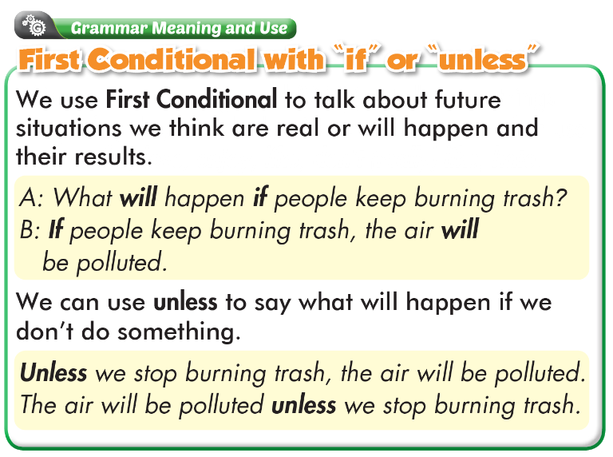
Unless : trừ khi
Unless + Hiện tại đơn
Unless+ câu khẳng định
will happen
keep
keep
will die

Slide 11

will happen
keep
keep
will die

Slide 12
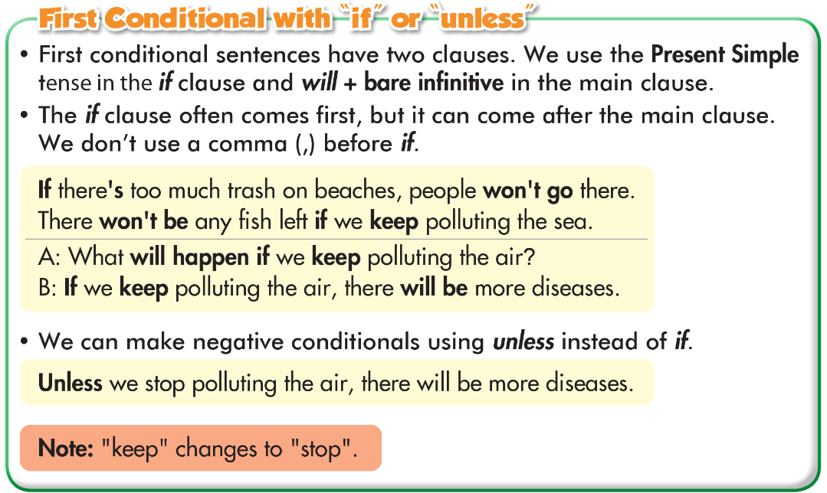

Slide 13
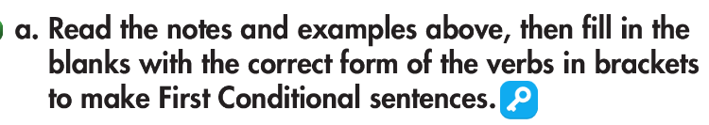
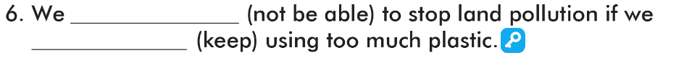
will happen
don’t do
won’t affect
keep
will be
don’t stop
is
will want
won’t able to
keep

Slide 14

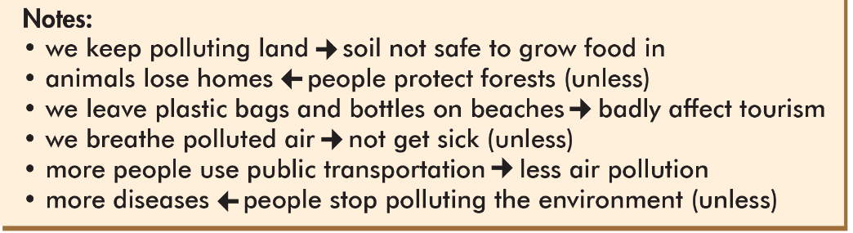
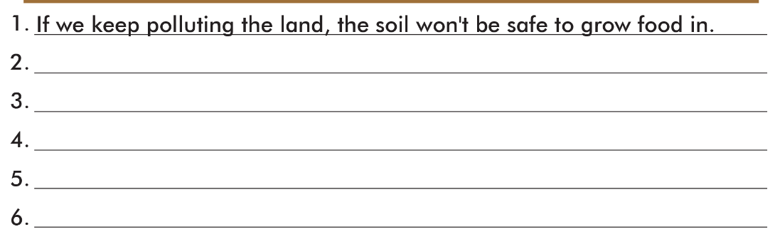
Animals will lose home unless people protect forests.
If we keep leaving plastic bags and bottles on beaches, it’ll badly affect tourism
If we breathe polluted air, we’ll get sick.
If more people use public transportation, there will be less air pollution.
There will be more diseases if people keep polluting the environment.

Slide 15
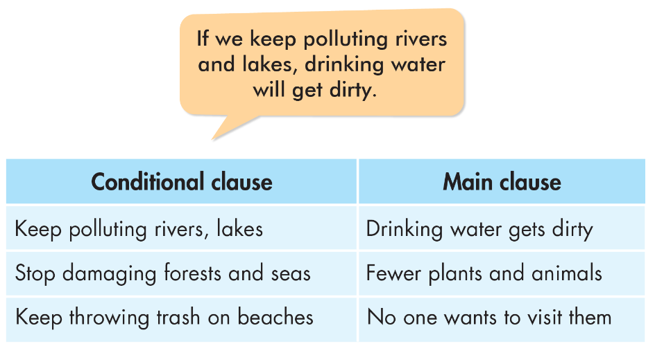

Slide 16
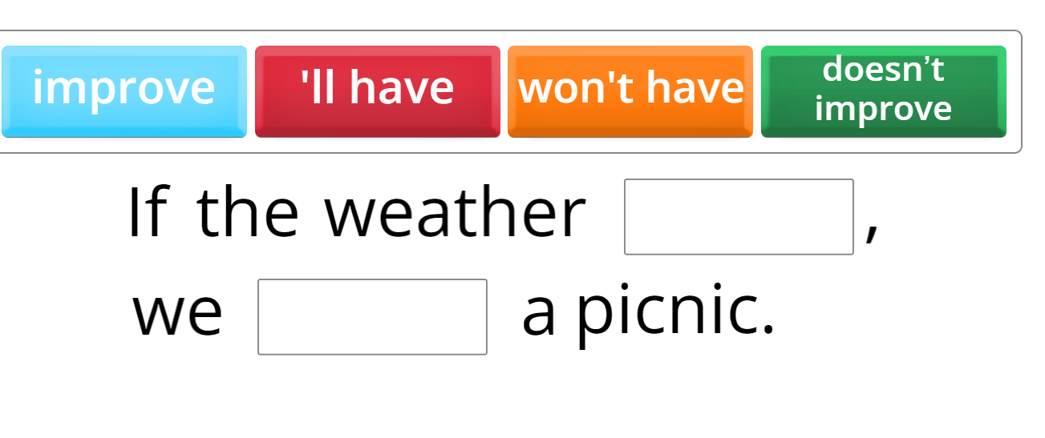
ONLINE GAME

Slide 17
WARP-UP
Unit 3
PROTECTING THE ENVIRONMENT
Lesson 2: FIRST CONDITIONAL
Ms Phương
Zalo: 0966765064
Grammar:
We use First Conditional to talk about future situations we think are real or will happen and their result.
Speaking:
Make First Conditional sentences with the given prompts.

Slide 18

Homework
1. Make five sentences using First Conditional.
2. Do the exercises in WB: Grammar (page 15).
3. Play the consolidation games in Tiếng Anh 8 i-Learn Smart World DHA App on www.eduhome.com.vn
4. Do the exercises in Tiếng Anh 8 i-Learn Smart World Notebook, page 22.
5. Prepare: Lesson 1 – Pronunciation and Speaking (pages 26 & 27 – SB).

Slide 19


