Slide 1


Slide 2



LESSON 9
REVIEW 1

Slide 3


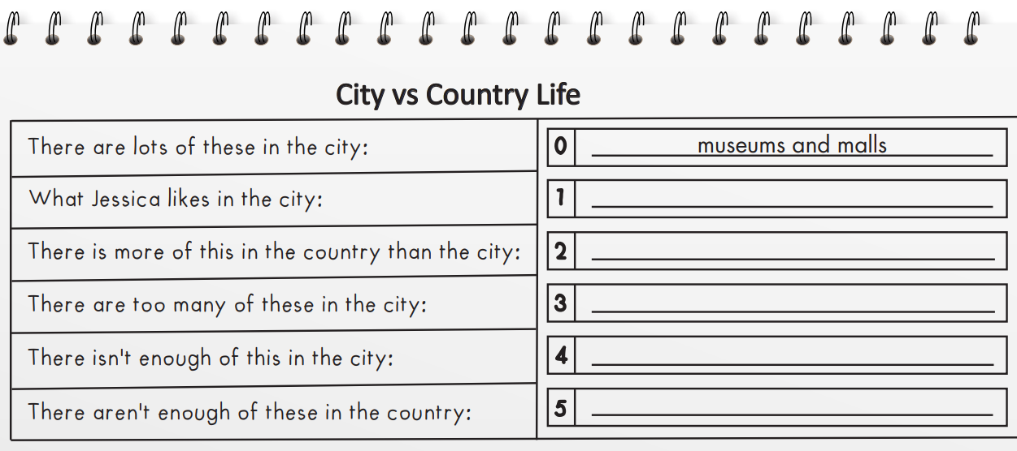
cafes
fresh air
vehicles
room
schools

Slide 4
Listen and fill in the blanks.
Rob: We need to plan our presentation on city and country life, Jessica.
Jessica: I know, I know. Let’s do it.
Rob: OK. What are some …………… things about living in the city?
Jessica: There are lots of ………………… and malls. There are so many things to do.
Rob: Yeah, that’s a good idea.
Jessica: I also like the ……………….
Rob: Me too. What about the country?
Jessica: Well…there’s lots of ………………. There’s more fresh air, too.
Rob: You’re right. Much more than the city.
Jessica: Yeah.
Rob: OK. What about ……….. things about the city?
Jessica: That’s easy. There are too many vehicles.
Rob: Yeah, there are.
Jessica: What else?
Rob: There isn’t enough room.
Jessica: I agree. There aren’t many ………………. or places to run around.
Rob: OK. And the country?
Jessica: There are too many ………………. I’m scared of snakes and so many other animals.
Rob: Hmm. OK. I like all the animals in the country. I think we should write that there aren’t enough ………………….
Jessica: That’s a good idea. Let’s write that.
good
museums
parks
cafes
animals
nature
schools
bad

Slide 5
Read and choose the correct answer (A, B, or C).
Hello. My name is Tâm, and I live in Di Linh, Vietnam. It's about 230 kilometers away from Ho Chi Minh City.
I really like to play and have fun with my friends. I love to play spinning tops. I think it's a really fun game. I also like to play tug of war. I'm strong, so I'm really good at it. My friends often play shuttlecock. I don't really like it. I think it's boring. I prefer to jump rope or go to my folk dance class. I dance with my sister every Sunday. We're not very good at it, but we always have a good time when we dance. My brother doesn't really like to dance. He usually picks flowers or makes jewelry. My family likes to play board games together. We sometimes play after dinner or before bed.
I want to learn some more folk games and teach them to my friends and family. I think they'll like it.

Slide 6
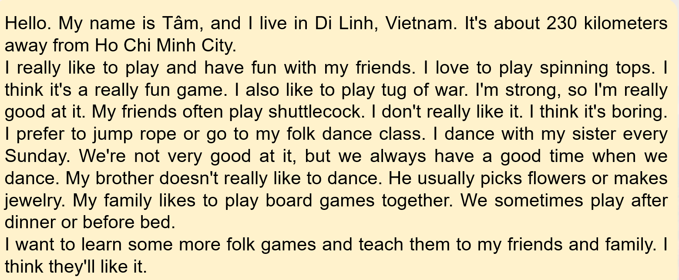
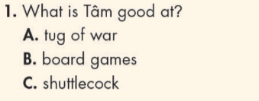
Read and choose the correct answer (A, B, or C).

Slide 7
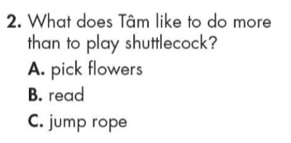
Read and choose the correct answer (A, B, or C).

Slide 8
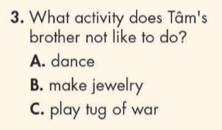
Read and choose the correct answer (A, B, or C).

Slide 9
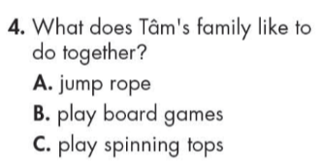
Read and choose the correct answer (A, B, or C).

Slide 10
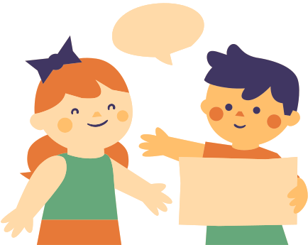
In pairs: tell your partner who you usually spend your free time with (friends or family) and what you usually do with them.
I usually spend my free time with my family. We usually have a picnic in the park on the weekends.
I usually spend my free time with my best friends. We usually play basketball together after school.

Slide 11
Write four sentences about what children in your hometown usually do with their family and friends in their free time.
For example:
Children in my hometown spend more time with their friends because their parents are busy with their work. They usually play folk games like tug of war, hide and seek or jumping rope. Sometimes, they play marbles or go fishing. In the evening, they usually watch TV with their parents while having dinner.

Slide 12

WARP-UP
Unit 2
LIFE IN THE COUNTRY
Lesson 8: SPEAKING & WRITING
Ms Phương
Zalo: 0966765064
Listening
Listen to a conversation about life in the country and the city.
Reading
Read a passage about leisure activities in the country.

Slide 13

HOMEWORK
1. Do the exercises on page 51 WB.
2. Review the vocab and grammar in the unit. Practice using them.
3. Prepare the next lesson (page 87 SB)
4. Play the consolidation games on www.eduhome.com.vn

Slide 14


