Slide 2
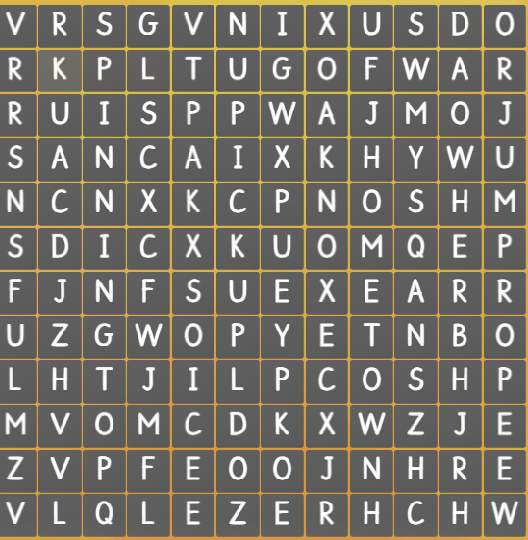
Find the words from the word search.
hometown
folk
tug of war
jump rope
pick up
spinning top
herb

Slide 3
LESSON 5
Ms Phương
Zalo: 0966765064
GRAMMAR

Slide 4
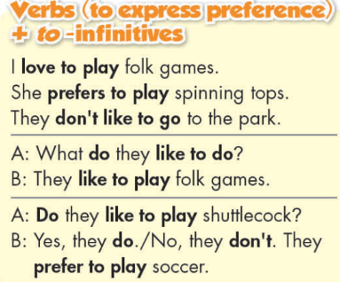
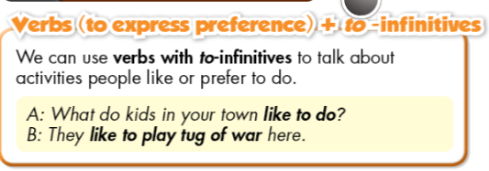
Verbs (to express preference) + to -infinitives
like, prefer + to V:
Diễn tả sự thích làm việc gì đó hơn..

Slide 5
Divide the class into two teams. Each team has a student come to the board and write the correct order of the word. Which team finishes faster and give more correct answer is the winner.
1. wayals
2. onftn
3. lyaerr
4. vener
5. mosmtites
6. lulusay
1. wayals
2. onftn
3. lyaerr
4. vener
5. mosmtites
6. lulusay

Slide 6
1. wayals
2. onftn
3. lyaerr
4. vener
5. mosmtites
6. lulusay
always
often
rarely
never
sometimes
usually

Slide 7
Work in group of four and put the adverbs in the correct position in these sentences
they
play
soccer
after
school
sometimes
He
is
late
for
school
always
make
She
doesn’t
dinner
on Sundays
often

Slide 8
Work in group of four and put the adverbs in the correct position in these sentences
they
play
soccer
after
school
sometimes
He
is
always
late
for
school
make
She
doesn’t
often
dinner
on Sundays

Slide 9
ADVERBS OF FREQUENCY
Trạng từ chỉ tần xuất

Slide 10
ADVERBS OF FREQUENCY
Cách dùng
Đứng trước động từ thường
Never : không bao giờ
rarely/seldom: Hiếm khi
Hardly ever: hầu như không
Sometimes: thi thoảng
Often: thường xuyên
Usually: thường thường
Always: luôn luôn
I often surf the internet
Sau động từ “ tobe”
He is always tired after school.
Giữa “ don’t/doesn’t” và động từ
My mother doesn’t often drink coffee in the morning.

Slide 12
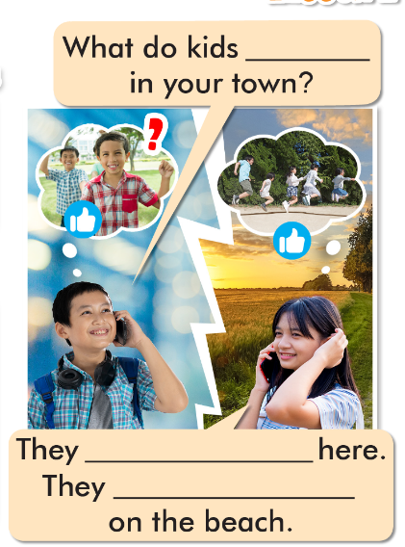
like to do
a. Fill in the blanks.
b. Listen and check your answers.
c. Listen again and repeat.
like to jump rope
usually jump rope

Slide 13
We love to visit the country.
Do they like to visit their hometown?
He prefers to play folk games.
I never play spinning tops with my sister.
Where does she like to play?
Do you always herd buffalo on the weekends?
I don't like to play shuttlecock.

Slide 14
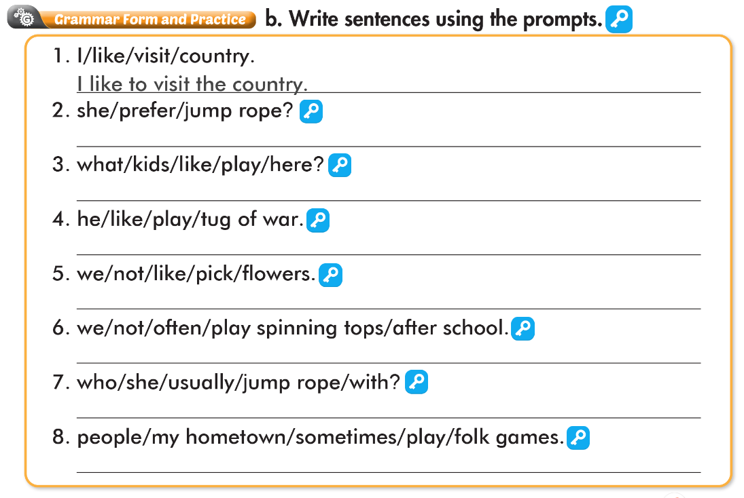
Does she prefer to jump rope?
What do kids like to play here?
Does she prefer to jump rope?
We don't like to pick flowers.
We don't often play spinning tops after school.
Who does she usually jump rope with?
People in my hometown sometimes play folk games.

Slide 15
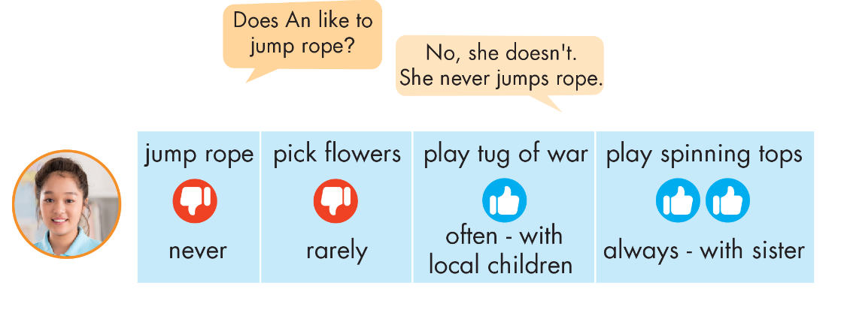

Slide 16
Does An like to pick flowers?
No, she doesn't.
She rarely picks flowers.

Slide 17
Does An like to play tug of war?
Yes, she does.
She often plays with local children.

Slide 18
Does An like to play spinning tops?
Yes, she does.
She always plays with her sister.

Slide 19
WARP-UP
Unit 2
LIFE IN THE COUNTRY
Lesson 5: Grammar
Ms Phương
Zalo: 0966765064
Grammar
Verbs expressing preference + to infinitive
Adverbs of frequency
Speaking
Talk about folk games and activities in the country.

Slide 20
HOMEWORK
1. Learn by hearts the grammar points and make sentences using them.
2. Do the grammar exercise on page 11 WB.
3. Do the exercises in Tiếng Anh 8 i-Learn Smart World Notebook on pages 16 & 17.
4. Prepare the next lesson (pages 20 & 21 SB)
5. Play the consolidation games on www.eduhome.com.vn

