Slide 1
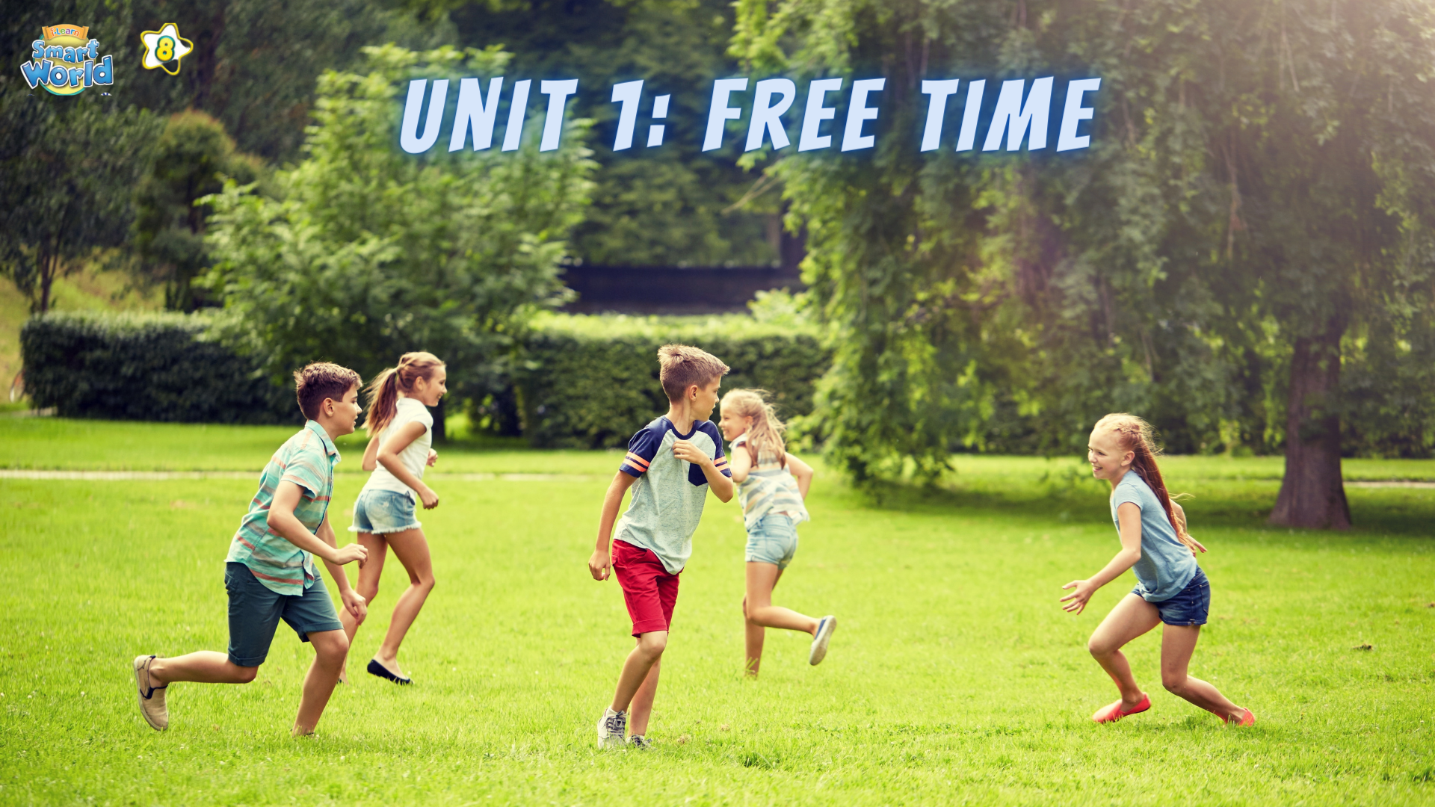

Slide 2
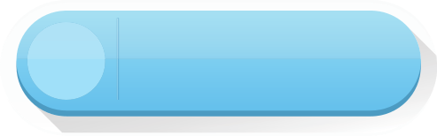


LESSON 8
WRITING
SPEAKING

Slide 3


Slide 4
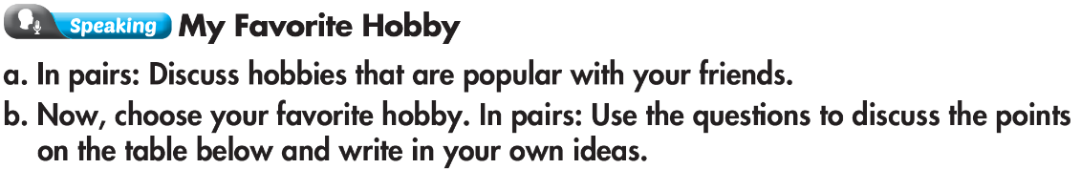
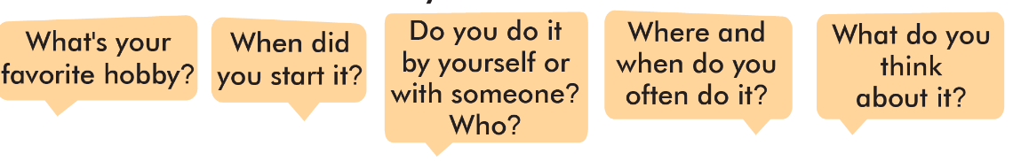

Slide 5
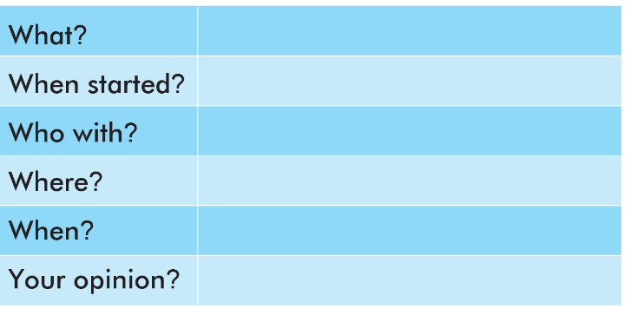
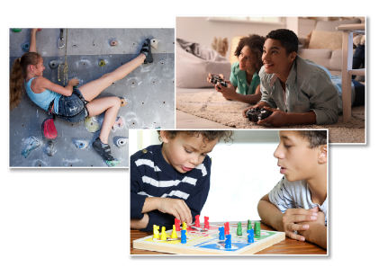
Building models
When I was ten
My little brother
In our living room at home
After school and on the weekends
Building models is interesting and fun.

Slide 6
Practice with your partner.
Questions | Answer
What's your favorite hobby?
My favorite hobby is building
When did you start it?
When I was ten years old.
Do you do it by yourself or with someone? Who?
I often build models with my little brother.
Do you do it by yourself or with someone? Who?
We build models in our living room at home after school and on the weekends.
What do you think about it?
I think building models is interesting and fun.

Slide 7
Practice with your own idea.
Questions | Answer
What's your favorite hobby?
My favorite hobby is ______.
When did you start it?
When I was ______________.
Do you do it by yourself or with someone? Who?
_______________________________.
Where and when do you often do it?
________________________________
What do you think about it?
I think ____________________________

Slide 8

Linda’s hobby
Read about Linda’s hobby and answer the question.
Cooking is my favorite hobby. My grandmother taught me how to cook my first dish when I was 8. My family enjoyed it so much so that is when I started this hobby. Some people say cooking is a waste of time but I find this hobby very interesting and meaningful. I really love trying new food and cooking for my family. The feeling of making my family happy with my food is amazing. I often collect recipes from my mother and my grandmother. Sometimes I also get recipes from the internet. Then I write them in a notebook. I hope I will become a good chef and have my own cookery book in the future.
1. What is Linda’s hobby?
cooking
2. When did she start it?
When she was 8.
3. How does she think about her hobby?
It’s interesting and meaningful.

Slide 9
Write a simple passage about the hobby you discussed. Write 80 to 100 words.
What is your favorite hobby?
When did you start it?
Who do you often do it with?
Where do you often do it?
When do you usually do it?
What do you think about that hobby?

Slide 10
Sample Answer
I have a lot of hobbies, but my favorite hobby is building models.
I started building models when I was ten years old. My uncle taught
me how to build a big model airplane, and we painted it red. It was
very fun! Now, I often build models with my little brother. He really
likes model cars, but I like building model planes. We always build
models in our living room. We usually build models after school and on the weekends. I think building models is interesting, and I love building models.

Slide 11

WARP-UP
Unit 1
FREE TIME
Lesson 8: Speaking & Writing
Ms Phương
Zalo: 0966765064
Speaking : Talking about your favorite hobby.
Writing
Writing a basic descriptive passage about your favorite hobby.

Slide 12

HOMEWORK
1. Do the writing exercises on page 7 WB.
2. Do the exercises in Tiếng Anh 8 i-Learn Smart World Notebook on page 11.
3. Prepare the next lesson (pages 14 & 15 SB)

Slide 13


