Slide 2
WRITING
LESSON 7
READING

Slide 3
In pairs: What hobbies can you see in the pictures? What are some popular hobbies in your country?
Hobbies in the pictures
Popular hobbies in Vietnam

Slide 4
Look at the picture. What are they doing?
Do you often bake cakes in your free time?

Slide 5
prepare (v)
relax (v)
recipe (n)
mess (n)
brownies

Slide 6
Look at the picture and match.
recipe (n)
1
2
prepare (v)
3
relax (v)
4
brownies
5
mess (n)

Slide 7
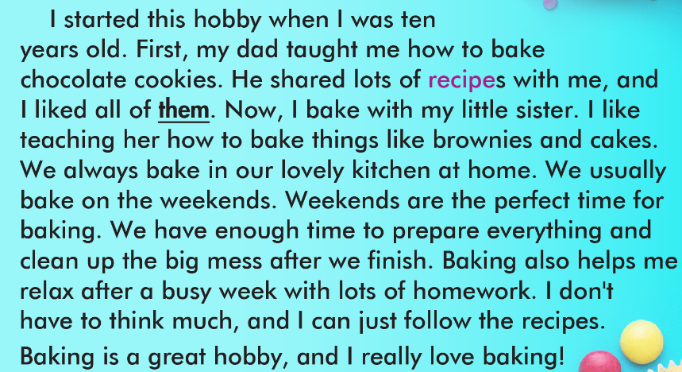

Slide 8
1. When did Linh start her favorite hobby?
When she was ten.

Slide 9
2. What does the word them in paragraph 2 refer to?
A. chocolate cookies B. recipes C. hobbies

Slide 10
3. Where does Linh do it?
In her kitchen

Slide 11
4. When does Linh usually bake?
On the weekends

Slide 12
5. What does baking help Linh do?
It helps her relax.

Slide 13
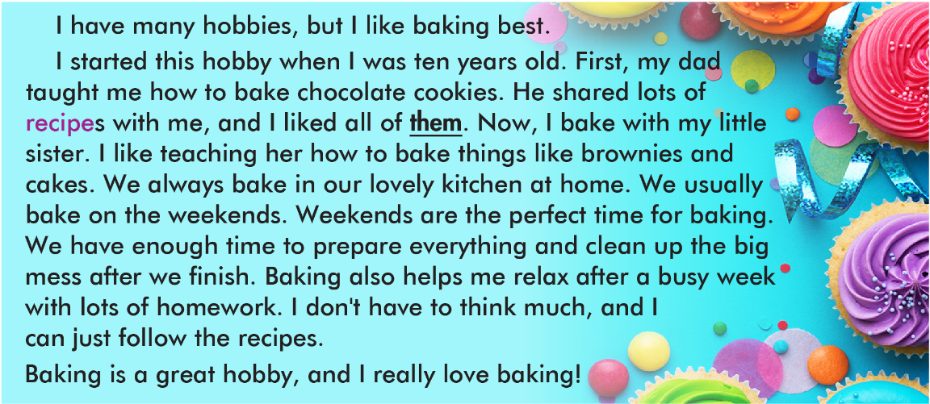

Slide 15
Writing basic descriptive passages
To write a basic descriptive passage, you should:
1. Start with a topic sentence: tell the readers what your passage is about.
I have a lot of hobbies, but my favorite hobby is taking pictures.
2. Write about 3–5 supporting ideas to explain your topic. You can answer questions what, when, where, who, how, etc. about the topic to think of ideas to write about.
I started taking pictures when I was eight years old. I usually take lots of pictures with my friends and family. I take pictures at the park. I do it on the weekends.
3. End with a concluding sentence: say your main topic again in different words.
I think taking pictures is lots of fun, and I love it.

Slide 17
Unscramble the sentences and then number them (1–5).
A. my/with/swimming/dad./always/go/I
_________________________________________________
B. best./hobbies,/I/many/like/swimming/but/have/I
_________________________________________________
C. I/great/think/swimming/a/is/hobby.
_________________________________________________
D. five/started/old./when/I/years/I/swimming/was
_________________________________________________
E. swimming/on/the/go/my/pool/near/We/weekends./house/the/at
_____________________________________________________
3
I always go swimming with my dad.
I have many hobbies, but I like swimming best.
1
I think swimming is a great hobby.
5
I started swimming when I was five years old.
2
4
We go swimming at the pool near my house on the weekends.

Slide 18
WARP-UP
Unit 1
FREE TIME
Lesson 7: Reading & Writing
Ms Phương
Zalo: 0966765064
Practice reading for gist and for detail
Learn how to write a descriptive passage
Vocabulary: recipe, prepare, mess, relax , brownies

Slide 19
HOMEWORK
1. Do the reading exercises on page 6 WB.
2. Do the exercises in Tiếng Anh 8 i-Learn Smart World Notebook on page 10.
3. Prepare the next lesson (page 13 SB)

