Slide 1
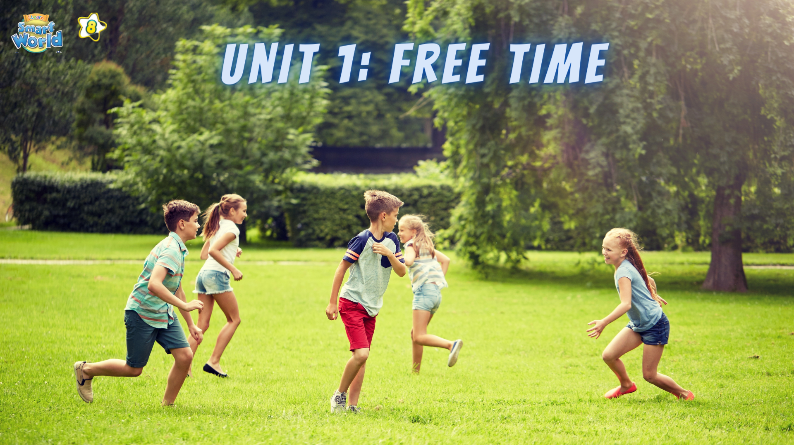

Slide 2
Each sentence has a mistake. Find and correct it.
1. I often hang out with my friends from 9 and 11 a.m at the weekend.
at
2.The bus is leaving at 8 p.m tomorrow.
leaves
3.My best friend hate fishing, but she likes collecting stamps.
hates
4.Do you prefer chat with your friends online?
chatting
5. I stayed up late last night at 11 p.m because I had to finish my English project.
until

Slide 3




PRONUNCIATION
LESSON 6
SPEAKING

Slide 4


Slide 5
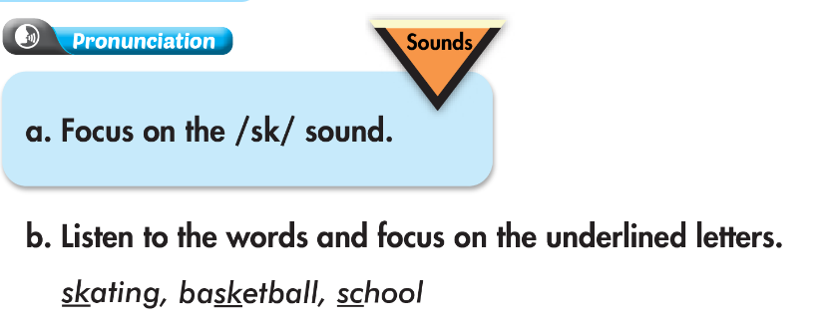


Slide 6
Practice the conversation. Fill in the blanks with the correct prepositions. Swap the roles.
Josh: Hi, Daniel. What's up?
Daniel: Oh, hey, Josh.
Josh: Do you want to come with me to a sewing class ___ Thursday evening?
Daniel: Sorry, I can't. I have table tennis practice ___ 9 p.m.
But, do you want to watch a soccer game ___ Saturday morning?
Josh: Maybe. When is it?
Daniel: It's ______ 9 a.m. ___ 11:30 a.m.
Josh: OK. Sounds great. See you there.
Daniel: See you there.
on
at
on
from
to

Slide 7
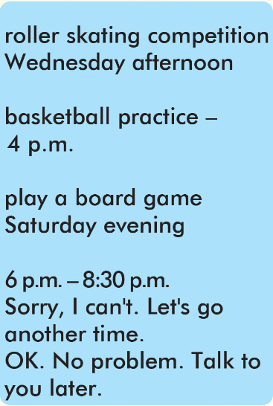
Josh: Hi Daniel. What’s up?
Daniel: Oh, hey, Josh.
Josh: Do you want to come with me to a rollerskating competition on Wednesday afternoon?
Daniel: Sorry, I can’t. I have basketball practice at 4 p.m. But do you want to play a board game on Saturday evening?
Josh: Maybe. When is it?
Daniel: It’s from 6 p.m. to 8:30 p.m.
Josh: Sorry, I can’t. Let’s go another time.
Daniel: OK. No problem. Talk to you later.

Slide 8
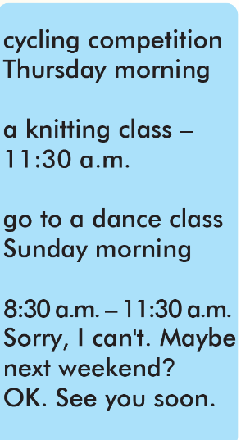
Josh: Hi Daniel. What’s up?
Daniel: Oh, hey, Josh.
Josh: Do you want to come with me to a cycling competition on Thursday morning?
Daniel: Sorry, I can’t. I have a knitting class at 11:30 a.m. But do you want to go to a dance class on Sunday morning?
Josh: Maybe. When is it?
Daniel: It’s from 8:30 a.m. to 11:30 a.m.
Josh: Sorry, I can’t. Maybe next weekend.
Daniel: OK. See you soon.

Slide 9
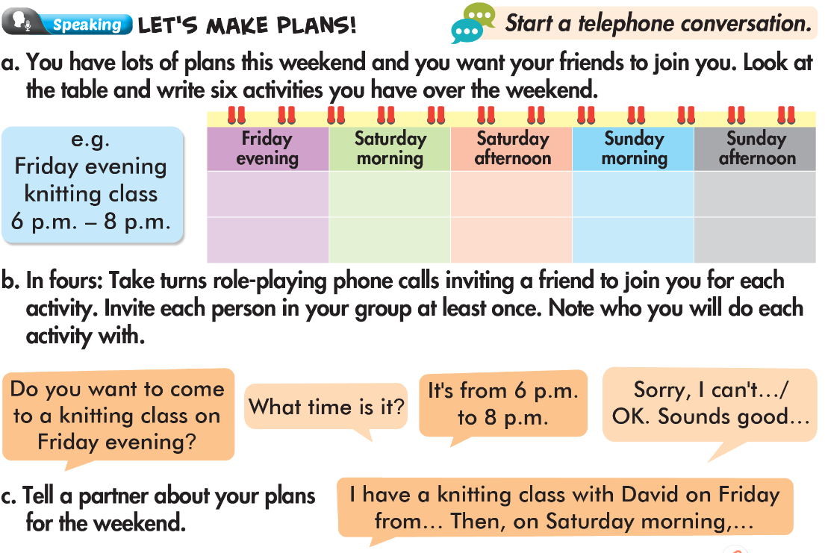

Slide 10
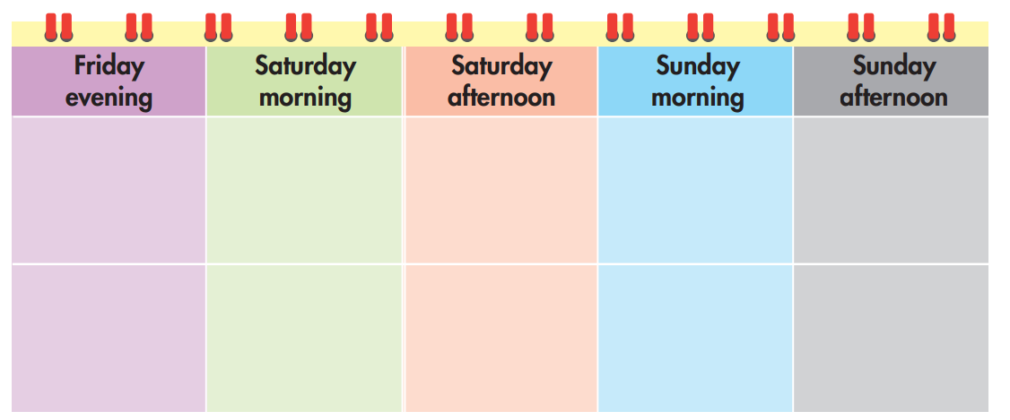
You have lots of plans this weekend and you want your friends to join you. Look at the table and write six activities you have over the weekend.
Dancing class
4 p.m. – 5 p.m.
Painting class
3 p.m. – 5 p.m.
knitting class
6 p.m. – 8 p.m.
Soccer practice
7 a.m. – 8 a.m.
Basketball practice
8 a.m. – 9 a.m.
Piano practice
8 am. – 9 a.m.

Slide 11
In fours: Take turns role-playing phone calls inviting a friend to join you for each activity. Invite each person in your group at least once. Note who you will do each activity with.
Do you want to come to a knitting class on Friday evening?
What time is it ?
It's from 6 p.m. to 8 p.m.
Sorry, I can't…/
OK. Sounds good…

Slide 12

Write five sentences about your plans for the weekend.
Example:
I have a knitting class with David on Friday from 6 p.m. to 8 p.m. Then, on Saturday morning, I practice basketball from 8 a.m. to 9 a.m. In the afternoon, I have a dancing class at 4 p.m. On Sunday morning, I practice soccer from 7 a.m. to 8 a.m. After that, I practice the piano until 9 a.m. in the afternoon, I have a painting class at 3 p.m. and finish it at 5 p.m.

Slide 13

WARP-UP
Unit 1
FREE TIME
Lesson 6: Pronunciation & Speaking
Ms Phương
Zalo: 0966765064
Pronunciation
Pronouncing /sk/.
Speaking
Making a plan.

Slide 14

HOMEWORK
1. Practice saying the /sk/ sound.
2. Prepare the next lesson (pages 12 SB)

Slide 15


