Slide 1
Work in pair, read the clues and match with the words.
1. Knitting
2. Karate
3. Roller skating
4. Sewing
5. Practice
6. Shuttlecock
7. Cycling
8. Table tennis
3
a. The sport of moving over the ground wearing shoes with wheels
2
b. martial art from Japan
5
c. A way of doing something again and again to help you become better.
6
d. The activity of making or fixing things made of cloth.
e. A sport that two or more players hit a ball over the net on a large table
8
7
f. The sport of riding a bicycle
g. a sport played by kicking a plastic object with feathers to keep it up in the air OR the object players hit in a game of badminton
6
h. The activity of making things like clothes from wool
1

Slide 3
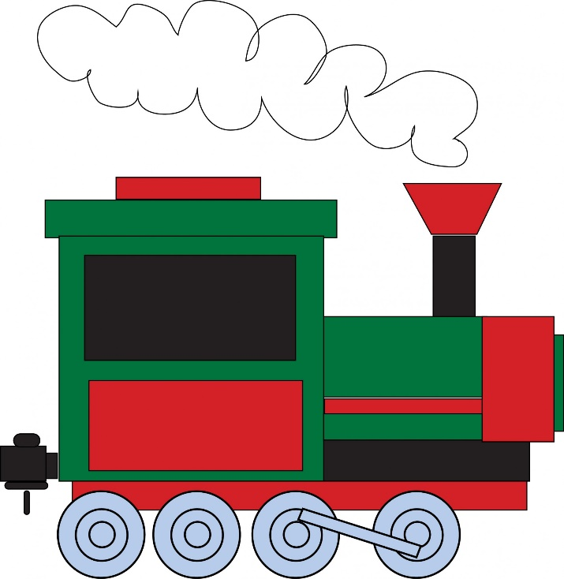
Listen to the song and fill in the blanks.
What time does the train leave?
What time does the train leave?
It (1)___________at ten p.m
Ten in the evening, ten in the (2)_________.
The train leaves at 10 p.m
leaves
What time does the (3)___________leave?
It leaves at five – thirty a.m
Five – thirty in the(4) _________.
It leaves at five –thirty a.m
evening
plane
morning
What (5)________ does the bus leave?
It leaves at eight – thirty a.m
Eight – thirty in the morning
It leaves at eight-thirty a.m
time

Slide 4
Listen to the song again, pay attention to the underlined words and discuss.
What time does the train leave?
What time does the train leave?
It (1)___________at ten p.m
Ten in the evening, ten in the (2)_________.
The train leaves at 10 p.m
What time does the (4)___________leave?
It leaves at five – thirty a.m
Five – thirty in the(5) _________.
It leaves at five –thirty a.m
plane
leaves
evening
morning
What (3)________ does the bus leave?
It leaves at eight – thirty a.m
Eight – thirty in the morning
It leaves at eight-thirty a.m
time
1. Which tenses is used in the song?
- Present simple tense
2. What do you know from the song?
- Schedule of the train, the bus and the plane

Slide 5
LESSON 5
GRAMMAR
PRESENT SIMPLE FOR FUTURE USE

Slide 6
PRESENT SIMPLE FOR FUTURE USE
Chúng ta sử dụng thì hiện tai đơn mang nghĩa tương lai khi nói về những lịch trình đã được sắp xếp ví dụ như : Lịch chiếu phim, chiếu bóng, tàu chạy, thời khoá biểu, thời gian biểu.

Slide 7
GIỚI TỪ CHỈ THỜI GIAN
IN
ON
at
Part of the day ( buổi)
Days ( thứ)
Time ( giờ)
In the morning , in the afternoon, in the evening
At 6 o’clock , at 10:30 p.m
Months ( tháng)
On Monday , on Sundays
In January , in May , in December…..
Date ( ngày)
Meals ( bữa ăn)
Seasons ( mùa)
at breakfast , at lunch , at dinner
On 15th Monday , on Tuesday 2nd
In summer, in spring, in winter, in autumn /fall.
Holidays ( kỳ nghỉ)
Parts of special day
Year ( năm)
at Christmas , at Easter , ….
In 2021 , in 2000
on Monday morning, on Tuesday afternoon.
Phrases ( cụm từ)
Decade, century( thế kỷ, thập kỷ)
At night , at midnight , at the moment, at the weekend, at the same time, at present…
In the 80s, in the 20 century.

Slide 8
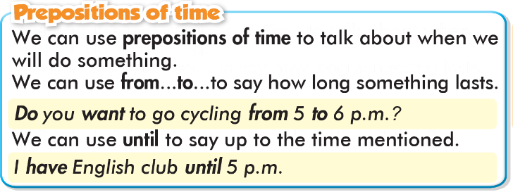
GIỚI TỪ CHỈ THỜI GIAN
From….to: Từ…..đến
Until = Till : Cho tới khi

Slide 9
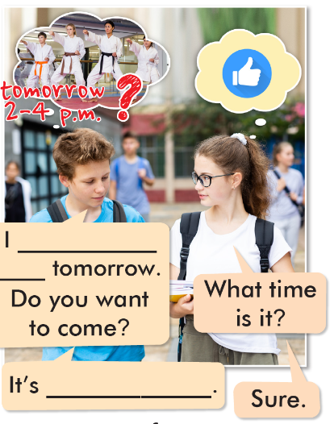
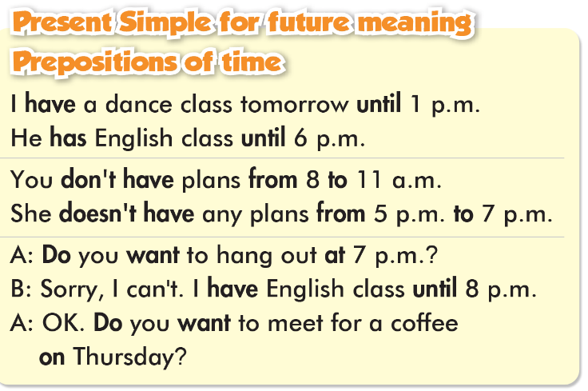
have karate
class
from 2 to 4 p.m.

Slide 10
a. Read the example above and circle the correct words.
I have shuttlecock practice in/until/on 5 p.m. on Saturday.
Do/Does you want to see a movie on the weekend?
I can't meet in the morning. I'm busy in/to/at 10 a.m.
My sewing class is from/on/until 2 p.m. to 4:30 p.m.
It's OK. The band practice hasn't/doesn't/don't start until 2 p.m.
I'd love to come. I don't have any plans in/from/on Saturday night.
Yes, I can come. I'm free from 10 a.m. to/in/from 4:30 p.m.

Slide 11
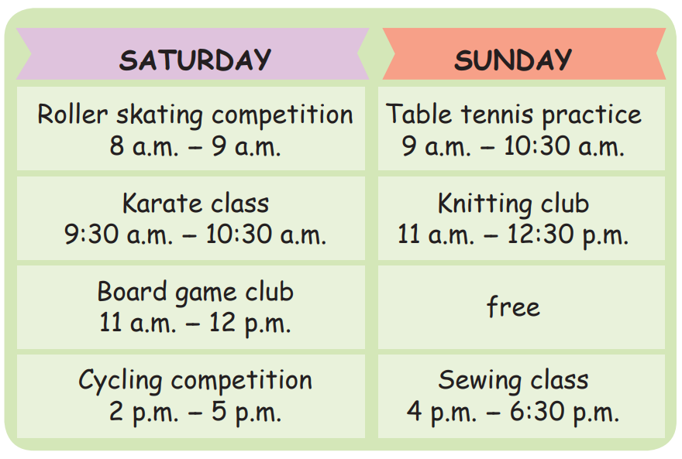
Answer the questions using the given prepositions and the information on your schedule.
When is the roller skating competition?
on
It’s on Saturday morning.
2. When is the cycling competition?
from…to
It’s from 2 p.m. to 5 p.m. (on Saturday)

Slide 12
Answer the questions using the given prepositions and the information on your schedule.
3. When do you have table tennis practice?
at
I have table tennis practice at 9 a.m. (on Sunday)
4. When are you free on Sunday afternoon?
until
I’m free (on Sunday afternoon) until 4 p.m.

Slide 14
ONLINE GAME

Slide 15
ONLINE GAME

Slide 16
WARP-UP
Unit 1
FREE TIME
Lesson 5: Grammar
Ms Phương
Zalo: 0966765064

Slide 17
HOMEWORK
1. Learn by hearts the grammar points and make sentences using them.
2. Do the grammar exercise b on page 5 WB.
3. Do the exercises in Tiếng Anh 8 i-Learn Smart World Notebook on page 9.
4. Prepare the next lesson (pages 10 & 11 SB)

