Slide 1
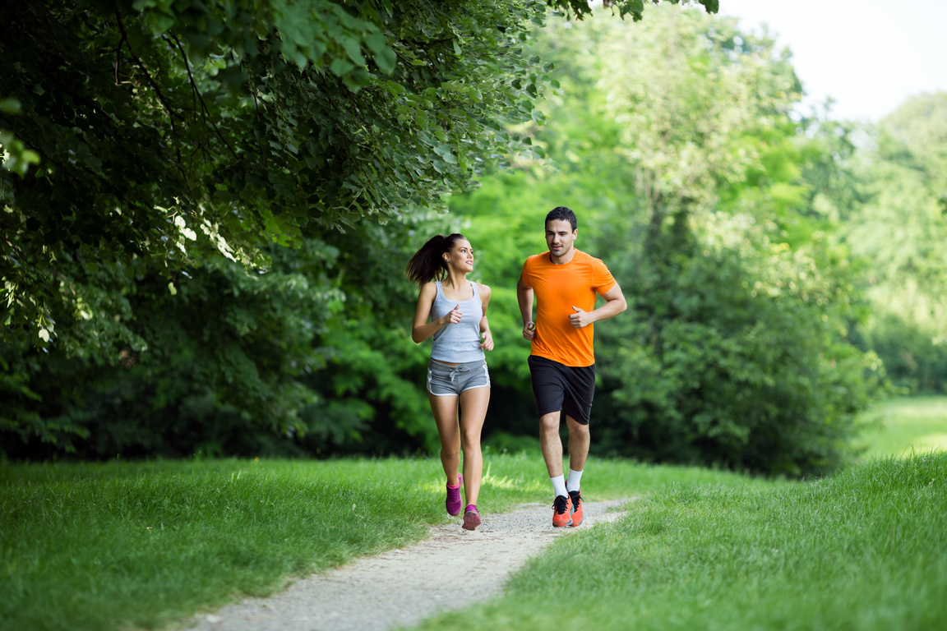
jogging
Remove

Slide 2
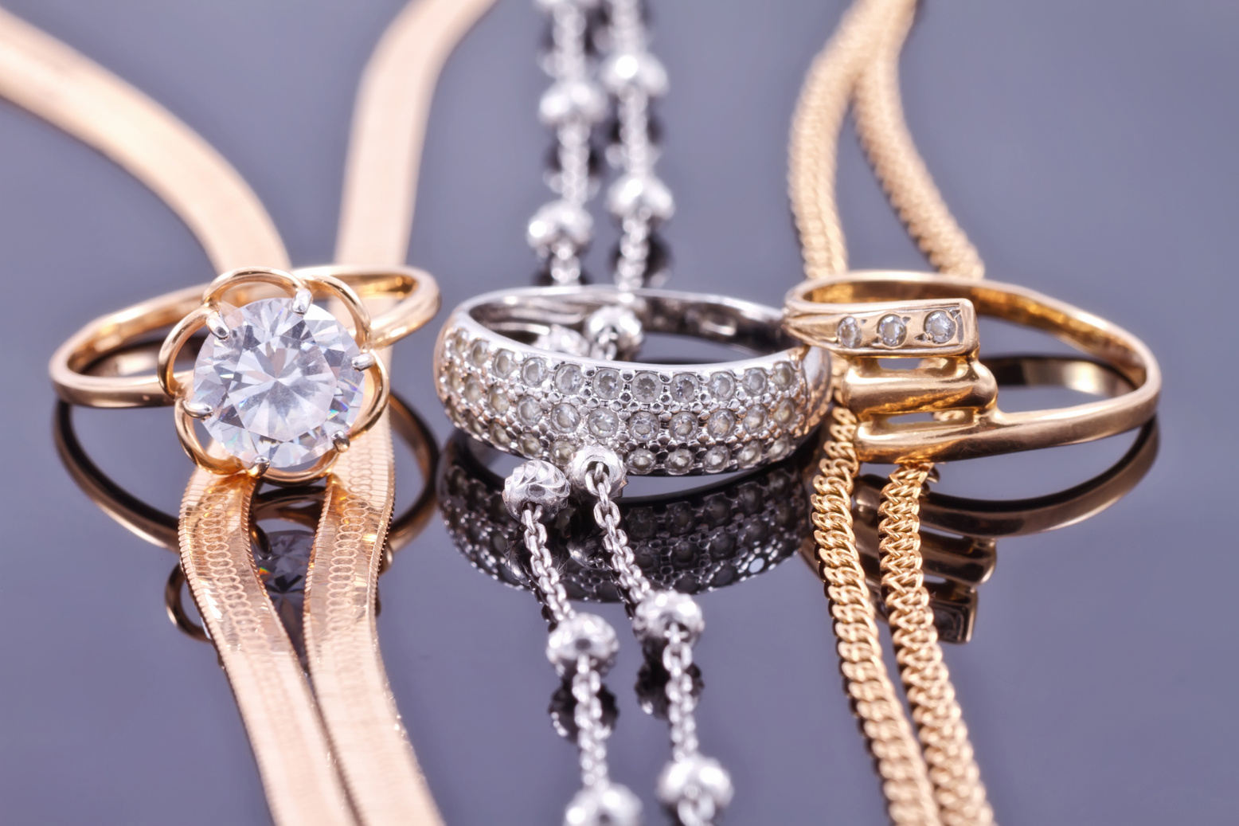
jewelry
Remove

Slide 3
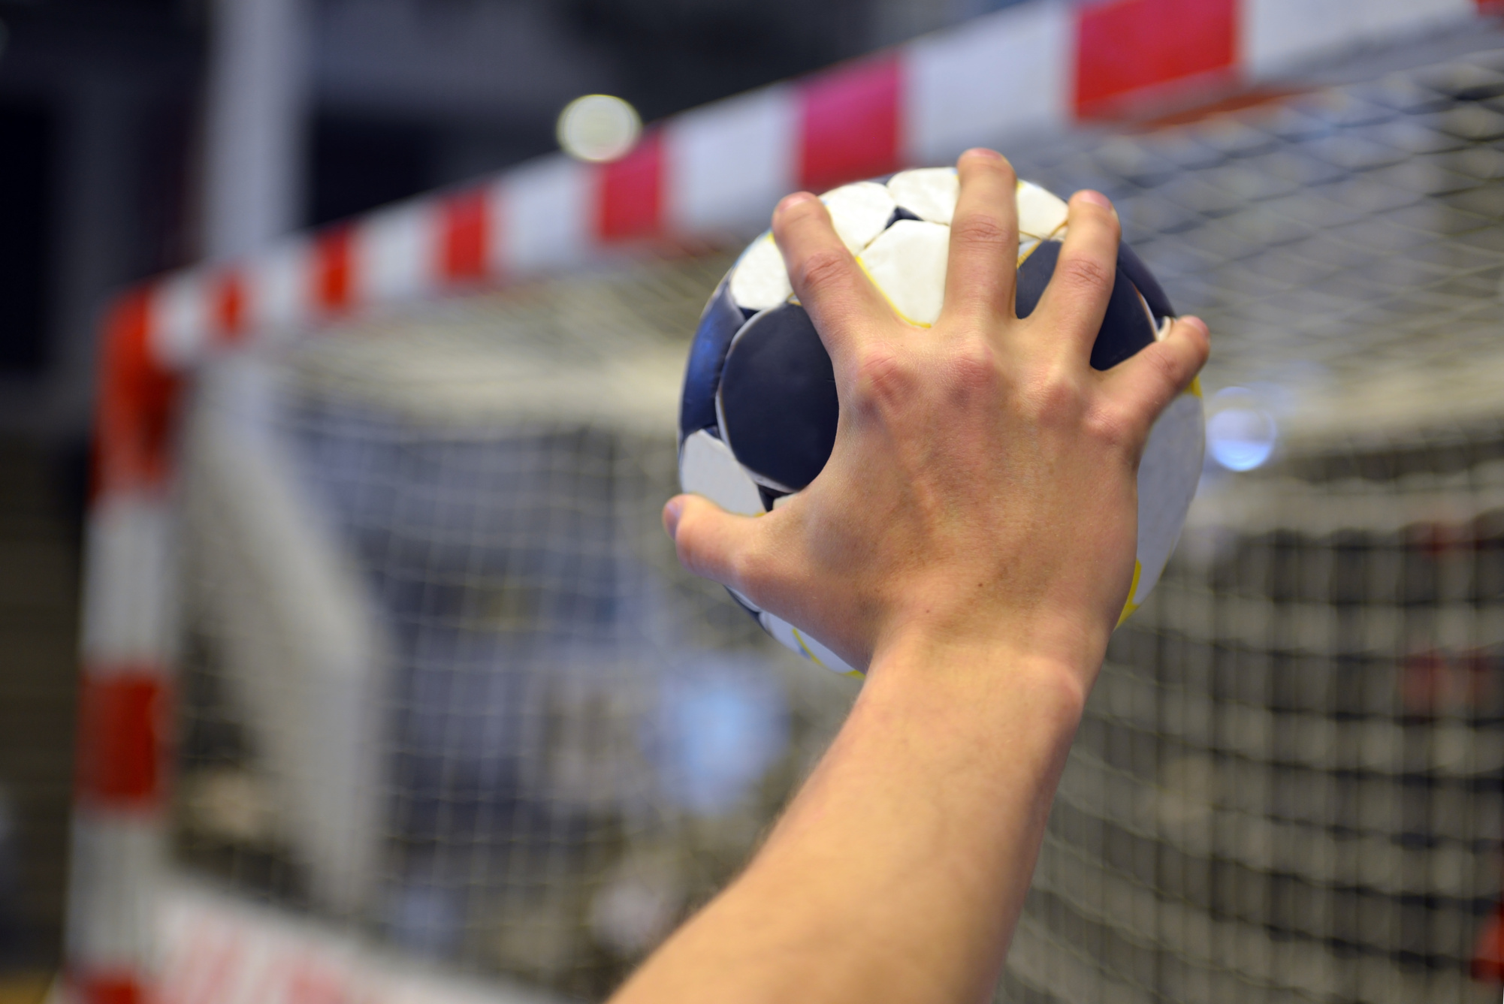
handball
Remove

Slide 4
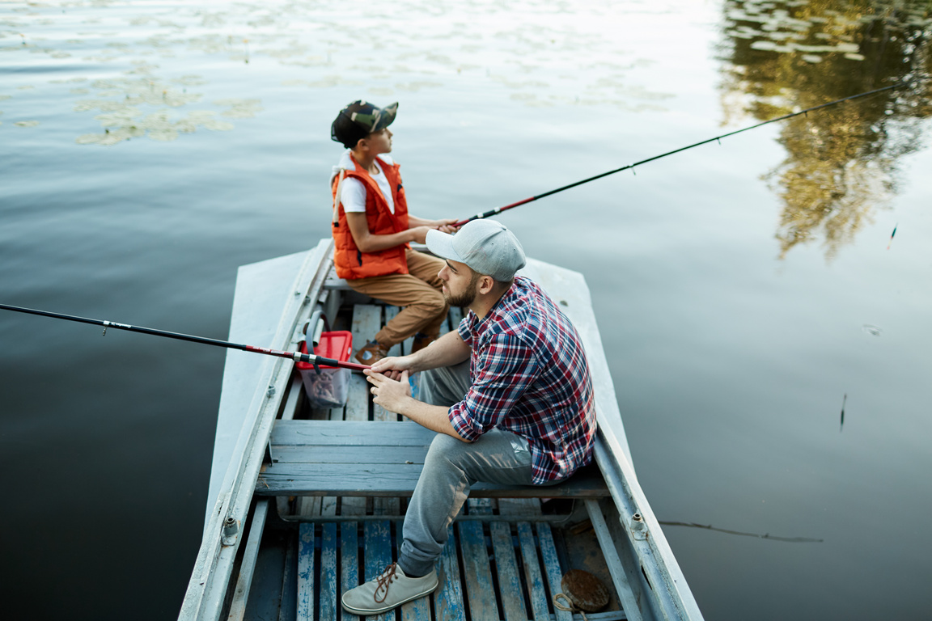
fishing
Remove

Slide 5
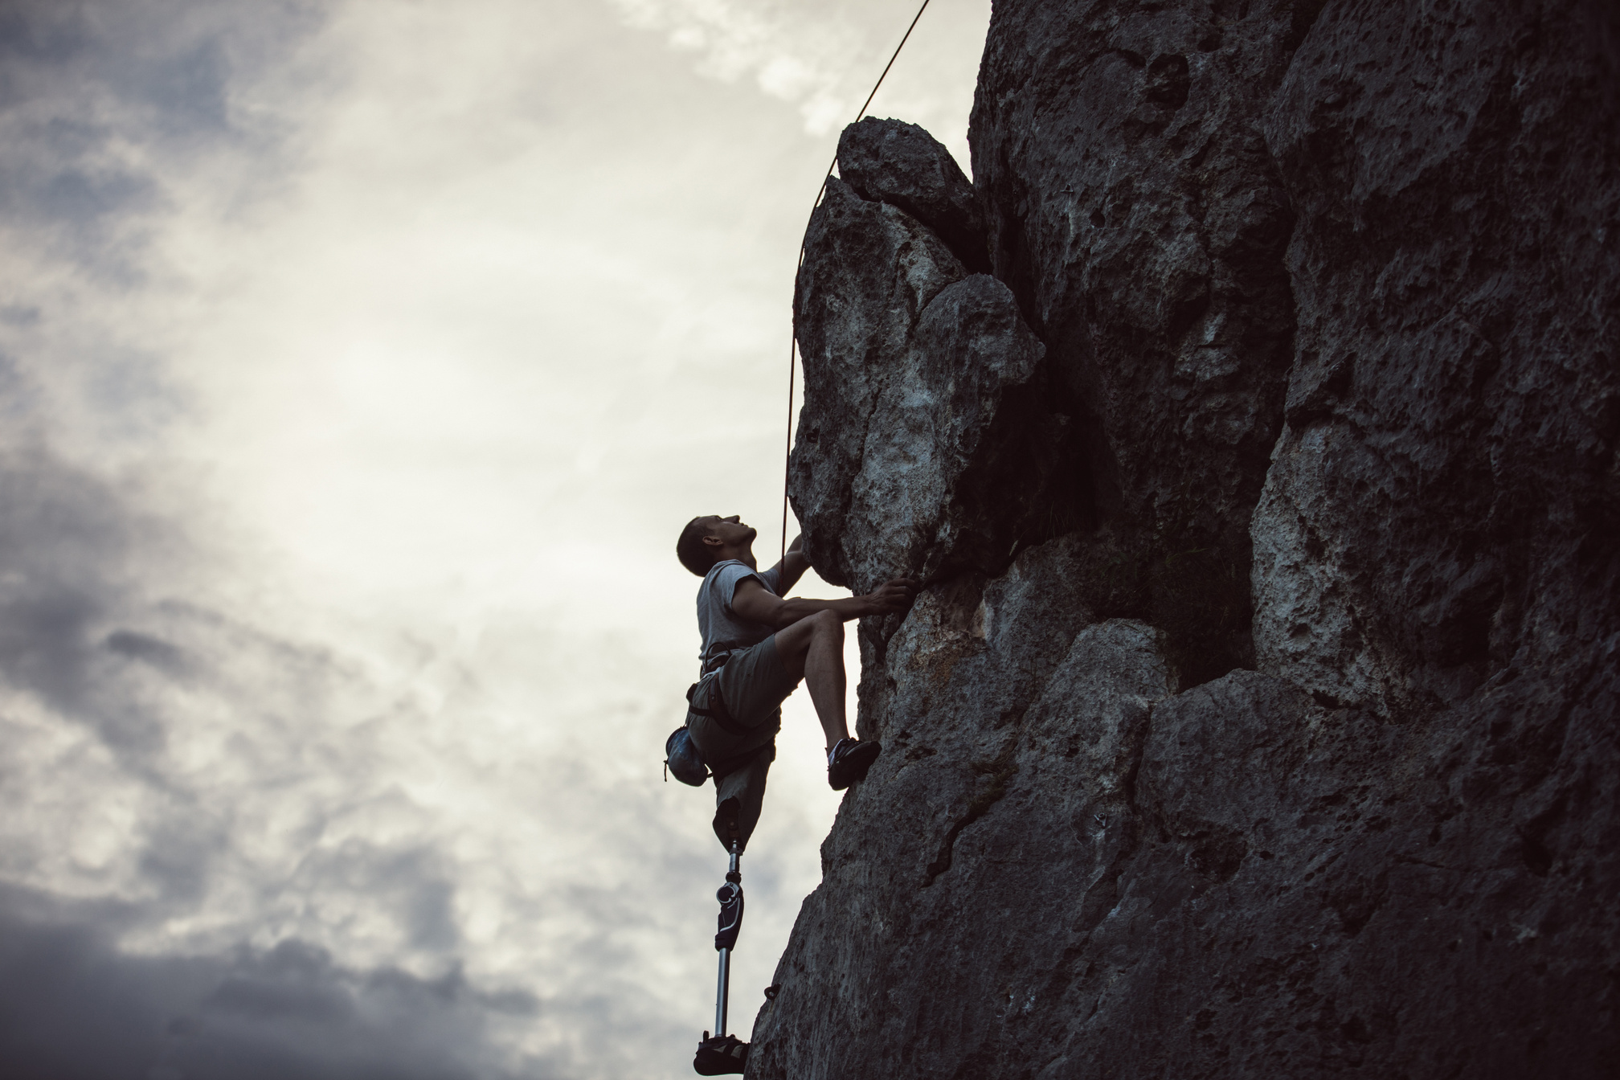
rock climbing
Remove

Slide 6

chat
Remove

Slide 7
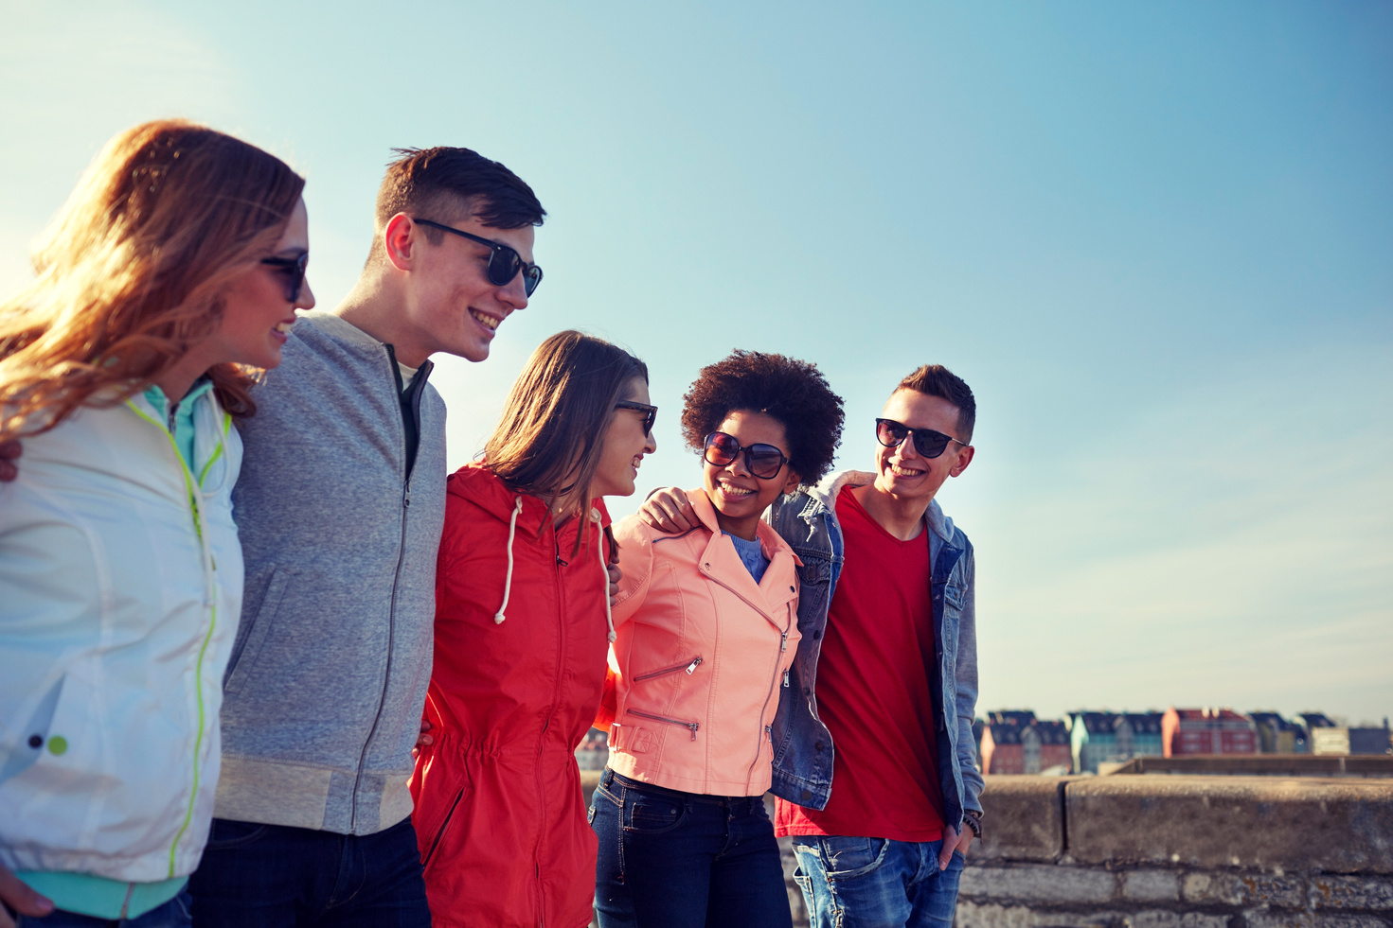
hang out
Remove

Slide 8
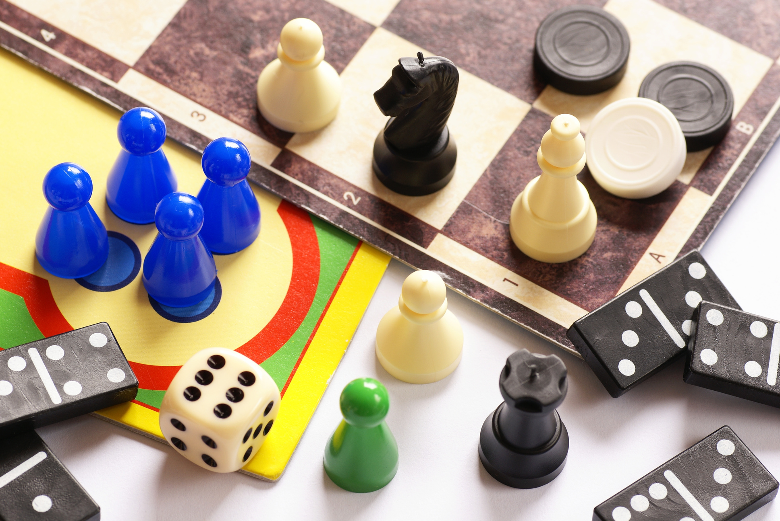
board games
Remove

Slide 9
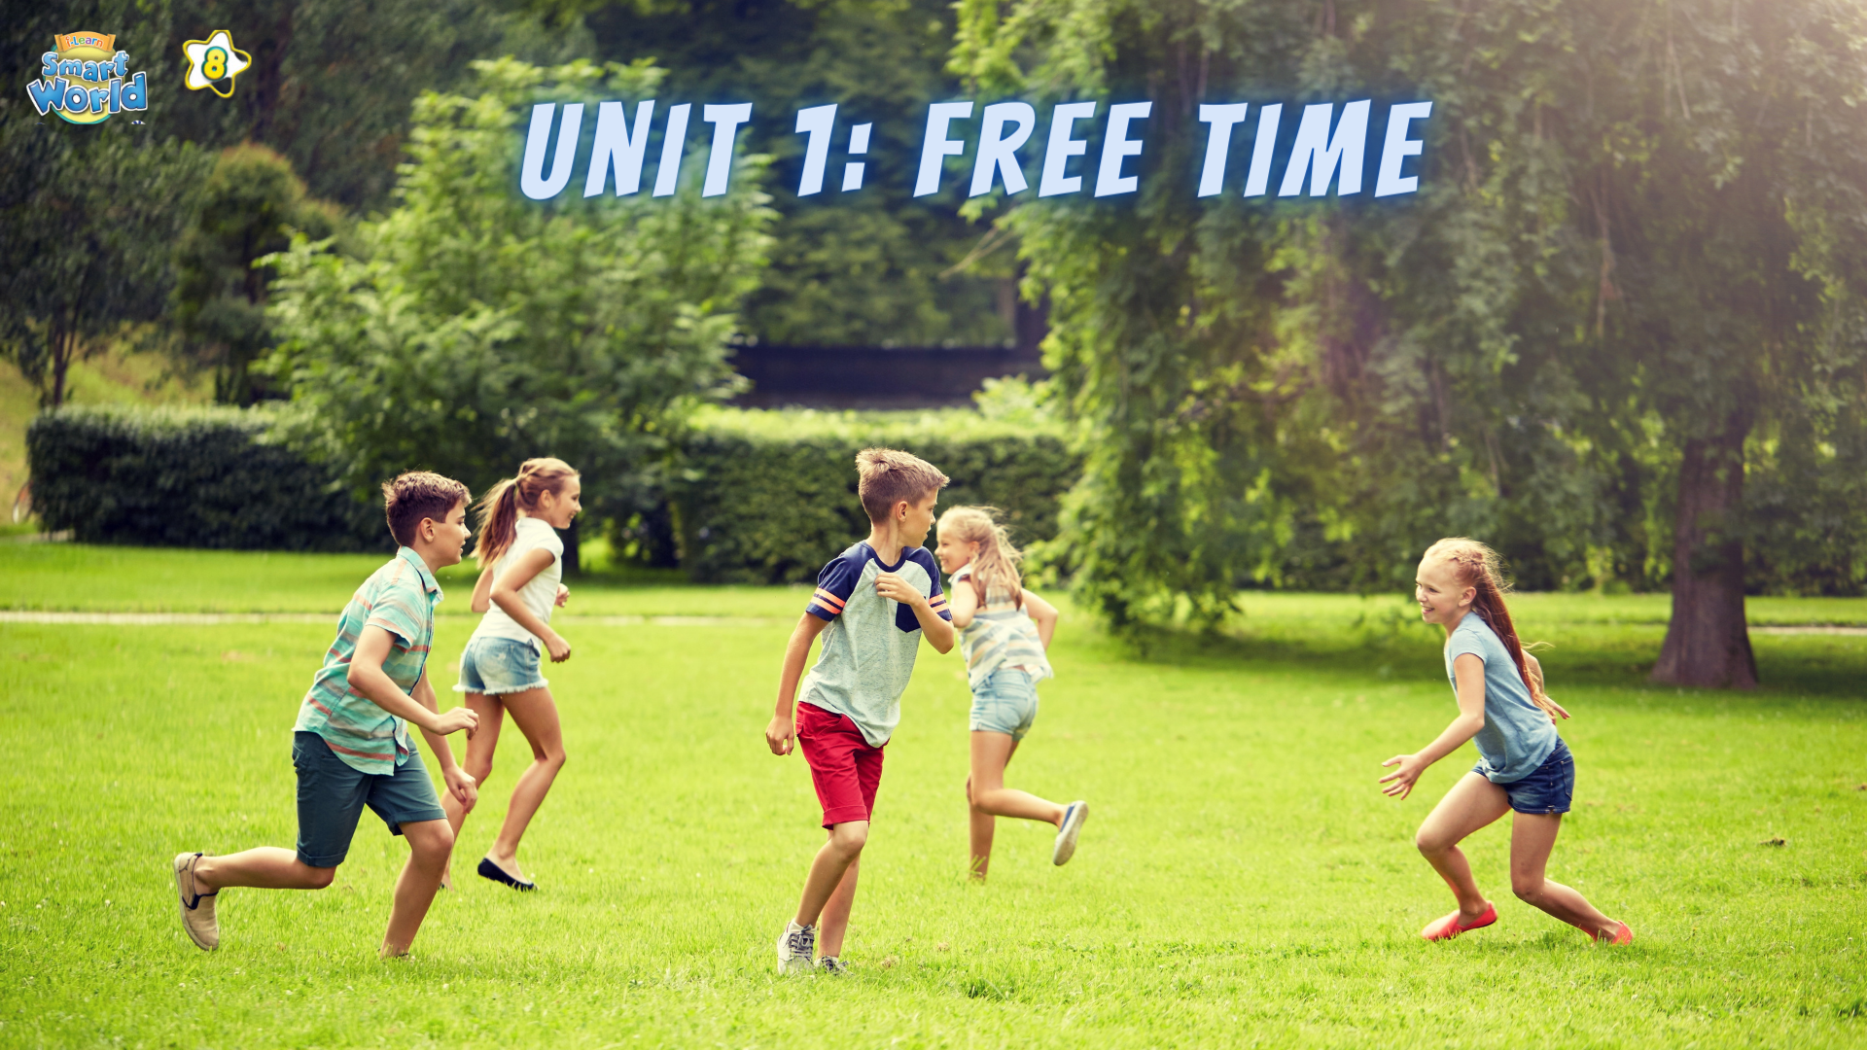

Slide 10


Slide 11




Ms Phương
Zalo: 0966765064
LESSON 2
GRAMMAR

Slide 12
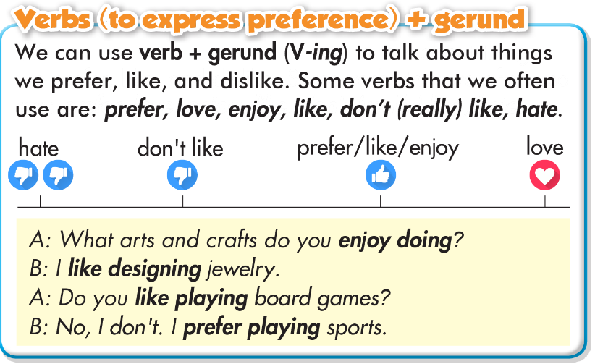
Look at the example and pay attention to the underline verbs.

Slide 13
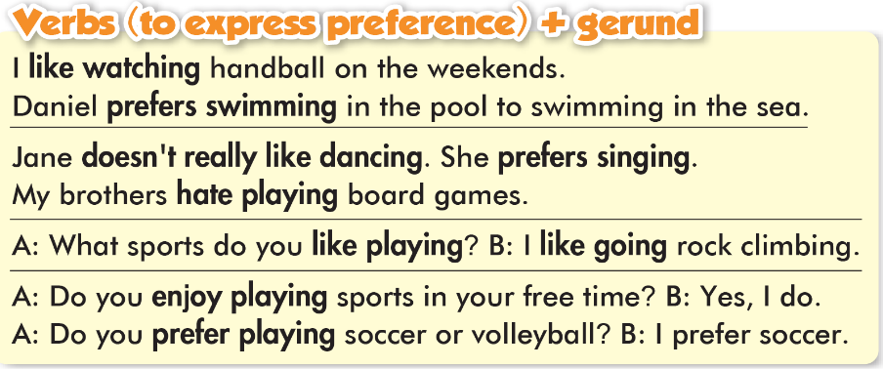

Slide 14
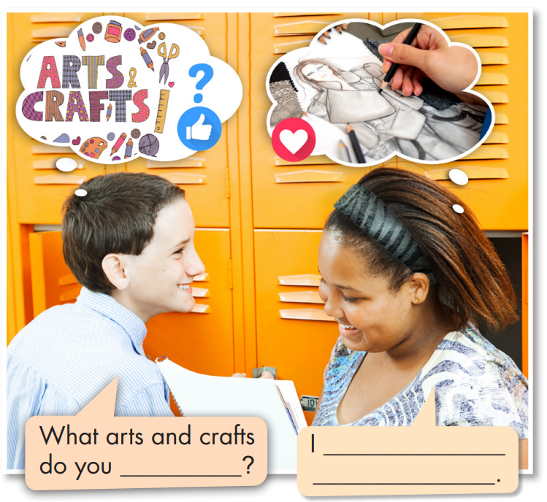

Fill in the blanks.
Listen and check your answers.
Listen again and repeat.
love designing clothes
like doing

Slide 15


Động từ ( Diễn tả Thích/Ghét + Danh Động Từ ( V-ing)
Like ( Thích) | Dislike ( Không thích)
Like : thích Enjoy : thích Prefer : Thích ( thường mang tính lựa chọn thích làm gì hơn) | Hate : Ghét Don’t like : Không thích = dislike

Slide 16
Qui tắc thêm “ing” vào động từ
V | Qui tắc | Ví dụ
 |  | V | Ving
- kết thúc là:
ng - p - e
Bỏ e
thêm “ing”
come
take
make
coming
taking
making
1
- kết thúc là:
p - ng – p
Và có trọng âm vào âm tiết này
Nhân 2 phụ âm cuối và thêm “ing”
run
sit
permit
running
sitting
permitting
2

Slide 17
Qui tắc thêm “ing” vào động từ
V | Qui tắc | Ví dụ
 |  | V | Ving
- kết thúc là:
“ie”
Đổi ie → y
thêm “ing”
lie
die
lying
dying
3
- Còn lại
Thêm “ing”
cook
go
see
begin
cooking
going
seeing
begining
4

Slide 19
Qui tắc thêm “ing” vào động từ
V kết thúc là: n.p.e → Bỏ e, thêm “ing”
V kết thúc là: p.n.p và có trọng âm → nhân 2 phụ âm cuối, thêm “ing”.
V kết thúc là: ie → Bỏ ie, thêm “ing”.
Các V còn lại: thêm “ing”.

Slide 20
a. Read the examples and notes above, then circle the correct words.
1. She loves/hates designing and making jewelry. She wants to open a jewelry store when she grows up.
2. I prefer/hate going fishing because I'm scared of water.
3. Lots of my friends enjoy/don't like playing mobile games. They spend lots of their free time playing them.
4. Do you like/hate going jogging? – Yes, my dad and I usually go jogging in the evening.
5. I don't like/love chatting online with friends. I prefer talking face to face.

Slide 21
b. Write sentences using gerunds and the prompts.
Jake/not enjoy/chat online/with his friends
2. what/activities/you/enjoy/do/free time?
3. I/not really like/play/handball./I prefer/watch/it.
Jake doesn’t enjoy chatting online with his friends.
What activities do you enjoy doing in your free time?
I don’t really like playing handball. I prefer watching it.

Slide 22
4. you/prefer/play/indoors or outdoors?
5. I/love/design clothes/free time
6. I/hate/make jewelry/because/it/boring
7. we/like/chat online/but/prefer/hang out/at the mall
Do you prefer playing indoors or outdoors?
I love designing clothes in my free time.
I hate making jewelry because it’s boring.
We like chatting online, but we prefer hanging out at the mall.

Slide 23
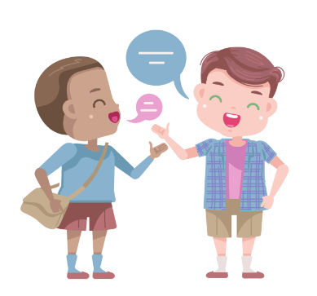
Take turns saying one thing you enjoy, love, don't really like, and hate doing.
I enjoy going rock climbing with my friends.
Nice. I enjoy hanging out with my friends in the park.

Slide 24
Work in pair. Unscramble the words to make complete sentences.
1. loves/sports/Alex /and/playing/hanging/with/ his/out/friends.
2.Alex /like/doesn’t/or/rock/skateboarding/ climbing.
3. games/Susan/playing/prefers/home/board/at.
4. Susan/playing/and/jogging/hates/sports.
5. enjoys/clothes/and/bags/designing/Peter.
Alex loves playing sports and hanging out with his friends.
Alex doesn’t like skateboarding or rock climbing.
Susan prefers playing board games at home.
Susan hates playing sports and jogging.
Peter enjoys designing clothes and bags.

Slide 25
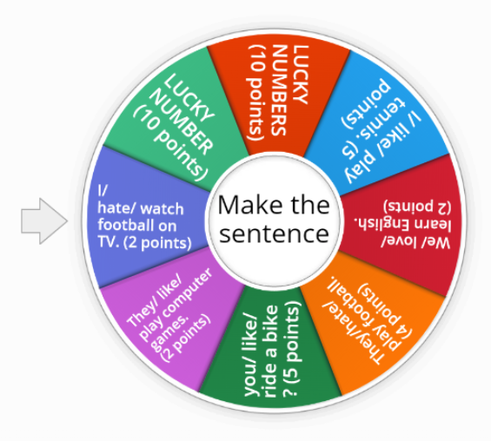

Spin the wheel and make the sentence.
ONLINE GAME

Slide 26
WARP-UP
Unit 1
FREE TIME
Lesson 2: GRAMMAR
Ms Phương
Zalo: 0966765064
Động từ ( Diễn tả Thích/Ghét + Danh Động Từ ( V-ing)
Like ( Thích) | Dislike ( Không thích)
Like : thích Enjoy : thích Prefer : Thích ( thường mang tính lựa chọn thích làm gì hơn) | Hate : Ghét Don’t like : Không thích = dislike

Slide 27

HOMEWORK
1. Do grammar and writing exercises in workbook on page 3.
2. Prepare the next lesson: Lesson 1.3 – Pronunciation & Speaking, pages 6 & 7
3. Do the exercises in Tiếng Anh 8 i-Learn Smart World notebook (page 6).

Slide 28


